Slide 1
Calcium Intake and Cardiovascular Disease Risk
A.H. Ghanooni M.D.
Fellowship of Endocrinology
December 2016

Slide 2
Agenda
Calcium role in atherosclerosis formation
Review of researches showed a potential effect of a high intake of calcium on CVD outcomes.
Review of researches showed no significant association between calcium intake and CVD outcomes.
Conclusion by the last a systematic review and meta-analysis study
review of the last Clinical Guideline

Slide 3
Calcium role in atherosclerosis formation
Atherosclerosis was considered to be the result of passive lipid accumulation in the vascular walls.
Calcium mineralization of the lumen in the atherosclerotic artery promotes and solidifies plaque formation causing narrowing of the vessel. Soft tissue calcification associated with tissue denegation or necrosis is a passive precipitation event.
Arterial calcification emerges from two different types, the medial-elastin dependent and the intimal, both of which are directly related to atherosclerosis due to osteoblast differentiation of vascular smooth muscle cells.
The deposition of minerals in the form of calcium (Ca(2+)) initially emerges from the inorganing mineral octacalcium phosphate [Ca8H2(PO4)6.5H2O] to the form of Hydroxylapatite [Ca10(PO4)6(OH)2]. This review is devoted to broaden the understanding regarding atherosclerosis and the central role of calcium in the development of the condition.

Slide 4
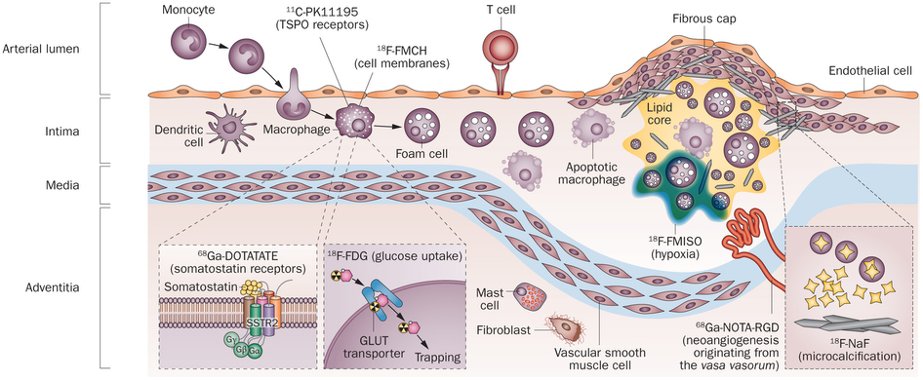
Nature Reviews Cardiology 11, 443–457 (2014)

Slide 5
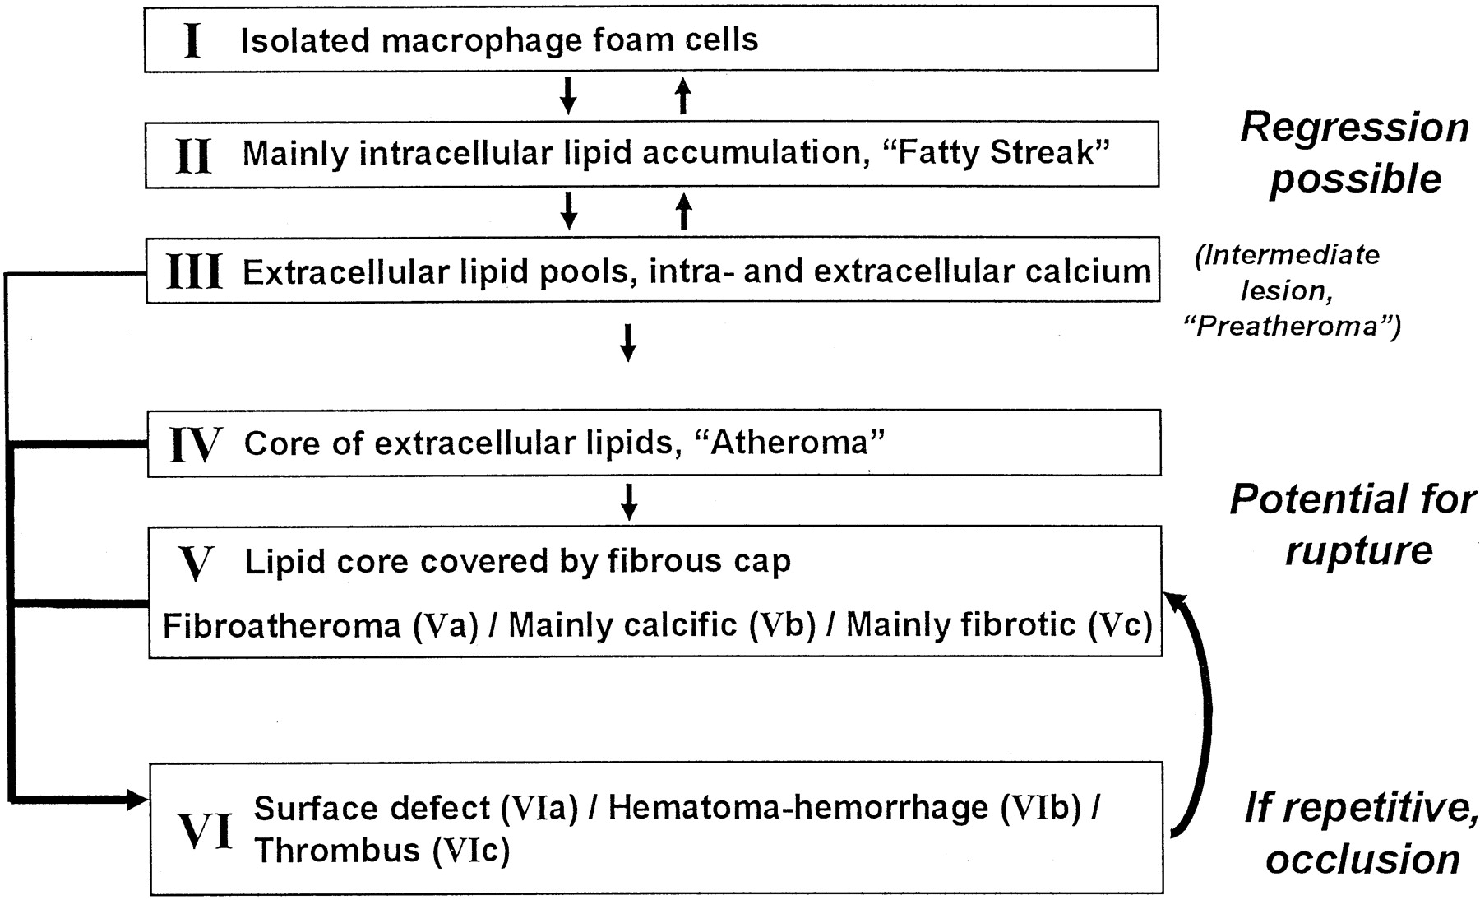

Slide 6
mechanisms for initiating vascular calcification:
four different mechanisms:
1- Loss of express inhibitors of mineralization, such as pyrophosphate and matrix gla protein, respectively, and that lack of these molecules (“loss of inhibition”) leads to spontaneous vascular calcification and increased mortality.
2- Presence of bone proteins such as osteopontin, osteocalcin, and BMP2, matrix vesicles, and outright bone and cartilage formation in calcified vascular lesions has suggested that osteogenic mechanisms may also play a role in vascular calcification
3-Bone turnover leading to release of circulating nucleational complexes has been proposed to explain the link between vascular calcification and osteoporosis in postmenopausal women.
4- Cell death can provide phospholipid-rich membranous debris and apoptotic bodies that may serve to nucleate apatite, especially in diseases where necrosis and apoptosis are prevalent, such as atherosclerosis.
Finally, via thermodynamic mechanisms (sometimes referred to as “passive” mechanisms), elevated Ca, P, and Ca × P promote apatite nucleation and crystal growth and would be expected to exacerbate vascular calcification initiated by any of the other mechanisms described above.

Slide 7
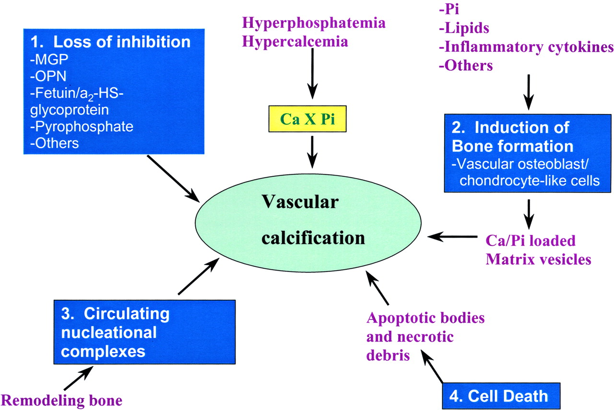

Slide 8
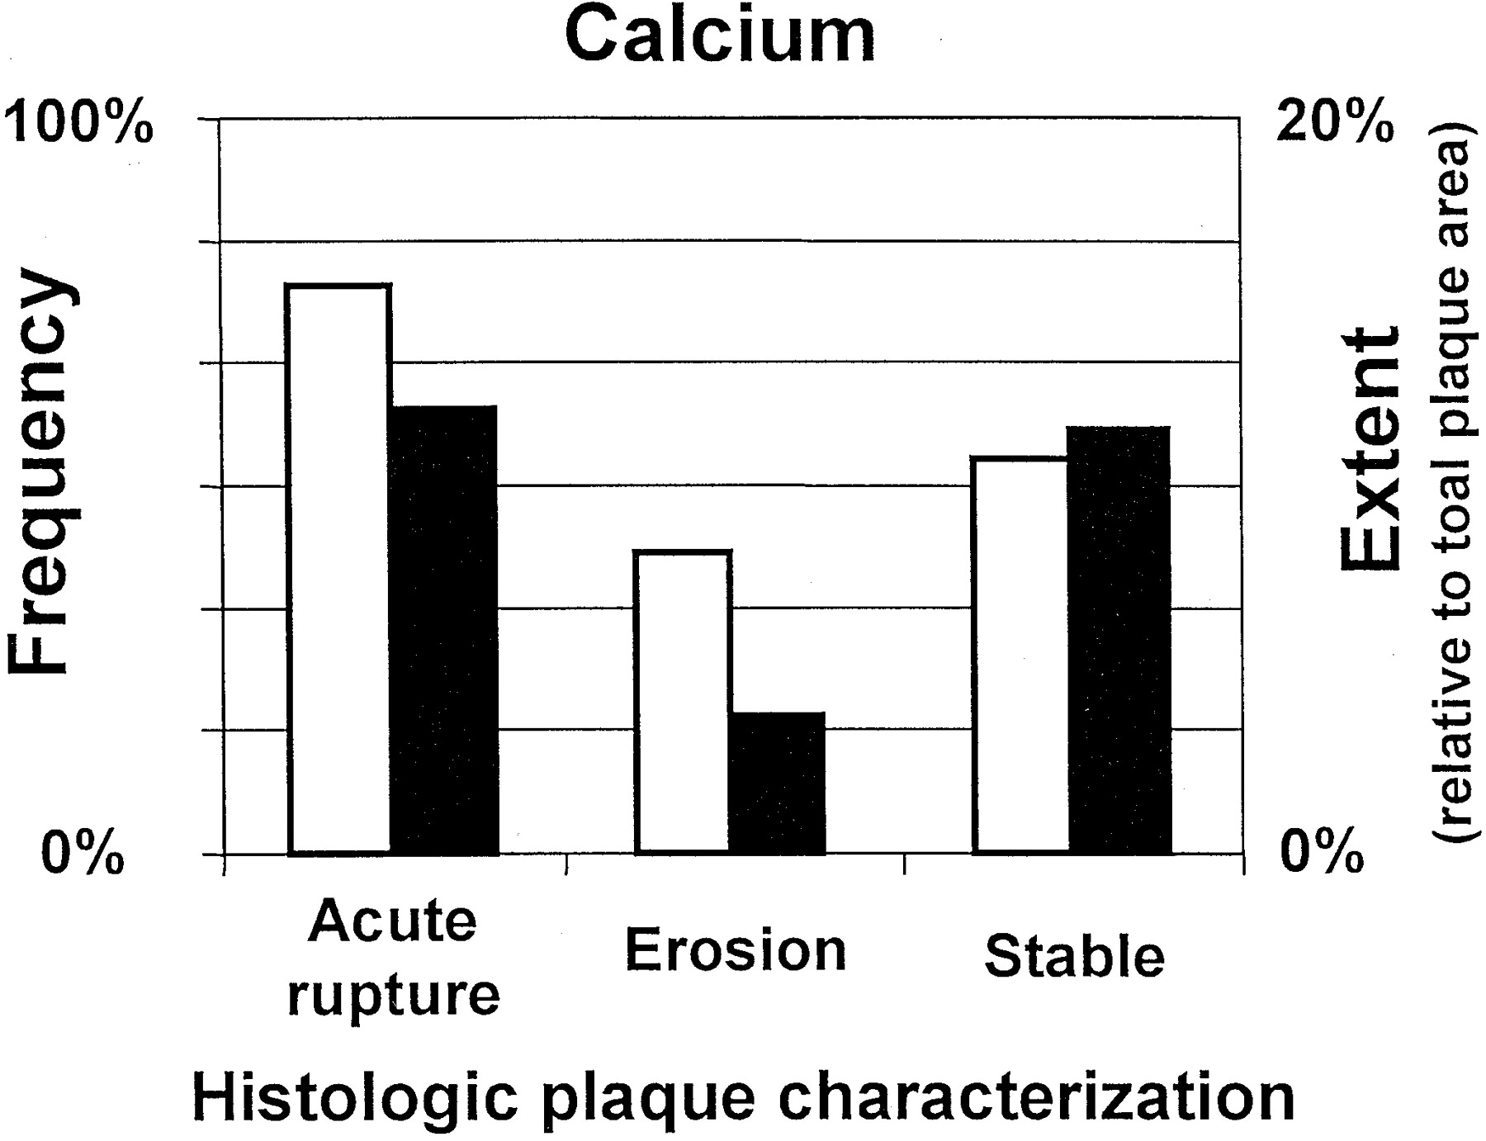
Frequency (open bars) and extent (solid bars) of calcium in culprit plaques in victims of sudden coronary death.

Slide 9
Agenda
Calcium role in atherosclerosis formation
Review of researches showed a potential effect of a high intake of calcium on CVD outcomes.
Review of researches showed no significant association between calcium intake and CVD outcomes.
Conclusion by the last a systematic review and meta-analysis study
review of the last Clinical Guideline

Slide 11
Study selection
(1966-March 2010)
Randomised, placebo controlled trials
calcium supplements (≥500 mg/day),
mean age at baseline was more than 40 years;
with 100 or more participants
Duration was more than one year

Slide 12
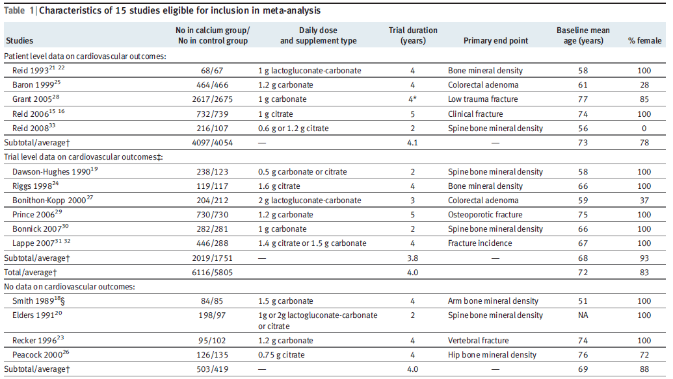

Slide 13
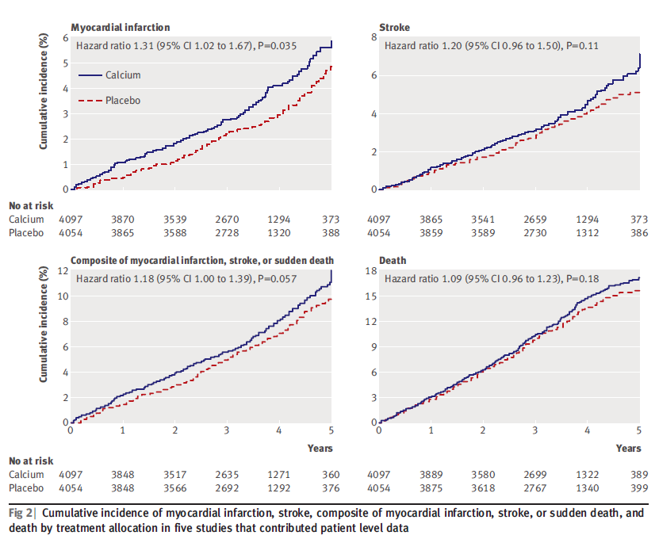

Slide 14
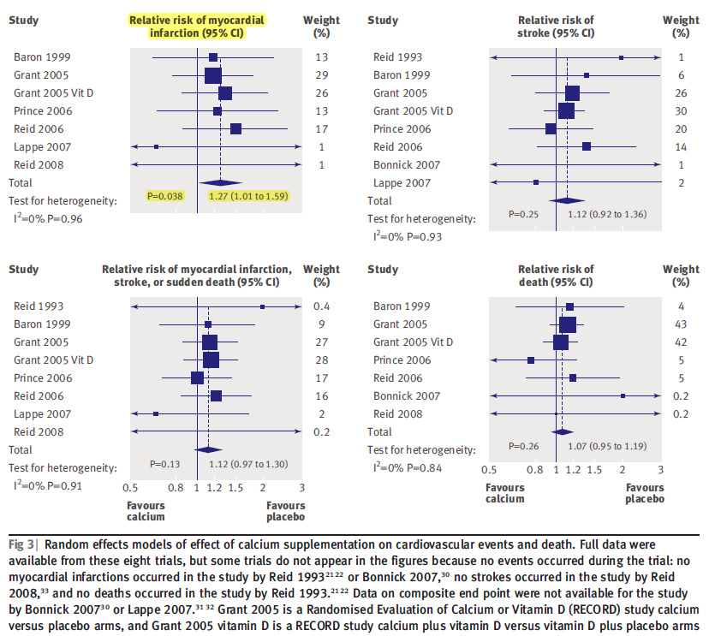

Slide 15
Key Message
A meta-analysis of trials totalling 12000 participants found that calcium supplements increase the risk of myocardial infarction by about 30%
a reassessment of the role of calcium supplements in the management of osteoporosis is warranted

Slide 16
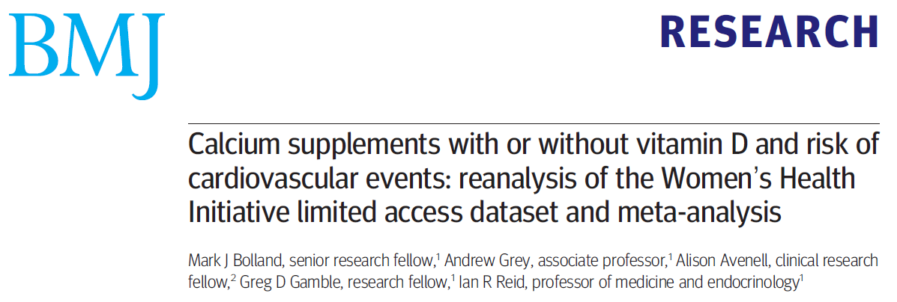

Slide 17
Women’s Health Initiative (WHI)
double-blind, placebo controlled clinical trial (CT)
assigned 36,282 postmenopausal women in the U.S.
to 1,000 mg elemental calcium carbonate plus 400 IU of vitamin D3 daily or placebo,
with average intervention period of 7.0 years.
evaluation hip fracture,
and secondarily, total fracture and colorectal cancer.

Slide 18
Calcium supplements with or without vitamin D and risk of cardiovascular events: reanalysis of the Women’s Health Initiative limited access dataset and meta-analysis
Design: Reanalysis of WHI CaD Study limited access dataset and incorporation in meta-analysis with eight other studies.
Main outcome measures Incidence of four cardiovascular events and their combinations (myocardial infarction, coronary revascularisation, death from coronary heart disease, and stroke) assessed with patient-level data and trial-level data.

Slide 19
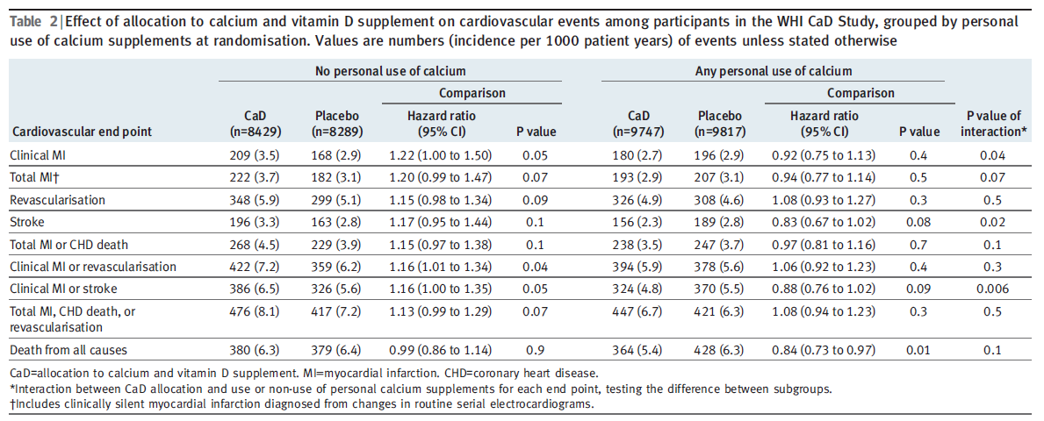

Slide 20
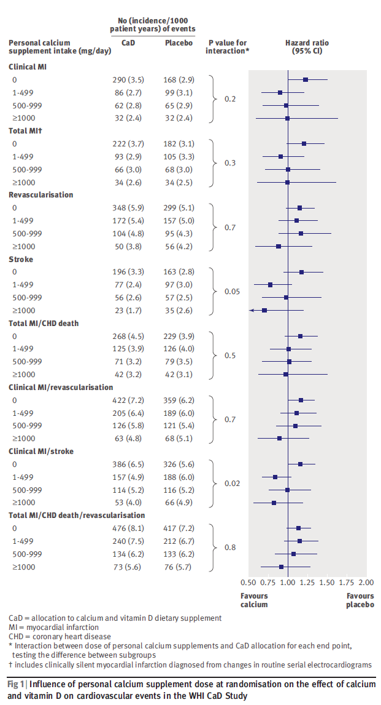

Slide 21
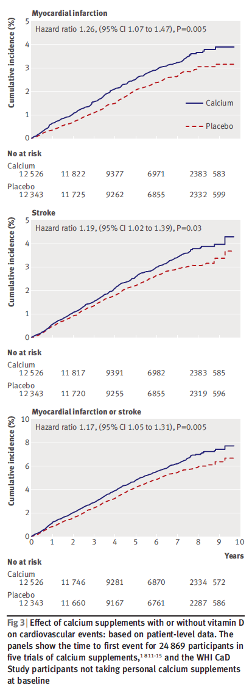

Slide 22
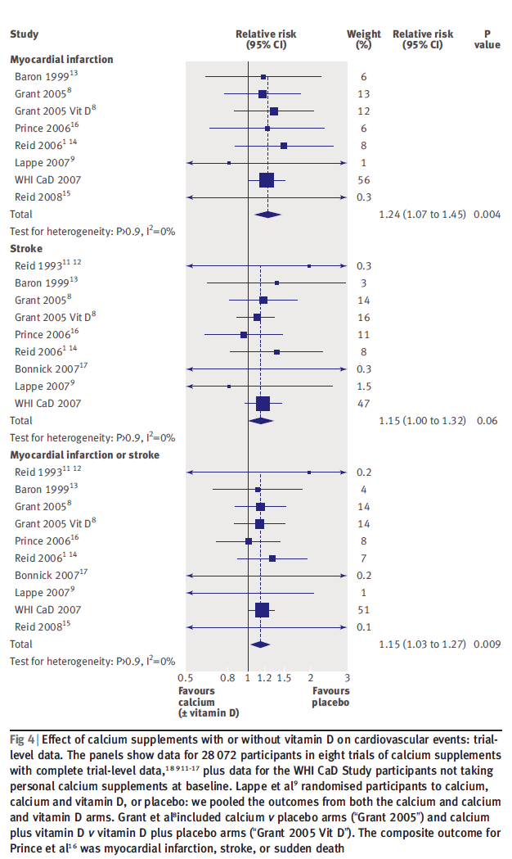

Slide 23
Key Messages
meta-analysis suggested that calcium supplements taken without vitamin D increase the risk of myocardial infarction
Re-analysis of the Women’s Health Initiative data shows women allocated to calcium and vitamin D administration who were not taking personal calcium supplements were at increased risk of cardiovascular events
suggesting use of calcium supplements with or without vitamin D in osteoporosis management should be reassessed

Slide 24
Agenda
Calcium role in atherosclerosis formation
Review of researches showed a potential effect of a high intake of calcium on CVD outcomes.
Review of researches showed no significant association between calcium intake and CVD outcomes.
Conclusion by the last a systematic review and meta-analysis study
review of the last Clinical Guideline

Slide 25
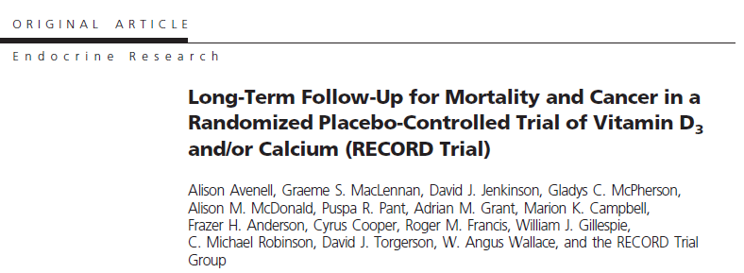

Slide 26
two by two factorial, randomized controlled trial
from 21 orthopedic centers in the United Kingdom
5292 people (85% women) aged at least 70 yr with previous low trauma fracture.
Participants were randomly allocated to daily vitaminD3 (800 IU), calcium (1000 mg), both, or placebo for 24–62 months,
with a follow-up of 3 yr after intervention.
All-cause mortality, vascular disease mortality, cancer mortality, and cancer incidence were evaluated.

Slide 27
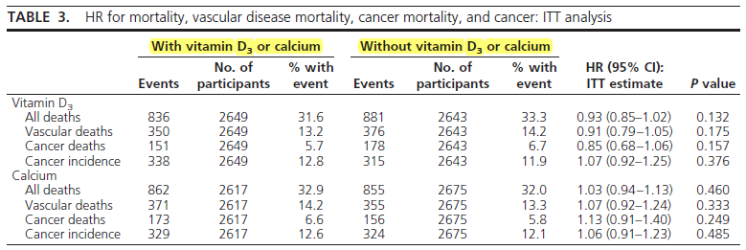

Slide 28
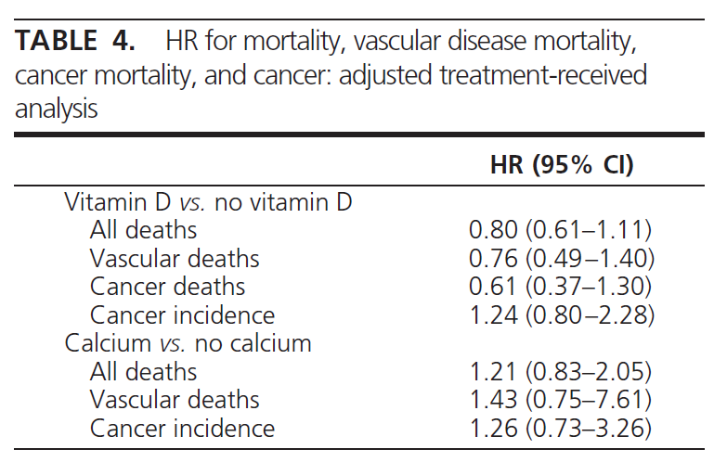

Slide 29
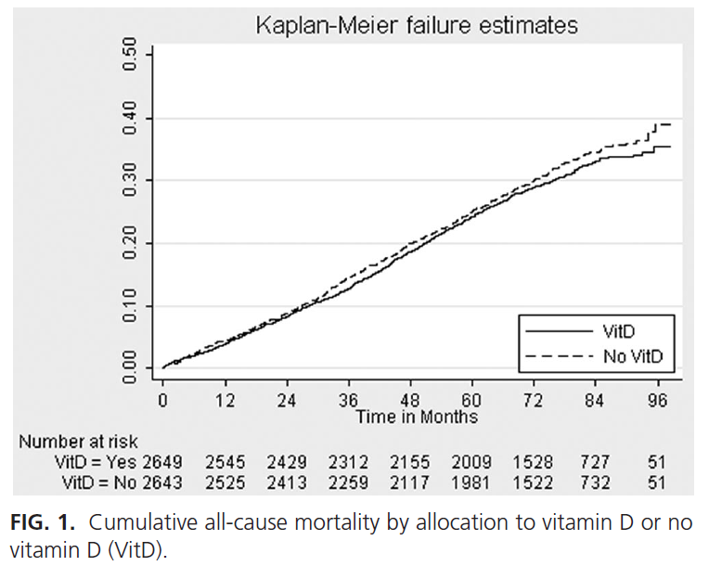
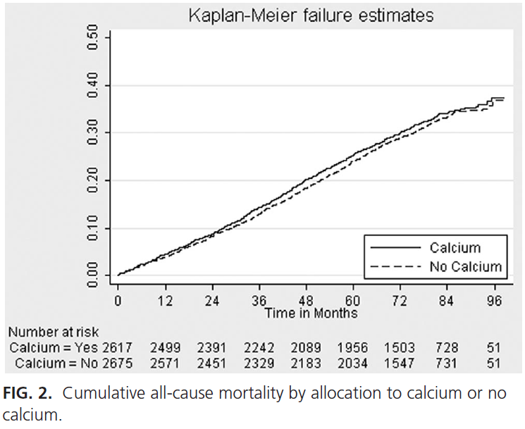

Slide 30
Key Message
Daily vitaminD or calcium supplementation did not affect mortality, vascular disease,
cancer mortality, or cancer incidence.

Slide 31
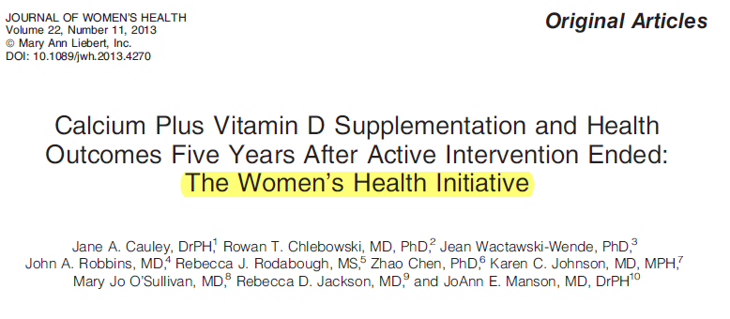

Slide 32
Clinical outcomes of the Women’s Health Initiative (WHI) calcium plus vitamin D supplementation trial have been reported during 7.0 years of active intervention. We now report outcomes 4.9 years after the intervention stopped and cumulative findings.
Postmenopausal women (N= 36,282) were randomized; postintervention follow-up continued among 29,862 (86%) of surviving participants.
Primary outcomes were hip fracture and colorectal cancer. Breast cancer, all cancers, cardiovascular disease (CVD), and total mortality were predetermined major study outcomes.

Slide 33
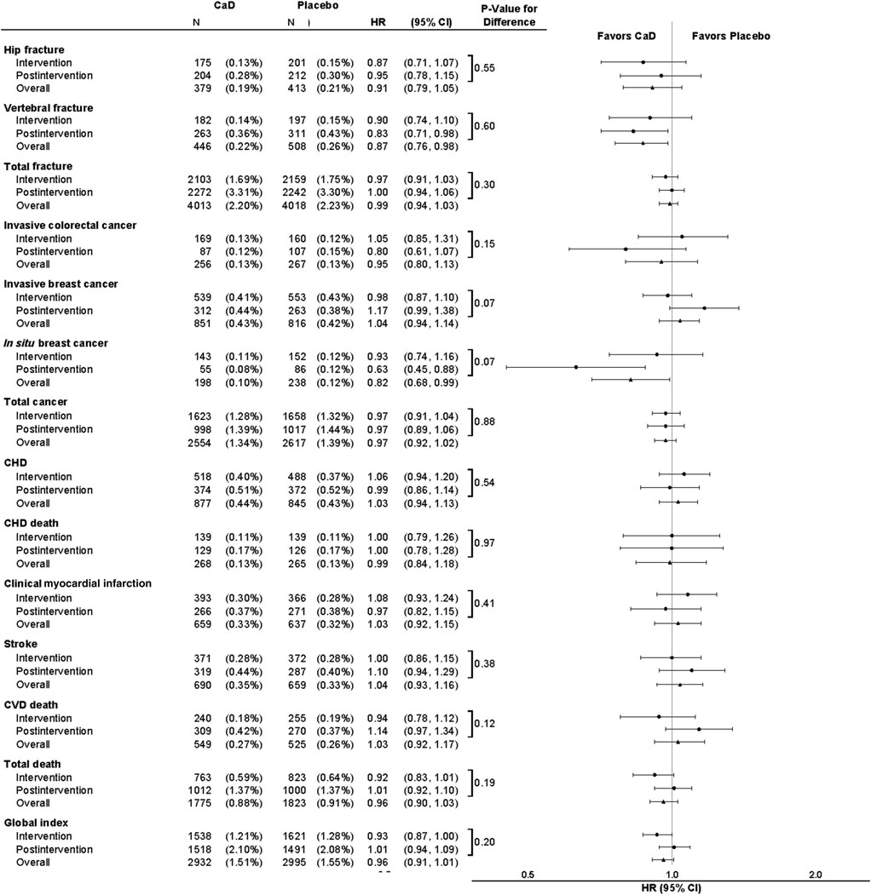

Slide 35
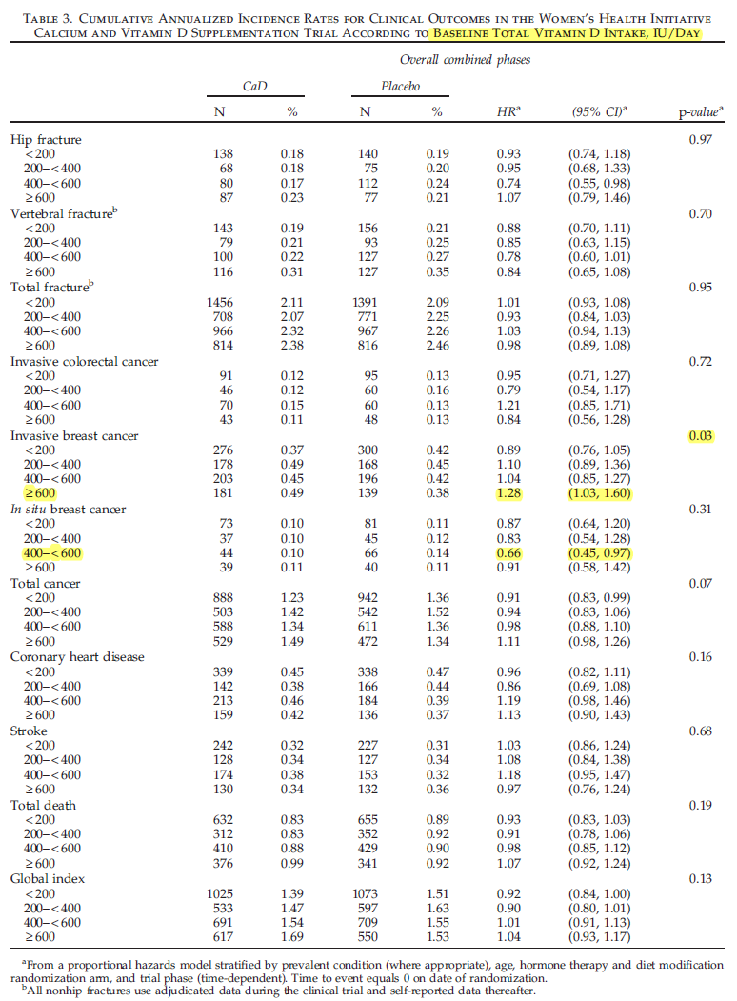

Slide 36
Key Messages
After an average of 11 years, calcium and vitamin D supplementation did not decrease hip fracture or colorectal cancer, coprimary outcomes.
There was no difference in invasive breast cancer, CVD, or all-cause mortality between groups.
Exploratory analyses found lower vertebral fracture and in situ breast cancers in supplement users, although absolute risk reduction was small. The incidence of invasive breast cancer differed across baseline intake of vitamin D with a significantly higher incidence for those with higher intakes.
Overall, a decreased risk of hip fracture was observed only among women adherent during the intervention.
JOURNAL OF WOMEN’S HEALTH Volume 22, Number 11, 2013

Slide 37
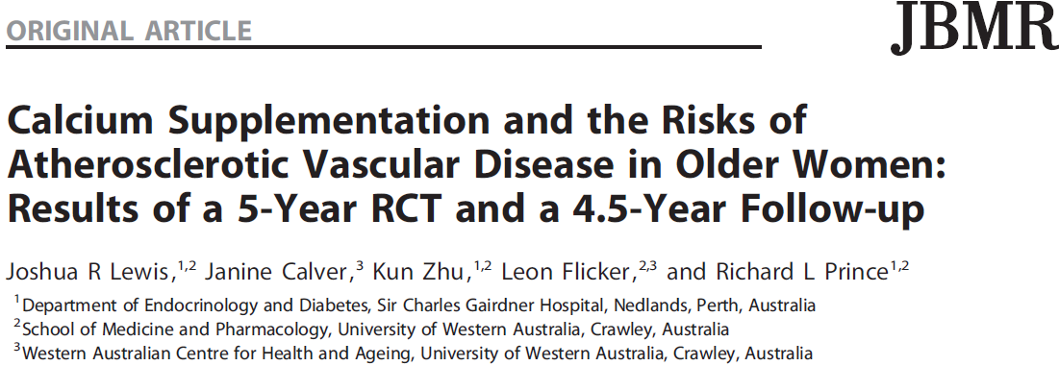

Slide 38
5-year randomized, controlled trial (RCT) of calcium carbonate
4.5 years of post trial follow-up
data from a published 5-year randomized, double-blinded, placebo-controlled trial [Calcium Intake Fracture Outcome Study (CAIFOS)].
The participants were 1460 women
to receive 1200mg of calcium carbonate daily or an identical placebo
The intervention group that received calcium supplementation did not have a higher risk of death or first-time hospitalization from atherosclerotic vascular disease in either the 5-year RCT [multivariate-adjusted HR¼0.938, 95% confidence interval (CI) 0.690–1.275] or during the 9.5 years of observational study (multivariate-adjusted HR¼0.919, 95% CI 0.737–1.146).

Slide 39
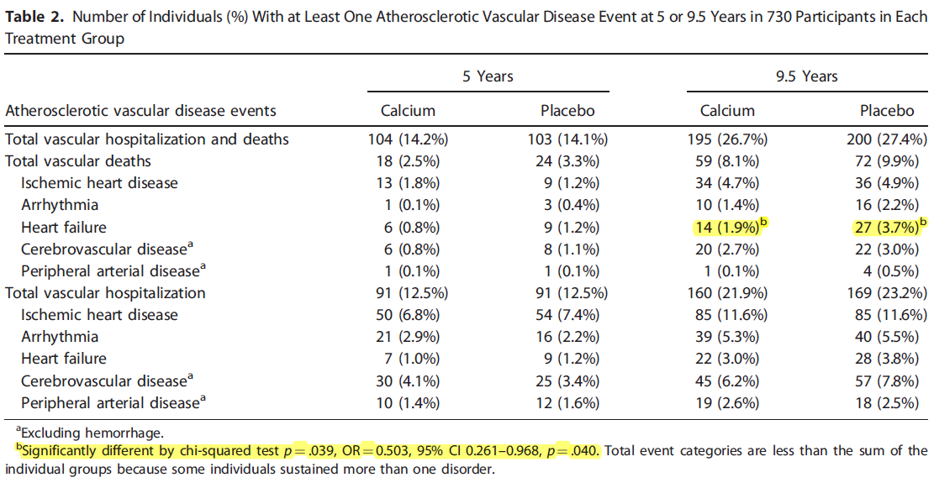
Journal of Bone and Mineral Research, Vol. 26, No. 1, January 2011, pp 35–41

Slide 40
Key Messages
Further analysis suggested that calcium supplementation may reduce the risk of hospitalization and mortality in patients with preexisting atherosclerotic cardiovascular disease.
This trial provides compelling evidence that calcium supplementation of 1200mg daily does not significantly increase the risk of atherosclerotic vascular disease in elderly women.

Slide 41
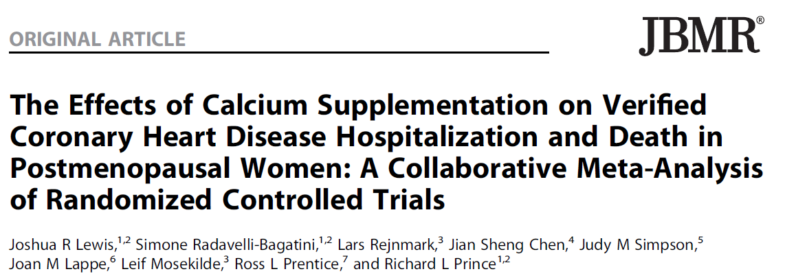

Slide 42
1966, to 2013,
18 studies included
63,563 participants with 3390 CHD events and 4157 deaths
compared calcium supplementation with or without vitamin D with a placebo or control group
Inclusion criteria :
randomized controlled trials
with a mean cohort age older than 50 years
trials with a dose at least 0.5 g of calcium per day

Slide 43
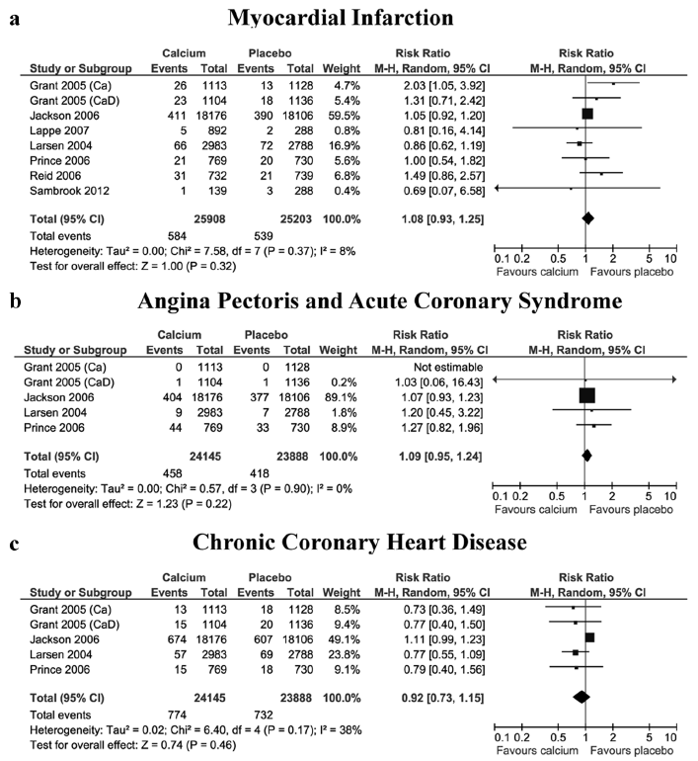

Slide 44
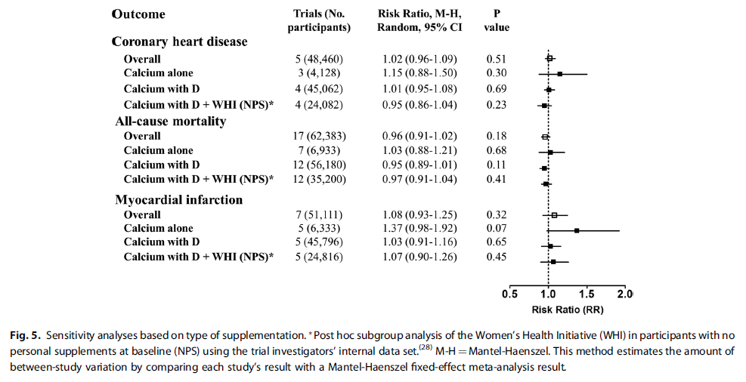

Slide 45
Key Messages
current evidence does not support the hypothesis that calcium supplementation with or without vitamin D increases coronary heart disease or all‐cause mortality risk in elderly women.
Journal of Bone and Mineral Research, Vol. 30, No. 1, January 2015, pp 165–175
© 2014 American Society for Bone and Mineral Research

Slide 46
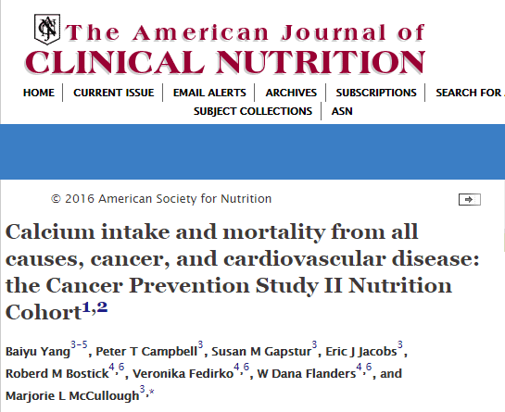

Slide 47
supplemental, dietary, and total calcium intakes with all-cause, CVD-specific, and cancer-specific mortality in a large, prospective cohort.
A total of 132,823 participants in the Cancer Prevention Study II Nutrition Cohort, who were followed from baseline (1992 or 1993) through 2012 for mortality outcomes, were included in the analysis.

Slide 48
Results: During a mean follow-up of 17.5 y, 43,186 deaths occurred.
For men, supplemental calcium intake was overall not associated with mortality outcomes (P-trend > 0.05 for all), but men who were taking ≥1000 mg supplemental calcium/d had a higher risk of all-cause mortality (RR: 1.17; 95% CI: 1.03, 1.33),
For women, supplemental calcium was inversely associated with mortality from all causes. (P-trend < 0.01) but not in men; dietary calcium was not associated with all-cause mortality in either sex.

Slide 49
Key message
Associations of calcium intake and mortality varied by sex.
For women, total and supplemental calcium intakes are associated with lower mortality, whereas for men, supplemental calcium intake ≥1000 mg/d may be associated with higher all-cause and CVD-specific mortality.

Slide 50
Agenda
Calcium role in atherosclerosis formation
Review of researches showed a potential effect of a high intake of calcium on CVD outcomes.
Review of researches showed no significant association between calcium intake and CVD outcomes.
Conclusion by the last a systematic review and meta-analysis study
review of the last Clinical Guideline

Slide 52
Included :
4 randomized, controlled trials (in 10 publications)
1 nested case–control study
and 26 cohort studies

Slide 53
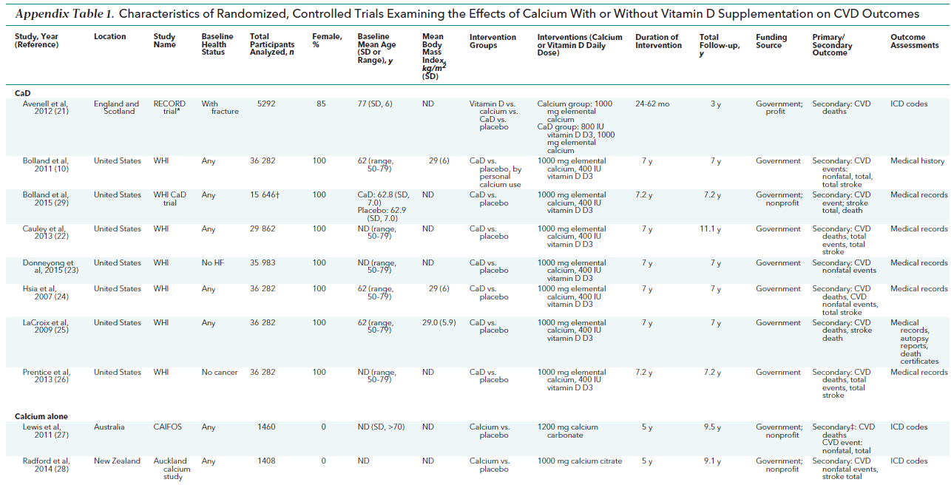

Slide 54
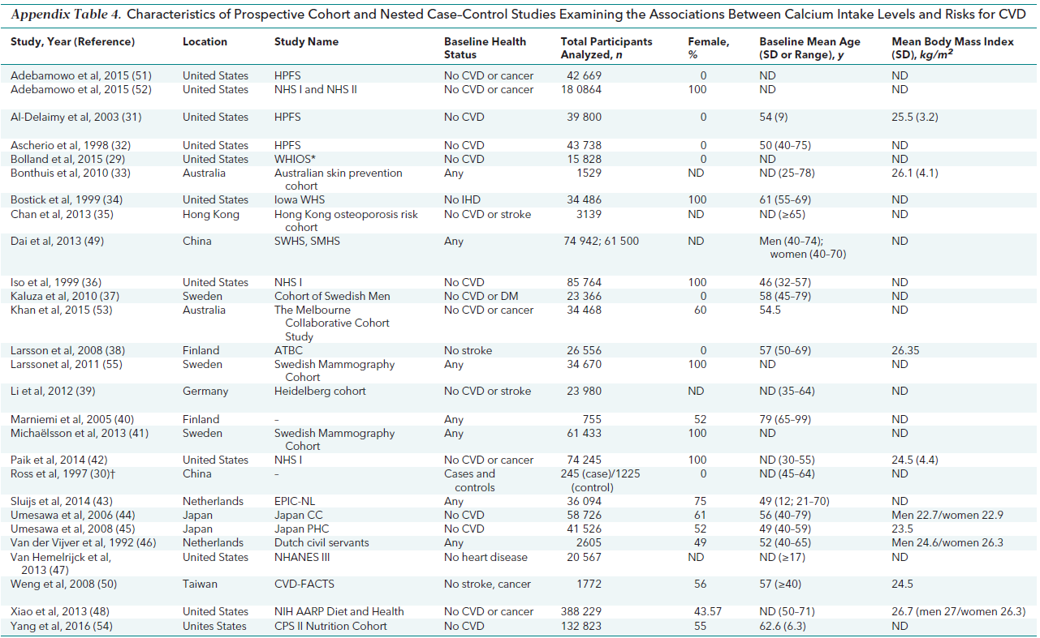

Slide 55
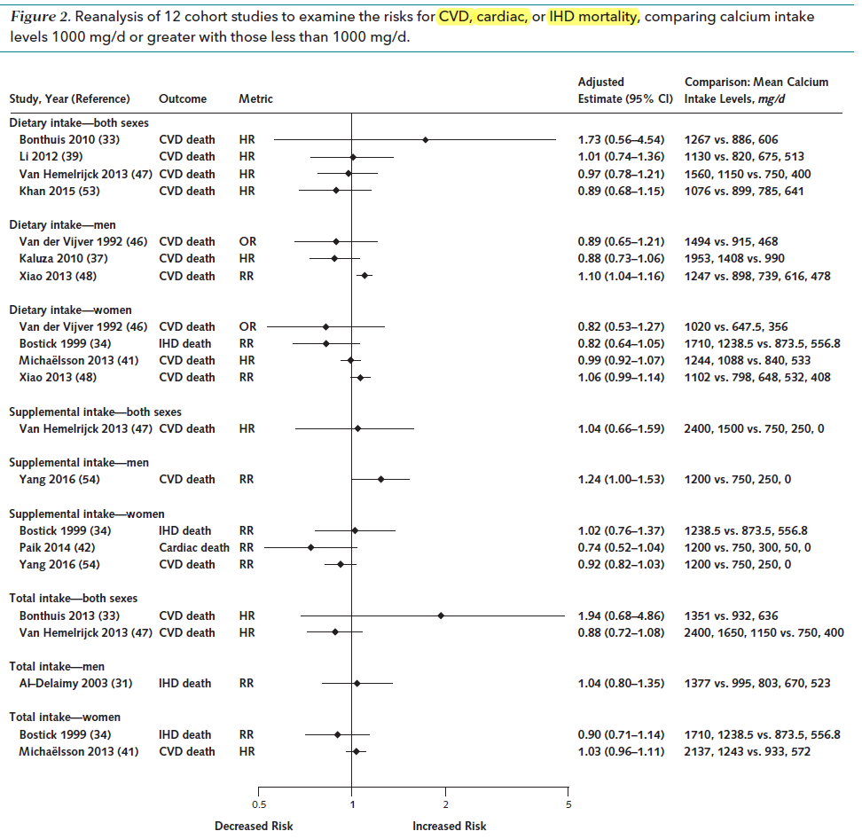

Slide 56
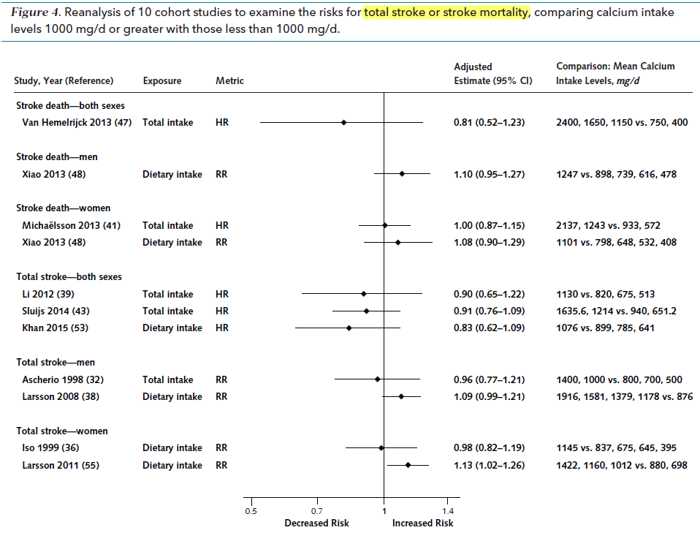

Slide 57
Key Messages
The trials did not find statistically significant differences in risk for CVD events or mortality between groups receiving supplements of calcium or calcium plus vitamin D and those receiving placebo.
Conclusion:Calcium intake within tolerable upper intake levels (2000 to 2500 mg/d) is not associated with CVD risk in generally healthy adults.

Slide 58
Agenda
Calcium role in atherosclerosis formation
Review of researches showed a potential effect of a high intake of calcium on CVD outcomes.
Review of researches showed no significant association between calcium intake and CVD outcomes.
Conclusion by the last a systematic review and meta-analysis study
review of the last Clinical Guideline

Slide 60
Thank you for your attention

