Slide 1
Management Of CAH In Adults
Zahra GhasemZadeh
FellowShip Of Endocrinology
Research Institute For Endocrine Sciences
Shahid Beheshti University Of Medical Science
Bahman 1393

Slide 2
Agenda:
Introduction
Diagnosis of NCCAH/CAH after Infancy
Treatment in CAH
Monitoring of treatment
Stress dosing
Complication of CAH
Genetic counceling
Counceling about fertility
Managemet during pregnancy
prenatal dexamethasone use

Slide 3
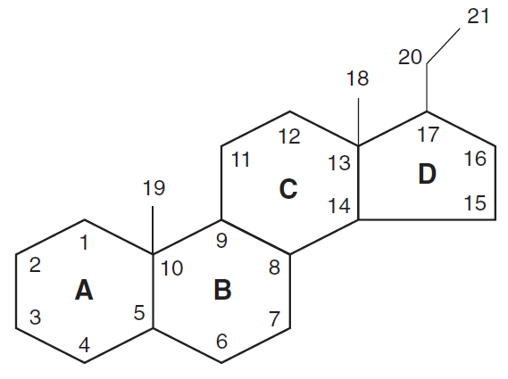
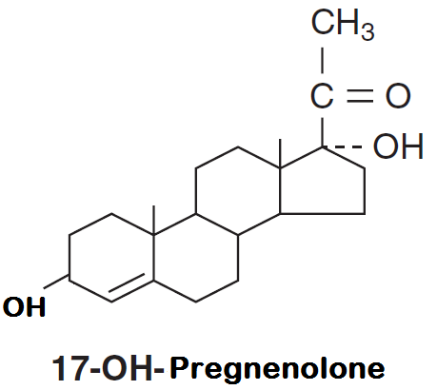
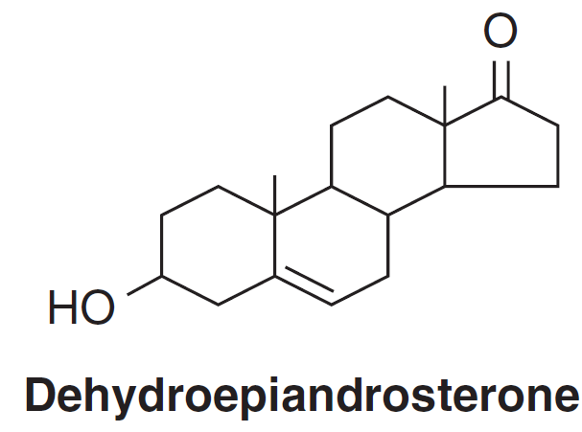
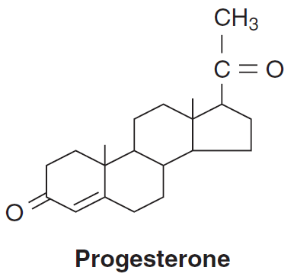
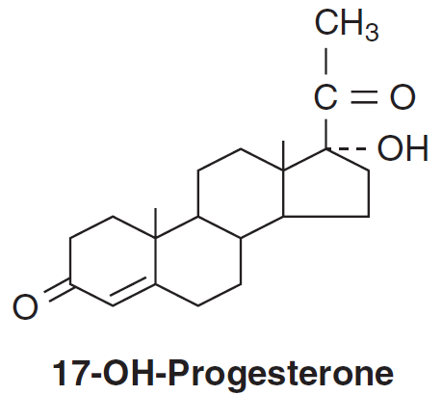
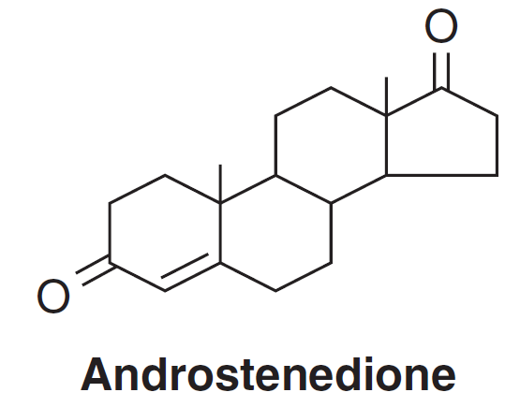
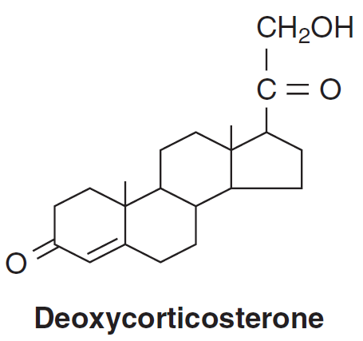
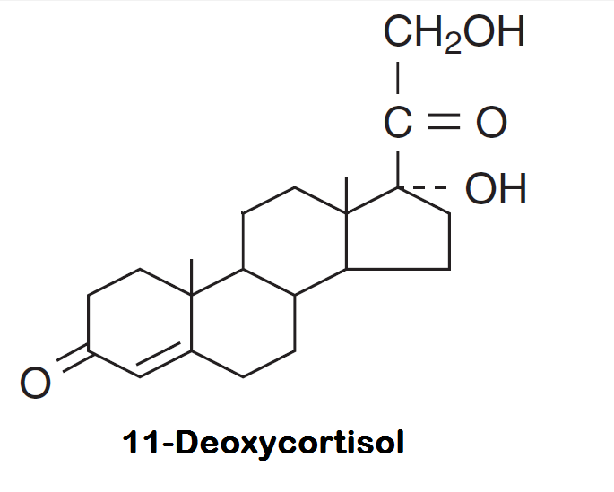
CYP 11A1
CYP 17A1
CYP 17A1
HSD 3B2
CYP 17A1
CYP 17A1
CYP 21A2
CYP 21A2

Slide 4
CAH is a group of autosomal recessive disorders characterized by impaired cortisol synthesis.
The incidence ranges from 1:10,000 to 1:20,000 births and is more prevalent in some ethnic groups.
The most common form of CAH is caused by mutations in CYP21A2, the gene encoding the adrenal steroid 21-hydroxylase enzyme.
This enzyme deficiency accounts for approximately 95%of CAH
Nonclassic forms of CAH are more prevalent, occurring in approximately 0.1–0.2% in the general Caucasian population

Slide 5
More than 100 CYP21A2 mutations are known.
Because more than 90% of mutant alleles carry one of 10 mutations (deletions or gene conversions), patients carrying none of these mutations are unlikely to be affected.

Slide 6
1:20,000
1:60,000
1:1000

Slide 7
Diagnosis
An Endocrine Society Clinical Practice Guideline

Slide 8
Treatment in CAH
In one trial, the estimated growth-suppressive effect of prednisolone was about 15-fold more potent than HC ,dexamethasone is 70- to 80-fold more potent.

Slide 9
treatment of adults with CAH
We suggest that adult patients with classic CAH be treated with HC or long-acting GCs (very low)
The need for MCs decreases with age, because serum aldosterone is high and renal MC receptor mRNA is low at birth ,and the degree of MC and/or salt supplementation must be monitored by blood pressure and renin measurements in blood.
The optimal dose of fludrocortisone substitution in adults has not been critically studied.

Slide 10
Treatment of NCCAH
We suggest treating NCCAH children with inappropriately early onset and rapid progression of pubarche or bone age, and adolescent patients with overt virilization(low)
We recommend against treatment in asymptomatic individuals with NCCAH(low)
We suggest treatment of adults with NCCAH with patient-importan hyperandrogenism or infertility (very low)
We suggest clinicians not prescribe daily GC substitution in adult males with NCCAH (very low)
We suggest that previously treated NCCAH patients be given the option of discontinuing therapy when symptoms resolve.(low)

Slide 11
Monitoring treatment in CAH
During puberty, despite adequate replacement therapy and compliance, control may be suboptimal because of increased cortisol clearance.
Although the aldosterone biosynthetic defect is clinically apparent only in the salt-wasting form, subclinical aldosterone deficiency is present in all forms of 21-hydroxylase deficiency and can be best evaluated by the aldosterone to PRA ratio.
Maintenance of sodium balance reduces vasopressin and ACTH levels, contributing to lower GC doses.
Therefore, the need for continuing MCs should be reassessed periodically based on blood pressure, PRA, and the aldosterone to PRA ratio.

Slide 12
Monitoring treatment in CAH
Height velocity, signs of virilization, and delayed or premature bone maturation
17-OHP, androstenedione, and testosterone are the best indicators of the adequacy of GC treatment.
ACTH measurements are not useful for a diagnostic or therapeutic profile in CAH patients.
and dose adjustments should be made in the context of the overall clinical picture and not solely based on a single 17-OHP Measurement.

Slide 13
We suggest that monitoring of GC and MC treatment include at least annual physical examination and appropriate hormone measureme.
The principles of monitoring GC treatment in adult CAH patients are similar to those employed in monitoring children.
Optimal levels for 17-OHP and androstenedione have not been defined; testosterone levels in men normally reflect gonadal rathe than adrenal function and therefore are not useful for monitoring therapy .
Men with large testicular adrenal rests may have low morning testosterone indicating poor Leydig cell function.

Slide 14
Stress dosing
We recommend increasing the GC dosage of CAH patients in situations such as febrile illness (>38.5ºC), gastroenteritis with dehydration, surgery accompanied by general anesthesia, and major trauma.(low)
we recommend against the use of increased GC doses in mental and emotional stress and minor illness and before physical exercise.(very low)
We recommend against the use of stress doses of GC in patients with NCCAH unless their adrenal function is suboptimal or iatrogenically suppressed.(very low)
An Endocrine Society Clinical Practice Guideline

Slide 15
Complications of CAH
We recommend close monitoring for iatrogenic Cushing’s syndrome in all GC-treated patients (low ).
We suggest against the routine evaluation of bone mineral density (BMD) in children (very low ).
We suggest that adrenal imaging be reserved for those patients who have an atypical clinical or biochemical course(very low)
The prevalence of testicular adrenal rests in boys with classic CAH aged 2–18 year varies from 21-28%.
Testicular masses in boys with classic CAH are usually bilateral and smaller than 2 cm in diameter and therefore not palpable but detectable by ultrasound (US).

Slide 16
Children with CAH have a higher BMI than do controls due to increased fat mass Approximately half are overweight, and 16-25% are obese.
Hypertension is more prevalent in children with classic CAH than in the general population, and systolic BP was related to BMI independent of GC or MC therapy.
Overtreatment with GCs may lead to osteoporosis Gestational diabetes was increased among CAH women
We suggest that bilateral adrenalectomy be considered only in select cases that have failed medical therapy, especially in rare cases of adult females with salt-wasting CAH and infertility.
If fertility is desired and adrenalectomy is not an option hyperandrogenism can be overridden by clomiphene or GnRH ovarian stimulation.

Slide 17
Genetic counseling
We recommend that genetic counseling be given to parents at birth of a CAH child and to adolescents at the transition to adult care(very low)
classical CAH incidence of 1:10,000–1:20,000
incidence of carriers in the general population is 1:50–1:71. Using a median value of 1:60
a patient with classic CAH would have a one in 120 probability of having a child with classic CAH
the NCCAH parent has a one in 240 risk of having a child with classic CAH

Slide 18
Counseling about fertility
Testicular adrenal rest tumors increase with age in CAH, impairing fertility.
Undetected adrenal rest tumors may obstruct the seminiferous tubules, causing secondary gonadal dysfunction and infertility.
Fertility may be impaired by suppression of gonadotropin secretion by adrenal steroids if adequate doses of GCs are not given.
Obstetricians should be aware that despite an apparent normal pregnancy rate of about 90%, classic CAH women have low fecundity
(0.25 live births per woman vs. 1.8 in the general population)
Psychosocial factors may also play a role.

Slide 19
Pregnancy and delivery rates were significantly lower in 62 women with CAH (ages 18–63), despite fertility treatments .
Only 30% of the women with CAH had ever tried to become pregnant, as compared with 66% of controls.
The number of children born to CAH women correlated with CAH genotype; three of six women with NCCAH had children, and nine of 27 women with simple virilizing CAH had children, but only two of 29 women with salt-wasting CAH had children.
an unexplained 2:1 female to male ratio for offspring of CAH women

Slide 20
Management of CAH and NCCAH during pregnancy
We recommend that patients with CAH who become pregnant continue their prepregnancy doses of HC/prednisolone and fludrocortisone therapy (low).
GC doses should be adjusted if symptoms and signs of GC insufficiency occur.
We recommend against the use of GCs that traverse the placenta, such as dexamethasone, for treatment of pregnant patients with CAH (low ).
Stress doses of GCs should be used during labor and delivery.

Slide 21
Androgen and cortisol levels increase gradually during Pregnancy due to increases in SHBG and CBG.
Maternal testosterone levels have been used to monitor CAH patients during pregnancy.
Higher binding globulins and placental aromatization protect the fetus from the potential virilizing effects of maternal androgens.
Maternal 17-OHP is elevated in normal pregnancy and hence cannot be used to monitor GC treatment.
High progesterone levels during pregnancy might compete for the MC receptor, theoretically requiring increased fludrocortisone doses, but this has not been studied.
Dexamethasone and other steroids that are not inactivated by placental 11ß-HSD 2 should not be used to treat the pregnant woman who is herself affected with CAH.

Slide 23
Fetal genital virilization begins 6-7 weeks after conception
Chorionic villus biopsy cannot be done until 10-12 weeks
Only one in eight pregnancies treated in this way will result in an affected female fetus,
A new highly sensitive real-time PCR was developed to detect an SRY gene sequence in maternal serum in the first trimester (6–11 weeks pregnancy)

Slide 24
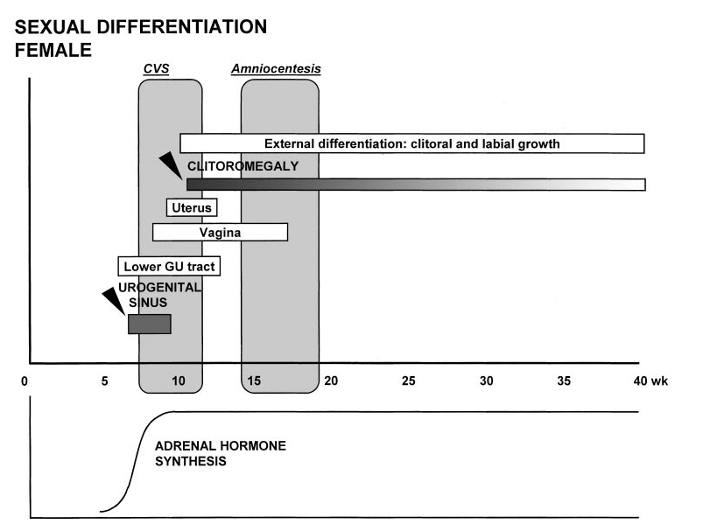
FIG. 2. Timetable of female sexual differentiation.
[Modified from P. Saenger
et al.: Diagnosis in Andrology, vol 4
(edited by S. J. Kogan and E. S. E.
Hafez), Martinus Nijhoff Publishers,
Boston, 1980, pp 31–52.]

Slide 25
Prenatal dexamethasone use
This use of dexamethasone was first described in 1984 in the Journal of Pediatrics by Michel David and Maguelone Forest, French clinician-researchers .
David and Forest reported apparent effectiveness of prenatal dexamethasone in eliminating genital virilization in a single girl affected by CAH

Slide 26
normal secretory rate of cortisol is 6-7 mg/m2/d,
dexamethasone is about 50-80 times more potent than cortisol (hydrocortisone),
adult physiologic replacement is about 0.1-0.12 mg dexamethasone/m2/d.
physiologic replacement in a 60-kg, 1.6-m2 woman would be approximately 0.2 mg/d
whereas 20 ᶙ g/kg/d used in prenatal therapy is 1.2 mg/d,
so that the woman is receiving about 6 times her physiologic glucocorticoid need
Mid gestation fetal glucocorticoid levels are less than one-tenth those in the mother, the fetus receives about 60 times its usual, physiologic glucocorticoid exposure.
Placental HSD11B2 inactivates cortisol, corticosterone, and prednisone (but not dexamethasone or betamethasone)
Unclear why such high doses would be needed

Slide 28
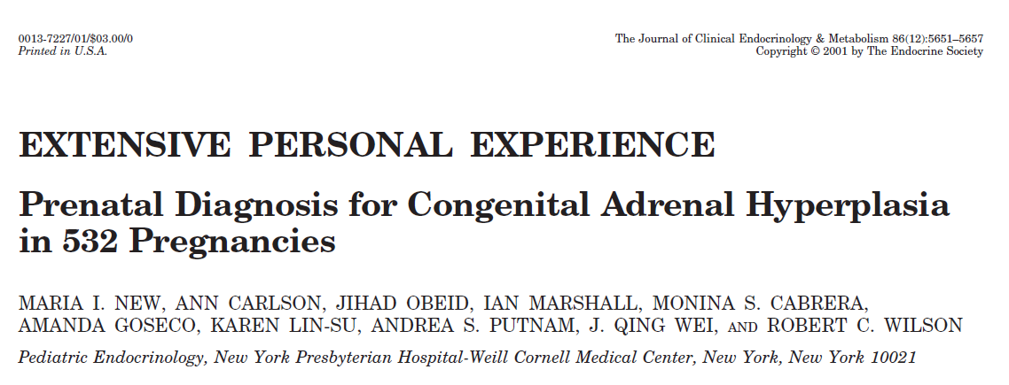
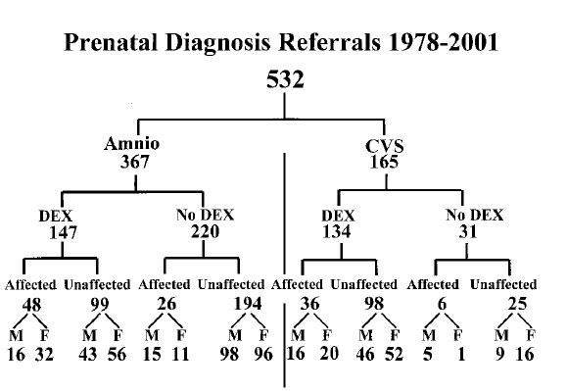

Slide 30
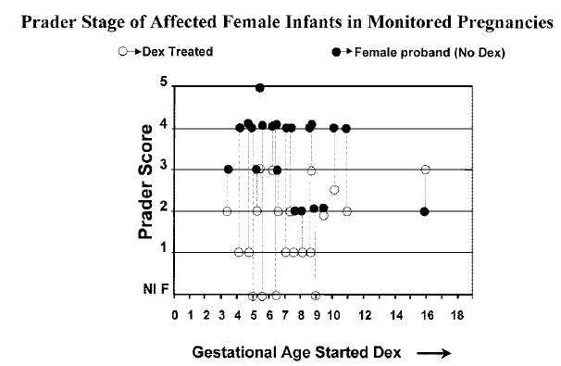

Slide 31
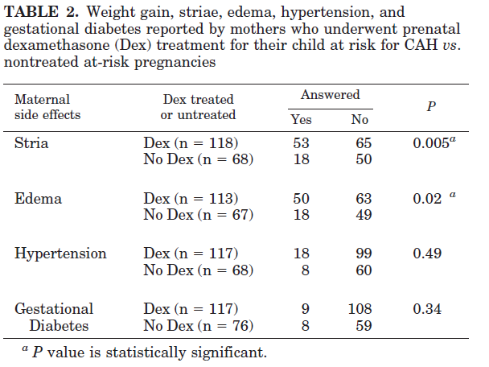

Slide 32
Objective : To conduct a systematic review and meta-analyses of studies that evaluated the effects of dexamethasone administration during pregnancies at risk for classical CAH because of 21-hydroxylase deficiency (CYP21A2).
Data Sources We searched MEDLINE, EMBASE, and Cochrane CENTRAL from inception through August 2009. Review of reference lists and contact with CAH experts further identified candidate studies.

Slide 33
Methods
Eligible studies were comparative studies that enrolled pregnancies at risk of classical CAH in which dexamethasone was given to one group and included a comparison unexposed group.
The outcomes of interest :
foetal death, foetal malformations,
foetal growth, and need for neonatal intensive care;
obstetric complications,
maternal hyperglycaemia
maternal hypertension
Studies were also included
long-term physical, metabolic, and neuropsychological outcomes, such as growth, dyslipidaemia, dysglycaemia,
cardiovascular outcomes
and neuropsychological outcomes,
school performance.
Excluded studies
using other glucocorticoids, such as hydrocortisone and betamethasone
for other medical condition
without a comparison group

Slide 37
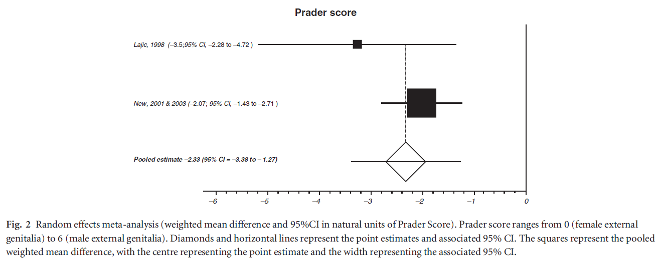
There is no significant change in either behavioural or temperamental problems in children exposed to dexamethasone during pregnancy

Slide 38
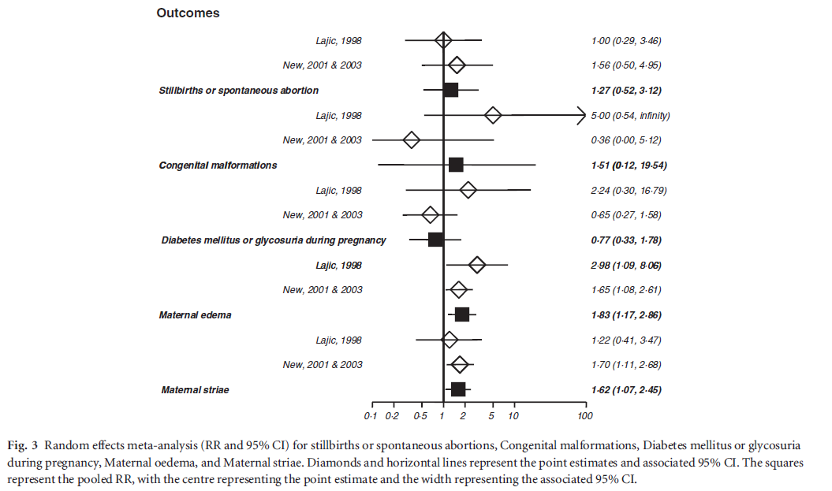

Slide 39
about 7 out of 8 (87.5 percent) of the individuals who have been exposed to many weeks of prenatal dexamethasone—at 60 to 100 times normal levels—never even had the condition that was being targeted with the prenatal intervention.
glucocorticoids may alter “fetal programming,” potentially resulting in serious metabolic problems that will not become apparent until adulthood (Hirvikoski et al. 2007; Marciniak et al. 2011).
the odds ratio for maternal glucocorticoid use in cleft palate was 1.7 (95% confidence interval, 1.1–2.6); exposures between conception and 8 weeks were considered, the odds ratio was 7.3 (Am J Obstet Gynecol 2007;197:585.e1-7).
the birthweights of prenatally treated infants are reduced by about 400 g. This reduction in birthweight is similar to that seen among women who smoke 2 packs of cigarettes per day (J Clin Endocrinol Metab 2001;86:5651-7.)

Slide 40
Maternal safety ?
Fetal safety ?
The prenatal treatment of CAH remains controversial
and poses unresolved ethical questions

Slide 41
Good luck

