Slide 1
Endocrine Treatment of Transsexual Persons
Dr. Abolfazl Heidari

Slide 2
Human sexuality is a broad concept that embodies interaction among
anatomy,
hormones and physiology,
psychology,
interpersonal relationships, and
sociocultural influences.

Slide 3
TERMINOLOGY
(These are cultural and descriptive terms, not diagnostic terms.)
Natal or birth-assigned sex – Typically assigned according to external genitalia or chromosomes.
Gender identity – An individual's innate sense of feeling male, female, neither, or some combination of both.
Gender expression – How gender is presented to the outside world (eg, feminine, masculine, androgynous); gender expression does not necessarily correlate with birth-assigned sex or gender identity.
Gender role -- is used to refer to behaviors, attitudes, and personality traits that a society, in a given culture and historical period, designates as masculine or feminine, that is, more appropriate to, or typical of, the social role as men or as women.

Slide 4
TERMINOLOGY
Gender nonconformity – Variation from the cultural norm in gender expression or gender role behavior (eg, in choices of toys, playmates, etc).
Transgender –term that is used to describe individuals with gender nonconformity; it includes individuals whose gender identity is different from their birth-assigned sex and/or whose gender expression does not fall within stereotypical definitions of masculinity and femininity; "transgender" is used as an adjective ("transgender people"), not a noun ("transgenders").
Gender dysphoria or incongruence – Distress or discomfort that may occur if gender identity and birth-assigned sex are not completely congruent.
Transsexuals – Older, clinical term that has fallen out of favor; historically, it was used to refer to transgender people who sought medical or surgical interventions for gender affirmation.

Slide 5
TERMINOLOGY
Transgender man/transman/FTM transsexual persons – Person with a masculine gender identity who was assigned a female sex at birth.
Transgender woman/transwoman/MTF transsexual persons – Person with a feminine gender identity who was assigned a male sex at birth.
.

Slide 7
1.0 Diagnostic procedure
Sex reassignment is a multidisciplinary treatment. It requires five processes:
diagnostic assessment
psychotherapy or counseling
real-life experience (RLE)
hormone therapy, and
surgical therapy
The focus of this Guideline is hormone therapy.

Slide 8
Diagnostic assessment and psychotherapy
Because GID may be accompanied with psychological or psychiatric problems, it is necessary that the clinician making the GID diagnosis be able
to make a distinction between GID and conditions that have similar features
to diagnose accurately psychiatric conditions
to undertake appropriate treatment thereof
Therefore, the SOC (Standards of Care) guidelines of the WPATH (World Professional Association of Transgender Health) recommend that the diagnosis be made by a MHP.
For children and adolescents, the MHP should also have training in child and adolescent developmental psychopathology.

Slide 9
Diagnostic assessment and psychotherapy
The MHP:
decides whether the applicant fulfills DSM-IV-TR or ICD-10 criteria for GID;
informs the applicant about the possibilities and limitations of sex reassignment and other kinds of treatment to prevent unrealistically high expectations;
assesses potential psychological and social risk factors for unfavorable outcomes of medical interventions.

Slide 10
Diagnostic assessment and psychotherapy
Gender identity disorder (GID) in DSM-IV-TR
This psychiatric diagnosis is given when
a strong and persistent cross-gender identification
Persistent discomfort with his or her sex or sense of inappropriateness in the gender role of that sex.
The disturbance is not concurrent with a physical intersex condition.
The disturbance causes clinically significant distress or impairment in social, occupational, or other important areas of functioning.

Slide 11
The real-life experience
WPATH’s SOC states that “the act of fully adopting a new or evolving gender role or gender presentation in everyday life is known as the real-life experience (RLE).
The real life experience is essential to the transition to the gender role that is congruent with the patient’s gender identity.
During the RLE, the person should fully experience life in the desired gender role before irreversible physical treatment is undertaken.
Living 12 months full-time in the desired gender role is recommended.

Slide 12
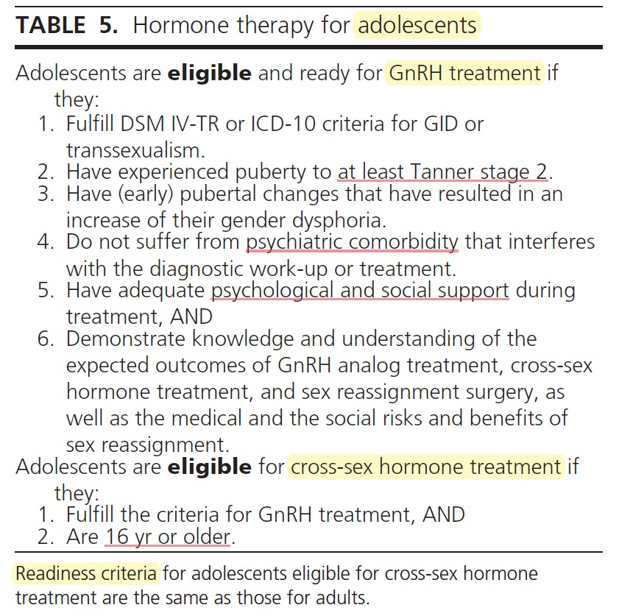
Eligibility and readiness criteria

Slide 13
1.0 Diagnostic procedure
1.1 We recommend that the diagnosis of GID be made by a MHP. For children and adolescents, the MHP must also have training in child and adolescent developmental psychopathology. (1 UOOO)
It is necessary that the clinician making the GID diagnosis be able to make a distinction between GID and conditions that have similar features, to accurately diagnose psychiatric conditions.

Slide 14
1.0 Diagnostic procedure
1.2 Given the high rate of remission of GID after the onset of puberty, we recommend against a complete social role change and hormone treatment in prepubertal children with GID. (1 UUOO)
Clinical experience suggests that GID can be reliably assessed only after the first signs of puberty.
This recommendation, however, does not imply that children should be entirely denied to show cross-gender behaviors or should be punished for exhibiting such behaviors.

Slide 15
1.0 Diagnostic procedure
1.3 We recommend that physicians evaluate and ensure that applicants understand the reversible and irreversible effects of hormone suppression (e.g. GnRH analog treatment) and of cross-sex hormone treatment before they start hormone treatment.

Slide 16
1.0 Diagnostic procedure
1.4 We recommend that all transsexual individuals be informed and counseled regarding options for fertility before initiation of puberty suppression in adolescents and before treatment with sex hormones of the desired sex in both adolescents and adults.

Slide 17
1.0 Diagnostic procedure
Prolonged pubertal suppression using GnRH analogs is reversible and should not prevent resumption of pubertal development upon cessation of treatment.
Although sperm production and development of the reproductive tract in early adolescent biological males with GID are insufficient for cryopreservation of sperm, they should be counseled that sperm production can be initiated after prolonged gonadotropin suppression, before estrogen treatment.

Slide 18
1.0 Diagnostic procedure
Girls can expect no adverse effects when treated with pubertal suppression.
They should be informed that no data are available regarding timing of spontaneous ovulation or response to ovulation induction after prolonged gonadotropin suppression.
The occurrence and timing of potentially irreversible effects should be emphasized.
Cryopreservation of sperm is readily available, and techniques for cryopreservation of oocytes, embryos, and ovarian tissue are being improved.

Slide 19
1.0 Diagnostic procedure
In biological males, when medical treatment is started in a later phase of puberty or in adulthood, spermatogenesis is sufficient for cryopreservation and storage of sperm.
Prolonged exposure of the testes to estrogen has been associated with testicular damage.
Restoration of spermatogenesis after prolonged estrogen treatment has not been studied.
In biological females, the effect of prolonged treatment with exogenous testosterone upon ovarian function is uncertain.

Slide 20
2.0 Treatment of adolescents
Over the past decade, clinicians have progressively acknowledged the suffering of young transsexual adolescents that is caused by their pubertal development.
Because early medical intervention may prevent this psychological harm, various clinics have decided to start treating young adolescents with GID with puberty-suppressing medication (a GnRH analog).
As compared with starting sex reassignment long after the first phases of puberty, a benefit of pubertal suppression is relief of gender dysphoria and a better psychological and physical outcome.

Slide 21
2.0 Treatment of adolescents
2.1 We recommend that adolescents who fulfill eligibility and readiness criteria for gender reassignment initially undergo treatment to suppress pubertal development. (1 UOOO)
2.2 We recommend that suppression of pubertal hormones start when girls and boys first exhibit physical changes of puberty (confirmed by pubertal levels of estradiol and testosterone, respectively), but no earlier than Tanner stages 2–3. (1 UUOO)

Slide 22
2.0 Treatment of adolescents
Pubertal suppression aids in the diagnostic and therapeutic phase, in a manner similar to the RLE.
Management of gender dysphoria usually improves.
In addition, the hormonal changes are fully reversible, enabling full pubertal development in the biological gender if appropriate.
Therefore, we advise starting suppression of puberty before irreversible development of sex characteristics.

Slide 23
2.0 Treatment of adolescents
The experience of full biological puberty, an undesirable condition, may seriously interfere with healthy psychological functioning and well-being.
Suffering from gender dysphoria without being able to present socially in the desired social role or to stop the development of secondary sex characteristics may result in an arrest in emotional, social, or intellectual development.
Another reason to start sex reassignment early is that the physical outcome after intervention in adulthood is far less satisfactory than intervention at age 16.

Slide 24
2.0 Treatment of adolescents
Pubertal suppression maintains end-organ sensitivity to sex steroids observed during early puberty, enabling satisfactory cross-sex body changes with low doses and avoiding irreversible characteristics that occur by midpuberty.
The protocol of suppression of pubertal development can also be applied to adolescents in later pubertal stages.
In contrast to effects in early pubertal adolescents, physical sex characteristics, such as breast development in girls and lowering of the voice and outgrowth of the jaw and brow in boys, will not regress completely.

Slide 25
2.0 Treatment of adolescents
Adolescents with GID should experience the first changes of their biological, spontaneous puberty because their emotional reaction to these first physical changes has diagnostic value.
Treatment in early puberty risks limited growth of the penis and scrotum that may make the surgical creation of a vagina from scrotal tissue more difficult.

Slide 26
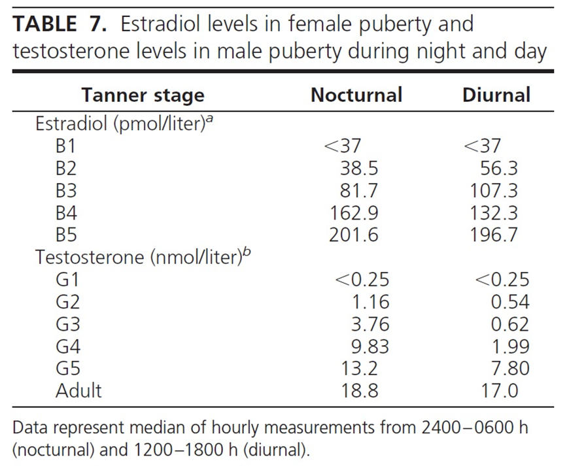

Slide 27
2.0 Treatment of adolescents
Careful documentation of hallmarks of pubertal development will ensure precise timing of initiation of pubertal suppression.
Irreversible and, for transsexual adolescents, undesirable sex characteristics
in female puberty are
large breasts and
short stature
and in male puberty are
Adam’s apple
low voice
male bone configuration such as large jaws, big feet, and hands; tall stature
and male hair pattern on the face and extremities.

Slide 28
2.0 Treatment of adolescents
2.3 We recommend that GnRH analogs be used to achieve suppression of pubertal hormones. (1 UUOO)
Suppression of pubertal development and gonadal function is accomplished most effectively by gonadotropin suppression with GnRH analogs and antagonists.
Analogs suppress gonadotropins after a short period of stimulation, whereas antagonists immediately suppress pituitary secretion.
Because no long-acting antagonists are available for use as pharmacotherapy, long-acting analogs are the currently preferred treatment option.

Slide 29
2.0 Treatment of adolescents
During treatment with the GnRH analogs, slight development of sex characteristics will regress and, in a later phase of pubertal development, will be halted.
In girls, breast development will become atrophic, and menses will stop; in boys, virilization will stop, and testicular volume will decrease.
An advantage of using GnRH analogs is the reversibility of the intervention. If, after extensive exploring of his/her reassignment wish, the applicant no longer desires sex reassignment, pubertal suppression can be discontinued. Spontaneous pubertal development will resume immediately

Slide 30
2.0 Treatment of adolescents
GnRH analogs are expensive and not always reimbursed by insurance companies.
Although there is no clinical experience in this population, financial considerations may require treatment with progestins as a less effective alternative.
They suppress gonadotropin secretion and exert a mild peripheral antiandrogen effect in boys.
Depomedroxyprogesterone will suppress ovulation and progesterone production for long periods of time, although residual estrogen levels vary.

Slide 31
2.0 Treatment of adolescents
In high doses, progestins are relatively effective in suppression of menstrual cycling in girls and women and androgen levels in boys and men.
However, at these doses, side effects such as suppression of adrenal function and suppression of bone growth may occur.
Antiestrogens in girls and antiandrogens in boys can be used to delay the progression of puberty.
Their efficacy, however, is far less than that of the GnRH analogs.

Slide 32
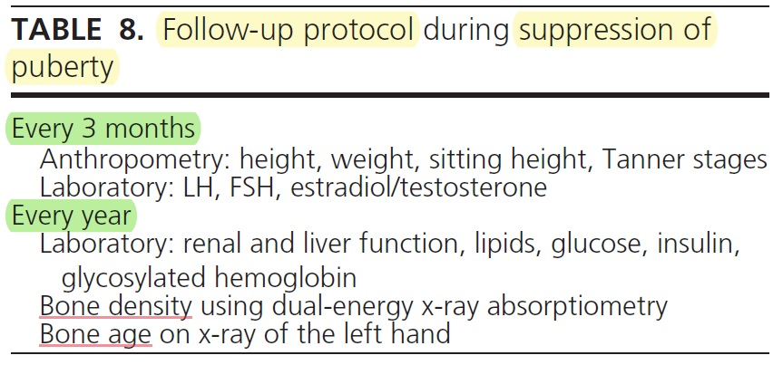
2.0 Treatment of adolescents
During treatment, adolescents should be monitored for negative effects of delaying puberty, including a halted growth spurt and impaired bone accretion.

Slide 33
2.0 Treatment of adolescents
2.4 We suggest that pubertal development of the desired, opposite sex be initiated at the age of 16yr, using a gradually increasing dose schedule of cross-sex steroids. (2 UOOO)
In many countries, 16-yr-olds are legal adults with regard to medical decision making. This is probably because, at this age, most adolescents are able to make complex cognitive decisions.

Slide 34
2.0 Treatment of adolescents
For the induction of puberty, we use a similar dose scheme of induction of puberty in these hypogonadal transsexual adolescents as in other hypogonadal individuals.
We do not advise the use of sex steroid creams or patches because there is little experience for induction of puberty.
The transsexual adolescent is hypogonadal and may be sensitive to high doses of cross-sex steroids, causing adverse effects of striae and abnormal breast shape in girls and cystic acne in boys.

Slide 35
2.0 Treatment of adolescents

Slide 36
2.0 Treatment of adolescents
We suggest that treatment with GnRH analogs be continued during treatment with cross-sex steroids to maintain full suppression of pituitary gonadotropin levels and, thereby, gonadal steroids.
When puberty is initiated with a gradually increasing schedule of sex steroid doses, the initial levels will not be high enough to suppress endogenous sex steroid secretion.
The estrogen doses used may result in reactivation of gonadotropin secretion and endogenous production of testosterone that can interfere with the effectiveness of the treatment.
GnRH analog treatment is advised until gonadectomy.

Slide 37
2.0 Treatment of adolescents

Slide 38
2.0 Treatment of adolescents
2.5 We recommend referring hormone-treated adolescents for surgery when
the RLE has resulted in a satisfactory social role change,
the individual is satisfied about the hormonal effects, and
the individual desires definitive surgical changes.
(1 UOOO)
2.6 We suggest deferring for surgery until the individual is at least 18 yr old. (2 UOOO)

Slide 39
3.0 Hormonal therapy for transsexual adults
3.1 We recommend that treating endocrinologists confirm the diagnostic criteria of GID or transsexualism and the eligibility and readiness criteria for the endocrine phase of gender transition. (1 UUUO)
3.2 We recommend that medical conditions that can be exacerbated by hormone depletion and cross-sex hormone treatment be evaluated and addressed before initiation of treatment (Table 11). (1 UUUO)
3.3 We suggest that cross-sex hormone levels be maintained in the normal physiological range for the desired gender. (2 UUOO)

Slide 40
3.0 Hormonal therapy for transsexual adults

Slide 42
3.0 Hormonal therapy for transsexual adults
FTM transsexual persons
Either parenteral or transdermal preparations can be used to achieve testosterone values in the normal male range (320–1000 ng/dl).
Similar to androgen therapy in hypogonadal men, testosterone treatment in the FTM individual results in increased muscle mass and decreased fat mass, increased facial hair and acne, male pattern baldness, and increased libido.
Specific to the FTM transsexual person, testosterone will result in clitoromegaly, temporary or permanent decreased fertility, deepening of the voice, and, usually, cessation of menses.

Slide 43
3.0 Hormonal therapy for transsexual adults
MTF transsexual persons
The hormone regimen for MTF transsexual individuals is more complex than the FTM regimen. Most published clinical studies report the use of an antiandrogen in conjunction with an estrogen.
The antiandrogens shown to be effective reduce endogenous testosterone levels, ideally to levels found in adult biological women, to enable estrogen therapy to have its fullest effect.
Measurement of serum estradiol levels can be used to monitor oral, transdermal, and im estradiol.
Use of conjugated estrogens or synthetic estrogens cannot be monitored by blood tests.
Serum estradiol should be maintained at the mean daily level for premenopausal women (200 pg/ml), and the serum testosterone level should be in the female range (55 ng/dl).

Slide 44
3.0 Hormonal therapy for transsexual adults
3.4 We suggest that endocrinologists review with persons treated the onset and time course of physical changes induced by cross-sex hormone treatment. (2 UUOO)

Slide 45
3.0 Hormonal therapy for transsexual adults

Slide 46
3.0 Hormonal therapy for transsexual adults

Slide 47
4.0 Adverse outcome prevention and long-term care
4.1 We suggest regular clinical and laboratory monitoring every 3 months during the first year and then once or twice yearly. (2 UUOO)

Slide 49
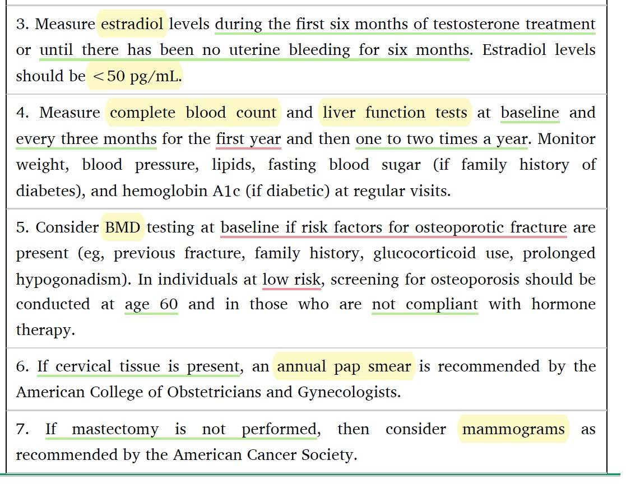

Slide 50
4.0 Adverse outcome prevention and long-term care
4.2 We suggest monitoring prolactin levels in MTF transsexual persons treated with estrogens.(2 UUOO)
Estrogen therapy can increase the growth of pituitary lactrotroph cells. There have been several reports of prolactinomas occurring after long-term estrogen therapy.
Up to 20% of transsexual women treated with estrogens may have elevations in prolactin levels associated with enlargement of the pituitary gland.
In most cases, the serum prolactin levels will return to the normal range with a reduction or discontinuation of the estrogen therapy.

Slide 51
4.0 Adverse outcome prevention and long-term care
The onset and time course of hyperprolactinemia during estrogen treatment are not known.
Prolactin levels should be obtained at baseline and then at least annually during the transition period and biannually thereafter.
Given that prolactinomas have been reported only in a few case reports and were not reported in large cohorts of estrogen-treated transsexual persons, the risk of prolactinoma is likely to be very low.
Because the major presenting findings of microprolactinomas (hypogonadism and sometimes gynecomastia) are not apparent in MTF transsexual persons, radiological examination of the pituitary may be carried out in those whose prolactin levels persistently increase despite stable or reduced estrogen levels.
Because transsexual persons are diagnosed and followed throughout sex reassignment by an MHP, it is likely that some will receive psychotropic medications that can increase prolactin levels.

Slide 52
4.0 Adverse outcome prevention and long-term care
4.3 We suggest that transsexual persons treated with hormones be evaluated for cardiovascular risk factors. (2 UUOO)

Slide 53
4.0 Adverse outcome prevention and long-term care
FTM transsexual persons
Testosterone administration to FTM transsexual persons will result in a more atherogenic lipid profile with lowered high-density lipoprotein cholesterol and higher triglyceride values.
Studies of the effect of testosterone on insulin sensitivity have mixed results. A recent randomized, open-label uncontrolled safety study of FTM transsexual persons treated with testosterone undecanoate demonstrated no insulin resistance after 1 yr.
Numerous studies have demonstrated effects of cross-sex hormone treatment on the cardiovascular system.
Long-term studies from The Netherlands found no increased risk for cardiovascular mortality.
Likewise, a meta-analysis of 19 randomized trials examining testosterone replacement in men showed no increased incidence of cardiovascular events.
A systematic review of the literature found that data were insufficient, due to very low quality evidence, to allow meaningful assessment of important patient outcomes such as death, stroke, myocardial infarction, or venous thromboembolism in FTM transsexual persons.

Slide 54
4.0 Adverse outcome prevention and long-term care
MTF transsexual persons
A prospective study of MTF subjects found favorable changes in lipid parameters with increased high-density lipoprotein and decreased low-density lipoprotein concentrations.
However, these favorable lipid changes were attenuated by increased weight, blood pressure, and markers of insulin resistance.
The largest cohort of MTF subjects (with a mean age of 41yr) followed for a mean of 10 yr showed no increase in cardiovascular mortality despite a 32% rate of tobacco use.
Thus, there is limited evidence to determine whether estrogen is protective or detrimental in MTF transsexual persons.

Slide 55
4.0 Adverse outcome prevention and long-term care
4.4 We suggest that BMD measurements be obtained if risk factors for osteoporosis exist, specifically in those who stop sex hormone therapy after gonadectomy. (2 UUUO)

Slide 56
4.0 Adverse outcome prevention and long-term care
FTM transsexual persons
Adequate dosing of testosterone is important to maintain bone mass in FTM transsexual persons.
In one study , serum LH levels were inversely related to BMD, suggesting that low levels of sex hormones were associated with bone loss.
Thus, LH levels may serve as an indicator of the adequacy of sex steroid administration to preserve bone mass.
The protective effect of testosterone may be mediated by peripheral conversion to estradiol both systemically and locally in the bone.

Slide 57
4.0 Adverse outcome prevention and long-term care
MTF transsexual persons
Studies in aging genetic males suggest that serum estradiol more positively correlates with BMD than does testosterone and is more important for peak bone mass.
Estrogen preserves BMD in MTF transsexuals who continue on estrogen and antiandrogen therapies.

Slide 58
4.0 Adverse outcome prevention and long-term care
4.5 We suggest that MTF transsexual persons who have no known increased risk of breast cancer follow breast screening guidelines recommended for biological women. (2 UUOO)
4.6 We suggest that MTF transsexual persons treated with estrogens follow screening guidelines for prostatic disease and prostate cancer recommended for biological men. (2 UOOO)

Slide 59
4.0 Adverse outcome prevention and long-term care
4.7 We suggest that FTM transsexual persons evaluate the risks and benefits of including a total hysterectomy and oophorectomy as part of sex reassignment surgery. (2 UOOO)

Slide 60
4.0 Adverse outcome prevention and long-term care
Although aromatization of testosterone to estradiol in FTM transsexual persons has been suggested as a risk factor for endometrial cancer, no cases have been reported.
The androgen receptor has been reported to increase in the ovaries after long-term administration of testosterone, which may be an indication of increased risk of ovarian cancer.
Cases of ovarian cancer have been reported.

Slide 61
5.0 Surgery for sex reassignment
5.1 We recommend that transsexual persons consider genital sex reassignment surgery only after both the physician responsible for endocrine transition therapy and the MHP find surgery advisable. (1 UOOO)
5.2 We recommend that genital sex reassignment surgery be recommended only after completion of at least 1 yr of consistent and compliant hormone treatment. (1 UOOO)
5.3 We recommend that the physician responsible for endocrine treatment medically clear transsexual individuals for sex reassignment surgery and collaborate with the surgeon regarding hormone use during and after surgery. (1 UOOO)

