Slide 1
Basal Insulins
Hengameh Abdi
Endocrine Research Center
Research Institute for Endocrine sciences
Shahid Beheshti University of Medical Sciences
16 February 2017

Slide 2
Outlines
Introduction to basal insulins
Pharmacodynamics of basal insulins
Comparison of the old conventional NPH insulin with the long-acting insulin analogues glargine and detemir in terms of efficacy and safety
Insulin glargine versus insulin detemir
Basal insulins in specific populations
Pregnancy
Pediatric
Conclusions

Slide 3
In T2DM, the contribution of fasting hyperglycemia increases
gradually with diabetes worsening.
100
70%
Relative contribution (%)
Fasting
50
30%
0
<7.3
7.3―8.4
8.5―9.2
9.3―10.2
>10.2
HbA_{1c} (%) quintiles
Monnier L, et al. Diabetes Care 2003; 26: 881-5.
Notes:
This study analysed the diurnal glycaemic profiles of 290 patients with T2DM investigated at different levels of HbA_{1c}. The patients were treated with diet or oral hypoglycaemic agents (not acarbose).
Plasma glucose (PG) concentrations were determined at fasting and during postprandial and post absorptive periods.
The areas under the curve above fasting PG concentrations and >6.1 mmol/l (110 mg/dl) were calculated for further evaluation of the relative contributions of postprandial and fasting PG increments to the overall diurnal hyperglycaemia. The value of 6.1 mmol/l (110 mg/dl) was chosen because this threshold has been defined as the upper limit of normal PG at fasting or preprandial times by the American Diabetes Association. The data were compared over quintiles of HbA_{1c.}
The main contributor to overall hyperglycaemia in patients with poorly controlled T2DM was found to be fasting hyperglycaemia. Fasting hyperglycaemia was the dominant factor in patients who were furthest from HbA_{1c} target.

Slide 4
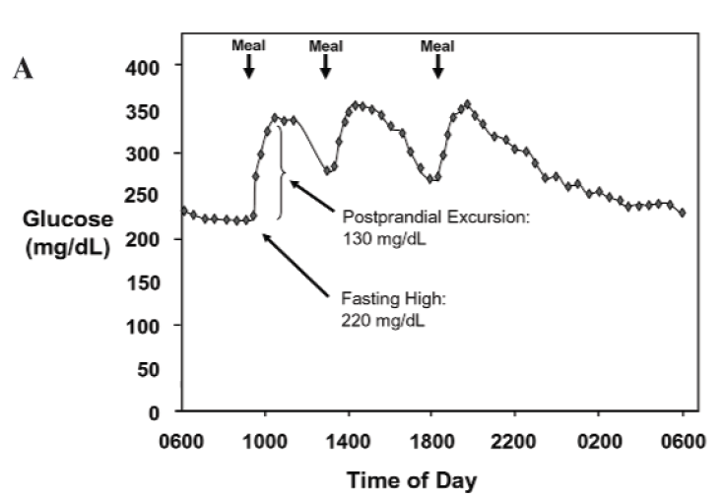
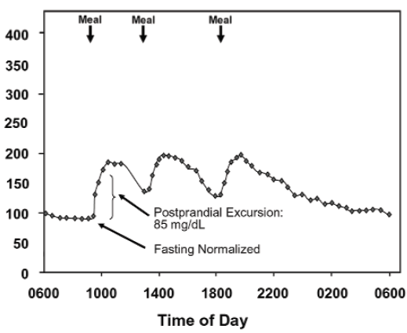
Addressing fasting glucose can initially lower fasting levels and even improve postprandial excursions by reducing glucotoxicity and improving ß-cell function.
Hirsch I, et al. Clin Diabetes 2005; 23(2): 78-86.

Slide 5
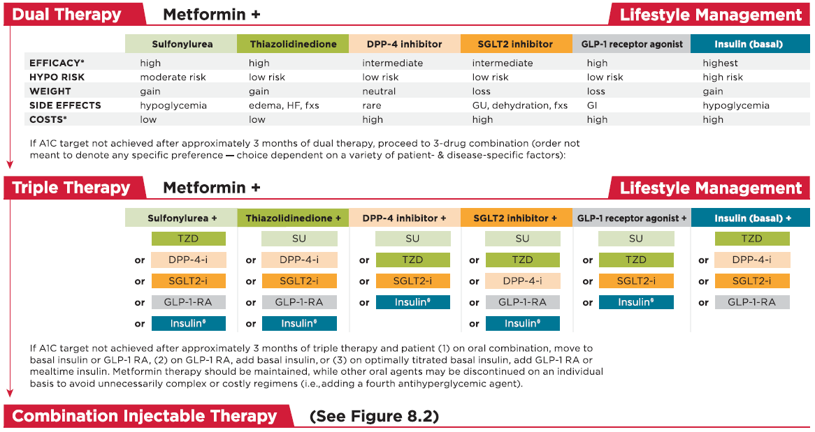
ADA. Diabetes Care 2017;40(Suppl 1)

Slide 6
Historical overview of basal insulins Initial FDA approval date

Slide 7
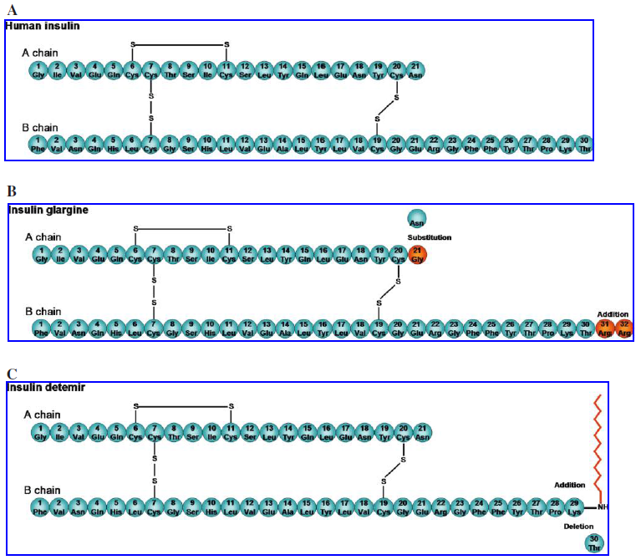
Primary structures of basal insulins
Owens DR, et al. Diabetes Technol Ther 2008; 10(5): 333-349.
Notes:
The primary structure of glargine is different from that of human insulin because of 2 modifications: 1) 2 arginine residues are added to the C-terminus of the B-chain, which raises the isoelectric point from pH 5.4 to 6.7, making the molecule less soluble at the physiologic pH of subcutaneous tissue; and 2) the asparagine residue at position 21 in the A-chain is replaced with a neutral glycine residue, which stabilizes the molecule, limiting dimerization at the acidic pH (4.0). Following injection of a homogeneous solution, glargine forms amorphous microprecipitates at the neutral pH of subcutaneous tissue and is slowly released to provide basal insulin supplementation over the once-daily dosage interval.
It has been suggested that 2 mechanisms contribute to the protracted action of detemir: the reversible binding to albumin and the delayed absorption due to selfassociation.Thus, 2 distinct “buffering” mechanisms likely contribute both to prolonged duration of action and to less injection-to-injection variability. It was hypothesized that the latter causes retention of the compound in the subcutaneous tissue long enough to establish albumin binding in the interstitial space. In circulation, detemir is 98% bound to albumin, which reduces the rate of transport from blood to interstitial fluid, relative to RHI. Importantly, plasma albumin binding of detemir acts as a buffering mechanism against any rapid or irregular changes in absorption. Because detemir is immediately and almost completely bound to albumin, the concentration of free insulin in the capillary is limited. Because the distribution of detemir from plasma to target tissues is slower than that of regular human insulin, changes in detemir concentration in the plasma will be slow to affect interstitial concentrations. These buffering mechanisms appear to underlie the low intrapatient variability observed with detemir.
Postgraduate Medicine, 2011, 123:4, 17-26

Slide 8
Ideal basal insulin
Mimic of normal pancreatic basal insulin secretion
Continued 24-h effect
Peakless (flatness) profile
Once-daily administration
Optimal glycemic control associated with:
Less hypoglycemia
Less weight gain
Acceptable cardiovascular safety

Slide 9
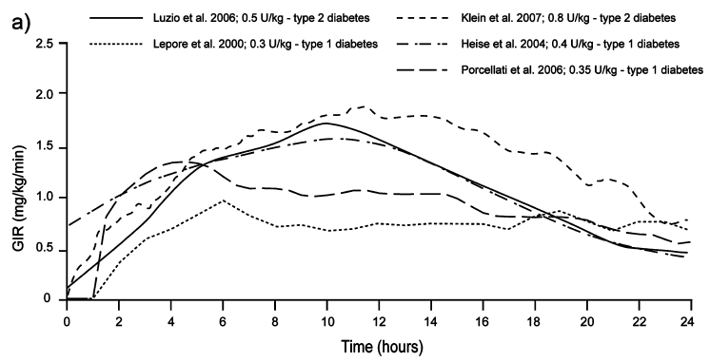
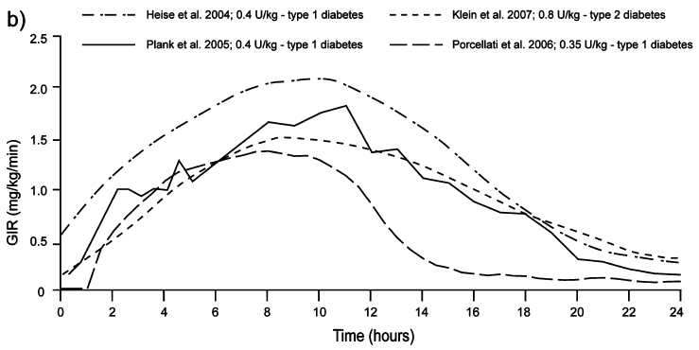
Pharmacodynamics of currently available basal insulins
Insulin formulation | Onset of action | Peak time | Duration of action
NPH | 1-2 (2-4) h | 4-10 h | 10-16 h
Glargine | 1-2 (2-4) h | - | 20-24 h
Detemir | 1-2 (2-4) h | - | 16-23 h
Glargine
Detemir
Hirsch I, et al. Clin Diabetes 2005; 23(2): 78-86.
Heise T. Diabetes, Obes Metab 2007; 9: 648-659
Rossetti P, et al. Diabetes, Obes Metab 2014; 16: 695–706.
Notes:
Glargine and detemir both typically show a gentle rise and fall in glucose-lowering action over time.
Duration of action with both analogues is dose dependent, but in the clinically relevant range of 0.35-0.8 U/kg it is close to 24 h in people with type 1 diabetes and in excess of this in people with type 2 diabetes.
Detemir shows less within-subject variability in its metabolic effect.
The duration of action of insulin detemir is dose-dependent, increasing from 5.7 h at a low dose (0.1 U/kg) to 23.2 h at a high dose (1.6 U/kg).

Slide 10
Lower within-subject variability of insulin detemir compared to insulin glargine and NPH in patients with T1DM
7
7
7
6
6
6
5
5
5
4
4
4
3
3
3
2
2
2
1
1
1
0
0
24
0
0
8
16
24
0
8
16
0
8
16
24
7
7
7
6
6
6
5
5
5
4
4
4
3
3
3
Glucose infusion rate (mg/kg/min)
2
2
2
1
1
1
100
0
0
0
0
8
16
24
0
8
16
24
0
8
16
24
80
7
7
7
6
6
6
60
68%
5
5
5
4
4
4
40
48%
3
3
3
2
2
2
20
27%
1
1
1
0
0
0
0
0
8
16
24
0
8
16
24
0
8
16
24
NPH
Glargine
Detemir
Heise T, et al. Diabetes 2004; 53:1614–1620.

Slide 11
Insulins Glargine and Detemir
versus
Insulin NPH

Slide 12
Cochrane Database of Systematic Reviews 2007, Issue 2.

Slide 13
Long-acting insulin analogues versus NPH insulin for type 2 diabetes mellitus
Objectives:
To assess the effects of long-term treatment with insulin glargine and insulin detemir compared to NPH insulin in patients with type 2 diabetes mellitus.
Selection criteria:
Randomised controlled trials with duration of at least 24 weeks.
Primary outcomes:
Number of overall, severe and nocturnal hypoglycemia.
Glycemic control (HbA1c).
Results:
6 studies: Glargine vs NPH
2 studies: Detemir vs NPH
Cochrane Database of Systematic Reviews 2007, Issue 2.

Slide 14
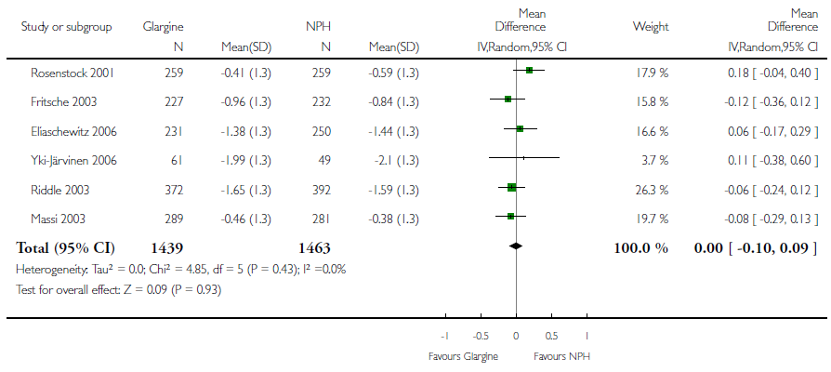
Change in HbA1c: Insulin glargine vs NPH No difference
Cochrane Database of Systematic Reviews 2007, Issue 2.

Slide 15
Change in HbA1c: Insulin detemir vs NPH No difference
Cochrane Database of Systematic Reviews 2007, Issue 2.

Slide 16
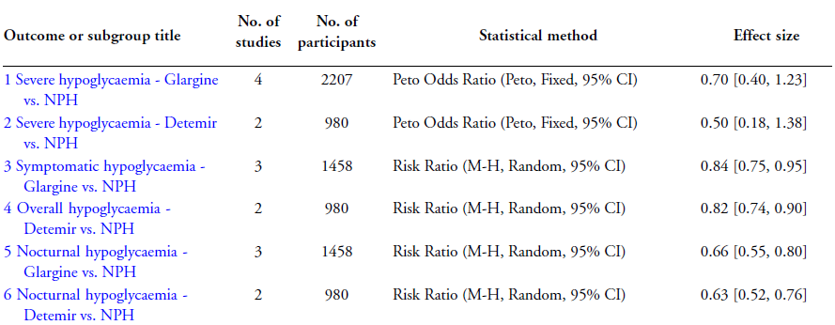
Fewer people experienced symptomatic, overall or nocturnal hypoglycemic episodes with treatment with either insulin glargine or detemir.
Cochrane Database of Systematic Reviews 2007, Issue 2.

Slide 17
Conclusions
Insulin glargine and insulin detemir were almost identically effective compared to NPH insulin in long-term metabolic control (HbA1c).
Fewer people experienced symptomatic, overall or nocturnal hypoglycemic episodes with treatment with either of the two analogues.
No evidence for a beneficial effect of long-acting analogues on patient-oriented outcomes like mortality, morbidity, quality of life or costs could be obtained.

Slide 18
Insulin Detemir
versus
Insulin Glargine

Slide 19
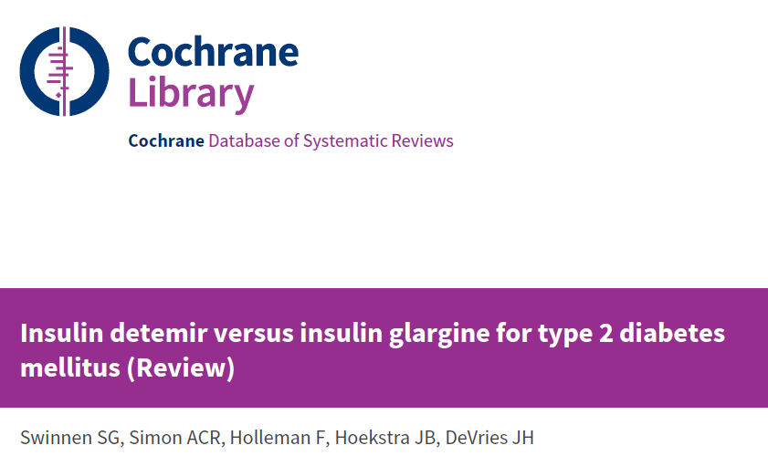
Cochrane Database of Systematic Reviews 2011, Issue 7.

Slide 20
Insulin detemir versus insulin glargine for type 2 diabetes
Objectives:
To assess the effects of insulin detemir and insulin glargine compared with each other in the treatment of type 2 diabetes mellitus.
Selection criteria:
Randomised controlled trials with duration of at least 12 weeks.
Primary outcomes:
Glycemic control.
Incidence and rate of overall, daytime, nocturnal and severe hypoglycemia.
Results:
4 studies including 2250 people with duration of 24-52 weeks.
Cochrane Database of Systematic Reviews 2011, Issue 7.

Slide 21
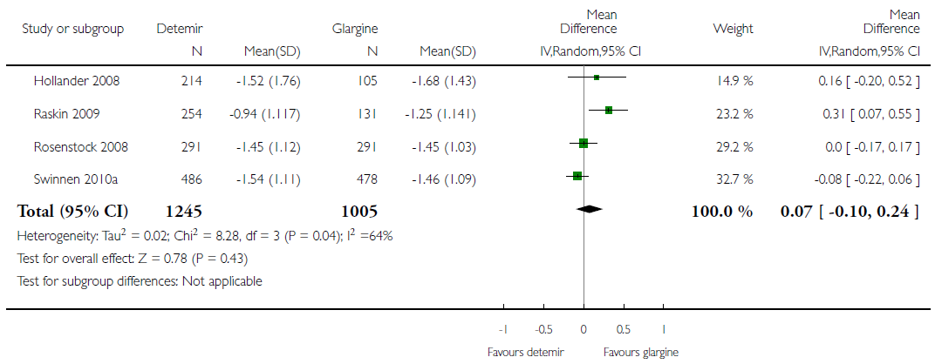
Change in HbA1c No difference
Cochrane Database of Systematic Reviews 2011, Issue 7.

Slide 22
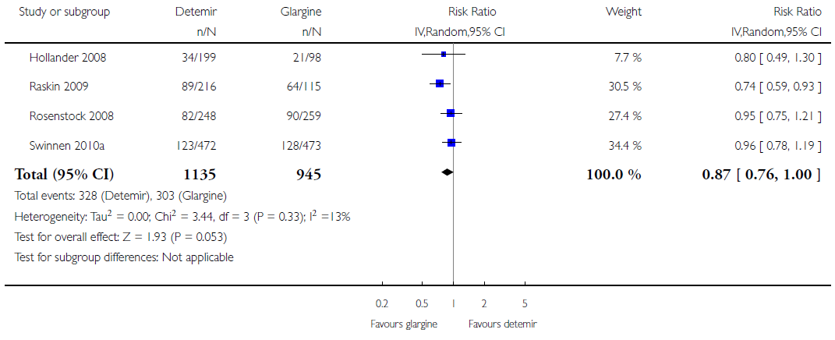
Percentage of participants achieving HbA1c ≤ 7% without hypoglycemia
Cochrane Database of Systematic Reviews 2011, Issue 7.

Slide 23
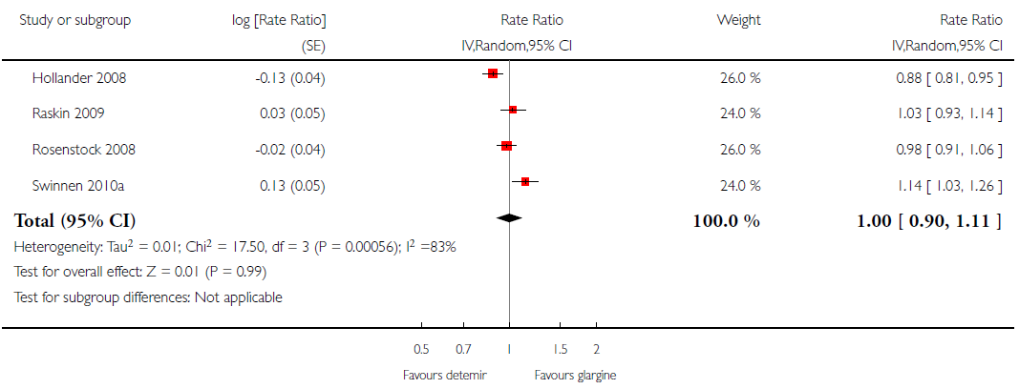
Event rate for overall hypoglycemia per patient-year No difference
Cochrane Database of Systematic Reviews 2011, Issue 7.

Slide 24
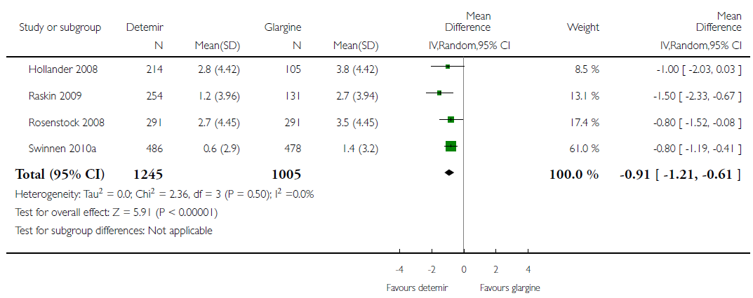
Weight gain Insulin detemir was associated with statistically significant relatively small reduction of weight gain (0.9 kg).
Cochrane Database of Systematic Reviews 2011, Issue 7.

Slide 25
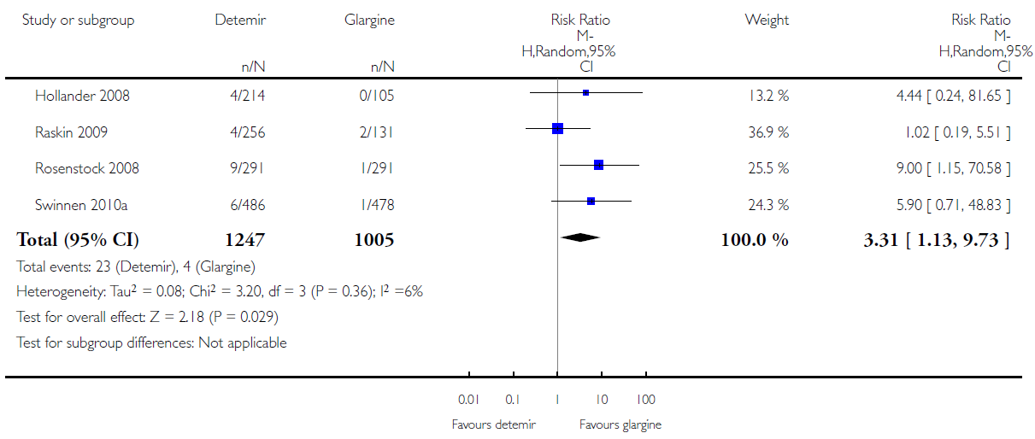
Percentage of participants having at least one injection site reaction Treatment with insulin glargine resulted in a lower number of injection site reactions.
Cochrane Database of Systematic Reviews 2011, Issue 7.

Slide 26
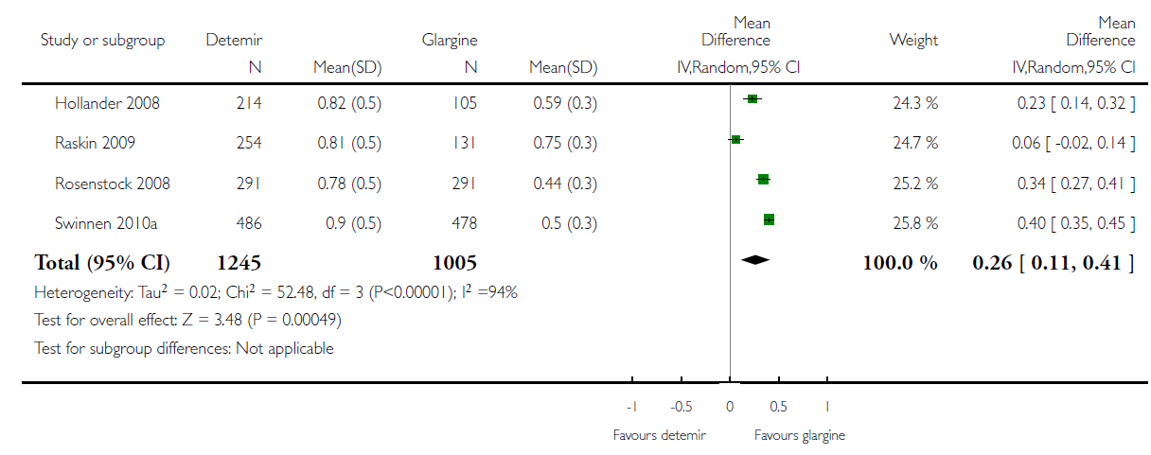
Daily basal insulin dose in units per kg Treatment with insulin glargine resulted in a lower daily dose.
Cochrane Database of Systematic Reviews 2011, Issue 7.

Slide 27
Conclusions
There is no clinically relevant difference in the efficacy or safety between the use of insulin detemir and insulin glargine for treating type 2 diabetes mellitus.
To achieve the same glycemic control, insulin detemir was often injected twice-daily in a higher dose but with less weight gain, while insulin glargine was only injected once-daily, with somewhat fewer injection site reactions.

Slide 28
This study was supported by a scientific grant from Sanofi Poland.
Rys P, et al. Acta Diabetol 2015; 52: 649-662.

Slide 29
Insulin glargine versus NPH insulin, premixed insulin preparations or insulin detemir in type 2 diabetes
Objectives:
To summarize scientific evidence on relative efficacy and safety of insulin glargine (IGlar) and other insulins in T2DM.
Selection criteria:
Relevant studies compared efficacy and safety of IGlar, added to oral drugs or/and in combination with bolus insulin, with NPH or premixed insulin (MIX) in the same regimen, as well as with insulin detemir (IDet).
Primary outcomes:
Target HbA1c level without hypoglycemic event.
Results:
28 randomized controlled trials with follow-up duration of 12-52 weeks.
Rys P, et al. Acta Diabetol 2015; 52: 649-662.

Slide 30
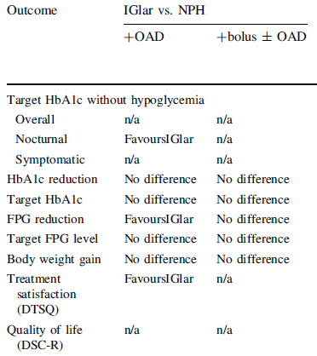
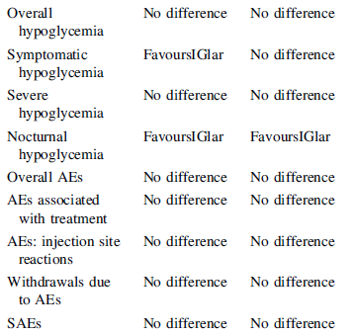
Glargine vs NPH
RR: 1.32(1.09-1.59)
Rys P, et al. Acta Diabetol 2015; 52: 649-662.

Slide 31
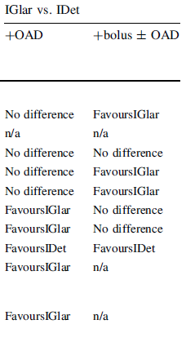
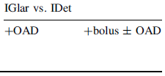
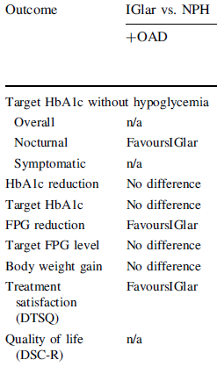
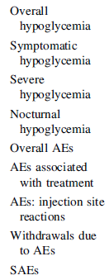
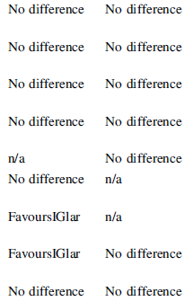
Glargine vs Detemir
0.77(0.44-1.11)
1.24(0.59-1.89) kg
Rys P, et al. Acta Diabetol 2015; 52: 649-662.

Slide 32
Conclusions
For the majority of examined efficacy and safety outcomes, insulin glargine use in T2DM patients was superior or non-inferior to the alternative insulin treatment options.

Slide 33
Cardiovascular Safety

Slide 34
Participants:
12,537 people (≥ 50 y/o; mean age, 63.5 years) with cardiovascular risk factors plus impaired fasting glucose, impaired glucose tolerance, or type 2 diabetes (~ 60%).
Intervention:
Insulin glargine (with a target FPG of ≤ 95 mg/dl) or standard care.
Primary outcomes:
Nonfatal myocardial infarction, nonfatal stroke, or death from cardiovascular causes and these events plus revascularization or hospitalization for heart failure.
Duration of follow-up:
Median: 6.2 years (interquartile range, 5.8 to 6.7)
N Engl J Med 2012; 367(4): 319-328.

Slide 35
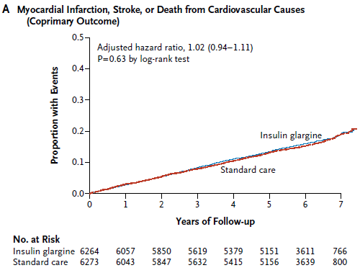
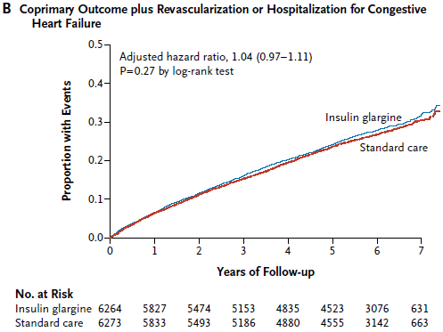
Similar rates of incident cardiovascular outcomes in the insulin-glargine and standard-care groups
N Engl J Med 2012; 367(4): 319-328.

Slide 36
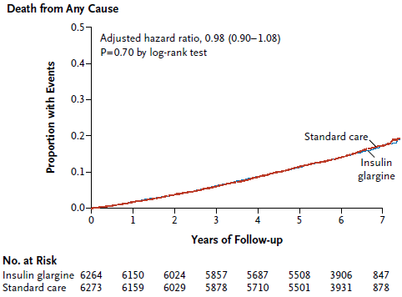
N Engl J Med 2012; 367(4): 319-328.

Slide 37
Conclusions
When used to target normal fasting plasma glucose levels for more than 6 years, insulin glargine had a neutral effect on cardiovascular outcomes and cancers.
Although it reduced new-onset diabetes, insulin glargine also increased hypoglycemia and modestly increased weight.
N Engl J Med 2012; 367(4): 319-328.

Slide 38
Design:
A nationwide, register-based longitudinal study from Finland.
Objective:
To investigate the differences in the safety of insulins NPH, detemir, and glargine in terms of all-cause and cause-specific mortality among real-life patients with type 2 diabetes.
Study population:
23,751 Finnish patients with type 2 diabetes, who at age of ≥ 40 years had initiated therapy with basal insulin (NPH, detemir, or glargine).
Duration:
Follow-up time was up to 4 years (median 1.7 years).
This study was supported by Novo Nordisk.
Strandberg AY, et al. PLoS ONE 2016; 11(3): e0151910

Slide 39
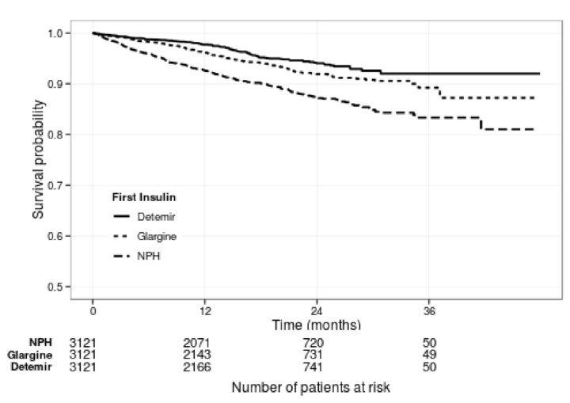
Adjusted hazard ratio for all-cause mortality: Glargine vs NPH: 0.55 (95% CI, 0.44 to 0.69) Detemir vs NPH: 0.39 (95% CI, 0.30 to 0.50) Detemir vs glargine: 0.71 (95% CI, 0.54 to 0.93)
Detemir
Glargine
NPH
Strandberg AY, et al. PLoS ONE 2016; 11(3): e0151910

Slide 40
Compared to NPH, the mortality risk for both cardiovascular causes as well as cancer were significantly lower for glargine, and especially for detemir.
Strandberg AY, et al. PLoS ONE 2016; 11(3): e0151910
Notes:
In the PS matched cohort, cardiovascular diseases were the most frequent cause of death.
With exposure to glargine as reference the HR for detemir was 0.64 (95% CI, 0.43 to 0.95).

Slide 41
Conclusions
In real clinical practice, mortality was substantially higher among users of NPH insulin as compared to insulins detemir or glargine.
Considering the large number of patients who require insulin therapy, this difference in risk may have major clinical and public health implications.
Strandberg AY, et al. PLoS ONE 2016; 11(3): e0151910

Slide 42
Specific populations: Pregnancy
Insulin glargine (category C)
There have been no randomized, well-controlled clinical studies of the use of insulin glargine in pregnant women. The available data suggest that there are no identifiable, consistent adverse maternal or fetal outcomes for specific malformations or other fetal/neonatal toxicity with the use of insulin glargine during pregnancy.
Insulin detemir (category B)
A randomized controlled clinical trial of pregnant women with type I diabetes using LEVEMIR during pregnancy did not show an increase in the risk of fetal abnormalities.
U.S Food & Drug Administration. www.fda.gov.
Notes:
Based on the spontaneous global pharmacovigilance data, the proportion of pregnancies with congenital anomalies while on insulin glargine was 3.7%, and with miscarriage in patients on insulin glargine was 4.7%.

Slide 43
Specific populations: Pediatric
Insulin glargine
The safety and effectiveness of LANTUS have been established in pediatric patients (age 6 to 15 years) with type 1 diabetes.
Insulin detemir
The pharmacokinetics, safety and effectiveness of subcutaneous injections of LEVEMIR have been established in pediatric patients (age 2 to 17 years) with type 1 diabetes.
U.S Food & Drug Administration. www.fda.gov.
Notes:
Based on the spontaneous global pharmacovigilance data, the proportion of pregnancies with congenital anomalies while on insulin glargine was 3.7%, and with miscarriage in patients on insulin glargine was 4.7%.

Slide 44
Currently available basal insulin formulations in Iran
NPH
Glargine (Lantus) Flexpen U-100
Sanofi-Aventis
Price: 29,500 T (2,950 T)
Detemir (Levemir) Flexpen U-100
Novo nordisk
Price: 35,500 T (10,300 T)

Slide 45
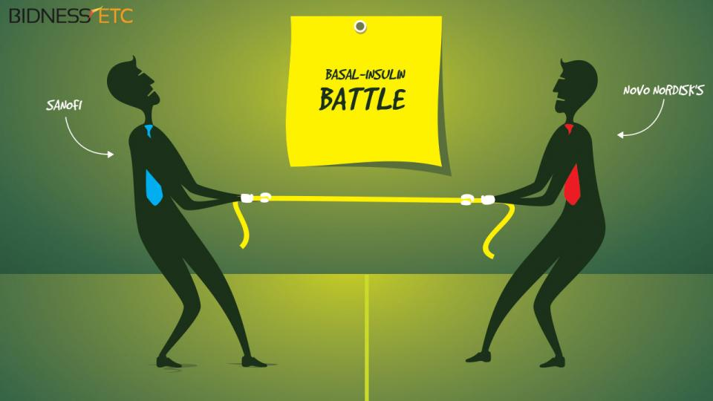
Sanofi And Novo Nordisk‘s basal-insulin battle continues.

Slide 46
Concluding remarks
Basal insulin regimen is recommended as the first step of insulin initiation.
Given that various basal insulin formulations are currently available, their different aspects of clinical pharmacology data should be considered for a personalized pharmacotherapy.
Regarding efficacy and safety outcomes, first-generation long-acting insulin analogues (Glargine and Detemir) seems to be superior to NPH insulin.

Slide 47
Concluding remarks
To achieve the same glycemic control, insulin detemir is often injected twice-daily in a higher dose but with less weight gain, while insulin glargine is injected once-daily, with somewhat fewer injection site reactions.
Well-designed studies of long-acting insulin analogues for evaluation and comparison of hard outcomes are necessary.

Slide 48
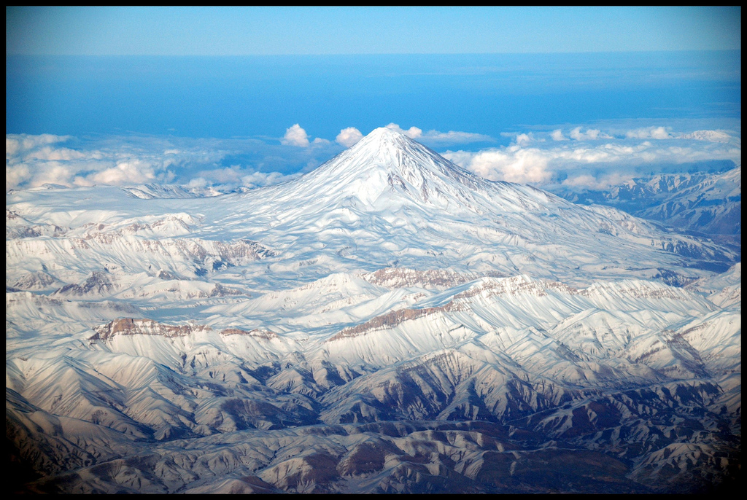
با توجه به بهبود هوشياري بيمار توصيه شما براي ادامه درمان وي چيست؟
Thanks for your patience!
Admission for at least 72 hours
Serum : DW5% 100 cc / h
saline for hydration

Slide 49
Case study (1)
A 34-year-old healthy pregnant woman with gestational age of 30 weeks is referred to you. Two weeks ago, based on the results of screening glucose tolerance test, gestational diabetes has been diagnosed and after 2 weeks diet therapy, her blood glucose levels are as follows:
FBS: 100-120 mg/dl, Postprandial BS: 90-120 mg/dl
Which of the following treatment strategies would you recommend?
Initiation of basal-bolus insulin regimen
Initiation of insulin glargine
Initiation of insulin NPH
Initiation of insulin detemir
C and D

Slide 50
Case study (2)
A 65-year-old driver man with 6-year history of T2DM is referred to you. He is taking Metformin 2000 mg/day and Gliclazide MR 60 mg/day. In the past few months, his fasting glucose levels have ranged from 160-200 mg/dl.
BMI: 25 kg/m², HbA1c: 9.2%, Cr: 0.8 mg/dl.
In addition to lifestyle modification, which treatment addition would you recommend to him?
Long-acting insulin analogue with titration
Insulin NPH with titration
Glucagon like peptide 1 agonist
Premixed insulin

