Slide 1
بسم الله الرحمن الرحیم

Slide 2
Hx & PI
Our patient is a 25 years old married woman, from Zanjan with a history of a progressively growing mass in the right side of her neck from 18 month ago.
She had no hoarseness, pain, weight loss, dysphagia, diarrhea or flushing
DH: levothyroxine 0.1 mg daily
FH: - PMH: - HH: - AH: -
PSH: cervical mass resection, total thyroidectomy, cervical lymph node dissection

Slide 3
ROS & PE
BW: 62.6 kg , Height: 156.5 Cm, BMI: 25.7
Normal VS
H&N: surgery scares on the both sides of her neck.
Chest: normal
Abdomen: normal
Extremities: normal

Slide 4
1. Mass detection, excision and diagnosis (Ordibehesht-Tir 1396)
Sonography(96/2/4): NL thyroid, no LAP, a solid & heterogeneous hypoechoic mass (50*25mm) lateral to Right thyroid lobe that shift cervical vessels to anteromedial. It had no connection with thyroid gland.
Neck CT(96/2/9): High vascularity enhanced mass (45*40*30mm) in Right side of neck that compress common carotid and Right jugular vein and trachea to left, delayed venous enhancement+
Surgery(96/2/31): mass radical resection, vascular exploration, one adjacent LN resection.
Pre op LAB: NL electrolyte, no CEA or calcitonin was checked.
Pathology: Glumeroloid hemangioendothelioma, papillary intralymphatic angioendothelioma, glumangioma.
d. IHC(96/4/11): Calcitonin+, CEA+, CK7+, TTF1 weakly+, AE1/AE3+, vimentin+, low Ki67, negative for CK20, S100, CD34, CDx2, napsin. (MTC)
(second IHC in Tehran: Chromogranin+, synaptophysin+, CEA+, CKAE1AE3+, calcitonin+, TG-)

Slide 5
Neck CT (96/2/9)

Slide 6
2. Post op FU, thyroid nodule detection (Tir-Mordad 1396)
Lab data
RET proto-oncogen: not checked
(after 43 days): Calcitonin: 232 , TSH: 1.94, T4: 96, T3: 1.7
(after 70 days): CEA: 1.12, Calcitonin: 444
(after 160 days): Calcitonin :231, TSH: 2.26, T4: 83, T3: 1.8
b. Abdominopelvic CT with IV contrast(96/4/25): NL
c. Sonography(96/4/25): No LAP or nodule
d. Tc99m scan(96/5/9): Mild diffuse goiter (early stages of nodule formation in Right lobe), no ectopic thyroid
e. FNA: Unsatisfactory, no follicular cell, no atypia
f. Chest CT: Lung LUL one calcified nodule (3mm)

Slide 7
Thyroid scan with Tc 99

Slide 8
3. Thyroidectomy, LN involvement (Aban-Bahman 1396)
Total thyroidectomy pathology(96/8/15): MTC in Right lobe nodule (0.2cm), NL other parts
Sonography
55 days after thyroidectomy: No thyroid residue, no LN in Right cervical chain, 3 non-reactive LN(8-13mm) in anterosuperior part of left jugular chain.
65 days after thyroidectomy: 3 LN (6-8mm) was founded in Left superior jugular chain, 2 LN(3mm) was founded in Left medial jugular chain, 2 LN(5,8mm) was founded in Right superior jugular chain, 3 nodule (3-5mm) was founded in the site of Right thyroid lobe (2 of them behind carotid).
c. Lab data:
Calcitonin level was ascending.
Ca, P were normal.

Slide 9
4. Neck LN dissection, Metastasis WU (Bahman 1396 – Aban 1397)
Radical LN dissection (Right and Left) (96/11/7): 0.5 to 2 cm lymph nodes was founded histologically metastatic MTC mostly in right side.
CT(96/12/5): Left & Rt post cervical LAP, no thyroid, 3 & 4 mm nodules in lung RUL, 3 mm calcified nodule in lung LUL, liver … NL
Calcitonin level rises after dissection (560 to 730 to 1408)
Metastasis work-up 3 month later: Neck sono & chest CT & Liver MRI: NL, whole body Octreoscan: negative
Sonography 5 month later : one enlarged parathyroid gland
Whole body bone scan (Tc 99-MDP) 6 month later: NL
Sonography 8 month later: No thyroid remnant, one abnormal LN (6*4mm) behind the Right common carotid artery.

Slide 10
Bone scan with Tc99m-MDP (97/7/17)

Slide 11
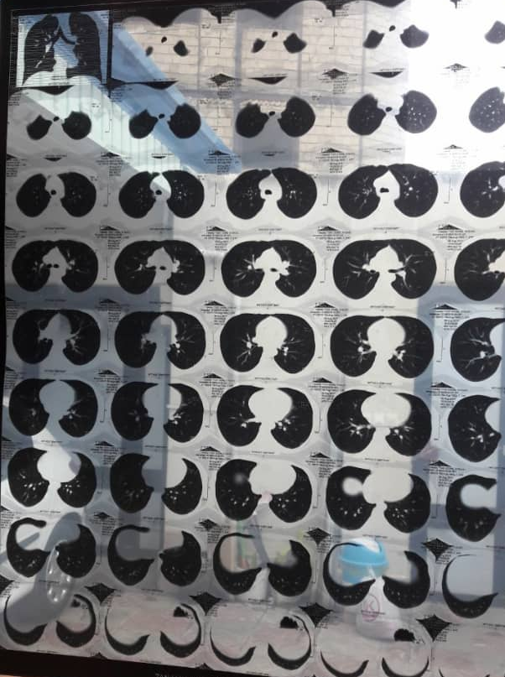

Slide 12
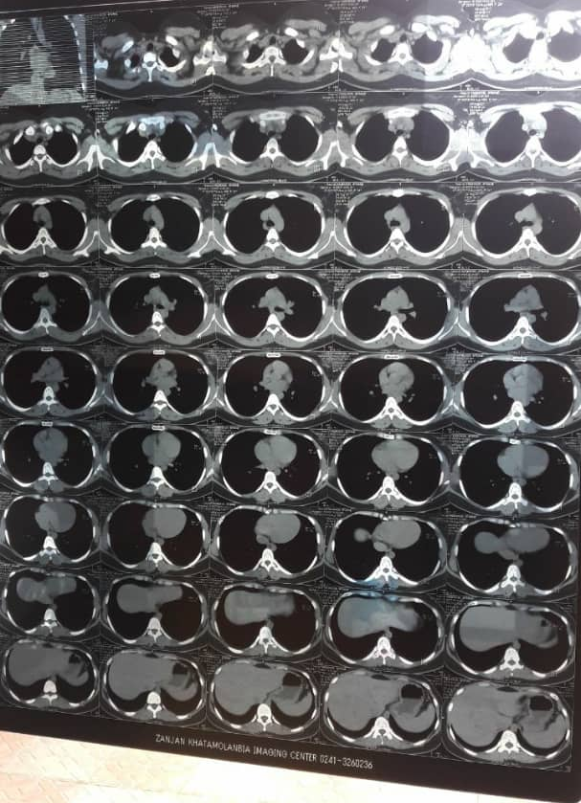

Slide 13
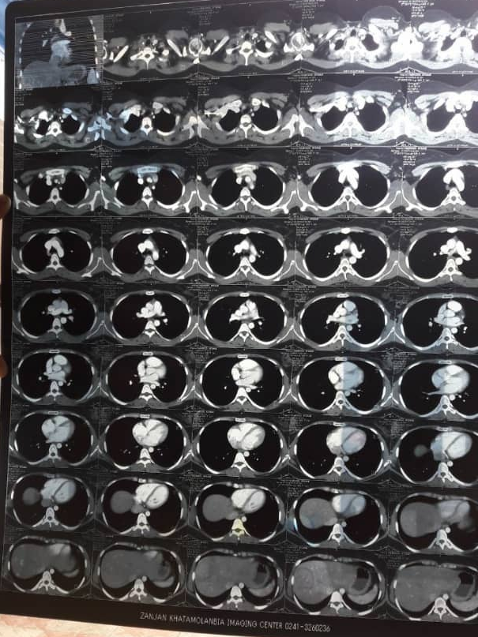

Slide 14
4. Neck LN dissection, Metastasis WU (Bahman 1396 – Aban 1397)
Lab data (97/8/7): TSH: 0.005, fT4: 1801, calcitonin: 1859, CEA: 0/889
Whole body PET scan (97/8/5): no active lesion

Slide 15
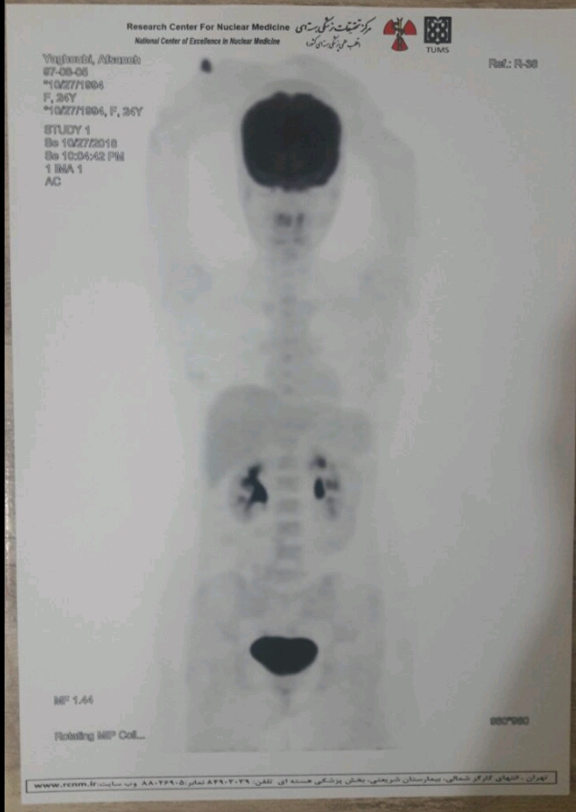

Slide 16
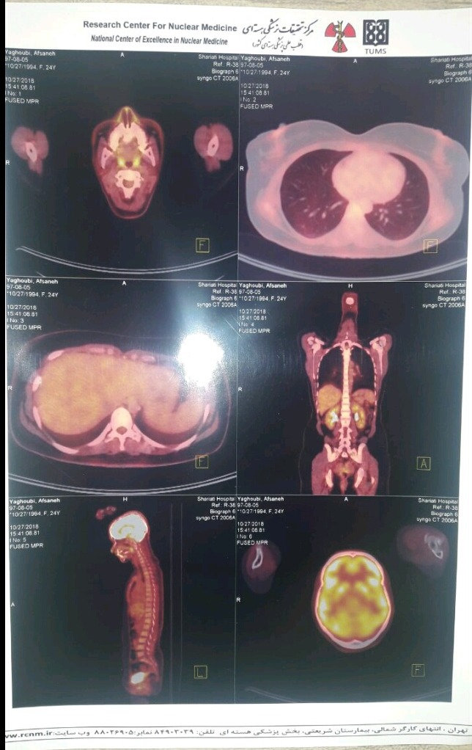

Slide 17
Calcitonin follow up

Slide 18
TSH follow up

Slide 19
CEA follow up

Slide 21
با تشکر

