Slide 1

In the name of GOD
1
1

Slide 2
Somatostatin analogues
F.Sarvghadi MD
Research Institute for Endocrine sciences
Shahid Beheshti University
of Medical Sciences

Slide 3
Agenda
Introduction.
Pharmacokinetics
Effects on Clinical Features
Predictors of response
Indication for usage
Primary vs. secondary efficacy trials
Side effects
New SRLs
Adverse effects
Conclusion

Slide 4
Introduction
Somatotropin release-inhibiting hormone (SRIF) or somatostatin 14 was discovered in 1973. Somatostatin (SRIF) is a cyclic peptide, includes SRIF-14 and SRIF-28.
SRIF14 is the predominant peptide in the brain, while SRIF28 is the predominant peptide in the GI tract.
The name somatostatin was given as this peptide was primarily discovered to inhibit pituitary GH release, however, this peptide also inhibits TSH, ACTH and other central and peripheral hormones.
Hypothalamic somatostatin is produced predominantly in the anterior periventricular nucleus, as well as in the paraventricular, arcuate and ventromedial hypothalamic nuclei.
Y.C. Patel, Front Neuroendocrinol 20 (1999) 157e198.

Slide 5
The primary function of somatostatin is to inhibit pituitary hormone secretion and, to a lesser extent, pituitary cell growth.
In the hypothalamus, somatostatin inhibits release of several hypothalamic hormones and neurotransmitters, including CRH, TRH, dopamine, norepinephrine and GHRH , also inhibits its own secretion from the periventricular nucleus.
In the pituitary, somatostatin inhibits secretion of GH, TSH and ACTH in the presence of low glucocorticoid levels.

Slide 6
Somatostatin actions usually are inhibitory:
Somatostatin also inhibits secretion of insulin, glucagon, and PP in the endocrine pancreas.
In the gastrointestinal tract:
Somatostatin inhibits pancreatic exocrine secretion and
gastric acid secretion.
In the brain, somatostatin regulates metabolism of amyloid-β peptide, a primary pathogenic agent of Alzheimer’s disease.

Slide 7
Somatostatin signals through five somatostatin receptor subtypes, SSTR1, 2, 3, 4 and 5. The SSTR2 and SSTR5 subtypes are preferentially expressed on somatotroph and thyrotroph cell surfaces .
Somatostatin 14 exhibits high binding affinities to all the receptor subtypes, but has greatest affinity to SSTR2, which is the subtype largely responsible for inhibiting pituitary hormone secretion.
A. Ben-Shlomo, S. Melmed, Endocrinol Metab 21 (3) (2010)

Slide 8
The inhibitory properties of somatostatin make it suitable
for the treatment of conditions characterized by excess
hormone secretion or GI disorders:
Neuroendocrine tumors.
Acromegaly.
Cushing syn.
Portal hypertension .
Gastrointestinal bleeding.

Slide 9
Somatostatin analogues

Slide 10
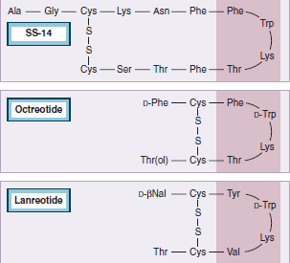
Background
The introduction of the long-acting SRIF analogues, octreotide, in 1984 as a thrice daily parenteral therapy established an undeniably important role for these analogs in the management of acromegaly.
Sustained release microparticle formulations of two SRIF analogues, lanreotide SR and octreotide LAR, became available for use in the early to mid-1990s, greatly improving convenience for the patient while allowing stable steady state levels of these drugs to be maintained.

Slide 11
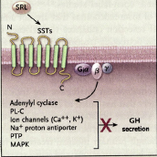
Somatostatin analogues
Somatostatin action is mediated by five specific receptor sub-types (SST1 through SST5) .
Somatotroph cells express predominantly SST2 and SST5
More than 90% of growth hormone–secreting tumors express SST2 and SST5
Somatostatin receptor ligands (SRLs ) bind SST2 with high affinity and,
to a lesser extent, SST5, whereas
octreotide also exhibits some SST3 affinity.
Endocrinol Metab Clin North Am. ,102-122,2009

Slide 12
Somatostatin analogues
Due to the short half-life of native somatostatin (2 minutes), longer acting and selective somatostatin analogues (i.e. octreotide, lanreotide,) have been used to treat acromegaly. Because of its relative resistance to enzymatic degradation, the in vivo half life of the analogue is prolonged (up to 2 hours) after subcutaneous injection.
Octreotide acetate(8-amino-acid analog) inhibits GH secretion with a potency 45 times greater than native SRIF, while its potency for inhibiting insulin and Glucagon release is 11 and only 1.3-fold that of SRIF.
Inhibits GH, glucagon, and insulin release, but the analog exhibits greater selectivity in suppressing GH and glucagon than does somatostatin.
Endocrinol Metab Clin North Am. ,102-122,2009

Slide 13
SRLs act at four levels
Suppression of GH secretion from the pituitary and from GH-secreting adenomas.
Decrease in binding to hepatocyte GH receptors.
Inhibition of hepatic IGF-1 synthesis.
Control of tumor growth.
S. Melmed, N Engl J Med 355 (24) (2006) 2558e2573.

Slide 14
Pharmacokinetics

Slide 15
A single subcutaneous administration of octreotide (50 or 100 μg) suppresses GH secretion for up to 5 hours. In a double-blind, placebo-controlled trial, octreotide (injections every 8 hours) significantly attenuated GH and IGF1 levels overall in more than 90% of patients.
Analogue resistance 10%.
Total daily octreotide doses : 300 to 1500 μg subcutaneously.
Sandostatin LAR is a sustained release intramuscular depot preparation of octreotide microspheres, Injection of 20-30 mg results in peak drug level at 28 days, with integrated GH levels effectively suppressed for up to 49 days.
Overall, IGF1 levels are normalized in 60% to 70% of patients and
increasing the monthly dose of octreotide (Sandostatin LAR) to as high as 40 to 60 mg may improve efficacy.
Giustina A, Eur J Endocrinol. 2009;161:331-338.

Slide 16
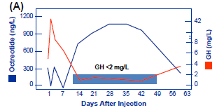
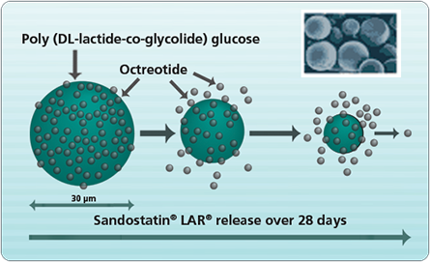
Pharmacodynamics of octreotide LAR injection in acromegaly.
Biphasic release of Octreotide LAR
I. Lancranjan, Metabolism 45 (1996) 67e71.

Slide 17
Drug Type Dosing
Octreotide Short-acting Subcutaneous 3 times/day; dose range of
50-500 ug
Octreotide LAR Long-acting Intramuscular every 28 days; dose range
of 10-40 mg
Lanreotide SRL Long-acting 30mg Intramuscular every 7-14 days
( cyclic octapeptide)
Lanreotide autogel Long-acting 60 – 120 mg Deep subcutaneous every 28 days
Pasireotide Long-acting 40-60 mg, every 4 weeks

Slide 18
Effects on Clinical Features

Slide 19
Effects of Octreotide on Clinical Features of Acromegaly
More than 70% of patients experience improved clinical features within several days after treatment:
General feeling of well-being.
Soft tissue swelling. Paresthesias,numbness and tenderness.
Oily perspiration.
Headache,a common symptom in acromegaly, usually resolves rapidly.(Short-acting octreotide is preferable).
Asymptomatic patients experienced decrease heart rate and left ventricular wall thickness and blood pressure.
Joint function and crepitus.
Sleep apnea.
N. Karavitaki et al Clin Endocrinol (Oxf) 68 (6) (2008) 970e975.

Slide 20
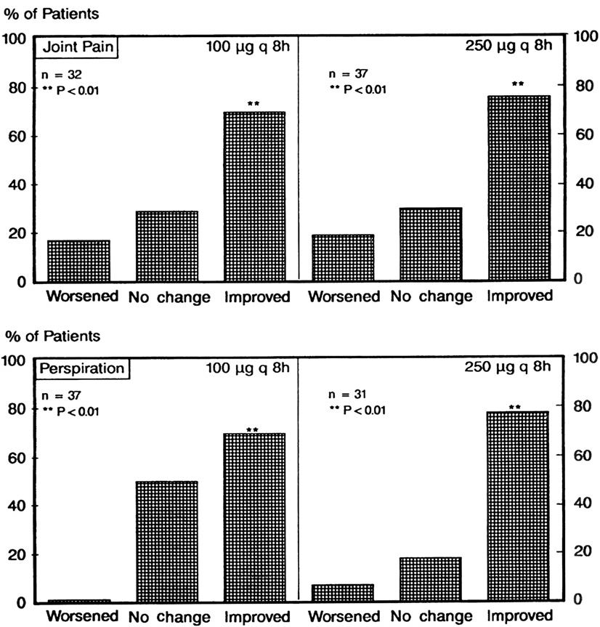
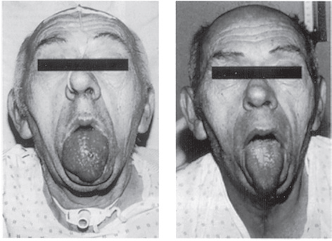
Clinical effects of octreotide onjoint pain and perspiration after 6 months’ treatment with
octreotide (100 or 250 ug 8-hourly)
S. Ezzat, Ann Intern Med 117 (9) (1992) 711e718.

Slide 21
Effect on tumor size

Slide 22
About 50% ( 20% - 80%) of all patients receiving SRIF analogues experience a reduction of pituitary adenoma size.( relatively rapidly and does dependent). *
Preoperative octreotide for 3 to 6 months demonstrated improved postoperative outcomes. A critical analysis of 14 studies reported that 37% of patients treated primarily by SRL experienced significant tumor shrinkage. * *
Preoperative SRIF analogue therapy may also facilitate safer anesthesia by reducing tracheal soft tissue swelling and macroglossia and by improving cardiac failure. * * *
*J.S. Bevan J Clin Endocrinol Metab 90 (3) (2005) 1856e1863.
* * Melmed S, J ClinEndocrinol Metab. 2005;90:4405-4410.
* * * A. Colao, J Clin Endocrinol Metab 85 (9) (2000) 3132e3140

Slide 23
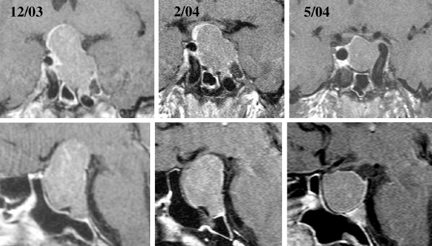
Pituitary tumor shrinkage due to primary medical therapy
Acromegaly patient aged 27 years received octreotide LAR 20 mg im every 4 weeks.

Slide 24
Prognostic factors

Slide 25
Factors that determine SRIF analogue efficacy
Tumor SSTR2 expression.
Frequency of drug administration.
Total dose.
Size of the tumor.
Presence of densely granulated tumors.
Pretreatment GH levels.
Elderly male patients.
Surgical debulking.
N. Karavitaki Clin Endocrinol (Oxf) 68 (6) (2008) 970e975.

Slide 26
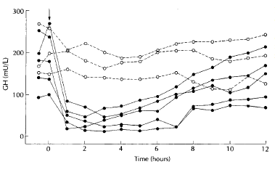
Pituitary tumor SSTR expression determines therapeutic responsiveness.
Growth hormone (GH) responses to a single 100 ug subcutaneous dose of octreotide in eight acromegalic patients. All patients were imaged with in vivo radiolabeled octreotide.
E. Ur, Clin Endocrinol (Oxf) 36 (2) (1992) 147e150.

Slide 27
Indication for SRLs usage
In acromegaly

Slide 28
Use of SRLs
After surgery has failed to achieve biochemical control .
As first-line therapy when there is a low probability of a surgical cure (for example, large extrasellar tumors with no evidence of central compressive effects).
Before surgery to improve severe comorbidities that prevent or could complicate immediate surgery (the benefits of this are unproven) .
Preoperative shrinkage of large invasive macroadenoma .
To provide disease control, or partial control, in the time between administration of radiation therapy.
Cushing disease ( research ).
J Clin Endocrinol Metab , 94:1509–1517 ,2009.

Slide 29
Are different types of somatostatin analogs are equal in terms of efficacy?

Slide 30
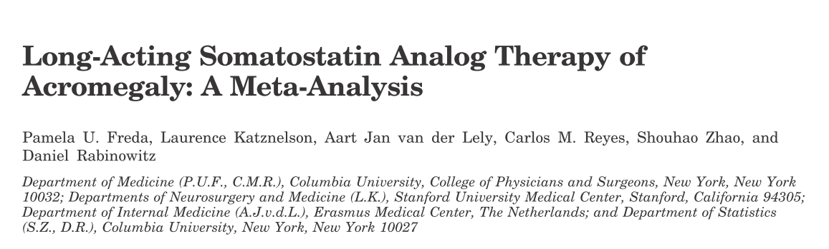
Study selection: at least 3 months of secondary octreotide (LAR) or lanreotide (SR) therapy or of primary octreotide LAR, lanreotide SR, or sc octreotide therapy and clearly reported data on biochemical efficacy and/or tumor shrinkage.
Sample size:44 trials were included
All but one octreotide LAR trial were open-label prospective studies
Freda PU ,J Clin Endocrinol Metab 90: 4465–4473, 2005

Slide 31
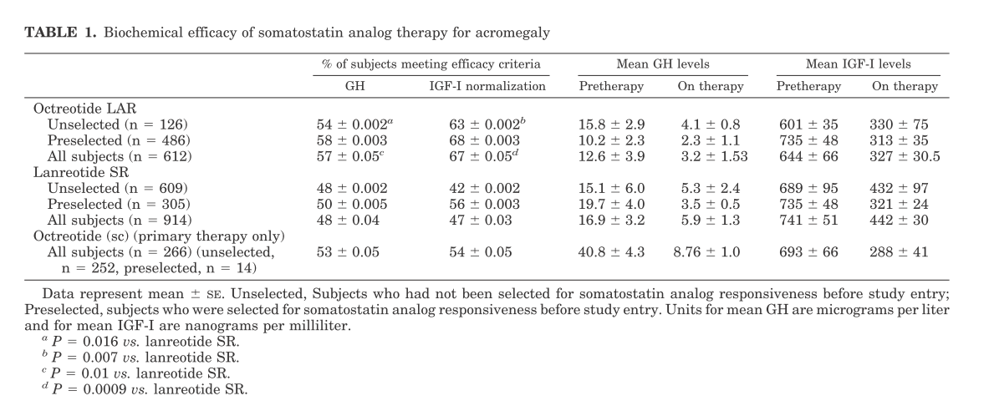

Slide 32
60
P<0.0001
Octreotide LAR (n=132)
Tumor shrinkage
Lanreotide SR (n=248)
50
47%
40
Patients achieving
tumor volume reduction (%)
29.5%
30
20
21%
15%
10
0
>10% reduction
25−50% reduction
P=0.0009
80
P=0.01
Patients (%)
Octreotide LAR (n=612)
70
67%
Lanreotide SR (n=914)
60
57%
50
48%
47%
40
Patients (%)
30
20
10
Biochemical control
0
GH <2.5 μg/L
IGF-1 normalized

Slide 33
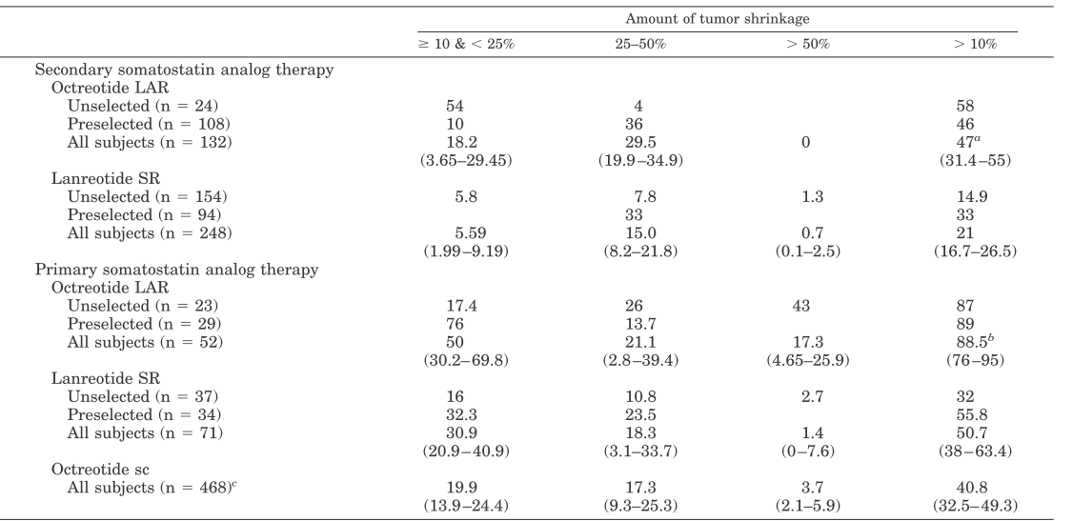

Slide 34
Results
The efficacy of octreotide LAR is greater than lanreotide SR among subjects unselected for prior somatostatin analog responsiveness.
Preselection is a significant positive predictor of IGF-I normalization tumor shrinkage, which is also greatest with octreotide LAR
Biochemical efficacy is similar, but tumor shrinkage is greater when these drugs are given as primary vs. secondary therapy

Slide 35
What is difference between primary and secondary studies?

Slide 36
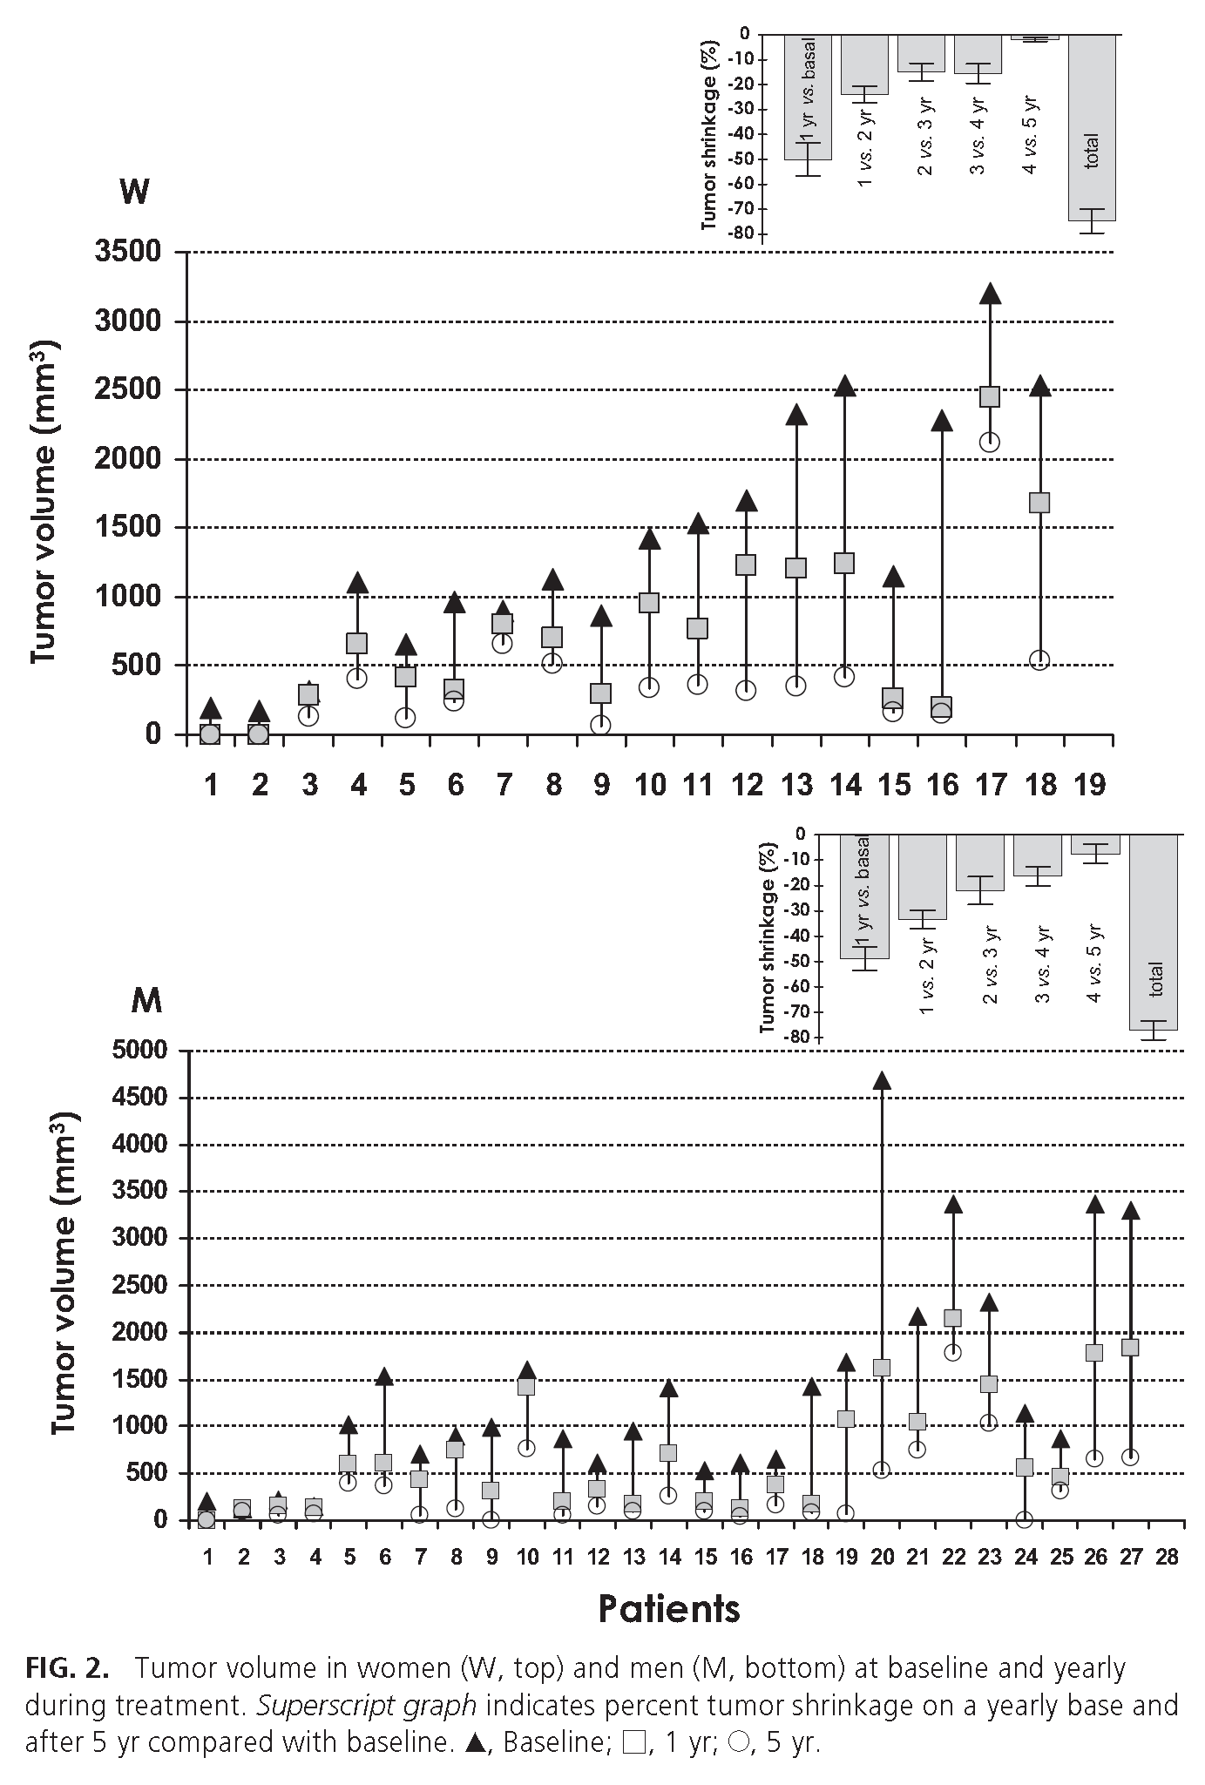
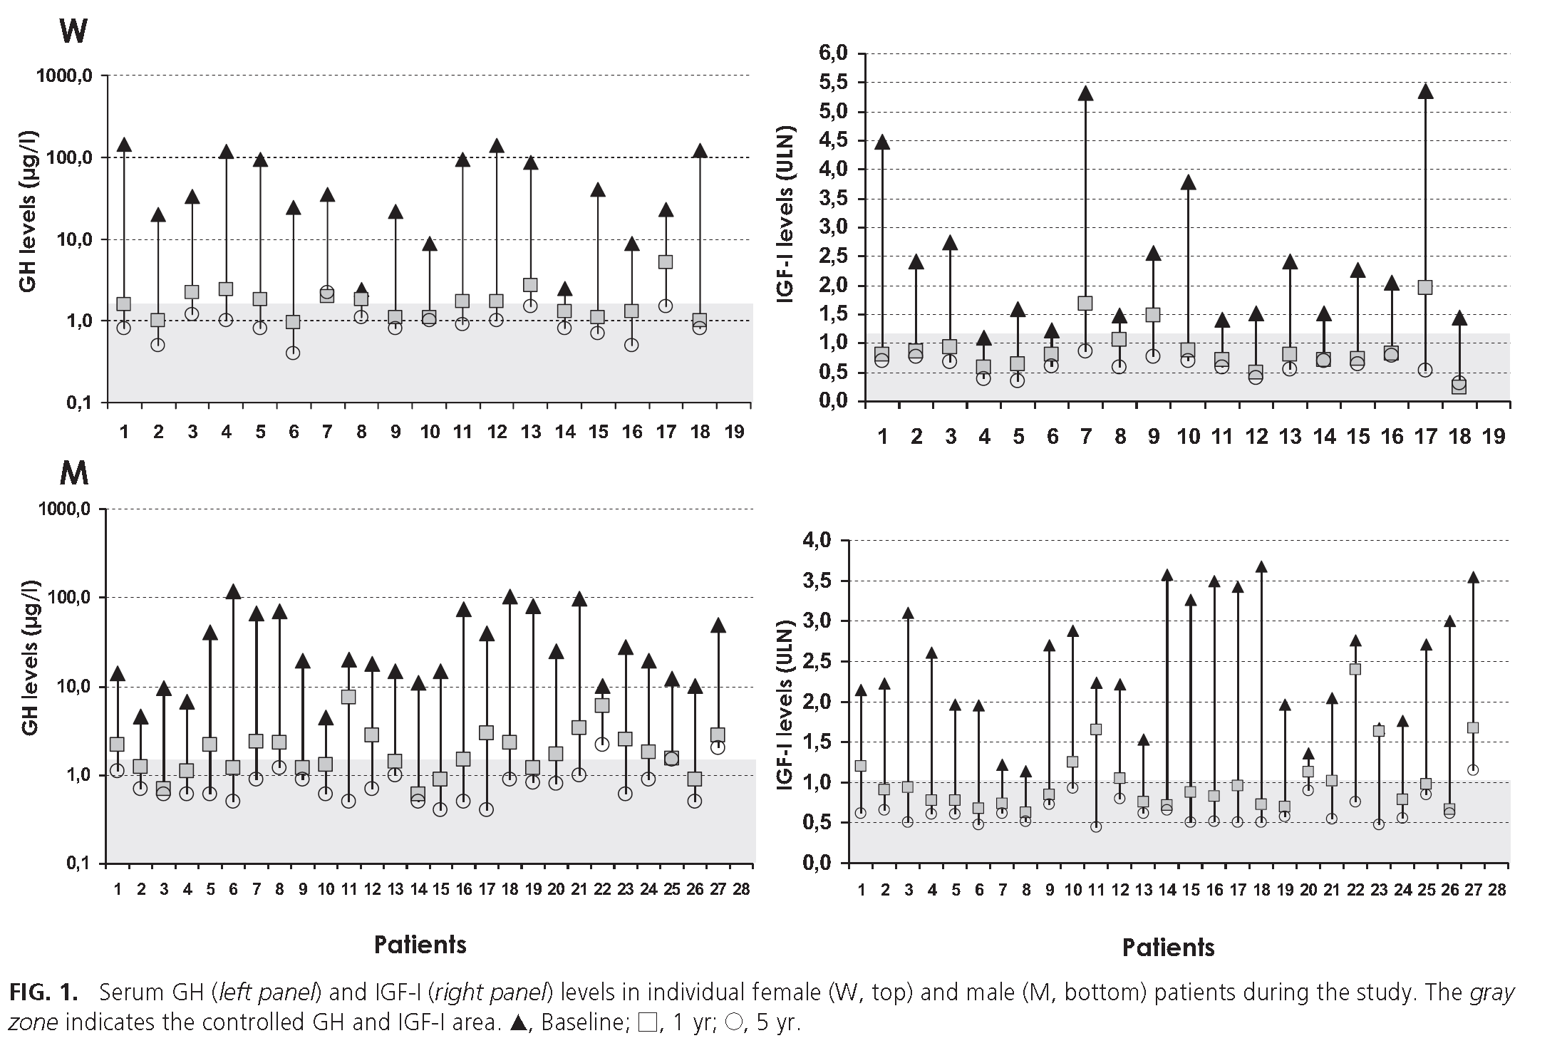
Effects of Initial Therapy for Five Years with Somatostatin Analogs for Acromegaly on Growth Hormone and Insulin-Like Growth Factor-I Levels, Tumor Shrinkage, and Cardiovascular Disease: A Prospective Study
Colao A et al, JCE&M, 2009
45 de novo pts studied,
28 on OCT LAR, 17 on LAN
GH < 2.5 µg/L 100% pts
Normal IGF-1 97.8% pts
Tumor shrinkage 75% pts

Slide 37
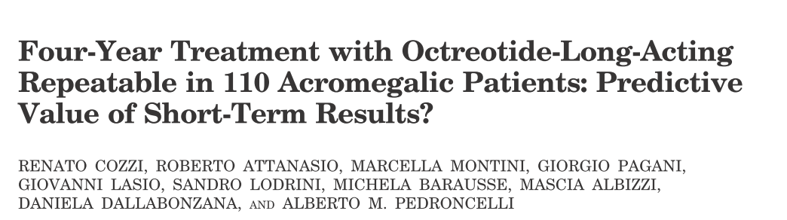
Retrospective study
Sample size: 110 (adjuvant treatment in 59 and primary therapy in 51 patients)
F/U: 30 months (median; range,18 –54)
Intervention : Sandostatin LAR 20 mg every 28 d for 3 injections, then individually tailored) as adjuvant treatment in 59 and the other 51 primary treatment were naive or previously treated by pharmacotherapy.

Slide 38
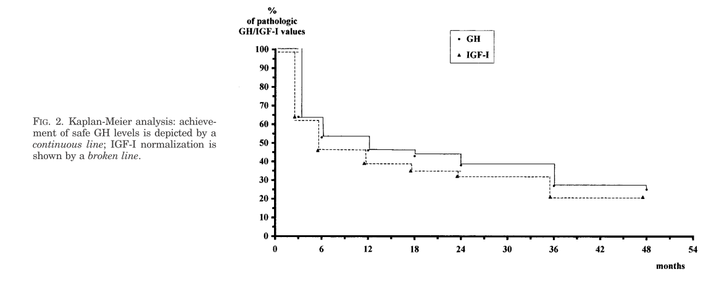
Rate of both safe GH (2.5 g/liter) and IGF-I normalization was 68% at 36 months.

Slide 39
Tumor size
It was assessed in 83 Patients
No increase in tumor size was observed in any patient.
Tumor volume reduction >25% in 46% patients overall, and 77% of primary therapy group.

Slide 40
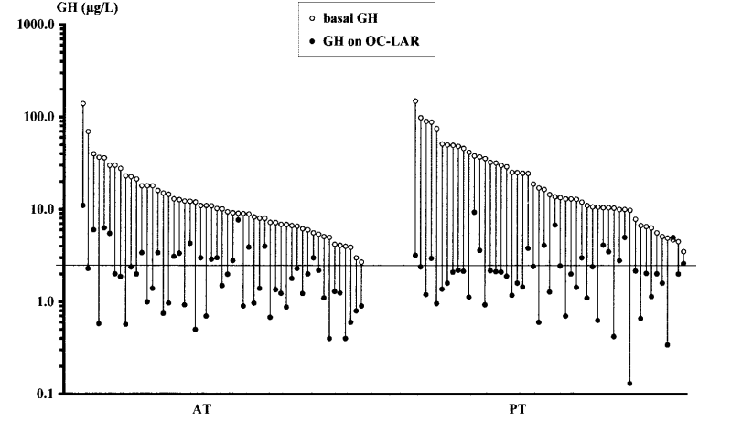
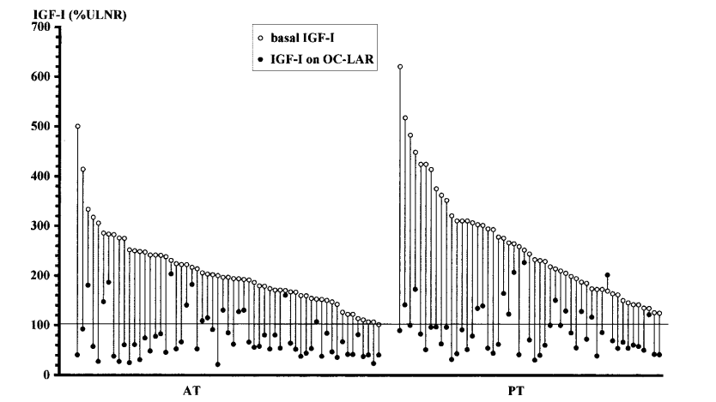
Results
Sandostatin LAR achieved safe GH in 72% of PT and in 71% of AT patients and normal IGF-I in 67% and 78%, respectively

Slide 41
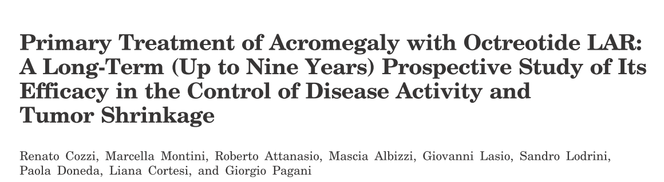
Objective: to evaluate primary pharmacological treatment in acromegaly.
Design: prospective open study
Participants:67 consecutive patients (36 women; age, 54.9 ±14.2 yr; 72% bearing macroadenoma).
Intervention: Individually tailored octreotide LAR
F/U: 48 months (range, 6-108)
Main Outcome Measures: Outcomes included safe GH (<2.5 μg/liter), normal age-matched IGF-I levels, and tumor shrinkage.
J Clin Endocrinol Metab 91: 1397–1403, 2006

Slide 42
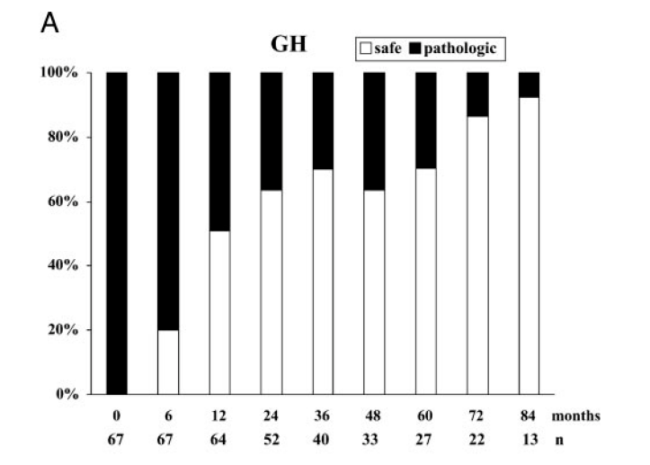
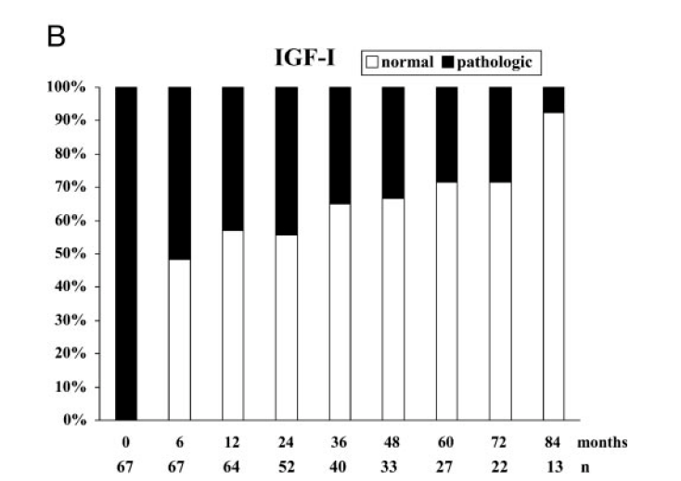
Results
OCLAR normalized GH and IGF-I values in 68.7 and 70.1%, respectively
Achievement of hormonal endpoints is quite independent from basal hormonal values.
Tumor size shrinkage in 82.1% of patients, more frequently in macro- than in microadenomas.

Slide 43
Results
The efficacy on GH/IGF-I levels in unselected patients indicate that treatment with OCLAR may be the first therapeutic approach to all acromegalic patients not amenable to surgical cure.

Slide 44
Potential candidate for primary therapy
No risk of visual impairment from the tumor
Poor candidates for surgery
Those who decline surgery
Tumors unlikely to be controlled by surgery (as in lateral cavernous sinus invasion)
Requirement for the preservation of intact pituitary function (especially fertility)
European Journal of Endocrinology 153 ,737–740 ,2005

Slide 45
Side effects

Slide 46
Side effects
SRLs are generally safe and well tolerated.
SRIF suppresses pancreatic secretions, gastrointestinal motility and
splanchnic blood flow, leading to predominantly gastrointestinal
side effects:
Short term side-effects that often resolve with continued treatment include abdominal pain, diarrhea, fat malabsorption, nausea, and flatulence (30%).
Biliary tract abnormalities, including gallstones, microlithiasis, sediment, sludge, and dilatation, are reported in up to 50% of patients ( reversible).
Asymptomatic cholelithiasis is described in 20% to 40% of patients and approximately 1% of these patients require cholecystectomy.

Slide 47
Side effects
Hypoglycemia or hyperglycemia are not commonly encountered and insulin requirements in diabetic patients with acromegaly are dramatically reduced within hours of receiving SRIF analogues.
Conduction abnormalities in up to 10% of patients
Asymptomatic sinus bradycardia occurs in approximately 25% of patients.
Injection site irritation (7%).
Endocrinol Metab Clin North Am. ,102-122,2009

Slide 48
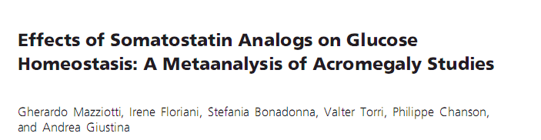
J Clin Endocrinol Metab 94: 1500 –1508, 2009

Slide 49
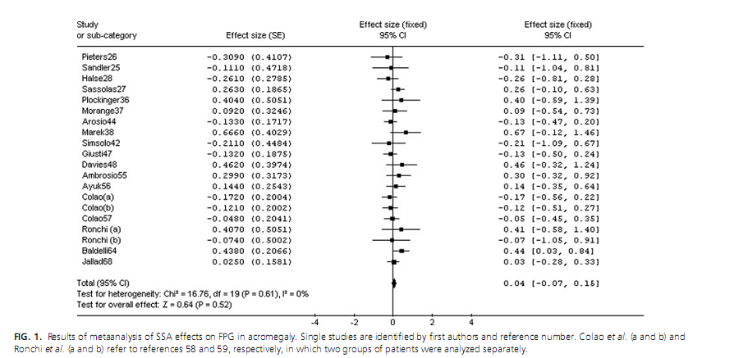
Effect on FPG

Slide 50
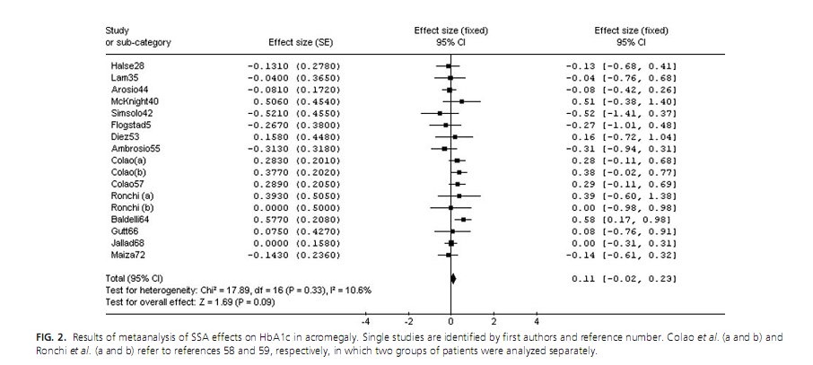
Effect on HbA1c

Slide 51
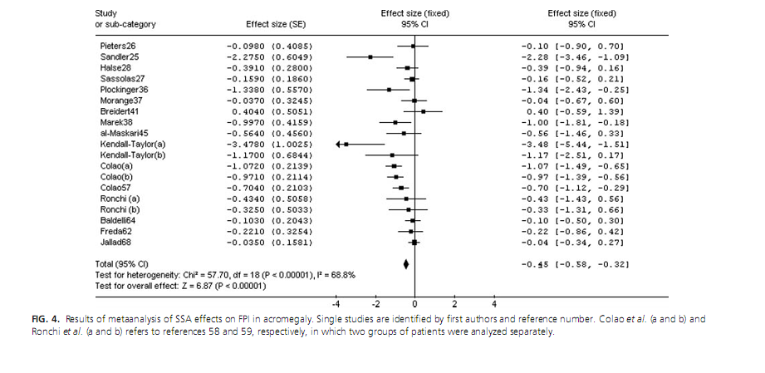
Effect on FPI

Slide 52
key message
Our meta-analysis of acromegaly studies shows that SSA decrease fasting serum insulin levels without consistent effects on glucose homeostasis.

Slide 53
New SRLs

Slide 54
New SRLs
Pasireotide LAR.
Oral Octreotide acetate.
Subcutaneous Octreotide Hydrogel Implant.
DG3173 (somatoprim).

Slide 55
Pasireotide LAR

Slide 56
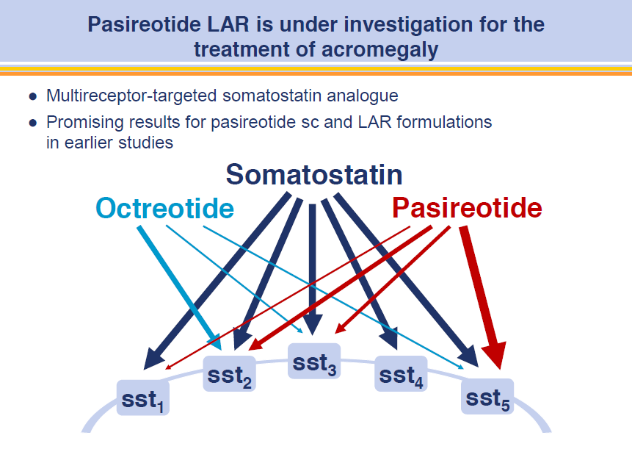

Slide 57
Receptor binding affinity of octreotide and pasireotide
Pasireotide has a 30-, 5- and 40-fold higher affinity for sst_{1,3,5} and slightly lower affinity for sst₂, than octreotide
 | Receptor binding affinity (IC₅₀ nmol/L)
 | sst₁ | sst₂ | sst₃ | sst₄ | sst₅ | t_{½} (h)
Somatostatin | 0.9 | 0.2 | 0.6 | 1.5 | 0.3 | ≤0.05
Octreotide | 280.0 | 0.4 | 7.1 | >1000 | 6.3 | 2
Pasireotide | 9.3 | 1.0 | 1.5 | >1000 | 0.2 | 12
Bruns et al. Eur J Endocrinol 2002;146:707–716
Notes:
57

Slide 58
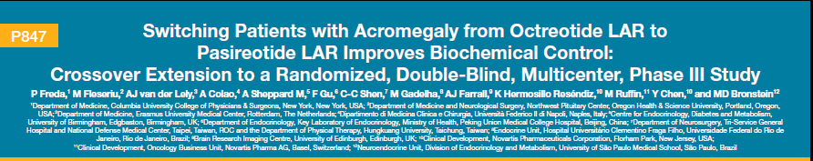
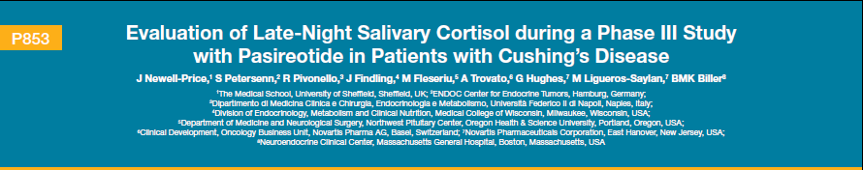
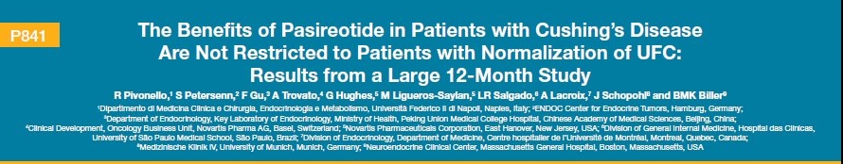

Slide 59
Pasireotide LAR: Large, randomized, double-blind
Phase III trial (N=358)
84 sites in 27 countries
Colao A et al. Endocrine Abstracts 2012;29

Slide 60
Pasireotide LAR superiority was driven by significantly higher rate of IGF-1 normalization
Similar proportion of pasireotide LAR and octreotide LAR patients had
GH <2.5µg/L
Significantly more pasireotide LAR patients achieved normal IGF-1 than octreotide LAR patients (P=0.002)
GH <2.5 µg/L
Pasireotide LAR
Normal IGF-1
Octreotide LAR
P=0.002
Percent patients achieving GH <2.5 µg/L
Percent patients achieving normalized IGF-1 levels

Slide 61
Percentage tumor volume change in patients with MRI at month 12
100
Pasireotide LAR (N=120)
100
Octreotide LAR (N=124)
80
80
60
60
40
40
20
20
0
0
Change from baseline (%)
–20
–20
–40
–40
–60
–60
81% with significant (≥20%) tumor volume reduction
77% with significant (≥20%) tumor volume reduction
–80
–80
–100
–100
The majority of patients achieved significant tumor volume reduction
  One patient in the octreotide LAR arm experienced a ≥20% increase
  Similar volume reduction in de novo/post-surgical patients in both groups

Slide 62
21% of patients switched to pasireotide LAR had
GH <2.5 µg/L and normal IGF-1
Patients (%)
Colao A et al. Endocrine Abstracts 2012;29:

Slide 63
Colao A et al. Endocrine Abstracts 2012;29
Pasireotide LAR was significantly superior to octreotide LAR in providing full biochemical control at 12 months.
Significant tumor volume reduction was achieved in most patients receiving pasireotide LAR or octreotide LAR.
The safety profile of pasireotide LAR was similar to that of octreotide LAR, except for hyperglycemia.
These results suggest that pasireotide LAR may become a new standard treatment option for patients with acromegaly.

Slide 64
Drug interactions

Slide 65
Drug interactions
Blood levels of cyclosporine may be attenuated, resulting in transplant rejection
Somatostatin might decrease cytochrome P450 enzyme action drugs metabolized mainly by CYP3A4 and that have a low therapeutic index (eg, quinidine, terfenadine, and warfarin) should be used cautiously
SRLs should be avoided in patients treated with drugs known to commonly prolong QT interval, such as cisapride.
SRL dose adjustments should be carefully titrated in patients who require insulin or oral hypoglycemic agents, calcium channel blockers, or β-blockers.

Slide 66
Conclusion

Slide 67
Conclusion
SRLS are effective and safe in managing GH hypersecretion.
In unselected populations, SRLs reduce GH to less than 2.5 ng/ml and normalize IGF-I in 44 and 34% of patients, respectively. 68% in selected patient populations.
Tumor shrinkage of more than 20% occurs in approximately 75% of acromegaly patients receiving these drugs (mean 50% reduction in tumor volume).

Slide 68
Conclusion
Octerotide LAR has marginally greater efficacy in control of the GH-IGF-I axis than lanreotide SR.
Lanreotide ATG and octreotide LAR are equivalent in the control of symptoms and biochemical markers .

Slide 69
Conclusion
The main indication are in patients in whom surgical intervention has failed to achieve biochemical remission and also in the time between radiation therapy and the onset of biochemical response.
Somatostatin analogues are the mainstay of medical therapy.
Primary therapy is currently becoming as a more frequent approach to the disease.
Pasireotide LAR provided higher response rates than octreotide LAR in medically naïve patients.

Slide 70

Thank you

Slide 71
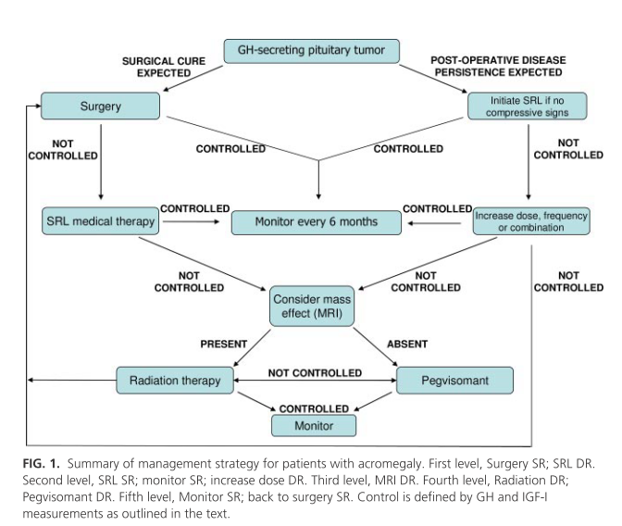
J Clin Endocrinol Metab , 94:1509–1517 ,2009.

Slide 72
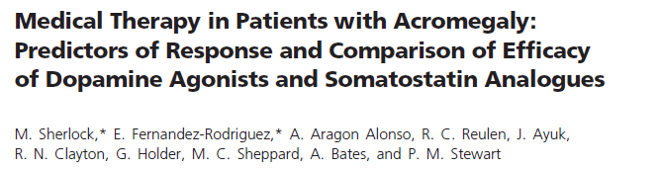
Objective: To examine the role of prolactin status, prior surgery, and radiotherapy on the response to medical therapy in patients with acromegaly and assess the relative efficacy of dopamine agonist therapy compared with somatostatin analog therapy.
Sample size :A total of 276 patients received either DA and/or SSA. 172 patients had received surgery and 73 radiotherapy prior to receiving medical therapy. 198 received DA, and 143 received SSA.
F/U: GH and IGF-I values at baseline and after 12 months on therapy were analyze
J Clin Endocrinol Metab 94: 1255–1263, 2009

Slide 73
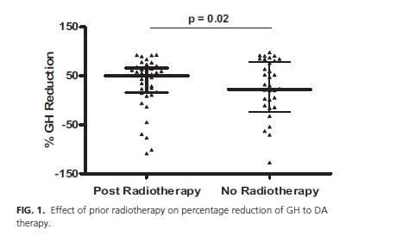
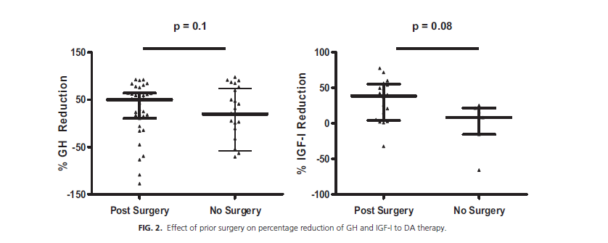

Slide 74
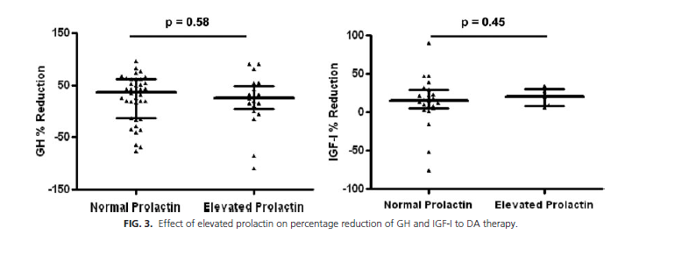

Slide 75
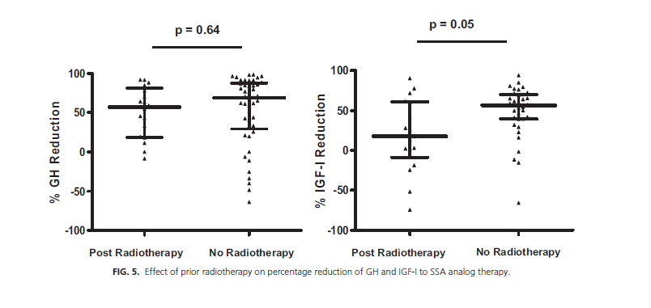

Slide 76
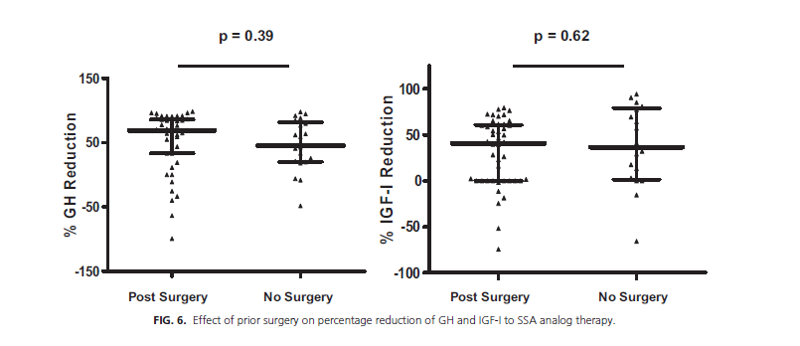

Slide 77
key message
The effects of DA are irrespective of baseline prolactin concentrations. Prior radiotherapy is associated with differences in GH and IGF-I response to DA and SSA therapy

Slide 78
Methodological flaws
Low statistical power particularly with respect to drawing comparisons between different treatment groups
No head to head studies of the different SRLs of adequate design
Different definitions for GH and IGF-I success
Variability in the GH and IGF-I assessment assays and reference standards
Pre-selection of patients according to response to octreotide
Majority of them are uncontrolled and open labeled

