Slide 1
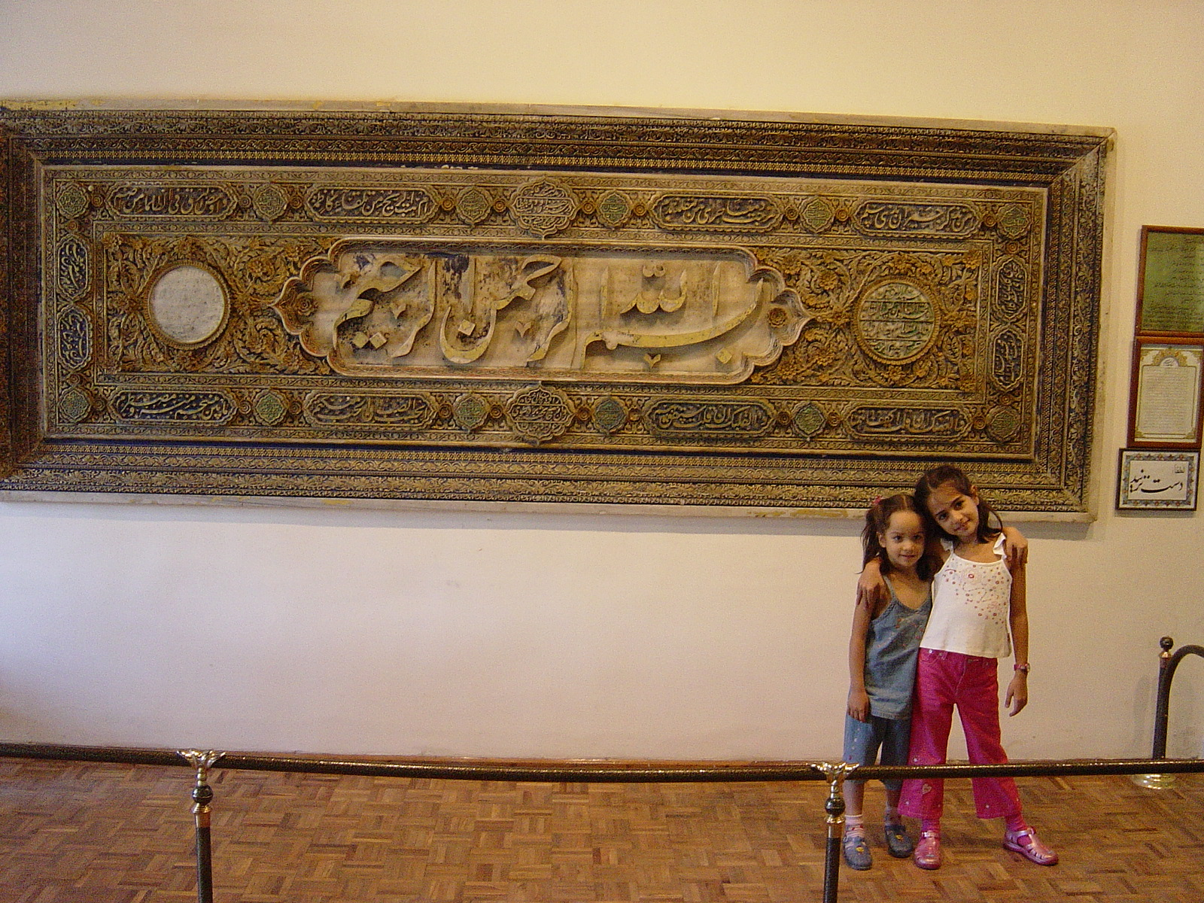

Slide 2
M.POURAFKAQRI M.D SHAHID BEHESHTI UNIVERSITY OF MEDICAL SCIENCE TALEGHANY HOSPITAL RADIOLOGY DEPARTMENT MARINA@AMS.AC.IR

Slide 3
Cushing's disease is responsible for roughly two thirds of the cases of endogenous Cushing's syndrome.(pituitary microadenomas)
The remainder of the endogenous cases are caused by ectopic ACTH-secreting tumors and primary adrenal neoplasms.

Slide 4
Imaging procedures are used to find a tumor after a diagnosis has been established. Imaging is not used to make the diagnosis of Cushing's syndrome
Benign tumors, sometimes called "incidentalomas,
are commonly found in the pituitary and adrenal glands.

Slide 5
Dynamic contrast MRI has been proven to be the best imaging tool in the evaluation of pituitary adenomas.

Slide 6
After a bolus injection of intravenous gadolinium, six consecutive sets of three images are obtained in coronal plane every 10 seconds.

Slide 7
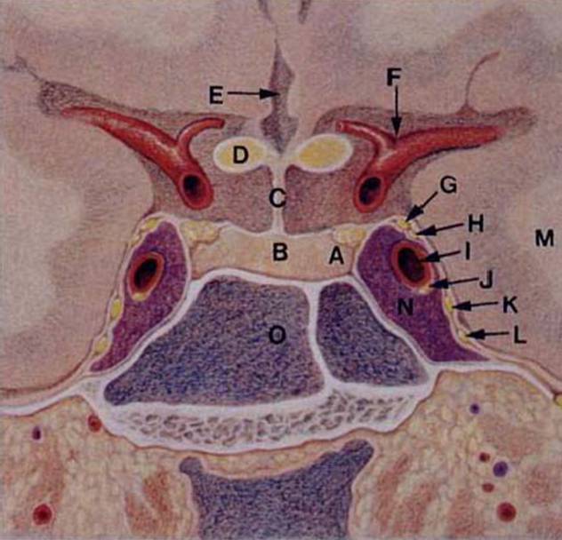

Slide 8
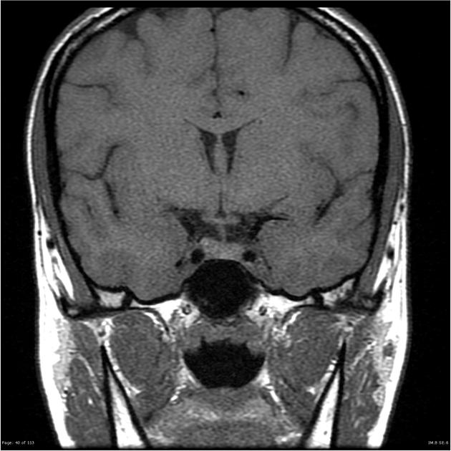

Slide 9
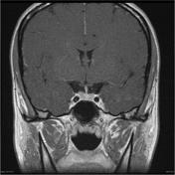

Slide 10
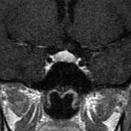

Slide 11
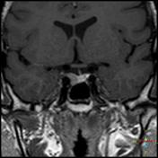

Slide 12
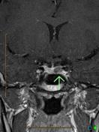

Slide 13
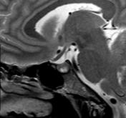

Slide 14
The aim of MR imaging is to obtain a high-spatial-resolution image with a reasonable signal to noise ratio. It is important to identify the gland separate from the lesion if possible. Initially, precontrast T1- and T2-weighted spin echo coronal and sagittal sections are acquired using a small FOV (20×25 cm), thin slices (3 mm), and high-resolution matrix (256×512). Both the dynamic and routine postcontrast images and delayed scanning after 30-60 minutes may be combined in one study for optimum imaging.

Slide 15
A CT or MRI of the pituitary may show the ACTH secreting tumor if present. However, in 40% of Cushing's disease patients MRI is unable to detect a tumor.

Slide 16
In many cases, the tumors causing Cushing's disease are less than 2 mm in size and difficult to detect using MRI or CT imaging.

Slide 17
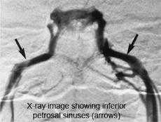

Slide 18
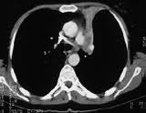

Slide 19
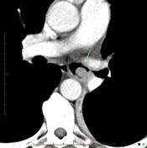

Slide 20
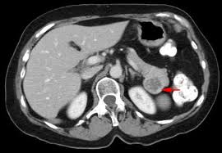

Slide 21
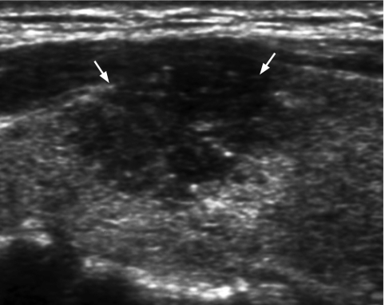

Slide 22
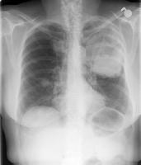

Slide 23
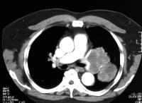

Slide 25
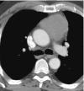

Slide 26
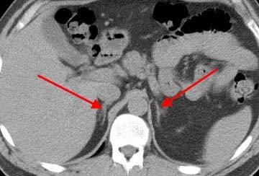

Slide 27
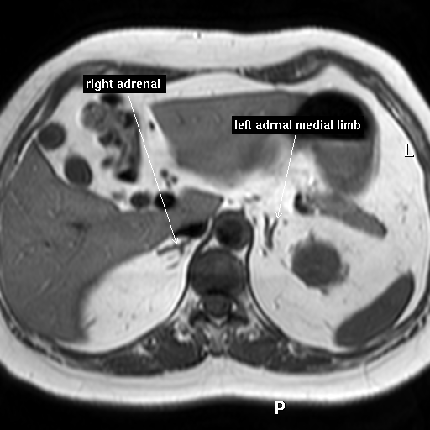

Slide 28
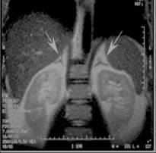

Slide 29
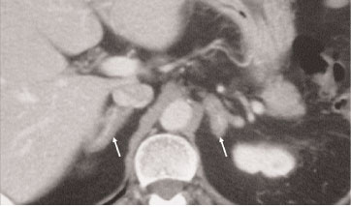

Slide 30
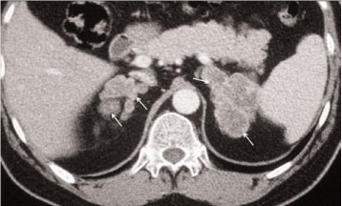

Slide 31
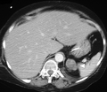

Slide 32
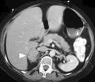

Slide 33
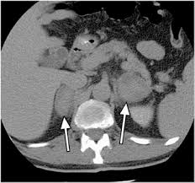

Slide 34
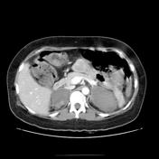

Slide 35
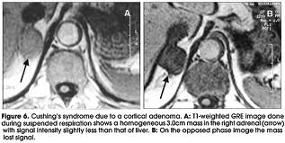

Slide 36
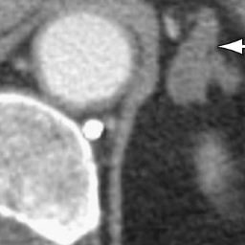

Slide 37
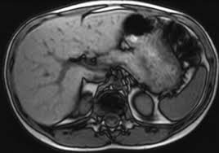

Slide 38
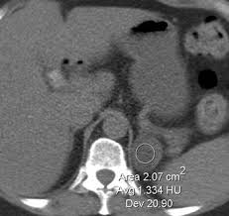

Slide 39
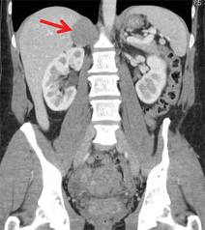

Slide 41
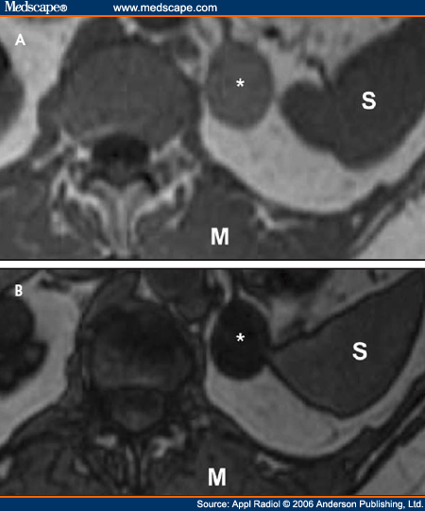

Slide 42
THANKS

