Slide 2
Diabetes Mellitus During Pregnancy
Seyed Adel Jahed, M.D.
Islamic Azad University, Tehran Medical Sciences Branch
Gabric Diabetes Education Association
RIES 27th Nov 2014 Tehran, Iran

Slide 3
AGENDA Diabetes in Pregnancy
Definition
Pathogenesis, Prevalence, Health Risks, Risk Factors
Screening
HAPO Study
The 2013 Endocrine Society Clinical Practice Guideline
Preconception care of women with diabetes
Gestational diabetes (GDM)
Glucose monitoring and glycemic targets
Nutrition therapy and weight gain targets for women with overt or GDM
Blood glucose lowering pharmacological therapy during pregnancy
Labor, delivery, lactation, and postpartum care
Available Medications
Oral glucose lowering agents
Prandial insulins
Basal insulins
Pitfalls and Conclusion

Slide 4
Case 1
خانم 26 ساله ای در هفته 3 بارداری دوم جهت مشاوره تشخیصی به شما ارجاع شده است. بارداری اول بدون هیچ مشکلی بود و نوزاد ترم 3 کیلویی به دنیا آمد. سابقه سقط نداشته است. سابقه خانوادگی از دیابت ندارد و BMI 24 kg/m² دارد.
در مورد بررسی وی از نظر احتمال دیابت بارداری چه توصیه ای مى نمایید؟

Slide 5
Case 2
خانم 23 ساله ای در هفته 4 بارداری اول جهت مشاوره تشخیصی به شما ارجاع شده است. وی از قبل مبتلا به PCOS بوده است و با متفورمین درمان می شده است ولی هیچ اختلالی در تحمل گلوکز نداشته است. سابقه سقط نداشته است. سابقه خانوادگی از دیابت ندارد و BMI 26 kg/m² دارد.
در مورد بررسی وی از نظر احتمال دیابت بارداری چه توصیه ای مى نمایید؟

Slide 6
Case 3
خانم 24 ساله ای در هفته 11 بارداری بررسي آزمایشگاهی شده است و با توجه به FBS=96 mg/dl، جهت مشاوره تشخیصی به شما ارجاع شده است. در مورد وی چه پاسخی مى دهید؟
الف- مورد قطعی دیابت بارداری است و نیاز به تست تشخيصی دیگر ندارد. ب- مورد قطعی دیابت آشکار (overt) است و نیاز به تست تشخيصی دیگر ندارد. ج- لازم است یک بار دیگر FBS تکرار شود. د- لازم است جهت تشخیص قطعی، OGTT شود.

Slide 7
GDM: Old Definition
“Glucose intolerance with onset or first recognition during pregnancy”
whether or not insulin is used for treatment or hyperglycemia persists after pregnancy
Criteria for the diagnosis were initially established about 50 years ago.
With minor modifications, remained in use for more than 40 years.
O’sullivan JB. Criteria for oral glucose tolerance test in pregnancy. Diabetes 1964;13:278–285

Slide 8
Diabetes in Pregnancy: Current Definitions (IADPSG & ADA)
Overt diabetes (type 1 or 2) in initial visit:
FPG ≥126 mg/dl
Random PG ≥200 mg/dl
A_{1C} ≥ 6.5%
these women are at increased risk of having a child with a congenital anomaly and may be at increased risk of complications from diabetes.
Gestational diabetes:
92 ≤ FPG <126 mg/dl at any gestational age
At 24-28 weeks of gestation: 75 gr 2-hr OGTT with any of the below:
FPG ≥92 mg/dl
1-hr ≥180 mg/dl
2-hr ≥153 mg/dl
NIH & ACOG still believe on 2 step approach & old criteria.

Slide 9
GDM Pathogenesis
Pregnancy is characterized by insulin resistance and hyperinsulinemia due to:
placental secretion of diabetogenic hormones including:
GH
CRH
Human placental lactogen (hPL)
Progesterone
increased maternal adipose deposition
decreased exercise
increased caloric intake
These and other endocrinologic and metabolic changes ensure that the fetus has an ample supply of fuel and nutrients at all times.
GDM occurs when pancreatic function is not sufficient to overcome the insulin resistance created by changes in diabetogenic hormones during pregnancy.

Slide 10
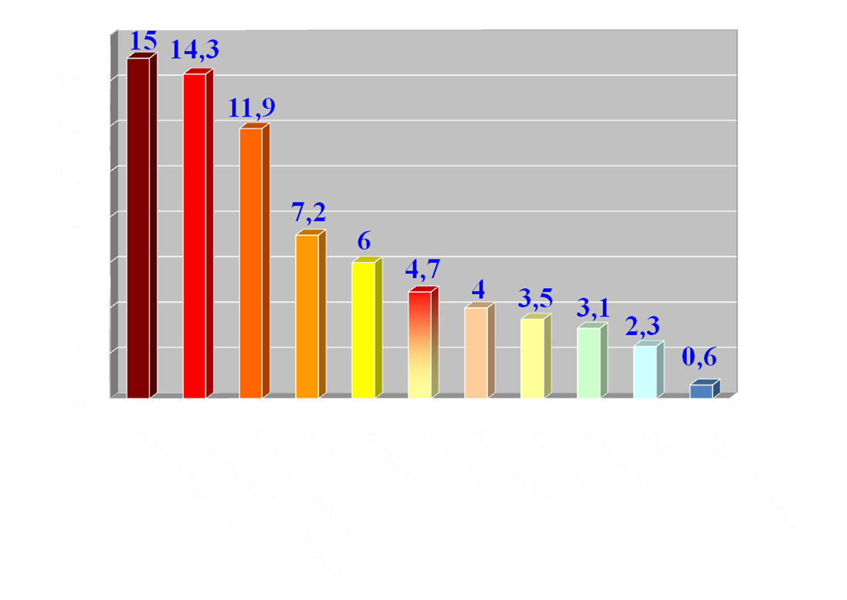
Prevalence of GDM
Epidemiology of glucose intolerance and GDM in women of child bearing age, Diabetes Care, 21, 1998

Slide 11
Overall Prevalence of Pregnancy Complicated by DM
Pre-GDM: 0.8 % in 1999
1.8 % in 2005
The prevalence of GDM remained constant at about 7.5% during the same interval. ¹
Using new diagnostic IADPSG criteria: 18% ²
Lawrence JM, et al. Trends in the prevalence of preexisting diabetes and GDM among a racially/ethnically diverse population of pregnant women, 1999-2005. Diabetes Care 2008; 31:899
C.D.C 2011. http://www.cdc.gov/diabetes/pubs/pdf/ndfs

Slide 12
Health Risks of Gestational Diabetes
Mother | Fetus | Newborn | Child/Adult
Birth trauma | Hyperinsulinemia | Hypoglycemia | Obesity
Increased cesarean delivery | Cardiomyopathy | Respiratory distress syndrome | Metabolic syndrome
Preeclampsia/ Gestational hypertension | Fetal organomegaly | Hypocalcemia | Type 2 diabetes
 | Hydramnios | Hyperviscosity | impaired fine and gross motor functions
 | Stillbirth | Hypomagnesemia
Metabolic syndrome | LGA/ macrosomia | Cardiomyopathy Hyperbilirubinemia Perinatal mortality | higher rates of inattention and/or hyperactivity
Type 2 diabetes | Birth trauma | Polycythemia
Diabetes Care 2008; 31:340.
Obstet Gynecol Clin N Am 2010; 37:255–67.

Slide 13
Risk Factors for Gestational Diabetes
Risk Factor | Odds Ratio | References
Prior GDM | 23 | McGuire et al
South East Asian | 7.6ª | Dornhorst et al
Sibling with Diabetes | 7.1 | Kim et al
Severe Obesity | 7 | Torloni et al; Chu et al
Obesity | 3.7 | Torloni et al; Chu et al
Prior Macrosomic Infant | 3.3 | McGuire et al
Parent with Diabetes | 3.2 | Kim et al
PCOS | 2.9 | Toulis et al
Periodontal Disease | 2.6 | Xiong et al
Hispanic | 2.4ª | Dooley et al
Maternal Age Greater than 35 y | 2.3 | Xiong et al
Multiple Gestation | 2.2 | Rauh-Hain et al
Overweight | 2 | Torloni et al; Chu et al
Low Maternal Birth Weight | 1.9 | Seghieri et al
African American | 1.8ª | Dooley et al
Maternal Age Greater than 25 y | 1.4 | Cypryk et al
ª Relative risk compared with white race
Obstet Gynecol Clin N Am 2010; 37:255–67

Slide 14
SCREENING
Selective vs. Universal?
One step vs. two step?

Slide 15
SCREENING
Whom to be screened ?
low risks of GDM should have all below criteria:
<25 yrs
non-Hispanic white
BMI <25 kg/m²
no history of previous glucose intolerance or adverse pregnancy outcomes associated with GDM
no first degree relative with diabetes
Only 10% of the general obstetric population meets all of these criteria.
2.7-20% of women diagnosed with GDM have no risk factors.
Thus, universal screening is recommended.
Obstet Gynecol 2013; 122:406.

Slide 16
Old Screening for GDM
Two approaches may be followed for GDM screening at 24–28 weeks:
Two-step approach:
A. Perform initial screening by measuring plasma or serum glucose 1 h after 50-g load (GCT). 1-hPG of >140 mg/dl identifies 80% of women with GDM, while the sensitivity is further increased to 90% by a threshold of >130 mg/dl.
B. Perform diagnostic 100-g OGTT on a separate day in women who exceed the chosen threshold on 50-g screening.
One-step approach:
Perform a diagnostic 100-g OGTT in all women to be tested at 24–28 weeks.
May be preferred in clinics with high prevalence of GDM.
Diabetes Care 2010; 33 (Suppl 1): S16

Slide 17
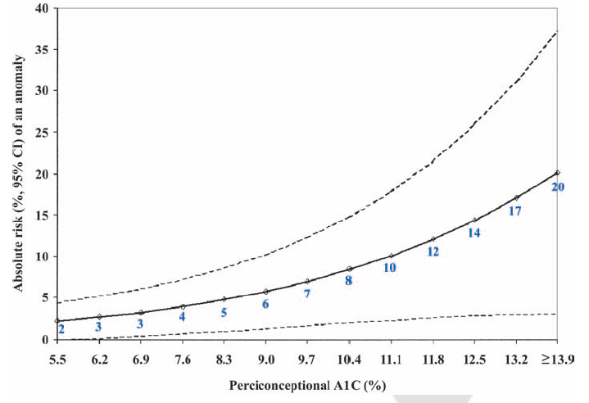
Risk of Fetal Anomaly Relative to Periconceptional A1C
Guerin A et al. Diabetes Care 2007;30:1-6.

Slide 18
Are there clear threshold glucose levels above which the risk of adverse neonatal or maternal outcomes increases?
Diagnosis of GDM: which criteria to be used?

Slide 19
IADPSG Consensus
Diabetes Care 2010; 33(3): 676-82

Slide 20
International Association of Diabetes and Pregnancy Study Groups (IADPSG)
Was formed in 1998; 225 conferees from 40 countries.
The principal objectives of IADPSG are to foster an international approach to enhancing the quality of care, facilitating research, and advancing education in the field of diabetes in pregnancy.
Diabetes Care 2010; 33(3): 676-82

Slide 21
Hyperglycemia and Adverse Pregnancy Outcome study (HAPO)
25,505 pregnant women at 15 centers in nine countries
Primary outcomes
birth weight > 90th percentile for gestational age
primary cesarean delivery
clinically diagnosed neonatal hypoglycemia
cord-blood serum C-peptide level > 90th percentile
Secondary outcomes
delivery before 37 wks of gestation
shoulder dystocia or birth injury
need for intensive neonatal care
hyperbilirubinemia
preeclampsia
N Engl J Med 2008; 358:1991-2002

Slide 22
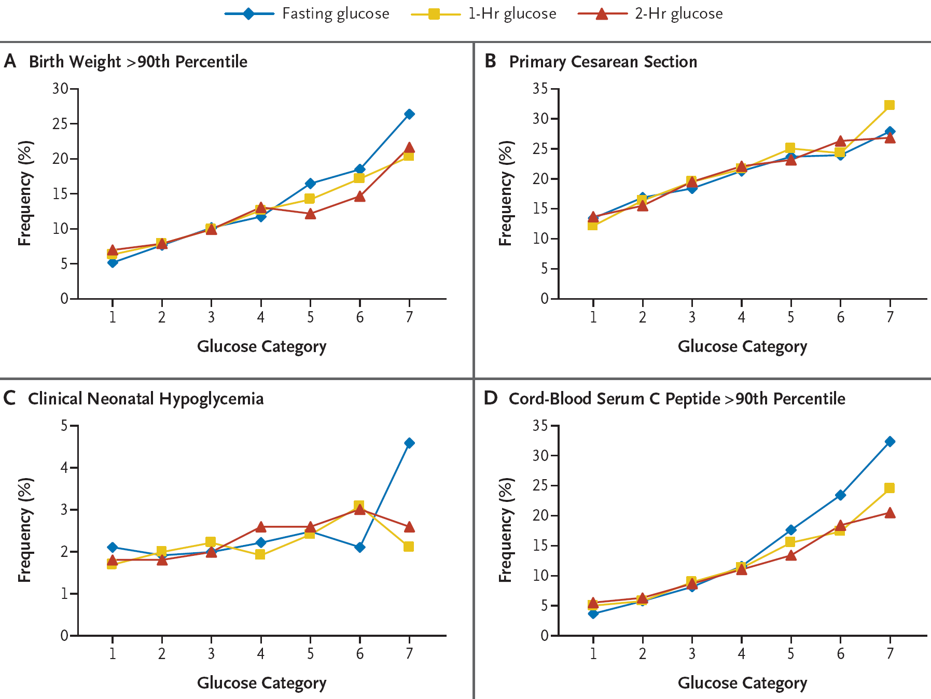
HAPO Primary Outcomes
N Engl J Med 2008; 358:1991-2002

Slide 23
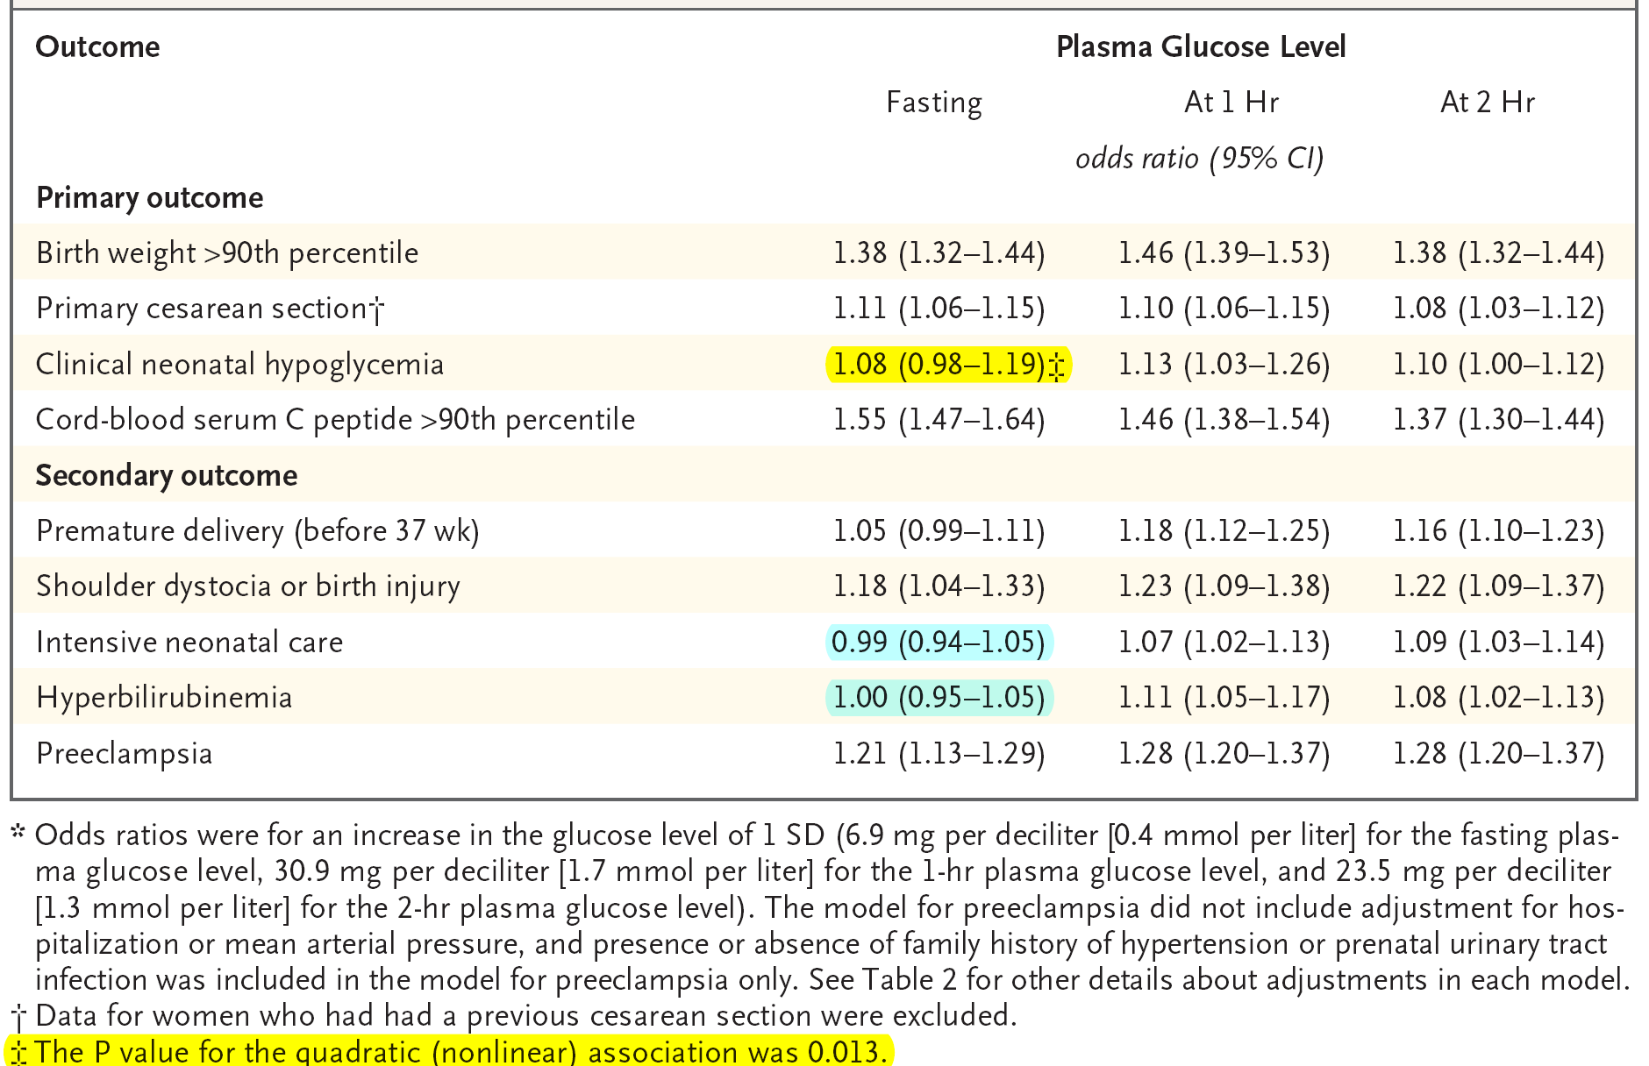
Adjusted OR for Associations between Maternal Glycemia as a Continuous Variable and Primary and Secondary Perinatal Outcomes*
N Engl J Med 2008; 358:1991-2002

Slide 24
Are there clear threshold glucose levels above which the risk of adverse neonatal or maternal outcomes increases?
Diagnosis of GDM: which criteria to be used?
NO

Slide 25
HAPO Key Messages
Based on odds ratio of 1.75 for primary outcome:
The frequency of birth weight, C-peptide, preeclampsia, or percent infant body fat >90th percentile was approximately twofold greater when any of the glucose values were greater than or equal to the threshold.
The frequencies of preterm delivery and primary C/S were >45% higher when one or more glucose values met or exceeded threshold.
Diabetes Care 2010; 33(3): 676-82

Slide 26
IADPSG Consensus Threshold Values for Diagnosis of GDM (≥1 Value is Diagnostic)
Glucose measure with a 75 g OGTT | Glucose threshold (mg/dL) | Proportion of HAPO cohort above threshold (%)
FPG | 92 | 8.3
1-h PG | 180 | 14.0
2-h PG | 153 | 16.1
Based on odds ratio (OR) of 1.75 for primary outcome
OGTT = Oral Glucose Tolerance Test
HAPO = Hyperglycemia and Adverse Pregnancy Outcomes study
IADPSG. Diabetes Care 2010;22:676-682
Notes:
Given the lack of a clear threshold, the IADPSG chose an odds ratio of 1.75 for developing the primary outcome of HAPO as their threshold for determining the diagnostic criteria for HAPO. The glucose thresholds as well as proportion of HAPO cohort above threshold are shown here.

Slide 27
Threshold Values for Diagnosis of GDM or Overt Diabetes in Pregnancy
Glucose measure | Glucose concentration threshold* (mg/dl)
FPG 1-h plasma glucose 2-h plasma glucose | 92 180 153
To diagnose overt diabetes in pregnancy
FPG‡ A1C‡ Random plasma glucose | ≥126 mg/dl ≥6.5% (DCCT/UKPDS standardized) ≥200 mg/dl + confirmation§
* One or more of these values from a 75-g OGTT must be equaled or exceeded for the diagnosis of GDM.
‡ One of these must be met to identify the patient as having overt diabetes in pregnancy.
§ If a random PG is the initial measure, the tentative diagnosis of overt diabetes in pregnancy should be confirmed by FPG or A1C using a DCCT/ UKPDS-standardized assay.
Diabetes Care 2010; 33(3): 676-82.

Slide 28
Still Remains a Controversial Topic …
Notes:
Obstet Gynecol. 2013 Jan;121(1):177-82. doi: http://10.1097/AOG.0b013e31827711e5.
Perspectives on the proposed gestational diabetes mellitus diagnostic criteria.
Langer O, Umans JG, Miodovnik M.
Source
Cookeville Regional Medical Center, Cookeville, Tennessee 38501, USA. odlanger@gmail.com
Abstract
To date, The International Association of the Diabetes and Pregnancy Study Groups (IADPSG) criteria for the diagnosis of gestational diabetes mellitus (GDM) have not been analyzed systematically for medical, social, and economic ramifications if used in substitution for the current GDM diagnostic criteria. The IADPSG dependence on expert opinion and consensus rather than on rigorously obtained outcome measures is concerning given the dramatic changes in clinical intervention and medical-resource reallocation that would follow their wide adoption. This commentary attempts to highlight needed research as well as the key knowledge gaps that should prevent adoption of the revised criteria until their effect on perinatal outcomes and health care costs is determined. In light of the overall, ethnic, and regional variation in GDM prevalence and the demands of increased GDM diagnosis on clinical resources, it may not be realistic and practical to impose universal strategies and standards for diagnosis. The newly proposed criteria may affect medical care negatively, unnecessarily stigmatize patients with a "sick label," and adversely affect health care costs without ensuring the desired improvements in maternal and neonatal outcomes. This commentary serves as a caution to not promote a new endeavor until it has been compared rigorously with current practice and its implications are understood fully.
Diabetologia. 2011 Mar;54(3):480-6. doi: 10.1007/s00125-010-2005-4. Epub 2011 Jan 4.
Diagnosing gestational diabetes.
Ryan EA.
Source
Division of Endocrinology and Metabolism, Department of Medicine, 362 Clinical Wing, Heritage Medical Research Building, Alberta Diabetes Institute, University of Alberta, Edmonton, AB, Canada. edmond.ryan@ualberta.ca
Abstract
The newly proposed criteria for diagnosing gestational diabetes will result in a gestational diabetes prevalence of 17.8%, doubling the numbers of pregnant women currently diagnosed. These new diagnostic criteria are based primarily on the levels of glucose associated with a 1.75-fold increased risk of giving birth to large-for-gestational age infants (LGA) in the Hyperglycemia Adverse Pregnancy Outcome (HAPO) study; they use a single OGTT. Thus, of 23,316 pregnancies, gestational diabetes would be diagnosed in 4,150 women rather than in 2,448 women if a twofold increased risk of LGA were used. It should be recognised that the majority of women with LGA have normal glucose levels during pregnancy by these proposed criteria and that maternal obesity is a stronger predictor of LGA. The expected benefit of a diagnosis of gestational diabetes in these 1,702 additional women would be the prevention of 140 cases of LGA, 21 cases of shoulder dystocia and 16 cases of birth injury. The reproducibility of an OGTT for diagnosing mild hyperglycaemia is poor. Given that (1) glucose is a weak predictor of LGA, (2) treating these extra numbers has a modest outcome benefit and (3) the diagnosis may be based on a single raised OGTT value, further debate should occur before resources are allocated to implementing this change.
Diabet Med. 2012 Feb;29(2):176-80. doi: 10.1111/j.1464-5491.2011.03407.x.
Proposed new diagnostic criteria for gestational diabetes--a pause for thought?
Cundy T.
Source
Department of Medicine, Faculty of Medical & Health Sciences, University of Auckland, Auckland, New Zealand. t.cundy@auckland.ac.nz
Abstract
New criteria for the diagnosis of gestational diabetes promulgated by the International Association of Diabetes and Pregnancy Study Groups (IADSPG) have been adopted by a number of groups, including the American Diabetes Association. These criteria will increase two- to three-fold the number of women diagnosed with gestational diabetes and have enormous resource implications. The recommendations are derived from observations made in the Hyperglycemia and Adverse Pregnancy Outcomes (HAPO) study, which demonstrated continuous relationships between maternal glucose tolerance and two clinically relevant outcomes of pregnancy (caesarean section rate and neonatal hypoglycaemia) and two surrogate measures (birth weight and cord C-peptide). The recent randomized intervention studies in mild gestational diabetes indicate that the major effects of detecting and treating mild gestational diabetes are a reduction in mean birth weight of 100-140 g, and a reduction in the incidence of shoulder dystocia. However, the women included in these studies were identified using different diagnostic criteria, and it cannot be assumed that women diagnosed by the less stringent IADSPG criteria will have the same benefit. Moreover, as the majority of cases of macrosomia and shoulder dystocia occur in women with normal glucose tolerance, the real impact of diagnosing many more 'cases' of gestational diabetes is likely to be minimal. The concentration on mild degrees of hyperglycaemia may well be misplaced, as most of the outcomes usually attributed to gestational diabetes are more strongly associated with maternal obesity and weight gain in pregnancy. The new testing procedure (with diagnosis based on a single blood glucose measurement) will inevitably be imprecise. Given the many reservations about the new criteria an urgent but dispassionate debate is required on the risks, costs and benefits of their introduction.

Slide 31
1.0. Preconception care of women with diabetes

Slide 32
1.1. Preconception Counseling
We recommend that preconception counseling be provided to all women with diabetes who are considering pregnancy. (1 OO)

Slide 33
1.2. Preconception Glycemic Control
We suggest that women with diabetes seeking to conceive strive to achieve blood glucose and HbA_{1C} levels as close to normal as possible when they can be safely achieved without undue hypoglycemia. (2 OO)

Slide 34
1.3. Insulin Therapy-1 Regimens
a. We recommend that insulin-treated women with diabetes seeking to conceive be treated with multiple daily doses of insulin or continuous sc insulin infusion in preference to split-dose, premixed insulin therapy, because the former are:
more likely to allow for the achievement and maintenance of target blood glucose levels preconceptionally.
in the event of pregnancy, are more likely to allow for sufficient flexibility or precise adjustment of insulin therapy. (1 OO)

Slide 35
1.3. Insulin Therapy-2 Change Time
b. We suggest that a change to a woman’s insulin regimen, particularly when she starts continuous sc insulin infusion, be undertaken well in advance of withdrawing contraceptive measures or otherwise trying to conceive to allow the patient to acquire expertise in, and the optimization of, the chosen insulin regimen. (Ungraded recommendation)

Slide 36
1.3. Insulin Therapy-3 Analogues
c. We suggest that insulin-treated women with diabetes seeking to conceive be treated with rapid-acting insulin analog therapy (with insulin aspart or insulin lispro) in preference to regular insulin. (2 OO)
d. We suggest that women with diabetes successfully using the long-acting insulin analogs insulin detemir or insulin glargine preconceptionally may continue with this therapy before and then during pregnancy. (2 OO)

Slide 37
1.4. Folic Acid Supplementation
We recommend that beginning 3 months before withdrawing contraceptive measures or otherwise trying to conceive, a woman with diabetes take a daily folic acid supplement to reduce the risk of neural tube defects. (1 OO)
We suggest a daily dose of 5 mg based on this dose’s theoretical benefits. (2 OO)

Slide 38
1.5. Ocular Care: Preconception, During pregnancy, & Postpartum
a. We recommend that all women with diabetes who are seeking pregnancy have a detailed ocular assessment by a suitably trained and qualified eye care professional in advance of withdrawing contraceptive measures or otherwise trying to conceive. (1 )
If retinopathy is documented, the patient should be apprised of the specific risks to her of this worsening during pregnancy.
If the degree of retinopathy warrants therapy, we recommend deferring conception until the retinopathy has been treated and found to have stabilized. (1 )
b. We recommend that women with established retinopathy be seen by their eye specialist every trimester, then within 3 months of delivering, and then as needed. (1 OOO)
c. We suggest that pregnant women with diabetes not known to have retinopathy have ocular assessment performed soon after conception and then periodically as indicated during pregnancy. (2 OO)

Slide 39
2.0.
Gestational diabetes (GDM)

Slide 40
2.1. Testing for overt diabetes in early pregnancy
We recommend universal testing for diabetes with a FPG, HbA_{1C}, or an untimed random PG at the first prenatal visit (before 13 weeks gestation or as soon as possible thereafter) for those women not known to already have diabetes. (1 OO)
In the case of overt diabetes, but not GDM, a second test (either a FPG, untimed random plasma glucose, HbA_{1C}, or OGTT) must be performed in the absence of symptoms of hyperglycemia and found to be abnormal on another day to confirm the diagnosis.

Slide 41
1st Prenatal Visit Abnormal Plasma Glucose Classification

Slide 42
2.2. Testing for GDM at 24-28 weeks gestation-1
We recommend that pregnant women not previously identified with overt diabetes or GDM be tested for GDM (Table 2) by having a 2-hr, 75-g OGTT performed at 24-28 weeks gestation. (1 O)
We recommend that GDM be diagnosed on this test using the IADPSG criteria (majority opinion of this committee). (1 O)

Slide 43
2.2. Testing for GDM at 24-28 weeks gestation-2
The 75-g OGTT should be performed after an overnight fast of at least 8 hrs (but not >14 hrs) and without having reduced usual carbohydrate intake for the preceding several days.
The test should be performed with the patient seated, and the patient should not smoke during the test.
One or more abnormal values establishes the diagnosis.
The exception is that in the case of overt diabetes, but not GDM, a second test (either a FPG, untimed random PG, HbA1C, or OGTT), in the absence of symptoms of hyperglycemia, must be performed and found to be abnormal on another day to confirm the diagnosis of overt diabetes.

Slide 44
2.3. Management of Elevated Blood Glucose
a. We recommend that women with GDM target blood glucose levels as close to normal as possible. (1 OO)
b. We recommend that the initial treatment of GDM should consist of MNT and daily moderate exercise for ≥30 minutes. (1 O)
c. We recommend using blood glucose-lowering pharmacological therapy if lifestyle therapy is insufficient to maintain normoglycemia in women with GDM. (1 )

Slide 45
2.4. Postpartum Care-1
a. We recommend that postpartum care for women who have had GDM should include measurement of FPG or fasting SMBG for 24-72 hrs after delivery to rule out ongoing hyperglycemia. (1 OOO)
b. We recommend that a 2-hr, 75-gOGTT should be undertaken 6-12 weeks after delivery in women with GDM to rule out prediabetes or diabetes. (1 O)
If results are normal, we recommend this or other diagnostic tests for diabetes should be repeated periodically as well as before future pregnancies. (1 OO)

Slide 46
2.4. Postpartum Care-2
c. We suggest the child’s birth weight and whether or not the child was born to a mother with GDM become part of the child’s permanent medical record. (Ungraded recommendation)
d. We recommend that all women who have had GDM receive counseling on lifestyle measures to reduce the risk of type 2 diabetes, the need for future pregnancies to be planned, and the need for regular diabetes screening, especially before any future pregnancies. (1 OOO)
e. We suggest blood glucose-lowering medication should be discontinued immediately after delivery for women with GDM unless overt diabetes is suspected.
in which case the decision to continue such medication should be made on a case-by-case basis. (2 OO)

Slide 47
3.0.
Glucose Monitoring and Glycemic Targets

Slide 48
3.1. Self-monitoring of blood glucose (SMBG)
We recommend SMBG in all pregnant women with GDM or overt diabetes (1 ) and suggest testing before and either 1 or 2 hours after the start of each meal (choosing the post meal time when it is estimated that peak postprandial blood glucose is most likely to occur) and, as indicated, at bedtime and during the night. (2 OO)

Slide 49
3.2. Glycemic Targets-1 FPG
a. We recommend pregnant women with overt or GDM strive to achieve a target pre-prandial blood glucose 95 mg/dl. (1QQOO for fasting target, 1QOOO for other meals)
b. We suggest that an even lower FPG target of 90 mg/dl be strived for (2QOOO) if this can be safely achieved without undue hypoglycemia.

Slide 50
3.2. Glycemic Targets-2 Post Prandials
c. We suggest pregnant women with overt or GDM strive to achieve target blood glucose levels 1 hr after the start of a meal 140 mg/dl and 2 hrs after the start of a meal 120 mg/dl (2QOOO) when these targets can be safely achieved without undue hypoglycemia.
d. We suggest pregnant women with overt diabetes strive to achieve a HbA_{1C} 7% (ideally 6.5%). (2QOOO)

Slide 51
3.2. Glycemic Targets-3

Slide 52
3.3. Continuous Glucose Monitoring System (CGMS)
We suggest that CGMS be used during pregnancy in women with overt or GDM when SMBG levels (or, in the case of the woman with overt diabetes, HbA_{1C} values) are not sufficient to assess glycemic control (including both hyperglycemia and hypoglycemia). (2 OO)

Slide 53
4.0.
Nutrition Therapy And Weight Gain Targets For Women With Overt Or GDM

Slide 54
4.1. Nutrition Therapy
We recommend MNT for all pregnant women with overt or GDM to help achieve and maintain desired glycemic control while providing essential nutrient requirements. (1 OO)

Slide 55
4.2.Weight Management
a. We suggest that women with overt or GDM follow the Institute of Medicine revised guidelines for weight gain during pregnancy (Table 4). (Ungraded recommendation)
b. We suggest obese women with overt or GDM reduce their calorie intake by approximately one-third (compared with their usual intake before pregnancy) while maintaining a minimum intake of 1600-1800 kcal/d. (2QQOO)

Slide 56
4.3. Carbohydrate Intake
We suggest women with overt or GDM limit carbohydrate intake to 35-45% of total calories, distributed in
3 small- to moderate-sized meals
&
2-4 snacks including an evening snack. (2QQOO)

Slide 57
4.4. Nutritional Supplements
We recommend pregnant women with overt or GDM should follow the same guidelines for the intake of minerals and vitamins as for women without diabetes (1QQEE), with the exception of taking folic acid 5mg daily beginning 3 months before withdrawing contraceptive measures or otherwise trying to conceive.
We suggest that at 12 weeks gestation, the dose of folic acid be reduced to 0.4-1.0 mg/d, which should be continued until the completion of breastfeeding. (2QQOO)

Slide 58
5.0.
Blood Glucose Lowering Pharmacological Therapy During Pregnancy

Slide 59
5.1. Insulin Therapy-1 Basal Insulin Analogues
a. We suggest that the insulin analog detemir may be initiated during pregnancy for those women who require basal insulin and for whom NPH insulin, in appropriate doses, has previously resulted in, or for whom it is thought NPH insulin may result in, problematic hypoglycemia.
Insulin detemir may be continued in those women with diabetes already successfully taking insulin detemir before pregnancy. (2QQQQ)
b. We suggest that those pregnant women successfully using insulin glargine before pregnancy may continue it during pregnancy. (2QQOO)

Slide 60
5.1. Insulin Therapy-2 Prandial Insulins
c. We suggest that insulin analogs lispro and aspart be used in preference to regular insulin in pregnant women with diabetes. (2QQQO)
d. We recommend the ongoing use of CSII during pregnancy in women with diabetes when this has been initiated before pregnancy. (1QQQO)
but suggest that CSII not be initiated during pregnancy unless other insulin strategies including multiple daily doses of insulin have first been tried and proven unsuccessful. (2QQOO)

Slide 61
5.2. Noninsulin Anti-hyperglycemic Agent Therapy
a. We suggest that Glibenclamide is a suitable alternative to insulin therapy for glycemic control in women with GDM who fail to achieve sufficient glycemic control after a 1-week trial of MNT and exercise, except for:
a diagnosis of GDM before 25 weeks gestation
FPG levels 110 mg/dl
in which case insulin therapy is preferred. (2QQOO)
b. We suggest that metformin therapy be used for glycemic control only for those women with GDM who do not have satisfactory glycemic control despite MNT and who refuse or cannot use insulin or glyburide and are not in the 1st trimester. (2QQOO)

Slide 62
6.0.
Labor, Delivery, Lactation, and Postpartum Care

Slide 63
6.1. Blood Glucose Targets During Labor and Delivery
We suggest target blood glucose levels of 72-126 mg/dl during labor and delivery for pregnant women with overt or GDM. (2 OO)

Slide 64
6.2. Lactation
a. We recommend whenever possible women with overt or GDM should breastfeed their infant. (1 )
b. We recommend that breastfeeding women with overt diabetes successfully using metformin or glyburide therapy during pregnancy should continue to use these medications, when necessary, during breastfeeding. (1 )

Slide 65
6.3. Postpartum Contraception
We recommend that the choice of a contraceptive method for a woman with overt diabetes or a history of GDM should not be influenced by virtue of having overt diabetes or a history of GDM. (1 O)

Slide 66
6.4. Screening for Postpartum Thyroiditis
We suggest that women with type 1 diabetes be screened for postpartum thyroiditis with a TSH at 3 and 6 months postpartum. (2 OO)

Slide 67
Oral Glucose Lowering Agents

Slide 68
Diabetes in Pregnancy: Pharmacologic Therapy
When MNT alone fails, pharmacologic therapy is indicated
AACE guidelines recommend insulin as the optimal approach¹
Insulin therapy is required for the treatment of T1DM during pregnancy²
Metformin and glyburide are the 2 most commonly prescribed OADs during pregnancy^{1,2}
Due to efficacy and safety concerns, the ADA does not recommend OADs for GDM or preexisting T2DM^{3,4}
Medication | Crosses Placenta | Classification | Notes
Metformin | Yes | Category B¹ | Metformin and glyburide may be insufficient to maintain normoglycemia at all times, particularly during postprandial periods²
Glyburide | Minimal transfer | Some formulations category B, others category C^{1,5,6}
1. AACE. Endocr Pract. 2011;17(2):1-53. 2. Castorino K, Jovanovic L. Clin Chem. 2011;57(2):221-30. 3. ADA. Diabetes Care. 2004;27(suppl 1):S88-90. 4. Jovanovic L, et al. Mt Sinai J Med. 2009;76(3):269-80. 5. Micronase PI. Pifizer. Division of Pifizer, NY, NY, 2010. 6. Diabeta PI. Sanofi-Aventis

Slide 69
Metformin
↑ Skeletal glucose uptake and inhibit hepatic gluconeogenesis
Renal dysfunction may increase risk of lactic acidosis; an extremely rare (< 1/100,000 treated pts) but potentially fatal event.
Usage contra-indications:
GFR < 30
CHF ( NYHA class 3 or 4)
Severe liver insufficiency
Hypoxemic pulmonary diseases

Slide 70
Metformin Characteristics
Target tissue | Liver
Δ HbA_{1c} (monotherapy) | 1-2%
Fasting effect | Good
Postprandial effect | Good
Severe hypoglycemia | No
Dosing interval | BID or TDS
Δ Weight (lb/yr) | 0 to - 6
Δ Insulin | Modest decrease
Δ LDL | Decrease
Δ HDL | Increase
Δ TG | Decrease
Common problem | Transient GI
Rare problem | Lactic acidosis
Contraindications | Renal failure , Liver failure, CHF, >80 yrs old
Maximum effective dose | 1000 mg bid

Slide 71
Treatment of infertility in PCOS Legro RS. Diagnosis and Treatment of PCOS: An Endocrine Society Clinical Practice Guideline. JCEM 2013; 98: 4565–92.
The routine use of metformin during pregnancy in women with PCOS is unwarranted, although it may be useful to treat GDM ¹.
A meta-analysis of RCTs demonstrated no effect of metformin on abortion rate (OR: 0.89; CI_{95%}: 0.59–1.75; P: 0.9) ².
A large RCT demonstrated no difference in the prevalence of pre-eclampsia, preterm delivery, or GDM in women with PCOS treated with metformin during pregnancy ³.
Metformin was associated with a significantly higher incidence of GI disturbance, but no serious maternal or fetal adverse effects ^{3,4}.
Metformin vs. insulin for the treatment of GDM. NEJM 2008;358:2003–15.
Effect of preconceptional metformin on abortion risk in PCOS: a systematic review and meta-analysis of RCTs. Fertil Steril. 2009;92:1646–58.
Metformin vs. placebo from 1st trimester to delivery in PCOS: a randomized, controlled multicenter study. JCEM 2010;95:E448–55.
Insulin sensitising drugs for women with PCOS, oligo amenorrhoea and subfertility. Cochrane Database Syst Rev. 2010;1:CD003053.

Slide 72
Glibenclamide Characteristics
Target tissue | Beta cell
Δ HbA_{1c} (monotherapy) | 1-2%
Fasting effect | Good
Postprandial effect | Good
Severe hypoglycemia | Yes
Dosing interval | QD to TDS
Δ Weight (lb/yr) | +1-3
Δ Insulin | Increase
Δ LDL | None
Δ HDL | None
Δ TG | None
Common problem | Hypoglycemia, weight gain
Contraindications | Allergy
Maximum effective dose | ½ max
Kronenberg: Williams Textbook of Endocrinology, 11th ed. 2008 Saunders

Slide 73
Comparisons of Oral Anti-diabetic Drugs
Property | Sulfonylureas | Metformin
Target tissue | Beta cell | Liver
Δ HbA_{1c} (monotherapy) | 1%-2% | 1%-2%
Fasting effect | Good | Good
Postprandial effect | Good | Good
Severe hypoglycemia | Yes | No
Dosing interval | qd to tid | bid or tid
Δ Weight (lb/yr) | +1-3 | 0 to - 6
Δ Insulin | Increase | Modest decrease
Δ LDL | None | Decrease
Δ HDL | None | Increase
Δ TG | None | Decrease
Common problem | Hypoglycemia, weight gain | Transient GI
Rare problem |  | Lactic acidosis
Contraindications | Allergy | Renal or Liver failure CHF >80 yr old
Maximum effective dose | ½ max or double starting | 1000 mg bid
Kronenberg: Williams Textbook of Endocrinology, 11th ed. 2008 Saunders

Slide 74
Prandial Insulins

Slide 75
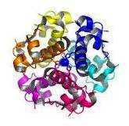
Regular Human Insulin
After SQ injection regular insulin tends to
dissociate from its normal hexameric form, first
into dimers and then monomers.
Only dimeric & monomeric forms can pass through the endothelium.
The resulting delay in the onset and duration of action, limits its effectiveness in controlling postprandial glucose.
Dose dependent pharmacokinetics, with prolonged onset, peak, duration of action with higher doses.
Med Clin North Am 1998

Slide 76
Pharmacokinetic Properties of Regular Insulin
Regular Insulin
Onset of action: 0.5-1 hr
Peak activity: 2-4 hrs
Duration of activity: 6-8 hrs
Med Clin North Am 1998

Slide 77
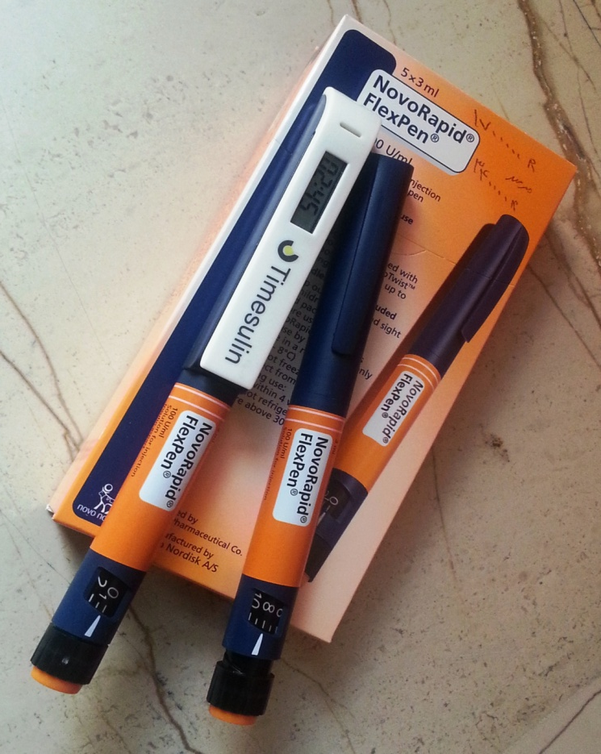
Pharmacokinetic Properties of Rapid acting insulin Preparations
Rapid acting insulins
Onset of action: 15 minutes
Peak activity: 1 hr
Duration of activity: 3-4 hrs
Lancet 1997 Jan

Slide 78
Structural Formula of Insulin Aspart

Slide 79
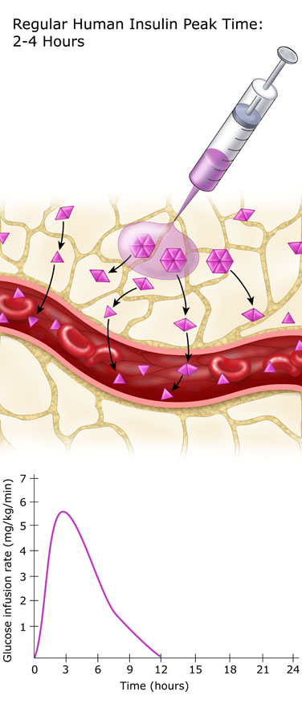
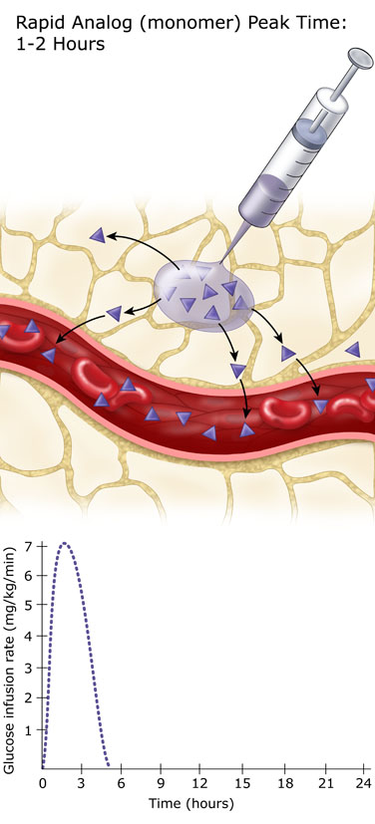
Regular Insulin vs. Rapid Analogue

Slide 80
Basal Insulins

Slide 81
Pharmacokinetic Properties of Basal Insulin Preparation
NPH Insulin
Onset of action: 1-4 hrs
Peak activity: 6-10 hrs
Duration of activity: 10-16 hrs
Long Acting Insulin Analogous: Glargine & Detemir
Were designed to provide a reliable, constant basal insulin concentration to control basal metabolism.
They are more predictable than conventional insulins and allow simplified insulin-replacement strategies.

Slide 82
Types Of Basal Insulin
 | Intermediate-Acting NPH | Long-Acting Analogues Glargine, Detemir
Onset | 1-3 hrs | 1.5 - 3 hrs
Peak | 5-8 hrs | Glargine: No peak Detemir: dose-dependent peak
Duration | Up to 18 hrs | Detemir: 9-24 hrs Glargine: 20-24 hrs

Slide 83
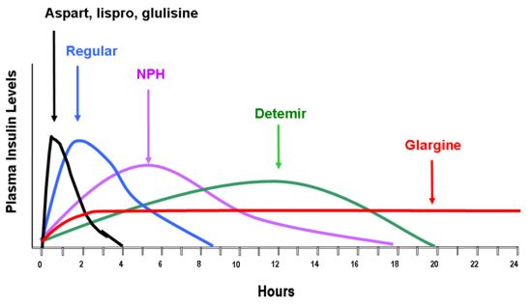
Endotext.com

Slide 84
The new analogues are more predictable than conventional insulins and allow simplified insulin replacement strategies
Lispro, glulisine, or aspart or regular
μU/mL
100
Glargine
80
60
40
Normal pattern
20
0600
0800
1200
1800
2400
0600
Time of day
Detemir

Slide 85
Insulin Therapy
Dealing with the “Insulin Fear”!
Type of insulin to be used?
SMBG patterns
Prandial vs. Basal?
Analogues vs. Human insulins
Availability?
Cost?
Insurance?
The physician’s experience with insulin therapy
Number of injections?
Starting dose? 0.5-1 IU/kg/day ?
Which part of the body to be injected in?
Rapid absorption in the abdominal wall
Delayed absorption in the thigh

Slide 86
Take Home Message- 1
Team work!
Education:
structured program, experienced educators
Gabric Diabetes Education Association: +98 21 82433
Iran Diabetes Society: +98 21 8827 5274
Discuss the fundamental principals in each visit
Supervise self-adjustments
Importance of SMBG
Have a contact with the patient to assess SMBG chart
Discuss with the patient: OAD or Insulin?
Which prandial insulin: Aspart vs. Regular
Ease of use, Hypos, Eating habits, SMBG chart review

Slide 87
Take Home Message- 2
Individualization of therapy is key, incorporating the degree of hyperglycemia needing to be addressed and the overall capacities of the patient.

Slide 89
Thanks for your attention

