Slide 1
Insulin therapy for type 2 diabetes
By: Maryam kabootari
Endocrinologist
Esfand 96

Slide 2
General principles of insulin therapy in diabetes mellitus
Many patients with type 2 diabetes will require insulin as their beta-cell function declines over time.
Clinical features that, if present in a patient with diabetes at any age, suggest the need for insulin therapy include:
Marked and otherwise unexplained recent weight loss (irrespective of the initial weight)
Short history with severe symptoms
Presence of moderate to heavy ketonuria.

Slide 3
Normal patterns of insulin secretion
Insulin is secreted in a pulsatile manner; pulses occur under basal (unstimulated) conditions and in response to meals.
Basal insulin secretion represents approximately 50 percent of 24-hour insulin production, with the remainder accounted for by prandial (mealtime) excursions.

Slide 4
Cont…
"conventional insulin therapy"
simpler insulin regimens, such as single daily injections, or two injections per day of regular and NPH insulin, mixed together in the same syringe and given in fixed amounts before breakfast and dinner.
"intensive insulin therapy"
More complex regimens that separate basal insulin delivery (given as one to two daily injections of intermediate- or long-acting insulin) with superimposed doses of short-acting or rapid-acting insulins three or more times daily.
For patients with type 1 diabetes, they are now frequently used for patients with type 2 diabetes, as well.

Slide 5
Addressing patient resistance to insulin therapy for patients with type 2 diabetes
Patient concerned with pain from injection
Minimal with thinner, smaller needles
Use of insulin pens
Patient worried that starting insulin signifies worsening diabetes
Diabetes is a progressive disease
Taking insulin will control blood glucose and help prevent complications
Taking insulin may slow down the rate of beta cell failure

Slide 6
Cont…
Patient fears low blood sugar reactions
Explain that severe hypoglycemia is rare in type 2 diabetes
Self-monitoring glucose levels
Explain how to avoid and how to treat hypoglycemia
Patient believes that insulin will decrease his/her quality of life
Benefits from glucose control: more energy, better sleep, overall well-being
Patient thinks insulin will lead to diabetic complications
Patient concerned that he/she will be treated differently by friends and family
Patient has heard insulin causes weight gain
Role of diet and exercise

Slide 7
INSULIN PREPARATIONS
Biosynthetic human insulin (eg, neutral protamine hagedorn [NPH], regular)
Synthetic insulin analog (eg, glargine, lispro).
Animal-sourced insulins (derived from the pancreas of cows and pigs)

Slide 8
Cont..
In type 2 diabetes, insulin is generally provided in three ways:
As a basal supplement with an intermediate- to long-acting preparation (NPH, glargine, detemir, or the very-long-acting degludec) to suppress hepatic glucose production and maintain near normoglycemia in the fasting state.
As a premeal (prandial) bolus dose of short-acting (regular) or rapid-acting (lispro, aspart, glulisine) insulin to cover the extra requirements after food is absorbed
As a premixed combination of intermediate-acting and short- or rapid-acting insulin

Slide 9
Pharmacokinetics of the most commonly used insulin preparations
NPH: neutral protamine hagedorn; NPL: neutral protamine lispro.
*Duration of action is dose-dependent. At higher doses (≥0.8 units/kg), mean duration of action is longer and less variable (22 to 23 hours).

Slide 10
Time-action profiles for NPH and insulin glargine

Slide 11
DETERMINANTS OF INSULIN EFFICACY
Type of insulin
the degree of absorption of any dose, both among patients and in the same patient, can vary from day to day by as much as 25 to 50 percent, leading to unexplained fluctuations in glycemic control.
Size of subcutaneous depot
Injection technique
Alterations in subcutaneous blood flow
Insulin absorption is reduced by smoking and increased by any increases in skin temperature induced by exercise, saunas or hot baths, and local massage.
These variations are more marked with regular and rapid-acting insulins than with longer-acting insulins
Notes:
This effect is greatest with longer-acting insulins and least with regular, lispro, aspart, and glulisine insulin
The variability in absorption is increased and net absorption is reduced with increasing size of the subcutaneous depot.
The recommended technique is to use an area of the body in which approximately 2.5 cm (one inch) of subcutaneous fat can be pinched between two fingers. The needle should be held in place for several seconds before being withdrawn The common practice of cleaning the skin with an alcohol swab before injection may not be necessary.

Slide 12
Site of injection
Random rotation of injection sites
Insulin is absorbed fastest from the abdominal wall
Slowest from the leg and buttock
Intermediate rate from the arm
At any of these sites, the rapidity of insulin absorption varies inversely with subcutaneous fat thickness.

Slide 13
Disadvantages
Weight gain
The magnitude of the weight gain depends upon the intensity of regimen (dose and frequency of insulin)
Hypoglycemia
Patients with type 2 diabetes experience less hypoglycemia.
Basal insulin is associated with less hypoglycemia than prandial insulin.
Among basal insulin preparations, insulin glargine, detemir, and degludec may have some relatively modest clinical advantages over NPH (less symptomatic and nocturnal hypoglycemia) with the important disadvantage of high cost

Slide 14
Indications for insulin
Persistent hyperglycemia on oral agents
Initial therapy
severity of the baseline metabolic disturbance.
Difficulty distinguishing type of diabetes
patients who are underweight, are losing weight, or are ketotic

Slide 15
DESIGNING AN INSULIN REGIMEN
Add insulin to oral medication
By suppressing hepatic glucose production, the patient can retain the convenience of oral agents while minimizing total insulin requirements and weight gain.
The addition of basal insulin will improve nocturnal and fasting blood glucose (FBG)
we suggest initiating basal rather than prandial insulin.
Either insulin NPH or detemir given at bedtime, or insulin glargine or degludec given in the morning or at bedtime, is a reasonable initial regimen.
The timing of daily insulin glargine or degludec is based on patient preference and when the patient is less likely to miss a dose.
A morning rather than a bedtime dose of insulin glargine may provide better glycemic control in patients with type 2 diabetes who are also treated with a sulfonylurea.

Slide 16
DESIGNING AN INSULIN REGIMEN
SWITCHING TO INSULIN MONOTHERAPY
INSULIN AS INITIAL THERAPY
when blood glucose is ≥300 mg/dL (16.7 mmol/L) or A1C is ≥10% (86 mmol/mol) or if the patient has symptoms of hyperglycemia (i.e., polyuria or polydipsia).
By inducing near normoglycemia with intensive insulin therapy, both endogenous insulin secretion and insulin sensitivity improve.
Insulin can be considered as initial therapy for all patients with type 2 diabetes and can result in remission for one year or longer.
The improvement in insulin secretion is presumably due to the elimination of the deleterious effects of hyperglycemia on beta cell secretory function, and, in some patients, it results in better glycemic control that can then be maintained with diet and exercise for many months or even years.

Slide 17
Persistent hyperglycemia
In general, dietary indiscretion and/or inadequate doses of insulin underlie the apparent failure of many patients treated with insulin regimens.
Daily insulin doses typically exceed 65 to 100 units per day and may sometimes be much higher before obese, type 2 diabetic patients can achieve near-normal glycemia.

Slide 18
Basal versus bolus
Basal:
Intermediate- to long-acting preparations (NPH, NPL, detemir, glargine, or degludec)
Continuous infusion of a short- or rapid-acting insulin via an insulin pump
Bolus :
Short-acting (regular) insulin
Rapid-acting (lispro, aspart, or glulisine)

Slide 19
Basal Insulin
Basal insulin alone is the most convenient initial insulin regimen, beginning at 10 units per day or 0.1–0.2 units/kg/day, depending on the degree of hyperglycemia.
Basal insulin is usually prescribed in conjunction with metformin and sometimes one additional noninsulin agent.
When basal insulin is added to antihyperglycemic agents in patients with type 2 diabetes, long-acting basal analogs (U-100 glargine or detemir) can be used instead of NPH to reduce the risk of symptomatic and nocturnal hypoglycemia.

Slide 20
Longer acting basal analogs (U-300 glargine or degludec) may additionally convey a lower hypoglycemia risk compared with U-100 glargine when used in combination with oral antihyperglycemic agents.
While there is evidence for reduced hypoglycemia with newer, longer-acting basal insulin analogs, people without a history of hypoglycemia are at decreased risk and could potentially be switched to human insulin safely.

Slide 21
Bolus Insulin
Many individuals with type 2 diabetes may require mealtime bolus insulin dosing in addition to basal insulin.
Rapid acting analogs are preferred due to their prompt onset of action after dosing.
The recommended starting dose of mealtime insulin is 4 units, 0.1 units/kg, or 10% of the basal dose.
If A1C is < 8% when starting mealtime bolus insulin, consideration should be given to decreasing the basal insulin dose.

Slide 22
Premixed Insulin
Premixed insulin products contain both a basal and prandial component, allowing coverage of both basal and prandial needs with a single injection.
NPH/Regular 70/30 insulin, for example, is composed of 70% NPH insulin and 30% regular insulin.
Insulin glargine and insulin detemir should not be mixed with other insulins due to the low pH of the diluents.
After mixing NPH with regular insulin, the formulation should be used immediately.
Rapid-acting insulin can be mixed with NPH.
When this is done, the mixture should be injected within 15 minutes prior to a meal.

Slide 23
Concentrated Insulin Products
U-500 regular insulin, by definition, is five times as concentrated as U-100 regular insulin and has a delayed onset and longer duration of action than U-100 regular, possessing both prandial and basal properties.
U-300 glargine and U-200 degludec are three and two times as concentrated as their U-100 formulations and allow higher doses of basal insulin administration per volume used.
U-300 glargine has a longer duration of action than U-100 glargine.

Slide 24
Inhaled Insulin
Inhaled insulin is available for prandial use with amore limited dosing range.
It is contraindicated in patients with chronic lung disease such as asthma and chronic obstructive pulmonary disease and is not recommended in patients who smoke or who recently stopped smoking.
It requires spirometry (FEV1) testing to identify potential lung disease in all patients prior to and after starting therapy.

Slide 25
Combination Injectable Therapy
Consider advancing to combination injectable therapy If:
Basal insulin has been titrated to an acceptable fasting blood glucose level or
If the dose is.0.5 units/kg/day
and A1C remains above target
When initiating combination injectable therapy, metformin therapy should be maintained while other oral agents may be discontinued on an individual basis to avoid unnecessarily complex or costly regimens.

Slide 26
Cont…
In general, GLP-1 receptor agonists should not be discontinued with the initiation of basal insulin.
Sulfonylureas, DPP-4 inhibitors, and GLP- 1 receptor agonists are typically stopped once more complex insulin regimens beyond basal are used.

Slide 27
Cont…
In patients with suboptimal blood glucose control, especially those requiring large insulin doses:
Adjunctive use of a thiazolidinedione or SGLT2 inhibitor may help to improve control and reduce the amount of insulin needed, though potential side effects should be considered.

Slide 28
Options for treatment intensification
Basal insulin plus GLP-1 receptor agonists are associated with less hypoglycemia and with weight loss instead of weight gain but may be less tolerable and have a greater cost.
In November2016, the FDA approved two different once-daily fixed-dual combination products containing basal insulin plus a GLP-1 receptor agonist: insulin glargine plus lixisenatide and insulin degludec plus liraglutide.
Adding a single injection of rapid-acting insulin analog (lispro, aspart, or glulisine) before the largest meal
Stopping the basal insulin and initiating a premixed (or biphasic)

Slide 29
Consider switching to another regimen to achieve A1C targets (i.e., basal insulin plus single injection of rapid-acting insulin or premixed insulin twice daily).
Regular human insulin and human NPH/Regular premixed formulations (70/30) are less costly alternatives to rapid-acting insulin analogs and premixed insulin analogs, respectively, but their pharmacodynamics profiles may make them less optimal.

Slide 30
If a patient is still above the A1C target on premixed insulin twice daily, consider switching to premixed analog insulin three times daily (70/30 aspart mix, 75/25 or 50/50 lispro mix).
In general, three times daily premixed analog insulins have been found to be noninferior to basal-bolus regimens with similar rates of hypoglycemia.
If a patient is still above the A1C target on basal insulin plus single injection of rapid-acting insulin before the largest meal, advance to a basal-bolus regimen with ≥ 2 injections of rapid-acting insulin before meals.

Slide 31
Consider switching patients from one regimen to another (i.e., premixed analog insulin three times daily to basal-bolus regimen or vice-versa) if A1C targets are not being met and/or depending on other patient considerations.
Metformin should be continued in patients on combination injectable insulin therapy, if not contraindicated and if tolerated, for further glycemic benefits.

Slide 34
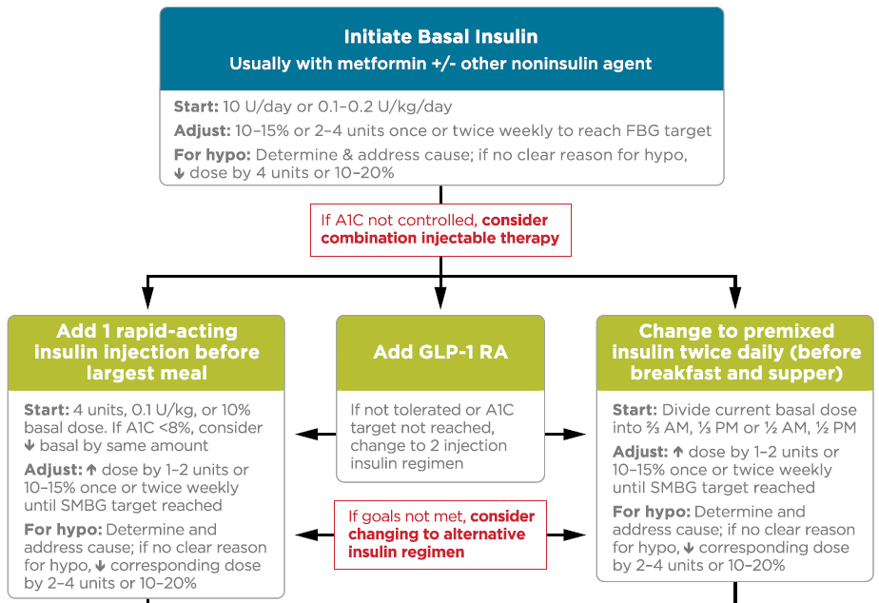

Slide 36
Thanks For Your Attention

