Slide 1
In the name of god
Mohammad Nabi Sanaee

Slide 2
Case:
Patient is a 31 years old female from Mazandaran who developed with gradually progressive back pain since 3 years ago after her last pregnancy, in workups multiple vertebral fractures and osteoporosis was detected and treatment started.

Slide 3
Past medical history:
Not any significant dx.
Neg. history of fracture
Neg. history of renal stone
Normal growth and development in childhood
Puberty started at age 14 with regular mensturation

Slide 4
Family history:
She has a healthy well developed 3 years old daughter
A healthy 67 years old mother without any history of fracture
Her father died due to electrical injury at age 40
And a healthy 29 years old brother
Social, Habitual and Surgical history:
Negative

Slide 5
Drug history: (since 3 years ago)
Vitamin D weekly then monthly
Calcium-D po BD
Alendronate 70mg po weekly

Slide 6
Physical exam:
BP: 90/60, H: 169cm, W: 62, BMI: 21.7
HEENT: Neg LAP, NL. Thyroid, NL. Mucosa, Flat JVP
Lung and Heart: Clear and normal sounds
Abdomen: Soft without organomeghaly or tenderness
Ext.: Normal
Neurologic Exam: MP: 5/5, DTR:2/2, Neg. Ataxia, Neg. neuropathy and sensory loss
Positive point: Multiple point tenderness at spine

Slide 7
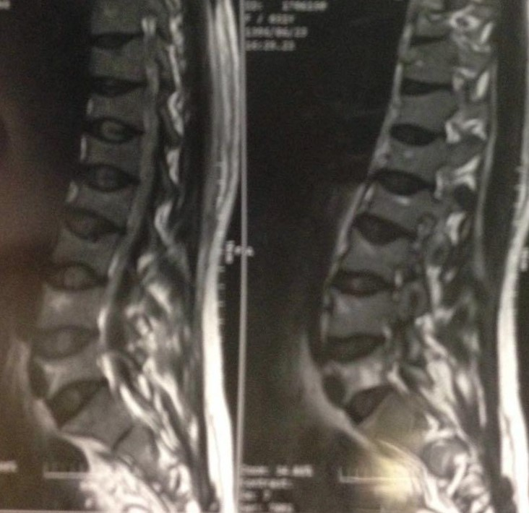
mri

Slide 8
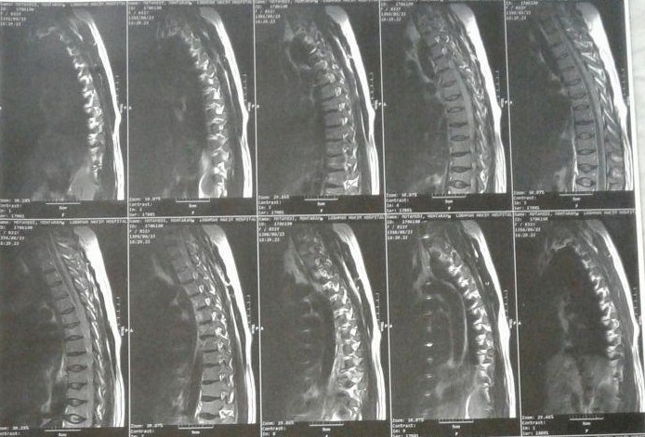

Slide 9
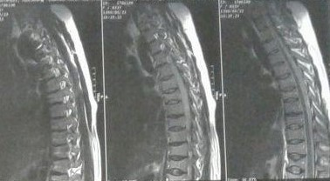

Slide 10
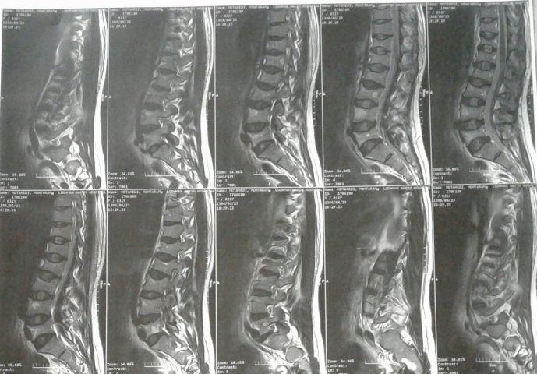

Slide 11
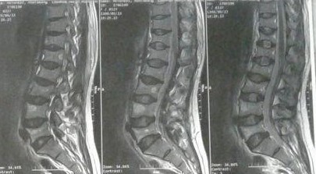

Slide 12
Report:

Slide 13
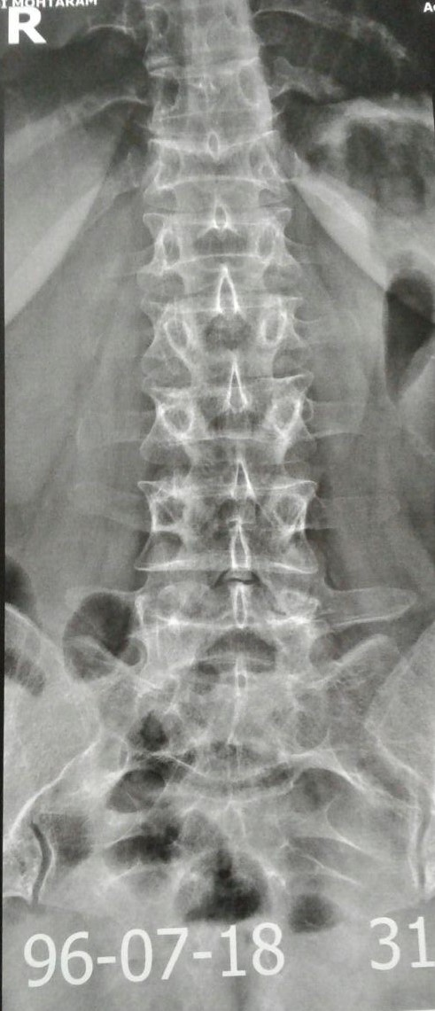
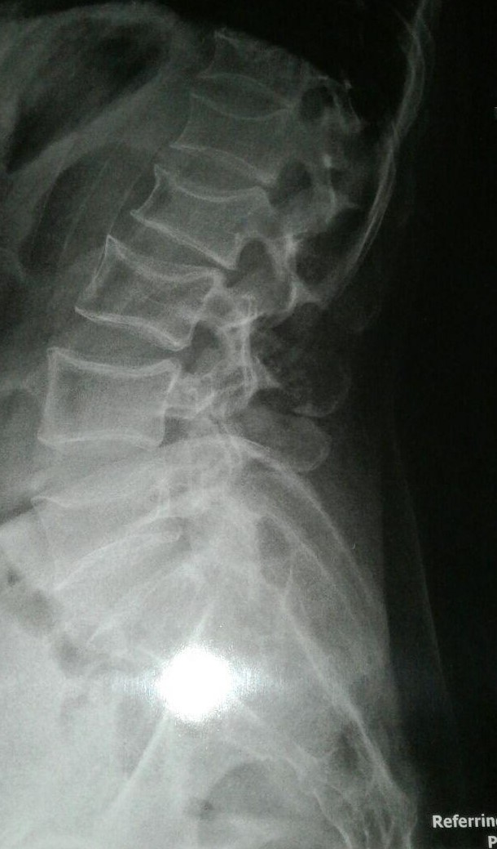
X-ray

Slide 14
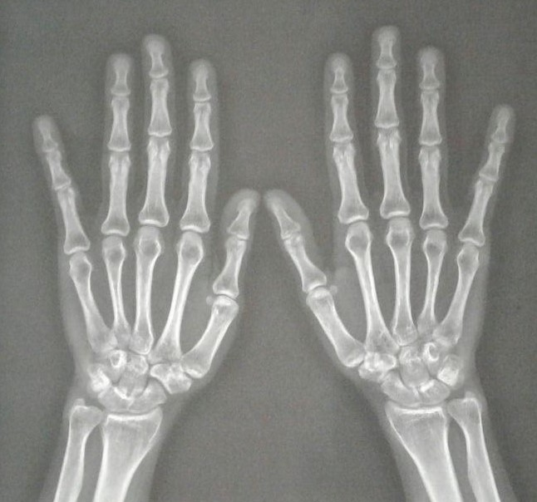

Slide 15
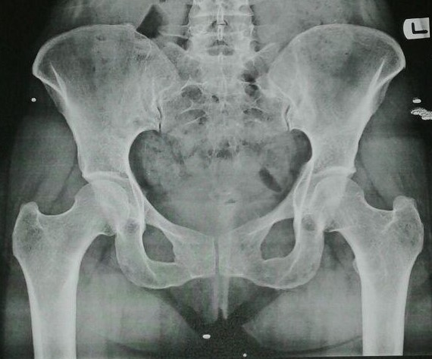

Slide 16
LAB:
96/7/17 | 96/4/26
5500 | 4800 | WBC
12/8 | 12/2 | HB
84 | 85/8 | MCV
225000 | 254000 | PLT
8 | 17 | BUN
0/7 | 1/1 | Cr
140 |  | Na
4/1 |  | K
96/7/17 | 96/4/26
86 | 103 | FBS
5/2 | 4/9 | Hb A1C
71 |  | TG
148 |  | CHOL
99 |  | LDL
40 |  | HDL
NL |  | U/A
21/1 |  | Ferritn

Slide 17
96/7/29 | 96/7/17 | 96/4/26
9/4 | 9/3 | 10/2 | Ca
4/1 | 3/8 | 5 | Ph
 | 28 | 23 | PTH
14/3 L |  |  | IPTH
 | 34 |  | ALK
 | 69/4 | 51 | 25(OH)D3
96/7/17 | 96/4/26
 | 1/5 | T3
 | 7 | T4
2/75 | 1 | TSH
20 |  | AST
15 |  | ALT
 | Neg. | CRP
 | Neg. | RF

Slide 18
96/7/29 | 96/7/17 | 96/4/26
398 | 97 |  | 24hrs Urine Ca
1.3 | 366 |  | 24hrs Urine Cr
1150 | 2150 |  | 24hrs Urine Vol.
 | 3/8 |  | 24hrs Urine Ca/Cr
 | 6 |  | 24hrs Urine Cr/Kg
 |  | Positive | Rubella Ab IgG
 |  | Negative | Rubella Ab IgM
 |  | Negative | HBS Ag
 |  | Negative | HBC Ab
 |  | Negative | HIV Ab
245 |  |  | IgA
Neg. |  |  | Anti EMA IgG
Neg. |  |  | Anti EMA IgA
1 |  |  | Anti t.T.G IgA
1/4 |  |  | Anti t.T.G IgG

Slide 19
bmd

Slide 20
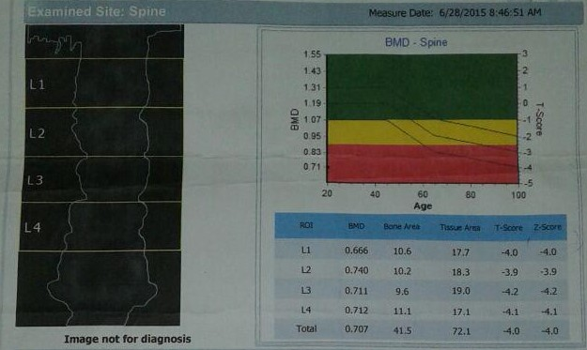
94/4/7

Slide 21
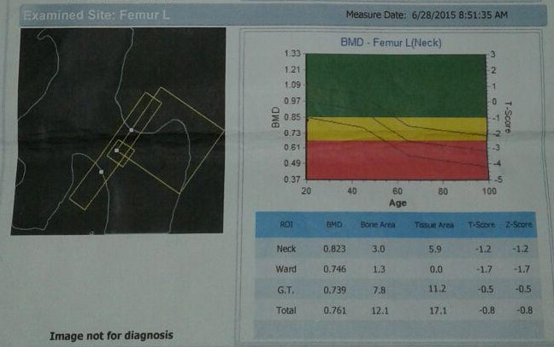

Slide 22
96/5/5

Slide 24
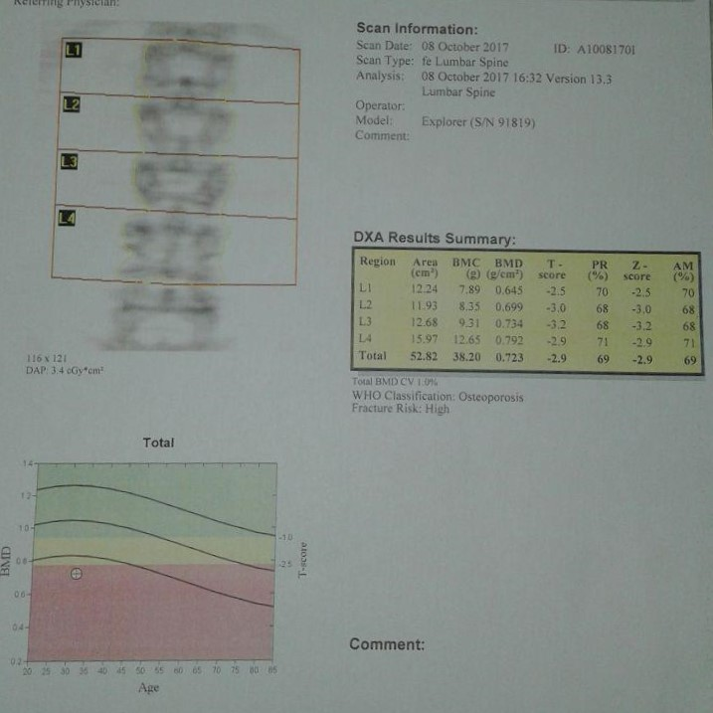
96/7/16

Slide 25
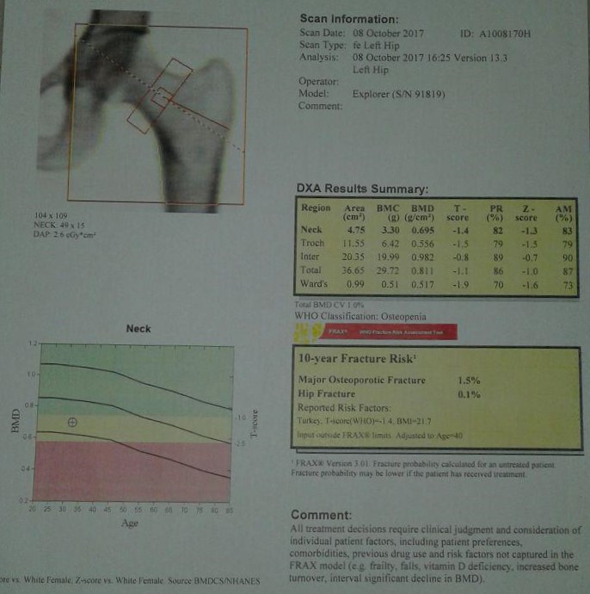

Slide 26
bmd
BMD(gr/cm2) |  | Femoral neck |  | Total femor |  | Lumbar spine |  | Date
Spine | Hip | Z.Score | T.Score | Z.Score | T.Score | Z.Score | T.Score
0/707 | 0/761 | -0/8 | -0/8 | -1/2 | -1/2 | -4 | -4 | 94/4/7 (GMI C.B.D)
0/736 | 0/803 | -2/1 | -2/2 | -2/1 | -2/2 | -3/9 | -3/9 | 96/5/5 (Osteosys, dexxum t)
0/723 | 0/811 | -1/3 | -1/4 | -1 | -1/1 | -2/9 | -2/9 | 96/7/16 (Hologic)

Slide 27
Summary:
Patient is a 31 years old female, with gradually progressive back pain since 3 years ago after her last delivery
Point tenderness on her spine at thoracic and lumbar area at exam
Multiple fractures at MRI and X-Ray
Osteoporosis at BMD
Treated with Alendronate, Ca-D, Vitamin D
Not any secondary causes detected
Primary osteoporosis is the most possible diagnosis

