Slide 2
Diabetic Neuropathy
Dr.vahideh sadra endocrinologist tabriz university of medical science

Slide 3
Diabetic polyneuropathy is the most .common neuropathy in the Western world
-Diabetic neuropathies are the most prevalent chronic complications of diabetes.
-This heterogeneous group of conditions affects different parts of the nervous system and presents with diverse clinical manifestations.
-They are among the most common long-term complications of diabetes and are a significant source of morbidity and mortality.

Slide 4
“the presence of symptoms and/or signs of peripheral nerve dysfunction in people with diabetes after the exclusion of other causes
The importance of excluding nondiabetic causes was emphasized in the Rochester Diabetic Neuropathy Study, in which up to
10% of peripheral neuropathy in diabetic patients was deemed to be of nondiabetic cause.

Slide 5
Epidemiology and classification of diabetic neuropathy

Slide 6
The true prevalence is not known and depends on the criteria and methods used .to define neuropathy

Slide 7
Clinical and subclinical neuropathy has been estimated to occur in 10 to 100 percent of diabetic patients, depending upon the diagnostic criteria and patient populations examined.
Prevalence is a function of disease duration, and a reasonable figure, based upon several large studies, is that approximately 50 percent of patients with diabetes will eventually develop neuropathy.

Slide 8
In a landmark study, over 4400 patient with diabetes were serially evaluated over 25 years Neuropathy was defined as decreased sensation in the feet and depressed or absent ankle reflexes.
The onset of neuropathy correlated positively with the duration of diabetes and, by 25 years, 50 percent of patients had neuropathy.

Slide 9
In the UKPDS trial, 3867 newly diagnosed patients with type 2 diabetes were randomly assigned to either intensive therapy (sulfonylurea or insulin) or conventional therapy (diet control) .
After ten years, absent ankle reflexes, as a sign of diabetic neuropathy, were noted in 35 and 37 percent, respectively.

Slide 10
The high rate of diabetic neuropathy results in substantial morbidity
:Including
-recurrent lower extremity infections
-ulcerations
-subsequent amputations

Slide 11
The major morbidity associated with somatic neuropathy is foot ulceration the precursor of gangrene and limb
loss.
Neuropathy increases the risk of amputation 1.7-fold overall, 12-fold if there is deformity (itself a consequence
of neuropathy), and 36-fold if there is a history of previous ulceration.

Slide 12
Once autonomic neuropathy is present, life can become quite dismal, and the mortality rate approximates 25% to 50% within 5 to 10 years.
The presence of neuropathy can severely affect quality of life, causing impaired activities of daily living, compromised physical functioning, .and depression

Slide 13
Impairment of physical functioning is associated with a 15-fold increase in the likelihood of falling and fractures, particularly in older diabetics.
Depression complicates the management
of neuropathic pain and is a predictor of
progression of neuropathy.

Slide 14
PATHOGENESIS

Slide 15
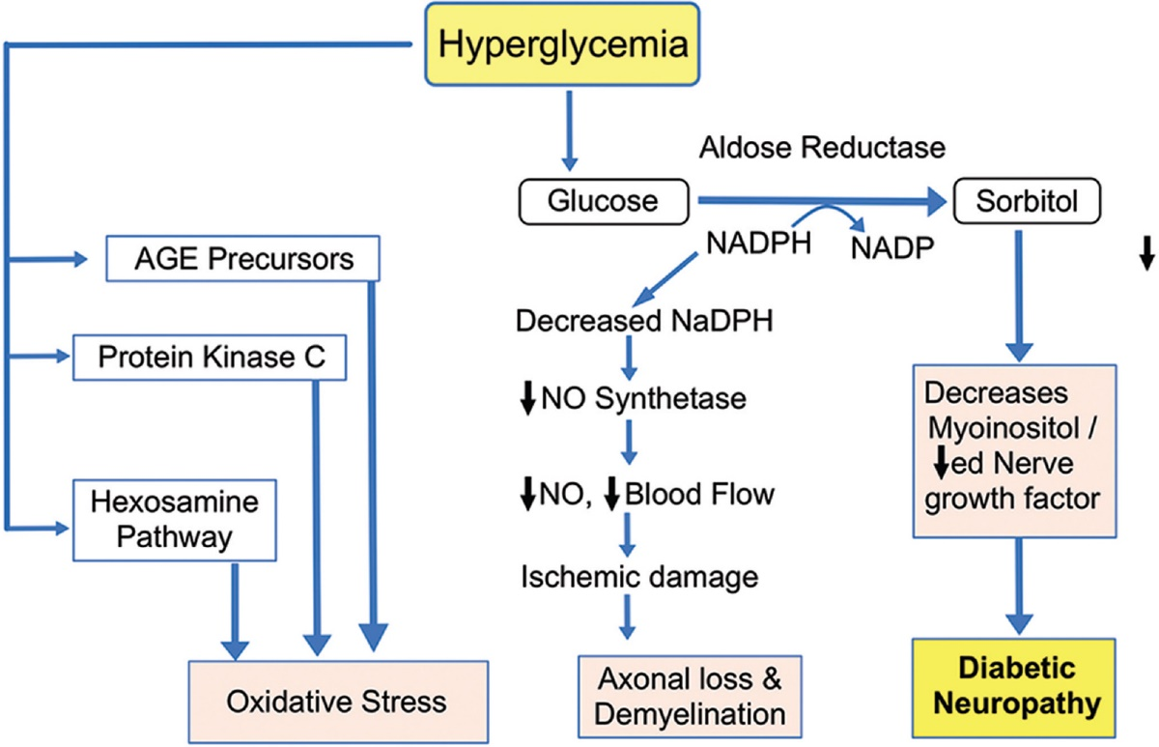

Slide 16
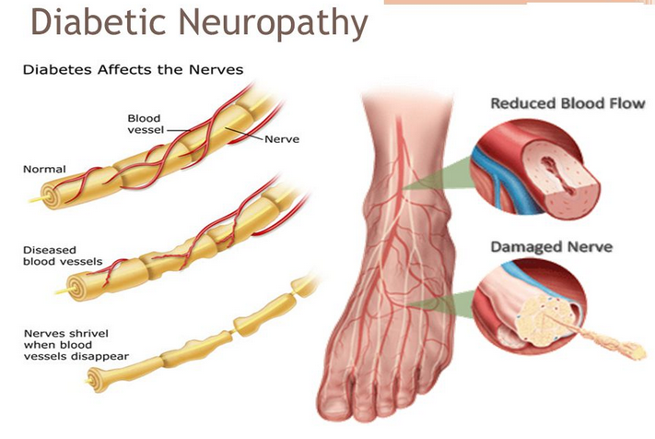

Slide 18
diabetic neuropathy
Classification

Slide 19
According to the San Antonio Convention, the main groups of neurologic disturbance in diabetes mellitus include the following:
• Subclinical neuropathy, which is determined by abnormalities in electrodiagnostic and quantitative sensory testing
• Diffuse clinical neuropathy with distal symmetric sensorimotor and autonomic syndromes
• Focal syndromes

Slide 24
n engl j med 374;15 nejm.org April 14, 2016

Slide 25
Natural History
The natural history of neuropathies separates them into
two distinct entities:
those that progress gradually with increasing duration of diabetes and those that remit, usually completely.
Sensory and autonomic neuropathies typically progress.
Although the symptoms of mononeuropathies,
radiculopathies, and acute painful neuropathies
are severe, they are short-lived, and patients tend to
recover

Slide 26
Distal symmetric polyneuropathy
the most common form of diabetic neuropathy, isa chronic, nerve-length–dependent, sensorimotor polyneuropathy that affects
at least one third of persons with type 1 or type 2 diabetes and up to one quarter of persons .with impaired glucose tolerance

Slide 27
Persons with distal symmetric polyneuropathy often have length-dependent symptoms, which usually affect the feet first and progress proximally.
The symptoms are predominantly sensory and can be classified as “positive” (tingling, burning, stabbing pain, and other abnormal sensations) or “negative” (sensory loss, weakness, and numbness)

Slide 28
Decreased or absent ankle reflexes occur early in the disease, while more widespread loss of reflexes and motor weakness are late findings

Slide 29
Symptoms and signs
The earliest signs of diabetic polyneuropathy probably reflect the gradual loss of integrity of both large myelinated and small myelinated and unmyelinated nerve fibers:
Loss of vibratory sensation and altered proprioception reflect large-fiber loss
Impairment of pain, light touch and temperature is secondary to loss of small fibers

Slide 30
Complications —
Diabetic polyneuropathy is frequently insidious in onset and can lead to formation of foot ulcers and muscle and joint disease.
Progressive sensory loss predisposes to ulcer formation. Foot ulcers are usually classified into two groups:
acute ulcers secondary to dermal abrasion from poorly fitting shoes
chronic plantar ulcers occurring over weight-bearing areas.
Chronic ulceration is probably multifactorial, due to a combination of diabetic neuropathy (with decreased pain sensation), autonomic dysfunction and vascular insufficiency.

Slide 31
Distal motor axonal loss results in atrophy of intrinsic foot muscles and an imbalance between strength in toe extensors and flexors.
This ultimately leads to chronic metatarsal-phalangeal flexion (claw-toe deformity) which shifts weight to the metatarsal heads. This weight shift results in formation of calluses that can fissure, become infected and ulcerate. There may also be other arthropathic changes including collapse of the arch of the midfoot and bony prominences, leading to Charcot arthropathy, fragmentation and sclerosis of bone, new bone formation, subluxation, dislocation, and stress fractures.

Slide 32
Screening
All patients should be assessed for diabetic peripheral neuropathy starting at diagnosis of type 2 diabetes and 5 years after the diagnosis of type 1 diabetes and at least annually thereafter. B
Symptoms and signs of autonomic neuropathy should be assessed in patients with microvascular complications. E
Diabetes Care 2019;42(Suppl. 1):S124–S138 | https://doi.org/10.2337/dc19-S011

Slide 34
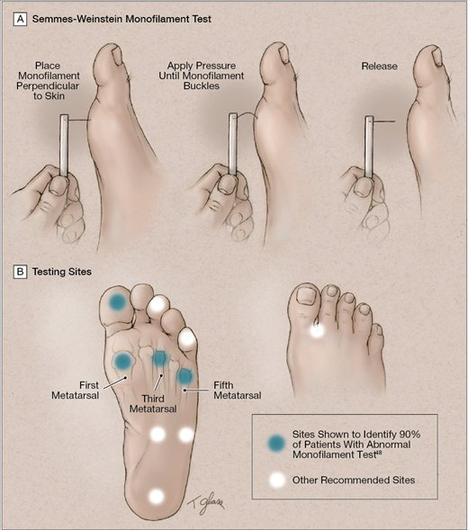

Slide 35
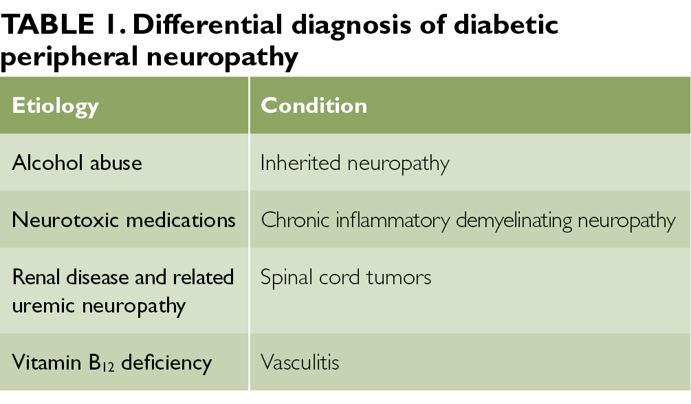

Slide 36
Objective testing for neuropathy (including quantitative sensory testing, measurement of nerve-conduction velocities, and tests of autonomic function) is required to make a definitive diagnosis of neuropathy, although it is not essential for clinical care.
Laboratory studies
thyrotropin level,
a complete blood count,
serum levels of folate and vitamin B12 (metformin has been associate with vitamin B12 deficiency),
Serum immunoelectrophoresis, the results of which are
often abnormal in patients with chronic inflammatory
Demyelinating polyneuropathy.

Slide 37
Proximal Motor Neuropathies.
The condition has a number of synonyms:
Proximal neuropathy, femoral neuropathy, diabetic amyotrophy, and diabetic neuropathic cachexia.
It primarily affects the elderly.
Its onset, which can be gradual or abrupt, begins with pain in the thighs and hips or buttocks, followed by significant weakness of the proximal muscles of the lower limbs with inability to rise from the sitting position (positive Gower maneuver).
The neuropathy begins unilaterally, spreads bilaterally, and coexists with DSPN and spontaneous muscle .fasciculation It can be provoked by percussion

Slide 39
Focal Neuropathies
Mononeuropathies occur primarily in the older population.
Their onset is usually acute and associated with pain,
and their course is self-limited, resolving within 6 to
8 weeks.
Mononeuropathies result from vascular obstruction
after which adjacent neuronal fascicles take over the
function of those infarcted.
Mononeuropathies must be distinguished from entrapment syndromes, which start slowly, progress, .and persist without intervention

Slide 41
Acute Painful Neuropathy
Some patients develop a predominantly small-fiber neuropathy,which is manifested by pain and paresthesias early in the course of diabetes.
It may be associated with the onset of insulin therapy and has been termed insulin neuritis.
By definition, it has been present for less than 6 months.
Symptoms often are exacerbated at night and are manifested in the feet more than the hands.
Spontaneous episodes of pain can be severely disabling.

Slide 42
Chronic Painful Neuropathy
Chronic painful neuropathy is another variety of painful
polyneuropathy.
Onset is later, often years into the course of the diabetes; pain persists for longer than 6 months and becomes debilitating.
This condition can result in tolerance to narcotics and analgesics, finally resulting in addiction.
It is extremely resistant to all forms of intervention and is most frustrating to both patient and physician.

Slide 43
Autonomic Neuropathies

Slide 46
Clinical Management
-Control of Hypergylcemia
-Pharmacologic Therapy

Slide 47
Lifestyle interventions may prevent or possibly reverse neuropathy.
Among patients with neuropathy associated with impaired glucose tolerance, a diet and exercise regimen was shown to be associated with increased intraepidermal nerve-fiber .density and reduced pain

Slide 48
Control of Hypergylcemia
Retrospective and prospective studies have suggested a relationship between hyperglycemia and the development and severity of diabetic neuropathy.
The DCCT Research Group4 reported significant effects
of intensive insulin therapy on prevention of neuropathy.
The prevalence rates for clinical or electrophysiologic evidence of neuropathy were reduced by 50% in those treated by intensive insulin therapy during 5 years.

Slide 49
conventional insulin therapy had a 76% lower incidence of retinopathy, a 54% lower incidence of nephropathy, and
a 60% reduction in neuropathy.

Slide 50
In the UKPDS, control of blood glucose was associated with improvement in vibration perception.
Similar to what was found in the DCCT
The follow-up study to the DCCT, the EDIC study, has
shown that, despite convergence of A1c levels with time,
the advantage accrued to the intensively controlled people
.during the course of the study persists

Slide 51
Pharmacologic Therapy

Slide 52
Topical Capsaicin
Capsaicin is extracted from chili peppers, and
a simple, cheap mixture can be made by adding 1 to 3 teaspoons (15 to 45 mL) of cayenne pepper to a jar of cold cream and applying the cream to the area of pain.
Capsaicin has high selectivity for a subset of sensory neurons that have been identified as unmyelinated C-fiber afferent or thinmyelinated (Aδ) fibers.

Slide 53
α-Lipoic Acid
Lipoic acid (1,2-dithiolane-3-pentanoic acid),
a derivative of octanoic acid, is present in food and is synthesized by the liver.
It is a natural cofactor in the pyruvate dehydrogenase complex, where it binds acyl groups and transfers them from one part of the complex to another.

Slide 54
The results of this meta-analysis provide evidence that treatment with ALA (300–600 mg/day i.v. for 2–4 weeks) is safe and that the treatment can significantly improve both nerve conduction velocity and positive neuropathic symptoms.
However, the evidence may not be strong because most of the studies included in this meta-analysis have poor .methodological quality

Slide 55
Anticonvulsants
Gabapentin and pregabalin are α2δ2 voltage-gated
calcium modulators that are frequently used to
treat painful diabetic neuropathy.
These agents relieve pain by means of direct mechanisms and by improving sleep. In contrast to gabapentin
pregabalin has linear and dose-proportional
absorption in the therapeutic dose range (150 to
600 mg per day); it also has a more rapid onset
of action than gabapentin and a more limited
dose range that requires less adjustment.
Gabapentin requires gradual adjustment to the dose
that is usually clinically effective (1800 to 3600 mg
per day).

Slide 56
Topiramate
has also been shown to reduce the intensity of pain and to improve sleep;
studies indicate that it stimulates the growth
of
intraepidermal nerve fibers.
Unlike pregabalin and gabapentin, which can cause weight gain, topiramate causes weight loss, which has been accompanied by improvements in lipid level and blood pressure and increases in the density
of intraepidermal nerve fibers of 0.5 to 2.0
fibers per millimeter per year, as compared with
a decline of 0.5 to 1.0 fibers per millimeter per yearin untreated patients.

Slide 57
Tricyclic Antidepressants
Tricyclic antidepressants may offer substantial relief from neuropathic pain through mechanisms that are unrelated to their anti depressan effects. However, their use is often limited by
adverse cholinergic effects such as blurred vision,
dry mouth, constipation, and urinary retention,
particularly in elderly patients.
The secondary amines, nortriptyline and desipramine,
tend to have less bothersome anticholinergic
effects than amitriptyline or imipramine and are generally preferred.
Tricyclic antidepressants should be used with caution in patients
with known or suspected cardiac disease; electrocardiography
should be performed before these drugs are initiated to rule out the presence of QT-interval prolongation and rhythm disturbances

Slide 58
Serotonin–Norepinephrine Reuptake Inhibitors
The serotonin–norepinephrine reuptake inhibitors
(SNRIs) venlafaxine and duloxetine have proved to be effective in relieving neuropathic pain;
duloxetine has also been shown to improve
quality of life.
These agents inhibit reuptake of both serotonin and norepinephrine without the muscarinic, histamine-related, and adrenergic side effects that accompany the .use of the .tricyclic antidepressants

Slide 59
Recommendations
Consider either pregabalin or duloxetine as the initial approach in the symptomatic treatment for neuropathic pain in diabetes. A

Slide 60
Gabapentin may also be used as an effective initial approach, taking into account patients’ socioeconomic status, comorbidities, and
potential drug interactions. B
Although not approved by the U.S. Food and Drug Administration, tricyclic antidepressants are also effective for neuropathic pain in
diabetes but should be used with caution given the higher risk of serious side effects. B

Slide 61
Coexisting Conditions and Choice of Therapy
Coexisting conditions, including sleep loss, depression,
and anxiety, should be considered in
choosing therapy. In contrast to duloxetine,
which increases fragmentation of sleep,
pregabalin and gabapentin have been shown to
improve the quality of sleep, both directly and
through relief of pain; the response to treatment
with pregabalin correlates with the degree of
sleep loss before treatment

Slide 62
An SNRI or a tricyclic antidepressant may be preferred in patients with depression.
Pregabalin, gabapentin, or an SNRI may be appropriate choices for patients with anxiety, although gabapentin and pregabalin may cause .weight gain

Slide 63
Opioid Analgesics
Opioids may be effective in the treatment of
neuropathic pain caused by distal symmetric
polyneuropathy. However, given the attendant
risks of abuse, addiction, and diversion, opioids should generally be used only in selected cases and only after other medications have failed to be effective.

Slide 64
Tramadol, an atypical opiate analgesic,
also inhibits the reuptake of norepinephrine
and serotonin and provides effective pain
relief.
This drug also has a lower potential for
abuse than other opioids.
Extended-release tapentadol
has similar actions and has been approved
for the treatment of diabetic neuropathic
pain by the Food and Drug Administration.

Slide 65
Given the high risks of addiction and other complications, the use of opioids, including tapentadol or tramadol, is not recommended
as first- or second-line agents for
treating the pain associated with
DSPN. E

Slide 67
Key clinical points
The diabetic neuropathies are a heterogeneous group of disorders with diverse clinical manifestations.
The early recognition and appropriate management of neuropathy in the patient with diabetes is important.
Diabetic neuropathy is a diagnosis of exclusion. Nondiabetic neuropathies
may be present in patients with diabetes and may be treatable.
Recognition and treatment of autonomic neuropathy may improve
symptoms, reduce sequelae, and improve quality of life.
Optimize glucose control to prevent or delay the development
of neuropathy in patients with type 1 diabetes A and to slow the progression of neuropathy in patients with type 2 diabetes
Pregabalin, duloxetine, or gabapentin are recommended as initial pharmacologic treatments for neuropathic pain in diabetes.

Slide 68
THANK YOU
THANK YOU

