Slide 1
Diabetic Foot Infection
Zahra Ghasem Zadeh
Fellow of endocrinology
Research Institute for Endocrine Sciences Shahid Beheshti University of Medical Sciences
Azar 93

Slide 2
A retrospective study (between 1979-2001) in Tehran university of medical sciences determined that over the 22-year period of the study, 281 patients (61% men and 39% women) were hospitalized for diabetic foot ulcers.
The overall lower limb amputation rate was 30%. Mean hospital stay
The rate of lower limb amputation secondary to diabetic foot ulcer is higher in Iran than the global average.
Mean duration of hospital admission for diabetic foot was 4 weeks, amputation rate was 40% in 1995 and decreased to 14% in 2001.
Survival of amputee patients' life expectancy following amputation was 4.32 years in a study
Abol Hassani F, Mohajeri Tehrani MR, Tabatabaei O, Larijani B - Iran J Diabetes and Lipid Disord 2005; 5:35-48

Slide 3
Bacteriological Study of Diabetic Foot Infections at an Iranian Hospital
A total of 77 patients with diabetic foot infection who were referred to the surgery ward of Taleghani Hospital between 2007 and 2009 were included in this study. The samples obtained from these patients included ulcers curettages, abscesses, and deep-tissue needle aspirates. Standard identification tests and antimicrobial susceptibility testing using disc diffusion method were performed for all the isolated strains.
Staphylococcus aureus, coagulase-negative Staphylococci (CoNS), and Escherichia coli were the most common bacterial species.
Antibiotic susceptibility analysis of S. aureus and Staphylococcus epidermidis showed that all strains were methicillin resistant; a majority of the isolates of S. aureus were sensitive to vancomycin and imipenem.

Slide 4
Clinical microbiology study of diabetic foot ulcer in Iran; pathogens and antibacterial susceptibility
This was a one-year cross sectional study on diabetic patients with infected diabetic foot ulcer at Shariati Teaching Hospital, Tehran, Iran.
Total of 546 pathogens were isolated from 165 ulcers of 149 patients. Gram positive aerobes including Enterococcal species and methicillin resistant Staphylococcus aureus (S. aureus) (21.4 and 19.4%, respectively) were identified as the most common pathogens followed by Gram negative isolates including Escherichia coli and Pseudomonasaeruginosa (12.6 and 5.4%, respectively).
The majority of wounds were classified as Wagner grades 2 and 3 (15.7 and 75.7%). Appropriate empiric treatment to cover both these Gram positive and Gram negative pathogens is crucially important.

Slide 5
Diabetic Foot: Infections and Outcomes in Iranian Admitted Patients
Patients and Methods: All patients with diabetic foot infection admitted to the infectious diseases, surgery and endocrinology wards of two teaching hospitals from 2007 to 2010 (n = 196) were recruited. In this retrospective study, demographic characteristics, type of lesions, history of hospitalization/antibiotic therapy, isolated microorganisms, clinical complications, administered treatment (medical or surgical) and outcome were recorded.
Results: Patients’ mean age was 60.84 (± 10.30) years. Totally, 113 (57.65%) of the patients were male and 83 (42.35%) were female. According to Wagner’s grading, deep ulcers with/without osteomyelitis accounted for the majority of lesions. A single microorganism was isolated (most common: Escherichia coli, Staphylococcus aureus and Klebsiella spp.) from 81 of the patients (80.20%); while for the remaining polymicrobial infection was reported.
The majority of patients (n = 118, 60.20%) were treated surgically; however 11 patients expired due to sepsis. Amputation (most common at toes and below the knee) was performed for 89 patients (45.40%). The response rate to medical treatment was 31.6% for single-pathogen and 10% for polymicrobial infection (with a 30% mortality rate).
Conclusions: Physicians are recommended to take microbiological cultures before starting empirical therapy recommended to cover Gram-negative microorganisms in order to lower the risk of antibiotic resistance.

Slide 6
Systemic symptoms and signs of infection
Fever ,chills, delirium, diaphoresis, anorexia, hemodynamic instability(tachycardia, hypotension),
and metabolic derangements(acidosis, dys glycemia, electrolyte abnormalities, worsening azotemia)
Laboratory markers suggesting systemic infection
leukocytosis, a left-shifted leukocyte differential, and elevated inflammatory markers .
An elevated level of procalcitonin has recently been found to be a useful adjunct to diagnosing various bacterial infections, including DFI.
procalcitonin levels (using reported cut off values of 17 mg/L) correlate more accurately with clinical evidence of infection (using the IDSA criteria) than levels of white blood cells, ESR, or CRP.
Levels of CRP and procalcitonin, especially when these values were combined, accurately distinguished clinically uninfected ulcers from those with mild or moderate infections (Jeandrot,2008)

Slide 7
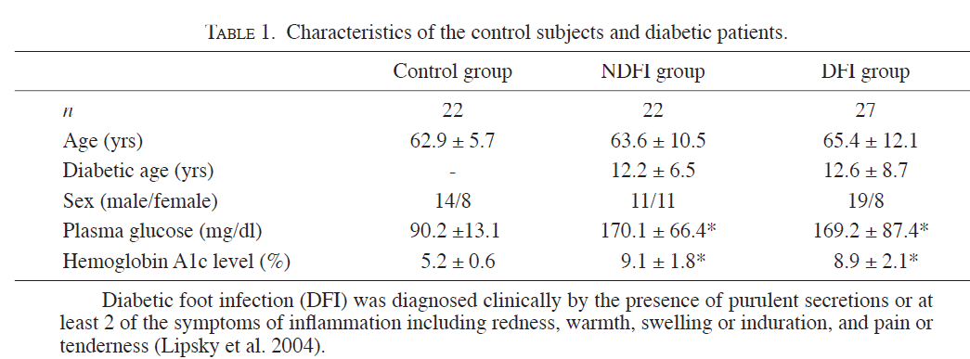
1:

Slide 10
2: Can procalcitonin predict bone infection in people with diabetes with infected foot ulcers? A pilot study
Methods: Twenty-four patients (18 male, mean age: 61.9 10.8 years) with infected foot ulcers were prospectively enrolled. Clinical characteristics of the wounds were noted. Blood samples were obtained for biochemical analysis.
Magnetic resonance imaging of the foot was performed in all patients to diagnos osteomyelitis.
Results: Osteomyelitis was found in 13 of 24 (54%) patients. PCT levels were 66.7 +-43.5 pg/ml in patients with osteomyelitis and 58.6 +- 35.5 pg/ml in patients without osteomyelitis.
The difference did not reach statistical significance ( p = 0.627).
Erythrocyte sedimentation rate, but not C-reactive protein and white blood cell count, was found significantly higher in patients with osteomyelitis.
Conclusion: In this group of patients, PCT failed to discriminate patients with bone infection. Erythrocyte sedimentation rate can be used as a marker of osteomyelitis in diabetic persons.(sen:72 ,sp:84 cut-off value for ESR was 47 mm/h.)

Slide 11
3:The Performance of Serum Inflammatory Markers for the Diagnosis and Follow-up of Patients With Osteomyelitis
The aim of this prospective study was to examine the performance of serum inflammatory markers for the diagnosis and follow-up of patients with osteomyelitis.
A total of 61 patients (age 63.1 ± 7.0 years, 45 men and 16 women, 7 with type 1 and 54 with type 2 diabetes) with untreated foot infection (34 with soft-tissue infection and 27 with osteomyelitis) were recruited.
Diagnosis of osteomyelitis was based on clinical examination and was confirmed by imaging studies (X-ray, scintigraphy, MRI).
Determination of the inflammatory markers was performed at baseline, after 1 week, after 3 weeks, and after 3 months of treatment

Slide 14
4:Can Procalcitonin Be an Accurate Diagnostic Marker for the Classification of Diabetic Foot Ulcers?
Materials and method: We evaluated PCT serum level as a marker of bacterial infection in patients with diabetic foot ulcers. Sixty patients with diabetic foot ulcers were consecutively enrolled in the study. A total of 30 patients were clinically identified as IDFU by an expert clinician, taking as criteria for purulent discharges or at least two of manifestations of inflammation including warmth, redness, swelling and pain.
Results:. The area under the receiver operating characteristic curve for ESR was the greatest (0.967; P < 0.001), followed by CRP (0.871; P < 0.001), PCT (0.729; P < 0.001), and finally WBCs (0.721; P = 0.001).
Conclusions: These results suggest that PCT can be a diagnostic marker in combination with other markers like ESR and CRP to distinguish infected from non-infected foot ulcers, when clinical manifestations are un specific.
Additional research is needed before the routine usage of PCT to better define the role of PCT in IDFU
 | Cut off | Sensitivity | Specificity
ESR | 40.5mm/h | 90 | 94
CRP | 7.1mg/dl | 80 | 74
PCT | 0.21 | 70 | 74
WBC | 7.7*10/l | 66 | 67

Slide 15
Infectious Diseases Society of America and International Working Group on the Diabetic Foot Classifications of Diabetic Foot Infection
Clinical Manifestation of Infection | PEDIS Grade | IDSA Infection Severity
No symptoms or signs of infection | 1 | Uninfected
Infection present, as defined by the presence of at least 2 of the following items: • Local swelling or induration • Erythema • Local tenderness or pain • Local warmth • Purulent discharge (thick, opaque to white or sanguineous secretion)
Local infection involving only the skin and the subcutaneous tissue (without involvement of deeper tissues and without systemic signs as described below). If erythema, must be >0.5 cm to ≤2 cm around the ulcer. Exclude other causes of an inflammatory response of the skin (eg, trauma, gout, acute Charcot neuro-osteoarthropathy, fracture, thrombosis, venous stasis). | 2 | Mild
Local infection (as described above) with erythema > 2 cm, or involving structures deeper than skin and subcutaneous tissues (eg, abscess, osteomyelitis, septic arthritis, fasciitis), and No systemic inflammatory response signs (as described below) | 3 | Moderate
Local infection (as described above) with the signs of SIRS, as manifested by ≥2 of the following: • Temperature >38°C or <36°C • Heart rate >90 beats/min • Respiratory rate >20 breaths/min or PaCO2 <32 mm Hg • White blood cell count >12 000 or <4000 cells/μL or ≥10% immature (band) forms | 4 | Severe

Slide 16
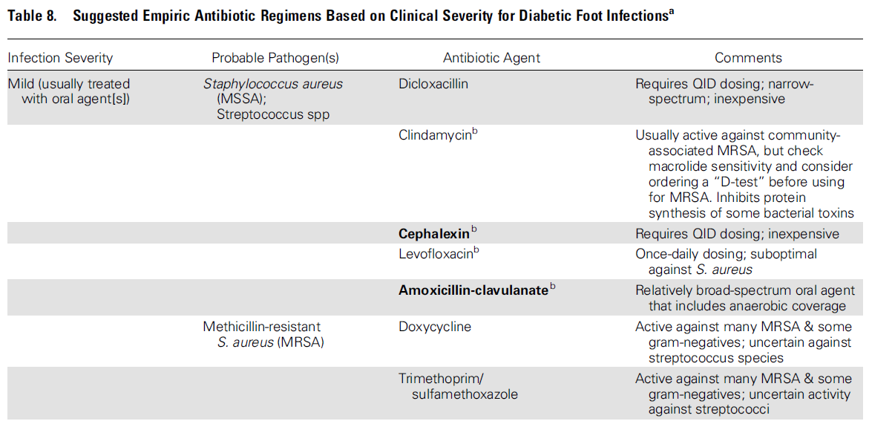

Slide 17
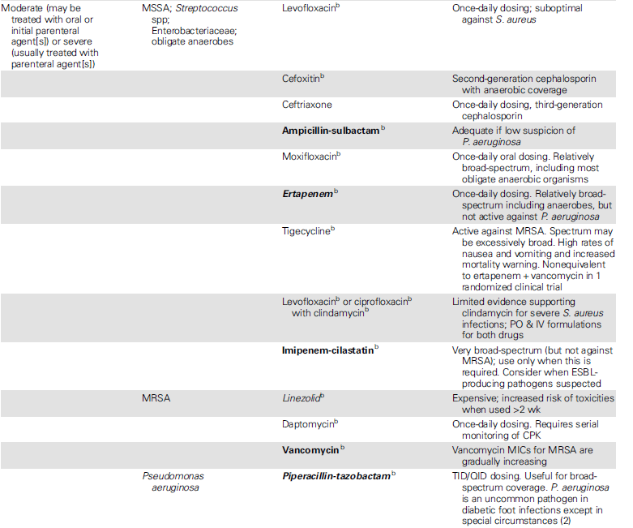

Slide 18
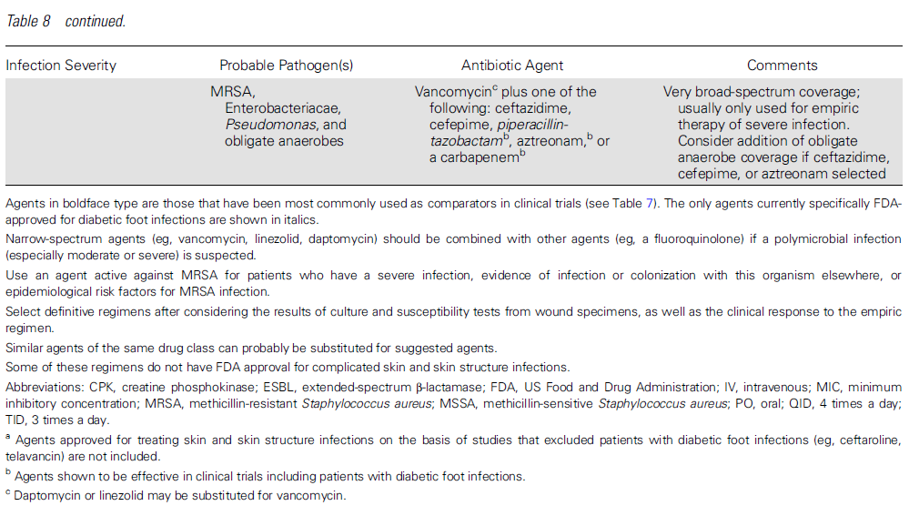

Slide 19
1)Risk factors for developing osteomyelitis in patients with diabetic foot wounds
Methods: We enrolled consecutive persons with diabetes who presented to a managed-care diabetes disease management program. The patients underwent standardized assessments. We monitored for all foot complications, defined infections by criteria consistent with IWGDF , and defined osteomyelitis as a positive culture from a bone specimen.
Results: 1666 persons were enrolled, 50% male, mean age 69 years. Over a mean of 27.2 months of follow-up, 151 patients developed foot infections, 30 (19.9%) of which involved bone. Independent risk factors for osteomyelitis were: wounds that extended to bone or joint (relative risk [RR] = 23.1), previous history of a wound prior to enrollment (RR=2.2), and recurrent or multiple wounds during the study period (RR = 1.9).
Conclusions: In this study population, managed in a specialized diabetic foot care center, the results suggest that independent risk factors for developing osteomyelitis are deep, recurrent and multiple wounds. These results may help clinicians target their efforts at diagnosing foot osteomyelitis to the highest risk patients

Slide 20
2)Controversies regarding radiological changes and variables predicting amputation in a surgical series of diabetic foot osteomyelitis
Methods: Data of patients included in a prospective cohort who underwent surgical treatment for definitive osteomyelitis were analyzed. Cases were classified according to radiological changes as ‘‘early osteomyelitis’’ when no radiological changes were found or in cases showing periosteal elevation and/or subcortical demineralization and/or cortical disruption. Cases showing sequestra and/or gross bone destruction were classified as ‘‘advanced osteomyelitis’’.
Results: Early osteomyelitis was defined according to radiological findings in 37 cases (45.7%) and advanced in 44 (54.3%). Advanced osteomyelitis was not associated with the risk of undergoing amputation.
Conclusions: The bone changes seen in simple X-rays in cases of osteomyelitis do not have any prognostic value when surgical treatment is undertaken. The outcomes are more related to soft tissue involvement than bone destruction seen in simple X-rays.

Slide 21
3) Diagnostic Accuracy of the Physical Examination and Imaging Tests for Osteomyelitis Underlying Diabetic Foot Ulcers: Meta-Analysis
Accurate diagnosis of osteomyelitis underlying diabetic foot ulcers is essential to optimize outcomes. We undertook a meta-analysis of the accuracy of diagnostic tests for osteomyelitis in diabetic patients with foot ulcers.
The presence of exposed bone or a positive probe-to-bone test result is moderately predictive of osteomyelitis.
MRI is the most accurate imaging test for diagnosis of osteomyelitis.
 | sensitivity | specificity | OR
PTB | 0.6 | 0.91 | 49.45
Radiography | 0.54 | 0.68 | 2.84
MRI | 0.90 | 0.79 | 24.36
Bone scan | 0.81 | 0.28 | 2.10
Leukocyte scan | 0.74 | 0.68 | 10.07

Slide 22
4) Does This Patient With Diabetes Have Osteomyelitis of the Lower Extremity?
MEDLINE search of English-language articles published between 1966 and March 2007 related to osteomyelitis in patients with diabetes.
Of 279 articles retrieved,21 form the basis of this review. Data from a single high-quality meta-analysis were used to summarize the diagnostic characteristics of MRI in osteomyelitis.
Conclusions An ulcer area larger than 2 cm2, a positive probe-to-bone test result, an erythrocyte sedimentation rate of more than 70 mm/h, and an abnormal plain radiograph result are helpful in diagnosing the presence of lowe extremity osteomyelitis in patients with diabetes.
No single historical feature or physical examination reliably excludes osteomyelitis.

Slide 23
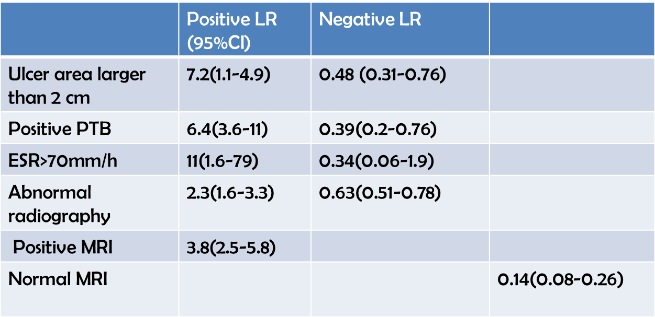

Slide 24
5) Outcome of Diabetic Foot Osteomyelitis Treated Nonsurgically
OBJECTIVE— The purpose of this article was to identify criteria predictive of remission in nonsurgical treatment of diabetic foot osteomyelitis.
RESEARCH DESIGN AND METHODS— Diabetic patients who were initially treated without orthopedic surgery for osteomyelitis of the toe or metatarsal head of a nonischemic foot between June 2002 and June 2003 in nine French diabetic foot centers were identified, and their medical records were reviewed. Remission was defined as the absence of any sign of infection at the initial or contiguous site assessed at least 1 year after the end of treatment. A total of 24 demographic, clinical, and therapeutic variables including bone versus swab culture– based antibiotic therapy were analyzed.
RESULTS— Fifty consecutive patients aged 62.2 11.1 years (mean SD) with diabetes duration of 16 10.9 years were included. The mean duration of antibiotic treatment was 11.5 4.21 weeks. Bone biopsy was routinely available in four of the nine centers. Overall patient management was similar in the different centers except for the use of rifampin, which was recorded more frequently in patients from centers in which a bone biopsy was available. At the end of a 12.8-month post treatment mean follow-up, 32 patients (64%) were in remission. Bone culture– based antibiotic therapy was the only variable associated with remission, as determined by both univariate (18 of 32 [56.3%] vs. 4 of 18 [22.2%], P 0.02) and multivariate analyses (odds ratio 4.78 [95% CI 1.0 –22.7], P 0.04).
CONCLUSIONS— Bone culture– based antibiotic therapy is a factor predictive of success in
diabetic patients treated nonsurgically for osteomyelitis of the foot.

Slide 25
VIII. How should I diagnose and treat osteomyelitis of the foot in a patient with diabetes
Clinicians should consider osteomyelitis as a potential complication of any infected, deep, or large foot ulcer , especially one that is chronic or overlies a bony prominence
DFO may be present in up to 20% of mild to moderate infections and in 50%–60% of severely infected wounds
The criterion standard for diagnosing osteomyelitis is isolation of bacteria from a reliably obtained sample of bone (using measures to minimize contamination) concomitant with histological findings of inflammatory cells and osteonecrosis.
Culture of the bone specimen may be falsely negative because of sampling errors, prior antibiotic therapy or inability to culture fastidious organisms;
they may also be falsely positive because of contamination by wound-colonizing flora or skin commensals
IWGDF proposed consensus diagnostic criteria for defining osteomyelitis in the diabetic foot, stratified into 4 categories based on the results of clinical, imaging, and bone sampling methods (ranging from unlikely [<10% posttest probability], through possible [10%–50%], probable [51%–90%], and definite [>90%])

Slide 26
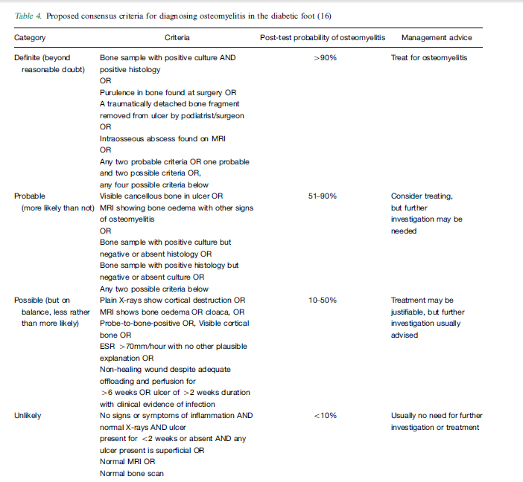

Slide 27
should suspect osteomyelitis in a patient with an adequate blood supply to the affected foot when an ulcer, especially if it is deep, does not heal after at least 6 weeks of appropriate wound care and off-loading.
Both the presence of any exposed bone and ulcer area larger than 2 cm2 increase the likelihood of osteomyelitis
clinical and laboratory findings (ulcer depth >3 mm or CRP >3.2 mg/dL, or ESR >60 mm/hour) is likely to help differentiate osteomyelitis from cellulitis
We suggest doing a PTB test for any DFI with an open wound. When properly conducted and interpreted, it can help to diagnose (when the likelihood is high) or exclude (when the likelihood is low) DFO (strong, moderate).
a positive PTB test is not specific for osteomyelitis, but this diagnosis is unlikely if the PTB test is negative .
The main value of bone biopsy is to provide reliable data on the organisms responsible for the infection and to determine their profile of susceptibility to antimicrobial agents

Slide 28
In almost all reported DFO series, S. aureus is the most common pathogen, followed by Staphylococcus epidermidis
Among the gram-negative bacilli, Escherichia coli, Klebsiella pneumoniae, and Proteus species are the most common pathogens, followed by P. aeruginosa.
The frequency of isolation of obligate anaerobes (mostly Peptostreptococcus, Peptococcus, and Finegoldia magna) is low, but depends on the method by which the bone fragments are sampled and transported to the laboratory.
An increasing prevalence of multiresistant bacteria, already established for soft tissue infections of the diabetic foot, has also been reported for DFO
report success rates of 75% in the empiric treatment of DFO

Slide 29
If MRI is unavailable, contraindicated, or difficult following protocol should suffice:
If the plain radiograph has changes suggestive of osteomyelitis (cortical erosion, active periosteal reaction, mixed lucency, and sclerosis), treat for presumptive osteomyelitis, after obtaining appropriat specimens for culture.
If the radiographs show no evidence of osteomyelitis, treat the patient with antibiotics for up to 2 weeks if there is soft tissue infection, in association with optimal care of the wound and off-loading.
Perform repeat radiographs of the foot 2–4 weeks after the initial radiographs.
If these repeat bone radiographs remain normal but suspicion of osteomyelitis remains:
Where the depth of the wound is decreasing and the PTB test is negative, osteomyelitis is unlikely
Where the wound is not improving or the PTB test is positive, 1 of the following choices should be considered:
preferably MRI. If results are negative, osteomyelitis is unlikely.
Bone biopsy for culture and histology.
Empiric treatment: Provide antibiotic therapy (based on any available culture results, and always covering at least for S. aureus) for another 2–4 weeks and then perform radiography again.

Slide 30
There are 4 situations in which nonsurgical management of osteomyelitis might be considered :
1. There is no acceptable surgical target (ie, radical cure of the infection would cause unacceptable loss of function).
2. The patient has limb ischemia caused by un reconstructable vascular disease but wishes to avoid amputation.
3. Infection is confined to the forefoot, and there is minimal soft tissue loss.
4. The patient and healthcare professional agree that surgical management carries excessive risk
No studies directly compare primarily surgical and primarily medical strategies, but nonsurgical treatment with a prolonged (3–6 months) course of antibiotics has a reported clinical success rate of 65%–80%

Slide 32
When therapy for osteomyelitis fails, clinicians should consider several possible reasons:
1. Was the original diagnosis correct?
2. Is there residual necrotic or infected bone or surgical hardware that should be resected or removed?
3. Did the selected antibiotic regimen likely cover the causative organism(s) and achieve adequate levels in bone, and was it administered for a sufficient duration?
4. Are noninfectious complications (eg, inadequate offloading of the wound or insufficient blood supply to the foot), rather than failure to eradicate bone infection, the real problem?
Selected patients may benefit from implanted antibiotic carriers (eg, poly[methyl methacrylate] beads or calcium sulfate pellets)
or from revascularization, whereas others may elect long-term or intermittent antibiotic suppression or, in some cases, amputation.

Slide 33
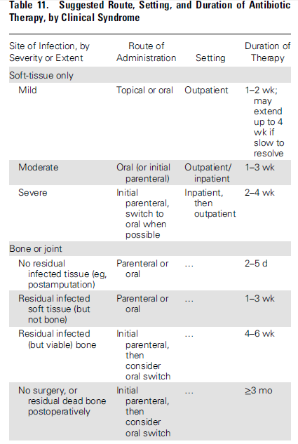

Slide 34
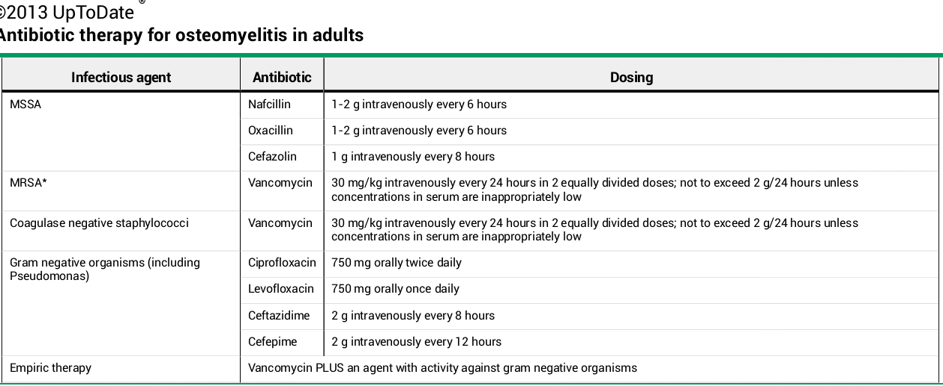

Slide 36
The most appropriate duration of therapy for any type of DFI is not well defined
It is important to consider the presence and amount of any residual dead or infected bone and the state of the soft tissues
suggestive of a response:
a decrease in previously elevate inflammatory markers (especially the ESR); resolution of any overlying soft tissue infection;
healing of any wound;
and evolution of radiographic changes that suggest healing
When a radical resection leaves no remaining infected tissue, we suggest prescribing antibiotic therapy for only a short duration (2–5 days) (weak, low).
When there is persistent infected or necrotic bone, we suggest prolonged (≥4 weeks) antibiotic treatment (weak, low).

Slide 37
IX. In which patients with a diabetic foot infection should I consider surgical intervention, and what type of procedure may be appropriate?
We suggest that nonsurgical clinicians consider requesting assessment by a surgeon for patients with a moderate or severe DFI (weak, low).
urgent surgical intervention for most foot infections accompanied by gas in the deeper tissues, an abscess, or necrotizing fasciitis,
and less urgent surgery for wounds with substantial nonviable tissue or extensive bone or joint involvement (strong, low).
vascular surgeon early on to consider revascularization whenever ischemia complicates a DFI, but especially in any patient with a critically ischemic limb (strong, moderate)

Slide 38
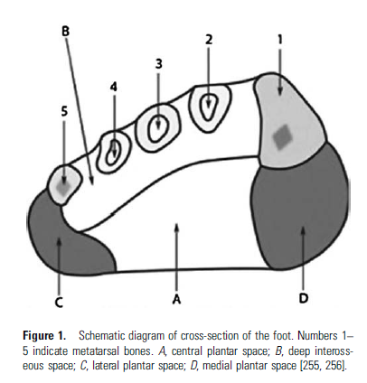
The absence of fever or leukocytosis should not dissuade the clinician from considering surgical exploration of a DFI
The most common site for a severe foot infection is the plantar surface.
A plantar wound accompanied by dorsal erythema or fluctuance suggests that the infection has passed through fascial compartments, likely requiring surgical drainage
there are between 4 and 7 compartments in the foot;
the 4 in the plantar aspect are
medial, lateral,
and central plantar
and deep plantar

Slide 39
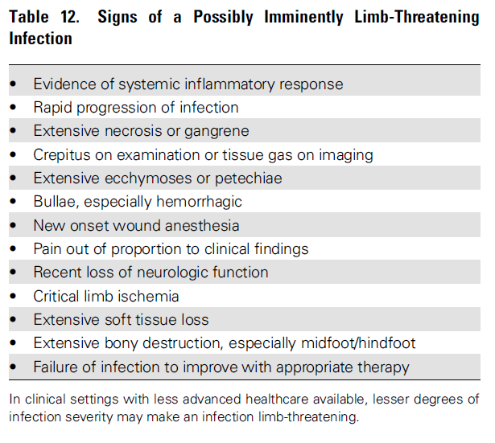

Slide 40
X. What types of wound care techniques and dressings are appropriate for diabetic foot wounds?
Clinicians should base dressing selections on the wound’s location, size, and depth, amount of exudate, presence of infection or necrosis, and the condition of the surrounding tissue.
The goal is to create a moist wound environment to promote
granulation (new tissue containing all the cellular components for epithelialization),
autolytic processes (wherein host generated enzymes help break down devitalized tissues),
angiogenesis (new blood vessel formation),
and more rapid migration of epidermal cells across the wound base
if dry, it should be hydrated;
if draining, the exudate should be absorbed;
if necrotic, it should be debrided.

Slide 41
Continuously moistened saline gauze: for dry or necrotic wounds
Hydrogels: for dry and or necrotic wounds and to facilitate autolysis
Films: for moistening dry wounds
Alginates: for drying exudative wounds
Hydrocolloids: for absorbing exudate and to facilitate autolysis
Foams: for exudative wounds
there is insufficient evidence to recommend one specific dressing type over another, but some data support the effectiveness of hydrogels
We do not advocate using topical antimicrobials for treating most clinically uninfected wounds (strong, low).

Slide 42
Debridement. Debridement involves removing necrotic or nonviable tissue, slough, or foreign material from the wound, as well as trimming any surrounding hyperkeratosis (callus).
This process also removes colonizing bacteria, aids granulation tissue formation and reepithelialization, reduces pressure at callused sites, facilitates the collection of appropriate specimens for culture, and permits examination for the presence of deep tissue (especially bone) involvement
Debridement may be relatively contraindicated in wounds that are primarily ischemic
No adjunctive therapy has been proven to improve resolution of infection, but for selected diabetic foot wounds that are slow to heal, clinicians might consider using bioengineered skin equivalents (weak, moderate), growth factors (weak, moderate,) granulocyte colony-stimulating factors (weak, moderate), hyperbaric oxygen therapy (strong, moderate), or negative pressure wound therapy (weak, low)..

