Slide 2
Long-acting Insulin Analogues
Seyed Adel Jahed, MD
Islamic Azad University, Tehran Medical Branch
23rd June 2011
RIES, Tehran, Iran

Slide 3
AGENDA
Overview On Insulin
Long-acting Insulin Analogues
Clinical Studies on Glargine and Detemir
Insulins and Cancer
What’s new?

Slide 4
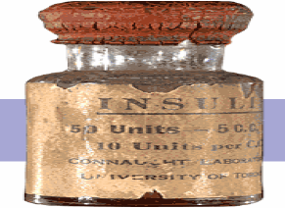
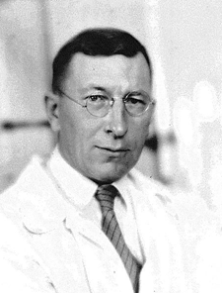
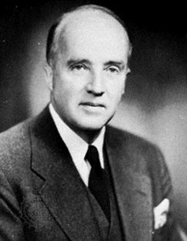
INSULIN
The most powerful agent we have to control glucose
Summer 1921, Banting and Best
Isolation of pancreatic extracts (Isletin) from dog pancreas,
Administration of Isletin to diabetic dogs

Slide 5
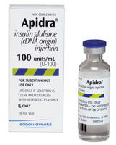
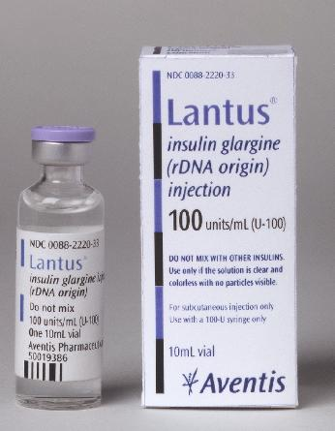
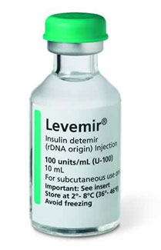
Insulin Analogues: 2000
Lispro Aspart Glulisine Glargine Detemir
June 29 , 2010 , ADA 70th Scientific Session:
Ultrarapid = Technosfer (Inhaled Insulin)
Ultralong = Degludec

Slide 6
Conventional insulins do not replicate the pattern of basal and postprandial endogenous insulin secretion
Breakfast
Lunch
Dinner
Snack
Split-mix twice-Daily
Pre-Mixed twice-Daily
Plasma levels
Time of day
Conventional insulins fail to meet the two fundamental features of normal insulin secretion

Slide 7
The new analogues are more predictable than conventional Insulins and allow simplified insulin replacement strategies.
Lispro, glulisine, or aspart or regular
μU/mL
100
Glargine
80
60
40
Normal pattern
20
0600
0800
1200
1800
2400
0600
Time of day
Detemir

Slide 8
Long Acting Insulin Analogous
Glargine & Detemir
Were designed to provide a reliable, constant basal insulin concentration to control basal metabolism.
They are more predictable than conventional insulins and allow simplified insulin-replacement strategies.

Slide 9
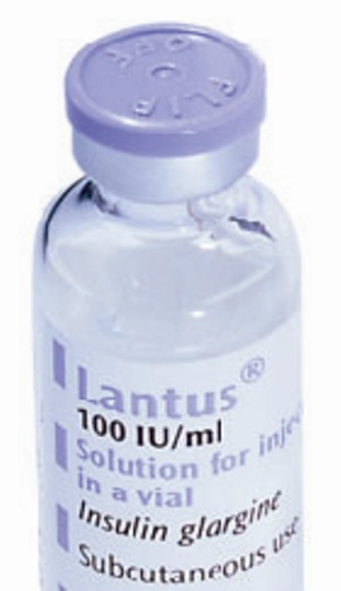
INSULIN GLARGINE
A-chain has an Asparagine to Glycine substituiation at position A21
Two positively charged Arginine are added at the C terminus of the B chain
G
l
y
-
A-Chain
Substitution
A
s
2
n
1
0
0
1
1
5
5
1
0
2
1
1
0
5
2
5
3
5
0
B-Chain
Extension
A
r
A
g
r
g

Slide 10
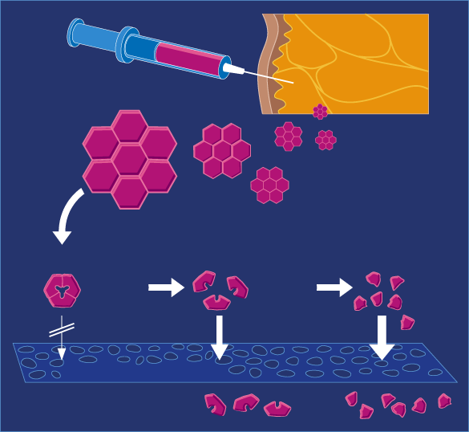
GLARGINE: Mechanism of Action
Clear Solution pH4
pH 7.4
Injection of an acidic solution (pH 4.0)
Precipitation of insulin glargine in subcutaneous tissue (pH 7.4)
Slow dissolution of free insulin glargine hexamers from micro precipitates (stabilized aggregates)
Protracted action
Precipitation
Dissolution
Hexamers
Dimers
Monomers
10⁻³ M
10⁻⁵M
10⁻⁸ M
Capillary Membrane
Insulin in Blood

Slide 11
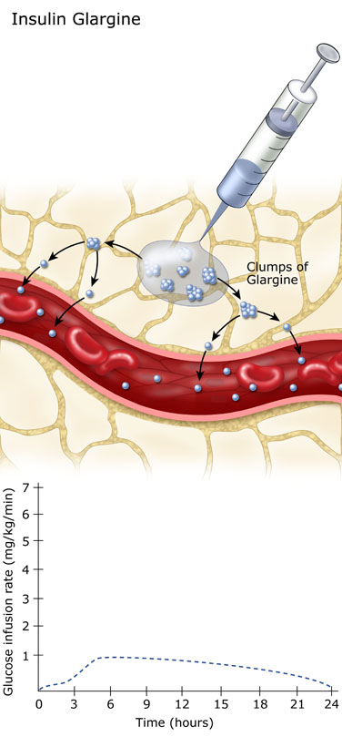
GLARGINE: PHARMACOKINETICS
Slow dissolution of the Glargine hexamers at the injection site results in a relatively constant release with no pronounced peak over a period of up to 24 hours.
Onset of action= 2 hours
Peak= flat
Duration= 24 hours

Slide 12
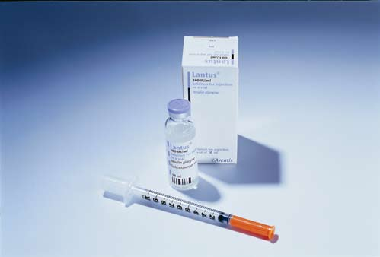
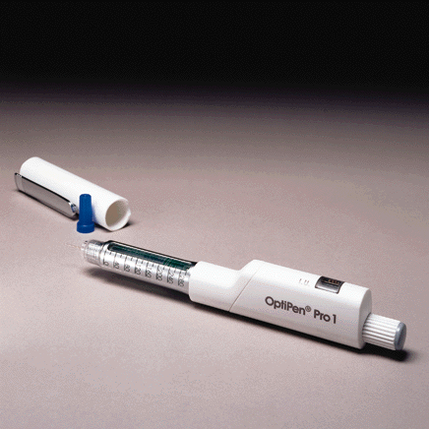
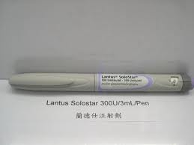
Administration of Insulin Glargine Injection
SC once a day
Not intended for intravenous administration
Must not be diluted or mixed with any other insulin or solution
Available in 10-mL vials and 3-mL Pens and cartridges for injection ( 100 IU/ml)
Notes:
Lantus® (insulin glargine) should be administered subcutaneously once daily.^{1,2} The prolonged duration of activity of Lantus is dependent on injection into the subcutaneous space.¹ Lantus is not intended for intravenous administration.¹ Intravenous administration of the usual subcutaneous dose could result in severe hypoglycaemia^{1,2}
Lantus must not be diluted or mixed with any other insulin or solution.^{1,2} If Lantus is diluted or mixed, the solution may become cloudy and the pharmacokinetic/pharmacodynamic profile (eg, onset of action, time to peak effect) of Lantus and/or the mixed insulin may be altered in an unpredictable manner¹
Lantus 100 units per mL (U 100) is available in 10-mL vials¹ and 3-mL cartridges³ for injection. Patients should be instructed on self-management procedures, including glucose monitoring, proper injection technique, and hypoglycaemia and hyperglycaemia management. As with any insulin therapy, continuous rotation of the injection site within a given area may help to reduce or prevent injection-site reactions^{1,2}
1. Lantus® (insulin glargine) US Prescribing Information. Bridgewater, NJ: Aventis Pharmaceuticals; 2002.
2. Lantus© (insulin glargine) EMEA Summary of Product Characteristics. Bridgewater, NJ: Aventis Pharmaceuticals; 2002.
3. Physicians’ Desk Reference®. Lantus® Prescribing Information. 56th ed. Montvale, NJ: Medical Economics; 2003.

Slide 13
Initial Dosing Guidelines for Insulin Glargine
Type 2 Patient
Appropriate Glargine Dosage
Initiate at 10 IU once daily , titrate appropriately
Initiate at same dosage; titrate appropriately
Reduced total daily dose by 20%-30% compared to NPH; titrate appropriately
Insulin-naïve
Switched from NPH
once daily
Switched from NPH
twice daily
Titration of Glargine to a final dose range of 2 to 100 IU is suggested
Notes:
When initiating Lantus® (insulin glargine) therapy in insulin-naïve patients with type 2 diabetes, an average dose of 10 IU once daily should be administered. Titration of Lantus to a final dose range of 2 to 100 IU is suggested¹
Patients switching from NPH once daily to Lantus should initiate Lantus therapy at the same dose and titrate the dose based on patient response¹
For patients switching from NPH twice daily, the initial dose of Lantus should be reduced by 20% to 30% to decrease the risk of hypoglycaemia. The Lantus dose should be titrated according to patient response¹
1. Lantus® (insulin glargine) EMEA Summary of Product Characteristics. Bridgewater, NJ: Aventis Pharmaceuticals; 2002.

Slide 14
Titrate basal insulin as long as FPG > target
INITIATE
Bedtime or morning long-acting insulin
Daily dose: 10 units or 0.2 units/kg
Check FPG daily
In the event of hypoglycemia or FPG level < 70 mg/dL
Reduce bedtime insulin dose by ≥4 units, or by 10% if >60 units
Increase dose by 2 units every 3 days until FPG is (70–130 mg/dL)
If FPG is >180 mg/dL), increase dose by 4 units every 3 days
TITRATE
MONITOR
Continue regimen and check HbA_{1c} every 3 months
Notes:
The introduction of basal insulin into the treatment regimen of a patient with type 2 diabetes can be done with a single daily injection. The availability of basal insulin analogs addresses fasting blood glucose levels and overall glycemic control and can be administered in one injection daily. This may help overcome patient anxiety over injections. The international consensus group recommends that basal insulin is administered either at bedtime or in the morning and should be started at a dose of 10 units per day or 0.2 units/kg. Then basal insulin needs to be titrated by monitoring fasting blood glucose levels daily. The dose should be increased by 2 units every 3 days until fasting blood glucose levels are in range (3.89–7.22 mmol/L; 70–130 mg/dL). If the fasting blood glucose value is > 10 mmol/L (> 180 mg/dL), 4 units of insulin may be used instead of 2 units. In the event of hypoglycemia or inappropriate fasting blood glucose levels, the insulin dose should be reduced by ≥ 4 units or 10% if the dose is > 60 units. The regimen should then be continued and HbA_{1c} levels checked every 3 months.

Slide 15
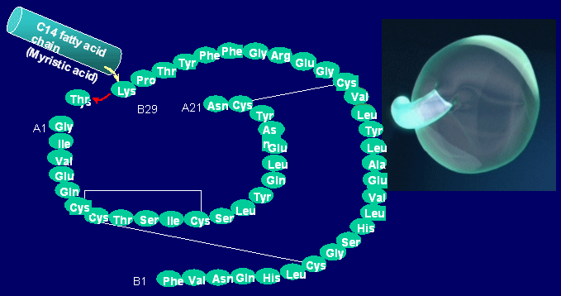
INSULIN DETEMIR
A soluble derivative of human insulin
Threonine has been removed at position B30
A 14-carbon fatty acid side-chain has been attached to position B29

Slide 16
INSULIN DETEMIR: PHARMACOKINETICS
The fatty acid, enable Detemir to bind albumin in subcutaneous tissue and circulation.
98% of Detemir in the blood stream is albumin bound.
Distribute more slowly to peripheral target tissues.
It doesn’t precipitate during administration or absorption.
Protracted absorption may contribute to reduced
variability in Detemir action.
Onset of action= 2 hrs
(dose dependent decrease in time to action)
Peak= flat
Duration= 14–16 hrs
(dose dependent : 0.4 IU/Kg , average 20 hours)
Meneghini L. Insulin Detemir. Therapy. 2008; 5:513-529.

Slide 17
Types Of Basal Insulin
 | Intermediate-Acting (NPH, lente) | Long-Acting. ultralente | Long-Acting Analogues (glargine, detemir)
Onset | 1-3 hr(s) | 3-4 hrs | 1.5 - 3 hrs
Peak | 5-8 hrs | 8-15 hrs | No peak with glargine, dose-dependent peak with detemir
Duration | Up to 18 hrs | 22-26 hrs | 9-24 hrs (detemir) 20-24 hrs (glargine)
Notes:
17

Slide 18
Ideal Basal Insulin
Balance between good glycaemic control and low incidence of hypoglycemia
Problems:
Hypoglycaemia,
weight gain
Glycaemic control

Slide 19
INSULIN ANALOGUES
EFFICACY & SAFETY
♣ GLYCAEMIC CONTROL
♣ HYPOGLYCAEMIA

Slide 20
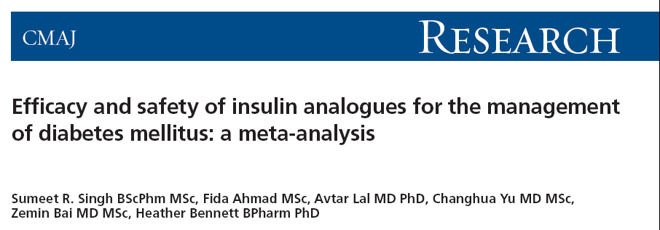
From the Canadian Agency for Drugs and Technologies in Health,,
Aim: To compare the outcomes of insulin analogues with conventional insulins in the treatment of DM₁, DM₂ and GDM
CMAJ 2009;180(4):385-97

Slide 21
Efficacy and safety of insulin analogues for the management of diabetes mellitus: a meta-analysis
Study Selection
Databases : 1966-2007
Rapid-acting insulin analogues
Long-acting insulin analogues
765 citations
940 citations
68 trials
49 trials
were selected for analysis
were selected for analysis.
Singh SR, Ahmad F, LaI A, et al. CMAJ 2009; 180:385-397

Slide 22
Differences in glycemic control, as measured by hemoglobin A1c , between insulin analogues and other treatments in patients with DM₁
Long-acting insulin analogues
Singh SR, Ahmad F, LaI A, et al. CMAJ 2009; 180:385-397

Slide 23
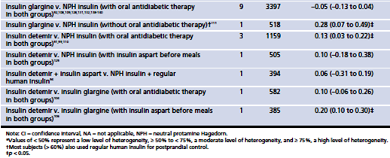
Differences in glycemic control, as measured by hemoglobin A1c , between insulin analogues and other treatments in patients with DM₂
Long-acting insulin analogues
Singh SR, Ahmad F, LaI A, et al. CMAJ 2009; 180:385-397

Slide 24
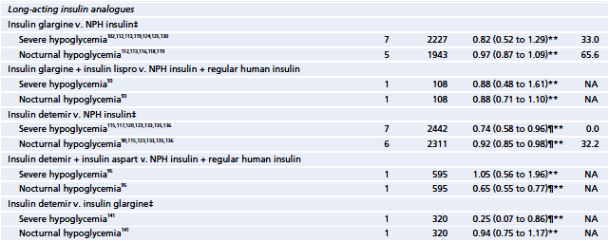
Efficacy and safety of insulin analogues for the management of diabetes mellitus: a meta-analysis
Singh SR, Ahmad F, LaI A, et al. CMAJ 2009; 180:385-397

Slide 25
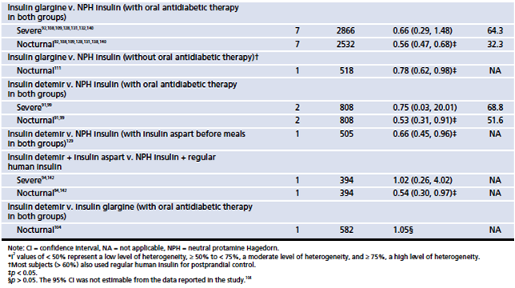
Efficacy and safety of insulin analogues for the management of diabetes mellitus: a meta-analysis
Singh SR, Ahmad F, LaI A, et al. CMAJ 2009; 180:385-397

Slide 26
Efficacy and safety of insulin analogues for the management of diabetes mellitus: a meta-analysis
Interpretation
Most estimates of differences in HbA₁c between treatment groups were not statistically significant.
Where they were statistically significant in favor of insulin analogues, the differences were smaller than minimal clinically important differences described in the literature.
We found statistically significant benefits of insulin analogues over conventional insulins in terms of hypoglycemia
These agents may be an option for patients with problematic hypoglycemia despite optimization of conventional insulin therapy.
Singh SR, Ahmad F, LaI A, et al. CMAJ 2009; 180:385-397

Slide 27
Consistently low incidence of hypoglycaemia with insulin glargine
Insulin glargine
NPH
Premix
Symptomatic hypoglycaemia
p<0.05
All hypoglycaemia
p<0.0001
Symptomatic hypoglycaemia
p=0.0009
Symptomatic hypoglycaemia
p<0.02
Confirmed hypoglycaemia ≤72 mg/dl (p<0.005)
20
17.7
15
Events per patient-year
13.9
12.9
10
9.9
8.0
9.2
5
5.5
5.7
4.1
2.6
0
LANMET¹
LAPTOP²
Treat to Target³
Yki-Jarvinen H, et al. Diabetes 2004;53(suppl 2). Abstract 2181-PO.
JanRiddle M, et al. Diabetes Care 2003;26:3080−6.
ka H, et al. Diabetes Care 2005;28:254−9.

Slide 28
Lower Risk of Hypoglycemia with Detemir than with NPH in Older Persons with DM₂:
A Pooled Analysis of Phase III Trials
Aim: To compare the safety and efficacy of Detemir with that of NPH in older (aged 65) and younger (aged 18–64) persons with DM₂.
Analysis of data from three open-label, randomized studies:
Haak T, et al. Diab Obes Metab 2005;7:56–64.
Lower within-subject variability of fasting blood glucose and reduced weight gain with insulin detemir compared to NPH insulin in patients with DM₂.
Raslova K, et al. Diabetes Res Clin Pract 2004;66:193–201.
Erratum in: Diab Res Clin Pract 2006;72:112.
Insulin detemir and insulin aspart: A promising basal-bolus regimen for DM₂.
Hermansen K, al. Diabetes Care 2006;29:1269–1274.
A 26-week, randomized, parallel, treat-to-target trial comparing insulin detemir with NPH insulin as add-on therapy to oral glucose-lowering drugs in insulin-naive people with DM₂.
Garber AJ et al. J Am Geriatr Soc 55:1735–1740, 2007.

Slide 29
Lower Risk of Hypoglycemia with Detemir than with NPH in Older Persons with DM₂:
A Pooled Analysis of Phase III Trials
PARTICIPANTS
416 older and 880 younger persons with DM, treated for 22-26 weeks with basal insulin plus mealtime insulin or OHA
RESULTS
Mean treatment difference for HbA1c indicated that insulin Detemir was not inferior to NPH insulin for both age groups
Relative risk of all hypoglycemic episodes (Detemir/NPH):
0.59 (95% CI- 0.42–0.83) for older persons
0.75 (95% CI-0.59–0.96) for younger persons
Garber AJ et al. J Am Geriatr Soc 55:1735–1740, 2007.

Slide 30
INSULIN ANALOGUES
EFFICACY & SAFETY
♣ Body Weight

Slide 31
Detemir vs. Glargine: Head-to-Head Comparisons
Hollander P, et al. Clin Ther.. 2008; 30:1976–1987.
A 52-week, multinational, open-label, parallel-group, non-inferiority, treat-to-target trial comparing insulin detemir with insulin glargine in a basal-bolus regimen with mealtime insulin aspart in patients with type 2 diabetes.
Rosenstock J, et al. Diabetologia. 2008; 51:408–416.
A randomised, 52-week, treat-to-target trial comparing insulin detemir with insulin glargine when administered as add-on to glucose-lowering drugs in insulin-naive people with type 2 diabetes.
Raskin P, et al. Diabetes Metab Res Rev. 2009; 25:542–548.
Comparison of insulin detemir and insulin glargine using a basal-bolus regimen in a randomized, controlled clinical study in patients with type 2 diabetes.
Swinnen SG, et al. Diabetes Care. 2010; 33:1176-8.
A 24-week, randomized, treat-to-target trial comparing initiation of insulin glargine once-daily with insulin detemir twice-daily in patients with type 2 diabetes inadequately controlled on oral glucose-lowering drugs

Slide 32
Detemir vs. Glargine: Comparison of Weight Gain in 4 Trails
At the end of these studies, decreases of HbA1c from baseline for Detemir and Glargine were similar.
Both insulin analogs were well tolerated with no significant differences in the frequency of Hypoglycemia.
Mean weight gain was significantly lower with Detemir than Glargine:
1- 2.8 vs 3.8 kg (p< 0.05)
2- 3.0 vs 3.9 kg (p< 0.01)
3- 1.2 vs 2.7 kg (p< 0.001)
4- 0.6 vs 1.44 kg (p< 0.001)

Slide 33
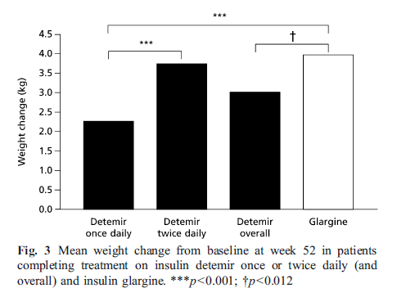
Detemir vs. Glargine: Comparison of Weight Gain
Detemir usage:
45% once daily
55% twice daily
Rosenstock J, et al. Diabetologia. 2008; 51:408–416.

Slide 34
Insulin Analogues
EFFICACY & SAFETY
♣ WITHIN-SUBJECT VARIABILITY

Slide 35
Within-subject Variability
Subcutaneous administration of insulin often does not result in a reproducible metabolic effect even when injected at the same dose under comparable conditions.
Few studies have assessed the variability of insulin absorption after subcutaneous administration.
In a study in DM₁, Detemir was associated with significantly less within-subject variability than both NPH and Glargine.
27% (Detemir) vs. 59% (NPH) vs. 46% (Glargine) ¹
Similar results has also been shown in DM₂, and diabetic children and adolescents. ^{2,3}
1- Heise T, et al. Diabetes. 2004; 53:1614–1620.
2- Klein O, et al. Diabetes Obes Metab. 2009; 9:290-299.
3- Danne T, et al. Diabetologia. 2007; 50 (Suppl. 1), S84.

Slide 36
INSULIN ANALOGUES
EFFICACY & SAFETY
♣ CONCLUSION

Slide 37
CONCLUSIONS
Long-acting Insulin Analogues offer improved pharmacokinetic and pharmacodynamic profiles compared with NPH.
They offers advantages with respect to safety, efficacy and variability.
Long-acting Insulin Analogues are associated with equivalent glycemic control, less risk of hypoglycemia, and lower within-subject day to-day FPG variability compared with NPH.
These advantages may help patients with T₂DM to overcome some of the barriers associated with insulin initiation and therapy, such as fear of hypoglycemia, and weight gain, and number of injections.

Slide 38
INSULIN ANALOGUES
SAFETY

Slide 39
The relationship between insulin structure, insulin receptor and IGF-1R binding, and metabolic and mitogenic potency of insulin analogues.
Analogue | Insulin receptor affinity (%) | Insulin receptor off-rate (%) | Metabolic potency (lipogenesis) (%) | IGF-1 receptor affinity (%) | Mitogenic potency (%)
Human insulin | 100 | 100 | 100 | 100 | 100
B10Asp | 205 ± 20 | 14 ± 1 | 207 ± 14 | 587 ± 50 | 975 ± 173
Insulin aspart | 92 ± 6 | 81 ± 8 | 101 ± 2 | 81 ± 9 | 58 ± 22
Insulin lispro | 84 ± 6 | 100 ± 11 | 82 ± 3 | 156 ± 16 | 66 ± 10
Insulin glargine | 86 ± 3 | 152 ± 13 | 60 ± 3 | 641 ± 51 | 783 ± 132
A21Gly | 78 ± 10 | 162 ± 11 | 88 ± 3 | 42 ± 11 | 34 ± 12
B31B32diArg | 120 ± 4 | 75 ± 8 | 75 ± 5 | 2049 ± 202 | 2180 ± 390
Insulin detemir | 46 ± 5 | 204 ± 9 | ca | 16 ± 1 | ca
“It is not easy to assess to what extent an IGF-I receptor–mediated effect of insulin can add to the biological response of endogenous IGF-I.”
“The clinical safety implications of the elevated IGF-I receptor affinity and mitogenic potency of insulin glargine are not clear.”
Kurtzhals, et al. Diabetes. 2000; 49:999–1005.

Slide 40
The use of insulin Glargine may potentially be associated with an increased risk of cancer
SOME QUESTIONS:
What is known about diabetes, cancer and IGF-1?
Can we extrapolate findings from in vitro studies?
What is the clinical evidence?

Slide 41
What is known about diabetes, insulin and cancer?
It is generally recognized that both obesity and DM₂ are associated with an increased risk of cancer.
In particular, DM₂ is associated with an increased risk for pancreatic cancer, colorectal cancer and breast cancer.
Garg, et al. Diabetes Technol Ther 2009;11:473–6.

Slide 42
Limitations of in vitro studies
Mitogenic activity measured in vitro cannot be extrapolated to carcinogenicity in vivo for the following reasons:
While insulin glargine has a higher affinity for IGF-1R (5-12 fold) compared with human insulin, its affinity is significantly lower than the affinity of endogenous IGF-1 for IGF-1R.
The in vitro ability for insulin glargine to stimulate cell proliferation can only be demonstrated when serum is removed. In vivo, human cells are in constant interaction with the same factors that are present in serum used for cell cultures.
In vivo, the binding of insulin glargine to the IGF-1R is inhibited by the presence of endogenous IGF-1, which competes more effectively for the binding to its own receptor.
In vivo, insulin glargine is quickly metabolized. The two main metabolites M1 and M2 have a much lower affinity for the IGF-1R.

Slide 43
Glargine and cancer
What is the clinical evidence?

Slide 44
Human studies : An ‘unwarranted alarm’
On June 26, 2009, Diabetologia published on their internet site articles on four registry analyses, prompting an ‘unwarranted alarm’
1- Hemkens, et al. (Germany) Diabetologia 2009; 52:1732–44
2- Jonasson, et al. (Sweden) Diabetologia 2009; 52:1745–54
3- Colhoun and SDRN Epidemiology Group. (Scotland)
Diabetologia 2009; 52:1755–65
4- Currie, et al. (UK) Diabetologia 2009; 52:1766–77

Slide 45
The 4 analyses published in Diabetologia at a glance
Country and population | Main allegations concerning Lantus | Remarks
Germany N=127,031 | Lower risk of cancer in Glargine patients vs human insulin in crude analysis Higher risk only after debatable adjustment for insulin dose | Short exposure to insulin No correction for BMI
Sweden N=114,841 | No increased risk of cancer overall Higher risk of breast cancer only in patients taking Glargine alone but not in patients taking Lantus plus other insulins | Low number of breast cancers Demographic data different between patients groups; a strong possibility for an allocation bias
Scotland N=49,197 | Higher overall cancer rate in patients treated with Glargine alone, but not in patients treated with Glargine plus other insulins | Inconsistency in cancer findings among cohorts Differences between patient groups; patients treated with Lantus alone being older than other insulin users Allocation bias may explain findings
UK N=62,809 | No evidence of increased risk of cancer with Glargine compared with human insulin | Less heterogeneity between insulin-treated patients than in the other analyses

Slide 46
Limitations of the analyses
The results from the 4 analyses are not consistent within or across studies.
Definition of the treatment group is highly selective.
No control for critical baseline risk factors.
Insulin/drug utilization is poorly defined.
Small sample size for some of the registries and very short duration of follow up
Short duration from exposure to drug to the reported development of cancer, indicating sub-clinical findings before inclusion in the registries
No explanation for why insulin glargine monotherapy would increase risk, but insulin glargine + another insulin reduces the risk.

Slide 47
Combined RCTs experience of malignancies in studies using insulin Glargine
Meta-analysis of the Sanofi-aventis pharmacovigilance database for all RCTs
Comparing Glargine with any comparator
31 studies: 12 in T₁DM and 19 in T₂DM
10,880 patients were included in the analysis
RR= 0.90
(95% CI= 0.60-1.36)
P=NS
Glargine Group = 5657
52 cases of cancer
Comparator Group= 5223
48 cases of cancer
In these 31 RCTs insulin Glargine was not associated with an increased incidence of cancer
Home P , Lagarenne P. Diabetologia. 2009; 52:2499-2506.

Slide 48
Diabetes and Cancer
A consensus report of ADA and American Cancer Society
Evidence from observational studies suggests that some medications used to treat hyperglycemia are associated with either increased or reduced risk of cancer. Against this backdrop, the American Diabetes Association and the American Cancer Society convened a consensus development conference in December 2009.
Following a series of scientific presentations by experts in the field, the writing group independently developed this consensus report.
Giovannucci E, et al. Diabetes Care. 2010; 33:1674–1685.

Slide 49
A consensus report of ADA & American Cancer Society Summary and recommendations
● Diabetes (primarily DM₂) is associated with increased risk for some cancers (liver, pancreas, endometrium, colon and rectum, breast,bladder). Diabetes is associated with reduced risk of prostate cancer. For some other cancer sites there appears to be no association or the evidence is inconclusive.
● The association between diabetes and some cancers may partly be due to shared risk factors between the two diseases, such as aging, obesity, diet, and physical inactivity.
● Possible mechanisms for a direct link between diabetes and cancer include hyperinsulinemia, hyperglycemia, and inflammation.
Giovannucci E, et al. Diabetes Care. 2010; 33:1674–1685.

Slide 50
A consensus report of ADA & American Cancer Society Summary and recommendations
Healthful diets, physical activity, and weight management reduce risk and improve outcomes of DM₂ and some forms of cancer and should be promoted for all.
Patients with diabetes should be strongly encouraged by their health care professionals to undergo appropriate cancer screenings as recommended for all people in their age and sex.
The evidence for specific drugs affecting cancer risk is limited, and observed associations may have been confounded by indications for specific drugs, effects on other cancer risk factors such as body weight and hyperinsulinemia, and the complex progressive nature of hyperglycemia and pharmacotherapy in DM₂ .
Giovannucci E, et al. Diabetes Care. 2010; 33:1674–1685.

Slide 51
A consensus report of ADA & American Cancer Society Summary and recommendations
● Although still limited, early evidence suggests that metformin is associated with a lower risk of cancer and that exogenous insulin is associated with an increased cancer risk.
Further research is needed to clarify these issues and evaluate if insulin glargine is more strongly associated with cancer risk compared with other insulins.
● Cancer risk should not be a major factor in choosing between available diabetes therapies for the average patient.
For selected patients with very high risk for cancer occurrence (or for recurrence of specific cancer types) these issues may require more careful consideration.
Giovannucci E, et al. Diabetes Care. 2010; 33:1674–1685.

Slide 52
FDA Overview
FDA has reviewed the four studies and has determined that the evidence presented in the studies is inconclusive, due to limitations in how the studies were designed and carried out and in the data available for analysis. These limitations prevent our ability to attribute the observed cancer risk to Lantus.
FDA has also reviewed results from a five-year RCT, “Evaluation of Diabetic Retinopathy Progression in Subjects with Type 2 Diabetes Mellitus Treated with Oral Agents Plus Insulin”, which compared Lantus to NPH in individuals with DM2.
The results did not show an increased risk of cancer in subjects treated with Lantus compared to those treated with NPH insulin; however, this study was not specifically designed to evaluate cancer outcomes.
Data from: http://www.fda.gov/Drugs/DrugSafety/ucm239376.htm; last visited on 17 June 2011

Slide 53
FDA Overview
At this time, FDA has not concluded that Lantus increases the risk of cancer.
Healthcare professionals should continue to follow the recommendations in the drug label when prescribing Lantus.
Patients should continue taking Lantus unless told otherwise by their healthcare professional.
Patients who have concerns about using Lantus should talk to their healthcare professional.
Data from: http://www.fda.gov/Drugs/DrugSafety/ucm239376.htm; last visited on 17 June 2011

Slide 54
WHAT’S NEW?

Slide 55
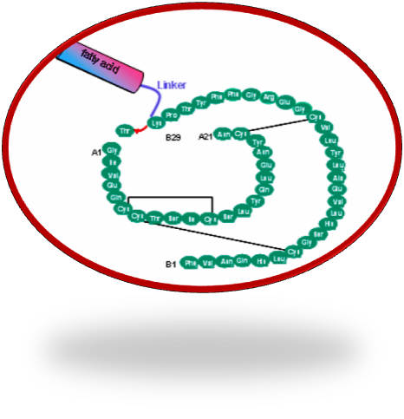
Insulin degludec is a new generation, ultra-long acting basal insulin
De
glu
dec
Degludec: Insulin backbone
Side chain: fatty acid + linker
Allows formation of multi-hexamers
Confers albumin binding
Notes:
55
55
Insulin degludec is a new generation ultra-long acting basal insulin. When injected into the subcutaneous tissue, self-association and formation of multi-hexameric chains occur at the injection site. The formation of the multi-hexameric chain is the principle mechanism of protraction. The insulin molecules slowly dissociates and enter the circulation as monomers. Reversible binding to albumin contributes further to the mechanism of protraction. The result is a long, flat and extended insulin profile as shown in the following slides.

Slide 56
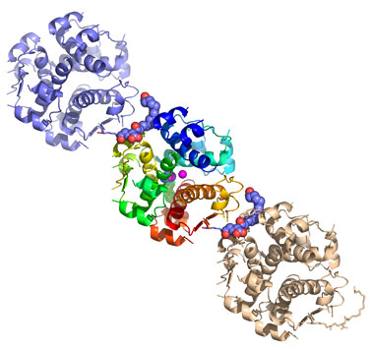
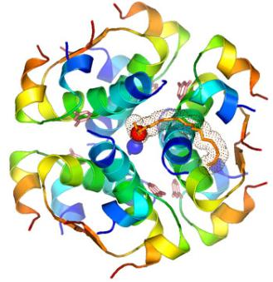
Degludec – Multi-hexamer formation key to protraction mechanism
Degludec ligand carboxy group binds to Zn in hexamer
The side chain (linker) forms an accurate fit between Degludec hexamers to form multi-hexamers
Notes:
56
Degludec is a new generation ultra-long acting basal insulin. When injected into the subcutaneous tissue, self-association and formation of multihexameric chains occur at the injection site. The formation of the multihexameric chain is the principle mechanism of protraction. The insulin molecules slowly dissociates and enters the circulation a monomers. Reversible binding to albumin contributes further to the mechanism of protraction. The result is a long, flat and extended insulin profile as shown in the following slides.

Slide 57
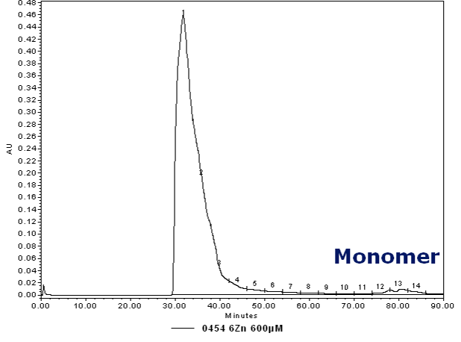
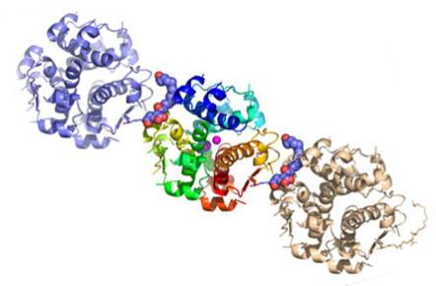
Size exclusion chromatography of Degludec in a subcutaneous model
Multi-hexamer
After injection, Degludec exists only in the multi-hexamer state
Notes:
57
57

Slide 58
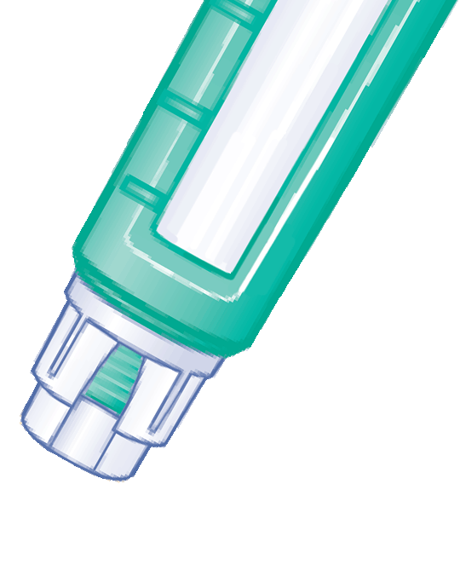
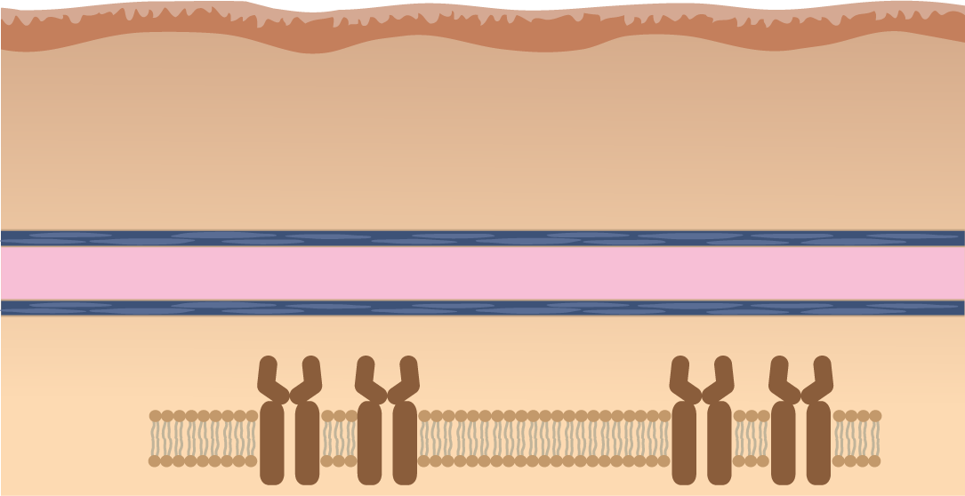
Insulin Degludec:
Mechanism of protraction
Multi-hexamers
Subcutaneous tissue
Monomers
Capillary membrane
Capillary blood
Insulin degludec in blood
Albumin binding
Cell Membrane
Insulin Receptors
Notes:
58
*DO NOT EDIT* Note: this slide is animated
Insulin degludec tends to exist as dihexamers in the formulation (in pen). At the injection site, as phenol is rapidly diffuses away, insulin degludec quickly forms multihexamers. The unique properties of the side chain (glutamic acid and fatty acid) facilitates the formation of multihexamers in the presence of zinc ions (contained in the formulation). The multihexamers form a depot at the site of injection and represents the primary mechanism of protraction. With time, the monomers slowly dissociate. The monomers are able to diffuse into the capillary where they bind to albumin (due to the fatty acid side chain). This represents the secondary mechanism of protraction and provides a form for “buffering” of insulin degludec blood levels. At the target organs, the insulin degludec monomers are able to activate the insulin receptors as the affinity for the IR is much higher than for the albumin (which is also present in the interstitial fluid, but at a lower concentration than in blood).
58

Slide 59
DEGLUDEC
NEW CLINICAL EVIDENCES

Slide 60
OBJECTIVE Insulin degludec (IDeg) is a basal insulin that forms soluble multihexamers after subcutaneous injection, resulting in an ultra-long action profile. We assessed the efficacy and safety of IDeg formulations administered once daily in combination with mealtime insulin aspart in people with type 1 diabetes.
The aim of this phase 2 trial was not to determine superiority or noninferiority of IDeg but rather to estimate a treatment difference (in A1C) with a sufficient precision.
no formal statistical testing was undertaken, and therefore no P values were reported.
Birkeland K, Home P, Wendisch U, et al. Insulin Degludec in Type 1 Diabetes. Diabetes Care. 2011; 34: 661-5

Slide 61
Insulin Degludec in DM₁: A RCT of a new-generation
ultra-long-acting insulin compared with insulin glargine
RESEARCH DESIGN AND METHODS
16-week, randomized, open-label trial
Participants
178 cases
28 centers, 5countries: Australia, Germany, Norway, Sweden, and the U.S.
mean: 45.8 years old
A1C 8.4%
FPG 178 mg/dL
BMI 26.9 kg/m²
Treatment groups: once daily in the evening of either
IDeg(A) (600 μmol/L; n = 59)
IDeg(B) (900 μmol/L; n = 60)
Glargine (IGlar; n = 59)
plus
Insulin aspart at mealtimes
Birkeland K, Home P, Wendisch U, et al. Insulin Degludec in Type 1 Diabetes. Diabetes Care. 2011; 34: 661-5

Slide 62
Insulin Degludec in DM₁: A RCT of a new-generation
ultra-long-acting insulin compared with insulin glargine
Figure 1- Mean change from baseline in A1C. Data are mean (last observation carried forward) for each time point.
Birkeland K, Home P, Wendisch U, et al. Insulin Degludec in Type 1 Diabetes. Diabetes Care. 2011; 34: 661-5

Slide 63
Cumulative number of hypoglycemic episodes
Insulin Degludec in DM₁: A RCT of a new-generation
ultra-long-acting insulin compared with insulin glargine
A: confirmed episodes (PG < 56 mg/dL or requiring assistance)
B: nocturnal episodes
(all confirmed episodes between 2300 and 0559 h, inclusive)
Birkeland K, Home P, Wendisch U, et al. Insulin Degludec in Type 1 Diabetes. Diabetes Care. 2011; 34: 661-5

Slide 64
Insulin Degludec in DM₁: A RCT of a new-generation
ultra-long-acting insulin compared with insulin glargine
CONCLUSIONS
In this clinical exploratory phase 2 trial in people with DM₁, Ideg (used in combination with mealtime Iasp) is safe and well tolerated and provides comparable glycemic control to IGlar at similar doses, with reduced rates of hypoglycemia.
Birkeland K, Home P, Wendisch U, et al. Insulin Degludec in Type 1 Diabetes. Diabetes Care. 2011; 34: 661-5

Slide 65
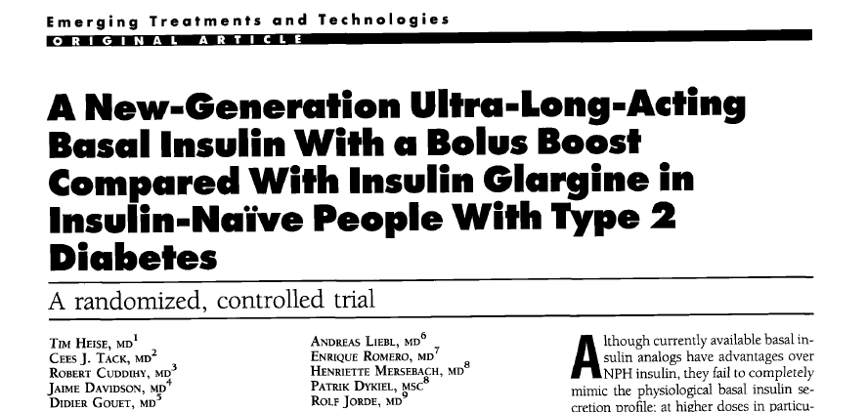
OBJECTIVE Insulin degludec/insulin aspart (IDegAsp) is a soluble coformulation of the novel basal analog insulin degludec (IDeg: 70%) and insulin aspart (IAsp: 30%). We compared the safety and efficacy of IDegAsp, an alternative formulation (AF) (55% IDeg and 45% IAsp), and insulin glargine (IGlar) in insulin-naïve subjects with type 2 diabetes inadequately controlled with oral antidiabetic drugs.
Heise T, Tack CJ, Cuddihy R, et al. Diabetes Care. 2011; 34: 669-74.

Slide 66
A New-Generation Ultra-Long-Acting Basal Insulin With a Bolus Boost Compared With Insulin Glargine in Insulin-Naïve People With DM₂, A randomized, controlled trial
RESEARCH DESIGN AND METHODS
Phase 2, open-label, randomized, controlled 16-week trial.
Participants
178 insulin-naïve subjects with DM₂ inadequately controlled with OADs
22 sites in 5 European countries (France, Germany, Norway, Romania, and Spain)
Mean age: 59.1 years
A1C 8.5%
BMI 30.3 kg/m²
Treatment groups: Insulin was administered before the evening meal and dose-titrated to a FPG target of 72–108 mg/dL.
IDegAsp (n = 59)
AF (n = 59)
IGlar (n = 60)
all in combination with metformin
Heise T, Tack CJ, Cuddihy R, et al. Diabetes Care. 2011; 34: 669-74.

Slide 67
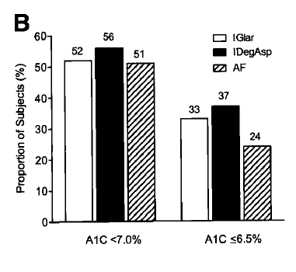
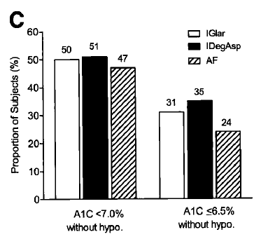
Figure 1- Mean A1C over time (A), percentage of subjects achieving A1C targets of <7.0% and ≤6.5% at end of study (B), and percentage of subjects treated for at least 8 weeks achieving A1C targets of <7.0% and ≤6.5% at end of study in the absence of confirmed hypoglycemia in the last 4 weeks of treatment (C).
A New-Generation Ultra-Long-Acting Basal Insulin With a Bolus Boost Compared With Insulin Glargine in Insulin-Naïve People With DM₂, A randomized, controlled trial
Heise T, Tack CJ, Cuddihy R, et al. Diabetes Care. 2011; 34: 669-74.

Slide 68
Figure 2. Mean 9-point SMPG profiles. Mean 2-h postdinner PG increase was lower for IDegAsp (0.13 mmol/L) and AF (0.24 mmol/L) than IGlar (1.63 mmol/L)
A New-Generation Ultra-Long-Acting Basal Insulin With a Bolus Boost Compared With Insulin Glargine in Insulin-Naïve People With DM₂, A randomized, controlled trial
Hypoglycemia rates were lower for IDegAsp and IGlar than AF (1.2, 0.7, and 2.4 events/patient year). Nocturnal hypoglycemic events occurred rarely for IDegAsp (1 event) and IGlar (3 events) compared with AF (27 events).
Heise T, Tack CJ, Cuddihy R, et al. Diabetes Care. 2011; 34: 669-74.

Slide 69
A New-Generation Ultra-Long-Acting Basal Insulin With a Bolus Boost Compared With Insulin Glargine in Insulin-Naïve People With DM₂, A randomized, controlled trial
CONCLUSIONS
In this proof-of-concept trial, once-daily IDegAsp was safe, well tolerated, and provided comparable overall glycemic control to IGlar at similar low rates of hypoglycemia, but better post-dinner plasma glucose control.
Heise T, Tack CJ, Cuddihy R, et al. Diabetes Care. 2011; 34: 669-74.

Slide 70
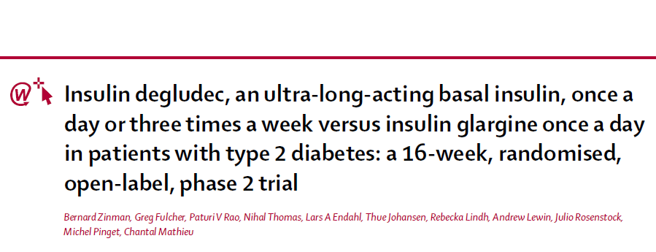
www.thelancet.com Vol 377 March 12, 2011
Aim: to assess efficacy and safety of insulin degludec injected once a day or 3 times a week compared with insulin glargine once a day in insulin-naive people with DM₂, who were inadequately controlled with OADs.
Zinman B, Fulcher G, Rao P, et al. Lancet 2011; 377: 924–31.

Slide 71
Insulin degludec, an ultra-long-acting basal insulin, once a day or 3 times a week vs. insulin glargine once a day in patients with DM₂: a 16-week, randomised, open-label, phase 2 trial
RESEARCH DESIGN AND METHODS
16-week, randomised, open-label, parallel-group phase 2 trial
Participants
245 insulin-naïve subjects with DM₂ inadequately controlled with OADs
28 clinical sites in 5 countries (Canada, India, South Africa, and the USA)
aged 18–75 years
HbA1C :7–11%
BMI: 23–42 kg/m2
Treatment group: Insulin was dose-titrated to a FPG target of 72–108 mg/dL.
IDeg (n=62) three times a week, starting dose 20 U [1 U=9 nmol]
IDeg (n=60) once a day, starting dose 10 U [1 U=6 nmol]; group A
IDeg (n=61) once a day, starting dose 10 U [1 U=9 nmol]; group B
IGlar (n=62) once a day, starting dose 10 U [1 U=6 nmol] once a day
all in combination with metformin
Zinman B, Fulcher G, Rao P, et al. Lancet 2011; 377: 924–31.

Slide 72
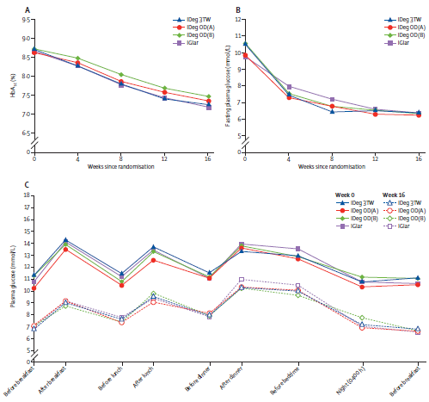
Insulin degludec, an ultra-long-acting basal insulin, once a day or 3 times a week vs. insulin glargine once a day in patients with DM₂: a 16-week, randomised, open-label, phase 2 trial
Zinman B, Fulcher G, Rao P, et al. Lancet 2011; 377: 924–31.
Zinman B, Fulcher G, Rao P, et al. Lancet 2011; 377: 924–31.

Slide 73
Insulin degludec, an ultra-long-acting basal insulin, once a day or 3 times a week vs. insulin glargine once a day in patients with DM₂: a 16-week, randomised, open-label, phase 2 trial
HYPOGLYCEMIA
Overall reported rates of hypoglycemia were low in all treatment groups
77–92% of participants did not have a hypoglycemic episode.
Rates of hypoglycemia did not differ between groups.
The proportion of participants who had hypoglycemia in insulin degludec group A was lower than was the proportion in the insulin glargine group and the insulin degludec 3 times a week group (odds ratio 0.26 and 0.31, respectively).
The rate of confirmed nocturnal hypoglycemia was low in all treatment
Zinman B, Fulcher G, Rao P, et al. Lancet 2011; 377: 924–31.

Slide 74
Insulin degludec, an ultra-long-acting basal insulin, once a day or 3 times a week vs. insulin glargine once a day in patients with DM₂: a 16-week, randomised, open-label, phase 2 trial
This proof-of-concept trial has several limitations inherent to phase 2 regulatory studies. Caution should be exercised in drawing of firm conclusions from the data.
The open-label design that was used to accommodate the different insulin-injection systems could have affected efforts to attain blood glucose control and reporting of hypoglycemia and adverse events.
Zinman B, Fulcher G, Rao P, et al. Lancet 2011; 377: 924–31.

Slide 75
Insulin degludec, an ultra-long-acting basal insulin, once a day or 3 times a week vs. insulin glargine once a day in patients with DM₂: a 16-week, randomised, open-label, phase 2 trial
CONCLUSION
Insulin degludec (once a day or three times a week as add-on to Metformin) provides comparable glycaemic control to insulin glargine without additional adverse events and might reduce dosing frequency due to its ultra-long action profile.
The safety, efficacy, and optimum use of treatment regimens for insulin degludec need to be established.
Zinman B, Fulcher G, Rao P, et al. Lancet 2011; 377: 924–31.

Slide 76
_{Thanks for your patience}

