Slide 1
CC : seizure
PI : A 15 year old boy with seizure from 12 years ago , who had been threated with antiepileptic drugs and Carbamazepine from 8 years ago .
Recently after detection of low calcium in his lab tests he was referred to an endocrinologist for further evaluation and treatment .

Slide 2
PMH :
seizure
Mental retardation ( He had a bad school performance even was not able to finish elementary school .
DH :
Carbamazepine 200 mg/TDS

Slide 3
FH:
He is the second child in his family .
The first child is a 17 year old girl .
The 3rd and 4th children are 14 year old twins .
The 5th one is a 6 year old girl .
All his siblings are normal .
There is no one with the history of seizure or mental retardation or Ca , P abnormalities in his family .
His parents are cousins .

Slide 4
PE :
Height : 139 cm
Arm span : 139 cm
Mid parental height : 166.5 cm
Weight : 44 Kg
BMI : 23.8 Kg/m2
SD : - 3.2

Slide 5
Head and neck :
Rounded face , Short neck
Chest : Nl
Abdomen : Nl
Extremities :
Nl hands and feet , Flexion contracture in elbows and knees , No subcutaneous calcifications .
External genitalia :
P5 G5 .

Slide 12
Lab Data's :
CBC : Nl
BUN : 12 Cr :0.8
Na : 138 K : 4.4 Mg : 1.9
AST : 34 ALT : 38 Alk ph : 223
Ca : 5 Ph : 6.9
iCa :2.12 Alb : 4.2
PTH : 140.9 pg/ml
TSH : 3.31 IU/lit T4 : 7.2 µg/dL
25OH Vit D : 38.4 ng/ml

Slide 13
24 h urine volume : 1050 ml
24 h urine creatinine : 987 mg
24 h urine Cr/Kg :22
24 h urine Calcium : 5 mg

Slide 21
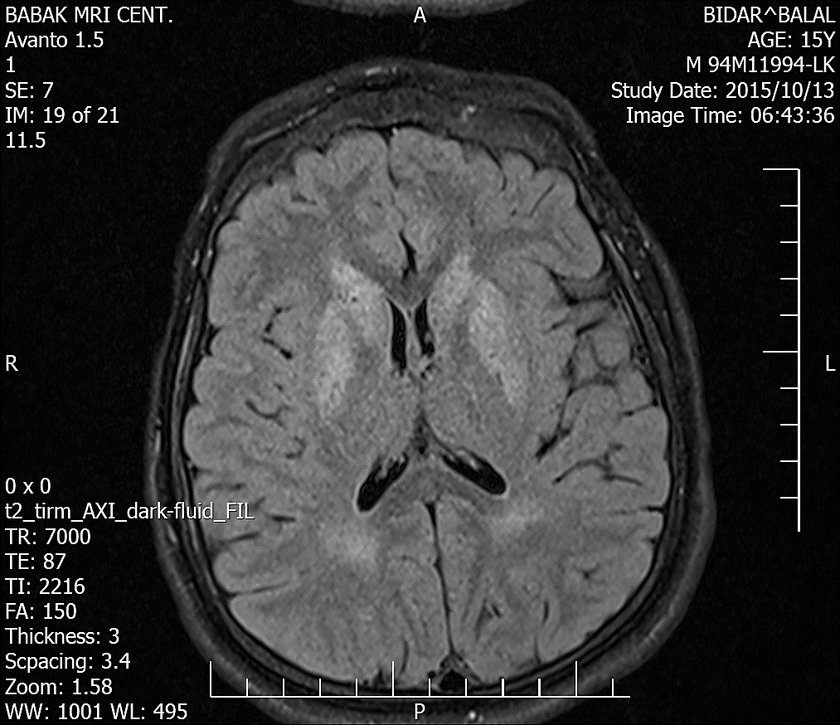
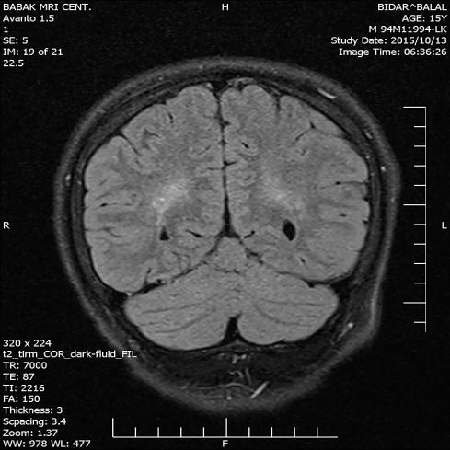

Slide 22
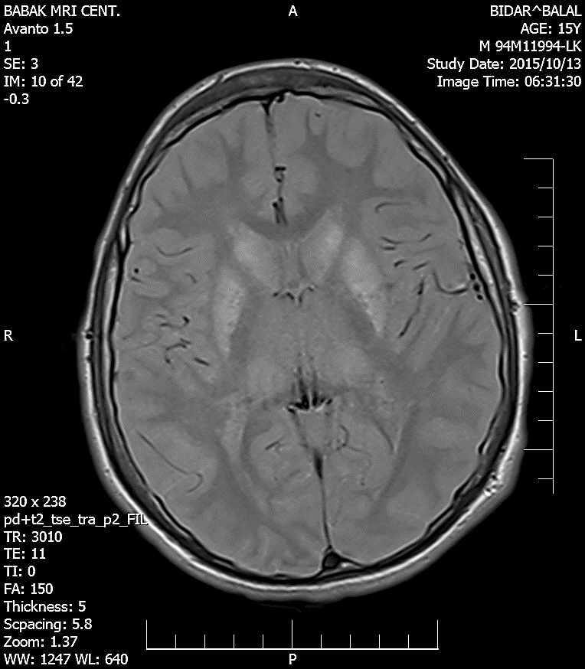
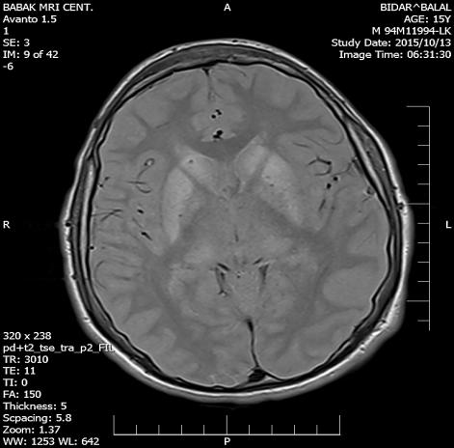

Slide 23
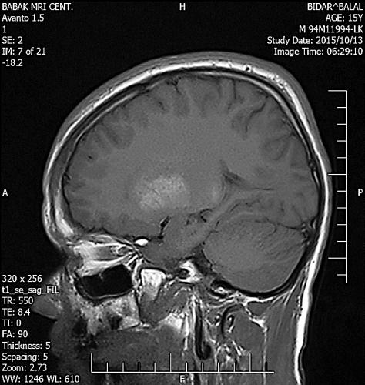
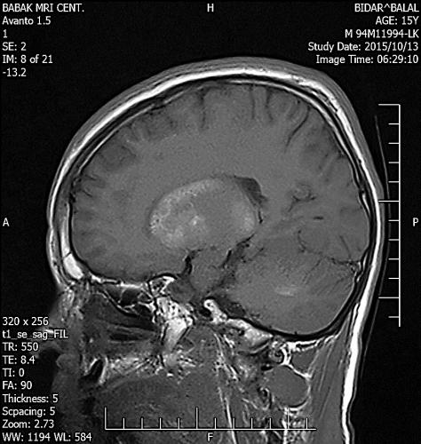

Slide 26
Problem list
A 15 year old boy
AHO :
Mental retardation
Rounded face
Short neck
Short stature
Repeated seizure
Low Ca , High Ph , High PTH
Normal 25 OH Vit D
Basal ganglia calcification

Slide 27
Treatment during admition
Calcium IV infusion then Tab Ca fort /1000 mg /Daily
Tab Calcitriol 0.5 µg / Daily
Pearl Vit D 50000 U / Daily

Slide 28
DD of low Ca in early life
Congenital hypoparathyroidism
DiGeorge syndrome
Autoimmune polyglandular syndrome type 1
PTH gene mutation
Autosomal dominant hypocalcemia (Activating mutations in the CASR )
Vit D deficiency
Psudo vit D deficiency rickets
Hereditary vit D-resistant rickets (HVDRR)
Pseudohypoparathyroidism

Slide 29
Psudohypoparathyroidism

Slide 30
In 1942, Fuller Albright and cols. described 3 patients with clinical and laboratorial hypocalcemia and AHO feature .
Administration of parathyroid tissue extracts did not promote an increase in serum calcium or phosphaturia.

Slide 31
In 1966, Tashjian et al. demonstrated an increase in serum PTH concentrations in these patients .
In 1969, Chase et al. presented that there was no urinary cAMP generation in patients with PHP and the pathogenesis of this abnormality should be related to a renal defect in the generation of urinary cAMP by the PTH receptor.

Slide 34
Clinical findings
AHO
Rounded face, short stature, centripetal obesity, short neck, brachydactyly, short and low-set nasal bridge, ectopic subcutaneous calcifications, and cognitive abnormalities of varying degree.
Archibald sign
Murderers thumb or Potters thumb

Slide 36
Laboratory findings
Low Ca High Ph High PTH
Hypocalciuria
TSH resistance
Gonadotropins resistance
GHRH resistance

Slide 39
Arq Bras Endocrinol Metab vol 50 nº 4 Agosto 2006

Slide 40
Treatment
The goal is keeping the serum TSH level within or close normal range
Oral calcium supplements
Activated vit D analogues

