Slide 1
Bariatric surgical procedures

Slide 2
Overview of bariatric surgery
Bariatric operations produce weight loss through at least two mechanisms and probably many more that are not known.
Restriction of intake.
Malabsoption of ingested food

Slide 3
Type of commonly performed bariatric operations by mechanism of action
Primarily Restrictive
Laparoscopic adjustable gastric banding(LAGB)
Sleeve gastrectomy(SG)
Primarily Malabsorptive
Biliopancreatic diversion(BPD)
Duodenal switch(DS)
Combination
Roux-en-Y gastric bypass(RYGB)

Slide 4
Evolution of Bariatric surgery
1950s - Ileocolic Bypass: operations were first performed to treat severe hyperlipidemia with associated obesity
1970s – Jejunoileal Bypass
1969 – Gastric Bypass: Mason
1977 – Roux-en-Y Gastric Bypass: Griffin
1970s-1980s – Gastric Stapling
1980 – Vertical Banded Gastroplasty: Mason

Slide 5
Evolution of Bariatric surgery(con.)
1980s – Biliopancreatic Diversion: Scopinaro
1980s – Fixed Banding of Stomach: Kuzmak
1990s – RYGB became the procedure of choice for bariatric surgery
1990s – Laparoscopic alternative to bariatric surgery
1994 – Laparoscopic Adjustable Gastric Banding: Belachew
1994 – Laparoscopic RYGB: Wittgrove and Clark
2008 – Sleeve Gastrectomy rapidly popularized

Slide 6
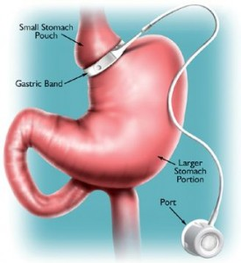
Laparoscopic adjustable gastric banding(LAGB)

Slide 7
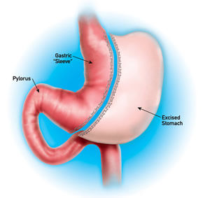
Sleeve gastrectomy(SG)

Slide 8
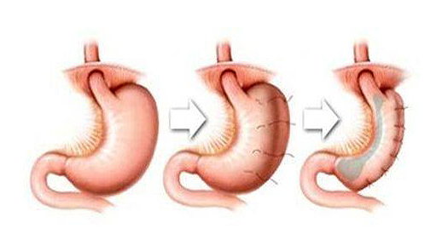
Gastric plication

Slide 9
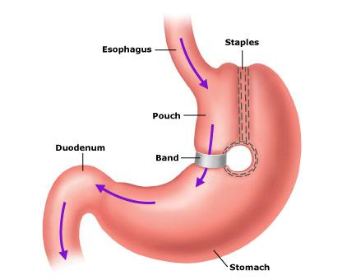
Vertical banded gastroplasty(VGB)

Slide 10
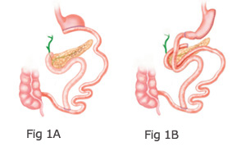
Biliopancreatic diversion(BPD) and Duodenal switch(DS)

Slide 11
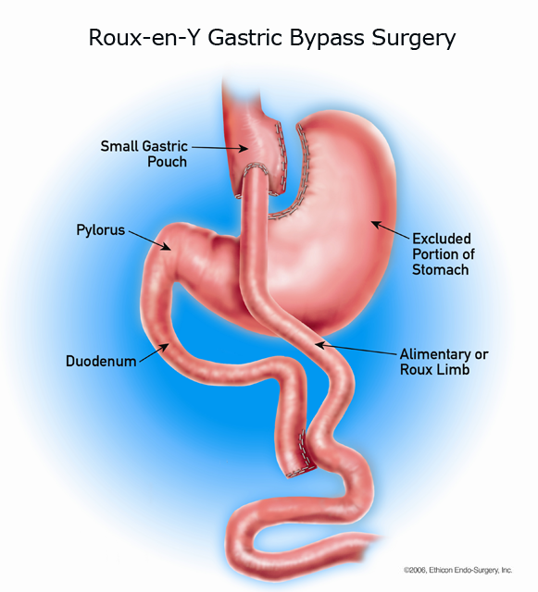
Roux-en-Y gastric bypass(RYGB)

Slide 12
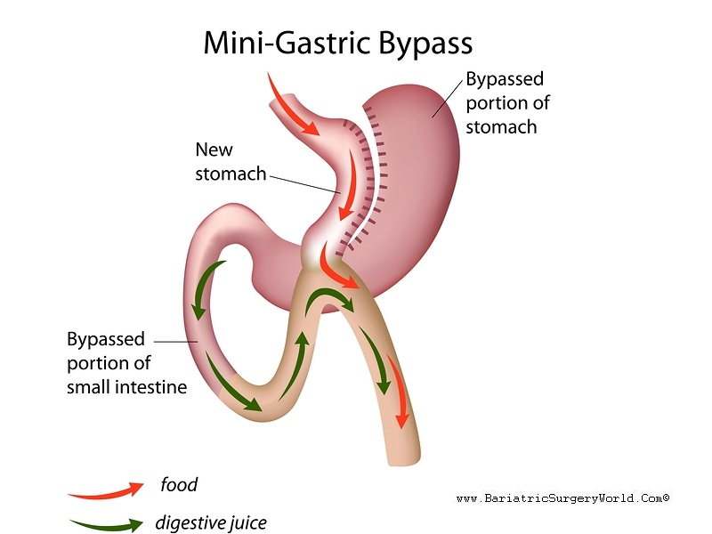
Minigastric bypass(MGB)

Slide 13
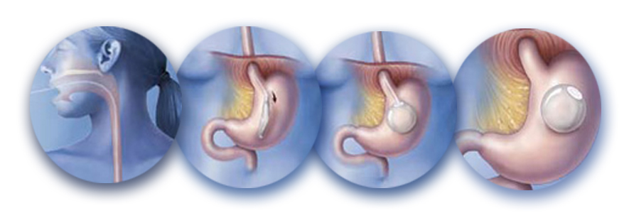
Intragastric balloon

