Slide 1
Hypoglycemia in Diabetes
Hengameh Abdi, M.D.
Endocrine Research Center
Research Institute for Endocrine sciences
Shahid Beheshti University of Medical Sciences
6 January 2016

Slide 2
Agenda:
A case vignette
Definition and Classification
Symptoms
Pathophysiology
Prevalence
Risk factors and Etiology
Clinical implications
Hypoglycemia during pregnancy
Prevention
Treatment
Conclusions

Slide 3
A case vignette:
A 72 year-old woman with history of T2DM since 12 years ago, was brought to emergency department because of loss of consciousness.
She has history of hypertension and coronary heart disease.
Medications:
Glibenclamide 20 mg/d
Metformin 2000 mg/d
Losartan 50 mg/d
Propranolol 40 mg/d
ASA 80 mg/d

Slide 4
A case vignette:(cont.)
POC glucose measurement showed a plasma glucose concentration of 32 mg/dL.
After infusion of hypertonic glucose, she was conscious and oriented.
She reports anorexia, nausea, vomiting and diarrhea over the past 2 days.
She denies any alarming symptoms preceding loss of consciousness.
Her last visit by primary care physician was in about 1 year ago.

Slide 5
A case vignette:(cont.)
Etiology of hypoglycemia?
Further assessment?
Short- and long-term management?

Slide 6
Objective: To provide guidance about how the new information about the impact of hypoglycemia on patients with diabetes should be incorporated into clinical practice.
Seaquist ER, et al. J Clin Endocrinol Metab 2013;98:1845-1859

Slide 7
Definition:
All episodes of an abnormally low plasma glucose concentration that expose the individual to potential harm.
A single threshold value for plasma glucose concentration that defines hypoglycemia in diabetes cannot be assigned because there are varying glycemic thresholds for symptoms of hypoglycemia.

Slide 8
Clinical classification of hypoglycemia:
1) Severe hypoglycemia:
An event requiring assistance of another person to actively administer carbohydrates, glucagon, or take other corrective actions. Plasma glucose concentrations may not be available during an event, but neurological recovery following the return of plasma glucose to normal is considered sufficient evidence that the event was induced by a low plasma glucose concentration.
2) Documented symptomatic hypoglycemia:
An event during which typical symptoms of hypoglycemia are accompanied by a measured plasma glucose concentration ≤ 70 mg/dL.
3) Asymptomatic hypoglycemia:
An event not accompanied by typical symptoms of hypoglycemia but with a measured plasma glucose concentration ≤ 70 mg/dL.

Slide 9
Clinical classification of hypoglycemia: (cont.)
4) Probable symptomatic hypoglycemia:
An event during which symptoms typical of hypoglycemia are not accompanied by a plasma glucose determination but that was presumably caused by a plasma glucose concentration ≤ 70 mg/dL.
5) Pseudo-hypoglycemia:
An event during which the person with diabetes reports any of the typical symptoms of hypoglycemia with a measured plasma glucose concentration > 70 mg/dL but approaching that level.

Slide 10
Proposed glucose levels when reporting hypoglycemia in clinical trials
Level 1: Glucose alert value (≤ 70 mg/dL)
Sufficiently low for treatment with fast-acting carbohydrate and dose adjustment of glucose-lowering therapy.
Level 2: Clinically significant hypoglycemia (< 54 mg/dL)
Sufficiently low to indicate serious, clinically important hypoglycemia.
Level 3: Severe hypoglycemia (no specific glucose threshold)
Hypoglycemia associated with severe cognitive impairment requiring external assistance for recovery.
International Hypoglycaemia Study Group. Diabetes Care 2017;40:155-157

Slide 11
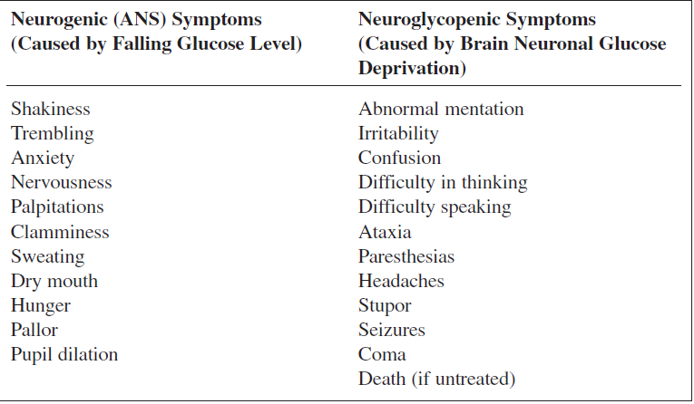
Symptoms of Hypoglycemia
Briscoe VJ, et al. Clinical Diabetes 2006; 24(3): 115-21

Slide 12
Pathophysiology

Slide 13
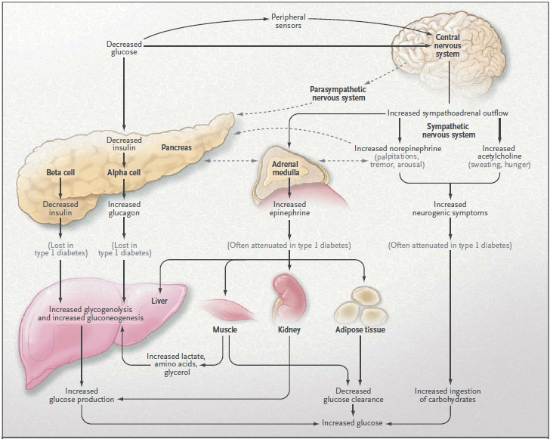
Physiologic and Behavioral Defenses against Hypoglycemia
Cryer PE. NEJM 2013; 369: 362-72

Slide 14
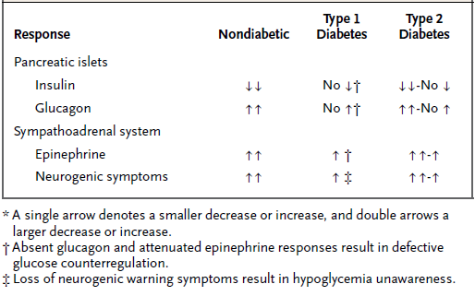
Neuroendocrine and Symptomatic Responses to Hypoglycemia
Cryer PE. NEJM 2004; 350: 2272-9

Slide 15
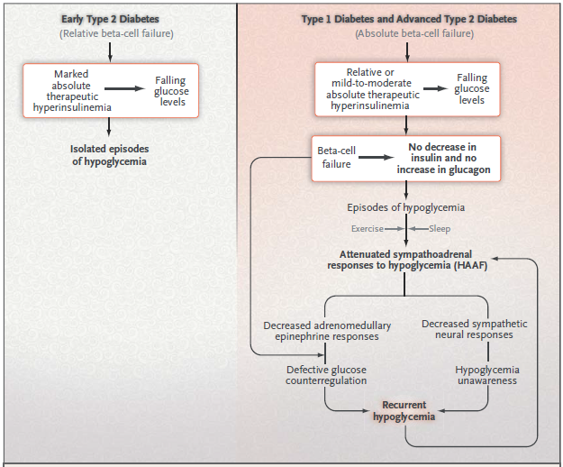
Hypoglycemia-Associated Autonomic Failure (HAAF)
Cryer PE. NEJM 2013; 369: 362-72

Slide 16
Hypoglycemia-Associated Autonomic Failure (HAAF)
Patients with impaired counterregulation have at least a 25-fold increased risk for recurrent severe hypoglycemia.
Risk factors for HAAF:
Absolute endogenous insulin deficiency
History of severe hypoglycemia, hypoglycemia unawareness, or both (as well as recent antecedent hypoglycemia, prior exercise, or sleep)
Aggressive glycemic therapy per se (lower HbA1c, lower glycemic goals)
Cryer PE, et al. J Clin Endocrinol Metab 94: 709–728, 2009

Slide 18
Nocturnal hypoglycemia
Nighttime:
The longest period between self monitoring of plasma glucose, between food ingestion, and the time of maximum sensitivity to insulin.
In one report of patients undergoing continuous glucose monitoring, patients with type 1 diabetes had hypoglycemic values (glucose < 70 mg/dL) an average of 2.3 hours/day and type 2 patients 1 hour/day; most of the hypoglycemic values occurred at night.
Bode BW, et al. Diabetes Care 28:2361–2366, 2005

Slide 19
Nocturnal hypoglycemia
Nocturnal hypoglycemia is less common in individuals using rapid acting insulin analogs (lispro, aspart, glulisine) rather than regular insulin before meals and in individuals using long acting insulin analogs (glargine, detemir) rather than NPH as the basal insulin.

Slide 20
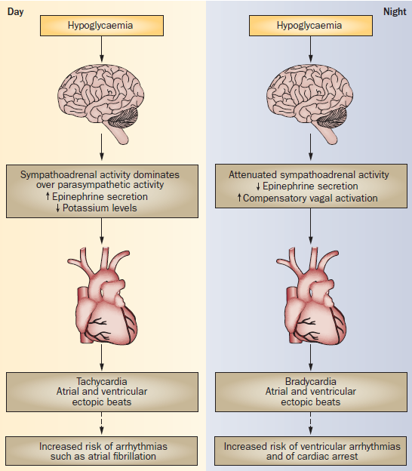
Frier, B. M. Nat. Rev. Endocrinol. 2014; 10:711–722
Notes:
Attenuated sympathoadrenal activity at night leads to compensatory activation of the parasympathetic system, which increases the frequency of bradycardia and the risk of fatal ventricular arrhythmias.

Slide 21
HAAF is largely preventable and/or reversible
A little as 2–3 week of scrupulous avoidance of treatment-induced hypoglycemia reverses hypoglycemia unawareness, and improves the reduced epinephrine component of defective glucose counterregulation in most affected patients.
Diabetes.1994;43:1426-1434
Lancet.1994;344:283-287
Seaquist ER, et al. J Clin Endocrinol Metab 2013;98:1845-1859

Slide 22
Magnitude of the Problem

Slide 23
Hypoglycemia in T1DM:
Hypoglycemia occurs 2-3 times more frequently than in patients with T2DM.
Countless episodes of hypoglycemia
Severe hypoglycemia:
62-320 episodes per 100 patient-years
(35-70 episodes in T2DM)

Slide 24
This review of 46 studies (n = 532,542) estimates that the prevalence of hypoglycemia is 45% for mild/moderate and 6% for severe in population-based studies of type 2 diabetes, and that on average an individual with T2DM experiences 19 mild/moderate episodes and 0.8 severe episodes per year.
Edridge CL, et al. PONE 2015; 10(6): 1-20

Slide 25
Hypoglycemia is particularly prevalent amongst those on insulin.
Yet still fairly common for treatment regimens that include sulphonylureas.
Edridge CL, et al. PONE 2015; 10(6): 1-20

Slide 26
Etiology:
Hypoglycemia in diabetes is fundamentally the result of treatments that raise insulin levels:
Insulin
Insulin secretagogues
Sulfonylureas
Nonsulfonylurea insulin secretagogues (e.g. nateglinide or repaglinide)

Slide 27
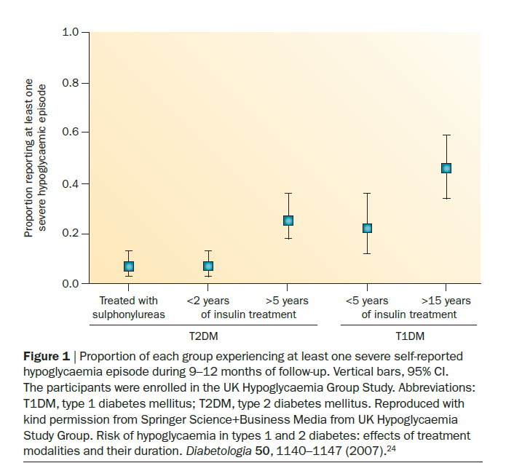

Slide 28
Risk factors:
Young children with type 1 diabetes and the elderly are particularly vulnerable to clinically significant hypoglycemia because of their reduced ability to:
recognize hypoglycemic symptoms
AND
effectively communicate their needs

Slide 29
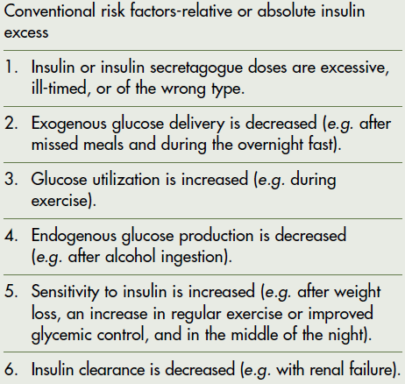
Risk factors for hypoglycemia
Cryer PE. J Clin Endocrinol Metab 94: 709–728, 2009

Slide 30
Mismatch between insulin or insulin secretagogues and food absorption
Ill-timed insulin doses
Missed meals
Gastroparesis
Post gastric bypass surgery
Gastrointestinal disease with malabsorption (eg, celiac disease)

Slide 31
Errors and medication administration issues
Lack of diabetes education (eg, injecting insulin into lipohypertrophy or intramuscularly)
Poor adherence to regimen or distraction (eg, miscalculated carbohydrate content or taking wrong type of insulin)
Functional neurologic deficit (eg, cognitive or visual impairment leading to incorrect dosing)

Slide 32
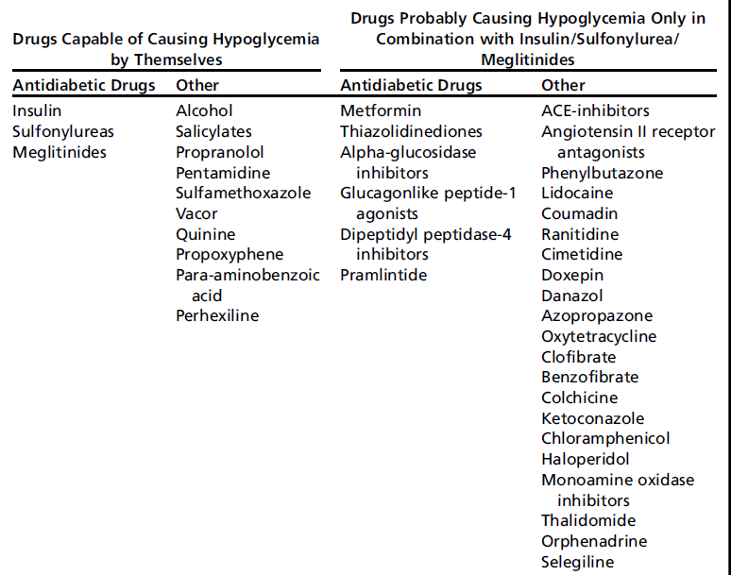
Drug induced hypoglycemia

Slide 33
Implications of hypoglycemia on
short- and long-term outcomes

Slide 34
Severe hypoglycemia AND Cardiovascular events
ACCORD, ADVANCE, VADT Trials in T2DM:
Association between episodes of severe hypoglycemia and increased CV events and mortality.

Slide 35
Severe hypoglycemia AND Cardiovascular events
In the ADVANCE study, severe hypoglycemia was associated with increased risk of adverse clinical outcomes: major macrovascular events, major microvascular events, all-cause mortality and CV death (all P<0.001).
Clinical outcome | Adjusted HR (95% CI) for outcomes among patients who had severe hypoglycemia vs those who did not | P value
Major macrovascular events | 2.88 (2.01–4.12) | <0.001
Major microvascular events | 1.81 (1.19–2.74) | <0.001
Death from CV cause | 2.68 (1.72–4.19) | <0.001
Death from any cause | 2.69 (1.97–3.67) | <0.001
ADVANCE analysis
T2DM
N=11,140
5 year follow-up
SAGLB.DIA.14.06.0065a / 2014.06

Slide 36
Impact of hypoglycemia on quality of life and activities of daily living
Nocturnal hypoglycemia in particular may impact one’s sense of well-being on the following day because of its impact on sleep quantity and quality.
Patients with recurrent hypoglycemia have been found to have chronic mood disorders including depression and anxiety.
Interpersonal conflict
Reduced productivity
Seaquist ER, et al. J Clin Endocrinol Metab 98: 1845–1859, 2013

Slide 37
Fear of hypoglycemia reduces patient adherence.
Proportion of patients modifying insulin dose to avoid future hypoglycemia
Patients, %
90
T1DM
80
T2DM
70
74.1
78.2
60
50
57.9
40
43.3
30
20
10
0
Following mild episodes
Following severe episodes
Leiter LA et al. Can J Diabetes 2005;29:186-192.
SAGLB.DIA.14.06.0065a / 2014.06
Notes:
37

Slide 38
Hypoglycemia AND Pregnancy
Normal blood glucose levels during pregnancy are 20% lower than in nonpregnant women, making the definition and detection of hypoglycemia more challenging.
For women with type 1 diabetes, severe hypoglycemia occurs 3–5 times more frequently in the first trimester and at a lower rate in the third trimester.
Hypoglycemia is generally without risk for the fetus as long as the mother avoids injury during the episode.
Seaquist ER, et al. J Clin Endocrinol Metab 98: 1845–1859, 2013

Slide 39
Hypoglycemia AND Pregnancy(cont.)
For women with preexisting diabetes, insulin requirements rise throughout the pregnancy and then drop precipitously at the time of delivery of the placenta, requiring an abrupt reduction in insulin dosing to avoid post-delivery hypoglycemia.
Breastfeeding may be a risk factor for hypoglycemia in women with insulin-treated diabetes.
Seaquist ER, et al. J Clin Endocrinol Metab 98: 1845–1859, 2013

Slide 40
Prevention

Slide 41
Strategies to prevent hypoglycemia
Patient education
Dietary intervention
Exercise management
Medication adjustment
Glucose monitoring
Clinical surveillance
Hypoglycemia patient questionnaire
Hypoglycemia provider checklist
Seaquist ER, et al. J Clin Endocrinol Metab 98: 1845–1859, 2013

Slide 42
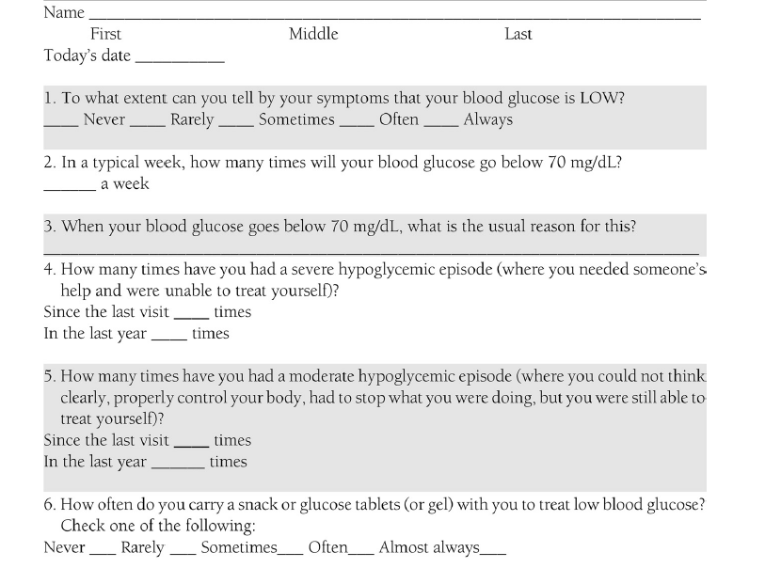
Hypoglycemia Patient Questionnaire
Seaquist ER, et al. J Clin Endocrinol Metab 98: 1845–1859, 2013

Slide 43
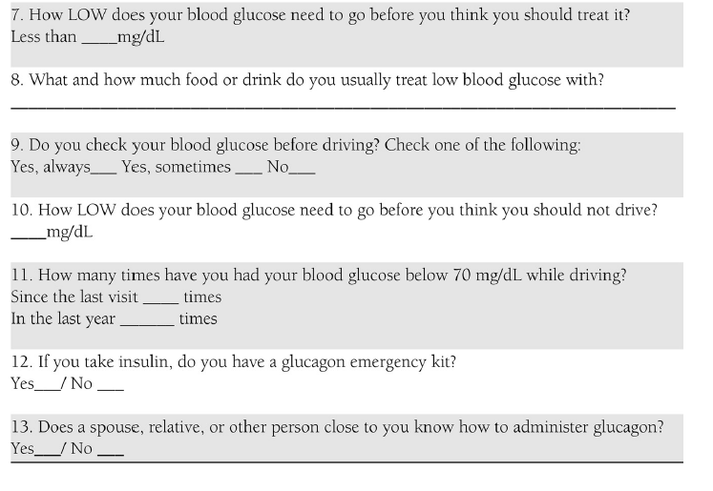
Hypoglycemia Patient Questionnaire
Seaquist ER, et al. J Clin Endocrinol Metab 98: 1845–1859, 2013

Slide 44
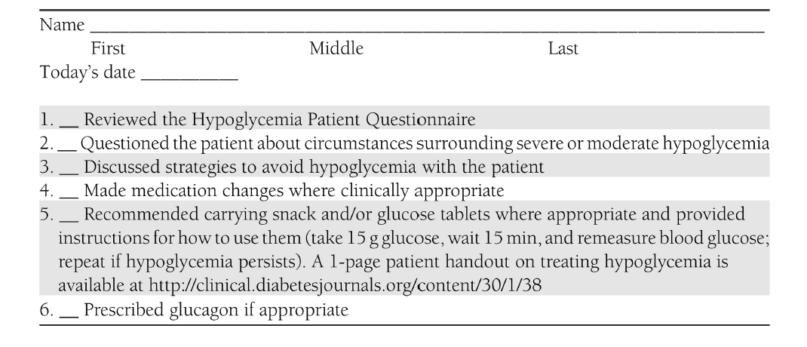
Hypoglycemia Provider Checklist
Seaquist ER, et al. J Clin Endocrinol Metab 98: 1845–1859, 2013

Slide 45
Recommendations of the International Hypoglycemia Study Group
People with diabetes treated with a sulfonylurea, a glinide, or insulin should
Be educated about hypoglycemia.
Treat SMPG levels ≤ 70 mg/dL to avoid progression to clinical iatrogenic hypoglycemia.
Regularly be queried about hypoglycemia, including the glucose level at which symptoms develop. Those developing symptoms at a glucose level < 55 mg/dL should be considered at risk.
Cryer P, et al. Diabetes Care 2015; 38: 1583–1591

Slide 46
Recommendations of the International Hypoglycemia Study Group
When hypoglycemia becomes a problem, the diabetes health-care provider should
Consider each conventional risk factor and those indicative of compromised glucose counterregulation.
Avoid sulfonylureas (and glinides) if possible, using insulin analogs when insulin is required, and consider using CSII, CGM, and CSII + CGM in selected patients.
Provide structured education and, in patients with impaired awareness of hypoglycemia, prescribe short-term scrupulous avoidance of hypoglycemia.
Seek to achieve the lowest A1C level that does not cause severe hypoglycemia and preserves awareness of hypoglycemia.
CSII: Continuous Subcutaneous Insulin Infusion, CGM: Continuous Glucose Monitoring
Cryer P, et al. Diabetes Care 2015; 38: 1583–1591

Slide 47
Treatment

Slide 49
Examples of 15–20 g oral carbohydrates for treatment of hypoglycemia

Slide 50
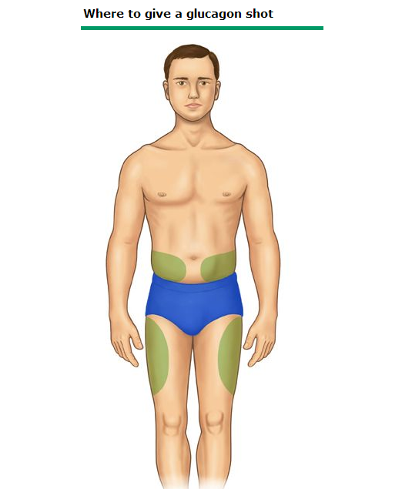
Glucagon kit

Slide 51
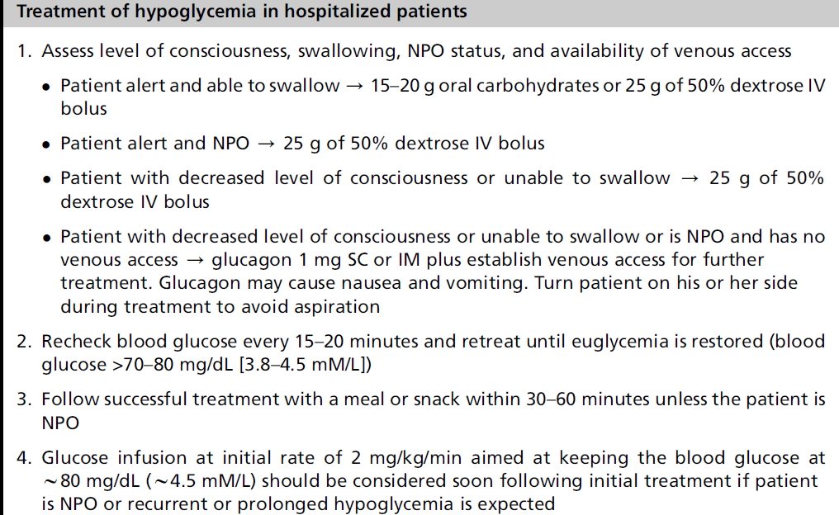

Slide 52
Return to the case problem

Slide 53
A case vignette:
A 72 year-old woman with history of T2DM since 12 years ago, was brought to emergency department because of loss of consciousness.
She has history of hypertension and coronary heart disease.
Medications:
Glibenclamide 20 mg/d
Metformin 2000 mg/d
Losartan 50 mg/d
Propranolol 60 mg/d
ASA 80 mg/d

Slide 54
A case vignette:(cont.)
POC glucose measurement showed a plasma glucose concentration of 32 mg/dL.
After infusion of hypertonic glucose, she was conscious and oriented.
She reports anorexia, nausea, vomiting and diarrhea over the past 2 days.
She denies any alarming symptoms preceding loss of consciousness.
Her last visit by primary care physician was in about 1 year ago.

Slide 55
A case vignette:(cont.)
Etiology of hypoglycemia?
Further assessment?
Short- and long-term management?

Slide 56
Conclusions:
Glycemic control, a worthwhile goal for people with diabetes, is limited by the barrier of iatrogenic hypoglycemia.
Hypoglycemia is a fact of life for most people with type 1 diabetes.
Adults with insulin-treated type 2 diabetes mellitus experience a lower frequency of hypoglycemia but frequency rises progressively with increasing duration of insulin therapy.

Slide 57
Conclusions:
Hypoglycemia has a substantial clinical impact in terms of mortality, morbidity and quality of life.

Slide 58
Conclusions:
Effective approaches known to decrease the risk of iatrogenic hypoglycemia include:
Patient education
Dietary and exercise modifications
Medication adjustment
Careful glucose monitoring by the patient
Conscientious surveillance by the clinician

Slide 59
با توجه به بهبود هوشياري بيمار توصيه شما براي ادامه درمان وي چيست؟
Thanks for your patience!
Admission for at least 72 hours
Serum : DW5% 100 cc / h
saline for hydration

