Slide 1
Adrenal CT
Pooneh Dehghan, MD
Assistant Professor of Radiology
Taleghani Hospital, SBMU

Slide 2
Adrenal CT
Morphology and anatomy in CT
Lesion characterisation

Slide 3
Location & Boundaries

Slide 4
Schematic presentation of the adrenal in CT

Slide 5
Shape
The shape of the gland is determined on the section where the gland was best seen.
In most cases the right gland appeared linear or slightly curvilinear.
The left gland had more of a V on a Y shape, but occasionally appeared more squat or triangular

Slide 6
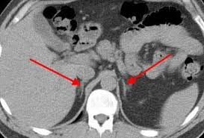
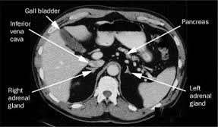

Slide 7
Location of right adrenal gland
Superiorly, the anterior margin of the right adrenal gland was immediately posterior to the inferior vena cava at the level of junction of the intra- and extrahepatic portions.
Its lateral margin was adjacent to the postenomedial aspect of the right lobe of the liver.
The separation of the gland from the liven was variable, depending on the amount of retroperitoneal fat.
The right crus of the diaphragm is just medial to the right adrenal.

Slide 8
Location of left adrenal gland
The medial margin of the left adrenal gland is lateral to the left crus of the diaphragm, but somewhat more anterior than the right gland.
Its lateral margin is posterior to the pancreatic tail and to the splenic vessels.
Most of the right adrenal gland was cephalad to the upper pole of the right kidney, whereas the left gland and the superior pole of the left kidney were usually seen on the same sections.
The upper pole of the right gland was either at the same level or cephalad to the upper pole of the left gland.
The lower pole of both glands was cephalad to the renal vessels, but the left gland was frequently in closer apposition to the left renal pedicle than the right.

Slide 9
Length of the gland
The length of the gland was defined as its cephalocaudal dimension and the width as the greatest linear dimension seen on any single tomographic section.
The thickness of the adrenal gland was defined as its dimension perpendicular to the long axis of the gland or one of its limbs.
The greatest thickness at any site was the measurement recorded.
In the linear glands this tended to occur at the anterior portion, while in the V- and Y-shaped glands the site was usually at the junction of the limbs.
Thickness was not measured in triangular-shaped glands because a long axis could not be defined.

Slide 10
Length of the gland
The length of the gland was defined as its cephalocaudal dimension and the width as the greatest linear dimension seen on any single tomographic section.
The length of each adrenal gland was estimated by counting the number of transverse cross sections on which each was visualized.
The precise length could not be measured because of the associated partial volume error in estimating the cephalad and caudal extent of each gland.

Slide 11
Dimensions of the gland
Adrenal glands can be divided into a body, medial and lateral limbs.
Confusion in measurements due to inconsistent shape
Generally the measurements include: Length, Width and Thickness.
Thickness was the most consistent measurement and is universally accepted as the most reliable.

Slide 12
Thickness of the adrenal gland
Its dimension perpendicular to the long axis of the gland or one of its limbs.
In the linear glands this tended to occur at the anterior portion, while in the V- and Y-shaped glands the site was usually at the junction of the limbs.
Thickness was not measured in triangular-shaped glands because a long axis could not be defined

Slide 13
The greatest thickness at any site was the measurement recorded.

Slide 14
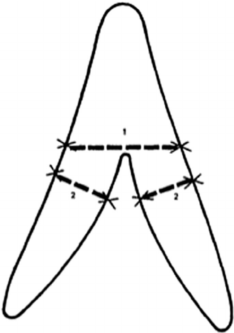
. Gland and limb thickness
Most of the left glands were 1 .0 cm thick, whereas most of the right glands were less than1 .0 cm.
The maximum normal adrenal limb thickness is 5 mm

Slide 15
Dimensions of the glands
The normal adrenal gland was usually seen on two on three consecutive cross sections, corresponding to an approximate length of 2-4 cm.
The width of each gland was determined on the section in which the adrenal appeared largest during the examination.
About 75% of the right adrenal glands and 80% of the left glands had a maximal width of 2.0-2.5 cm.

Slide 16
Measurements of all the parameters described may not be necessary or useful in all patients with suspected adrenal pathology.
Measurement of the length is severely restricted by the partial volume error that affects measurements of size in the plane perpendicular to the scanning beam.
Measurement of the width may be affected by the orientation of the adrenal axis with respect to the scanning plane.
The range of values for adrenal thickness was quite narrow, and initial evaluation of proven adrenal pathology in our department suggests that the thickness may be the most useful of the three measurements.

Slide 17
Lesion Characterization on CT
Findings that suggest a higher likelihood of malignancy
Large lesion size,
Irregular contour
Heterogeneous appearance
Pattern of enhancement
Temporal increase in size.

Slide 18
Size
Lesions greater than 4 cm in diameter have a higher likelihood to be either metastases or primary adrenal carcinomas
Using 3.0 cm as the maximum size cut-off, the sensitivity and specificity for adenomas was only 79 and 84%, respectively

Slide 19
Shape and growth pattern
Although it has been suggested that adenomas have a smooth contour, whilst malignant lesions have an irregular shape, this as a single feature is insufficient in discriminating
Rapid change in size does raise the suspicion of malignancy as adenomas are slow-growing lesions.

Slide 20
Intracellular Lipid Content of the Adrenal Mass
The majority (>70%) of adenomas have a high intracellular lipid content.
If an adrenal mass measures 0 HU or less, the specificity of the mass being a benign lipid-rich adenoma is 100% but the sensitivity is only an unacceptable 47%.
By using a threshold of 10 HU, the sensitivity and specificity for the detection of an adenoma at unenhanced CT is 89% and 100%, respectively.

Slide 21
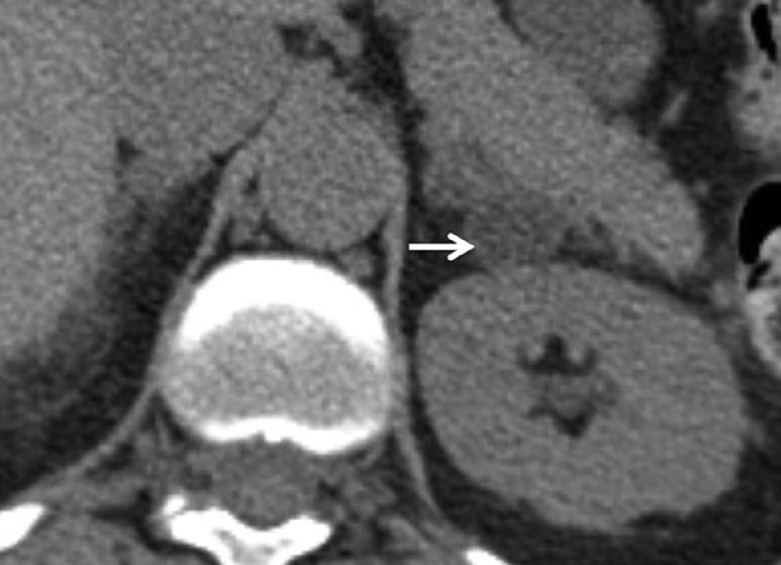
Unenhanced CT of the adrenal glands demonstrating a left-sided adenoma.
The non-contrast-enhanced CT attenuation value of the mass is –13 HU, consistent with a lipid-rich adenoma. If the adenoma demonstrates no biochemical function, no further imaging or follow-up would be necessary.

Slide 22
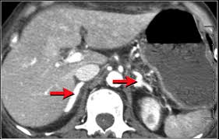
Contrast enhancement
The normal adrenal demonstrates uniform contrast enhancement on arterial and venous phase CT and the cortex cannot be distinguished from the medulla

Slide 23
Contrast Enhancement and Contrast Washout Characteristics
On unenhanced CT, up to 12–30% of benign adenomas have an attenuation value of greater than 10 HU and are considered lipid poor.
Malignant lesions and phaeochromocytomas are also lipid poor.
Adenomas enhance rapidly after contrast medium administration and also demonstrate a rapid washout of contrast medium.
Malignant lesions and phaeochromocytomas enhance rapidly but demonstrate a slower washout of contrast medium.

Slide 24
The difference in contrast enhancement washout characteristics between adenomas and malignant lesions has been shown to be a consistent and reliable technique.
The percentage of contrast enhancement washout between enhanced images acquired 60 s after contrast medium administration and the delayed images acquired 15 min after contrast medium administration can be used to differentiate adenomas from malignant lesions

Slide 25
Word of caution:
These contrast medium enhancement washout values are only applicable to relatively homogeneous masses without large areas of necrosis or haemorrhage.

Slide 26
% ACEW (Absolute Contrast Enhancement Washout)
If a 15-min delayed protocol is used, an absolute contrast enhancement washout of 60% or higher has a sensitivity of 86–88% and a specificity of 92–96% for the diagnosis of an adenoma
(VA - DA) / (VA - PCA) × 100
VA = venous attenuation, DA = delayed attenuation, and PCA = precontrast attenuation.

Slide 27
%RCEW (Relative Contrast Enhancement Washout)
Frequently, in clinical practice, only post-contrast are available.
In these patients, by performing a delayed 15-min CT the percentage relative contrast enhancement washout can be calculated thus:
(VA - DA) / VA × 100
After 15 min, if a relative enhancement washout of 40% or higher is achieved, this has a sensitivity of 96% and a specificity of 100% for the diagnosis of an adenoma.

Slide 28
In summary
Most lesions can be fully characterized by CT alone and require no further confirmatory imaging.
If an adrenal mass measures 0 HU or less, the lesion is definitely benign.
Lesions on unenhanced CT with an attenuation greater than 10 HU require further evaluation with either contrast-enhanced washout CT, MRI or scintigraphy.

Slide 29
Guidelines published by the American College of Radiology suggest that for lesions >4 cm in size, adrenal resection without any other additional imaging work-up should be considered once
biochemical evaluation to exclude phaeochromocytomas has been performed
if typical imaging features such as those seen in benign lesions such as myelolipomas, adenomas, cysts are not present.

Slide 30
The same guidelines also controversially suggest
In patients with no history of prior malignancy who present with a <4 cm adrenal mass
with benign imaging features such as smooth external contour and homogeneous appearance,
a follow-up in 6–12 months is adequate and no additional imaging with contrast enhancement or chemical shift imaging (CSI) MRI is required.
In the authors’ experience, other confirmative features of a benign lesion are needed before this guideline can be safely applied.

Slide 31
References
William W. Mayo-Smith, MD; Giles W. Boland, MD; Richard B. Noto, MD; Michael J. Lee, MD: “State-of-the-Art Adrenal Imaging”; RadioGraphics 2001; 21:995–1012
Pamela T. Johnson, MD • Karen M. Horton, MD • Elliot K. Fishman, MD: “Adrenal Imaging with Multidetector CT: Evidence-based Protocol Optimization and Interpretative Practice”; RadioGraphics 2009; 29:1319–1331P

