Slide 2
Management of Antithyroid Drug Therapy in Pregnancy
Fereidoun Azizi
Research Institute for Endocrine Sciences
Shahid Beheshti University of Medical Sciences
Tehran, I.R. Iran
15th International Congress of Endocrinology
August 31 - Sept. 4, 2016, Beijing, China

Slide 3
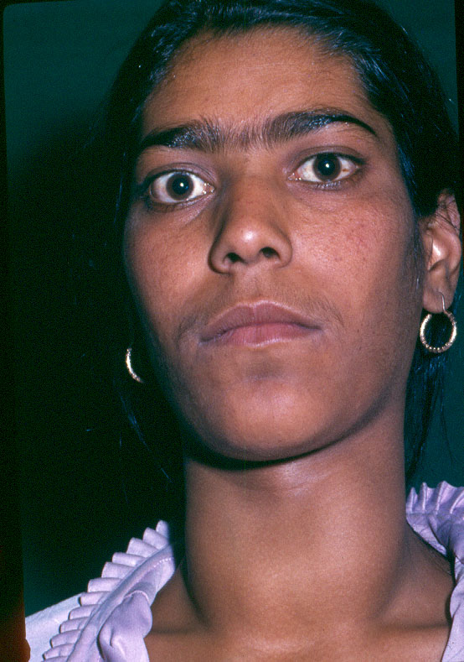
Thyrotoxicosis in pregnancy
Occurs in 0.2% of women
Mostly caused by Graves’ disease

Slide 4
Causes of hyperthyroidism in pregnant women
Graves’ disease
Gestational transient thyrotoxicosis
Molar pregnancy
Subacute or silent thyroiditis
Toxic adenoma
Multinodular toxic goitre
Iodine-induced thyrotoxicosis
Thyrotoxicosis factitia
Lao TT. Current Opin Obstet Gyne 2005; 17: 123

Slide 5
Guideline of the American Thyroid Association for the diagnosis and Management of Thyroid Disease during Pregnancy and Postpartum
The American Thyroid Association Taskforce on Thyroid Disease During Pregnancy and postpartum
Alex Stargnaro-Green (Chair), Marcos Abalovich, Erik Alexander, Fereidoun Azizi,
Jorge Mestman, Roberto Negro, Angelina Nixon, Elizabeth N. Pearce, Office P.
Soldin, Scott Sullivan and Wilmar Wiersinga
All: Thyrotoxicosis:
84 Questions 16
76 Recommendations 17
Thyroid 2011; 21: 1081-1125

Slide 6
Management of Thyroid Dysfunction during Pregnancy and Postpartum: An Endocrine Society Clinical Practice Guideline Leslie De Groot, Marcos Abalovich, Erik K. Alexander, Nobuyuki Amino, Linda Barbour, Rhoda H. Cobin, Creswell J. Eastman, John H. Lazarus, Dominique Luton, Susan J. Mandel, Jorge Mestman, Joanne Rovet, and Scott Sullivan J Clin Endocrinol Metab, August 2012; 97 (8): 2543-2565

Slide 7
Complications of thyrotoxicosis
in pregnancy
Maternal | Neonatal
Miscarriage Abruptio placenta Preterm delivery Preeclampsia CHF Thyroid storm | Hyperthyroidism Central hypothyroidism Prematurity IGR Fetal death ? Abnormalities
Adopted from Laurberg P et al. Europ J Endocrinol 2009; 160:1

Slide 8
WHAT IS THE RECOMMENDED MANAGEMENT OF GRAVES’ HYPERTHYROIDISM IN PREGNANCY?
Antithyroid drugs are the mainstay of therapy for hyperthyroidism during pregnancy
Azizi F. Expert Opin Daug saf 2006; 5: 107
Mandel SJ et al. J Clin Endocrinol Metab 2001; 86: 2354

Slide 9
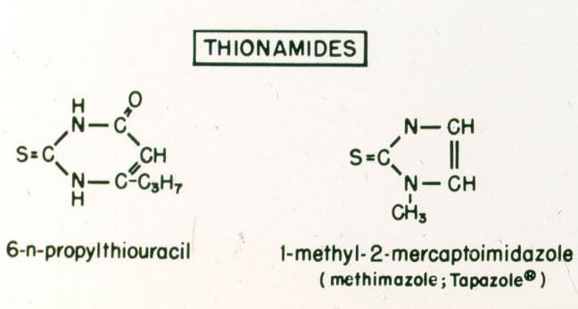
Notes:
Number 22

Slide 10
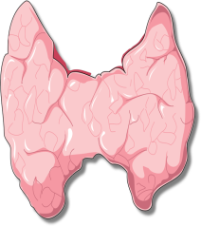
Mother
Placenta
Fetus
TRH
TRH
TSH
T3
T3
TSH
T4
T4
Stimulate
TSH receptor antibodies
Block
TPOAb & TgAb
Anti-thyroid drugs
Block
Spencer CA 2006

Slide 11
Notes:
Number 23

Slide 12
Management of hyperthyroidism during pregnancy in Asia Azizi F, Amouzegar A, Mehran L, Alamdari SH, Subekti I, Bijay V, Poppe K, Sarvghadi F, San Luis Jr T, Akamizu T Endocrin Journal, 2014; 61 (8): 751-758

Slide 13
A 26 year old woman is newly diagnosed with Graves’ disease. She has no goitre or thyroid eye disease and expresses her wish to become pregnant soon. Provided that the patient’s preference is neutral, how would you treat her thyrotoxicosis?
Methimazole/carbimazole
Propylthiouracil
Refer for definitive treatment with surgery before pregnancy
Refer to definitive treatment with radioiodine before pregnancy

Slide 14
A 26 year old woman is newly diagnosed with Graves’ disease. She has no goitre or thyroid eye disease and expresses her wish to become pregnant soon. Provided that the patient’s preference is neutral, how would you treat her thyrotoxicosis?
Variable | %
A. Methimazole/carbimazole | 40
B. Propylthiouracil | 52
C. Refer for definitive treatment with surgery before pregnancy | 4
D. Refer to definitive treatment with radioiodine before pregnancy | 4

Slide 15
Possible differences between PTU and MMI in pregnancy
Fractional transfer to the fetus less than MMI?
Aplasia cutis with MMI and not PTU
Choanal/esophagheal atresia with MMI
Liver failure with PTU

Slide 16
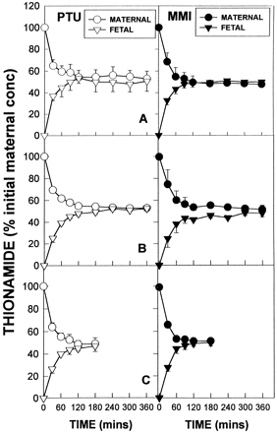
PTU and MMI levels (± SD), expressed as a percentage of initial concentration in maternal (circles) and fetal (triangles) circuits of the perfused human placental lobule.
Mortimer et al.JCEM 1997;82:3099

Slide 17
Congenital anomalies
Two epidemiological studies: no increase in the frequency of congenital anomalies in children prenatally exposed to MMI.
Momotani et al 1984; (243 MMI, 400 control)
Gianantonio et al 2001;(241 MMI,1089 control)
Increased rate of aplasia cutis in an area where MMI was used in animal feed
Martinez-Firas et al. Lancet 1992; 339: 742
Aplasia Cutis
Baseline occurrence rate: 1 in 33,000 births
Rate associated with MMI not different from baseline rate:
Van Dijke et al. Ann Inter Med 1987; 106: 60
Momotani et al. Clin Endocrinol 1994; 20: 695
Azizi F. Int J Endoc Metab 2008; 4: 109
↑sinus inverses ± dextrocardia, kidney a/dysgenesis and cardiac outflow tract defect with PTU
Clementi et al. JCEM 2010; 95: E337

Slide 18
Reports of Choanal Atresia and Gastro-intetinal Anomalies with Methimazol/Carbimazole
Author, Year | Choanal Atresia | GI anomaly
Greenberg, 1987 | Bilateral | ___
Ramirez et al, 1992 | ___ | EA/TEF
Johnsson et al, 1997 | Bilateral | EA/TEF
Hall, 1997 | Bilateral | ___
Wilson et al, 1998 | Bilateral | ___
Clementi et al, 1999 | Bilateral | EA/TEF
Di Gianantonio et al, 2001 | + | EA
Karlsson et al, 2002 | ___ | Omphalocele, EA/TEF
Barwell, et al, 2002 | Bilateral | ___
Babero et al, 2004 | Bilateral | ___
Foulds et al, 2005 | + | ___
Myers & Reardon, 2005 | + | ___
Wolf et al, 2006 | + | ___
Andersen et al, 2013 | + | +
General incidence | 1:10,000 | EA: 1,2500-4,500
EA; esophageal atresia; TEF: tracheo-esophageal fistula

Slide 19
Expected yearly occurance of congenital anomalies in hyperthyroid pregnancies unrelated to ATD in the world
No of birth / year | 140,000,000
No of pregnant hyperthyroids (0.2%) | 28,000,000
Expected anomalies
Aplasia cutis (1:33,000) | 8
Choanal atresia (1:10,000) | 24
Esophageal atresia (1:3,500) | 80

Slide 20
Most Recent Studies and ATD Use in Pregnancy and Birth Defect
study | MMI exposed (n) | PTU exposed (n) | Controls (n) | MMI defects detected | PTU defects detected
Significant association
Yoshihara (2012) | 1231 | 1399 | 1906 | Aplasia cutis Abdom. Wall | None
Andersen (2012) | 1097 | 564 | 811,730 | Abdom. wall Aplasia cutis Eye; Urinary Digestive tract Respiratory; VSD | Face and neck Urinary
No association
Chen (2011) | 73 | 603 | 14,150 | None | None
Korelitz (2013) | 108 | 915 | 634,858 | None | None
Lo (2015) | 30 | 507 | 1171 | None | None
Gianetti (2015) | 124 | 52 | 203 | None | None

Slide 21
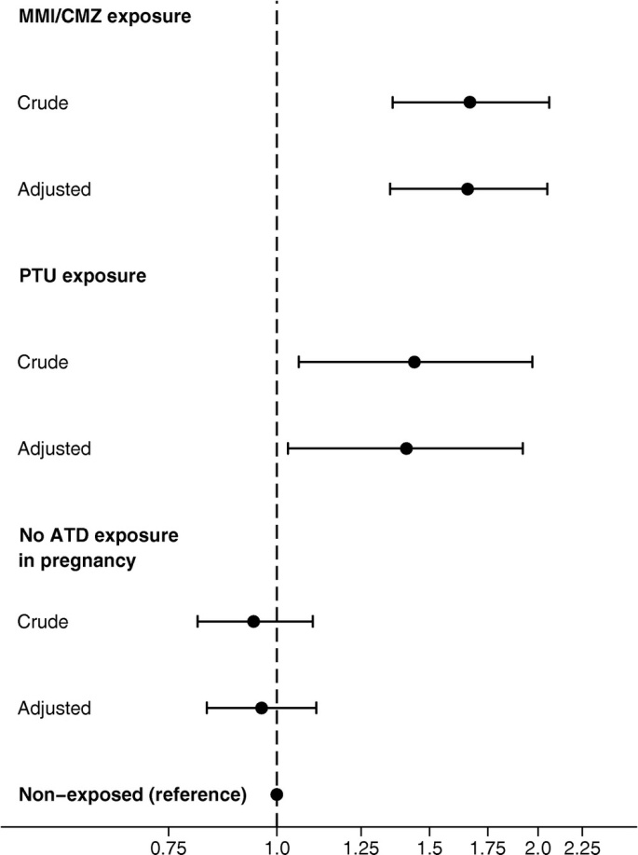
Odds ratio for having one or more birth defects diagnosed before 2 years
of age in children exposed to methimazole/carbimazole and propylthiouracil
Andersen SL, et al. J Clini Endocrinol Metab 2013, 98: 4373-4381.

Slide 22
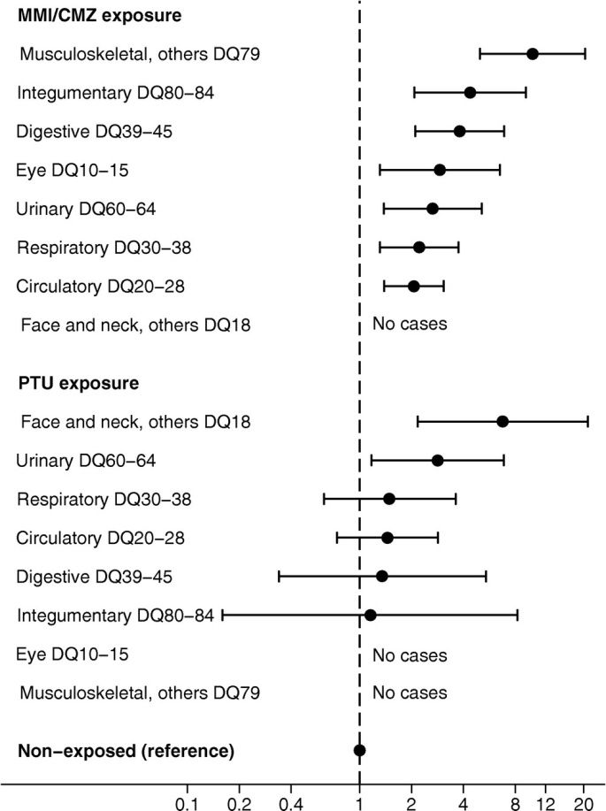
Subgroups of birth defects with significant association to
antithyroid drug (ATD)
Andersen SL, et al. Andersen SL, et al. J Clini Endocrinol Metab 2013, 98:4373-4381.

Slide 23
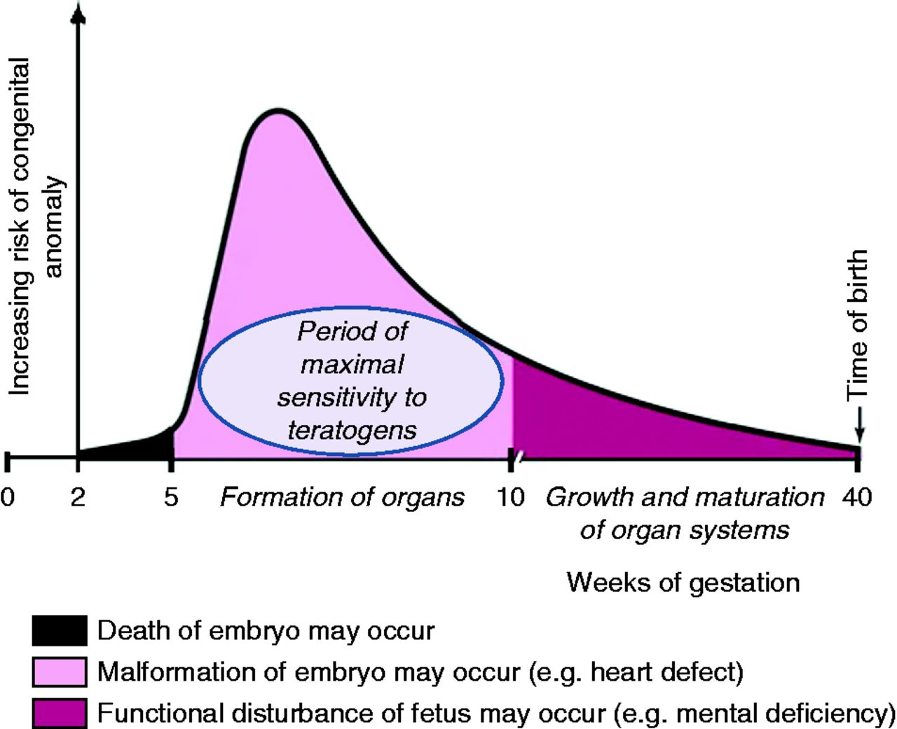
Schematic illustration showing the time period in gestational weeks of maximal sensitivity to abnormal development in humans
Peter Laurberg, and Stine Linding Andersen .Eur J Endocrinol 2014;171:R13-R20
Notes:
Schematic illustration showing the time period in gestational weeks of maximal sensitivity to abnormal development in humans. Note that no embryo is present during the 1st and 2nd gestational weeks, because the average time span from 1st day of last menstrual period to conception is 2 weeks. Thus, gestational weeks 6–10 correspond to embryological weeks 4–8. The figure is adapted from Moore et al. (12) with permission. Full colour version of this figure available via http://dx.doi.org/10.1530/EJE-14-0135

Slide 24
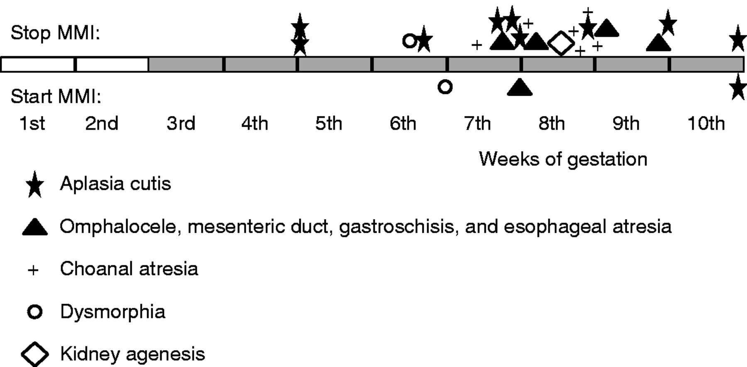
Gestational week in children exposed to MMI/CMZ
during first 10 weeks
Peter Laurberg, and Stine Linding Andersen. Eur J Endocrinol 2014;171:R13-R20
Notes:
Data from a literature search. Symbols indicate the gestational week when start or stop of MMI/CMZ therapy was reported in 24 cases of MMI/CMZ-associated birth defects where change of medication had occurred in early pregnancy (7, 8, 10, 23, 24, 25, 26, 27, 28, 29, 30, 31, 32, 33, 34, 35). Symbols above the line indicate that MMI/CMZ exposure took place until the symbol. Symbols below the line indicate that MMI/CMZ exposure took place after the symbol. Additional birth defects were recorded in some of the cases. A case of choanal atresia after stop of MMI at 7 weeks of pregnancy had started ATDs at 4 weeks of pregnancy (25), and a case of facial dysmorphia after stop of MMI at 5½ weeks of pregnancy had restarted MMI at 9 weeks of pregnancy (28).

Slide 25
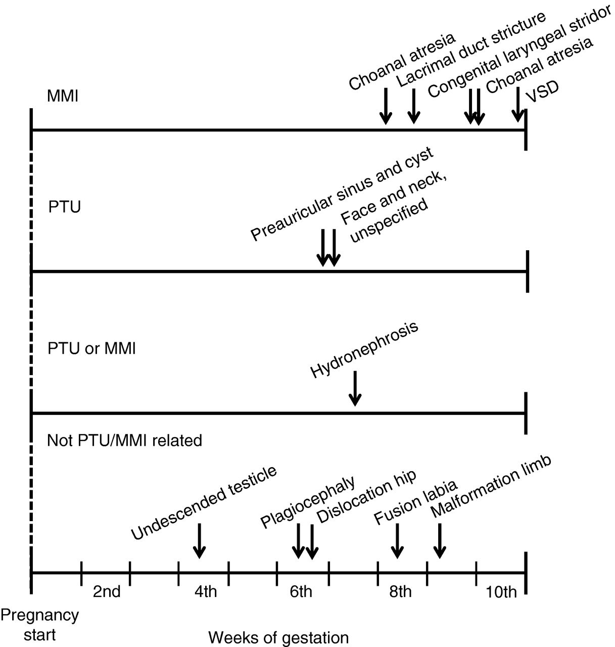
Data from the Danish National Registry study on birth defects after early pregnancy use of ATDs
Peter Laurberg, and Stine Linding Andersen. Eur J Endocrinol 2014;171:R13-R20
Notes:
Data from the Danish National Registry study on birth defects after early pregnancy use of ATDs (11). Arrows indicate the week of gestation when shift from MMI/CMZ to PTU had been performed in 13 children with birth defects. Patients were stratified according to the type of birth defect in the registry study (11): associated with early pregnancy MMI/CMZ therapy, with PTU therapy, with PTU or MMI/CMZ therapy, and not associated with ATD therapy. Time of shift and the type of birth defect in individual children is indicated by arrows. Data adapted from Andersen et al. (11).

Slide 26
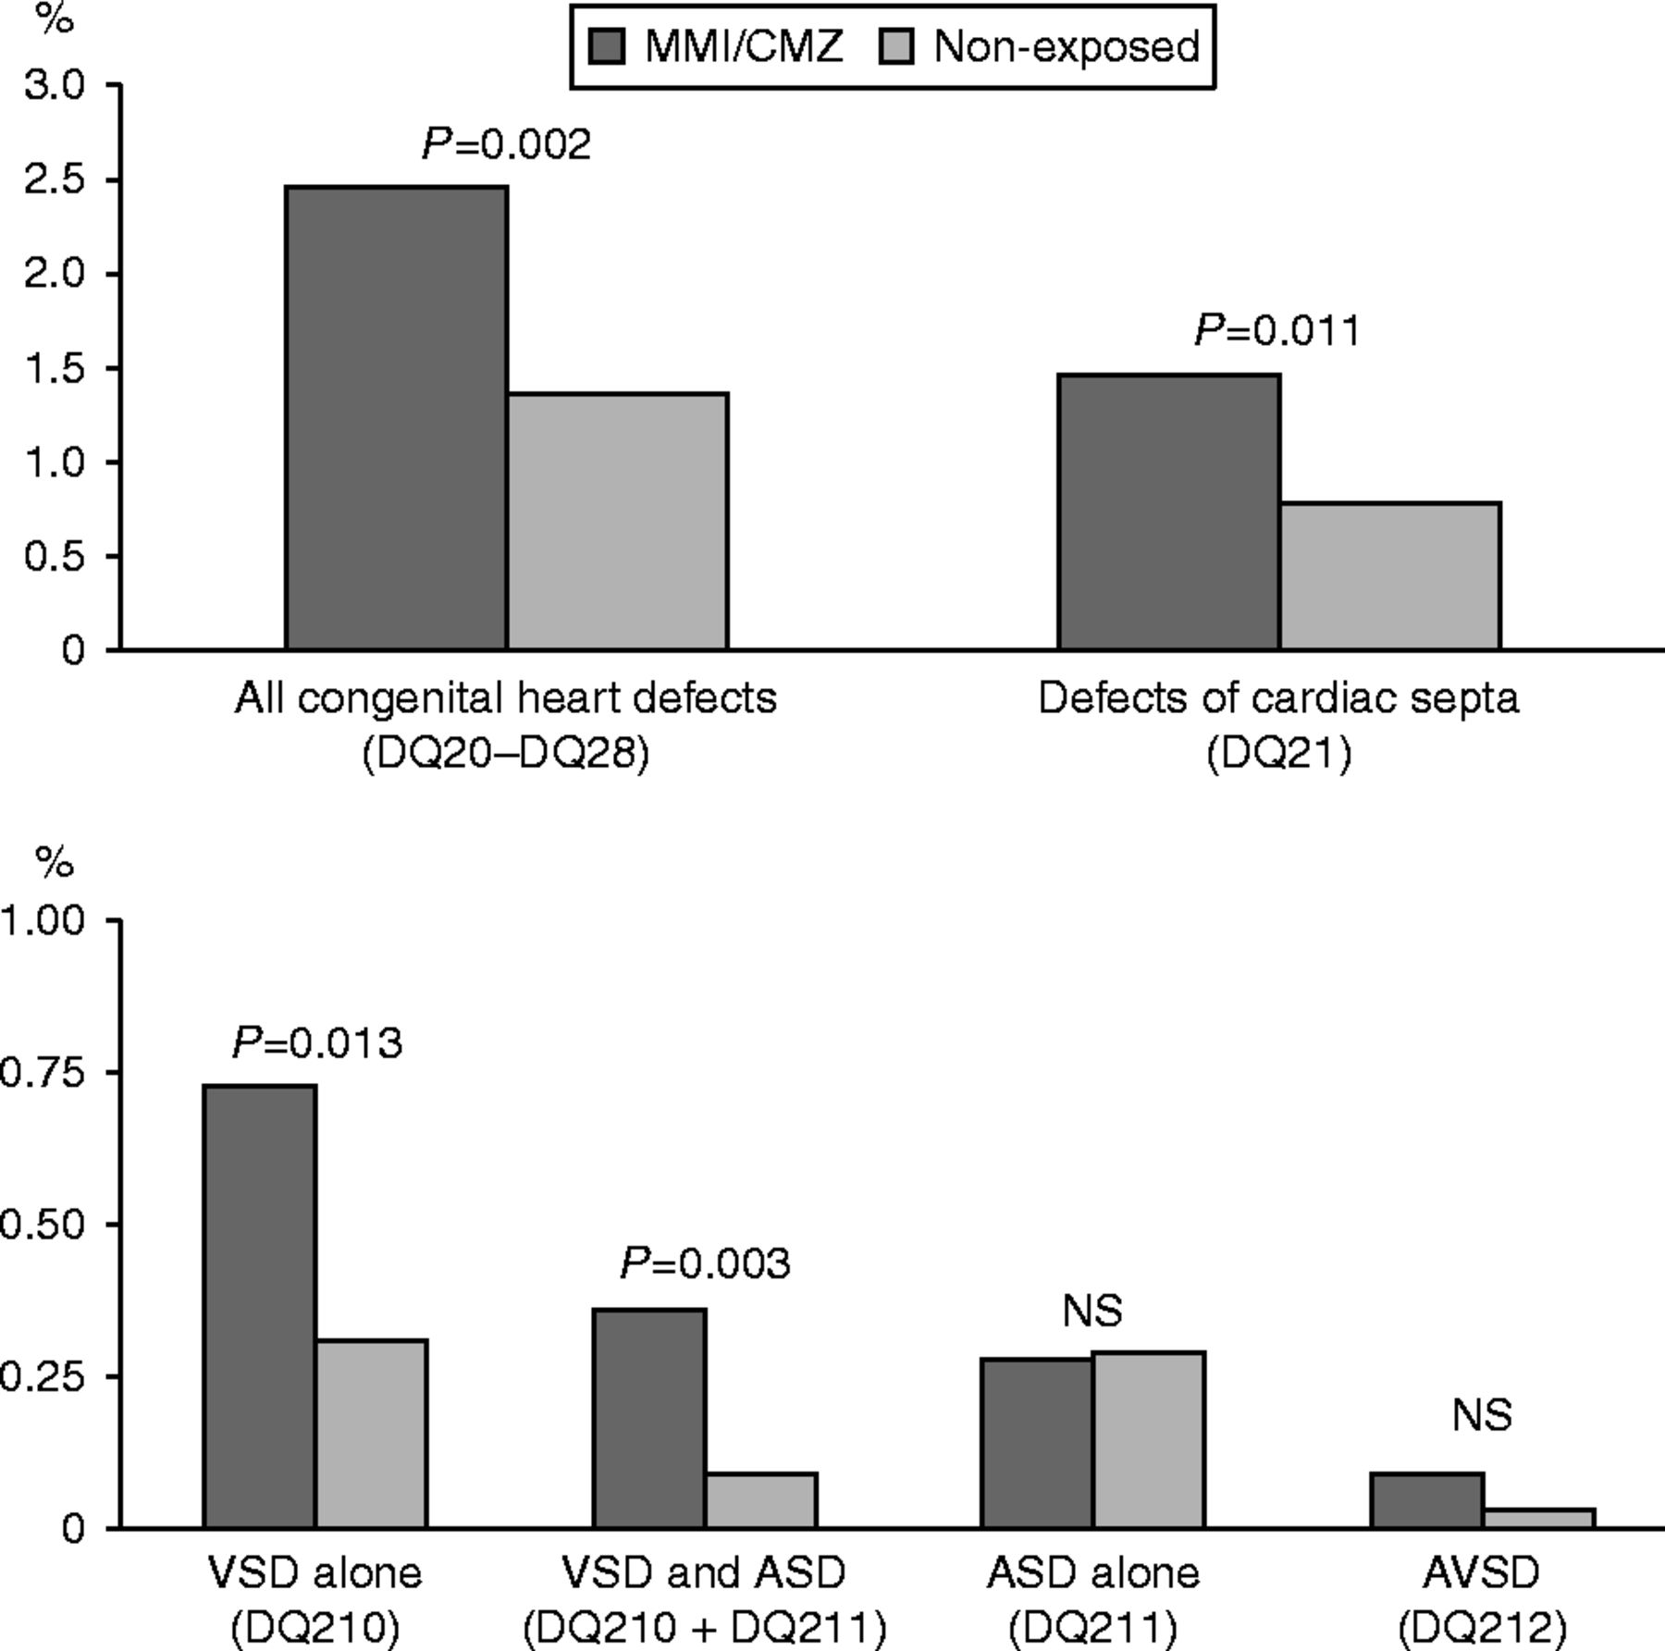
Prevalence of congenital heart defects in children exposed to methimazole/carbimazole (MMI/CMZ) in early pregnancy (n=1097) and non-exposed children (n=811 730)
Stine Linding Andersen, and Peter Laurberg. Eur J Endocrinol 2014;171:C1-C3
Notes:
Prevalence of congenital heart defects in children exposed to methimazole/carbimazole (MMI/CMZ) in early pregnancy (n=1097) and non-exposed children (n=811 730). The children were followed from birth to a median age of 8.3 years (range 0–15 years), as previously described (8). Among all congenital heart defects (DQ20–28), the subgroup ‘defects of cardiac septa’ (DQ21) was significantly associated with MMI/CMZ exposure (upper figure). Among defects of cardiac septa (lower figure), all MMI/CMZ-exposed cases had a diagnosis of DQ210 (VSD, ventricular septal defect), DQ211 (ASD, atrial septal defect) or DQ212 (AVSD, atrioventricular septal defect). P values are results of the χ² test: MMI/CMZ exposed vs non-exposed. NS, non-significant. DQ; diagnosis according to the 10th revision of the International Classification of Disease (ICD-10).

Slide 27
Reported cases of severe liver failure in pregnancy occurring secondary to PTU
Report | Country | Duration of PTU exposure (gestation) | Management | Maternal outcom | Fetal outcome
Parker | Canada | 6 months (20 weeks) | PTU discontinued; treated with MMI and propranolol | Recovered | Not described
Morris et al. | USA | Unclear (25 weeks) | PTU discontinued; treated with MMI and propranolol; required liver transplant | Recovered | Growth retardation, premature, jaundice, fetal death
Kontoleon et al. | Greece | Unclear | Cessation of PTU at 12 weeks; conversion to CBZ | Recovered Uneventful | Recovered Uneventful
Ruiz et al. | Chile | 5 months (4 months) | Liver failure requiring ICU, initial recovery; however, subsequent miscarriage and recurrence of liver failure and death | Death | Death
Sequeira et al. | Kenya/ USA | 7 weeks (17 weeks) | Liver transplant at 18 weeks’ gestation. Thyroidectomy | Recovered | MRI features suggestive of antenatal ischemic encephalopathy. Developmental delay
Taylor et al. | UK | 16 weeks (20 weeks) | Immediate cessation of PTU; started CBZ 3 weeks later. Transplant considered but not required | Recovered | Healthy baby at term
Taylor PN, et al. Side effects of anti-thyroid drugs and their impact on the choice of treatment for thyrotoxicosis in pregnancy. Eur Thyroid J 2012; 1: 176-85

Slide 28
Major adverse reactions to propylthiouracil
22 serious liver injury over the past 20 years
(FDA Adverts Event Reporting System)
9 death
5 liver transplants
16 adults liver transplants for PTU-related liver failure
(United Network for Organ Sharing)
Ocurrence:
1: 10,000 adults
1: 2,000 children
Liver failure can occur any time over the course of therapy
Bahn et al. Thyroid 2009; 19: 673

Slide 29
Reported cases of agranulocytosis secondary to antithyroid drugs during pregnancy and subsequent outcomes
Taylor PN, et al. Side effects of anti-thyroid drugs and their impact on the choice of treatment for thyrotoxicosis in pregnancy. Eur Thyroid J 2012; 1: 176-85

Slide 30
Comparison of recommendations of American Thyroid Association and Endocrine Society on the treatment of hyperthyroidism in pregnancy
Topic | Recommendations
 | American Thyroid Association (2011) | Endocrine Society (2012)
Antithyroid (ATD) treatment | PTU is preferred for the treatment of hyperthyroidism in the first trimester, patients on MMI should be switched to PTU if pregnancy is confirmed in the first trimester. Following the first trimester, consideration should be given to switching to MMI | Propylthiouracil (PTU), if available, is recommended as the first-line drug for treatment of hyperthyroidism during the first trimester of pregnancy because of the possible association of methimazole (MMI) with specific congenital abnormalities that occur during first trimester organogenesis, MMI may also be prescribed if PTU is not available or if a patient cannot tolerate or has an adverse response to PTU. Practitioners should use their clinical judgment in choosing the ATD therapy, including the potential difficulties involved in switching patients from one drug to another, If switching from PTU to MMI, thyroid function should be assessed after 2 wk and then at 2-to 4-wk intervals.
Alamdari S, Azizi F, et al. J thyroid Res, 2013

Slide 31
Ways to restrict the teratogenic effect of ATD in early pregnancy
To advocate ablative therapy before attempting conception
Change MMI to PTU before planning for pregnancy
Early detection of pregnancy (<5 wk) and change to PTU
Early detection of pregnancy, withdraw ATD and weekly TFT’s

Slide 32
The following recommendation is based on limited or inconsistent scientific evidence (Level B):
Either propylthiouracil or methimazole, both thioamides, can be used to treat pregnant women with overt hyperthyroidism.
The American College of Obstetricians and Gnecologists, 2015

Slide 33
What tests would you use to monitor the dose of antithyroid drugs in pregnancy?
Free T4 alone TSH and Free T4 TSH alone | D. TSH, and total T4 E. TSH, total T4 and total T3 F. Other

Slide 34
What tests would you use to monitor the dose of antithyroid drugs in pregnancy?
Variable | %
A. Free T4 alone | 9
B. TSH and FreeT4 | 53
C. TSH Alone | 20
D. TSH, and total T4 | 5
E. TSH, total T4 and total T3 | 9
F. Other | 4

Slide 35
What are the target thyroid test results you aim to achieve with antithyroid drugs in pregnancy?
TSH and FT4 (or TT4) in the normal range
Low TSH and FT4 (or TT4) in the normal range
Low TSH and FT4 (or TT4) in the upper end of the normal range
Low TSH, independent of FT4 (or TT4) levels
Other (please specify)

Slide 36
What are the target thyroid test results you aim to achieve with antithyroid drugs in pregnancy?
Variable | %
TSH and FT4 (or TT4) in the normal range | 24
B. Low TSH and FT4 (or TT4) in the normal range | 6
C. Low TSH and FT4 (or TT4) in the upper end of the normal range | 66
D. Other (please specify) | 4

Slide 37
Should anithyroid drug therapy be discontinued in the last part of pregnancy?
Can postpartum recurrence of Graves’ disease be prevented by the continuation of antithyroidis during pregnancy?

Slide 38
Postpartum recurrence and exacerbation of Graves’ hyperthyroidism
Nekagawa et al. Clin Endocrinol 57: 467,2002

Slide 39
What are the long-term effects of antithyroid treatment in pregnancy on growth, intellectual development and thyroid function of the offspring?

Slide 40
Wechsler tests scores in children whose mothers were taking methimazol (MMI)
( ), and in control ( )
20
control
case
15
IQ (verbal)
10
5
0
Information
Vocabulary
Mathe matics
Similarities
Comprehension
Sentences
Azizi et al.J Endocrinol Invest 2002;25:586

Slide 41
In a pregnant woman with Grvaves’ disease treated with antithyroid drug, do you routinely chack TSH receptor antibodies?
No
Yes, in each trimester
Yes, in the first and third trimester
Yes, in the first trimester, and if positive in the third trimester

Slide 42
In a pregnant woman with Grvaves’ disease treated with antithyroid drug, do you routinely chack TSH receptor antibodies?
Variable | %
No | 43
B. Yes, in each trimester | 11
C. Yes, in the first and third trimester | 10
D. Yes, in the first trimester, and if positive in the third trimester | 32

Slide 43
TSH receptor antibody tests: Diagnostic use
True GD hyperthyroidism can not occur without TRAb
The use of TRAb as the primary test in the workup?!
Differential diagnostic test of hyperthyroidism:
Radioiodine uptake and scan $1000
Third generation TRAb test $70
TBI assays: 99% specificity and 97% sensitivity in untreated hyperthyroids
Differential test from:
Subacute painless thyroiditis
Postpartum thyroiditis
Interferon induced thypotoxicosis
Amiodaron-induced thyrotoxocosis (type 1)
Barbesino G, et al. J Clin Endocrinol Metab 2013; 98: 2247.
Kahaly GJ, Thyroid 2011; 21: 585–591.
Davies TF, J Clin Endocrinol Metab 1998; 83: 3777–3785.

Slide 44
TSH receptor antibody in pregnancy
A significant decrease in TRAb during pregnancy
Euthyroid or hypothyroid GD patients may still have high TRAb
High TRAb is more common after radioiodine therapy
Fetal and neonatal thyrotoxicosis occur in 1-5% of mothers with current or past GD.
TRAb is the best predictor (predictive value 42%)
Over 3 times UNL of TRAb at 24-28 weeks →close follow-up of the fetus.
Barbesino G, et al. J Clin Endocrinol Metab 2013; 98: 2247.
Kamijo K. Endocr J 2007;54:619–624.
Laurberg P, et al. Eur J Endocrinol 2009; 160: 1–8.

Slide 45
WHAT IS THE VALUE OF TSHRAB MEASUREMENT IN THE EVALUATION OF A PREGNANT WOMAN WITH GRAVES’ HYPERTHYROIDISM?
If the patient has a past or present history of Graves’ disease, a maternal serum measure of TSHRAb should be obtained at 24-28 weeks gestation.
Lution O et al. J Clin Endocrinol Metab 2005; 90: 6093
Laurberg P et al. Europ J Endocrinol 2009;160: 1-8
Zwaveling- Soonawala N et al. Thyroid 2009; 19: 661-2.

Slide 46
TSH receptor autoimmunity in Graves’ disease after therapy
70
60
50
40
TRAb %
30
Radioiodine
20
Surgery
10
Medication
0
0 1 2 3 4 5
Laurberg et al EJE 2008
Years

Slide 47
Measurements of TSH-Receptor antibodies in a pregnant woman with Graves’ disease
Patient status | Measurement
1. Euthyroid-previous ATD only | Not necessary
2. Euthyroid/hypothyroid +/- T4 | Check in early pregnancy:
therapy, previous ¹³¹I/surgery | if low or absent, no further testing
 | if high, check fetus and check
 | antibodies in last trimester
3. Receiving ATD during pregnancy | Measure in last trimester
Lazarus, Thyroid 12: 861, 2002

Slide 48
UNDER WHAT CIRCUMSTANCES SHOULD ADDITIONAL FETAL ULTRASOUND MONITORING FOR GROWTH, HEART RATE, AND GOITER BE PERFORMED IN WOMEN WITH GRAVES’ HYPERTHYROIDISM IN PREGNANCY?
Fetal surveillance should be performed in women who have uncontrolled hyperthyroidism or who have highly elevated TSHRAb titers. Such monitoring may include ultrasound monitoring for heart rate, growth, and fetal goiter.
Papendieck P et al. J Ped Endocrinol Metabol 2009; 22: 547

Slide 49
Management of thyrotoxicosis in pregnancy
Confirm diagnosis
Start propylthiouracil in first trimester; methimazole in the 2nd and 3nd trimester
Render patient euthyroid: continue with low-dose ATD up to and during labor and postpartum
Monitor thyroid function:
Throughout gestation; adjust ATD if necessary to maintain
T4 at upper level of normal
Check TSHRAb at 26 weeks
Discuss treatment with patient
effect on patient
effect on fetus
breast feeding
Inform obstetrician and pediatrician
Review postpartum-check for exacerbation

Slide 50
Conclusion
Clinical (Overt) thyrotoxicosis is rather common during pregnancy and postpartum and influence the health of mother, fetus and infant.
Effective evidence based strategies for both detection and management should be developed for the benefit of both mother and child.
Prompt and appropriate treatment of hyperthyroidism could dramatically improve the pregnancy outcome and ensure health promotion for mother and infant.

Slide 52
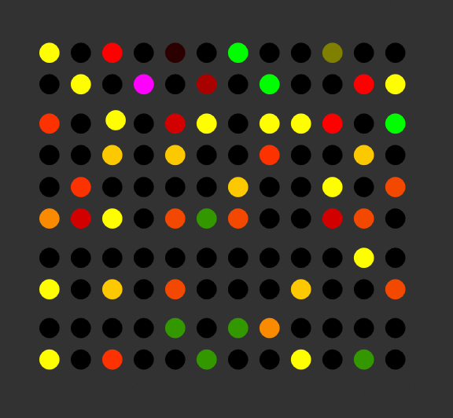
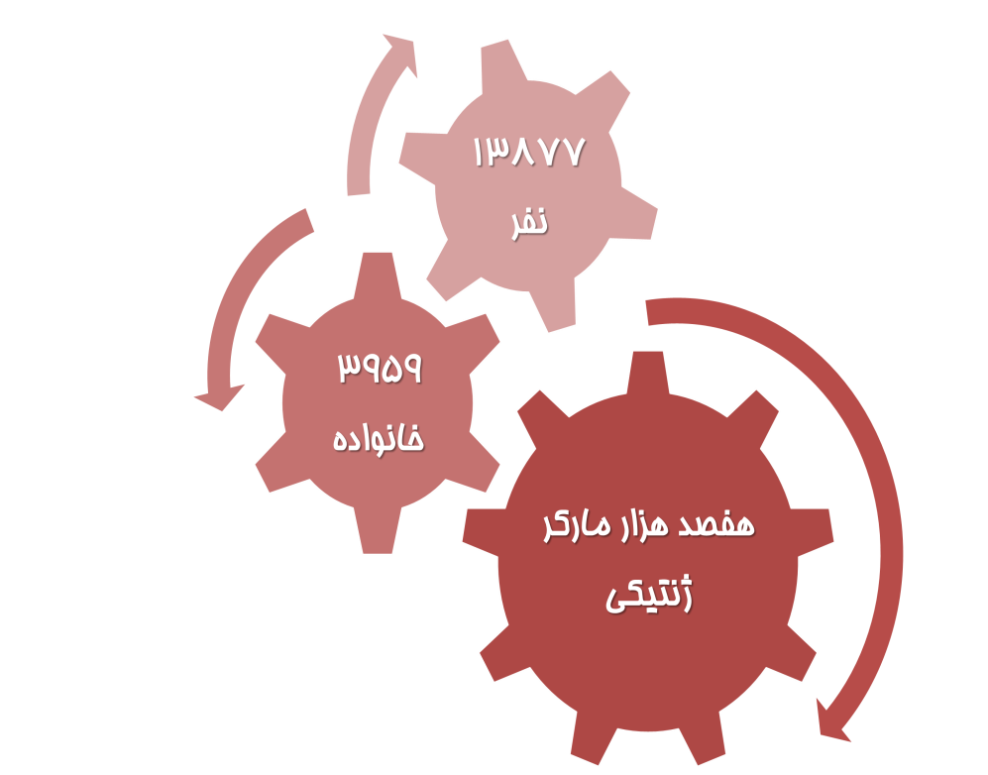
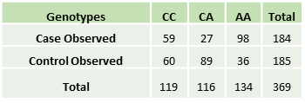
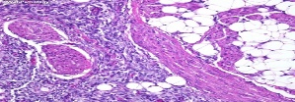
روند انجام مطالعه گسترده ژنومی
Genome Wide Association Study

