Slide 1
Cardiovascular safety of insulin therapy
F. Hosseinpanah, M.D.
Obesity Research Center
Research Institute for Endocrine sciences Shahid Beheshti University
of Medical Sciences
10-August -2017

Slide 2
Agenda
Introduction
Observational studies
RCTs
Conclusion

Slide 3
Introduction
Exogenous insulin is one of the most established blood glucose- lowering therapies, and its use in people with type 2 diabetes mellitus (T2DM) has grown markedly over recent years
While the benefits clearly outweigh the risks in the management of type 1 diabetes, emerging evidence suggests that this may not be the case for all people with type 2 diabetes
Initial concerns regarding the utility of insulin inT2DM emerged from epidemiological data characterizing the mortality impact of insulin from a large, population-based study in Canada, in which a dose–response relationship was observed between insulin use and all-cause mortality
Insulin use and increased risk of mortality in type 2 diabetes: a cohort study. Diabetes Obes Metab. 2010;12:47–53

Slide 4
Introduction
A hallmark of type 2 diabetes is resistance to insulin action
Furthermore, the broader negative clinical consequences of insulin resistance are—for the most part—a result of compensatory hyperinsulinaemia
This being the case, it would plausibly seem counter-productive to add to the problem with exogenous insulin therapy.
Currie CJ, Johnson JA. The safety profile of exogenous insulin in
people with type 2 diabetes: justification for concern. Diabetes Obes
Metab. 2012;14:1–4

Slide 5
Physiologic perspective
Consequence of hyperinsulinemia
Hypoglycemia Weight gain
Increased retention of salt, water and uric acid in kidney
Increased sympathetic nervous system activity
Well-established role on cell growth, differentiation and proliferation
CMAJ 2011; 183: 536–537
AmJ Kidney Dis 1997; 30: 928–931
NatRev Cancer 2008; 8: 915–928

Slide 6
Objective: To compare population-based rates of all-cause and cardiovascular (CV) mortality in newly treated patients with type 2 diabetes according to levels of insulin exposure
Methods: Using the administrative databases of Saskatchewan Health, 12 272 new users of oral antidiabetic therapy were identified between 1991 and 1996 and grouped according to cumulative insulin exposure based on total insulin dispensations per year: no exposure (reference group); low exposure (0 to <3); moderate exposure (3 to <12) and high exposure (≥12)
F/U: 5.1 (s.d. 2.2) years
Diabetes, Obesity and Metabolism 12: 47–53, 2010

Slide 7
A consistent and graded increase in mortality
associated with increasing insulin exposure was observed

Slide 8
The magnitude of effect was smaller than all-cause mortality

Slide 9
Key messages
Our findings suggest that increasing levels of insulin exposure are associated with higher mortality in older patients with type 2 diabetes.
Owing to the observational design, it is always possible that some form of bias or residual confounding might provide an alternate explanation for our findings

Slide 10
A nested case-control study design among members of Kaiser Permanente Southern California(KPSC) was used to evaluate the association between average A1C and cardiovascular outcomes
A conditional logistic regression model was used to estimate the odds ratio of cardiovascular events and compare three patient groups based on average A1C measured in the preindex period (≤6, 6–8, >8%)
Diabetes Care 34:77–83, 2011

Slide 11
{
Each case subject was matched with four control subjects based on age and sex

Slide 12
Compared with the group with no diabetes medication use, patients using insulin (alone or in combination) experienced a 2.5-fold increase in the risk of a cardiovascular event

Slide 13
Objective : To characterize the risk of adverse events associated with glucose-lowering therapies in people with T2DM
Design: A retrospective cohort study using data from the UK General Practice Research Database, 2000–2010
Outcomes: The risk of the first major adverse cardiac event, first cancer, or mortality was measured. Secondary outcomes included these individual constituents and microvascular complications
J Clin Endocrinol Metab 98: 668–677, 2013

Slide 14
Adjusted variables
Age, gender, systolic blood pressure, HbA1c, total cholesterol, serum creatinine, body mass index, smoking status, other risk-factor management (antihypertensive, lipid-lowering, and antiplatelet therapy), duration of diabetes, prior history of cancer, LVD, microvascular disease, number of contacts with the general practitioner in the year prior to the index date, and the Charlson comorbidity index.

Slide 19
Key messages
In people withT2DM,exogenous insulin therapy was associated with an increased risk of diabetes-related complications, cancer, and all-cause mortality.
Differences in baseline characteristics between treatment groups should be considered when interpreting these results

Slide 20
Possible source of bias in observational studies
Exposure Misclassification
Time lag bias (confounding by indication)
Choice of comparator
Diabetes Care 2017;40:706–714

Slide 21
Time Lag bias

Slide 22
Inclusion criteria: Randomised control trials which randomised patients aged >18 years with Type 2 Diabetes (T2D) to insulin vs non-insulin GLT
18 RCTs with 19,300 participants
Diabetes Res Clin Pract. 2016 Nov;121:69-85

Slide 23
The primary outcomes of all-cause mortality and CV events were only reported by two trials involving a total of 13,317 participants in which 6738 were randomised to insulin and 6579 to the non-insulin arm

Slide 26
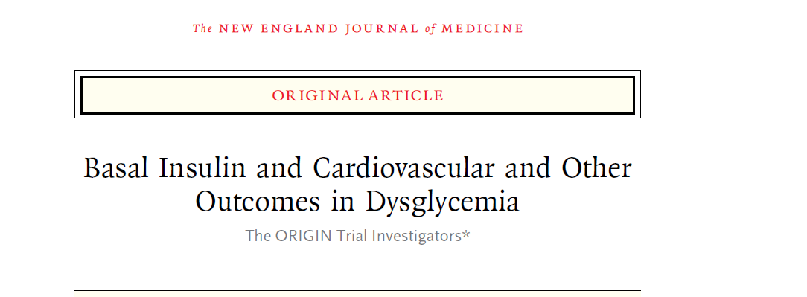
N Engl J Med. 2012 Jul 26;367(4):319-28

Slide 27
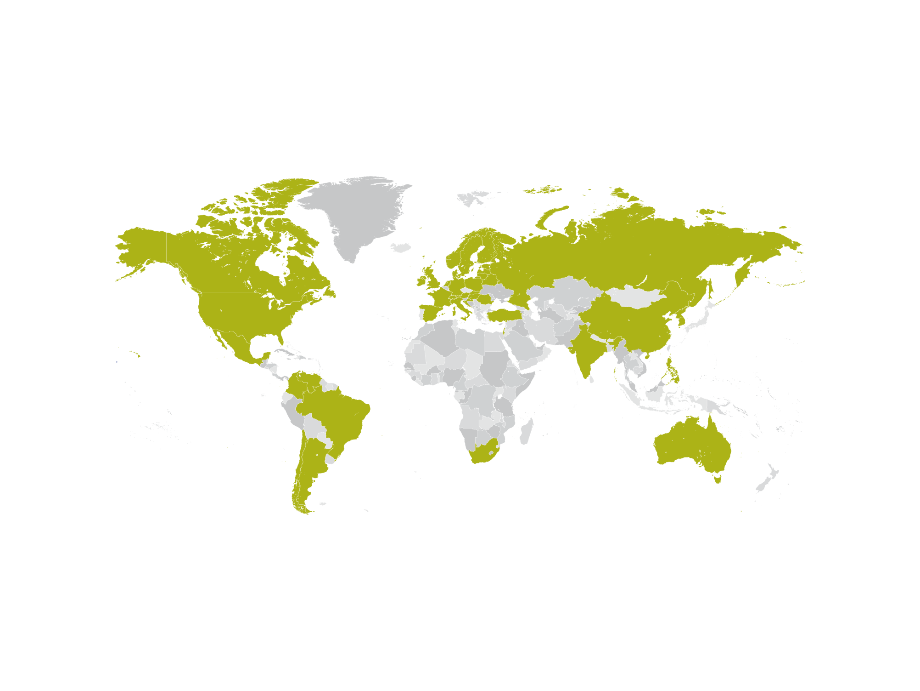
ORIGIN: An International Trial
Led by an independent Steering Committee
40 countries, >12500 patients, 6.2 years of follow-up
Gerstein HC, et al. Am Heart J 2008;155:26-32.

Slide 28
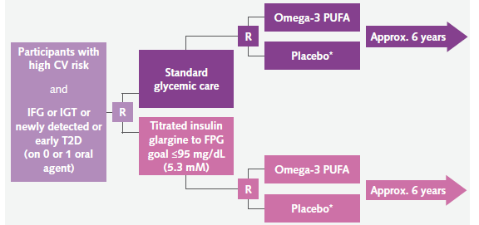
ORIGIN Study Design
Study objectives
To determine whether insulin replacement therapy, using insulin glargine to target fasting normoglycemia (FPG ≤95 mg/dL [5.3 mM]), can reduce CV morbidity and/or mortality in people at high CV risk with either IFG, IGT or early T2D
To determine whether omega-3 PUFA can reduce CV mortality in this population
Study design
Multicenter, international 2x2 factorial design
Approximately 12,500 patients randomised from 40 countries
1st co-primary endpoint:
Composite of CV death, nonfatal MI
or nonfatal stroke
2nd co-primary endpoint:
Composite of CV death, nonfatal MI
or nonfatal stroke or revascularization
procedure or hospitalization for heart
failure
Secondary endpoints:
Microvascular events
Rate of progression of IGT or IFG
to T2D
All-cause mortality
* Placebo of omega-3 PUFA
CV, cardiovascular; FPG, fasting plasma glucose; IFG, impaired fasting glucose; IGT, impaired glucose tolerance;
MI, myocardial infarction; PUFA, polyunsaturated fatty acids; T2D, type 2 diabetes
Gerstein HC, et al. Am Heart J 2008;155:26-32.
28
28
ORIGIN Trial Investigators, et al. N Engl J Med 2012: June 11 [Epub ahead of print].

Slide 31
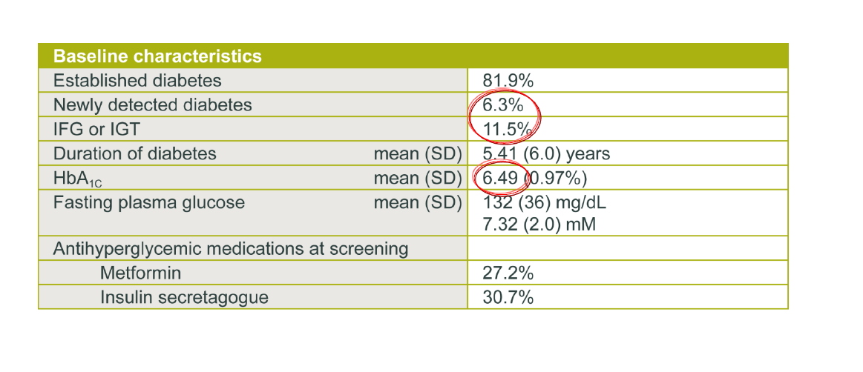

Slide 32
Baseline Characteristics – CV Profile
Baseline characteristics are balanced and include a population at high CV risk
 | Insulin Glargine (N=6264) | Standard (N=6273)
Demographics
Mean (SD) Age (yrs) | 63.6 (7.8) | 63.5 (7.9)
Females (%) | 2082 (33.2) | 2304 (36.7)
Prior CV Event (%)* | 3712 (59.3) | 3666 (58.4)
Hypertension (%) | 4974 (79.4) | 4989 (79.5)
Current Smoking (%) | 781 (12.5) | 771 (12.3)
Any Albuminuria (%) | 939 (15.0) | 985 (15.7)
ABI < 0.9 (%) | 470 (7.5) | 501 (8.0)
Other CV Risk Factors
Mean (SD) Systolic BP (mm Hg) | 146 (22) | 146 (22)
Mean (SD) Diastolic BP (mm Hg) | 84 (12) | 84 (12)
Mean(SD) Body Mass Index (kg/m²) | 29.8 (5.2) | 29.9 (5.3)
Mean (SD) LDL Cholesterol (mg/dl) | 113 (40) | 112 (40)
Mean (SD) Creatinine (mg/dl) | 1.0 (0.2) | 1.0 (0.2)
Other CV Drugs
Statin (%) | 3373 (53.8) | 3367 (53.7)
ACE-I or ARB (%) | 4330 (69.1) | 4351 (69.4)
Beta Blocker (%) | 3273 (52.3) | 3325 (53.0)
Other BP Drug (%) | 2567 (41.0) | 2577 (41.1)
Antiplatelet (%) | 4296 (68.6) | 4370 (69.7)
32
* MI, stroke or revascularisation
ORIGIN Trial Investigators, et al. N
Notes:
32

Slide 33
Baseline Characteristics – Glycemic Profile
 | Insulin Glargine (N=6264) | Standard (N=6273)
Glycemic Characteristics
Prior DM on oral agent (%) | 3748 (59.8) | 3692 (58.9)
Prior DM drug naive (%) | 1414 (22.6) | 1467 (23.4)
New DM (%) | 365 (5.8) | 395 (6.3)
IGT/IFG (%) | 735 (11.7) | 717 (11.4)
Mean (SD) Years of Diabetes | 5.5±6.1 | 5.3±5.9
Median (IQR) FPG (mg/dl) | 125 (109, 148) | 124 (108, 148)
Median (IQR) A1c (%) | 6.4 (5.8, 7.2) | 6.4 (5.8, 7.2)
Glycemic Drugs
Metformin (%) | 1694 (27.0) | 1741 (27.8)
Sulfonylurea (%) | 1901 (30.3) | 1810 (28.9)
Other (%) | 173 (2.8) | 178 (2.8)
* MI, stroke or revascularisation
ORIGIN Trial Investigators, et al. N
Notes:
33

Slide 36
Insulin Glargine Dose – Steady Dose Maintained For Study Duration
ORIGIN Trial Investigators, et al. N
Notes:
36

Slide 37
A1C Levels: Consistently Below 6.5% Over 7 Years
Insulin glargine patients achieve and maintain a significantly lower HbA1c for the duration of the study compared with standard care (p < 0.001)
ORIGIN Trial Investigators, et al. N
Notes:
37

Slide 38
Adherence to Insulin Glargine Remains High Throughout Study
By study end, 16% glargine patients come off insulin glargine and 11% start insulin in standard care arm
ORIGIN Trial Investigators, et al. N
Notes:
38

Slide 39
Hypoglycemia and Severe Hypoglycemia
Rates are Low in ORIGIN
 | Insulin Glargine (N=6264) | Standard Care (N=6273) | P
Severe Hypoglycemia
> 1 Episode (N/100 person-years)ª | 359 (1.00) | 113 (0.31) | <0.001
Total Episodes During Follow-up | 457 | 134
Confirmed Nonsevere Symptomatic Hypoglycemia
> 1 Confirmed Episode (N/100 person-years)^{b} | 2614 (9.83) | 904 (2.68) | <0.001
Median (IQR) Number of Episodes/yr | 0.5 (0.2, 1.4) | 0.3 (0.2, 0.8) | <0.001
No Confirmed Episodes During follow-up (%) | 3650 (58.3) | 5369 (85.6) | <0.001
Any Nonsevere Symptomatic Hypoglycemia
> 1 Episode (N/100 person-years)^{c} | 3575 (16.72) | 1580 (5.16) | <0.001
Median (IQR) Number of Episodes/yr | 1.1 (0.4, 3.1) | 0.5 (0.2, 1.3) | <0.001
No Episodes During Follow-up (%) | 2689 (42.9) | 4693 (74.8) | <0.001
ª requiring assistance that was either confirmed by a self-measured or laboratory plasma glucose level ≤ 2 mmol/l (36 mg/dl) or that recovered promptly after oral carbohydrate, intravenous glucose, or glucagon administration; ^{b} any symptomatic nonsevere hypoglycemic episode that was confirmed by a self-measured glucose level ≤ 3 mmol/l (54 mg/dl); ^{c} any symptomatic nonsevere hypoglycemic episode for which there was no confirmatory glucose level
ORIGIN Trial Investigators, et al. N Engl J Med 2012: June 11 [Epub ahead of print].
Notes:
39

Slide 40
Antihyperglycemic and CV Drugs Used at Study End
1/3 patients on insulin glargine required no additional antidiabetic treatment. Patients remained well-treated throughout the study
 | Glargine Group % | Standard Care % | P
No Oral Agents¹ | 35.1 | 19.2 | <0.001
1 Oral Agents¹ | 50.7 | 38.6 | <0.001
2 Oral Agents¹ | 11.5 | 27.8 | <0.001
> 3 Oral Agents¹ | 2.8 | 14.4 | <0.001
Rapid insulin | 2.0 | 5.0 | <0.001
Any Insulin | 83.2 | 10.8 | <0.001
Metformin¹ | 46.5 | 59.7 | <0.001
Sulfonylurea¹ | 24.6 | 46.5 | <0.001
Statin | 62.2 | 60.3 | 0.06
ACE-I/ARB | 76.7 | 76.4 | 0.71
Beta Blocker | 56.1 | 56.1 | 0.97
Antiplatelet | 71.2 | 70.7 | 0.57
¹ Oral agents refers to oral glucose lowering drugs taken at the penultimate visit (i.e. before insulin glargine was stopped in people without diabetes)
ORIGIN Trial Investigators, et al. N Engl J Med 2012: June 11 [Epub ahead of print].
Notes:
40

Slide 41
Primary Endpoints and Mortality: No Increase nor Decrease in Cardiovascular Events with Glargine vs Standard Care
The incidence of the composite outcome of nonfatal MI, nonfatal stroke or CV death (i.e. the first co-primary outcome) was 2.94/100 person-years and 2.85/100 person-years for the insulin glargine and standard care group respectively (HR 1.02: 95%CI 0.94, 1.11; P=0.63), NS
For the incidence of the composite of CV death, nonfatal MI or nonfatal stroke or revascularization procedure or hospitalization for heart failure (i.e. second co-primary outcome) was 5.52/100 person-years and 5.28/100 person-years for each group respectively (HR 1.04: 95%CI 0.97, 1.11; P=0.27), NS
There was also no difference in the secondary outcome of total mortality
(HR 0.98: 95%CI 0.90, 1.08; P=0.70)
ORIGIN Trial Investigators, et al. N
Notes:
41

Slide 42
Secondary Endpoint: Microvascular Complications
There was no statistically significant reduction in the composite microvascular endpoint
(HR 0.97: 95%CI 0.90, 1.05; P=0.43)
42
ORIGIN Trial Investigators, et al. N Engl J Med 2012: June 11 [Epub ahead of print].
Notes:
42

Slide 43
Weight Changes in ORIGIN Study Over 6 Years
The change in body weight over 6 years was minimal (+1.6 kg weight change) for insulin glargine compared with -0.5 kg weight change in the standard of care group
43
ORIGIN Trial Investigators, et al. N Engl J Med 2012: June 11 [Epub ahead of print].
Notes:
43

Slide 44
Why ORIGIN is a negative trial
Short duration of trial ?
No meaningful A1c difference between two groups (6.2 vs. 6.5%)?
Too much elevated CV at baseline with no margin to improve glucose control?

Slide 45
What is the problem with RCTs ?
In these trials, objectives were typically pursued with protocol-driven treatment escalation resulting in the postrandomization addition of multiple oral agents to insulin
This sort of design makes it difficult to discern the effect of individual drug therapies, as the risk associated with any one agent would be largely confounded by exposures to other glucose-lowering agents, most notably metformin, which is associated with reduced risk of macrovascular events

Slide 46
Conclusion
Epidemiological data are always open to criticism
Current RCT data are inadequate because of complex therapeutic regimens
It is very difficult to run long-term randomized trial to assess efficacy, perhaps, with a simpler design of varying insulin doses in the absence of oral therapy changes

Slide 47
Conclusion..
We have to rely on accumulating evidence from mechanistic and observational studies
It is better to use as little exogenous insulin as possible to achieve reasonable glycemic control and try to minimize insulin resistance through healthy eating, physical activity and other non-pharmacologic means, and then through non-insulin, antihyperglycemic drugs.??????

