Slide 1
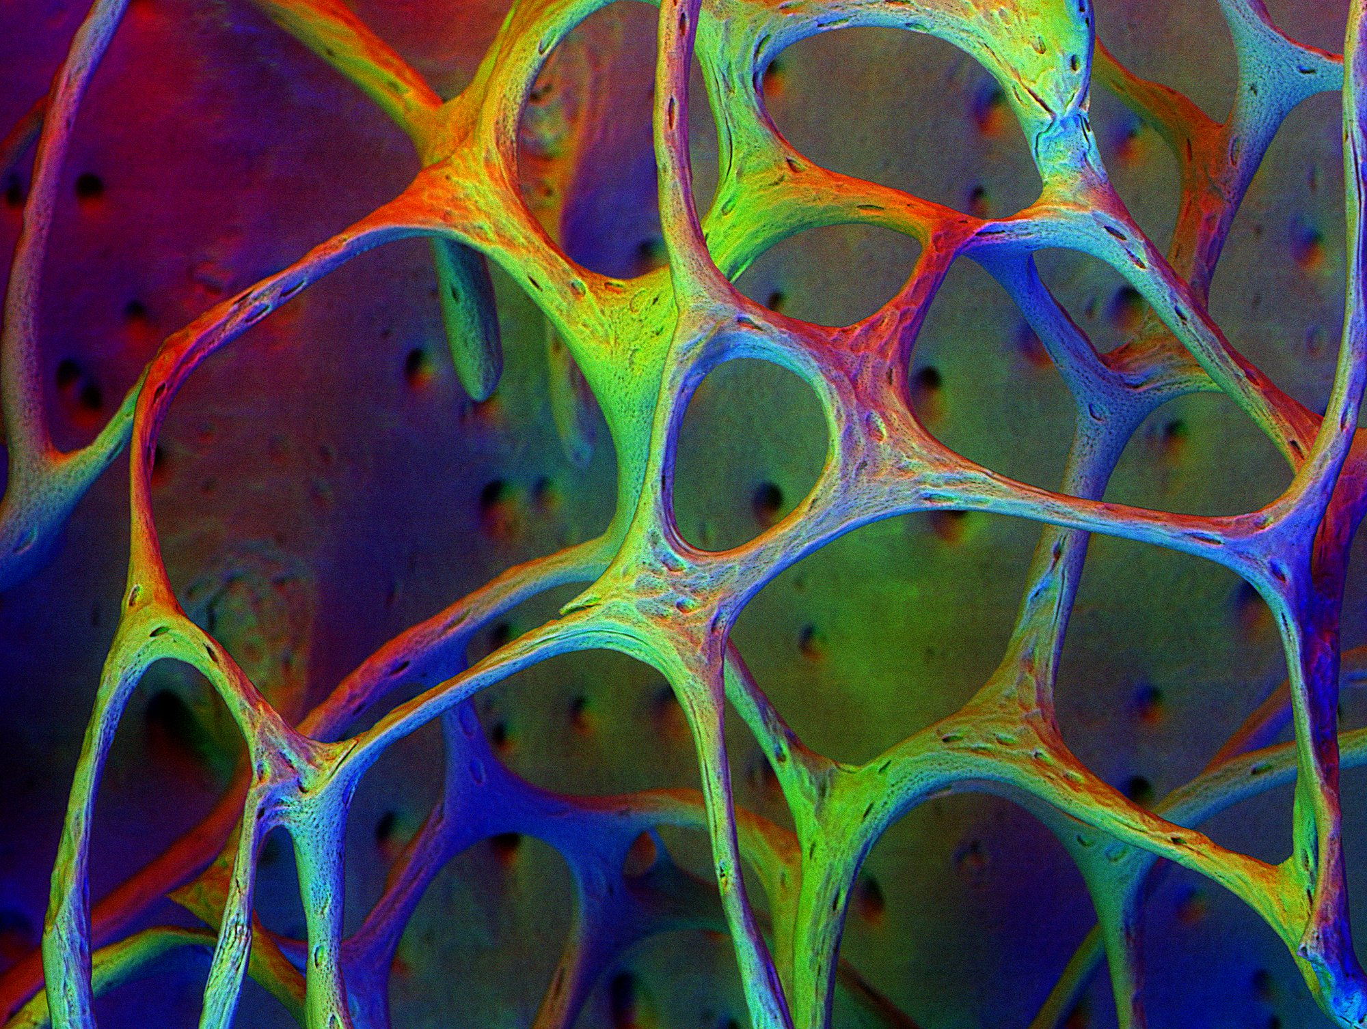
Glucocorticoid Induced Osteoporosis (GIO)
In The name of God
M. Shams, M.D.
Endocrine and Metabolism Research Center
Shiraz University of Medical Sciences

Slide 2
Glucocorticoid Induced Osteoporosis (GIO)
Glucocorticoids (GC) are important in the treatment of many inflammatory, allergic, immunologic, and malignant disorders.
Osteoporosis is a well-known adverse effect of glucocorticoid.
GIO is the most common cause of secondary osteoporosis.
It is estimated that >10% of patients who receive long-term glucocorticoid treatment are diagnosed with a fracture.
How often do we use Glucocorticoids?
- More than 10 million Americans receive pharmacologic doses of glucocorticoids each
year. US: 1% (Fardet 2015)
- 3% in 50 years and over, 5.2% in 80 and over (Kanis 2004)
- Global Longitudinal Study of Osteoporosis in Women (GLOW),
in 10 countries: 4.6% of 60,393 postmenopausal women used GC.

Slide 3
Glucocorticoid Induced Osteoporosis
Epidemiology
Risk factors
Pathogenesis
Clinical features
Prevention
Guidelines
Pharmacologic therapy
Monitoring

Slide 4
Glucocorticoid Induced Osteoporosis
Epidemiology
Risk factors
Pathogenesis
Clinical features
Prevention
Guidelines
Pharmacologic therapy
Monitoring

Slide 5
Epidemiology
Fractures have been reported in as many as 30 to 50 percent of glucocorticoid (GC) users.
GCs increase the risk of fracture, particularly vertebral fractures, which occur early in the course of treatment, during the rapid phase of bone loss.
Glucocorticoid-induced bone loss is most rapid in the first 6 months of steroid use, with a slower decline with chronic use.
Fractures due to GC use occur at higher BMD values than occur in postmenopausal osteoporosis.

Slide 6
Glucocorticoids alter the BMD fracture threshold
 GC users
 Nonusers of GC
Incidence of Vertebral fracture (%)
Van Staa TP, et al. Bone Density Threshold and Other Predictors of Vertebral Fracture in Patients Receiving Oral Glucocorticoid Therapy. Arthritis and Rheumatism. 2003; 48 (11): 3224-9.
Notes:
Fracture incidence was considerably higher in the GC users at any given level of BMD.
Incidence of vertebral fracture in patients receiving glucocorticoids (GCs) () compared with nonusers of GCs (), by baseline lumbar spine BMD and femoral neck BMD. The individual data points correspond to the incidence in subgroups of the GC user and nonuser populations, as based on quintiles of baseline BMD. The solid line is a curve representing smoothing of these individual estimates.

Slide 7
Glucocorticoid Induced Osteoporosis
Epidemiology
Risk factors
Pathogenesis
Clinical features
Prevention
Guidelines
Pharmacologic therapy
Monitoring

Slide 8
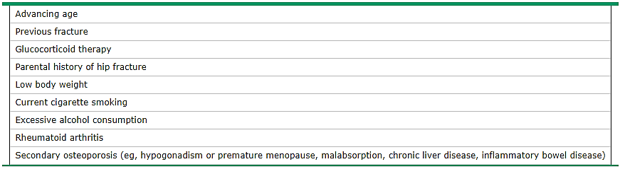
Clinical risk factors for fracture
Kanis JA, Borgstrom F, De Laet C, et al. Assessment of fracture risk. Osteoporos Int 2005; 16:581.

Slide 9
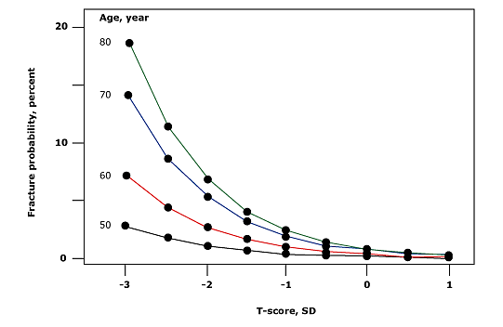
Ten-year fracture probabilities according to BMD T-score and age
Kanis JA, Johnell O, Oden A, et al. Ten year probabilities of osteoporotic fractures according to BMD and diagnostic thresholds. Osteoporos Int 2001; 12:989.
Notes:
The relationship between BMD femoral neck T-score, age and hip fracture probability in women. The probability of hip fracture for any given T-score is higher with increasing age.

Slide 10
Risk factors
The incidence of fracture is higher with:
Advanced age,
Larger dose of GC,
Longer duration of GC therapy.
An increased risk has been reported with doses of prednisone or its equivalent even as low as 2.5 to 7.5 mg daily and with short-term use (<30 days).

Slide 11
The effect of GC on bone is dose dependent
Notes:
The effect on bone is dose dependent, with relative risk significantly increased at daily doses higher than 2.5mg prednisolone equivalent.

Slide 12
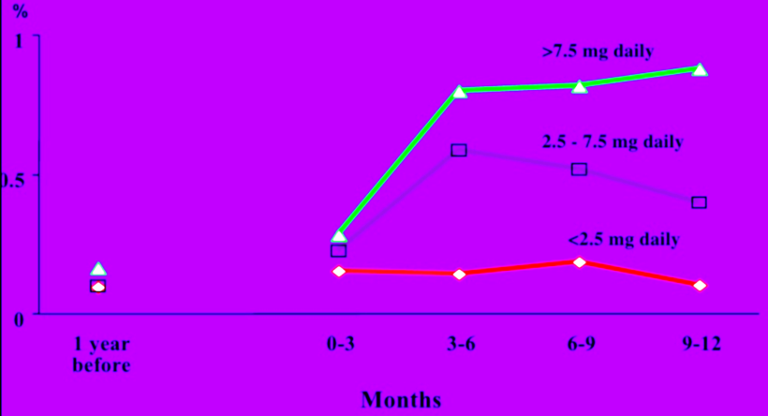
Time course of vertebral fractures during glucocorticoid use
Van Staa et al, Osteoporosis International 2002; 13:777-87.

Slide 13
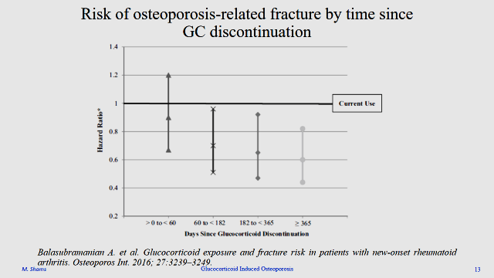
Risk factors
The sparse data that have been published on alternate-day prednisone therapy suggest that this regimen is not protective of bone.
Duration of GC use is important,
Fracture risk returning to baseline months after cessation of therapy.
The increased risk of fracture in patients taking GCs declines rapidly
in the first year off therapy.

Slide 14
Risk of osteoporosis-related fracture by time since GC discontinuation
Balasubramanian A. et al. Glucocorticoid exposure and fracture risk in patients with new-onset rheumatoid arthritis. Osteoporos Int. 2016; 27:3239–3249.

Slide 15
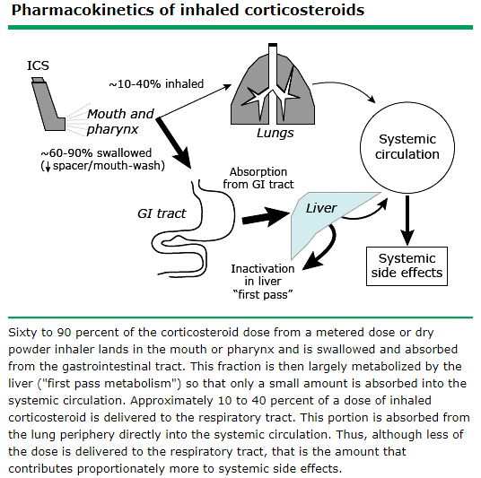
Inhaled Glucocorticoids

Slide 16
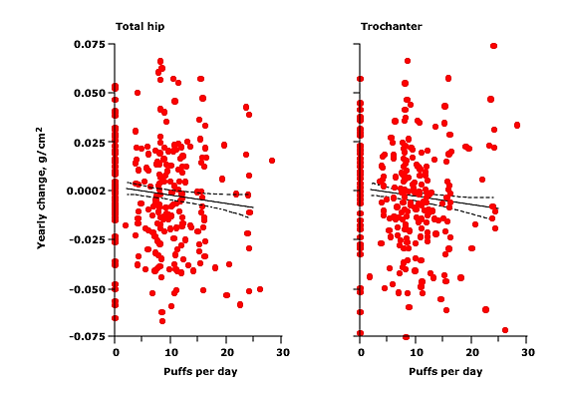
Change in BMD in adults with Asthma taking Inhaled Glucocorticoids
The rate of decline in bone density was 0.00044 g/cm2 per year for each additional daily puff of inhaled glucocorticoid
Isreal E, Banerjee TR, Fitzmaurice GM, et al. N Engl J Med 2001; 345:941.
Notes:
For both the total hip and the trochanter, the rate of decline in bone density was 0.00044 g/cm² per year for each additional daily puff of inhaled glucocorticoid (p = 0.01 and p = 0.005, respectively). The solid line in each panel represents the mean yearly change in bone density. The dashed lines indicate the 95 percent confidence interval for the mean.

Slide 17
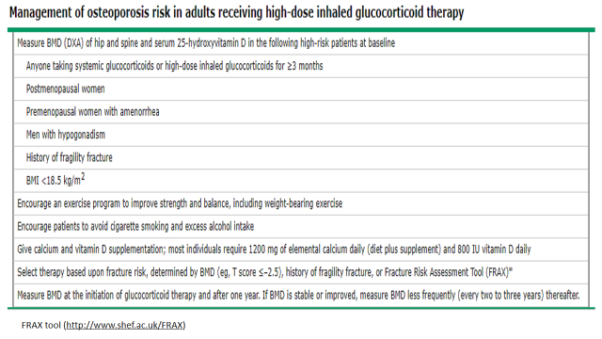
Inhaled Glucocorticoids & BMD
In adults:
The impact of inhaled corticosteroids (ICS) on the bone density and osteoporotic fracture is not well defined.
The majority of studies suggest that ICS therapy
is associated with an accelerated ↓ in BMD.
At least a few studies have detected a small but significant increased risk for fracture.
Suggestions for monitoring and protecting bone health in adult patients receiving high-dose ICS:

Slide 18
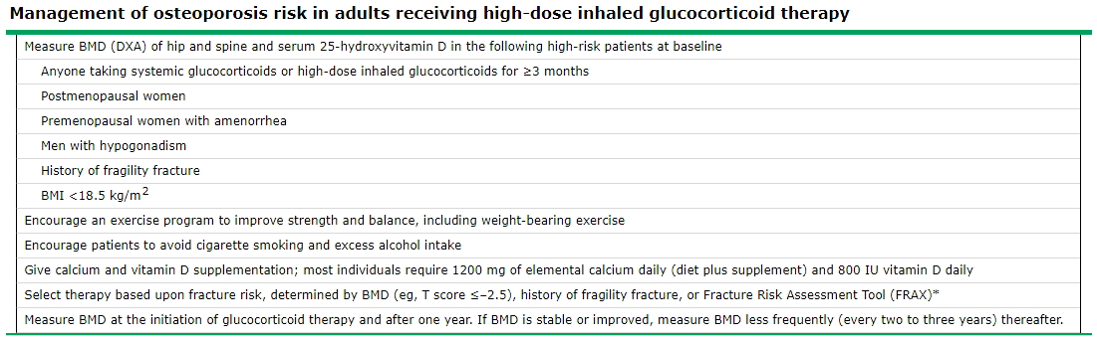
FRAX tool (http://www.shef.ac.uk/FRAX)

Slide 19
Inhaled Glucocorticoids & BMD
In children:
A dose-dependent reduction in bone formation with use of IGC has been demonstrated in older children, by monitoring sensitive markers for bone metabolism.
Fracture risk does not appear to be increased in children using IGC.
Guideline (Pediatric Endocrine Society Drugs and Therapeutics Committee): Routine testing of BMD NOT be performed in children on IGC as decreases in bone density are generally not of clinical significance.
Vitamin D and calcium sufficiency should be ensured with adequate dietary intake of vitamin D (ie, 400 to 800 IU/day) and calcium (ie, 1000 to 1300 mg/day).
Monitoring of vitamin D levels is generally not needed.

Slide 20
Intraarticular Glucocorticoid Injection and BMD
Glucocorticoid injections can cause transient hyperglycemia, which may pose a risk to patients with DM by raising the blood glucose to hyperglycemic levels. Patients generally experience an isolated increase in blood glucose for one to two days, which rarely poses a significant clinical risk when the DM is well controlled.
A rare side effect related to systemic absorption of intraarticular GC is suppression of the hypothalamic-pituitary axis.

Slide 21
Intraarticular Glucocorticoid Injection and BMD
Other rare systemic complications: Ecchymoses, Menstrual irregularity, Cataract formation, and Osteoporosis.
Bone metabolism markers suggest that bone metabolism recovers completely in one to two weeks after the injection.
GIO probably not a major concern for the majority of patients who have reasonably long intervals between their injections.

Slide 22
Glucocorticoid Induced Osteoporosis
Epidemiology
Risk factors
Pathogenesis
Clinical features
Prevention
Guidelines
Pharmacologic therapy
Monitoring

Slide 23
Pathogenesis
The deleterious effects of GC excess on bone result from direct effects on osteoblasts, osteocytes, and osteoclasts.
Because GCs accelerate resorption while inhibiting formation, their use is associated with early rapid bone loss.
With chronic use, osteoclast-mediated bone resorption slows, and suppression of bone formation becomes the predominant skeletal effect.
The primary difference between GIO and postmenopausal osteoporosis is the suppression of osteoblastic activity, leading to decreased bone formation.

Slide 24
Weinstein RS. Glucocorticoid induced bone disease.NEJM 2011.
Notes:
Direct Effects of Glucocorticoids on Bone Cells. Shown are the adverse skeletal changes that result from an excess of glucocorticoids and lead to osteoporosis and osteonecrosis. The brown, condensed cells are apoptotic osteoblasts and osteocytes. Apoptotic osteocytes disrupt the osteocyte–lacunar–canalicular network.

Slide 25
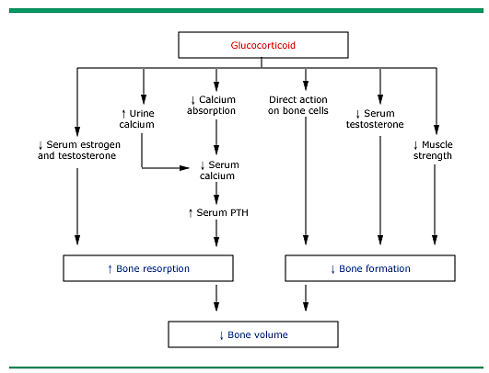
Glucocorticoid-induced osteoporosis: Mechanisms of bone loss
Libanati CS, Baylink DJ. Prevention and treatment of glucocorticoid-induced osteoporosis: A pathogenetic perspective. Chest 1992; 102:1426.
Notes:
Schematic representation of the mechanisms of bone loss in patients with glucocorticoid-induced osteoporosis.

Slide 26
Pathogenesis
The risk of bone loss is most pronounced in the first few months of use, followed by slower but steady loss of bone with continued use.
An early phase consists of rapid loss of BMD due mostly to excessive bone resorption,
Impaired bone formation usually manifests more progressively with long-term therapy.
Trabecular bone loss predominates, with most marked changes not only in the lumbar spine, but also in the femoral neck and other sites.

Slide 27
Glucocorticoid Induced Osteoporosis
Epidemiology
Risk factors
Pathogenesis
Clinical features
Prevention
Guidelines
Pharmacologic therapy
Monitoring

Slide 28
Clinical features
The clinical manifestations of GIO are the same as those of other causes of osteoporosis.
Most often, there are no clinical manifestations until there is a fracture.
Vertebral fractures are most common and are often asymptomatic.
These are diagnosed as an incidental finding on chest or abdominal radiograph.
In patients who have a symptomatic vertebral fracture, there is often no history of preceding trauma.
The typical symptomatic patient presents with acute back pain after sudden bending, coughing, or lifting.

Slide 29
Glucocorticoid Induced Osteoporosis
Epidemiology
Risk factors
Pathogenesis
Clinical features
Prevention
Guidelines
Pharmacologic therapy
Monitoring

Slide 30
Prevention
General Measures
All patients receiving any dose of GCs for a duration of ≥3 months:
The dose and duration of GC therapy should be as low as possible.
(Even what are thought to be replacement doses or chronic inhaled GCs can
cause bone loss)
Alternative therapy should be used whenever possible.
Topical therapy (such as inhaled GCs or GC enemas for asthma or bowel disease, respectively) is preferred over enteral or parenteral GCs.
Weight bearing exercises to prevent both bone loss and muscle atrophy
Avoid smoking and excess alcohol
Take measures to prevent falls

Slide 31
Prevention
Calcium & Vitamin D
The American College of Rheumatology (ACR) Task Force osteoporosis Guidelines:
All patients taking GCs (any dose with an anticipated duration of ≥3 months) maintain a
Total Calcium intake of 1000 to 1200 mg/day
&
Vitamin D intake of 600 to 800 IU/day
through either diet and/or supplements.

Slide 32
Glucocorticoid Induced Osteoporosis
Epidemiology
Risk factors
Pathogenesis
Clinical features
Prevention
Guidelines
Pharmacologic therapy
Monitoring

Slide 33
Fracture Risk Assessment Tool (FRAX)
For patients without established osteoporosis, fracture risk can be assessed using a fracture risk calculator, such as the Fracture Risk Assessment Tool (FRAX).
FRAX estimates the 10-year probability of fracture for untreated patients between ages 40 and 90 years, using femoral neck BMD and clinical risk factors, including GC exposure.
FRAX does not account for GC dose or duration, and therefore, FRAX risk estimates must be corrected according to the dose of GC.
For patients taking prednisolone >7.5 mg/day or equivalent, the risk estimate should be increased by
15% for major osteoporotic fracture
20% for hip fracture

Slide 34
Fracture Risk Assessment Tool (FRAX)
In North America, glucocorticoid-corrected thresholds to indicate high, moderate, and low risk of fracture are as follows:
High risk: A 10-year probability of fracture
Hip: ≥3% or
Major osteoporotic: 20%
Moderate risk: A 10-year probability of fracture
Hip: 1 to 3% or
Major osteoporotic: 10 to 19%
Low risk: A 10-year probability of fracture
Hip: ≤1% or
Major osteoporotic: <10%

Slide 35
Fracture Risk Assessment Tool (FRAX)
Some patients receiving GCs are at high risk, even if they fail to meet the FRAX criteria for high risk.
Example: Patients with clinical risk factors for fracture, low lumbar spine BMD, but normal femoral neck BMD, FRAX is likely to underestimate fracture risk. This situation is especially likely in patients taking GCs, which are more likely to cause osteoporosis of the spine than of the hip.
Intervention guidelines with or without the use of FRAX provide only general clinical guidance.
Treatment should remain individualized through shared decision-making between patient and clinician.

Slide 36
Guidelines
The American College of Rheumatology (ACR)
Recommend: Intervention based upon risk of fracture (high, medium, low), guided in part by the Fracture Risk Assessment Tool (FRAX).

Slide 37
Emory Hsu and Mark Nanes. Advances in treatment of glucocorticoid-induced osteoporosis.
Curr Opin Endocrinol Diabetes Obes 2017, 24:411–417.
Notes:
Risk assessment. Flow-chart for stratifying fracture risk in adult patients on chronic glucocorticoids (prednisone at >2.5 mg/day for >3 months) without impaired renal function (glomerular filtration rate of <30 ml/min). The FRAX score is calculated for those on prednisone equivalent of 2.5–7.5 mg/day, while those receiving higher doses should increase their major osteoporotic fracture risk by 15% and by 20% for the hip. GC, glucocorticoids; FRAX, Fracture Risk Assessment Tool (https://www.shef.ac.uk/FRAX/tool.jsp).

Slide 38
Emory Hsu and Mark Nanes. Advances in treatment of glucocorticoid-induced osteoporosis. Curr Opin Endocrinol Diabetes Obes 2017, 24:411–417.

Slide 39
Age<40 yrs.
Emory Hsu and Mark Nanes. Advances in treatment of glucocorticoid-induced osteoporosis. Curr Opin Endocrinol Diabetes Obes 2017, 24:411–417.

Slide 40
Guidelines
The American College of Rheumatology (ACR)
Recommend:
Lifestyle modification and calcium and vitamin D supplementation.
Oral bisphosphonates for adults at medium or high risk of major fracture.
If oral bisphosphonates contraindicated or not tolerated, options include intravenous (IV) bisphosphonates, teriparatide, denosumab, and raloxifene.
For premenopausal women of childbearing potential, confirm that effective contraception is utilized.
The patient should be followed yearly to determine if bone loss continues.

Slide 41
Guidelines
UK National Osteoporosis Guideline Group (NOGG)
Recommend: Using FRAX (adjusted for GC dose) to determine assessment thresholds (fracture probabilities for BMD testing) and intervention thresholds (fracture probabilities for therapeutic intervention)

Slide 42
Guidelines
UK National Osteoporosis Guideline Group (NOGG)
Recommend:
Antiresorptive therapy should be initiated at the time of starting GCs in patients at highest risk for fracture:
Age ≥70 years,
History of prior fragility fracture,
Taking large doses of GCs (ie, ≥7.5 mg prednisolone/day)
Good nutrition, adequate dietary calcium intake, and a bisphosphonate are recommended as therapy.
Alendronate or risedronate are the preferred bisphosphonates because of efficacy and low cost.

Slide 43
Guidelines
The International Osteoporosis Foundation (IOF)

Slide 44
Guidelines
The International Osteoporosis Foundation (IOF)
Recommend:
Osteoporosis therapy in postmenopausal women and men who are ≥70 years, have a previous fragility fracture, or a dose of prednisolone ≥7.5 mg daily (or its equivalent) for ≥3 months.
For those at highest risk, bone protective therapy should be started at the onset of GC therapy.
Who do not meet these criteria: Fracture risk should be assessed using FRAX with intervention thresholds based upon country-specific population fracture risks and health economic assessments and corrected for GC exposure.
For premenopausal women and men <50 years of age who are taking GCs for ≥3 months, osteoporosis therapy is considered for those with a history of a fragility fracture.
For all others, treatment decisions are individualized based upon patient characteristics and clinical judgement.

Slide 45
Glucocorticoid Induced Osteoporosis
Epidemiology
Risk factors
Pathogenesis
Clinical features
Prevention
Guidelines
Pharmacologic therapy
Monitoring

Slide 46
Pharmacologic therapy
Awareness of osteoporosis risk mandates the stratification of patients into low, moderate and high-risk categories.
All patients should maintain adequate intake of calcium and vitamin D.
Those in moderate and high-risk categories should initiate bisphosphonate therapy,
or if bisphosphonates are contraindicated,
use of alternative agents such as teriparatide or denosumab.

Slide 47
Bisphosphonates
Bisphosphonates, such as once-weekly oral alendronate or once-monthly oral ibandronate, have been the most studied agent for prevention and treatment of GIO.
Most studies have focused on vertebral fractures as a primary endpoint.
A 2016 Cochrane review of 27 randomized control trials for bisphosphonates in chronic GC users found:
Bisphosphonates are beneficial in
Reducing the risk of vertebral fractures at 24 months of use,
Preventing bone loss at the lumbar spine and femoral neck.
(Allen CS, Yeung JH, Vandermeer B, Homik J. Bisphosphonates for steroid-induced osteoporosis. Cochrane Database Syst Rev 2016; 10:Cd001347).

Slide 48
Bisphosphonates
In addition to improving BMD or vertebral fracture risk, treatment can also reduce the risk of hip fractures.
In a Swedish retrospective cohort study of patients aged 65 years or older who were on 3 months or more of at least 5mg/day oral prednisolone, alendronate treatment resulted in a lower risk of hip fracture than no bisphosphonate treatment.
(Axelsson KF, Nilsson AG, Wedel H, et al. Association between alendronate use and hip fracture risk in older patients using oral prednisolone. JAMA 2017; 318:146–155). This is the first major article to show that bisphosphonates reduce the risk of hip fracture in GC use. Most of the previous literature looked at vertebral fractures or at BMD.

Slide 49
Effects of alendronate for treatment of glucocorticoid-induced osteoporosis
Systematic review and Meta-analysis of RCTs
Wang YK, et al. Effects of alendronate for treatment of glucocorticoid-induced osteoporosis A meta-analysis of randomized controlled trials. Medicine 2018; 97:42.
Notes:
Alendronate significantly increases BMD of the lumbar spine and femoral neck in patients with GIO, but does not appear to reduce the risk of fractures.

Slide 50
Effects of alendronate for treatment of glucocorticoid-induced osteoporosis
Systematic review and Meta-analysis of RCTs
Wang YK, et al. Effects of alendronate for treatment of glucocorticoid-induced osteoporosis A meta-analysis of randomized controlled trials. Medicine 2018; 97:42.
Notes:
Alendronate significantly increases BMD of the lumbar spine and femoral neck in patients with GIO, but does not appear to reduce the risk of fractures.

Slide 51
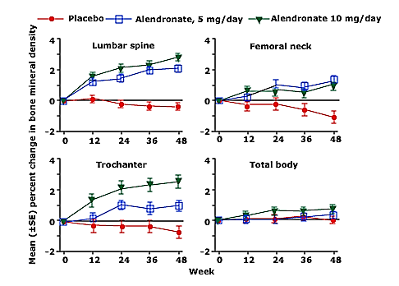
Benefit of Alendronate in Glucocorticoid-treated patients
Saag KG, Emkey R, Schnitzer TJ, et al. Alendronate for the prevention and treatment of glucocorticoid-induced osteoporosis. Glucocorticoid-Induced Osteoporosis Intervention Study Group. N Engl J Med 1998; 339:292.
Notes:
Effect of alendronate (5 or 10 mg/day) or placebo on bone mineral density in 477 patients receiving an average daily dose of at least 7.5 mg of prednisone per day or its equivalent. The mean bone mineral density of the lumbar spine increased by 2.1 and 2.9 percent over 48 weeks in the patients receiving 5 and 10 mg of alendronate daily, respectively, while decreasing 0.4 percent in the placebo group (top left panel). Femoral neck, trochanter, and total body bone mineral density also increased significantly in the alendronate groups.

Slide 52
Teriparatide
- Teriparatide (a recombinant PTH) has also been shown to reduce fracture risk, in fact, proving superior to alendronate in a comparison trial.
A 2016 meta-analysis found that teriparatide (as well as certain bisphosphonates) were associated with decreased vertebral fracture risk.
(Amiche MA, Albaum JM, Tadrous M, et al. Efficacy of osteoporosis pharmacotherapies in preventing fracture among oral glucocorticoid users: a network meta-analysis. Osteoporos Int 2016; 27:1989–1998).
In theory, as GCs do have a suppressive effect on osteoblasts, teriparatide would be an appropriate countermeasure as an anabolic agent.
- Due to higher cost and inconvenience of administration, teriparatide remains in practice largely a second-line agent behind bisphosphonates in treating patients who are on GCs.

Slide 53
Teriparatide or alendronate in glucocorticoid-induced osteoporosis
S KaagG, Shane E, Boonen S, et al. Teriparatide or alendronate in glucocorticoid-induced osteoporosis. N Engl J Med 2007; 357:2028.
Notes:
Percent Change in Mean BMD at the Lumbar Spine and Total Hip from Baseline to 18 Months or the Last Measurement. The asterisk denotes P<0.05, the single dagger P<0.01, and the double dagger P<0.001 for between-group comparisons. Within-group changes from baseline at the lumbar spine (Panel A) and total hip (Panel B) were significant at all time points (P<0.001). The I bars represent standard errors.

Slide 54
Teriparatide
- Teriparatide (a recombinant PTH) has also been shown to reduce fracture risk, in fact, proving superior to alendronate in a comparison trial.
A 2016 meta-analysis found that teriparatide (as well as certain bisphosphonates) were associated with decreased vertebral fracture risk.
(Amiche MA, Albaum JM, Tadrous M, et al. Efficacy of osteoporosis pharmacotherapies in preventing fracture among oral glucocorticoid users: a network meta-analysis. Osteoporos Int 2016; 27:1989–1998).
In theory, as GCs do have a suppressive effect on osteoblasts, teriparatide would be an appropriate countermeasure as an anabolic agent.
- Due to higher cost and inconvenience of administration, teriparatide remains in practice largely a second-line agent behind bisphosphonates in treating patients who are on GCs.

Slide 55
Denosumab (a RANKL inhibitor)
Denosumab is given as a subcutaneous injection every 6 months, which may result in better adherence than oral bisphosphonate therapy.
However, data are more limited than that for use of bisphosphonates for GIO. Despite its proven efficacy in postmenopausal women, there remain few studies specifically looking at GIO.
One study of concurrent GC and denosumab use in RA patients found increased lumbar spine and hip BMD
(Dore RK, Cohen SB, Lane NE, et al. Effects of denosumab on bone mineral density and bone turnover in patients with rheumatoid arthritis receiving concurrent glucocorticoids or bisphosphonates. Ann Rheum Dis 2010; 69:872–875)

Slide 56
Denosumab (a RANKL inhibitor)
A few small prospective studies of patients on GCs from Japan have found that lumbar spine, but not hip, BMD increased with denosumab treatment.
(Ishiguro S, Ito K, Nakagawa S, et al. The clinical benefits of denosumab for prophylaxis of steroid-induced osteoporosis in patients with pulmonary disease. Arch Osteoporosis 2017; 12:44)
(Sawamura M, Komatsuda A, Togashi M, et al. Effects of denosumab on bone metabolic markers and bone mineral density in patients treated with glucocorticoids. Intern Med (Tokyo, Japan) 2017; 56:631–636)
A small study has shown preliminary data that switching from bisphosphonate to denosumab results in increased BMD while on long-term steroids, though the sample size was small and clinical fracture data were lacking.
(Mok CC, Ho LY, Ma KM. Switching of oral bisphosphonates to denosumab in chronic glucocorticoid users: a 12-month randomized controlled trial. Bone 2015; 75:222–228)

Slide 57
Denosumab (a RANKL inhibitor)
In a trial evaluating denosumab versus risedronate in 505 patients receiving GCs for ≥3 months and 290 patients who were initiating GCs (<3 months), the increase in lumbar spine BMD was greater with denosumab (4.4 versus 2.3% for GC continuing and 3.8 versus 0.8% for GC initiating).
There was no difference in adverse events including incidence of fracture. (osteoporosis-related fractures, 7 and 6%, respectively; new and worsening vertebral fractures in postmenopausal women, 5 percent in each group)
(Saag KG, Wagman RB, Geusens P, et al. Denosumab versus risedronate in glucocorticoid-induced osteoporosis: a multicentre, randomised, double-blind, active-controlled, double-dummy, non-inferiority study. Lancet Diabetes Endocrinol 2018; 6:445).

Slide 58
Denosumab (a RANKL inhibitor)
Denosumab may be beneficial in some patients with GIO.
Emerging data have raised concern about increased risk of vertebral fracture after discontinuation of denosumab, and the need for indefinite administration of denosumab should be discussed with patients prior to its initiation.
If denosumab is discontinued, administering an alternative therapy (typically a bisphosphonate) to prevent rapid bone loss and vertebral fracture is advised.

Slide 59
Glucocorticoid Induced Osteoporosis
Epidemiology
Risk factors
Pathogenesis
Clinical features
Prevention
Guidelines
Pharmacologic therapy
Monitoring

Slide 60
Monitoring
There are several published guidelines for monitoring the response to osteoporosis therapy. Although all recommend follow-up BMD testing, there is no consensus on the optimal frequency of monitoring and the preferred site to monitor.
Measure BMD (dual-energy x-ray absorptiometry [DXA]) of the lumbar spine and hip at the initiation of GC therapy and after one year.
BMD stable or improved: Measure BMD less frequently (every two to three years) thereafter.
If GCs are discontinued and BMD is stable, measurement at five-year intervals may be sufficient.

Slide 61
Monitoring
BMD decrease or a new fragility fracture:
Additional evaluation for contributing factors:
Poor adherence to therapy,
Inadequate GI absorption,
Inadequate intake of calcium and vitamin D,
Development of a disorder with adverse skeletal effects.
Switching from oral bisphosphonates to IV zoledronic acid may be effective in patients with poor absorption or poor compliance with the oral regimen.
Alternative options for patients who fail oral bisphosphonate therapy are similar to those for patients with osteoporosis in general.

Slide 62
Key Points
1- Glucocorticoid use is a leading cause of secondary osteoporosis; however, patients at risk of GIO are often not evaluated or treated in a timely manner.
2- Extra-physiologic doses of glucocorticoids suppress osteoblastogenesis and alter osteoclast activity.
3- Using as low of a dose and as short of a duration of GCs as possible.
4- Patients on a dose equivalent of 2.5mg prednisone or greater for 3 months or longer duration should have their fracture risk assessed.
5- Those at moderate or high risk should start bisphosphonate therapy, or if contraindicated, a second-line agent such as teriparatide or denosumab.

Slide 63
Key Points
6- A prior osteoporotic fracture, a T score of less than -2.5 in the hip or spine for men ≥50 years or postmenopausal women, or a 10-year estimated risk of greater than 10% major osteoporotic fracture or 1% hip fracture based on FRAX, are qualifications for moderate to high risk.
7- For adults less than 40 years old, a Z score of less than -3 at the hip or spine, or rapid bone loss of more than 10% over 1 year, in addition to higher dose glucocorticoid use of greater than 7.5mg equivalent a day, are qualifications for moderate risk.
8- Evidence supports use of bisphosphonates, teriparatide or denosumab in adults with moderate to high risk on chronic glucocorticoids.

Slide 64
Thank you for attention

