Slide 1
IN THE NAME OF ALLAH
Shahin Nosratzehi

Slide 2
PROBLEM LIST
History of paraganglioma
Hypertension
Abdominal pain
Amenorrhea
Positive biochemical testing (Normetanephrine)
Microcytic Anemia
A mass like lesion with enhancement in liver (FNH)
Homogenous mass in pelvis
Nodular uptake in both lungs in 123IMIBG scan.
A 1-cm nodule in right lung in chest CT

Slide 3
Clinical Question
Dose this patient have malignant paraganglioma?
What are condition that PPGL can be biochemically negative?
Where is the tumor located ?
what is the treatment in this patient ?
How should the genetic testing be performed in this patient?
what is the prognosis in this patient ?

Slide 4
Malignant paraganglioma
The definition of malignancy in pheochromocytoma /paraganglioma is not always straightforward.
given that there is no combination of clinical ,histopathologic ,or biochemical features shown to reliably predict biologic behavior.
Pathologic evaluations generally provide little prognostic insight to predict risk of recurrence or metastases .Mitotic activity, cellular atypia, or vascular invasion do not reliably predict malignant predisposition of these tumors

Slide 5
Malignant paraganglioma
WHO considers that diagnosis of malignancy can only be made by identifying tumor deposits in tissues that do not normally contain chromaffin cells(eg lymph nodes ,liver ,bone ,lung and other distant metastatic sites).
Armed forces institute of pathology fascicle for tumors of the Adrenal Glands and Extra Adrenal paraganglia defines malignancy as “extensive local invasion or documentation of metastases”

Slide 6
Malignant paraganglioma
The incidence of MPPs is<1 per 1million people/year
Malignant disease has been reported in 2% - 13% of patients with PHEO and >25% with PGL
The usual sites of metastatic involvement include the lymph nodes (80% of patients), bones (71%), liver (50%), and Lung(50%)

Slide 7
Clinical Question
Dose this patient have malignant paraganglioma?
What are condition that PPGL can be biochemically negative?
Where is the tumor located ?
what is the treatment in this patient ?
How should the genetic testing be performed in this patient?
what is the prognosis in this patient ?

Slide 8
There are nevertheless situations that clinicians should be aware of where PPGL can be biochemically negative:
1) skull base and neck PGL, often biochemically silent and for which imaging represents the principal means for diagnosis
2) PGL in patients with SDHx mutations. Emerging evidence indicates that some of these PGL lack the biosynthetic machinery for catecholamine production and may present with biochemically silent features

Slide 9
presence of a smaller piece of functional tissue
release of a small amount of un metabolised catecholamines due to a rapid intra tumoural turnover rate
silent stress-activated tumors
DA-producing pheochromocytomas
familial PCC syndromes screened at early stages
pheochromocytoma :an uncommon presentation of an asymptomatic and biochemically silent adrenal incidentaloma Malays j Med Sci June 2012

Slide 10
Clinical Question
Dose this patient have malignant paraganglioma?
What are condition that PPGL can be biochemically negative?
Where is the tumor located ?
what is the treatment in this patient ?
How should the genetic testing be performed in this patient?
what is the prognosis in this patient ?

Slide 12
123IMIBG
up to 50% of normal adrenal glands demonstrate physiological uptake of 123I-MIBG, false positive results can be a problem.
Asymmetric uptake in normal adrenal glands can lead to mis interpretation.
Sensitivity of 123I-MIBG :85-88% for PCC and 56 -75% for PGL
specificity ranges from 70– 100% and 84–100%, respectively PCC and PGL
Sensitivity for metastatic PPGLs is 56 - 83%, whereas for recurrent PPGLs it is approximately 75%

Slide 14
21 patients with false-negative 123I-MIBG SPECT, aged 13–55 years were included.
13 patients were evaluated for metastatic tumors while 8 others were seen for non-metastatic disease.
All primary tumors and multiple metastatic foci did not show avid 123IMIBG uptake regardless of the tumor diameter.
SDHB mutation was present in 52% (n=11) of cases, RET mutation in 4% (n=1), and the rest were apparently sporadic.
majority of patients had extra-adrenal tumors with NMN or NE

Slide 15
14 patients were followed-up for 3–7 years.
From them, 71% (n=10) had metastatic disease and majority had SDHB mutation.
Nine are still alive while 5 (4 were SDHB) died due to metastatic disease.

Slide 16
several factors that can cause a false-negative 123I-MIBG study.
SDHB mutations
metastatic PHEO and PGL :The suboptimal sensitivity of 123/131I-MIBG is related to the dedifferentiation that results in loss of NETs among these tumors
familial cases of PHEO and PGL
Medications: such as labetalol, reserpine, CCB, and antidepressants may interfere with MIBG uptake

Slide 17
small tumors
extra-adrenal PGLs: the sensitivity of 131/123IMIBG scintigraphy is also generally suboptimal for extra-adrenal PGLs
Studies have also shown that a predominant NE and NMN secretion predicts negative123I-MIBG scintigraphy which was also observed in the current study

Slide 18
Recommendation
2.5 We suggest the use of 18F-FDG PET/CT scanning in patients with metastatic disease.
18F-FDG PET/CT is the preferred imaging modality over 123I-MIBG scintigraphy in patients with known metastatic PPGLs. (øøøō)
Overall, the sensitivity of 18F-FDG PET was shown to be 74 - 100%, with the highest performance for metastatic, particularly SDHB-related, PPGLs

Slide 21
A 43-year-old female with abdominal pain ,underwent abdominal CTA with a suspected diagnosis of an abdominal aortic dissecting aneurysm.
A right ovarian tumor was found, and no dissecting abdominal aortic aneurysm was detected.
For the past seven years she had experienced sustained HTN, with the highest BP recorded being 200/100 mmHg.
The patient had not taken any medication to treat the HTN until one month prior to the present hospital visit for abdominal pain. No headache, syncope or palpitations were indicated.

Slide 22
Abdominal CTA showed a well‑defined 5.2x5.7x4.0‑cm tumor in close proximity to the right ovary ,The tumor was highly vascularized
Laboratory results indicated a significantly elevated total urinary VMA of 111.8 µmol/24 h (VMA<68)
Surgical resection of a 5x5x6-cm mass located superior to the right ovary was performed.
tumor cells were positive for chromogranin A, neuron‑specific enolase and synaptophysin
Following surgery, the patient's BP stabilized to 115/95 mmHg, with no significant fluctuations, and abdominal pain was no longer experienced.

Slide 24
A 33-yearold woman presented with a 12-month history of HTN and weight loss.
CT-scan chest abdomen-pelvis revealed bilateral complex ovarian masses, peritoneal carcinomatosis, para-aortic lymphoadenopathy with Inferior vena cava-wall infiltration, and no parenchymal organs involvement.
A laparoscopic ovarian biopsy was taken and was reported as SLOT
she underwent laparotomy with extensive debulking surgery involving TAH, BSO, RSC with primary end-toend anastomosis, systematic pelvic and para-aortic lymphadenectomy

Slide 25
Histology reported a solid cordonal neoplasm with neuroendocrine immunophenotype consistent with SLOT with neuroendocrine differentiation
She recurred after 6 months and was started on somatostatin-analogue. Following further disease progression with bone metastasis (treated with palliative radiotherapy), a trial with Sunitinib was started.
The patient died 30 months after initial diagnosis.

Slide 26
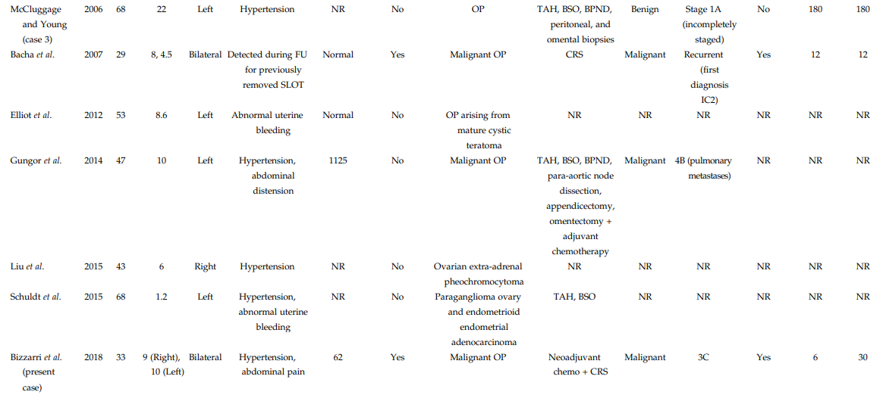

Slide 28
Clinical Question
Dose this patient have malignant paraganglioma?
What are condition that PPGL can be biochemically negative?
Where is the tumor located ?
what is the treatment in this patient ?
How should the genetic testing be performed in this patient?
what is the prognosis in this patient ?

Slide 29
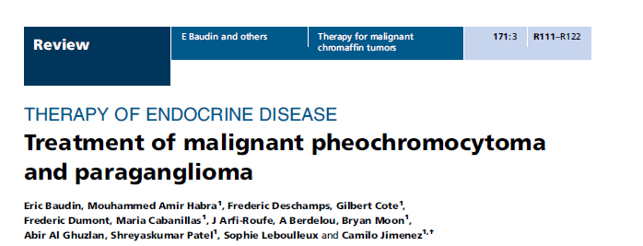
2014 European Society of Endocrinology

Slide 30
Treatment
Control of hormone- and tumor-related symptoms
Three types of complications stemming from the damage and dysregulation highly affect clinical outcomes and therapeutic decisions in MPP patients:
cardiovascular disease
gastrointestinal dysfunction
and skeletal-related events (SREs).
Approximately 70% of MPP patients develop bone metastases, 20% who develop bone metastases exclusively , 80% develop SREs that include bone pain, pathological fractures, and/or cord compression

Slide 31
Treatment
Local therapy
Systemic therapy
Resection
external beam radiation therapy
Nonsurgical ablative therapy
Trans arterial chemoembolization for liver metastases
Meta-iodobenzylguanidine (MIBG) I-131 (therapeutic)
Peptide receptor radioligand therapy
Cytotoxic chemotherapy
Molecular targeted therapies

Slide 32
Local therapy
Resection — There are no curative treatments for metastatic PPGL.
both the primary and metastatic lesions should be resected, if possible
Resection :may improve symptoms
reduce hormone secretion
prevent complications related to a critical anatomic location
and improve the efficacy of subsequent therapies
Resection may also possibly improve survival, although there are no clinical trial data to support this.

Slide 33
Local therapy
external beam radiation therapy (EBRT)
It was previously thought that MPP were relatively radioresistant.
However, EBRT at doses >40 Gy can provide local tumor control and relief of symptoms for tumors at a variety of sites( the soft tissues of the skull base and neck, thorax, abdomen as well as painful bone metastases).
In a series of 17 patients with malignant paraganglioma who received EBRT, 76 percent had local control or clinically significant symptomatic relief for at least one year or until death.

Slide 34
Local therapy
Nonsurgical ablative therapy
including radiofrequency ablation (RFA)
cryoablation
percutaneous ethanol injection
Percutaneous ablation for metastatic lesions at a variety of sites, (soft tissue, bone, and liver).
The ablation procedure chosen (RFA, cryoablation, or ethanol injection) was based upon the lesion target location; bone, chest wall, and retroperitoneal lesions were treated with either RFA or cryoablation, while liver tumors were treated with either RFA or ethanol injection.

Slide 35
Local therapy
Trans arterial chemoembolization for liver metastases
For patients with multiple liver metastases that are not amenable to resection or nonsurgical methods of ablation,
isolated case reports suggest benefit (decreased tumor bulk and improved symptom control) from TACE As with other forms of local therapy
TACE can induce massive catecholamine secretion and a hypertensive crisis; preprocedure medical preparation is needed

Slide 36
Systemic therapy
Meta-iodobenzylguanidine (MIBG) I-131 (therapeutic)
The diagnostic and therapeutic value of MIBG is based upon its structural similarity with noradrenaline and a high affinity to, and uptake in, chromaffin cells
Radioactive iodine (I131) is attached to the MIBG molecule to produce Iobenguane I-131 (therapeutic), which functions as a semi-selective agent for MPP.
This treatment only works for the approximately 60 % of tumors that take up MIBG as determined by Iobenguane I-123 (diagnostic) scintigraphy
A lower fraction of dopamine-secreting PGL take up Iobenguane I-123
EBRT abolishes the ability of these tumors to take up MIBG, making Iobenguane I-131 (therapeutic) treatment ineffective in any irradiated site.

Slide 37
Systemic therapy
For patients with metastatic disease whose tumors secrete catecholamines and take up MIBG, the therapeutic value of Iobenguane I-131 to achieve symptom palliation and tumor regression or stabilization has been shown in many small case series.
Objective response rates are approximately 30 percent, and another 40 percent of tumors remain stable; less than 5 percent have a complete remission.
Hormonal response is reported in 45 to 67 percent of cases.
In general, better objective responses are achieved in patients with limited disease and in those with soft tissue rather than bone metastases

Slide 38
Systemic therapy
Iobenguane I-131 treatment can be repeated, usually at six-month intervals
The optimal dosimetry is not established.
Most of the published reports have used single therapy doses between 100 to 200 mCi, with cumulative doses ranging from 557 to 2322 mCi and averaging 400 and 600 mCi
At these doses, treatment is generally well tolerated with the main side effects being transient mild leukopenia and thrombocytopenia. Hypothyroidism was reported in 3 of 28 patients receiving cumulative doses of 111-916 mCi in one series

Slide 39
Systemic therapy
Treatment with Iobenguane I-131 should be considered in patients with good uptake of Iobenguane I-123 by dosimetry who fall into one of the following categories:
Unresectable progressive pheochromocytoma/paraganglioma
Symptoms from disease that is not amenable to locoregional of control
A high tumor burden and a low number of bone metastases For patients with rapidly progressive tumors or bone-predominant extensive disease, chemotherapy is a preferred option even if Iobenguane I-123 (diagnostic) scintigraphy is positive.

Slide 40
Systemic therapy
Peptide receptor radioligand therapy
MPP expresses somatostatin receptors (as determined by positive uptake with 111In-pentetreotide or where available, PET imaging using gallium-68-labeled somatostatin analogs such as gallium Ga-68 DOTATATE benefit from therapy using radiolabeled somatostatin analogs.
Two studies have shown that targeted radiotherapy with these agents elicits response rates of <10%
This contrasts with the higher sensitivity of somatostatin receptor scintigraphy as a diagnostic imaging study compared with MIBG scintigraphy.

Slide 41
Systemic therapy
Cytotoxic chemotherapy
should be considered for patients with unresectable and rapidly progressive MPP and patients with high tumor burden or a large number of bone metastases Most literature reports evaluating cytotoxic chemotherapy for progressive metastatic paraganglioma predominantly involve patients with retroperitoneal sympathetic catecholamine-secreting tumors.

Slide 42
Systemic therapy
Molecular targeted therapies— Tyrosine kinase inhibitors (TKIs) are a class of agents that interfere with cancer growth and metastatic progression by blocking angiogenesis through the vascular endothelial growth factor receptor (VEGFR) and other pathways.
Sunitinib, a vascular endothelial growth factor (VEGF) TKI, has demonstrated efficacy and manageable toxicity in patients with paraganglioma/pheochromocytom

Slide 43
Clinical Question
Dose this patient have malignant paraganglioma?
What are condition that PPGL can be biochemically negative?
Where is the tumor located ?
what is the treatment in this patient ?
How should the genetic testing be performed in this patient?
what is the prognosis in this patient ?

Slide 44
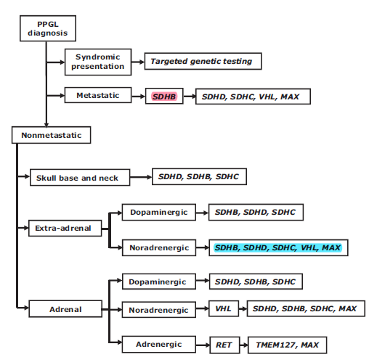

Slide 45
Genetic testing
Age: mutation in patients with non syndromic PPGLs younger than 45 years is 5-fold higher than in patients older than 45 years
Bilateral or multifocal PPGLs: In a large study of patients With non syndromic PPGLs, the prevalence of germline mutations associated with multiple PPGLs was 5-fold higher than for solitary PPGLs (54 vs 11.5%).
Extra-adrenal tumor location :In the same study, an extra-adrenal tumor location was shown to carry a 4-fold higher risk of a germline mutation than an adrenal location, with mutations confined to SDHx genes.
A positive family history or syndromic presentation in patients with PPGLs not only indicates a high priority for genetic testing, but also may direct targeted germline mutation testing.

Slide 46
Clinical Question
Dose this patient have malignant paraganglioma?
What are condition that PPGL can be biochemically negative?
Where is the tumor located ?
what is the treatment in this patient ?
How should the genetic testing be performed in this patient?
what is the prognosis in this patient ?

Slide 48
Main Outcome Measures: Baseline description, survival outcomes, and predictors of shorter survival were evaluated in patients with rapidly progressive (n = 29) and indolent disease (n = 188).
Although the five-year survival rate is less than 50 percent, many of these patients have prolonged survival and minimal morbidity.

Slide 49
prognosis
In 96 (35%) patients: synchronous metastases.
In 176 (65%) patients, metastases developed at a median of 5.5 years from the initial diagnosis.
Shorter survival correlated with
male sex
older age at the time of primary tumor
synchronous metastases (P < 0.0001),
larger primary tumor size (P = 0.0039)
elevated dopamine (P = 0.0195)
and not undergoing primary tumor resection (P < 0.0001).
There was no difference in the type of primary tumor or presence of SDHB mutation.

Slide 50
5-year overall survival rate was 85.4%
10-year overall survival rate was 72.5%
15-year overall survival was 65.4%.

Slide 51
What should be done in this case?
Hormone Control /Hypertension control
Approach to microcytic anemia
Abdominal pain /Amenorrhea/Homogenous mass in pelvis→
Pelvic sonography(mass characteristics)
MIBGscan may be false negative-->18F-FDG PET/CT scanning or gallium Ga-68 DOTATATE
Decision –making according location of tumor

Slide 53
2016 European Society of Endocrinology

Slide 54
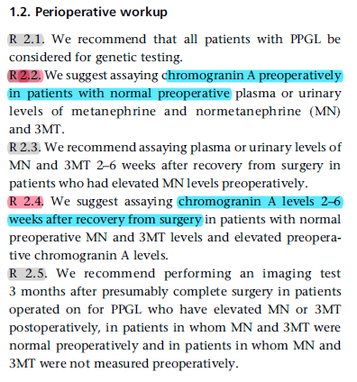

Slide 57
Clinical Question
Dose this patient have malignant paraganglioma?
What are condition that PPGL can be biochemically negative?
Where is the tumor located ?
what is the treatment in this patient ?
How should the genetic testing be performed in this patient?
what is the prognosis in this patient ?
How should follow-up be performed in this patient?

