Slide 1
IN THE NAME OF ALLAH
Choice of Glucose-Lowering
Pharmacotherapy in Patients With DM at High Risk for HF or With Established HF
SHAHIN NOSRATZEHI

Slide 2
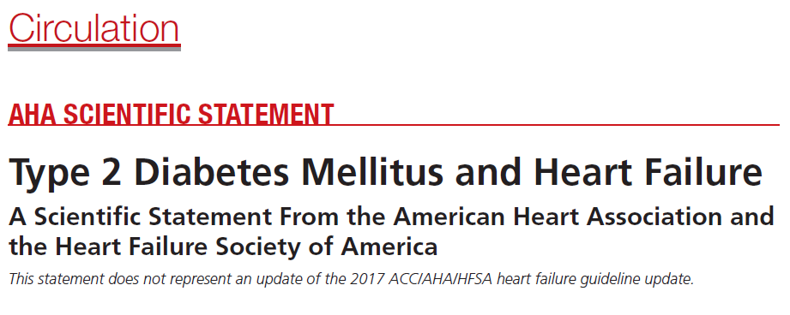

Slide 3
Agenda
Metformin
Insulin secretoguges
TZDs
DPP4 inhibitors
GLP1 analouges
SGLT2 inhibitors

Slide 4
Metformin

Slide 5
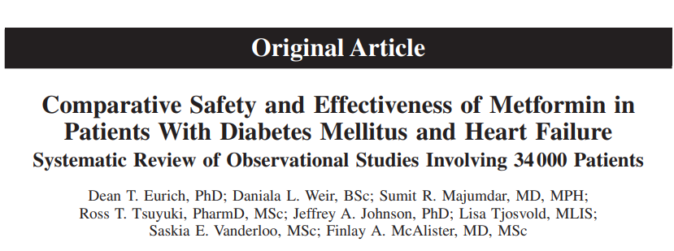
Circ Heart Fail is available at http://circheartfailure.ahajournals.org

Slide 6
Metformin
Among the 9 studies, 34504 patients with diabetes mellitus and HF were included, with 6624 patients (19%) using metformin
The majority of studies evaluated the use of metformin in combination with other oral agents or insulin
Two studies specifically evaluated the use of metformin as monotherapy
we examined 2 important subpopulations: those with reduced left ventricular ejection fraction (LVEF) and those with concomitant chronic kidney disease.
we further explored the potential role of metformin in patients with diabetes mellitus and HF with compromised kidney function.

Slide 7
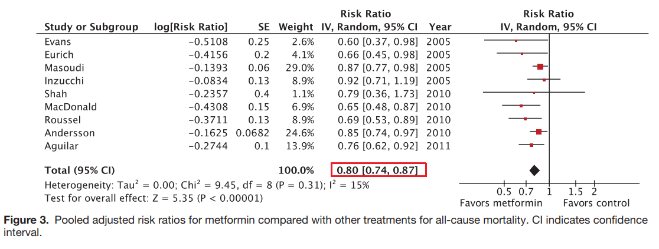
Metformin
main outcome : all-cause mortality
After pooling of the adjusted risk estimates, metformin based regimens were associated with a statistically significant 20% relative reduction in all-cause mortality compared with other treatments
Circ Heart Fail is available at http://circheartfailure.ahajournals.org

Slide 8
Metformin
In a subgroup of patients with LVEF of≤30 % did not observe any increased mortality associated with metformin compared with non metformin-based therapies
(mortality pooled adjusted risk estimate: 0.91; 0.72–1.14; P=0.34).
Metformin was associated with a small reduction in all-cause hospitalizations
(pooled adjusted risk estimate: 0.93; 0.89– 0.98; I 2 =0%; P=0.01).

Slide 9
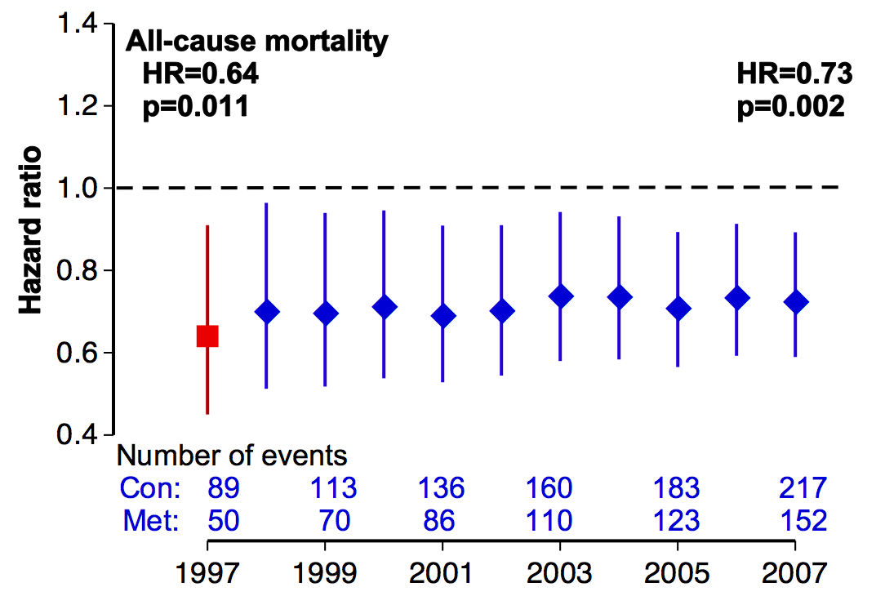
All-cause Mortality Hazard Ratio
Intensive (metformin) vs. Conventional glucose control
HR (95%CI)

Slide 10
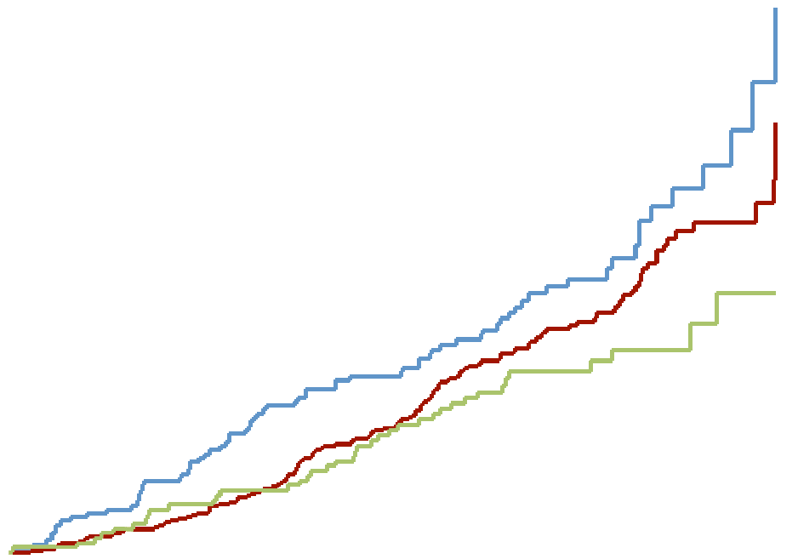
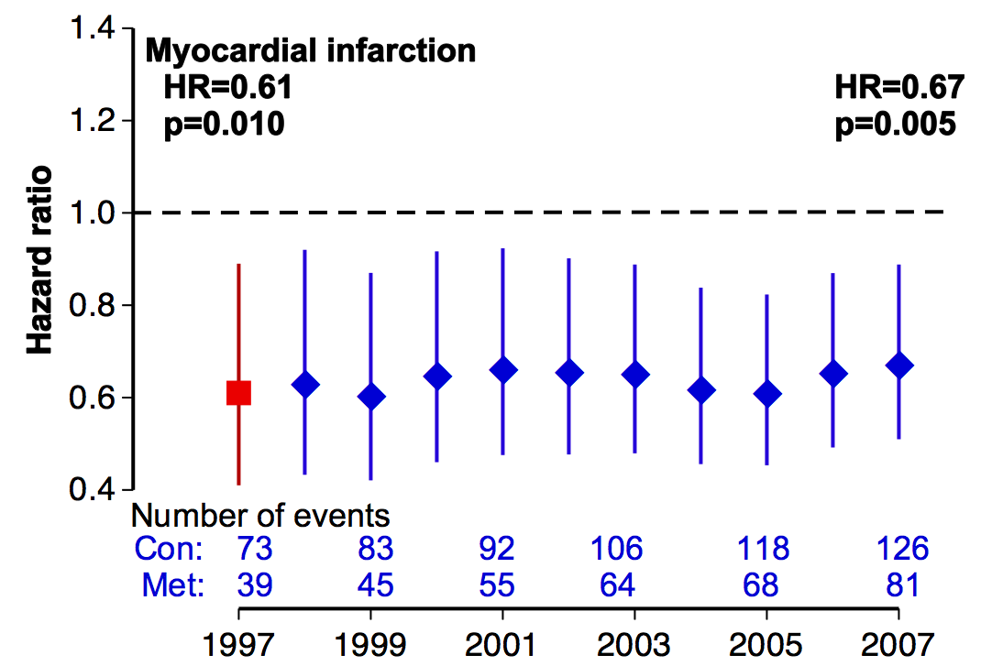
Myocardial Infarction Hazard Ratio
(fatal or non-fatal myocardial infarction or sudden death)
Risk of MI is 39% lower with metformin vs conventional therapy in obese patients^{1,2}
Significant reduction in MI maintained over 10 years’ follow-up³
Myocardial infarction
Overall values at study end in 1997
30
Conventional (n = 411; events = 73)
Annual values during 10-year post-trial monitoring period
Intensive (n = 951; events = 139)
1.4
Metformin (n = 342; events = 39)
RR 0.61¹
p = 0.01
RR 0.67
p = 0.005
20
HR (95% CI)
1.2
Metformin vs conventional
p = 0.01
Proportion of patients with events (%)
1.0
10
0.8
0.0
0.6
0
3
6
9
12
15
Time from randomisation (years)
0.4
0.4

Slide 11
Clinical Considerations(Metformin)
It is reasonable to use metformin in patients with DM at risk of or with established HF.
Metformin should be discontinued in patients presenting with acute conditions associated with lactic acidosis, such as cardiogenic or distributive shock

Slide 12
Sulfonylurea Drugs

Slide 13
Sulfonylurea Drugs
Limited data exist regarding the use of sulfonylurea therapy and the development of HF in individuals with DM.
In the UKPDS, intensive glycemic control with sulfonylurea drugs or insulin in patients with newly diagnosed DM was not associated with increased rates of HF compared with conventional diet-based therapy.
In the ADVANCE trial, no difference in HF hospitalization was observed in patients
In observational studies of patients with DM and HF, sulfonylurea therapy was associated with greater risk of death than metformin

Slide 14
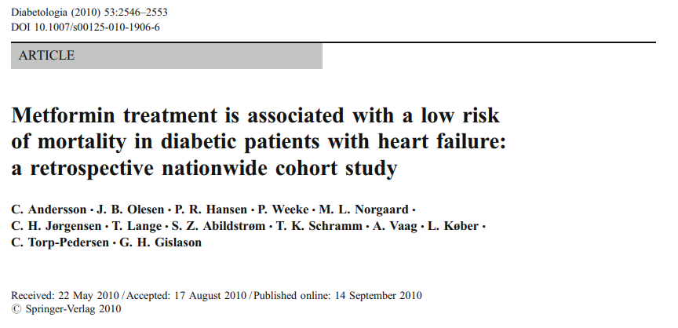

Slide 15
Methods :All patients aged ≥30 years hospitalised for the first time for HF in 1997–2006 were identified and followed until the end of 2006.
Patients who received treatment with metformin, a sulfonylurea and/or insulin were included
Results A total of 10,920 patients were included.
The median observational time was 844 days In total, 6,187 (57%) patients died.

Slide 16
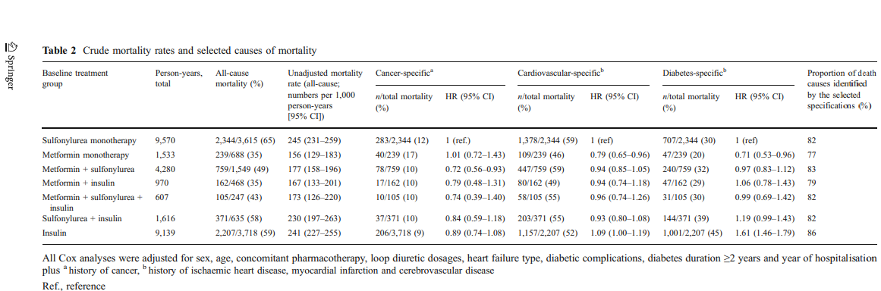

Slide 17
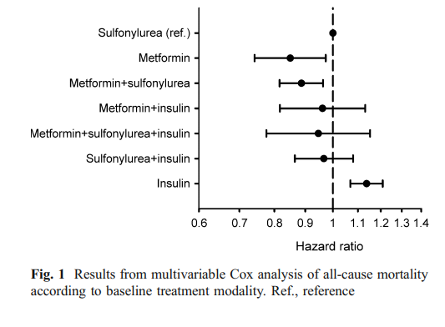
Treatment with metformin is associated with a low risk of mortality in diabetic patients with heart failure compared with treatment with a sulfonylurea or insulin.
Metformin: 0.85 (95% CI 0.75–0.98, p=0.02),
metformin+ sulfonylurea: 0.89 (95% CI 0.82–0.96, p=0.003),
metformin+ insulin :0.96 (95% CI 0.82–1.13, p=0.6),
metformin+insulin+ sulfonylurea :0.94 (95% CI 0.77–1.15, p=0.5)
sulfonylurea+ insulin :0.97 (95% CI 0.86–1.08, p=0.5)
insulin 1.14 (95% CI 1.06–1.20, p=0.0001).

Slide 18
Clinical Considerations(Sulfonylurea)
On the basis of the available data, use of other agents, such as metformin and SGLT-2 inhibitors is preferable to use of sulfonylurea drugs in patients at high risk for HF and those with established HF.

Slide 19
Insulin

Slide 20
Insulin
Many patients with DM require insulin as monotherapy or in combination with other glycemic agents to achieve adequate glycemic control.
The only RCT to specifically assess the cardiovascular safety of insulin was the ORIGIN trial (Outcome Reduction With Initial Glargine Intervention), which randomized 12 537 individuals with pre-DM or DM to insulin glargine or standard care and found no difference in any cardiovascular outcomes, including hospitalization for HF.
Other trials of DM treatment strategies that have included insulin, such as UKPDS and BARI-2D have not demonstrated increased rates of HF with insulin.

Slide 21
ORIGIN(Outcome Reduction with an Initial Glargine Intervention)
Patients and Methods
12,537 with cardiovascular risk factors plus impaired fasting glucose, impaired glucose tolerance, or type 2 diabetes to receive insulin glargine (with a target fasting blood glucose level of ≤95 mg per deciliter [5.3 mmol per liter]) or standard care and to receive n–3 fatty acids or placebo with the use of a 2-by-2 factorial design.
Primary outcomes
CV death or MI or stroke
  CV death or MI or stroke or revascularization or CHF hospitalization
Secondary outcomes
  Microvascular composite ,All cause death

Slide 22
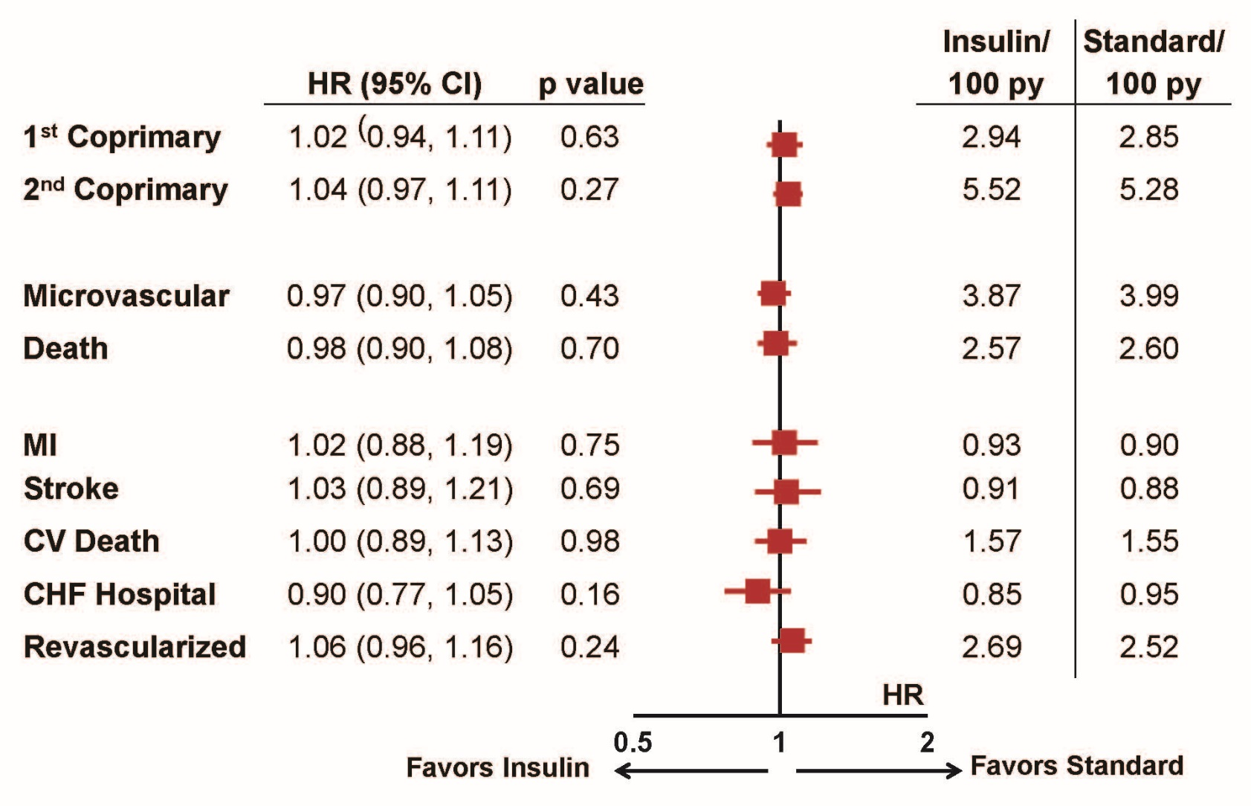

Slide 23
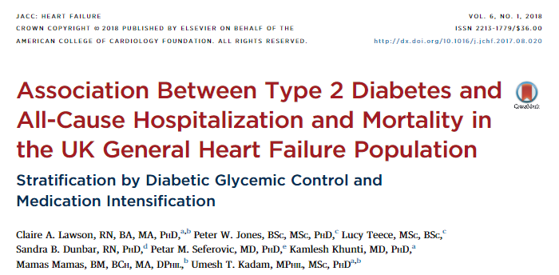

Slide 24
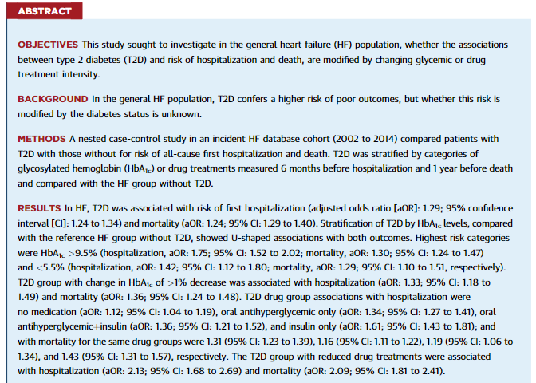

Slide 25
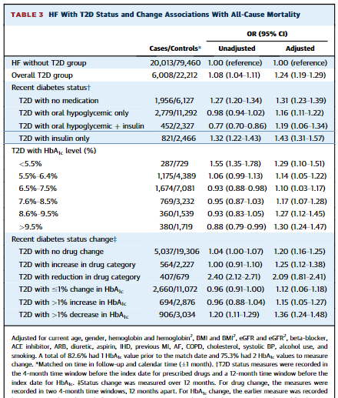

Slide 26
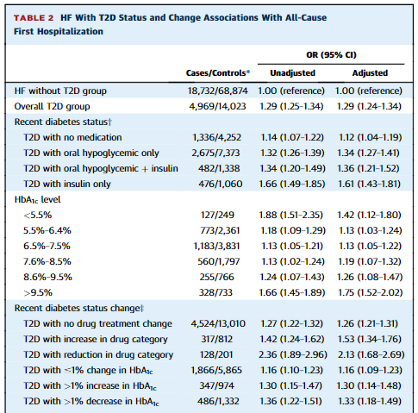

Slide 27
Clinical Considerations(Insulin)
Insulin is sometimes required to achieve adequate glycemic control in individuals with DM and HF.
Insulin use is associated with weight gain and risk of hypoglycemia and should be used with caution and close monitoring.
Other agents, such as metformin and SGLT-2 inhibitors, are preferred if adequate glycemic control can be achieved without insulin

Slide 28
Thiazolidinediones

Slide 29
Pioglitazone: PROactive trial design
Aim
Drug-specific trial to determine the impact of pioglitazone on macrovascular morbidity
and mortality in high-risk patients with T2D
Main inclusion criteria
1. Patients with T2D and evidence of macrovascular disease
2. Age 35–75 years
3. HbA_{1c} > 6.5%
With or without background therapy
Pioglitazone
versus
Placebo
N = 5238; average follow-up 34.5 months
Primary endpoint: time to first occurrence of all-cause mortality, non-fatal MI, stroke,
ACS, endovascular/surgical intervention in coronary/leg arteries, amputation above ankle
Secondary endpoint: time to first occurrence of all-cause mortality, non-fatal MI, stroke
Statistical analysis
≥ 760 patients with ≥ 1 endpoint event
Last patient recruited followed up for 30 months
Dormandy et al. Lancet 2005;366:1279–89.
Notes:
Notes
Data is available from CV outcome trials on pioglitazone (PROactive) and rosiglitazone (RECORD) to provide more robust evidence around the CV effects of the TZDs.
The PROactive trial examined CV outcomes in patients with T2D and existing macrovascular disease, following treatment with pioglitazone or placebo.
Abbreviations
ACS, acute coronary syndrome; HbA_{1C}, glycosylated haemoglobin; MI, myocardial infarction; PROactive, PROspective pioglitAzone Clinical Trial In macroVascular Events; RECORD, Rosiglitazone Evaluated for Cardiac Outcomes and Regulation of glycaemia in Diabetes; T2D, Type 2 diabetes.

Slide 30
PROactive: Pioglitazone was superior to placebo for main secondary endpoint, but not for primary endpoint
Time to primary endpoint*
Time to all-cause mortality, non-fatal MI, stroke
25
Pioglitazone (514 events)
25
Pioglitazone (301 events)
Placebo (572 events)
20
Placebo (358 events)
20
15
15
Proportion of events (%)
Proportion of events (%)
10
10
5
5
0
0
6
12
18
24
30
36
0
0
6
12
18
24
30
36
Time from randomisation (months)
Time from randomisation (months)
HR 0.90 (95% CI: 0.80–1.02)
p = 0.095
HR 0.84 (95% CI: 0.72–0.98)
p = 0.027
Hospitalisation for Heart Failure:
6% (149 of 2605) in pioglitazone vs 4% (108 of 2633) in placebo; p = 0.007
*Death from any cause, non-fatal MI (including silent MI), stroke, acute coronary syndrome, leg amputation, coronary revascularisation or revascularisation of the leg.
Dormandy et al. Lancet 2005;366:1279–89.
Notes:
Notes
The PROactive study demonstrated that pioglitazone was not significantly superior to placebo for the primary endpoint, which was the composite of all-cause mortality, non-fatal MI (including silent MI), stroke, ACS, endovascular or surgical intervention in the coronary or leg arteries, and amputation above the ankle.
However, pioglitazone was significantly superior to placebo for the key secondary endpoint, which was the composite of all-cause mortality, non-fatal MI and stroke.
6% (149 of 2605) and 4% (108 of 2633) of those in the pioglitazone and placebo groups, respectively, were admitted to hospital with heart failure; mortality rates from heart failure did not differ between groups.
Baseline characteristics: 43% on statins; HbA_{1c} 7.8% pioglitazone and 7.9% placebo; BP 144/83 mmHg pioglitazone and 143/83 for placebo
The effects of pioglitazone vs placebo on HbA_{1c} and lipids are shown below:
Pioglitazone Placebo
HbA_{1c} (% absolute change) -0.8 (-1.6 to -0.1) -0.3 (-1.1 to 0.4)
Triglycerides (% change) -11.4 (-34.4 to 18.3) 1.8 (-23.7 to 33.9)
LDL cholesterol (% change) 7.2 (-11.2 to 27.6) 4.9 (-13.9 to 23.8)
HDL cholesterol (% change) 19.0 (6.6 to 33.3) 10.1 (-1.7 to 21.4)
LDL/HDL (% change) -9.5 (-27.3 to 10.1) -4.2 (-21.7 to 15.8)
Abbreviations
ACS, acute coronary syndrome; BP, blood pressure; CI, confidence interval; HbA_{1c}, glycosylated haemoglobin; HDL, high-density lipoprotein; HR, hazard ratio; LDL, low-density lipoprotein; MI, myocardial infarction; PROactive, PROspective pioglitAzone Clinical Trial In macroVascular Events.
Copyright
Dormandy et al. Lancet 2005;366:1279–89. Figure 2 and 3. Page 1283

Slide 31
Rosiglitazone: RECORD trial design
Aim
Drug-specific trial to compare macrovascular morbidity and mortality in patients with
T2D treated with rosiglitazone + metformin / SU
Main inclusion criteria
1. Patients with T2D on maximum tolerated doses of metformin or SU monotherapy
2. Age 40–75 years
3. BMI ≥ 25.0 kg/m²
OPEN-LABEL
Rosiglitazone + metformin or
Rosiglitazone + SU
OPEN-LABEL
Metformin + SU
versus
N = 4447; follow-up 5–7 years
Primary endpoint:
Time to first occurrence of cardiovascular hospitalisation or cardiovascular death
Time to first occurrence of CV hospitalisation or CV death
Statistical analysis
Non-inferiority margin of 1.20 for HR
4000 participants followed for a median of 6 years to give 99% power
Home et al. Lancet 2009;373:2125–35.
Notes:
Notes
The design of the RECORD trial is shown here.¹
The rosiglitazone group comprised patients initially on metformin or SU monotherapy randomised to receive rosiglitazone on a background of metformin or SU. The active control group comprised patients initially on metformin monotherapy who were randomised to receive add-on SU and also patients initially on SU monotherapy who were randomised to receive add-on metformin.
It is important to note that a meta-analysis² of rosiglitazone trials was published in 2007, approximately half-way through the RECORD study, reporting an increased risk of MI and of CV death. Since RECORD was open-label, it is conceivable that this information compromised the integrity of RECORD’s finding.
It was noted that discontinuations from rosiglitazone therapy increased slightly (an excess of 32 people, 1.4% of the randomised population) compared with those in the active control group, in the 12 months following publication of the meta-analysis.¹
The meta-analysis demonstrated that rosiglitazone was associated with a significant increase in the risk of MI and with an increase in the risk of death from CV causes that had borderline significance.²
Baseline characteristics:¹
Statin use: 18% rosiglitazone; 19.2% active control.
SBP was 138–140 mmHg and DBP 82–84 mmHg across the arms.
HbA_{1c} 7.8% in background metformin arms, 8.0% in background SU arms.
Prior ischaemic heart disease (stable angina, MI): 14.8–20.1% across the arms.
Abbreviations
BMI, body mass index; CV, cardiovascular; DBP, diastolic blood pressure; HR, hazard ratio; RECORD, Rosiglitazone Evaluated for Cardiac Outcomes and Regulation of glycaemia in Diabetes; SBP, systolic blood pressure; SU, sulphonylurea; T2D, Type 2 diabetes.
References
Home et al. Lancet 2009;373:2125–35.
Nissen & Wolski. N Engl J Med 2007;356:2457–71.

Slide 32
Rosiglitazone: RECORD trial results showed no increase in CV death
CV outcomes for RECORD
trial (original data)^{1,2}
 | Rosiglitazone N = 2220 | Active control N = 2227 | HR | 95% CI
Primary endpoint
CV death or CV hospitalisation | 321 | 323 | 0.99 | 0.85–1.16
Secondary endpoint
All-cause death | 136 | 157 | 0.86 | 0.68–1.08
CV death | 60 | 71 | 0.84 | 0.59–1.18
MI | 64 | 56 | 1.14 | 0.80–1.63
Stroke | 46 | 63 | 0.72 | 0.49–1.06
CV death, MI or stroke | 154 | 165 | 0.93 | 0.74–1.15
Heart failure | 61 | 29 | 2.10 | 1.35–3.27
1. AVANDIA US Prescribing information. 2. Home et al. Lancet 2009;373:2125–35.
3. FDA Safety Information. 4. Rosenson et al. Am Heart J 2012;164:672–80.
Notes:
Notes
The RECORD trial showed no increase in CV death with rosiglitazone.¹
In 2013, the FDA reduced safety restrictions on rosiglitazone.²
However, controversy still remains, as there are no long-term prospective CV safety data for this agent.³
Abbreviations
CI, confidence interval; CV, cardiovascular; FDA, Food and Drug Administration; HR, hazard ratio; MI, myocardial infarction; RECORD, Rosiglitazone Evaluated for Cardiac Outcomes and Regulation of glycaemia in Diabetes.
References
AVANDIA US prescribing Information: https://www.gsksource.com/pharma/content/dam/GlaxoSmithKline/US/en/Prescribing_Information/Avandia/pdf/AVANDIA-PI-MG.PDF.
FDA safety information: http://www.fda.gov/NewsEvents/Newsroom/PressAnnouncements/ucm376516.htm
Rosenson et al. Am Heart J 2012;164:672–80.

Slide 33
Clinical Considerations (TZDs)
TZDs are not recommended in patients with established HF, and may
increase the risk of HF events in individuals with DM without HF.

Slide 34
DPP4 inhibitors

Slide 35
Summary of CV outcomes trials with DPP4 inhibitors
Intervention | Saxagliptin/ placebo | Alogliptin/ placebo | Sitagliptin/ placebo | Linagliptin/ glimepiride | Linagliptin/ placebo
Main inclusion criteria | History of or multiple risk factors for CVD | ACS within 15–90 days before randomisation | CVD | ≥ 2 specified traditional CV risk factors or manifest CVD | High risk of CV events (e.g. albuminuria, prior CVD)
No. of patients | 16,492 | 5380 | 14,671 | 6041 | 8300
Primary outcome | 3P-MACE | 3P-MACE | 4P-MACE | 4P-MACE | 4P-MACE
Key secondary outcome | Expanded MACE | 4P-MACE | 3P-MACE | 3P-MACE | 3P-MACE; renal composite
Target no. of events | 1040⁶ | 650 | 1300 | 631 | 625⁷
Median follow-up (y) | 2.1 | 1.5 | 3.0 | 6–7* | 4*⁷
Estimated completion | Completed | Completed | Completed | 2018⁸ | 2018
Scirica et al. N Engl J Med 2013;369:1317–26. 2. White et al. N Engl J Med 2013;369:1327–35. 3. Green et al. N Engl J Med 2015;
DOI: 10.1056/NEJMoa1501352. 4. Marx et al. Diabetes Vasc Dis Res 2015;12:164–74. 5. NCT01897532. 6. Scirica et al. Am Heart J 2011;162:818–25.e6. 7. Data on file (BI trial no. 1218.22 trial protocol). 8. NCT01243424.

Slide 36
Clinical Outcomes with Saxagliptin
SAVOR-TIMI
Study Design
Key Results
N=16,492 patients with T2D and CVD or CVD risk
Randomization
  Saxagliptin: n=8280
  Placebo: n=8212
Superiority study with provision to test for noninferiority
  Primary composite endpoint: CV death, nonfatal MI, or nonfatal ischemic stroke
  Secondary: CV death, nonfatal MI, nonfatal ischemic stroke, hospitalization for HF, coronary revascularization, or unstable angina
Median follow-up: 2.1 years
Endpoint A1C
  Saxagliptin: 7.7% ± 1.4% (P<0.001 vs placebo)
  Placebo: 7.9% ± 1.5%
CV outcomes
  Primary HR: 1.00 (0.89-1.27); P=0.99
  Secondary HR: 1.02 (0.94-1.11); P=0.66
Higher incidence of HF hospitalization in saxagliptin group
No difference between groups in incidence of acute or chronic pancreatitis; fewer cases of pancreatic cancer in saxagliptin group; more cases of nonfatal angioedema in saxagliptin group (8 vs 1)
CI, confidence interval; CV, cardiovascular; HF, heart failure; HR, hazard ratio; MI, myocardial infarction; SAVOR-TIMI, Saxagliptin Assessment of Vascular Outcomes Recorded in Patients with Diabetes Mellitus–Thrombolysis in Myocardial Infarction./ Saxagliptin Assessment of Vascular Outcomes Recorded in Patients with Diabetes Mellitus–Thrombolysis in Myocardial Infarction)
Scirica BM, et al. N Engl J Med. 2013;369,1317-1326.

Slide 37
Clinical Outcomes with Saxagliptin
SAVOR-TIMI Prespecified Composite Endpoints and Mortality
(n=16,492)
Median follow-up: 2.1 years
 |  | Hazard ratio (95% CI) | P value
Primary composite endpoint* |  | 1.00 (0.89-1.27) | 0.99
Secondary composite endpoint† |  | 1.02 (0.94-1.11) | 0.66
Death from any cause |  | 1.11 (0.96-1.27) | 0.15
CV death |  | 1.03 (0.87-1.22) | 0.52
Favors saxagliptin
*CV death, nonfatal MI, or nonfatal ischemic stroke; †CV death, nonfatal MI, nonfatal ischemic stroke, hospitalization for HF, coronary revascularization, or unstable angina.
CI, confidence interval; CV, cardiovascular; HF, heart failure; MI, myocardial infarction; SAVOR-TIMI, Saxagliptin Assessment of Vascular Outcomes Recorded in Patients with Diabetes Mellitus–Thrombolysis in Myocardial Infarction.
Scirica BM, et al. N Engl J Med. 2013;369,1317-1326.

Slide 38
Individual Secondary Outcomes with Saxagliptin
SAVOR-TIMI Prespecified Individual Endpoints
(n=16,492)
Median follow-up: 2.1 years
 |  | Hazard ratio (95% CI) | P value
Myocardial infarction |  | 0.95 (0.80-1.12) | 0.52
Ischemic stroke |  | 1.11 (0.80-1.12) | 0.38
Hospitalization for unstable angina |  | 1.19 (0.89-1.60) | 0.24
Hospitalization for heart failure |  | 1.27 (1.07-1.51) | 0.007
Hospitalization for coronary revascularization |  | 0.91 (0.80-1.04) | 0.18
Renal endpoint* |  | 1.08 (0.88-1.32) | 0.46
Hospitalization for hypoglycemia |  | 1.22 (0.82-1.83) | 0.33
Favors saxagliptin
*Doubling of creatinine, initiation of dialysis, renal transplantation, or creatinine >6.0 mg/dL
CI, confidence interval; CV, cardiovascular; SAVOR-TIMI, Saxagliptin Assessment of Vascular Outcomes Recorded in Patients with Diabetes Mellitus–Thrombolysis in Myocardial Infarction.
Scirica BM, et al. N Engl J Med. 2013;369,1317-1326.

Slide 39
Clinical Outcomes with Alogliptin
EXAMINE
Study Design
Key Results
N=5380 patients with T2D and ACS
Randomization
  Alogliptin: n=2701
  Placebo: n=2679
Noninferiority study: prespecified HR margin = 1.3 for primary endpoint
  Primary composite endpoint: CV death, nonfatal MI, or nonfatal stroke
  Secondary: CV death, nonfatal MI, nonfatal stroke, urgent revascularization for unstable angina
Median follow-up: 18 months
Least squares mean difference in A1C: -0.36% (95% CI -0.43 to -0.28; P<0.001) for alogliptin vs placebo
CV outcomes
  Primary HR: 0.96 (≤1.16); P=0.32
  Secondary HR: 0.95 (≤1.14*); P=0.26
No difference between alogliptin and placebo in incidence of acute and chronic pancreatitis, cancer, renal impairment, angioedema, or severe hypoglycemia
*Upper boundary of 1-sided repeated CI, alpha level 0.01./(Examination of Cardiovascular Outcomes with Alogliptin versus Standard of Care)
CI, confidence interval; CV, cardiovascular; EXAMINE, Examination of Cardiovascular Outcomes with Alogliptin versus Standard of Care; HR, hazard ratio; MI, myocardial infarction.
White W, et al. N Engl J Med. 2013;369:1327-1335.

Slide 40
Clinical Outcomes with Alogliptin
EXAMINE Safety Endpoints
(n=5380)
Median follow-up: 18 months
 |  | Hazard ratio (95% CI) | P value
Primary composite |  | 0.96 (≤1.16)* | 0.32
Primary endpoint components
CV death |  | 0.79 (0.6-1.04) | 0.10
Nonfatal MI |  | 1.08 (0.88-1.33) | 0.47
Nonfatal stroke |  | 0.91 (0.55-1.50) | 0.71
Primary secondary endpoint† |  | 0.95 (≤1.14)* | 0.26
Death from any cause |  | 0.85 (0.66-1.10) | 0.21
Favors alogliptin
*Upper boundary of 1-sided repeated CI, alpha level 0.01.
†CV death, nonfatal MI, nonfatal stroke, urgent revascularization for unstable angina.
CI, confidence interval; CV, cardiovascular; EXAMINE, Examination of Cardiovascular Outcomes with Alogliptin versus Standard of Care; MI, myocardial infarction.
White W, et al. N Engl J Med. 2013;369:1327-1335.

Slide 41
Impact on HF hospitalization(alogliptin)
No difference in risk HR:1.19(95% CI :1.07-1.51)

Slide 42
Clinical Outcomes with Sitagliptin
TECOS
Study Design
Key Results
N=14,671 patients with T2D and CVD
Randomization
  Sitagliptin: n=7332 (6972 completed)
  Placebo: n=7339 (6905 completed)
Noninferiority study: 1.3 marginal upper boundary of 2-sided 95% CI
  Primary composite outcome: cardiovascular death, nonfatal myocardial infarction, nonfatal stroke, or hospitalization for unstable angina
  Secondary composite outcome: cardiovascular death, nonfatal myocardial infarction, or nonfatal stroke.
Median follow-up: 3.0 years
Least squares mean difference in A1C: -0.29% (95% CI -0.32 to -0.27) for sitagliptin vs placebo
Noninferior to placebo for cardiovascular outcomes
  Primary HR: 0.98 (0.88-1.09); P<0.001
  Secondary HR: 0.99 (0.89-1.11); P<0.001
No difference between sitagliptin and placebo in incidence of infections, cancer, renal failure, hypoglycemia, or noncardiovascular death
CI, confidence interval; HR, hazard ratio; TECOS, Trial Evaluating Cardiovascular Outcomes with Sitagliptin.
Green JB, et al. N Engl J Med. 2015;373:232-242.

Slide 43
Individual Secondary Outcomes with Sitagliptin
TECOS Intent to Treat Analysis
(n=14,671)
Median follow-up: 3.0 years
 |  | Hazard ratio (95% CI) | P value
CV death |  | 1.03 (0.89-1.19) | 0.71
Hospitalization for unstable angina |  | 0.90 (0.70-1.16) | 0.42
Fatal or nonfatal MI |  | 0.95 (0.81-1.11) | 0.49
Fatal or nonfatal stroke |  | 0.97 (0.79-1.19) | 0.76
Death from any cause |  | 1.01 (0.90-1.14) | 0.88
Hospitalization for heart failure |  | 1.09 (0.83-1.20) | 0.98
Hospitalization for heart failure or CV death |  | 1.02 (0.90-1.15) | 0.74
Favors sitagliptin
CV, cardiovascular; MI, myocardial infarction; NF, noninferiority; TECOS, Trial Evaluating Cardiovascular Outcomes with Sitagliptin.
Green JB, et al. N Engl J Med. 2015;373:232-242.

Slide 44
Clinical Considerations(Dipeptidyl Peptidase-4 Inhibitors)
There is no evidence that DPP-4 inhibitors provide cardiovascular benefit.
In patients with DM at high cardiovascular risk, some DPP-4 inhibitors could increase the risk of hospitalization for HF.
On the basis of these data, the risk-benefit balance for most DPP-4 inhibitors does not justify their use in patients with established HF or those at high risk for HF

Slide 45
GLP-1 Receptor Agonists

Slide 46
GLP-1 Receptor Agonists
GLP-1 (glucagon-like peptide-1) receptor agonists stimulate glucose-dependent insulin release with a low risk of hypoglycemia.
Important secondary effects include a decrease in appetite and food intake, which leads to weight loss of 2 to 4 kg,
improved lipid levels, with decreased triglyceride levels and increased high-density lipoprotein levels.
Albiglutide, dulaglutide, exenatide, liraglutide, lixisenatide, and semaglutide are FDA approved for the treatment of type 2 DM

Slide 47
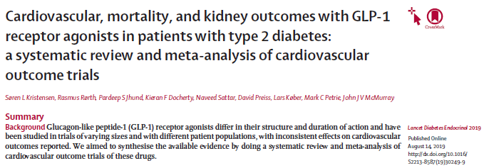

Slide 48
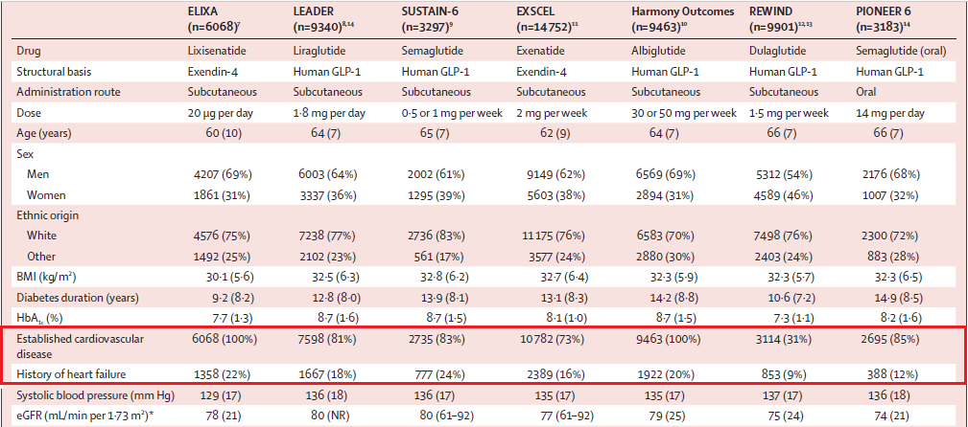
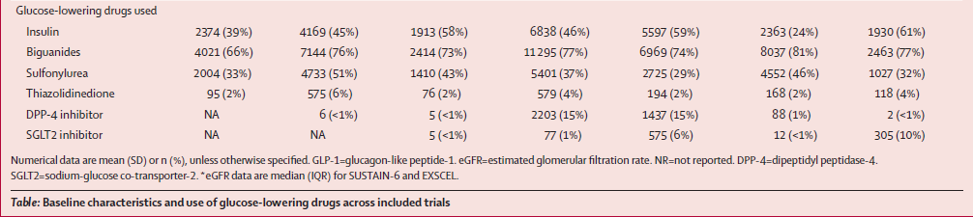
www.thelancet.com/diabetes-endocrinology Published online August 14, 2019

Slide 49
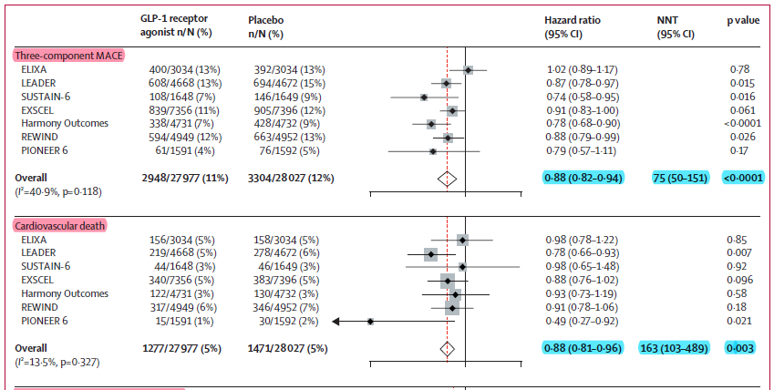
www.thelancet.com/diabetes-endocrinology Published online August 14, 2019

Slide 50
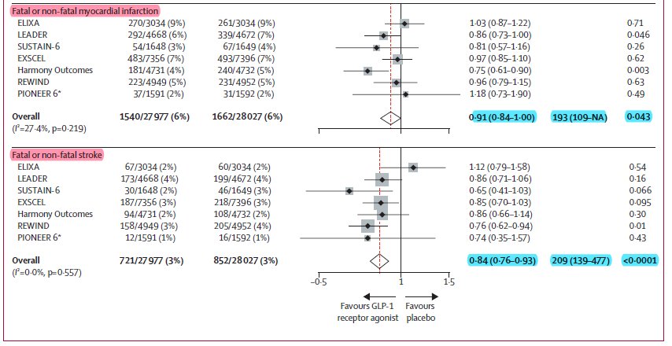
www.thelancet.com/diabetes-endocrinology Published online August 14, 2019

Slide 51
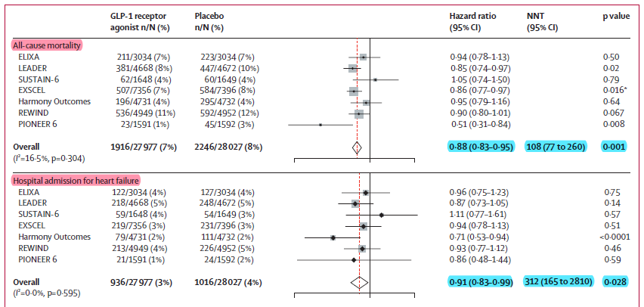
www.thelancet.com/diabetes-endocrinology Published online August 14, 2019

Slide 52
GLP-1 Receptor Agonists
In dogs with DCM, an infusion of recombinant GLP-1 improved LV contractility and cardiac output and decreased LV filling pressure and systemic vascular resistance.
In a mouse model of diabetic cardiomyopathy, administration of a selective GLP-1 agonist reduced LV hypertrophy, attenuated oxidative stress, and improved survival

Slide 53
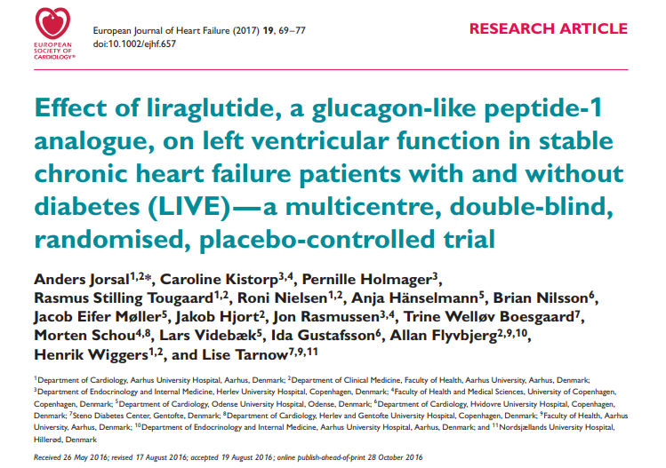

Slide 54
Aim: To determine the effect of the GLP-1 analogue liraglutide on left ventricular function in chronic HF patients with and without type 2 diabetes.
Patients (n=241) with reduced LVEF ≤45% were recruited (2012 to 2015).
Patients were clinically stable and on optimal heart failure treatment.
Intervention was liraglutide 1.8 mg /d or matching placebo for 24 weeks.
Change in LVEF did not differ between the liraglutide and the placebo group; mean difference (95% confidence interval) was −0.8% (−2.1, 0.5; P =0.24).
Heart rate increased with liraglutide (mean difference: 7 b.p.m.)

Slide 55
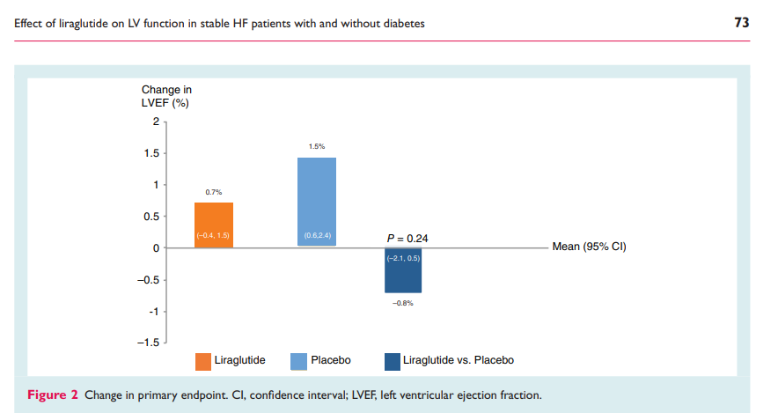

Slide 56
Clinical Considerations(GLP-1 receptor agonists)
GLP-1 receptor agonists may reduce the risk of major adverse cardiovascular events and mortality in the general population of patients with DM.
GLP-1 receptor agonists have had no impact on the risk of HF hospitalization in large RCTs, which suggests they are safe to use but not beneficial in preventing HF in patients at risk for HF.
In patients with established HFrEF and recent decompensation, GLP-1 receptor agonists should be used with caution, given no evidence of benefit and a trend toward worse outcomes in 2 small RCTs.
There are no data to guide their use in HFpEF.

Slide 57
SGLT-2 inhibitors

Slide 58
SGLT-2 inhibitors
SGLT-2 inhibitors lower glucose via an insulin-independent mode of action through increased urinary excretion of glucose.
In addition to glucose excretion, SGLT-2 inhibitors increase fractional excretion of sodium and have modest diuretic and natriuretic effects.
Canagliflozin, dapagliflozin, and empagliflozin are FDAapproved for the treatment of type 2 DM

Slide 59
EMPA-REG OUTCOME®
Trial design
Placebo
(n=2333)
Screening
(n=11531)
Randomized and treated
(n=7020)
Empagliflozin 10 mg
(n=2345)
Empagliflozin 25 mg
(n=2342)
Study medication was given in addition to standard of care.
The trial was to continue until ≥ 691 patients experienced an adjudicated primary outcome event.
Key inclusion criteria:
  Adults with type 2 diabetes and established CVD(100%)/HF:10%
  BMI ≤45 kg/m²; HbA1c 7–10%; eGFR ≥30 mL/min/1.73m² (MDRD)
  Zinman B et al. N Engl J Med 2015

Slide 60
EMPA-REG OUTCOME®
Trial design
Primary outcome: 3-point MACE (composite of death from cardiovascular causes, nonfatal MI, nonfatal stroke
Secondary outcome: composite of the Primary outcome plus hospitalization for unstable angina.
Further outcomes included: heart failure hospitalization or CV death, hospitalization for heart failure, all-cause mortality
Subgroup analyses were based on baseline characteristics, including the presence/absence of investigator-reported heart failure

Slide 61
Clinical Outcomes with Empagliflozin
EMPA-REG OUTCOME Pooled Analysis(N=7020)
Median follow-up: 3.1 years
Placebo vs Empagliflozin |  | Hazard ratio (95% CI) | P value
Primary composite endpoint* (12.1 vs 10.5%) |  | 0.86 (0.74-0.99) | 0.04
Secondary composite endpoint† (14.3 vs 12.8) |  | 0.89 (0.78-1.01) | 0.08
Death from any cause (8.3 vs 5.7%) |  | 0.68 (0.57-0.82) | <0.001
CV death (5.9 vs 3.7%) |  | 0.62 (0.49-0.77) | <0.001
Fatal or nonfatal MI (5.4 vs 4.8%) |  | 0.87 (0.70-1.09) | 0.23
Hospitalization for HF (4.1 * 2.7%) |  | 0.65 (0.50-0.85) | 0.002
Hospitalization for HF or CV death (8.5 vs 5.8%) |  | 0.66 (0.55-0.79) | <0.001
Favors empagliflozin
*CV death, nonfatal MI (excluding silent MI), or nonfatal stroke; †CV death, nonfatal MI (excluding silent MI), nonfatal stroke, and hospitalization for unstable angina.
CI, confidence interval; CV, cardiovascular; HF, heart failure; HR, hazard ratio; MI, myocardial infarction.
Zinman B, et al. N Engl J Med. 2015;373:2117-2128.

Slide 62
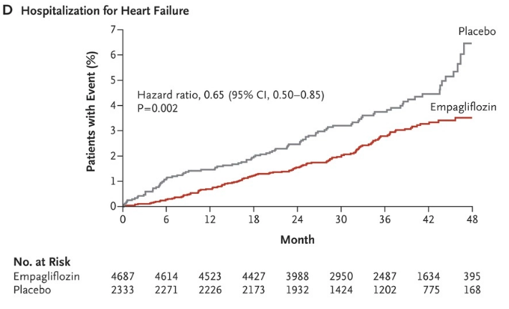
Although the trial enrolled primarily patients with DM and ASCVD(≈10% of patients had HF at baseline), there was also a 35% reduction in HF hospitalizations, an effect that was observed within weeks of randomization
  Zinman B et al. N Engl J Med 2015

Slide 63
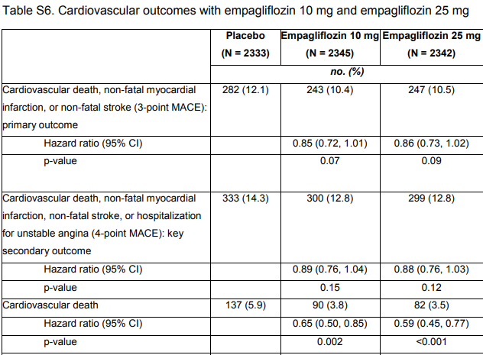
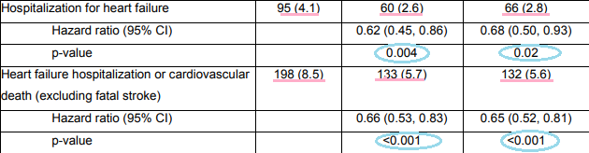

Slide 64
CANVAS Trial design
  Placebo
Randomized and treated
(n=4330)
Canagliflozin (100 mg)
Canagliflozin (300 mg)
Stable dose of background anti hyperglycemic agents administered for 8 weeks prior to screening
Aim : To determine CV risk associated with canagliflozin
Key inclusion criteria:
Patients with T2D
Age ≥ 30 years with history of established cardiovascular disease (65%) or ≥ 50 y or at high risk for cardiovascular events (35%) / History HF:14%

Slide 65
Clinical Outcomes with Canagliflozin
CANVAS Program Study Design
N=10,142 patients with T2D and high CV risk
  CANVAS: n=4330
  CANVAS-R: n=5812
Randomization (across both studies)
  Canagliflozin: n=5795
  Placebo: n=4347
Endpoints
  Primary endpoint: composite of CV death, nonfatal MI, or nonfatal stroke
  Secondary endpoints:
    All-cause death
    CV death
    Albuminuria progression
    Composite of CV death and HF hospitalization
CANVAS, Canaglflozin Cardiovascular Assessment Study; CI, confidence interval; CV, cardiovascular; HF, heart failure; HR, hazard ratio; MI, myocardial infarction.
Neal B, et al. N Engl J Med. 2017;377:644-657.

Slide 66
Clinical Outcomes with Canagliflozin
CANVAS Program(N=10,142)
Median follow-up: 2.4 years
No. of participants per 1000 patient-y |  | Hazard ratio (95% CI) | P value
Primary composite endpoint* 26.9 31.5 |  | 0.86 (0.75-0.97) | 0.02†
CV death 11.6 12.8 |  | 0.87 (0.72-1.06)
Nonfatal MI 9.7 11.6 |  | 0.85 (0.69-1.05)
Nonfatal stroke 7.1 8.4 |  | 0.90 (0.71-1.15)
Fatal or nonfatal MI 11.2 12.6 |  | 0.89 (0.73-1.09)
Fatal or nonfatal stroke 7.9 9.6 |  | 0.87 (0.69-1.09)
HF hospitalization 5.5 8.7 |  | 0.67 (0.52-0.87)
CV death or HF hospitalization 16.3 20.8 |  | 0.78 (0.67-0.91)
All-cause death 17.3 19.5 |  | 0.87 (0.74-1.01)
Progression of albuminuria 89.4 128 |  | 0.73 (0.67-0.79)
40% reduction in eGFR, renal replacement therapy, or renal death 5.5 9 |  | 0.60 (0.47-0.77)
Favors canagliflozin
*CV death, nonfatal MI, or nonfatal stroke. †Superiority.
CI, confidence interval; CV, cardiovascular; HF, heart failure; HR, hazard ratio; MI, myocardial infarction.
Neal B, et al. N Engl J Med. 2017 Jun 12 [epub ahead of print].

Slide 67
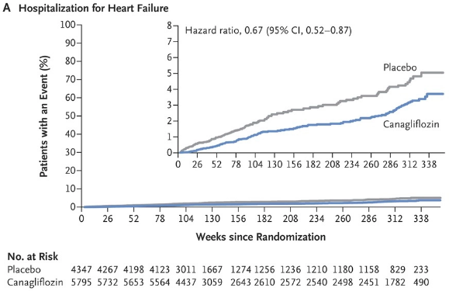
33% relative reduction in the risk of HF hospitalization compared with placebo.
Additional analyses suggested the morbidity and mortality benefits might be greater in patients with a prior history of HF
Neal B, et al. N Engl J Med. 2017 Jun 12 [epub ahead of print].

Slide 68
DECLARE-TIMI58
  Placebo
17,160 with Type 2 DM
Established CV Disease (6974) or
Multiple Risk Factors (10186)
DAPAGLIFLOZIN
10 mg DAILY
DURATION EVENT DRIVEN ≥1390 MACE
Median follow up 4.2 years
Patients 17,160 with Type 2 DM Established CV Disease (6974) or Multiple Risk Factors (10186)
History HF:14%
Primary Eps Safety: MACE (CVD/MI/Ischemic Stroke)
Dual Efficacy: CVD/HHF, MACE

Slide 69
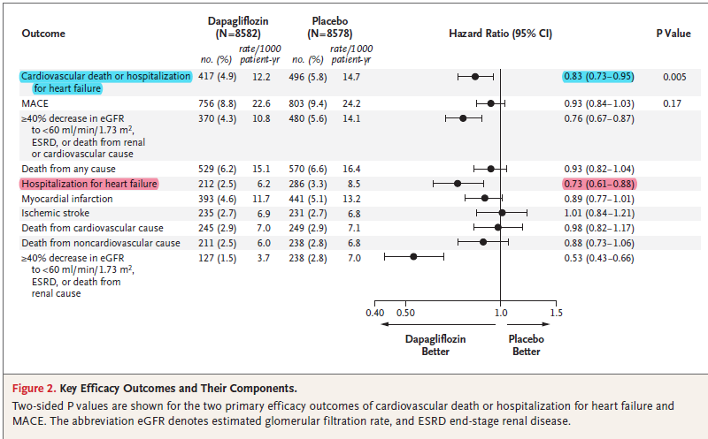

Slide 70
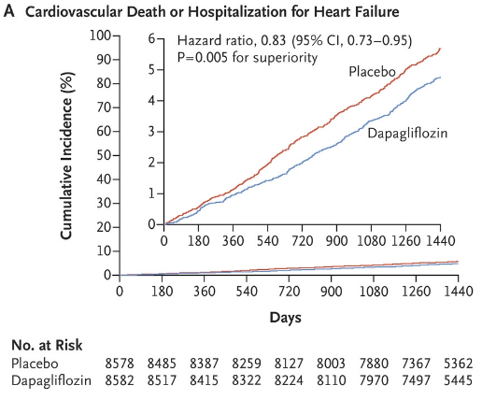
Wiviott SD, Raz I…Sabatine MA, AHJ 2018

Slide 71
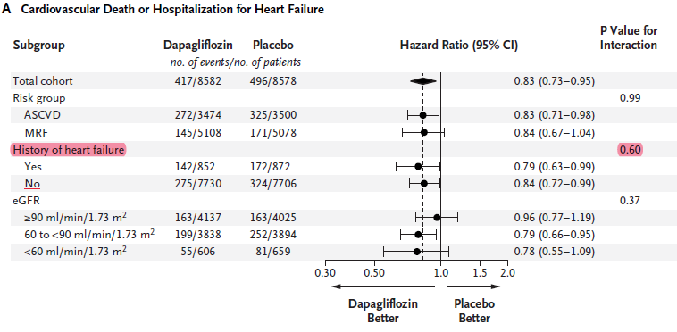
Wiviott SD, Raz I…Sabatine MA, AHJ 2018

Slide 72
The potential mechanisms by which SGLT-2 inhibitors might reduce HF-associated risk remain unclear
In fact, mechanisms beyond glucose lowering or diuresis might explain the reduction in HF events.
Provocative animal studies of SGLT-2 inhibitors show:
reductions in oxidative stress
improvement in endothelial function
neurohormonal modulation, anti-inflammatory effects.
Most recently, possibly a change in metabolic fuel sources away from glucose oxidation to free fatty acid and ketone bodies, could play a role in improving myocardial efficiency.

Slide 73
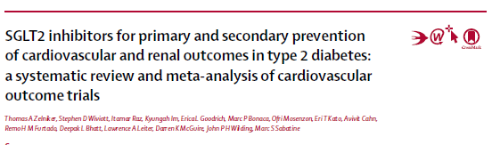

Slide 74
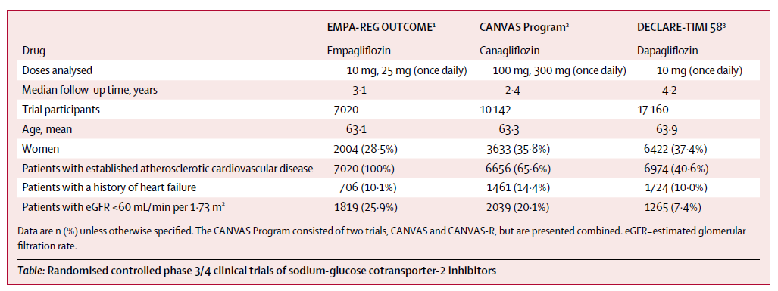

Slide 75
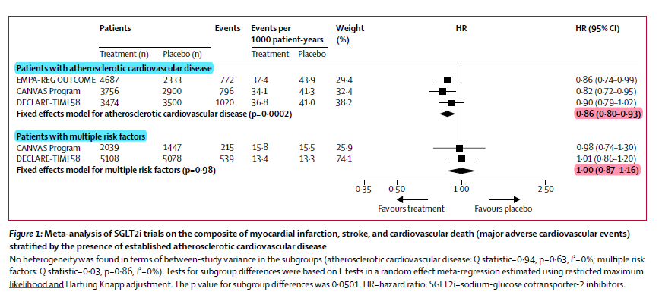

Slide 76
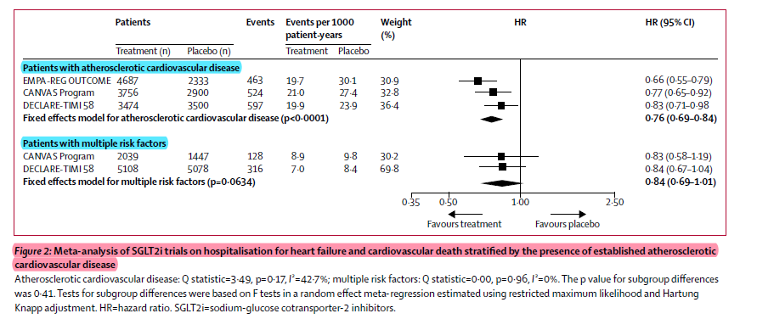
Wiviott SD, Raz I…Sabatine MA, AHJ 2018

Slide 77
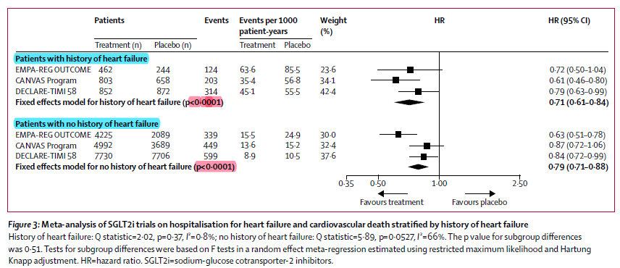

Slide 78
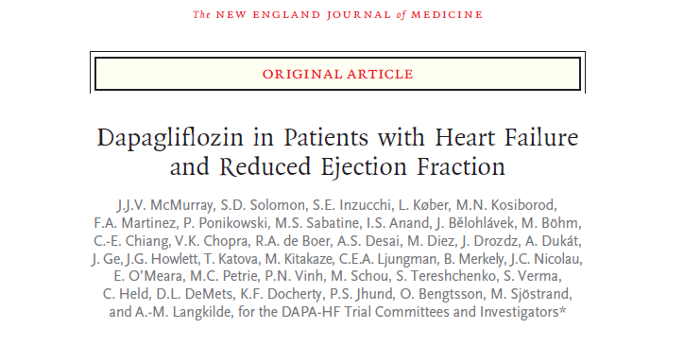
This article was published on September 19, 2019, at NEJM.org

Slide 79
METHODS
we randomly assigned 4744 patients with New York Heart Association class II, III, or IV heart failure and an ejection fraction of 40% or less to receive either dapagliflozin (at a dose of 10 mg once daily) or placebo,in addition to recommended therapy.
The primary outcome was a composite of worsening heart failure (hospitalization or an urgent visit resulting in intravenous therapy for heart failure) or cardiovascular death.

Slide 80
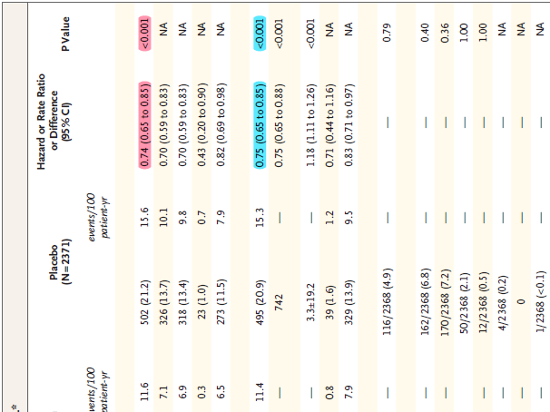
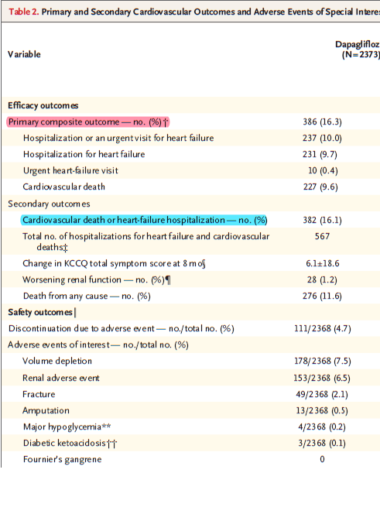

Slide 81
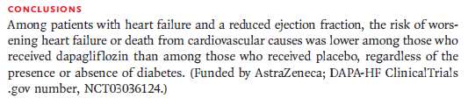

Slide 82
Conclusion
Metformin
Sulfonylurea Drugs
Insulin
DPP4 inhibitors
GLP-1 receptor agonists
SGLT-2 inhibitors

