Slide 1
Case Presentation
Dr. Sanaz Pilechian
99.12.18

Slide 2
Referral to an endocrinology clinic for re-examination of adrenal masses

Slide 3
A 50-year-old woman known case of HTN (for 10 years), who has had recurrent episodes of muscle weakness since that time, as it happened about once a month, lasted 24 hours and resolved spontaneously.
Once, following the aggravation of the weakness of the limbs, she suffered from falling down, which occurred three times in 24 hours, and she was referred to a doctor.
On 96.12, she was referred to a neurologist and was examined for Guillain-Barré disease. MRI and EMG_NCV were performed, which were normal and did not recur.

Slide 4
97/11/12, following a 10-day diarrhea and vomiting with severe weakness and inability to walk, she was referred to Taleghani Hospital.
At the time of arrival at the emergency room, she had a blood pressure of 160/100 and the initial tests were as follows:
BUN | Cr | Na | K
70 | 2.6 | 147 | 1.7

Slide 5
Complete Blood Cells
White Blood Cells count(WBC)/mcL | 2800
Hemoglubin consentration (Hb)g/dl | 12.4
Platlet count(Plt)/mcL | 277000
ESR | 78
Blood Urea | 69 mg/dl
Serum Creatinine(Cr) | 2.37 mg/dl
AST | 151
ALT | 165
ALP | 135
Bi-Total | 1.6
Bi-Direct | 0.6
Na | 147
K | 1.7
Mg | 3.5
VBG
PH | 7.41
PCO2 | 47
HCO3 | 30
U/A
WBC | 4-6
RBC | 6-8
Hb | 1+
Protein | 1+

Slide 6
Treated with KCL infusion, 30 cc/liter via CV line.
Due to leukopenia and high ESR and elevated liver enzymes, the patient with a possible diagnosis of sepsis was given broad-spectrum antibiotics and was admitted to the gastrointestinal service with a prerenal azotemia panel following diarrhea and vomiting and transferred to the ICU.
There, she received supportive cares, intravenous pantazole, KCL infusion and spironolactone.
During additional examinations and abdominal ultrasound, the intestinal loops are dilated and a CT scan is performed on the patient:

Slide 7
FIRST ABDOMINOPEVIC CT SCAN
Lesion about 32*20 mm in Lt Adrenal
Lesion about 30*20 mm in Rt Adrenal

Slide 8
The patient was transferred from the gastrointestinal to the endocrine service due to normal endoscopy and colonoscopy and improvement of diarrhea but due to refractory hypokalemia and adrenal masses on CT scan and the patient's history of hypertension.
At the beginning of admission to the endocrine department, spironolactone and losartan discontinued and the KCL infusion was continued.

Slide 9
On 97/11/28, due to the need not to take spironolactone and losartan for up to three weeks for adrenal function tests, she was discharged with the following commands:
Potassium citrate10meq 2 tabs TDS
Dilltiazem 60 BD
Ciprofloxacin 500 BD
Metronidazole 250 TDS
and Pentasa 1gr BD
Tests during discharge
Cr | Na | K | Ca | P
1.4 | 136 | 4.1 | 9.1 | 4.4

Slide 10
CBC | 12/12/97
WBC(mcL) | 10,270
Hb(g/dl) | 13
PLt count(mcl) | 281,000
Blood Urea(mg/dl) | 19
Cr(mg/dl) | 0.92 GFR=80.84
Na(meq) | 142
K(meq) | 3.4
ESR | 42
AST | 11
ALT | 10
ALP | 62
Ca(mg/dl) | 8.4
P(mg/dl) | 3.4
Mg(mg/dl) | 2
TSH | 2.5
2 weeks after discharge

Slide 11
Overnight Dexa supp. Test | 21/12/97
Cortisol 8 am(mic gr/dl) | 8.8

Slide 13
21/12/97 | 8/1/98 | 12/3/98 | 21/3/98
ODST:8/8 micgr/dl | ODST:13/2 micgr/dl | ODST:12/3 micgr/dl | ODST:20/9 micgr/dl
24 hr urine: Volume:1800 cr:1 gr/24 hr UFC:227 micg/24 hr(50-190) | 24 hr urine: volume:1900 cr:1300 UFC:131 micg/24 hr |  | 24 hr urine: Volume :1000 cr:1/3 gr/24 hr UFC: 360 micgr/24 hr
 | ACTH:0/4 pmol/l (1-3/5)
 |  | DHEAS:83(35-430)

Slide 14
AVS unstimulated on 98/2/31
After 4 weeks of discontinuing the Aldactone; because of the hypokalemia we couldn’t discontinue the losartan. She used losartan 50/TDS + Diltiazem 60/ TDS
 | Aldosterone(ng/dl) | Cortisol(µg/dl) | A/C Ratio
Right A | 62.2 | 11.29 | 5.50
Left Adrenal | 90.4 | 8.6 | 10.51
Common Femoral vein | 99 | 10.79 | 9.17
Cortisol of Rt Adrenal Vein/peripheral: 11.29/10.79= 1.04
Cortisol of Lt Adrenal Vein/peripheral: 8.6/10.79=0.797
A/C of Rt Adrenal V.: 62.2/11.29= 5.50
A/C of Lt Adrenal V.: 90.4/8.6=10.5
A/C of Peripheral V.= 99/10.79=9.17
A/C of Rt Adrenal V./peripheral V.= 5.50/9.17=0.599
A/C of Lt Adrenal V./peripheral V.=10.5/9.17=1.14

Slide 15
Due to AVS failure
Bilateral adrenal masses CT scan (homogeneous and size less than 4 cm)
high aldosterone
Two positive Overnight Dexamethasone Sup tests with normal UFC , Suppress ACTH
It was recommended to follow up annually with CT scans and lab tests AND medical treatment.

Slide 16
Foll0w UP LAB
 | 99.3.6… Gholhak Lab
FSH | 14 mIU/ml | 3.5-12.5
LH | 5.3 IU/L | 2.4-12.6
Cortisol (8am) | 10.5 mcgr/dl | 4.3-22.4
ACTH | 19.4 pg/ml | 7.1-56.3
Plasma Direct Renin | 17.6 micIU/ml | 5.3-99.1
Aldostrone | 79.8 ng/dl | 3.7-43.2
Na | 137
K | 4

Slide 17
24-h-Urine | 99.9.15-Gholhak
Volume(ml) | 1500
Cr(gr/24h) | 1395
UFC(micro gr/24h) | 41.6(3.5-142)
 | 99.9.15-Gholhak
VMA mg/24h | 5.1 (0-13.6)
Metanephrine | 69 (<350)
Normetanephrine | 791 (600)
Low Dose dexamethasone sup. test | 99.9.15…Gholhak Lab.
593 nmol/L | -
Low Dose dexamethasone sup. test | 99.10.27…Pars Lab.
12.5 am(micro gr/dl | -

Slide 18
Foll0w UP CT SCAN

Slide 19
97.11.13
Lesion about 32*20 mm in Lt Adrenal
Lesion about 30*20 mm Rt Adrenal
97.12.19
Hypodense lesion about 30*20 mm with absolute washout 73 in Lt Adrenal/ with peripheral enhancement that Suggestive for adenoma.
Iso to hyperdense soft tissue mass 31* 16 mm with absolute washout 76 in Rt Adrenal / heterogenous enhancement in arterial phase
98.3.8
30*19 mm cystic/necrotic mass in Lt Adrenal and 28*17 mm in Rt Adrenal

Slide 20
99.3.21
30*24 mm oval shape hypodense mass in Lt Adrenal with absolute washout 64 that Suggestive for lipid poor adenoma
31*23 mm oval shape iso to hypodense mass in Rt Adrenal with absolute washout 57 that suspicious
99.12.9
25*20*24 mm hemogenous mass( lipid poor adenoma) in Lt Adrenal ( 10 hounsfield unit in without contrast phase) absolute washout 70 (suggestive adenoma)
28*16*23 mm iso to hypodense mass in Rt Adrenal (30 hounsfield unit in without contrast phase) absolute washout 56 (that suspicious)

Slide 21
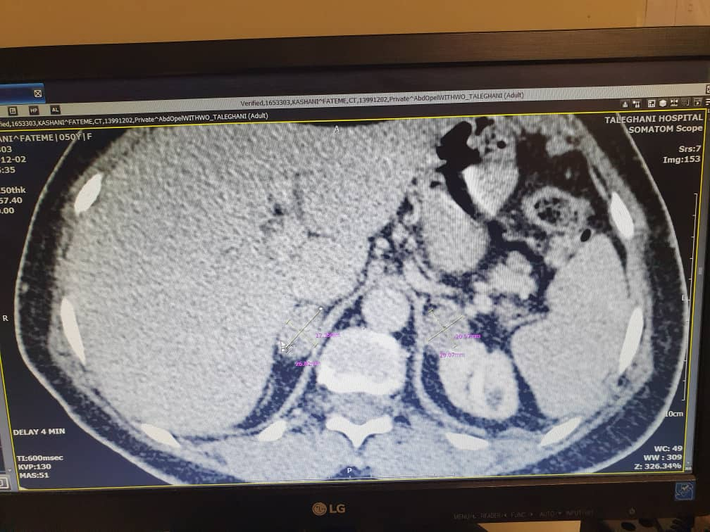

Slide 22
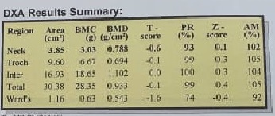
BMD : 98.03.22

Slide 23
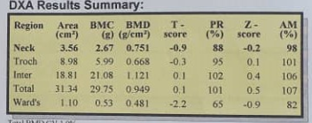
BMD : 98.11.1

Slide 24
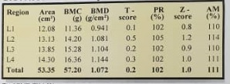
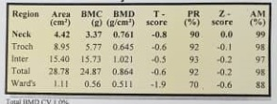
BMD : 99.12.3

Slide 25
PMH
HTN from10 years ago (BP was150/110 mmHg, But HTN was uncontrolled despite using 3 antihypertensive drug categories until 2 years ago.)
IBS
Low back pain (since the age of 18 with 10-min-morning stiffness, after Rheumatologist visits, naproxen 500 PRN was prescribed.
DH
Spironolactone 100 /BD
Losartan 25 /BID

Slide 26
Habit Hx.:
No usage of alcohol, cigarette, licorice and caffeine.
GYN Hx.:
She had two NVD (two live child), Irregular mense
(oligomenorrhea & hypermenorrhea) from 2 years ago
FH:
Mild HTN in her mother at 40, and dead in 57y (MI)
No CVA in her first degree family

Slide 27
Review of Systems
Constitutional symptoms: Negative (Lack of energy, no unexplained weight gain or weight loss, loss of appetite, fever, night sweats, pain in jaws when eating, scalp tenderness, prior diagnosis of cancer).
Eyes, Ears, nose, mouth, throat: Negative (Difficulty with hearing, sinus problems, runny nose, post-nasal drip, ringing in ears, mouth sores, loose teeth, ear pain, nosebleeds, sore throat, facial pain or numbness).
Cardiovascular: Negative (Irregular heartbeat, racing heart, chest pains, swelling of feet or legs, pain in legs with walking).
Respiratory: Negative (Shortness of breath, night sweats, prolonged cough, wheezing, sputum production, prior tuberculosis, pleurisy, oxygen at home, coughing up blood, abnormal chest x-ray).
Gastrointestinal: Negative (Heartburn, constipation, intolerance to certain foods difficulty swallowing, blood in stools, unexplained change in bowel habits, incontinence).
Genitourinary: Negative (Painful urination, frequent urination, urgency, bladder problems).

Slide 28
Musculoskeletal: muscle pain and cramps, chronic back pain without Joint pain, and joint deformities, episodes of muscle weakness ,falling downs.
Integumentary: Negative (Persistent rash, itching, new skin lesion, change in existing skin lesion, hirsutism, .)
Neurological: Negative (Frequent headaches, double vision, change in sensation, dizziness, tremor, loss of consciousness, uncontrolled motions, episodes of visual loss)
Psychiatric: Negative (Insomnia, irritability, depression, anxiety, recurrent bad thoughts, mood swings, hallucinations, compulsions).
Endocrine: Negative (Intolerance to heat or cold, menstrual irregularities, frequent hunger/urination/thirst).
Hematologic/Lymphatic: Negative (Easy bleeding, easy bruising, anemia, abnormal blood tests, leukemia, unexplained swollen areas).
Allergic/Immunologic: Negative (Seasonal allergies, hay fever symptoms, itching, frequent infections).

Slide 29
P/E
GA: She was a young woman, oriented, moon face and plethora was not visible.
VS: BP:130/70 mmHg, HR:80/min, T:37c, RR:16/min
Wt: 70 Kg, Ht:155 cm, BMI: 29.13 Kg/m2
H&N: conjunctiva were not pale, JVP: Nl , no bruit in carotids, no LAP , sclera was not icteric and mucosa was Nl, no buffalo hump.
Thyroid gland: NL in size and palpitation
Chest: NL

Slide 30
Abdomen: Mild abdominal obesity, no obvious mass, no tenderness, no rebound, no guarding, no bruit in renal arteries, no striate.
EXT: No significant prox. Myopathy, no edema, no
cyanosis, no clubbing
Pulses: NL and symmetrical
Neurological exam: DTRS: NL
Muscle force: NL
Skin: No ecchymosis, no hyperpigmentation, no petechia, no purpura
Joints: ROM :NL, no erythema , no swelling , no tenderness

Slide 31
Problem List:
HTN
Hypokalemia
High ARR
Bilateral Adrenal masses(3cm)
High cortisol level (positive overnight dexamethasone suppression test )
Suppressed ACTH

