Slide 1
Oral Hypoglycemic Agents
By Dr Motamed
Fellow of Endocrinology and Metabolism
Endocrine Research Center

Slide 2
Pathophysiology of Type 2 Diabetes
Peripheral Tissues
(Muscle)
Receptor +
post receptor defects
Insulin
resistance
Glucose
Liver
Increased glucose production
Pancreas
Impaired insulin secretion
Notes:
1
1

Slide 3
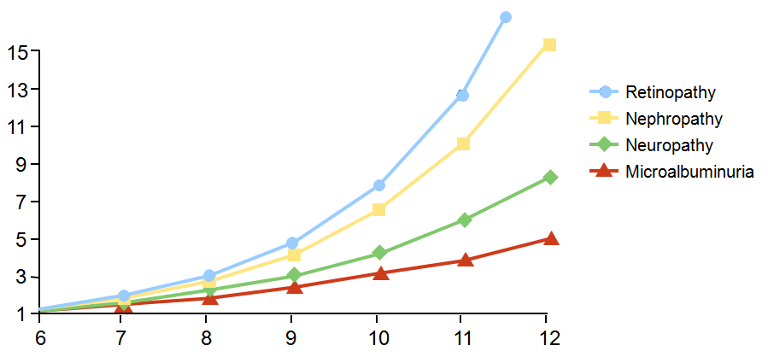
Relationship of HbA_{1C} to Risk of Microvascular Complications
Relative Risk (%)
HbA_{1C} (%)
Skyler JS. Endocrinol Metab Clin North Am. 1996;25:243-254.

Slide 4
Control of blood glucose is essential in diabetic patients with any possible method (Diet, Oral agents, or Insulin)
Otherwise, The complications of diabetes will appear

Slide 5
There currently are four therapeutic options for type 2 diabetes:
Increase insulin release with sulfonylureas or meglitinides
Increase insulin responsiveness with a biguanide (metformin) or a thiazolidinedione
Modify intestinal absorption of carbohydrate with an alpha-glucosidase inhibitor .
Administer exogenous insulin

Slide 6
Pharmacologic Therapy for Type 2 Diabetes
Sulfonylureas (glyburide or glibenclamide)
Biguanides (metformin)
Alpha-glucosidase inhibitors (acarbose)
Benzoic acid analogues (repaglinide)
Thiazolidinediones ( pioglitazone)
Insulin (human insulin, insulin analogues)

Slide 7
Considerations in Pharmacologic Treatment of Type 2 Diabetes
Efficacy (HbA_{1c} lowering capacity)
Mechanisms of action of drugs
Impact on weight gain
Complications/tolerability
Frequency of hypoglycemia
Compliance/complexity of regimen
Cost

Slide 8
Biguanides

Slide 9
Metformin
↑ Skeletal glucose uptake
inhibit hepatic gluconeogenesis
Renal dysfunction may increase risk of lactic acidosis
lactic acidosis an extremely rare (<1 case per 100,000 treated pts) but potentially fatal
Should not be used in renal failure
male Cr≥ 1.5 mg/dL
female Cr≥ 1.4 mg/dL
Diabetes Care 2009; 32:193–203

Slide 10
Metformin is the only currently available biguanide.
It is effective only in the presence of insulin
its major effects are to decrease hepatic glucose output and increase insulin action

Slide 11
Property | Metformin
Target tissue | Liver
Δ HbA_{1c} (monotherapy) | 1%-2%
Fasting effect | Good
Postprandial effect | Good
Severe hypoglycemia | No
Dosing interval | bid or tid
Δ Weight (lb/yr) | 0 to - 6
Δ Insulin | Modest decrease
Δ LDL | Decrease
Δ HDL | Increase
Δ TG | Decrease
Common problem | Transient GI
Rare problem | Lactic acidosis
Contraindications | Renal failure , Liver failure, CHF , >80 yr old
Maximum effective dose | 1000 mg bid
Kronenberg: Williams Textbook of Endocrinology, 11th ed. 2008 Saunders

Slide 12
Metformin is available as 500 and 1000 mg tablets, and should be taken with meals.
We begin with 500 mg once daily with the evening meal and, if tolerated, add a second 500 mg dose with breakfast.
The dose can be increased slowly (one tablet every one to two weeks) as necessary to a maximum of 2500 mg/day

Slide 13
contraindications to the metformin therapy
Renal insufficiency (serum creatinine concentration above 1.4 mg/dL in women and 1.5 mg/dL in men),
low creatinine clearance
Concurrent liver disease
alcohol abuse
Heart failure
Past history of lactic acidosis

Slide 14
Severe infection with decreased tissue perfusion
Hypoxic states
Serious acute illness
Hemodynamic instability
intravenous iodinated contrast material

Slide 15
Sulfonylureas

Slide 16
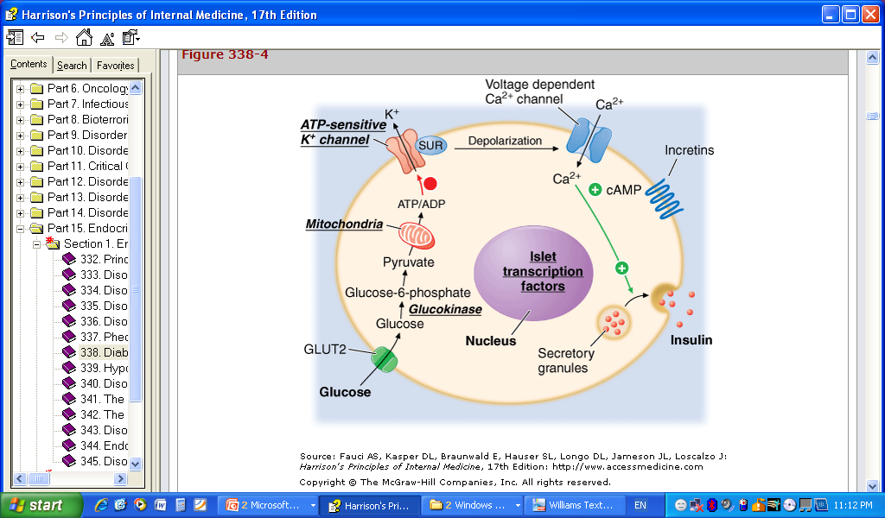

Slide 17
Sulfonylureas are the oldest class of oral hypoglycemic agents and are often used as a first line therapy(today is another recommendation)
Their effectiveness decreases over time; after five years of treatment, addition of a second agent or insulin therapy is often necessary.

Slide 18
Sulfonylureas usually lower blood glucose concentrations by about 20 percent like metformin
Different sulfonylureas are equally effective in lowering blood glucose concentrations.
There are, however, differences in absorption and metabolism, as well as in effective dosage

Slide 19
Property | Sulfonylureas
Target tissue | Beta cell
Δ HbA_{1c} (monotherapy) | 1%-2%
Fasting effect | Good
Postprandial effect | Good
Severe hypoglycemia | Yes
Dosing interval | Daily to tid
Δ Weight (lb/yr) | +1 to 3
Δ Insulin | Increase
Δ LDL | None
Δ HDL | None
Δ TG | None
Common problem | Hypoglycemia, weight gain
Contraindications | Allergy/GFR<50
Maximum effective dose | ½ max
Kronenberg: Williams Textbook of Endocrinology, 11th ed. 2008 Saunders

Slide 20
Meglitinides

Slide 21
The meglitinides, repaglinide and nateglinide, are short-acting glucose-lowering drugs for therapy of patients with type 2 diabetes.
These drugs have essentially no renal clearance and are safe in patients with renal failure .

Slide 22
MEGLITINIDES
Repaglinide The recommended starting dose is 0.5 mg before each meal for patients who have not previously taken oral hypoglycemic drugs.
The maximum dose is 4 mg before each meal; the dose should be skipped if the meal is missed

Slide 23
Property | Glinides
Target tissue | Beta cell
Δ HbA_{1c} (monotherapy) | 1%-2%
Fasting effect | Mod
Postprandial effect | Good
Severe hypoglycemia | Yes
Dosing interval | tid to qid with meals
Δ Weight (lb/yr) | +1 to 3
Δ Insulin | Increase
Δ LDL | None
Δ HDL | None
Δ TG | None
Common problem | Hypoglycemia
Maximum effective dose | Re: 4 mg with each meal
Kronenberg: Williams Textbook of Endocrinology, 11th ed. 2008 Saunders

Slide 24
THIAZOLIDINEDIONES

Slide 25
THIAZOLIDINEDIONES
The thiazolidinediones increase insulin sensitivity by acting on muscle and liver (PPAR gama)
They also improve insulin secretory dynamics in patients with impaired glucose tolerance and will delay or prevent DM development.

Slide 26
Example:
Rosiglitazone [Avanidia] (2 to 4 mg twice daily)
Pioglitazone [actos] (15 to 45 mg once daily)

Slide 27
Glitazones
FDA recommends measurement of LFT prior to initiating therapy and at regular intervals (every 2 months for the first year and then periodically)
Contraindicated in patients with active hepatocellular disease
in patients with unexplained serum ALT >2.5 times the upper limit of normal

Slide 28
Property | Glitazones
Target tissue | Muscle
Δ HbA_{1c} (monotherapy) | 0.5%-2%
Fasting effect | Good
Postprandial effect | Good
Severe hypoglycemia | No
Dosing interval | Pioglitazon: qd
Δ Weight (lb/yr) | +1 to 13
Δ Insulin | Decrease
Δ LDL | Increase
Δ HDL | Increase
Δ TG | Pioglitazon: Decrease
Common problem | Weight gain, edema, anemia
Rare problem | Hepatotoxicity
Contraindications | Hepatocellular disease, CHF (class III-IV)
Maximum effective dose | Pioglitazon: 45 mg qd
Kronenberg: Williams Textbook of Endocrinology, 11th ed. 2008 Saunders

Slide 29
Alpha-glucosidase inhibitors

Slide 30
Alpha-glucosidase inhibitors
Acarbose is available as 50 and 100 mg tablets which should be taken with the first bite of each meal.
We begin with 25 mg three times daily.
Flatulence, diarrhea, and abdominal discomfort are dose related and almost always resolve if the dose is decreased.

Slide 31
Property | α-Glucosidase Inhibitors
Target tissue | Gut
Δ HbA_{1c} (monotherapy) | 0.5%-1%
Fasting effect | Poor
Postprandial effect | Excellent
Severe hypoglycemia | No
Dosing interval | bid to qid
Δ Weight (lb/yr) | 0 to - 10
Δ Insulin | Modest decrease
Δ LDL | Minimal decrease
Δ HDL | None
Δ TG | Minimal decrease
Common problem | Flatulence
Contraindications | Intestinal disease
Maximum effective dose | 50 mg tid
Kronenberg: Williams Textbook of Endocrinology, 11th ed. 2008 Saunders

Slide 32
Comparisons of Oral Anti-diabetic Drugs
Property | Sulfonylureas | Metformin | α-Glucosidase Inhibitors | Glitazones | Glinides
Target tissue | Beta cell | Liver | Gut | Muscle | Beta cell
Δ HbA_{1c} (monotherapy) | 1%-2% | 1%-2% | 0.5%-1% | 0.5%-2% | Re: 1%-2%
Fasting effect | Good | Good | Poor | Good | Re: Mod
Postprandial effect | Good | Good | Excellent | Good | Re: Good
Severe hypoglycemia | Yes | No | No | No | Re: Yes
Dosing interval | qd to tid | bid or tid | bid to qid | P: qd | tid to qid with meals
Δ Weight (lb/yr) | +1-3 | 0 to - 6 | 0 to - 10 | +1-13 | +1-3
Δ Insulin | Increase | Modest decrease | Modest decrease | Decrease | Increase
Δ LDL | None | Decrease | Minimal decrease | Increase | None
Δ HDL | None | Increase | None | Increase | None
Δ TG | None | Decrease | Minimal decrease | P: Decrease | None
Common problem | Hypoglycemia, weight gain | Transient GI | Flatulence | Weight gain, edema, anemia | Hypoglycemia
Rare problem |  | Lactic acidosis |  | Hepatotoxicity?
Contraindications | Allergy | Renal failure Liver failure CHF >80 yr old | Intestinal disease | Hepatocellular disease
Maximum effective dose | ½ max or double starting | 1000 mg bid | 50 mg tid | P: 45 mg qd | Re: 2 mg tid
Kronenberg: Williams Textbook of Endocrinology, 11th ed. 2008 Saunders

Slide 33


