Slide 2
Type 2 DM treatment Intensification
H. Delshad M.D
Endocrinologist
Research Institute for Endocrine Sciences

Slide 3
Specific Goals in Management of Diabetes
Fasting < 80 -130 mg/dL
Post-meal < 180 mg/dL
A1C < 7%
Blood Pressure < 130 -140/80 – 90 mmHg
LDL < 100 mg/dL; HDL > 45 mg/dL
Triglycerides < 150 mg/dL
Notes:
3
Title
Subtitle

Slide 4
Relative Risk of Progression of Diabetes Complications (DCCT)
Relative Risk
Mean A1C
DCCT Research Group, N Engl J Med 1993, 329:977-986.
Notes:
4
Title
Subtitle

Slide 5
Effect of A1C On Complications in the UKPDS Study
%60
A1C
50
HbA1C
5.5%
40
6.5%
7.5%
30
8.5%
20
9.5%
10.5%
10
0
Myocardial Infarction
Microvasc Disease

Slide 6
Uncontrolled hyperglycaemia is a global problem
Prevalence data
80
HbA_{1c} <7.5%
60
67
HbA_{1c} ≤7.0%*
Proportion of patients achieving target HbA_{1c} (%)
51
HbA_{1c} <7.0%*
40
HbA_{1c} ≤6.5%*
37
31
20
0
CHINA
(CODIC-2)¹
CANADA
(DICE)²
USA
(NHANES)³
EUROPE
(CODE-2)⁴
*National guidelines target HbA_{1c}
¹Chen Xingbao, Chinese Health Economics 2003; Tang Ling, China Diabetic Journal 2003; ²Harris SB, et al. Diabetes Res Clin Pract 2005;70:90–7; ³Saydah SH, et al. JAMA 2004;291:335–42; ⁴Liebl A, et al. Diabetologia 2002;45:S23–8
Notes:
National and international diabetes management guidelines recommend targets for glycemic control.
Studies have looked at the proportion of patients who meet recommended HbA_{1c} targets:
Cost Of Diabetes In China Type 2 (CODIC-2; >5,000 T2D patients): 68% had HbA_{1c} <7.5%.¹
Diabetes in Canada Evaluation (DICE; 2,473 T2D patients): 51% had HbA_{1c} ≤7%.²
US National Health and Examination Survey (NHANES 1999–2000): 37% had HbA_{1c} <7%.³
Cost of Diabetes in Europe (CODE-2; 7,000 T2D patients): 31% had HbA_{1c} ≤6.5%.⁴
Around the world, many diabetes patients do not achieve HbA_{1c} targets.
In addition, when targets are more stringent, smaller proportions of patients achieve them.
1. Chen Xingbao, Chinese Health Economics 2003; Tang Ling, China Diabetic Journal 2003.
2. Harris SB et al. Diabetes Res Clin Pract 2005; 70: 90-7.
3. Saydah SH, et al. JAMA 2004; 291: 335-42.
4. Liebl A, et al. Diabetologia 2002; 45: S23-8.

Slide 7
Risk of complications
Correlation between a 1% A_{1C} decrease and reduced risk of complication
14%
14%
21%
37%
43%
Cardiovascular complications
Amputations or death from peripheral vascular disease (p < 0.0001)
Microvascular complications (p < 0.0001)
Diabetes-related death (p < 0.0001)
Myocardial infarction (p < 0.0001)
All-cause mortality (p < 0.0001)
Stratton IM, et al. BMJ. 2000:321:405-412.
Notes:
The UKPDS trial involved ~4000 patients with newly diagnosed T2D who received either conventional glucose control (diet; n=1138) or intensive glucose control.
Patients were treated for 10 years with standard or intensive glucose control (sulfonylurea/insulin n=2729; or metformin n=342). 3277 UKPDS patients were followed for an additional 10 years (without their original trial therapy).
In 2008, the additional 10 year follow-up data was published showing that, compared with conventional therapy:
relative risk was reduced in the sulfonylurea/insulin group by 9% for any diabetes-related end point (p=0.04) and 24% for microvascular disease (p=0.001)
post-trial risk reductions emerged for diabetes-related death (17%; p=0.01), myocardial infarction (15%; p=0.01) and death from any cause (13%; p=0.007).
Long-term follow-up data show that intensive BG control reduces the risk of long-term complications, compared with conventional therapy.
Holman RR, et al. N Engl J Med 2008;359:1577–89

Slide 8
Type 2 DM treatment
Intensification
why
?

Slide 9
Beta-cell function continues to decline
100
75
β-Cell Function (%)
50
IGT
Postprandial Hyperglycemia
Type 2 Diabetes Phase I
Type 2 Diabetes Phase III
25
Type 2 Diabetes Phase II
0
-12
-10
-6
-2
0
2
6
10
14
Years From Diagnosis
Notes:
Slide 1-24
Stages of Type 2 Diabetes
Epidemiological studies suggest that the onset of diabetes occurs 10 to 12 years before a clinical diagnosis is made. (Harris 1997) In the UKPDS study of type 2 diabetics, at least 50% of the patients had evidence of diabetic tissue damage when diabetes was first diagnosed. (UKPDS Study 16, 1995)
In the earliest phase, when beta-cell function is not impaired, the ability of the beta-cells to hypersecrete insulin masks the impaired glucose tolerance, often for years. During the IGT phase, the FPG will be higher than the normal 110 mg/dL but lower than the 126 mg/dL that is indicative of diabetes.
As beta-cell function continues to decline, mild postprandial hyperglycemia develops, reflecting the inability of the beta-cell to hypersecrete enough insulin to overcome insulin resistance. At the end of this prediabetic phase, the first phase of type 2 diabetes typically produces symptoms that lead to a diagnosis.
During phase I, in the first 2 years after diagnosis of diabetes, beta-cell function decreases to between 70% and 40% of normal function.
CORE

Slide 10
Progressive Loss of β-Cell Function in T2DM: UKPDS
100
Nonobese Patients
Obese Patients
100
80
80
60
60
β-Cell Function, %
β-Cell Function, %
40
40
20
20
0
0
0
1
2
3
4
5
6
7
0
1
2
3
4
5
6
7
Years From Randomization
Conventional
Sulphonylurea
Metformin
Notes:
10
The U.K. Prospective Diabetes Study Group (UKPDS) evaluated the efficacy of antidiabetic therapy over 6 years of follow-up and the overall incidence of diabetic complications. The study included 4209 patients newly diagnosed with type 2 diabetes who after 3 months' diet were asymptomatic and had fasting plasma glucose (FPG) levels from 6.0 to 15.0 mmol/L. The study consisted of a randomized controlled trial with 2 main comparisons: 1) 3867 patients with 1138 allocated to conventional therapy, primarily with diet, and 2729 allocated to intensive therapy with additional sulfonylurea or insulin, which increase insulin supply, aiming for FPG <6 mmol/L; and 2) 753 obese patients with 411 allocated to conventional therapy and 342 allocated to intensive therapy with metformin, which enhances insulin sensitivity.
β-Cell function deteriorated over 6 years in the 37% of patients allocated to and remaining on diet therapy at 0, 1, and 6 years, geometric means 51, 53, and 28 %β, respectively, with a significant decrease from 1 to 6 years (P<.0001). In the 50% of patients continuing on their allocated sulfonylurea therapy, geometric mean β-cell function increased in the first year from 46 to 78 %β (P<.0001), but subsequently the β-cell function decreased to 52 %β (P<.0001) at 6 years, the decrease being similar to that in those treated by diet over the same time period. In the obese patients allocated to conventional therapy and remaining on diet therapy, β-cell function also decreased, the geometric mean values at 0, 1, and 6 years being 60, 62, and 33 %β, respectively, with a significant decrease from 1 to 6 years (P<.0001). In the 56% of patients who remained on their allocated metformin therapy, the β-cell function in the first year increased from 51 to 66 %β (P<.0003), with a subsequent decrease to 38 %β at 6 years (P<.0001), similar to that in the 36% of patients treated by diet.
U.K. Prospective Diabetes Study Group. Overview of 6 years' therapy of type II diabetes: a progressive disease. U.K. Prospective Diabetes Study Group. Diabetes. 1995;44:1249-1258.

Slide 11
Type 2 DM treatment

Slide 12
Approach to hyperglycemia management:
Several factors should be considered

Slide 13
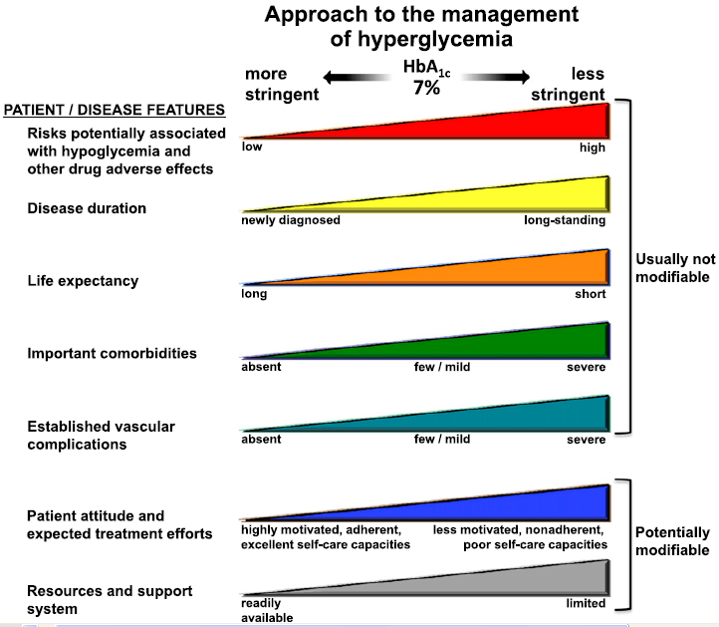
Inzucchi et al. Diabetes Care 2015;38:140-149

Slide 14
Expected HbA_{1c} reduction according to intervention
Intervention | Expected ↓ in HbA_{1c} (%)
Lifestyle interventions | 1 | to | 2%
Metformin | 1 | to | 2%
Sulfonylureas | 1 | to | 2%
Insulin | 1.5 | to | 3.5%
Glinides | 1 | to | 1.5%¹
Thiazolidinediones | 0.5 | to | 1.4%
α-Glucosidase inhibitors | 0.5 | to | 0.8%
GLP-1 agonist | 0.5 | to | 1.0%
Pramlintide | 0.5 | to | 1.0%
DPP-IV inhibitors | 0.5 | to | 0.8%
Nathan DM, et al. Diabetes Care 2009;32:193-203.
Notes:
14

Slide 15
Types of Insulin
More than 20 types of insulin
Different time of onset and duration of action.
Among the criteria considered in choosing insulin are:
○ How soon it starts working (onset)
○ When it works the hardest (peak time)
○ How long it lasts in the body (duration)

Slide 16
Available insulin injections
Insulin Type | Product | Onset |  | Peak | Duration
Rapid-Acting
Aspart Glulisine Lispro | Novolog Apidra Humalog |  | 10-30 min. 10-30 min. 10-30 min. | 0.5-3 h. 0.5-3 h. 0.5-3 h. | 3-5 h. 3-5 h. 3-5 h.
Short-Acting
Regular | Humulin R Novolin R |  | 0.5-1 h. | 2-5 h. | Up to 12 h.
Intermediate-Acting
NPH insulin | Humulin N Novolin N |  | 1.5-4 h. | 4-12 h. | Up to 24 h.
Long-Acting
Detemir Glargine Premixed | Levemir Lantus Novomix-30 |  | 0.75-4 h. 0.75-4 h. | Minimal peak Minimal peak | Up to 24 h. Up to 24 h.

Slide 17
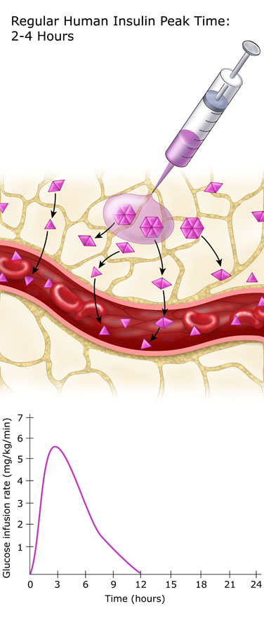
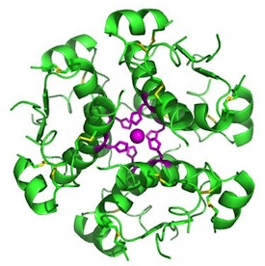
Regular Insulin
Exist in solution in hexameric form
Onset of action : 0.5 – 1 hour after SC
It peaks 2 – 4 hours after SC
The duration of action range 8 – 10 hours
It peaks much later than the blood glucose rise
Exerts its effect for too long
Risk of hyperglycemia in the first 30 minutes and hypoglycemia many hours after meals

Slide 18
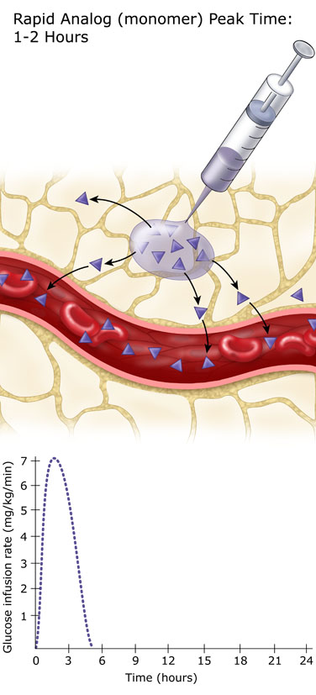
Rapid Analogs
○ Lispro
○ Aspart
○ Glulysine
Exist in solution in monomeric form
Onset of action : up to 0.5 hour after SC
Peaks 1– 2 hours after SC
The duration of action up to 4 hours
Peak when the blood glucose rise
No risk of hyper- or hypoglycemia
Dose given immediately pre-meal

Slide 19
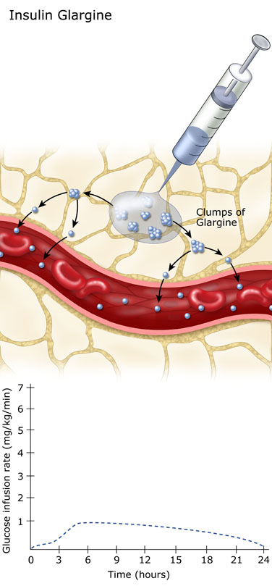
PHARMACOKINETICS :
Slow dissolution of the Glargine
hexamers at the injection site
results in a relatively constant
release with no pronounced
peak over a period of up to
24 hours.
Onset of action = 2 hours
Peak = flat
Duration = 24 hours

Slide 20
Insulin Time Action Curves
Rapid (Lispro, Aspart , Glulysine)
Short (Regular)
Relative Insulin Effect
Intermediate (NPH)
Long (Glargine)
0
2
4
6
8
10
12
14
16
18
20
Time (Hours)

Slide 21
T2DM Treatment: ADA/EASD position statement 2017
Healthy eating, weight control, increased physical activity
Initial monotherapy
MET
Not at target HbA_{1c} after ~3 months
SU
TZD
DPP-4i
SGLT-2i
GLP-1 RA
Insulin
Two-drug combinations
Not at target HbA_{1c} after ~3 months
Three-drug combinations
TZD DPP-4i GLP-1RA Insulin
SGLT-2i
SU DPP-4i GLP-1RA Insulin
SGLT-2i
SU TZD Insulin
SGLT-2i
SU TZD
GLP-1RA Insulin
SU TZD Insulin
TZD DPP-4i GLP-1RA
SGLT-2i
Not at target HbA_{1c} after 3-6 months combination therapy with insulin
More complex strategies
Basal Insulin + GLP-1 RA or Prandial Insulin
Inzucchi et al. Diabetes Care 2015;38:140-149
Notes:
ADA/EASD position statement now recommends GLP-1RAs as second line agents

Slide 22
T2DM Treatment: ADA/EASD position statement 2017
Initial therapy
A1c is≥9%
Consider Dual therapy
*A1c≥10%
*BS > 300 mg
*Markedly symptomatic
Consider
Combination injectable therapy

Slide 23
A logical stepwise approach
Basal bolus Basal + 3 prandial
Basal plus
Basal +
2 prandial
Basal plus
Basal +
1 prandial
Basal insulin
once daily
(treat-to-target)
± SU
Lifestyle + Metformin
HbA_{1c} ≥7.0%, FBG on target
PPG ≥160 mg/dL
HbA_{1c} ≥7.0%
Time
Adapted from Raccah et al. Diabetes Metab Res Rev 2007;23:257.

Slide 24
Treatment intensification routes as the diabetes progresses (ADA 2017)
Full
Basal-bolus
Basal-plus
TDS Premix
5
Basal Insulin
BID Premix Ins.
4
Additional
OADs
Lifestyle
+
Metformin
3
2
1

Slide 25
How do we define insulin initiation?
HbA1c
Setting HbA1c goal for a particular patient
Initiate
Starting insulin therapy basal bolus
Optimise
Dose titration to ensure that the patient receives the maximum benefit from the prescribed treatment
Intensify
Modification of the insulin regimen: adding to or changing the therapy in order to maintain euglycemia
Mosenzon O, et al. Diabetes Care 2013; 36(2):S212-S218.
Notes:
Animated slide

Slide 26
Insulin Treatment Patterns: common strategies
Starting regimens
Intensification regimens
Basal insulin + OADs
Premix BID or TID
Premix insulin OD or BID
Basal–bolus therapy
Prandial insulin
Notes:
Animated slide.
26

Slide 27
Treatment intensification routes as the diabetes progresses
Full
Basal-bolus
Basal-plus
TDS Premix
Basal Insulin
BID Premix Ins.
Additional
OADs
Lifestyle
+
Metformin
3

Slide 28
Initiate Basal Insulin
Usually with Metformin +/- other noninsulin agent
Start: 0.1 – 0.2 U/kg/day
Adjust : 2 – 4 U once or twice weekly to reach FBG target
If A1c not controlled
Add 1 rapid-acting insulin before largest meal
Change to premixed insulin twice daily
Add
GLP-1
Start: 0.1 U/kg or 4 units
Adjust : 1– 2 U once or twice weekly until SMBG target reached
Start: divide current basal dose into 2/3 AM, 1/3 PM or 1/2 + 1/2
Adjust : 1– 2 U once or twice weekly until SMBG target reached
If A1c not controlled
If A1c not controlled
Add ≥ 2 rapid-acting insulin before meal
Change to premixed insulin 3 times daily

Slide 29
Titrate basal insulin as long as FPG > target
Bedtime or morning long-acting insulin
Daily dose: 10 units or 0.2 units/kg
INITIATE
Check FPG daily
In the event of hypoglycemia or FPG level < 70 mg/dL
Reduce bedtime insulin dose by ≥4 units, or by 10% if >60 units
Increase dose by 2 units every 3 days until FPG is (70–130 mg/dL)
If FPG is >180 mg/dL, increase dose by 4 units every 3 days
TITRATE
MONITOR
Continue regimen and check HbA_{1c} every 3 months
Notes:
The introduction of basal insulin into the treatment regimen of a patient with type 2 diabetes can be done with a single daily injection. The availability of basal insulin analogs addresses fasting blood glucose levels and overall glycemic control and can be administered in one injection daily. This may help overcome patient anxiety over injections. The international consensus group recommends that basal insulin is administered either at bedtime or in the morning and should be started at a dose of 10 units per day or 0.2 units/kg. Then basal insulin needs to be titrated by monitoring fasting blood glucose levels daily. The dose should be increased by 2 units every 3 days until fasting blood glucose levels are in range (3.89–7.22 mmol/L; 70–130 mg/dL). If the fasting blood glucose value is > 10 mmol/L (> 180 mg/dL), 4 units of insulin may be used instead of 2 units. In the event of hypoglycemia or inappropriate fasting blood glucose levels, the insulin dose should be reduced by ≥ 4 units or 10% if the dose is > 60 units. The regimen should then be continued and HbA_{1c} levels checked every 3 months.

Slide 30
Once daily basal insulin maintains HbA1c target for at least 2.5 years
10
Reduced Hypoglycaemia
9
-1.6
-1.6
8
8.6
HbA_{1C} (%)
7
7.0
7.0
6
0
9
30
Time (months)
Schreiber S et al. . Curr Med Res Opin 2007 Dec;23(12):3131-6.

Slide 31
Initiate Basal Insulin
Usually with Metformin +/- other noninsulin agent
Start: 0.1 – 0.2 U/kg/day
Adjust : 2 – 4 U once or twice weekly to reach FBG target
If A1c not controlled
Add 1 rapid-acting insulin before largest meal
Change to premixed insulin twice daily
Start: 0.1 U/kg or 4 units
Adjust : 1– 2 U once or twice weekly until SMBG target reached
Start: divide current basal dose into 2/3 AM, 1/3 PM or 1/2 + 1/2
Adjust : 1– 2 U once or twice weekly until SMBG target reached
If A1c not controlled
If A1c not controlled
Add ≥ 2 rapid-acting insulin before meal
Change to premixed insulin 3 times daily

Slide 32
Change from Basal to Premixed Insulin twice daily
Start: Divide current basal dose into 2/3 AM & 1/3 PM or 1/2 AM & 1/2 PM
Adjust: Increase the dose 1-2U or 10-15% once-twice weekly until SMBG target is reached.
For Hypo: Determine and address cause; decrease corresponding dose 2-4U or 10-20%
Inzucchi et al. Diabetes Care 2015;38:140–149

Slide 33
Intensifying from BIAsp OD to BID
Unnikrishnan et al. Int J Clin Pract 2009;63:1571–7

Slide 34
Intensifying from BIAsp BID to TID
Unnikrishnan et al. Int J Clin Pract 2009;63:1571–7

Slide 35
BIAsp-30 dose titration
BIAsp 30 offers a simple dose titration based on FBG or pre-dinner SMBG
For once-daily dosing, the evening dose titration is done based on pre-breakfast blood glucose level
For twice-daily BIAsp 30, the morning dose is titrated on pre-dinner blood glucose level and evening dose is titrated based on pre-breakfast blood glucose level
For three-times daily BIAsp 30, the morning dose is titrated based on the pre-lunch blood glucose, midday dose is titrated on pre-dinner blood glucose and evening dose is titrated on pre-breakfast blood glucose

Slide 36
Which patient should be offered a premix versus basal- bolus/basal plus regimen?
Premix insulin analogs | Basal plus/basal bolus
Patient preference | Type 1 diabetes (any age)
Older age | Younger age
Need assistance with injections | Highly motivated and compliant
Organized lifestyle | Active lifestyle
Two meals a day or evening main meal | High variability in eating habits
Mosenzon O, et al. Diabetes Care 2013; 36(2):S212-S218.

Slide 37
Basal-plus therapy Vs. premixed insulin
All to Target Study
● 60 weeks randomized, open label :
Basal plus vs. Basal stepwise bolus, vs. 2 premixed
Riddle M.C, et al, Diabetes, Obesity and Metabolism, 2014

Slide 38
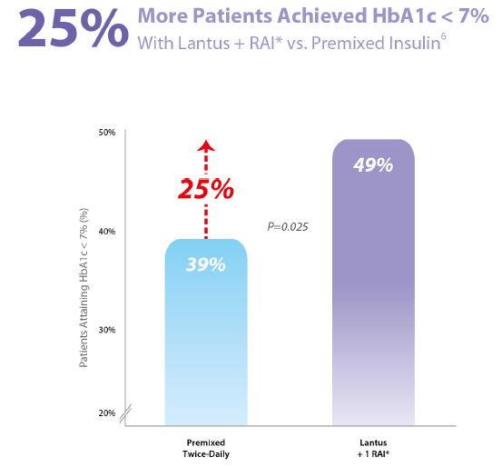
All to Target Study
Riddle M.C, et al, Diabetes, Obesity and Metabolism, 2014

Slide 39
All to Target Study

Slide 40
Glucose triad of diabetes management
PPG
FPG
HbA_{1c}
Monnier et al. Diabetes Care 2007;30:263–9; Monnier et al. Diabetes Care 2003;26:881–5

Slide 41
Type 2 DM Treatment: Key points
Glycaemic control is dependent on adequate regulation of FPG and PPG levels
Fasting and postprandial hyperglycaemia are associated with overall and CV mortality
Reducing PPG levels may lower CV risk, while reducing FPG can reduce the risk of microvascular complications
in poorly controlled patients

Slide 42
Maintain control as diabetes progresses
Long-term diabetes management aims to:
Keep HbA_{1c} below 7%
Control PPG as well as FPG :
both are important in overall glycaemia
Patients spend 50% of the day in the postprandial state
PPG is not directly targeted by basal insulin
1.American Diabetes Association. Diabetes Care 2007; 30(Suppl1): S4–S41
2.Monnier L. Eur J Clin Invest 2000; 30(Suppl2):3–11.
3.Hirsch IB et al. Clinical Diabetes 2005; 23(2): 78–86.
Notes:
References:
1.American Diabetes Association. Standards of Medical Care in Diabetes – 2007. Diabetes Care 2007; 30(Suppl1): S4–S41
2.Monnier L. Is postprandial glucose a neglected cardiovascular risk factor in type 2 diabetes? Eur J Clin Invest 2000; 30(Suppl2):3–11.
3.Hirsch IB et al. A real-world approach to insulin therapy in primary care practice. Clinical Diabetes 2005; 23(2): 78–86.

Slide 43
Relative contributions of PPG and FPG to diurnal hyperglycaemia
100
Postprandial
glucose
90
80
70
60
Fasting
plasma
glucose
Relative contribution of PPG and FPG
to diurnal hyperglycaemia (%)
50
40
30
20
10
0
<7.3
7.3–8.4
8.5–9.2
9.3–10.2
>10.2
HbA_{1c} quintiles
Monnier et al. Diabetes Care 2003;26:881–5

Slide 44
Treatment intensification routes as the diabetes progresses
Full
Basal-bolus
Basal-plus
TDS Premix
5
Basal Insulin
BID Premix Ins.
4
Additional
OADs
Lifestyle
+
Metformin
3
2
1

Slide 45
Basal Insulin Long acting analogous
Glargine , Detemir ,Degludeg
They are more predictable than
conventional insulins and allow
simplified insulin-replacement strategies.

Slide 46
Basal plus Prandial Insulin
Different types of regimens :
• Aspart, Glulisine and Lispro
Prandial insulin (before meals )
• Glargine, , Detemir , Degludeg
Basal insulin ( at bedtime or in the morning )

Slide 47
Fewer Nocturnal Hypoglycemic Events With Aspart vs Regular Human Insulin

Slide 48
How is insulin normally secreted ?
Bolus
Bolus
Bolus
Basal
Bolus (50%)
Serves to control postprandial
hyperglycemia in response to
food intake.
Basal ( 50%)
Serves to balance the rate
of hepatic glucose production
and peripheral uptake during
overnight and prolonged
periods between meals.

Slide 49
Determining initial insulin dosages for basal-bolus
Total Daily Dose (TDD) : 0.2 – 0.5 U/kg/day
Bedtime Glargine : 35 – 50 % TDD
Meal Boluses Rapid-acting ( % of TDD):
- Breakfast = 20 %
- Lunch = 15 %
- Dinner = 15 %

Slide 50
Determining initial insulin dosages for basal-bolus
35-y old man, W:90 kg
Total Daily Dose = 45 IU
Bedtime Glargine: 45 X 0.50= 22 IU
Meal Boluses Rapidacting:
- Breakfast = 45 X 0.20 = 9 IU
- Lunch = 45 X 0.15 = 7 IU
- Dinner = 45 X 0.15 = 7 IU

Slide 51
Initial Dosing Guidelines for Insulin Glargine
Type of Patient
Appropriate Glargine Dosage
Initiate at 10 IU once daily , titrate appropriately
Initiate at same dosage; titrate appropriately
Reduced total daily dose by 20%-30% compared to NPH; titrate appropriately
Insulin-naïve
Switched from NPH
once daily
Switched from NPH
twice daily
Titration of Glargine to a final dose range of 2 to 100 IU is suggested
Notes:
When initiating Lantus® (insulin glargine) therapy in insulin-naïve patients with type 2 diabetes, an average dose of 10 IU once daily should be administered. Titration of Lantus to a final dose range of 2 to 100 IU is suggested¹
Patients switching from NPH once daily to Lantus should initiate Lantus therapy at the same dose and titrate the dose based on patient response¹
For patients switching from NPH twice daily, the initial dose of Lantus should be reduced by 20% to 30% to decrease the risk of hypoglycaemia. The Lantus dose should be titrated according to patient response¹
1. Lantus® (insulin glargine) EMEA Summary of Product Characteristics. Bridgewater, NJ: Aventis Pharmaceuticals; 2002.

Slide 52
Making adjustment in insulin dosage
►Insulin Sensitivity Factor (ISF)
●ISF (For human insulin)= 1500 ÷ TDD
●ISF (For analogue insulin)= 1800 ÷ TDD
Example:
TDD= 50 (human insulin), ISF = 1500 ÷ 50 = 30
(It means that each unit of bolus decreases blood glucose by 30 mg/dl)
►Based on food intake :
- 1.0 U of Regular Insulin for every 15 gr. CAH

Slide 53
Supplemental Insulin for Correction of Hyperglycemia
Regular insulin, insulin Aspart /Glulisine / Lispro can be used to correct for hyperglycemia:
• In general, 1-2 units of insulin will lower the
blood glucose by 30-50 mg/dl.
• For every 50 mg/dl above the premeal glucose
target (e.g., 150 mg/dl), add 1 unit of insulin
• If premeal glucose is 250 mg/dl, 2 units of insulin
should be added to the usual dose of premeal
insulin.

Slide 54
Adjustments for Exercise
Exercise improves insulin sensitivity :
• For morning exercise :
Reduce pre-breakfast insulin (~25%)
• For early-afternoon exercise :
Reduce the pre-lunch insulin
• For evening exercise
Reduce pre-dinner insulin

Slide 56
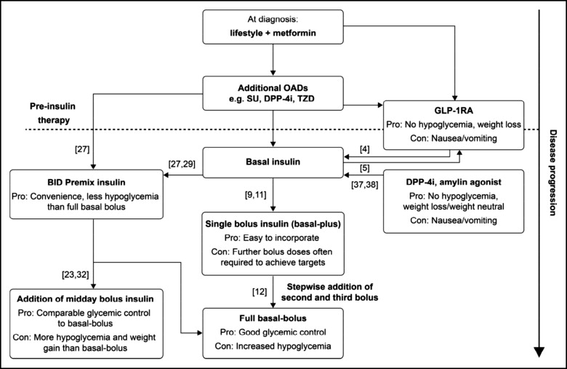
Figure. Simple flow diagram showing the suggested treatment intensification routes available to patients with T2D as the disease progresses.BID = twice daily; DPP-4i = dipeptidyl peptidase-4 inhibitor; OAD = oral antidiabetic drug; SU = sulfonylurea; T2D = typ...
Luigi F. Meneghini
Intensifying Insulin Therapy: What Options Are Available to Patients with Type 2 Diabetes?
The American Journal of Medicine, Volume 126, Issue 9, Supplement 1, 2013, S28–S37
http://dx.doi.org/10.1016/j.amjmed.2013.06.011

