Slide 2
تازه های غربالگری و مراقبت
بیماری های تیروئید در بارداری
دکتر فریدون عزیزی
پژوهشکده علوم غدد درون ریز و متابولیسم، دانشگاه علوم پزشکی شهید بهشتی
همایش تازه های آندوکرینولوژی
دانشگاه علوم پزشکی اصفهان، 1394/2/30

Slide 3
Early detection and optimized management
Four levels of prevention:
Primordial prevention is the prevention of occurrence of risk factors of disease.
Primary prevention is the prevention of new disease in previously healthy individuals, Achieved by decreasing risk factors for disease.
Secondary prevention is the prevention of progression of mild or latent disease to more severe disease, Typically involves screening for occult disease.
Tertiary prevention is the term used by some to describe medical care intended to improve already established disease.

Slide 4
Primordial prevention of thyroid disease
Iodine nutrition
Pregnant and lactating women in iodine sufficient areas
Whole population in iodine deficient regions (primary)
Autoimmunity
Thyroid disruptors

Slide 5
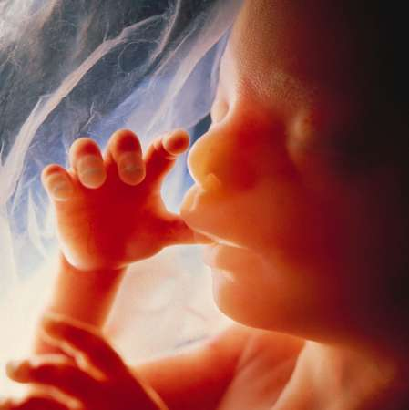
Importance of iodine in brain development
50,000 brain cells produced/second in developing fetal brain
100 billion brain cells in adult
One million billion connections between these brain cells: Determine IQ

Slide 6
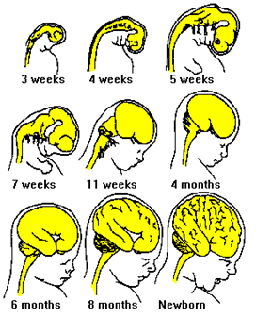
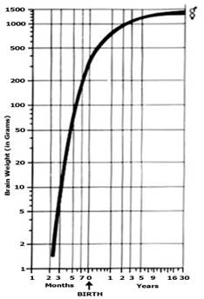
Importance of iodine in brain development
90 % of human brain development occurs between 3rd month of pregnancy & 3rd year of life (Critical period)

Slide 8
Iodine Requirement in Pregnancy (μg/day)
During pregnancy
Basal 150
40-50 % increased T4 requirements 50-100
transfer of T4 and I from mother to fetus 50
Increased renal clearance of I 50
Total requirement 250-300
Delange: Int.J. Endocrinol. Metab. 2: 1, 2004

Slide 9
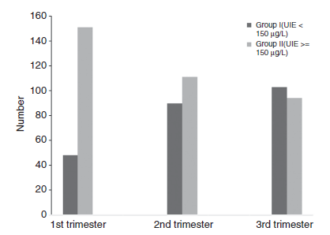
Urinary iodine excretion in groups I (UIE<150 μg/L and II (UIE ≥150 μg/L)
Amouzegar A, Khazan M, Hedayati M, Azizi F. An assessment of the iodine status and the correlation between iodine nutrition and thyroid function during pregnancy in an iodine sufficient area. Europ J Clin Nutr 2014; 68: 397

Slide 10
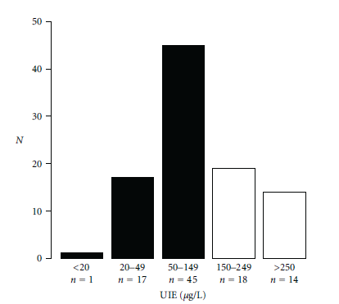
Distribution of ioduria (UIE) in healthy euthyroid pregnant women
Median UIE= 116 μg/L; 63% <150 μg/L
Brucker-Davis F, et al, Iodine Status Has No Impact on Thyroid Function in Early Healthy Pregnancy. J Thyroid Res 2012; 168-764

Slide 11
Recommendations
Strengthen and expand USI programs
In mild-moderate iodine deficiency, consider an I-containing supplement (~150 μg/d) for pregnant and lactating women, and those planning a pregnancy.
Encourage prenatal supplement manufacturers to include adequate iodine (~150 μg/d) in their products
Ensure national/international regulatory bodies for food supplements to establish optimal minimum and maximum iodine doses
Azizi & Smyth Clin Endocrinol 2009;70:803

Slide 12
ATA Recommendation
To achieve a total of 250 μg iodine ingestion daily, in North America all women who are planning pregnancy, pregnant, or breastfeeding, should supplement their diet with a daily oral supplement that contains 150 μg of iodine. This is optimally delivered in the form of potassium iodide, because kelp and other forms of seaweed do not provide a consistent delivery of daily iodide.
Stagnaro-Green A, Abalovich M, Alexander E, Azizi F, Mestman J, Negro R et al. Thyroid 2011; 21: 1081-1125

Slide 13
How much iodine we get from iodized salt? (number in red are daily iodine intake)*
Daily salt intake (gm) | Amount of iodine in table salt
 | 20 ppm | 30 ppm | 40 ppm
2 | 40 | 60 | 80
4 | 80 | 120 | 160
6 | 120 | 180 | 240
240
* Daily requirement of pregnant women: 200-300 μg/day

Slide 14
پایش ملی دریافت ید و عملکرد غده تیروئید زنان باردار کشور در سال 1392
هدف : بر رسی وضعيت دريافت يد و عملکرد غده تيروئيد زنان باردار کشور
روش کار : در طی يک بر رسی مقطعی ملی تعداد 1200 زن باردار در تريمستر های مختلف بارداری از 12 استان کشور از آبان ماه تا بهمن ماه سال 1392 وارد مطالعه شدند
شاخص ها : ميانه يد ادرار T4, T3RU, FT4I, TSH, تيروگلوبولين و آنتی تيروئيد پراکسيداز سرم مورد اندازه گيری قرار گرفتند.

Slide 15
نتايج کلی
 | میانه ید ادرار UIE (µg /L) | T4 (µg/dl) | TSH (miU/L)
Min. | 20 | 4.92 | 0.01
Max. | 400 | 23.92 | 14.05
Mean | 114 | 11.19 | 2.20
Median | 98 | 10.88 | 1.95
Preliminary Results :

Slide 16
میانه ید ادرار کمتر از 100
میانه ید ادرار بین 100 و 150

Slide 17
آخرین استاندارد میزان ید در نمک های خوراکی (ابلاغ شده معاون بهداشت وزارت 94/2/19)
میزان گاما ید موجود در نمک | وضعیت نمک
10 ± 40 گاما | خوب
60 – 51 | در حد قابل قبول
کمتر از 30 بیشتر از 60 | غیرقابل قبول

Slide 18
Iodine Supplementation in Pregnancy
First trimester:
Folic Acid + Iodine 150 μg
Second and third trimesters:
Multivitamins + Iodine 150 μg

Slide 19
Secondary prevention of thyroid disease
Congenital hypothyroidism
Subclinical hypothyroidism
Subclinical hyperthyroidism
Thyroid autoimmunity
Screening in pregnancy
Graves’ orbitopathy

Slide 20
Two Important and Controversial Issues in Pregnancy:
Screening for thyroid
dysfunction
2. Treatment of subclinical
hypothyroidism

Slide 21
Criteria for Screening
The condition sought should be an important health problem
Facilities should be available for confirmation of the diagnosis
A test that can detect the disease prior to the onset of signs and symptoms
There is an effective treatment
Early detection and treatment reduces morbidity and mortality
The expected benefits of early detection exceed the risks and costs.
Patient and management acceptability
The test must satisfy the criteria of:
Acceptability, Repeatability, Validity, Simplicity, Safety, Rapidity
ease of administration, cost.

Slide 22
A 30 year-old woman seeks pre-conception thyroid counseling. There is no personal or familial history of thyroid disease. She has a palpable thyroid of aprox. 20 gm in weight and is euthyroid.
Which one of the following would be your advise before pregnancy?
Thyroid screening is not indicated
Measure serum TSH
Assess TPOAb
Measure both TSH and TPOAb

Slide 23
Relative Risks for raised and fully suppressed TSH at universal screening in UK (n=1560)
Risk factors | Raised TSH (4.2 mIU/liter)
 | RR | 95% CI | P value
Personal history of thyroid disease | 12.2 | 6.8-22 | <0.0001
Personal history of type 1 diabetes and other Autoimmune disorders | 4.8 | 1.3-18.2 | 0.016
Family history of thyroid disorders | 3.4 | 1.8-6.2 | <0.0001
TPOAbs | 8.4 | 4.6-15.3 | <0.0001
Older age (35 yr) | 1.4 | 0.7-2.8 | 0.551
Smoking (all smokers) | 1.0 | 0.8-1.2 | 0.993
Smoking during pregnancy | 0.4 | 0.25-0.6 | 0.03
Previous pregnancy | 0.9 | 0.7-1.1 | 0.739
History of miscarriage | 1.3 | 1.1-1.6 | 0.425
Vaidya B et al. J Clin Endocrinol Metab 2007; 92: 203

Slide 24
High-risk patients in which screening for thyroid disorders is indicated
History of infertility, Menstrual irregularity
Family history of thyroid disorders
History of other autoimmune diseases
History of goiter or features suggestive of hyperthyroidism
Recurrent miscarriage or later pregnancy loss
Recurrent obstetric complications that include placental abruption, Previous children with impaired neuo-psychointellectual development
Insufficient dietary intake of iodine-containing food
Other evidences
Targeted screening of only the high-risk group misses 30-85% of hypothyroidism
Vaidya B et al. J Clin Endocrinol Metab 2007; 92: 203
Horacek J et al. Europ J Endocrinol 2010; 163: 650
Wang W. Europ J Endocrinol 2010; 164: 263
Granfors M et al. Obstet Gybecol 2014; 124: 10-5
Screening all pregnant women for autoimmune thyroid disease is cost effective
Dosiou C et al. Europ J Endocrinol 2008; 158: 841
Thung SF et al. Amer J Obstet Gynecol 2009; 200: 267.ed el
Dosiou C et al. J Clin Endocrinol Metab 2012; 97: 1536

Slide 25
The rates of missed diagnoses if screening were to be performed only in the high-risk population
Wang W, Euro J Endocrinol 2010; 164: 263

Slide 26
Antenatal thyroid screening and childhood cognitive function
John H. Lazarus, M.D., Jonathan P. Bestwick, M.Sc., Sue Channon, D.Clin.Psych., Ruth Paradice, Ph.D., Aldo Maina, M.D., Rhian Rees, M.Sc., Elisabetta Chiusano, M.Psy., Rhys John, Ph.D., Varvara Guaraldo, M.S.Chem., Lynne M. George, H.N.C., Marco Perona, M.S.Chem., Daniela Dall'Amico, M.D., Arthur B. Parkes, Ph.D., Mohammed Joomun, M.Sc., and Nicholas J. Wald, F.R.S.
N Engl J Med 2012; 366:493-501

Slide 27
21,846 pregnant women at 11-14 weeks
Control
Screen
TSH >97.5th% FT4 <2.5th%
Follow
T4Rx
IQ test in all children at age 3 were similar
Lazarus et al: N Engl J Med 2012;366:493-501

Slide 28
Standardized Full-Scale Child IQ and Scores on the Child Behavior Checklist (CBCL) and the Behavior Rating Inventory of Executive Function, Preschool Version (Brief-P), According to Study Group*
Test | Screening Group (N = 390 | Control Group (N = 404) | Difference (95% CI) (Control Group − Screening Group)† | P Value
IQ
Mean | 99.2±13.3 | 100.0±13.3 | 0.8 (−1.1 to 2.6) | 0.40
<85 (% of children) | 12.1 | 14.1 | 2.1 (−2.6 to 6.7) | 0.39
CBCL T score‡
Mean | 44.4±12.4 | 45.1±13.6 | 0.7 (−1.2 to 2.5) | 0.49
Brief-P T score§
Median | 40 | 40 | 0 | 0.59
Interquartile range | 47–55 | 47-55
* Plus–minus values are means ±SD. The full-scale child IQ test was standardized so that for each psychologist, the
mean score among the children in the control group whom they tested was 100. In the screening group, the women
were assigned to treatment with levothyroxine.
† For percentages of children with an IQ below 85, the absolute (percentage-point) differences are shown.
‡ For the CBCL, a T score above the 98th percentile is indicative of a clinically significant problem.
§ For the Brief-P, a T score above 65 is indicative of a clinically significant problem.
N Engl J Med 2012; 366:493-501

Slide 29
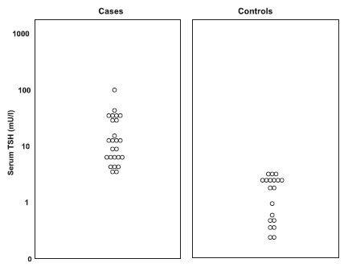
Serum TSH concentration in controlled and uncontrolled hypothyroid mothers during pregnancy
Serum thyrotropin, free thyroxine, urinary iodine concentrations and IQ in studied children
Variable | Cases (n=19) | Controls (n=19) | p-Value
TSH (mU/L) | 3.2±1.9 | 3.3±1.6 | NS
FT4 (pmol/L) | 13.8±3.1 | 13.9±2.2 | NS
Urine iodine (μg/L) | 162±87 | 140±69 | NS
Total IQ | 120±14 | 121±11 | NS
Performance IQ | 117±12 | 120±7 | NS
Verbal IQ | 121±16 | 117±15 | NS
Behrooz HG, et al. Subclinical Hypothyroidism in Pregnancy: Intellectual Development of Offspring. Thyroid 2011; 21: 1143-7

Slide 30
Screening for Thyroid Disease in Pregnancy
The benefits of universal screening for thyroid dysfunction may not be justified at this time, selected screening for the following should be done:
Positive FHx or personal history of thyroid disease
Prior thyroid surgey
>30 years
Infertility
Miscarriage or preterm delivery
Head and neck radition
Type 1 DM
Other autoimmune disease
Iodine deficiency
Morbid obesity
Symptoms
Goiter
TPOAb+
Amiodaron, lithium, iodinated
contrast media
ATA Guidelines: Thyroid 2011; 21: 1081-1125

Slide 31
Comparison of recommendations of American Thyroid Association and Endocrine Society on the time and target group for screening for hypothyroidism before and during pregnancy
Who should be screened?
American Thyroid Association guideline (2011) | Endocrine Society guideline (2012)
There is insufficient evidence to recommend for or against universal TSH screening at the first trimester visit. | Some members recommended screening of all pregnant women for serum TSH abnormalities by the 9th week or at the time of their first visit. Others recommended against universal screening of pregnant women at the time of their first visit and instead supported aggressive case finding to identify high-risk women
A case-finding approach targeting thyroid function testing in high-risk groups has been advocated | The same
Amouzegar A, et al. Hormone 2014

Slide 32
The American College of Obstetricians and Gynecologists
Universal screening for thyroid disease in pregnancy is not recommended because identification and treatment of maternal subclinical hypothyroidism has not been shown to result in improved neurocognitive function in offspring.
The first-line screening test used to assess thyroid status in patients is measurement of the TSH level.
Thyroid disease in pregnancy. Obstet Gynecol 2015;125(4):996-1005.

Slide 33
2014 European Thyroid Association Guidelines
Despite the beneficial effects of levothyroxine treatment on obstetric outcome and the fact that the previously recommended targeted approach to screening thyroid function will miss a large percentage of women with thyroid dysfunction, we do not recommend universal screening for SCH because of the lack of grade 1 evidence.
Note: although there are still no well-controlled studies to justify universal screening, the majority of the authors (C.D., A.H.-D., J.L., R.N.) recommend universal screening because of the beneficial effects of levothyroxine treatment on unknown overt hypothyroidism, on obstetric outcome and the fact that the targeted approach will miss a large percentage of women with SCH, especially in mildly iodine-deficient women.
Lazarus J, et al. Eur Thyroid J 2014; 3(2):76-94.

Slide 34
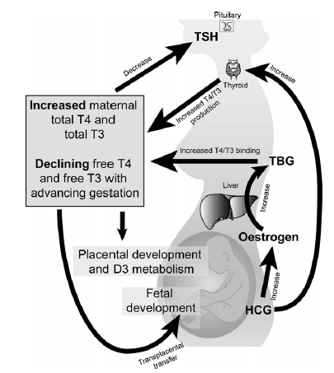
Maternal thyroid physiology
Chan SH, Boelaert K. Optimal management of hypothyroidism, hypothyroxinaemia and euthyroid TPO antibody positivity preconception and in. Pregnancy. Clinical Endocrinology 2015; 82: 313–326.

Slide 35
Guidelines for Serum TSH During Pregnancy
Recommendation 1 Trimester-specific reference ranges for TSH, as defined in populations with optimal iodine intake, should be applied
Recommendation 2 If trimester-specific reference ranges for TSH are not available in the laboratory, the following references ranges are recommend: 1st trimester, 0.1-2.5 mIU/L; 2nd trimester, 0.2-3.0 mIU/L; 3rd trimester, 0.3-3.0 mIU/L
Thyroid 2011; 21: 1081-1125

Slide 36
Sample trimester-specific reference intervals for TSH*
Reference | Year | 1st trimester | 2nd trimester | 3rd trimester
Stricker | 2007 | 1.04 (0.09-2.83) | 1.02 (0.20-2.79) | 1.14 (0.31-2.90)
Haddow |  | 0.94 (0.08-2.73) | 1.29 (0.39-2.70)
Panesar | 2001 | 0.80 (0.03-2.30) | 1.10 (0.03-3.10) | 1.30 (0.13-3.50)
Soldin | 2004 | 0.98 (0.24-2.99) | 1.09 (0.46-2.95) | 1.20 (0.43-2.78)
Bocos-Terraz | 2009 | 0.92 (0.03-2.65) | 1.12 (0.12-2.64) | 1.29 (0.23-3.56)
Blatt | 2012 | 1.01 (0.10-2.50) | 1.14 (0.35-2.75) | 1.26 (0.43-2.91)
Azizi | 2013 | 1.7 (0.2-3.9) | 1.9 (0.5-4.1) | 1.8 (0.6-4.1)
* median TSH mIU/L with 5th and 95th centiles or P2.5 and P 97.5 between brackets.
Soldin OP et al. Clin Chem Acta 2004; 349: 181
Haddow JE et al. J Med Screen 2004; 11: 170
Panesar NS et al. Ann Clin Biocliem 2001; 34: 67
Stricker R, et al. Eur J Endocrinol 2007; 157: 509
Bocos-Terraz JP, et al. BMC Res Notes 2009; 2: 237
Blatt AJ, et al. J Clin Endocrinol Metab 2012; 97: 777
Azizi f, et al. Thyroid 2013; 23: 354

Slide 37
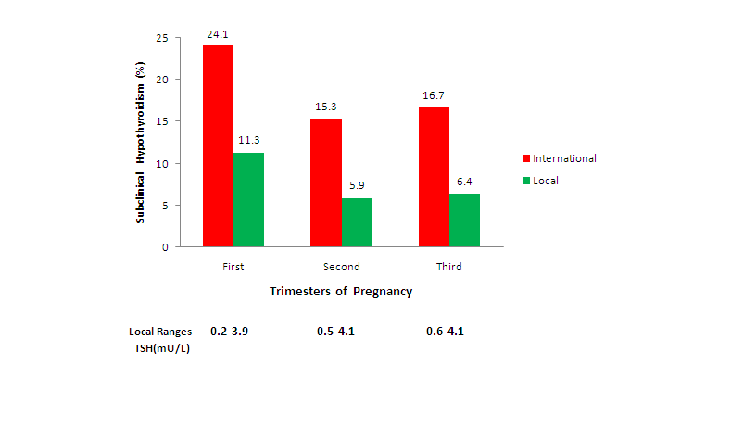
Local versus international recommended TSH references in a iodine sufficient region
Amouzegar A, et al. Hormone Metab Res 2014; 46: 206

Slide 38
MANAGEMENT OF SUBCLINICAL HYPOTHYROIDISM
TPOAb+
TPOAb-

Slide 39
A 31 year-old woman in the 9th week of pregnancy has free T4 of 1.3 ng/dl and serum TSH of 8.0 mU/L. Physical examination is normal, TPOAb is negative.
Do you give levothyroxine treatment?
Yes
No
What are possible adverse outcomes in pregnancy?
What are possible fetal outcomes?

Slide 40
What Adverse Fetal Qutcomes Are Associated With Mothers Subclinical Hypothyroidism?
The detrimental effect of SCH on fetal neurocognitive development is less clear.
prospective, randomized study confirms no fetal IQ benefit from screening and treating subclinically hypothyroid women at 12 weeks of gestation.
association between maternal SCH and adverse fetal neurocognitive development is biologically plausible, though not clearly demonstrated.

Slide 41
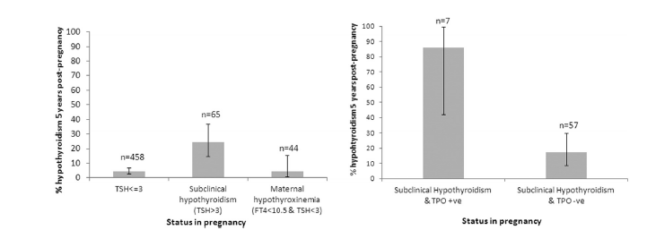
Prevalence of hypothyroidism 5 years postpregnancy
Beverley M, et al. Five-Year Follow-Up for Women With Subclinical Hypothyroidism in Pregnancy.
JCEM 2013; 98: E1941-45

Slide 42
WHAT ADVERSE OUTCOMES ARE ASSOCIATED WITH SUBCLINICAL HYPOTHYROIDISM IN PREGNANCY?
Negro et al reported a significantly higher miscarriage rate in TPO Ab- women with TSH levels between 2.5-5 mIU/L compared to those with TSH levels below 2.5mIU/L (6.1% vs 3.6% respectively, p=0.006).
2-3 fold increased risk of pregnancy related complication was also confirmed in untreated women with SCH.
No adverse effect from subclinical maternal hypothyroidism (detected in the 1st and 2nd trimester) in a cohort of 10,990 pregnant women.
Negro R et al. J Clin Endocrinol Metab 2006; 91: 2587
Casey B et al. Obset Gynecol 2005; 105: 239

Slide 43
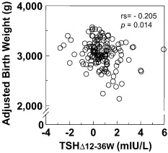
Relationship between maternal ΔTSH and adjusted birth weight
Nishioka E, et al. Early Hum Dev 2015; 91(3): 181-5.

Slide 44
Thyroid Antibodies and Spontaneous Miscarriage
Ab +
Ab –
Bagis (2001)
Singh (1995)
Glafoor (2006)
Lejeune (1993)
Stagnaro-Green (1990)
Glinoer (1991)
Negro (2006)
Lijima (1997)
Netto (2004)

Slide 45
Recurrent Abortion and Thyroid Antibodies
Ab +
Ab –
Bassen (1997)
Dendrinos (2000)
Bassen (1995)
Esplin (1998)
Pratt (1993)
Kutteh (1999)

Slide 46
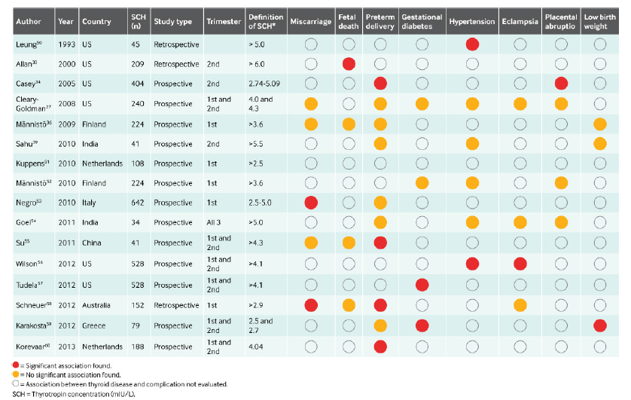
Data from 16 studies that have evaluated an association between thyroid disease and pregnancy and maternal, fetal, neonatal, or offspring complications. SCH=subclinical hypothyroidism
Negro N , Stagnaro-Green A. Diagnosis and management of subclinical hypothyroidism in pregnancy. BMJ 2014; 349: g 4929

Slide 47
Treatment with LT4 in Pregnant Women with TAI: Effects on Obstetrical Complications
58 TPOAb + No treatment
O
U
T
C
O
M
E
115 TPOAb +
984 pregnant women
57 TPOAb + LT4
869 TPOAb-
LT4: 0.5 μg/kg.d TSH <1.0 mIU/I
0.75 μg/kg.d TSH 1.0-2.0 mIU/I
1 μg/kg.d for TSH >2.0 mIU/I or TPOAb >1,500 kIU/L
Negro R et al: JCEM 91:2587-2591, 2006

Slide 48
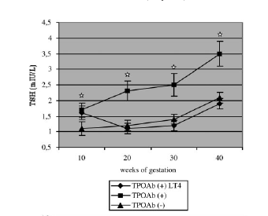
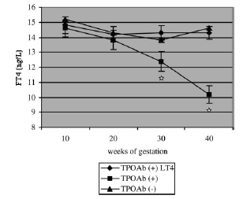
Treatment with LT4 in Pregnant Women with TAI: Effects on Obstetrical Complications
TSH concentration during gestation in
3 study groups
Free T4 concentration during gestation
in 3 study group
Negro R. J Clin Endocrinol Metab 2006; 91: 2587

Slide 49
Treatment with LT4 in Pregnant Women with TAI: Effects on Obstetrical Complications
Miscarriage
Preterm Delivery
%
Negro R et al: JCEM 91:2587-2591, 2006

Slide 50
Guidelines Recommendations
Recommendation 8
There is insufficient evidence to recommend for or against universal LT4 Rx in TPOAB negative women with SCHypo
Recommendation 9
Women who are positive for TPOAb and have SCHypo should be treated with LT4
Thyroid 2011; 21: 1081-1125

Slide 51
درمان کم کاری
آشکار تیروئید
قبل و هنگام بارداری

Slide 52
Hypothyroidism & Pregnancy
Recommendation 13 Treated hypothyroid women on LT4 who are newly pregnant should increase T4 dose by 30%
Recommendation 15 Treated hypothyroid women on LT4 who are planning pregnancy should have T4 dose adjusted to TSH <2.5 MIU/L
Recommendation 16 Maternal serum TSH should be monitored every 4 weeks during 1st half of pregnancy
Thyroid 2011; 21: 1081-1125

Slide 53
Serum TSH concentrations in pregnant women by weeks of gestation
* Median at pre-pregnancy
The line indicates the median value at each gestational week
Vadiveloo T, et al. Clin Endocrinol ,2012

Slide 54
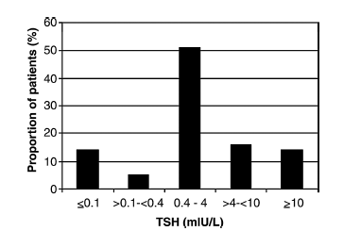
Serum thyrotropin (TSH) values at first laboratory control in 63 female pregnant patients on thyroxine substitution due to hypothyroidism
Hallengren B, et al. Pregnant women on thyroxine substitution are often dystregulated in early pregnancy.
THYROID 2009; 19: 391-94

Slide 55
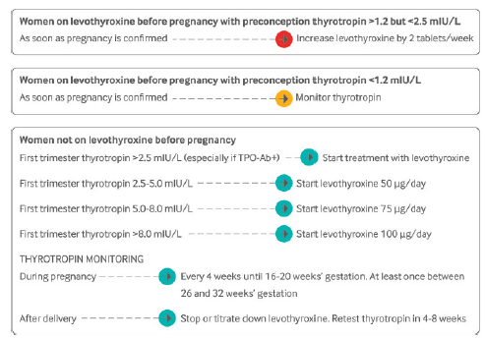
Treatment algorithm for women taking levothyroxine before pregnancy.() TPO-Ab=anti-thyroid peroxidase antibodies
Negro N , Stagnaro-Green A. Diagnosis and management of subclinical hypothyroidism in pregnancy. BMJ 2014; 349: g 4929

Slide 56
* National Institute of Child Health and Human Development’s Maternal-Fetal Medicine Units Network. * Tehran Thyroid Study in Pregnancy
Key Issues in thyroid disease during pregnancy
Questions remain regarding the clinical usefuliness of diagnosis and treatment of thyroid disease in pregnant women. Should all pregnant women be screened for thyroid disease? If universal screening is recommended, should it occur prior to pregnancy? Will treatment of subclinical hypothyroidism in pregnant women decrease the occurrence of adverse events in the mother, developing fetus, or both? Will treatment of women who are euthyroid but test positive for thyroid antibodies decrease the rate of miscarriage and preterm delivery? What is the iodine status of pregnant women in different regions worldwide? What is the impact of mild iodine deficiency on fetal cognitive development?
Stagnaro-Green A, Pearce E. et al. Thyroid disorders in pregnancy. Nat Rev Endocrinol 2012; 8: 650-8

Slide 57
Conclusion
Thyroid diseases, both clinical and subclinical, are common during pregnancy and postpartum and influence the health of mother, fetus and infant.
Effective evidence based strategies for both detection and management should be developed for the benefit of both mother and child.
Prompt and appropriate treatment of thyroid disease could dramatically improve the pregnancy outcome and ensure health promotion for mother and infant.

