Slide 1
METFORMIN
F.Hadaegh
Prevention of Metabolic Disorders Research Center
Research Institute for Endocrine Sciences
2011-05-19

Slide 2
Metformin (dimethylbiguanide)
is the only biguanide currently used in most countries .
The history of biguanides stems from a guanidine - rich herb Galega officinalis (goat ’ s rue or French lilac) that was used as a traditional treatment for diabetes in Europe.

Slide 4
Mode of Action
Metformin exerts a range of actions that counter insulin resistance and lower blood glucose:
the drug also offers some protection against vascular complications independently of its antihyperglycemic effect

Slide 6
Mode of action
The glucose - lowering efficacy of metformin requires a presence of at least some insulin because metformin does not mimic or activate the genomic effects of insulin.
Metformin does not stimulate insulin release; its main glucose - lowering effect appears to be a ↓of hepatic glucose production, but not sufficiently to cause frank hypoglycemia when used as monotherapy.
Metformin↓ gluconeogenesis by increasing hepatic insulin sensitivity and by decreasing hepatic extraction of some gluconeogenic substrates such as lactate
It also ↓ hepatic glycogenolysis.
Metformin can ↑ insulin - stimulated glucose uptake in skeletal muscle by increasing translocation of insulin - sensitive glucose transporters (GLUT - 4) into the cell membrane
and ↑ activity of glycogen synthase which promotes glycogen synthesis

Slide 7
Multiple cellular action mechanisms of metformin involve insulin dependent and independent effects.
metformin can improve insulin
sensitivity via effects on insulin receptor signaling and post - receptor signaling pathways of insulin action.
Metformin also appears to influence cellular nutrient metabolism and energy production independently of insulin via activation of adenosine 5 ′ - monophosphate (AMP) activated protein kinase (AMPK).
Oct1 organic , cation transporter 1; LKB1 protein kinase.

Slide 8
Main sites of action of metformin contributing to glucose – lowering action

Slide 10
Pharmacokinetics
Metformin is rapidly but incompletely absorbed, shows little binding to plasma proteins and is not metabolized, so it does not interfere with co - administered drugs.
Metformin is widely distributed at concentrations similar to plasma but much higher concentrations are retained in the walls of the gastrointestinal tract.
The plasma half - life is about 6 hours with elimination of unchanged drug in the urine, mostly within 12 hours.
Renal clearance is achieved more by tubular secretion than glomerular filtration, metformin is contraindicated for patients with signifi cant impairment of glomerular filtration.
Cimetidine is the only drug known to compete for clearance to cause a clinically significant increase plasma metformin concentrations.

Slide 11
Indications
Because metformin does not cause weight gain it is often preferred for overweight and obese people with T2DM, although it shows similar antihyperglycemic efficacy in normal weight patients.

Slide 12
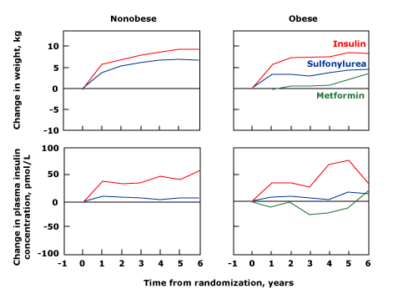
Mean changes in body weight (top) and fasting plasma insulin concentrations (bottom) over six years in patients with type 2 diabetes mellitus in the primary diet failure group who were allocated to therapy with insulin (red), sulfonylurea (blue), or, only in obese subjects, metformin (green). Left panels show data from nonobese patients, right panels show data from obese patients. Metformin did not increase weight or raise plasma insulin

Slide 13
Changes in HbA1c from baseline to end point
. The black bar indicates the HbA1c level at baseline and gray bar at end point.
differences between HbA1c at 0 week and 48 weeks (P value<0.001). Repeated measured ANOVA test was used for statistical analysis.
Between the three groups, HbA1c levels and changes were not statistically different (P value=0.62).
ΔHbA1c Mean doses at end point
Diabetes Metab J 2011;35:26-33

Slide 14
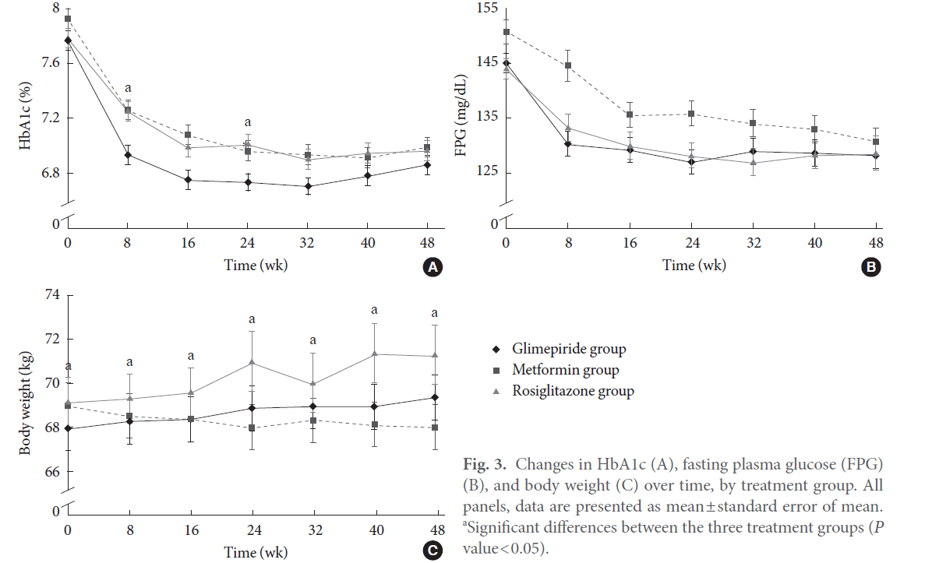

Slide 15
EFFICACY
Monotherapy — Metformin typically lowers FBS by approximately 20 percent and A1C by 1.5 percent, a response similar to that achieved with a sulfonylurea
In those who are obese, metformin promotes modest weight reduction or at least weight stabilization .
Metformin may be less likely to cause hypoglycemia. Careful blood glucose monitoring is still needed during the first weeks or months of treatment with metformin to avoid this problem.
It has lipid-lowering activity, ↓TG and FFA, a small decrease in serum LDL-C, and a very modest increase in serum HDL-C .

Slide 16
EFFICACY
As monotherapy in patients who are not adequately controlled by lifestyle management, optimally titrated metformin typically reduces FPG by 2 – 4 mmol/L(36-72 mg/dl), corresponding to a decrease in HbA 1c by ≈ 1– 2%.
This is independent of body weight , age and duration of diabetes provided that some β - cell function is still present.

Slide 17
Improvements in the lipid profile
mostly in hyperlipidemic patients:
These effects appear to be independent of the antihyperglycemic effect, although ↓triglyceride and FFA is likely to help ↑ insulin sensitivity and benefit the glucose – fatty acid cycle.

Slide 18
CVD PROTECTION
In the UKPDS, overweight patients who started with metformin showed a 39% reduced risk MI compared with conventional treatment ( P = 0.01) .
A recently published follow-up study of UKPDS studied patients for a further 5 years with no attempt made to maintain their previously assigned therapy :
There was a significant↓in the risk of MI with metformin of 33%, and a 30% ↓ in diabetes-related death compared with those in the original conventionally treated arm.

Slide 20
EFFICACY
A systematic review of 29 trials of metformin as monotherapy compared to other oral agents (sulfonylureas, thiazolidinediones, meglitinides, glucosidase inhibitors), insulin, diet, or placebo found that metformin, in overweight and obese diabetics, resulted in decreased all-cause mortality and decreased rate of myocardial infarction .

Slide 21
ADA &EASD
Metformin therapy (in the absence of contraindications) be initiated, concurrent with lifestyle intervention, at the time of diabetes diagnosis .
Metformin was chosen for initial therapy because of glycemic efficacy, absence of weight gain and hypoglycemia, general tolerability, and favorable cost.

Slide 22
ADA/EASD consensus algorithm: step 1
At diagnosis
STEP 1
Lifestyle
+
Metformin
Nathan DM, et al. Diabetes Care 2009;32 193-203.

Slide 23
Metformin* should be uptitrated over 1-2 months
Begin with
500 mg x1 or x2, or
850 mg x1
INITIATE
5-7 days
If well tolerated, advance dose to
850mg x2, or
1,000mg x2
1 to 2 months
TITRATE
If GI side effects, decrease to previous lower dose and try to advance the dose at a later time
Maximum effective dose:
Most often 850 mg x2
Can be up to 1,000 mg x2
Modest benefit up to 2,500mg
MAX DOSE
If GI side effects, decrease to previous lower dose and try to advance the dose at a later time
*Longer-acting formulation can be given once per day
Adapted from Nathan DM, et al. Diabetes Care 2009;32:193-203.
Notes:
1. Begin with low-dose metformin (500 mg) taken once or twice per day with meals (breakfast and/or dinner) or 850 mg once per day.
2. After 5–7 days, if gastrointestinal side effects have not occurred, advance dose to 850, or two 500 mg tablets, twice per day (medication to be taken before breakfast and/or dinner).
3. If gastrointestinal side effects appear as doses advanced, decrease to previous lower dose and try to advance the dose at a later time.
4. The maximum effective dose can be up to 1,000 mg twice per day but is often 850 mg twice per day. Modestly greater effectiveness has been observed with doses up to about 2,500 mg/day. Gastrointestinal side effects may limit the dose that can be used.
5. Based on cost considerations, generic metformin is the first choice of therapy.
A longer-acting formulation is available in some countries and can be given once per day.

Slide 24
ADA/EASD consensus algorithm: step 2
STEP 1
STEP 2
Lifestyle
+ Metformin
+ Basal insulin
At diagnosis:
Lifestyle + Metformin
HbA_{1c} ≥7%
Lifestyle + Metformin
+ Sulfonylurea
When HbA_{1c} is high (>8.5%), classes with greater and more rapid glucose-lowering effectiveness,
or potentially earlier initiation of combination therapy, are recommended
Notes:
If lifestyle intervention and the maximal tolerated dose of metformin fail to achieve or sustain the glycemic goals, another medication should be added within 2–3 months of the initiation of therapy or at any time when the target A1C level is not achieved. Another medication may also be necessary if metformin is contraindicated or not tolerated. The consensus regarding the second medication added to metformin was to choose either insulin or a sulfonylurea.
When HbA1c is high (>8.5%), classes with greater and more rapid glucose-lowering effectiveness, or potentially earlier initiation of combination therapy, are recommended

Slide 25
SIDE EFFECTS
The most common side effects of metformin are gastrointestinal, including a metallic taste in the mouth, mild anorexia, nausea, abdominal discomfort, and soft bowel movements or diarrhea.
These symptoms are usually mild, transient, and reversible after dose reduction or discontinuation of the drug.
In clinical trials, only 5 percent of study subjects discontinue metformin because of the gastrointestinal side effects.

Slide 26
Vit B12 Deficiency
Metformin reduces intestinal absorption of vitamin B12 in up to 30 percent of patients, and lowers serum vitamin B12 concentrations in 5 to 10 percent, but only rarely causes megaloblastic anemia.
The dose and duration of use of metformin correlates with the risk of vitamin B12 deficiency
This reduction appears to be due to absorption in the ileum and can be corrected by administration of oral calcium.
An annual Hb measurement is recommended especially for individuals with known or suspected nutritional deficiencies.

Slide 27
Lactic Acidosis
Symptoms may include anorexia, nausea, vomiting, abdominal pain, lethargy, hyperventilation, and hypotension.
Serum lactate concentrations are usually less than 2 mmol/L in patients taking metformin,
More serious lactic acid accumulation occurs with superimposed shock or in the presence of predisposing conditions to metformin toxicity
Metformin-induced lactic acidosis can occur in patients with normal renal and hepatic function.
In addition, patients with the genetic diabetes syndrome, maternally inherited diabetes and deafness (MIDD), are at increased risk of developing lactic acidosis with metformin therapy.

Slide 28
Predisposing factors
Most cases have occurred in patients with shock or tissue hypoxia or in the presence of several other predisposing conditions; all are relative or absolute contraindications to the institution of metformin therapy
Of these factors, impaired renal function is of greatest concern, heart failure least worrisome.
These predisposing factors/contraindications are:
1- Impaired renal function, serum creatinine concentration above 1.4 mg/dL (124 micromol/L) in women and 1.5 mg/dL (133 micromol/L) in men.

Slide 29
Predisposing factors
Concurrent liver disease or alcohol abuse
Heart failure
Past history of lactic acidosis
Decreased tissue perfusion or hemodynamic instability due to infection or other causes

Slide 30
Metformin and CHF
Metformin may be used in patients with stable CHF if renal function is normal.
It should be avoided in unstable or hospitalized patients with CHF.

Slide 31
Important Clinical Point
Use of the serum creatinine alone may not be accurate in elderly patients or others with reduced muscle mass. An estimated GFR less than 60 mL/min would be the approximate equivalent of the above serum creatinine cutoffs (1.4 mg/dL in women and 1.5 mg/dL .
Contraindication in EGFR of less than 30 mL/min per 1.73 m2, it can be used with caution in those with a GFR of 30–45 mL/min per 1.73 m2 .

Slide 32
Important Clinical Point
Poatients who are about to receive intravenous iodinated contrast material (with potential for contrast-induced renal failure) or undergo a surgical procedure (with potential compromise of circulation) should have metformin held until stable renal function can be established
Serum creatinine is typically assessed two to three days after contrast administration.

Slide 33
Mode of prescription
A standard tablet formulation of metformin should be taken with meals or immediately before meals to minimize possible gastrointestinal side effects.
Start with 500 or 850 mg once daily, or 500 mg twice daily (divided between the morning and evening meals). The dosage is increased slowly – one tablet at a time – at intervals of about 1 – 2 weeks until the target level of blood glucose control is attained.
If the target is not attained and an additional dose produces no further improvement, return to the previous dose.
In the case of monotherapy, consider combination therapy by adding in another agent (e.g. an insulin secretagogue or thiazolidinedione).
The maximal effective dosage of metformin is about 2000 mg/ day, taken in divided doses with meals, and the maximum is 2550 or 3000 mg/day in different countries.

Slide 34
Mode of prescription
The usual effective dose is 1500 to 2000 mg/day per day;
the maximum dose of 2550 mg/day (850 mg TID) provides only marginally better glycemic control and is often not tolerated due to GI side effects.

Slide 35
Combination therapy
UKPDS: %50 of patients originally controlled with a single drug required the addition of a 2th drug after 3 years.
By 9 years 75 percent of patients needed multiple therapies to achieve the target hemoglobin A1C (HbA1c) value .

Slide 36
Effect of Noninsulin Antidiabetic Drugs Added to Metformin Therapy on Glycemic Control,Weight Gain, and Hypoglycemia in Type 2 Diabetes
Mixed-treatment comparison meta-analysis was used to calculate the weighted mean difference for changes from baseline in HbA1c and body weight and relative risk (RR) of HbA1c goal attainment and hypoglycemia, with associated 95% credible intervals.
JAMA. 2010;303(14):1410-1418

Slide 37
Combination therapy
The different classes of drugs were associated with similar HbA1c reductions (range, 0.64%-0.97%) .
use of TZDs, sulfonylureas, and meglitinides was associated with weight gain, while GLP-1 analogs, alpha-glucosidase inhibitors, and DPP-IV inhibitors were associated with weight loss or no change .
weight loss associated with GLP-1 analogues was highly significant.
Sulfonylureas and glinides were associated with higher rates of hypoglycemia.

Slide 38
Metformin monotherapy failure
In patients with inadequate glycemic control on metformin and A1C >8.5 percent, adding insulin?
In patients with inadequate glycemic control on metformin (A1C >7.0 percent), with A1C close to target (≤8.5 percent), adding a short acting sulfonylurea, such as glipizide .
The addition of pioglitazone is an alternative option in individuals without risk factors for heart failure or fracture, who do not reach glycemic goals with metformin alone,
Another reasonable alternative is the addition of repaglinide, which can be considered in individuals who do not reach glycemic goals with metformin,

Slide 39
Triple therapy with Metformin
In individuals A1C >7 percent on two oral agents (usually metformin and sulfonylurea), switching to insulin (discontinue sulfonylurea and continue metformin) (Grade 2B).
However, three oral agents (metformin, sulfonylurea, pioglitazone) can be considered in patients with A1C values that are not too far from goal (A1C ≤8.5 %)

Slide 40
Triple therapy with Metformin
Metformin, sulfonylurea, GLP-1 analog (Exenatide, Liraglutide) for overweight patients
Metformin, sulfonylurea, DPP-IV inhibitors( Sitagliptin or saxagliptin )
long-term safety?????

Slide 42
Insulin requirements and weight
The summary means were significantly different between the groups for A, daily dose of insulin (P.001); B, body
weight (P.001); C, fasting plasma insulin (P=.02); and D, body mass index (BMI)
Arch Intern Med. 2009;169(6):616-625

Slide 43
Survival functions for the primary (lower pair of curves) and the secondary, macrovascular (upper pair of curves) end points
Metformin treatment was not associated with an improvement in the primary end point.
It was, however, associated with a decreased risk of the secondary,
macrovascular end point (hazard ratio, 0.61 [95% confidence interval,
0.40-0.94; P=.02]).
The number needed to treat to prevent 1 macrovascular end point was 16 (95% confidence interval, 9-67)
Arch Intern Med. 2009;169(6):616-625

Slide 45
Standardised mean difference of insulin dose between metformin-treated and metformin-free type 1 diabetes patients from five randomised controlled studies, including the largest study to date)

Slide 46
Standardised mean difference of HbA1c level between metformin-treated and metformin-free type 1 diabetes patients from four randomised controlled studies,

Slide 47
Metformin therapy for prevention of type 2 diabetes
In those at the highest risk for developing diabetes, such as those with multiple risk factors, especially if they demonstrate progression of hyperglycemia(e.g., A1C 6%) despite lifestyle interventions.

Slide 49
Thank you for your attention
CONTINUE STORY OF Metformin ….
Thank you for Attention

