Slide 1
IN THE NAME OF GOD

Slide 2
Papillary Thyroid Microcarcinomas Management
Shadi Haghi M.D.
Research Institute for Endocrine Sciences
Shahid Beheshti University of Medical sciences
21 April 2014

Slide 3
AGENDA
Introduction
ATA Guide line 2009
Rec.for FNA
3 level stratification for assessment of risk of recurrance in PTC
Thyroid surgury recommendation
AJCC cancer staging 2002 for PTC
AGES &MACIS prognostic risk index
5 STUDIES:
A retrospective chart review about differences in tumor characteristics &pt outcome in conventional PTC &PTMC
A retrospective study about classification of PTMC according to size &FNA cytology(behavior &therapy)
A retrospective study about risk factors for neck nodal metastasis in PTMC
A retrospective observational study to compare PTMC characteristics &risk factors in 2 cancer registeries
An editorial review of 32 articles about PTMC management
CONCLUSION

Slide 4
QUESTIONS?
What are the conflicts in PTMC management in current studies?
What is PTMC outcome?
What are poor prognostic factors in PTMC pts?
Is it possible to predict the clinical behavior of PTMC?

Slide 5
Introduction
ATA guideline 2009:
Thyroid microcarcinomas, ie, thyroid cancers smaller than 1 cm in diameter
Have become a public health issue due to the continuous worldwide increase of thyroid cancer incidence
nearly 50% of all thyroid cancers
Most thyroid microcarcinomas exhibit indolent behavior and require neither aggressive treatment nor in tensive follow-up,
WHO 2010:
the term ‘‘microcarcinoma’’ should be used for papillary carcinomas that are found in aspiration biopsies guided by ultrasound or incidentally after surgery and that are smaller than 1.0 cm

Slide 6
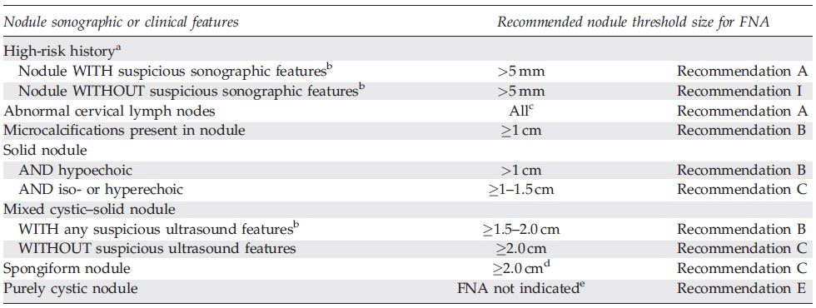
Sonographic and Clinical Features of Thyroid Nodules and Recommendations for FNA(Guideline ATA 2009)

Slide 7
High-risk history
History of thyroid cancer in one or more first degree relatives;
history of external beam radiation as a child;
exposure to ionizing radiation in childhood or adolescence;
prior hemithyroidectomy with discovery of thyroid cancer,
18FDG avidity on PET scanning;
MEN2/FMTC-associated RET protooncogene mutation,
calcitonin >100 pg/mL

Slide 8
Three-level stratification for assessment of risk of recurrence in PTC (ATA guideline 2009)
Low-risk patients:
no local or distant metastases;
all macroscopic tumor has been resected;
no tumor invasion of locoregional tissues or structures;
no aggressive histology (e.g., tall cell, insular, columnar cell carcinoma) or vascular invasion;
no ¹³¹I uptake outside the thyroid bed on the first posttreatment RxWBS
Intermediate-risk patients:
microscopic invasion of tumor into the perithyroidal soft tissues at initial surgery;
cervical lymph node metastases or ¹³¹I uptake outside the thyroid bed on the RxWBS done after thyroid remnant ablation;
tumor with aggressive histology or vascular invasion
High-risk patients:
macroscopic tumor invasion,
incomplete tumor resection,
distant metastases
thyroglobulinemia out of proportion to what is seen on the posttreatment scan

Slide 9
ATA guideline 2009
Neartotal or total thyroidectomy is recommended:
Primary thyroid carcinoma is >1 cm
contralateral thyroid nodules present
regional or distant metastases are present
personal history of radiation therapy to the head and neck
first-degree family history of DTC
Older age (>45 years) even with tumors <1–1.5 cm
Thyroid lobectomy alone may be sufficient treatment for:
Small (<1 cm), low-risk, unifocal, intrathyroidal papillary carcinomas in the absence of prior head and neck irradiation or radiologically or clinically involved cervical nodal metastases (Recommendation rating: A)

Slide 10
ATA guideline 2009
Total thyroidectomy
indeterminant nodules with tumor>4 cm
marked atypia
suspicious for PTC on biopsy
family history of thyroid carcinoma
history of radiation exposure
(Recommendation ratingA)
indeterminant nodules with bilateral nodular dis.
or those who prefer to undergo bilateral thyroidectomy to avoid future surgery on the contralateral lobe
(Recommendation rating C)

Slide 11
Major Factors Impacting Decision Making in Radioiodine Remnant Ablation

Slide 12
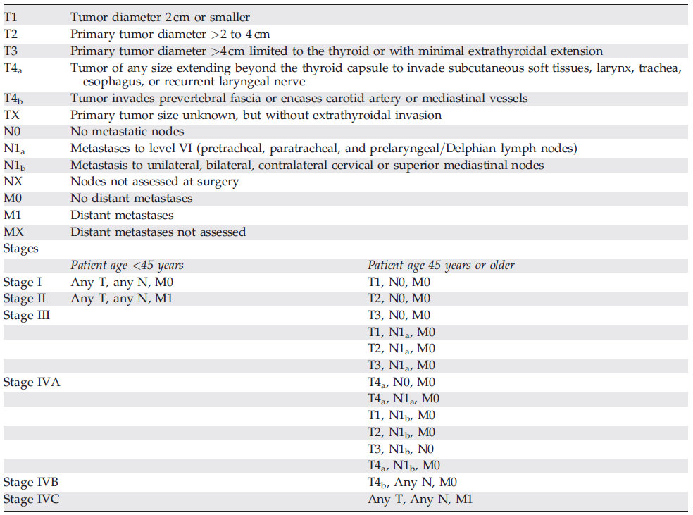
AJCC Cancer Staging 2002(forDTC)
Predict risk of death(rec.B)

Slide 13
AGES prognostic risk groups index
Age
Tumor grade
Tumor extend
Tumor size
AGES scores ≥ 4 → High risk group (20 Yr. CSM = 36%)
AGES scores < 4 → Low risk group (20 Yr. CSM = 1%)

Slide 14
MACIS prognostic model
Metastasis
Age
Completeness of resection
Invasion
Size
MACIS < 6 → 20 Yr. Survival rate = 99%
6 ≤ MACIS ≤ 6.99 → 20 Yr. Survival rate = 89%
7 ≤ MACIS ≤ 7.99 → 20 Yr. Survival rate = 56%
8 ≤ MACIS → 20 Yr. Survival rate = 27%

Slide 15
Papillary Thyroid Carcinoma and Microcarcinoma:
Is There a Need to Distinguish the Two?
Nimmi Arora, et al.
2009 THYROID

Slide 16
Objective
Compare conventional PTC (tumors>1 cm) to PTMC and assess for differences in tumor characteristics and patient outcome
Design
A retrospective chart review of patients with PTC or PTMC followed for a minimum of 3 years postoperatively and managed at a single academic institute was performed.

Slide 17
Patients and Methods
Patients with papillary or follicular variant of PTC carcinoma were identified from prospectively maintained pathology and surgical databases at a single tertiary referral center
Inclusion criteria:
All patients who underwent total or hemi-thyroidectomy between 1995 and 2005 and were followed for at least 3 years postoperatively.
Exclusion criteria:
Patients with distant metastasis that persisted and did not resolve with radioactive iodine therapy
or if incomplete information.
202 fit the criteria for the study

Slide 18
Results
Mean follow-up time was 5.5 years
202 study patients
66 had PTMC
14 (21.2%) had incidental PTMC
52 had nonincidental PTMC
50 had preoperative FNAs documenting malignancy or suspicious for malignancy
2 had history of radiation therapy and thyroid nodules on physical exam
136 had conventional PTC

Slide 19
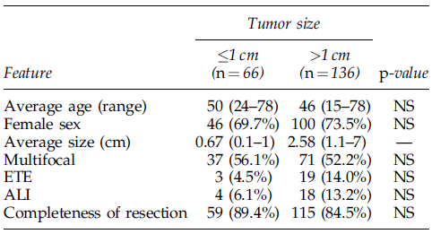
Results
Clinicopathologic Features of Study
Metastasis at Presentation

Slide 20
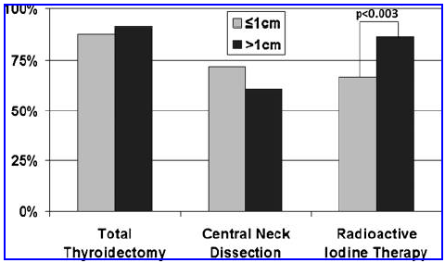
Results
Percentage of patients in each group receiving surgical
and adjuvant treatment
86.4%
66.7%
Types of Recurrences

Slide 21
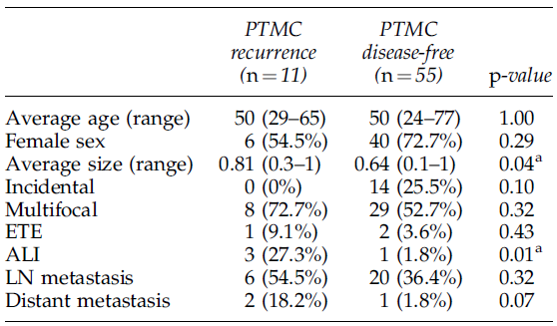
Results (Comparison of Papillary Thyroid Microcarcinoma Recurrence to Papillary Thyroid Microcarcinoma Disease-Free Patients)
angiolymphatic invasion in PTMC was the only predictor of disease recurrence ( p<0.02)

Slide 22
Discussion
Angiolymphatic invasion was the only factor significantly associated with disease recurrence in PTMC.
PTMC tumors that had recurrences were significantly larger than those that did not recur in this series (8.1 vs. 6.4mm)
Nonincidental PTMC was found to be significantly associated with more aggressive tumor features and disease recurrence compared to incidental PTMC

Slide 23
Key Messages
PTMCs can have features that are as aggressive as conventional PTC tumors.
Disease recurrence in nonincidental PTMC is not negligible.
These tumors should be treated like any other papillary thyroid malignancy

Slide 24
CLASSIFICATION OF PAPILLARY THYROID MICROCARCINOMA ACCORDING TO SIZE AND FINE-NEEDLE ASPIRATION CYTOLOGY: BEHAVIOR AND THERAPEUTIC IMPLICATIONS
Celso Ubirajara Moretto Friguglietti, et al.
2010 Head and Neck

Slide 25
Study Characteristics (Design)
448 cases of papillary thyroid micro carcinoma were studied retrospectively
The classify microcarcinomas into 3 groups: clinically detectable (presence of signs or symptoms of lymph node or distant metastasis); findings in autopsies or incidentally in histology; or findings from aspiration biopsies guided by ultrasound scan and preoperative thyroid assessment

Slide 26
Materials and Methods
2295 patients who previously underwent a total thyroidectomy during 2002 and 2008 were assessed retrospectively. All of the patients were operated on by the same surgeons
760 patients who underwent a thyroidectomy for a benign reason presented with malignant neoplasms
Exclusion criteria:
Cases subjected to a partial thyroidectomy
Inclusion criteria:
Papillary carcinoma was diagnosed in 715 patients by the histopathologic examination, and of these, 448 were microcarcinomas. All of these 448 cases were included in this study

Slide 27
Materials and Methods
In 396 cases, the patients were women and in 52 cases they were men.
There were 197 patients over 45 years of age and 251 under 45 years of age.
. In the cases in which metastasis was detected before surgery, by ultrasound scan, FNAC, or by palpitation during the intraoperatory examination of the central compartment, the patients underwent a level VI therapeutic dissection
In the cases that present metastasis diagnosed in the lateral compartment by FNAC, the patient also underwent a modified radical dissection of the lateral compartment of levels II and V

Slide 28
Materials and Methods
After surgery, patients underwent a whole-body scan, always with TSH levels greater than 30 U/mL
Radioiodine therapy was recommended whenever there was a factor for worse prognosis: tumor size above 1.5 cm, over 45 years of age, male sex, more aggressive histological type, presence of metastasis, or uptake of over 1% in the whole-body scan.
The ablative dose used was 100 mCi and the therapeutic doses ranged from 150 to 250 mCi
A new whole-body scan and Tg-S dosage were conducted after a year
The papillary carcinomas were initially divided according to size: 0.5 cm; from 0.6 to 1.0 cm; and >1.0 cm
A second analysis was also conducted. The patients were divided into 2 groups: patients diagnosed with papillary carcinoma in FNAC in the first group and patients with carcinomas found incidentally in histological analysis in the second group (incidentalomas).

Slide 29
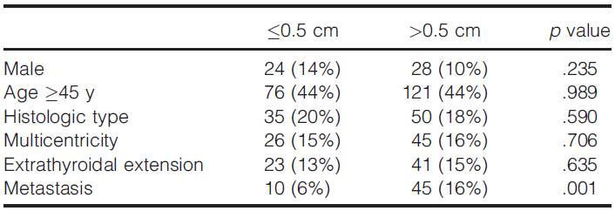
Results
Clinical and pathological factors for worse prognosis by size and ratio

Slide 30
Results
Classification of diagnosis by type and size

Slide 31
Results
Classification of diagnosis according to FNAC versus histology and size and ratio

Slide 32
Results
Clinical and pathological factors for worse prognosis by diagnosis (FNAC versus histology) and ratio

Slide 33
Results
Comparison of the stages according to TNM and OHIO

Slide 34
Results
Thyroglobulin-stimulated serum concentrations by diagnosis and size (absolute values and ratio)

Slide 35
Results
In the group of patients with tumor size 0.5 cm, we found 3 with distant metastasis; and in the group with tumors between 0.6 and 1.0 cm, we found 2 with distant metastasis
One year after surgery, the patients were again assessed for Tg-S in relation to the size of the neoplasm; and this time there was no difference between the groups

Slide 36
Discussion
Microcarcinomas are normally subcapsular, and can grow beyond the thyroid capsule and invade neighboring structures. We found extension in approximately 14% of the patients,
The presence of lymph node metastasis in microcarcinoma and the central compartment is frequent. It ranges from 5.2% to 44.2% when the patient is subjected to therapeutic or necessary dissection and as high as 29% to 64% when the patient is subjected to prophylactic or elective dissection
Therefore, we always examine the central compartment and upon finding macrometastasis recommend systematic therapeutic dissection.

Slide 37
CONCLUSION
The diagnosis of microcarcinoma although normally indolent, they can present with more aggressive behavior, with thyroglobulinemia, lymph node and distant metastasis.
It was demonstrated that the prior diagnosis provides the surgeon with surgical radicality and a greater chance of biochemical cure.
Unfortunately, there is no biological marker that defines prognosis; therefore, we recommend total thyroidectomy as the gold standard, followed by dosages of Tg-S and wholebody scan, and radioiodine therapy in those patients with clinical and histological factors for worse prognosis.

Slide 38
Risk Factors for Neck Nodal Metastasis in Papillary Thyroid Microcarcinoma: A Study of 1066 Patients
Ling Zhang , et al.
2012 J Clin Endocrinol Metab

Slide 39
Study Characteristics
Design:
retrospective cross-sectional study, risk factors and outcome variables were assessed at the time of surgery for the primary tumor.
Materials and Methods:
The study subjects were patients all treated at the Department of Head and Neck Surgery, Shanghai, China, from 2005 to 2009.
Inclusion criteria:
no previous thyroid surgery and the availability of an adequate medical history.
Exclusion criteria:
Patients with incidental PTMC found during thyroidectomy for benign conditions (without neck dissection)

Slide 40
Materials and Methods
Before surgery, each patient underwent a US examination from nodule <1 cm
Patients with lymphadenopathy in the central or lateral neck, as detected by palpation or US, underwent a CT scan of the neck as well as US-guided FNA of the suspected lymph node.
three criteria were used for selecting patients before surgery:
suspicious US images
changes in the US images during the 3- to 6-month follow-up;
patient consent.

Slide 41
Materials and Methods
5518 patients with primary lesions 1 cm or smaller in diameter underwent US examinations .
Using our selection criteria, 1440 patients underwent initial surgery .
Of these 1440 patients, 1124 were diagnosed with PTMC histologically
58 patients were excluded because their primary tumors were found incidentally during thyroidectomy. Thus, there were a total of 1066 patients who met the inclusion and exclusion criteria of the study.
and the remaining patients were diagnosed with benign tumors.

Slide 42
Materials and Methods
Lobectomy plus ipsilateral CLND was typically performed as the initial surgical treatment for PTMC patients with malignant lesions by FS that were limited to a single lobe.
When malignant lesions were found in both lobes of the thyroid by FS, a TT plus a bilateral CLND was performed.
A modified LLND, including levels II–V, with the preservation of the sternocleidomastoid muscle, internal jugular vein, and spinal accessory nerve, was performed only in cases with clinically evident LLNM
Radioactive iodine therapy was limited to patients who had distant metastasis

Slide 43
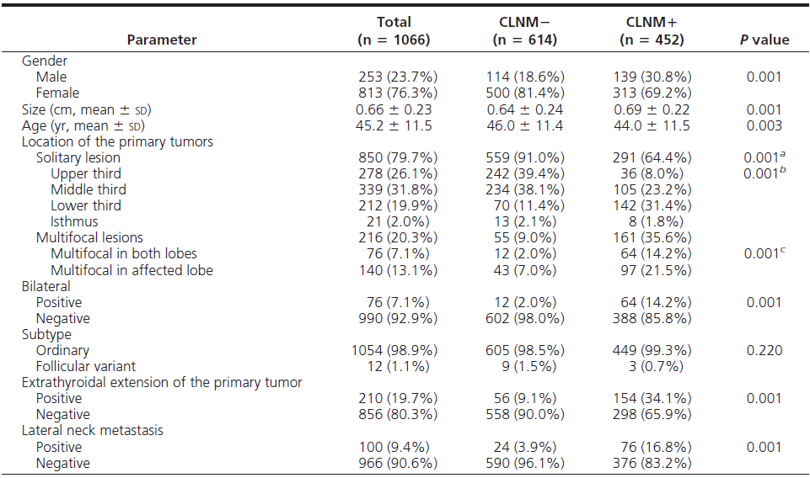
Results (Characteristics of patients)

Slide 44
Results
Univariate andmultivariate logistic regression for CLNM
The risk of location in the solitary primary tumor for CLNM adjusted for the factor of upper third

Slide 45
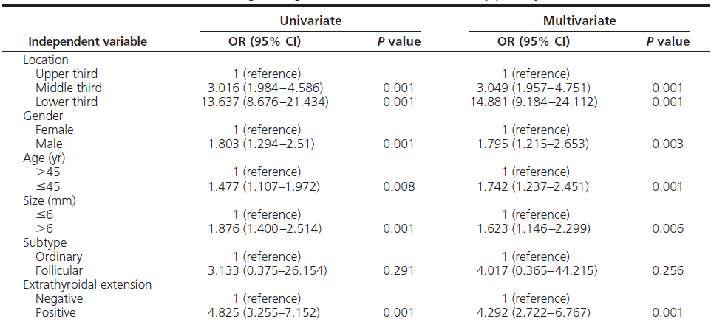
Results (Univariate and multivariate logistic regression for CLNM in the solitary primary tumor)

Slide 46
Results (Univariate and multivariate logistic regression for LLNM)

Slide 47
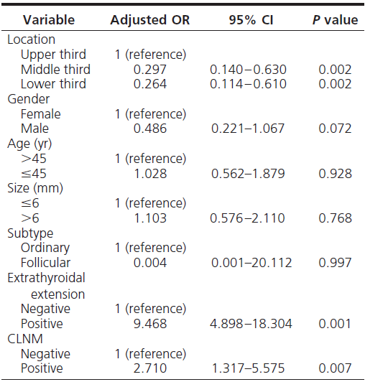
Results (Multivariate logistic regression for LLNM in the solitary primary tumor)

Slide 48
Discussion
The prevalence of:
CLNM 42.4%
LLNM 9.4%
This large range in the prevalence of LLNM may be due to differences in the number of patients and the performance of prophylactic LLND.
The mean length of follow-up was 33.5 ± 15.9 months
10 patients (0.94%) had locoregional recurrence;
no patient demonstrated distant metastasis or died.
Among 990 patients who did not undergo TT
seven (0.81%) malignant recurrence in the contralateral lobe.

Slide 49
Discussion
1066 patients:
80 (7.5%) transient hypoparathyroidism
3 (0.28%) permanent hypoparathyroidism.
12 (1.1%) recurrent laryngeal nerve injury (1 transient; 11 permanent)
Only the rate of transient hypoparathyroidism differed significantly between TT plus CLND group and the TT group.
Thus, it may be better to perform CLND in selected patients with high risk factors.

Slide 50
Key Messages
Risk factors for CLNM
male gender
younger age (45 yr of age)
multifocal lesions
extrathyroidal extension
larger sized primary tumor (6 mm)
Risk factors for LLNM
extrathyroidal extension
multifocal lesions
CLNM
In patients with a solitary primary tumor the upper third of the thyroid lobe had a lower risk of CLNM and a higher risk of LLNM.

Slide 51
Papillary Thyroid Microcarcinomas:
A Comparative Study of the Characteristics and Risk Factors at Presentation in Two Cancer Registries
Pasqualino Malandrino, et al.
2013 J Clin Endocrinol Metab

Slide 52
Study Characteristics
Design and Patients:
A retrospective, observational study of all incident cases of PTMCs recorded over a 5-year period in the Sicilian Regional Registry for Thyroid Cancer (SRRTC) and in the Surveillance Epidemiology and End Results (SEER) US registry.
Objective:
to evaluate the prevalence of PTMCs and the associated risk factors at presentation in 2 thyroid cancer registries from areas with different genetic and environmental characteristics

Slide 53
Patients and Methods
All of the PTMCs from the SRRTC were retrospectively selected in the 5-year period 2002–2006.
Papillary microcarcinomas represented 98.0% of all microcarcinomas diagnosed in Sicily
Data from SEER were analyzed after selecting all new cases of PTMCs in the 5-year period 2004–2008
PTMC represented 98.3% of all microcarcinomas registered in the SEER

Slide 54
Patients and Methods
The following parameters were analyzed:
Histotype
age at diagnosis (≤45 vs >45 y)
Gender
extent of surgery (total or near-total thyroidectomy vs hemithyroidectomy)
tumor size (≤6 mm vs >6 mm)
extrathyroid extension
multifocality (including both uni- and bilateral cancer foci)
TNMcategory classified

Slide 55
Patients and Methods
Because a much higher incidence of thyroid cancer is present in the volcanic area of Sicily, the Sicilian cohort was subdivided into microcarcinomas from residents of Catania and the rest of Sicily
Six patients from the SRRTC series who were missing the information were excluded.

Slide 56
Results
ASRw for All Thyroid Cancers and Papillary Microcarcinomas According to Residence

Slide 57
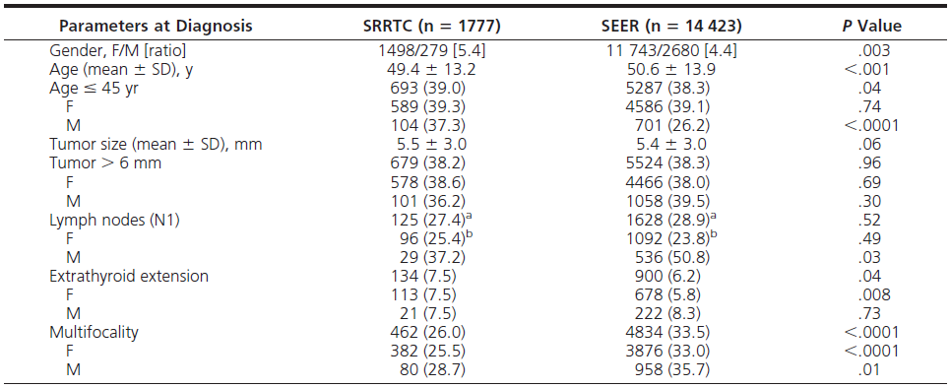
Results Clinical and Histopathological Features of Both SRRTC and SEER PTMC Patients

Slide 58
Results of SRRTC
Female/Male ratio was significantly higher in pts younger than 60 yrs (5.8:1)
The prevalence of N.M. are more frequent in:
>45 yrs (OR=2.4)
M>F
> 6mm (32% vs. 21.6%)
LN were excised in 24% T1 & 40.4% T3 PTMC
LN + was observed in 23.9% T1 and in 53.7% T3
Extra thyroid extension was more frequent in >6mm PTMC (13.5% vs. 3.8%)
Total or near-total thyroidectomy was performed in 92.4% patients, and only 7.6% patients were treated with hemithyroidectomy
Multifocality was observed in 26.0% patients, with a slightly higher prevalence, not statistically significant, in males (28.7 vs 25.5%)
Lymph node involvement was much higher in multifocal than in nonmultifocal microcarcinomas (40.7 vs 19.7%)
Multifocality occurred more frequently in both larger (6 mm) and extrathyroidal PTMC (31.7 and 53.0%) with respect to smaller (6 mm) and intrathyroidal PTMCs (22.5 and23.8%)

Slide 59
Results of SEER
positive lymph nodes were more frequent in male than in female patients (50.8 vs 23.8%) and in larger PTMCs (34.9 vs 23.6% in PTMCs smaller than 7 mm)
PTMCs in young patients (<45 y) exhibited a higher risk of nodal metastases than older patients (odds ratio 1.26)
Extrathyroid extension was more frequent among male patients than among female patients (8.3 vs 5.8%) and in larger PTMCs (11.3 vs 3.2%)
Lymph node involvement was more frequent in T3 tumors (63.5%) relative to T1 tumors (24.0%).
The percentage of T1 cancers with lymph node involvement in the SEER cohort was similar to that observed in Sicily, but the percentage of T3 tumors with lymph node involvement was higher than in Sicily.
Multifocality was present in 33.5% patients, a significantly higher percentage than in Sicily.
Lymph node involvement, as in Sicily, was much higher in multifocal PTMCs (37.4% of patients with excised cervical nodes) than in PTMCs without multifocality (21.9%).
Multifocality was more frequently observed in both larger (>6mm)and extrathyroidal PTMCs(42.0 and 55.3%) with respect to smaller (>6 mm) and intrathyroidal PTMCs(28.9 and 32.6%)

Slide 60
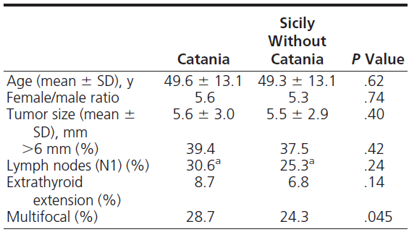
Results
Clinical and Histopathological Features of PTMCs in Patients Living in the Province of Catania or in the Rest of Sicily

Slide 61
Results
PTMC Stratification on the Basis of the Number of Risk Factors at Presentation in 2 Cancer Registries

Slide 62
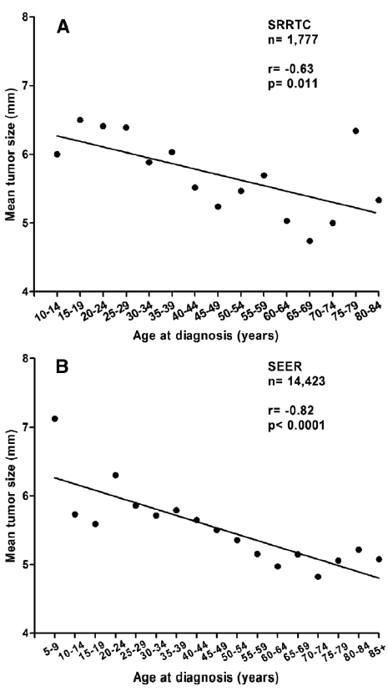
Results
Relationship between microcarcinoma size and patient age
at diagnosis.

Slide 63
Conclusion
PTMC incidence is twice as high in Sicily compared with the United States, and within Sicily, the incidence is twice as high in the volcanic area.
This finding may be dependent on the genetic cancer characteristics or influences of environmental factors
In young patients, PTMCs are larger at presentation and exhibit more risk factors. In both registries, more than 35% of PTMCs exhibited 2 or more risk factors, suggesting that they may require surgery and follow-up similar to that of larger carcinomas.

Slide 64
Management of Papillary Microcarcinoma: Primum Non Nocere?
Leonard Wartofsky
2012 J Clin Endocrinol Metab

Slide 65
Study Characteristics
Design:
An editorial review of 32 articles about PTMC

Slide 66
Nilsson et al., 2011 World J Surg
That a given nodule may be malignant can be signaled by uptake on pet scan and is based on the presence of an increased number of Glut transporters in cancer cells

Slide 67
Ito et al., 2010 World J Surg
An observational study from Japan of 162 patients with PTMC based upon FNA cytology who were not operated and conservative follow-up without surgery were done.
Over 70% of the patients were found to have stable tumors during a follow-up period of just under 4 yr with no intervention

Slide 68
Hay et al., 2008 World J Surg
A series of 900PTMC observed in a 60 yr period
The median tumor size was 7 mm, 98% were histologically grade 1 tumors with no local invasion , but three patients (0.3%) did have distant metastases at presentation, and one third of the patients who had positive nodes at presentation were noted to have a higher risk of recurrence.

Slide 69
Lee et al., 2011 World J Surg
Tumor size of 7 mm has been proposed as a cut point, were reviewed 275 patients with PTMC
It was found that those with tumors smaller than 7mm were less likely to have aggressive features such as lymph node metastases (30.6%) compared with tumors of 7–10 mm, of which 47.8% had central lymph node metastases.

Slide 70
Zhang et al., 2012 JCEM
attempt to identify risk factors for lymph node metastasis in patients with PTMC
multifocality, male gender, tumor size greater than 6 mm, and extrathyroidal extension were associated with higher risk of cervical lymph node metastases and could serve as the indications for central neck lymph node dissection

Slide 71
Hughes et al., 2011 Thyroid
although the most common thyroid tumor in patients more than 45 yr of age is a microcarcinoma, a significant number are found to be stage III or stage IV
Ross et al., 2009 Thyroid
observed that recurrences were not unusual in microcarcinoma patients, particularly those presenting with lymph node metastases, irrespective of whether radioiodine had been administered
tumor multifocality (not withstanding the ATA guidelines.Rec E) is another risk factor for recurrence that may be reduced by an initial total thyroidectomy

Slide 72
Pellegriti, et al., 2004 JCEM
retrospective review of 299 patients with microcarcinoma (<1.5cm)
During follow-up of 292 of these patients, persistent disease was found in 77 (26%), 68 patients(22%) had locoregional metastases, and 10(0.03%) had distant metastases. Tumor size was not predictive of relapse

Slide 73
Pearce, et al., 2004 JCEM
Although the initial management of cancers less than 1.5 cm has often been either subtotal thyroidectomy or near-total thyroidectomy but without radioiodine ablation, the authors and those of an accompanying editorial make a good case instead for total thyroidectomy followed by radioiodine ablation.
Based on their experience, ablation would be warranted in those patients who were more likely to have recurrent or residual disease after thyroidectomy, including those with multicentric tumors, positive lymph node metastases, or vascular or capsular invasion.

Slide 74
Mercante et al., 2009 Thyroid
on the course of 445 patients with PTMC followed for an average of 5.3 yr, 404 had total thyroidectomy and 389 had radioiodine ablation.
Multifocality was present in 35%, extrathyroidal extension in 30%, and lymph node metastases in41%.Neck recurrence or distant metastasis was seen in 3.8%, with the significant independent risk factors being capsular invasion, lymph node metastases at presentation, or extrathyroidal extension.

Slide 75
Yu XM et al., 2011 Ann Surg
the largest series of PTMC patients reviewed from the SEER Cancer Database of 18,445 patients).
92 of these patients (0.5%) died of the disease. Risk factors for recurrence included male gender, non-Caucasian race, age above 45, extrathyroidal extension, and both lymph node and distant metastases.
They found that mortality was associated with having two or more of these risk factors

Slide 76
Sugitani et al., 2010 World J Surg
management strategies differ on the basis of what they described as three different types of presentation of papillary microcarcinoma.
The first group patients with PTMC demonstrates biologically benign up behavior, with conserwative management
second group is comprised of typical PTC whose management could warrant near-total to total thyroidectomy but not radioiodine ablation.
Third category of PTMC demonstrated evidence at presentation of more invasive behavior such as lymph node metastases and extrathyroidal extension reflecting higher risk tumors that deserve more aggressive managemen

Slide 77
CONCLUSION
Thus, the early determination of which of these small tumors is likely to recur could permit less aggressive therapy such as subtotal rather than total thyroidectomy, avoidance of central compartment dissection and radioiodine ablation, and more physiological levothyroxine replacement rather than TSH suppression.
Because of the relatively low frequency of malignancy in incidentalomas and an excellent prognosis even if malignant, the management of these nodules as recommended by recently published guidelines is conservative (2009 ATA – 2010 JCEM)

Slide 78
KEY MESSAGES
According to current studies:
The treatment for PTMC, is still a subject of controversy
Most of PTMC pts are not at risk of distant spread or cancer mortality
RIA did not improve post operative outcome
PTMC pts that are not associated with unfavorable features can be candidates for observation. if there are subsequent signs of progression, such as tumor enlargement and nodal metastasis, it would not be too late to perform Surgical treatment
Finally in the future more RCT with long-term follow up and using morphological and or molecular markers to predict the clinical behavior of PTMC are needed

Slide 79
Thank You

