Slide 1
Normality assessment and dietary data categorization
Golaleh Asghari, PhD
2019

Slide 2
How to approach nutritional factors
When relationships with disease are analyzed, nutritional factors may be examined in terms of absolute amount (crude intake) or in relation to total caloric intake
Depends on:
the nature of the biologic relationship
and the public health considerations

Slide 3
How to approach nutritional factors
If a nutrient is metabolized in approximate proportion to total caloric intake (such as the macronutrients and some vitamins), nutrient intake is most likely biologically important in relation to caloric intake.
As body size is a major determinant of energy intake, adjustment for energy is usually appropriate because an absolute amount of nutrient have less effect for a larger person than for a smaller one.
If a nutrient selectively affects an organ’s system uncorrelated with body size (e.g., central nervous system), or if physical activity does not affect its metabolism, absolute intake may be most relevant.
For example: menstrual blood losses are not thought to increase with physical activity → iron requirements to prevent anemia might be related to absolute intake.

Slide 4
How to approach nutritional factors
If absolute nutrient intake rather than intake in relation to calories is biologically most relevant, caloric intake should be associated with disease, as intakes of all nutrients are ↑ with total caloric intake
Ex: if ↑ absolute intake of a nutrient is a cause of disease, then those who consume more total food due to being large, active, or metabolically inefficient should be at higher risk of disease. We would expect a greater risk of iron deficiency anemia among women with ↓ total energy intake due to ↓ physical activity.
Lack of association between total energy intake and disease: evidence against the importance of absolute nutrient intake, but not against the importance of nutrient composition of the diet.

Slide 7
Which kind of unit is appropriate for reporting data?
One gram
One serving
One standard deviation
Percent of energy
…??

Slide 8
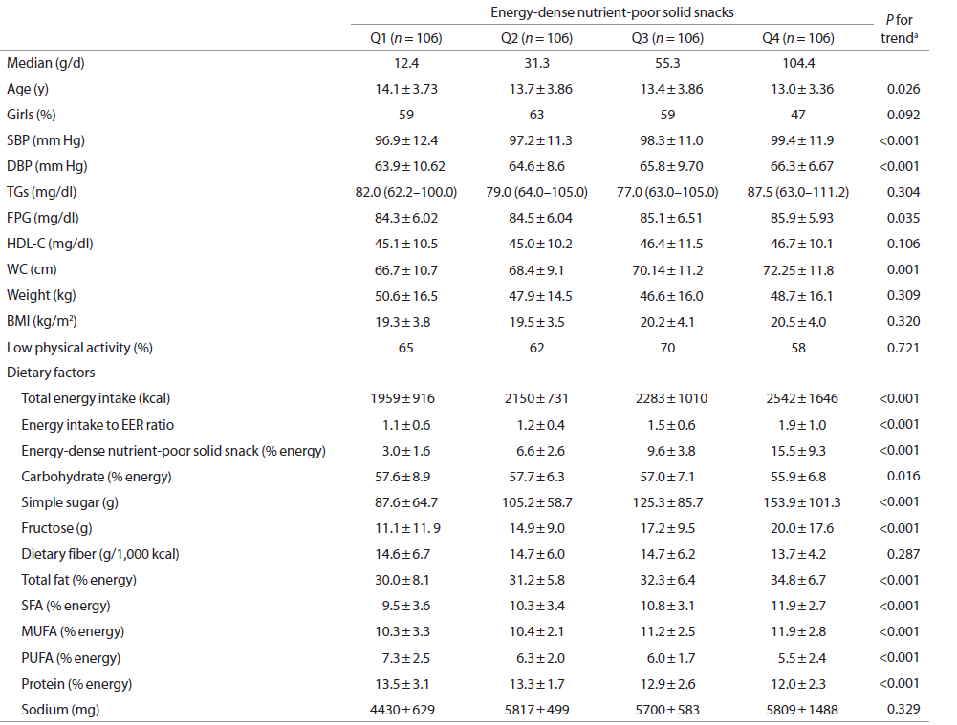

Slide 11
Descriptive statistics
Before data analysis, all data need to be checked even if data entry involved
verification methods (dual entry)
Scanning
computer entry
or Web-based entry
First step:
Run frequency analysis of every variable, review the results to ensure that the output matches the expected values for each variable.
Errors, implausible values, and outlier values need to be checked and any errors need to be corrected.

Slide 12
Descriptive statistics (cont.)
A height of 293 cm for a 30-year-old man is outside of the expected range and most likely represents an error.
If a more realistic value is not available and the value of 293 cm is considered biologically implausible, then the value is best changed to missing.
If the value is checked and it is within the realm of reality (eg, 203 cm) then it would be considered an outlier.
Because an outlier represents an observational value, any analyses should include the outlier value.

Slide 13
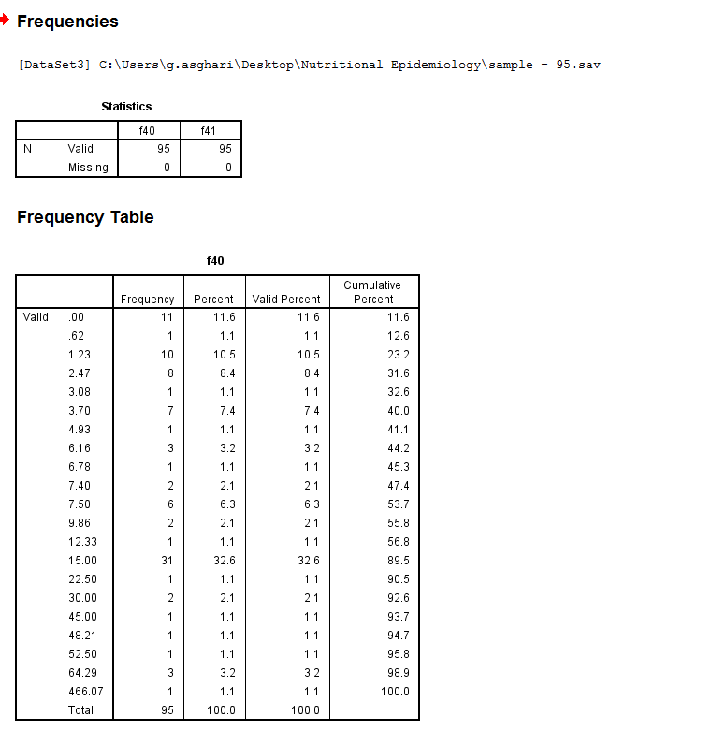
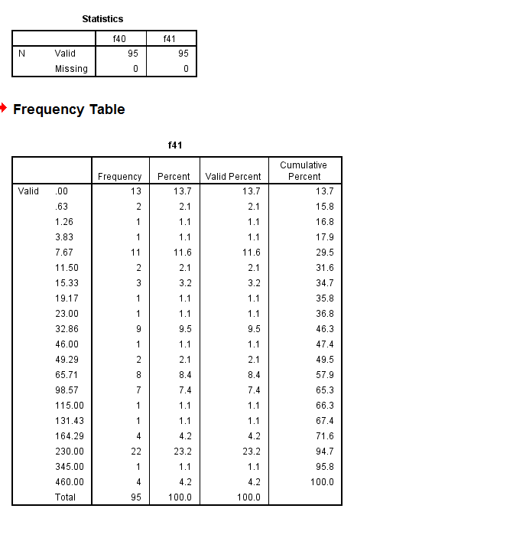

Slide 14
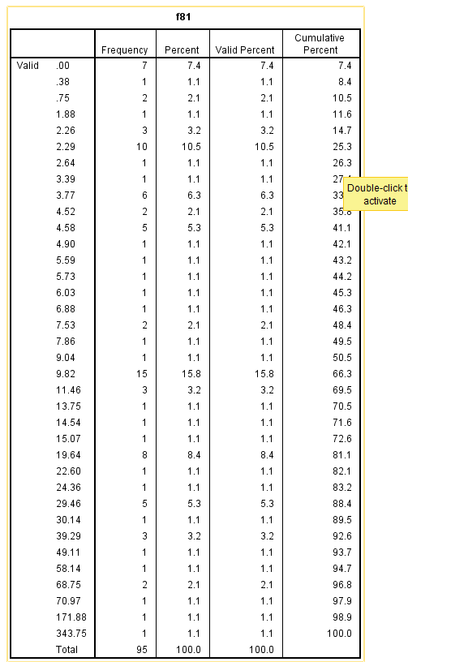
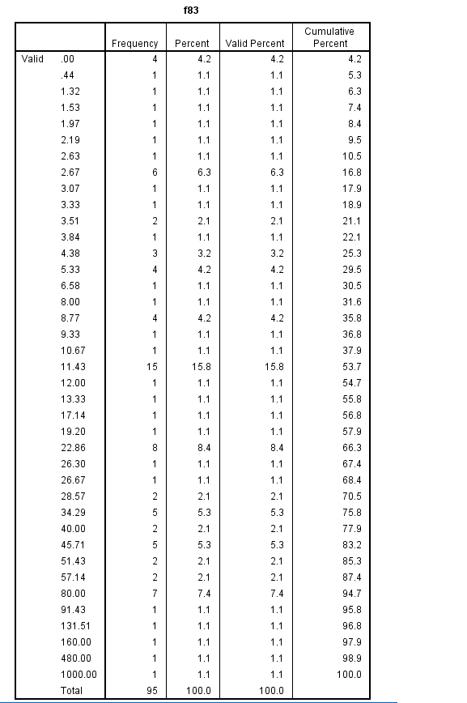

Slide 15
Descriptive statistics (cont.)
Just to remind:
if an implausible food item value is changed to missing, all the nutrients and energy intakes will be changed.
Food items are different from other variables

Slide 16
Descriptive statistics (cont.)
For reporting data:
If it is descriptive ( baseline table) Miss the implausible data
Mean ± SD
Mean ± SE ????
Median (inter-quartile range)
Percent

Slide 17
Descriptive statistics (cont.)
For reporting data:
If it is analytic and we want to report it in a categorized manner (relationships) Keep the implausible data
Ex: relationship between tertiles of dietary meat intake and incidence of chronic kidney disease.

Slide 18
Descriptive statistics (cont.)
Under these circumstances, analysis methods to consider:
separation into groups, such as quartiles
results can be presented with and without outliers
transformation
nonparametric analytical methods

Slide 19
Descriptive statistics (cont.)
Separation into groups:
with priori defined cut-points:
according to dietary standards such as RDA, AI, and DRI (calcium intake recommendation in different age groups)
or dietary guidelines such as recommended servings of food groups and moderation of fat and sodium (DASH diet)
without priori defined cut-points
such as median, tertile, quartile, quintile, decile, percentile, …

Slide 20
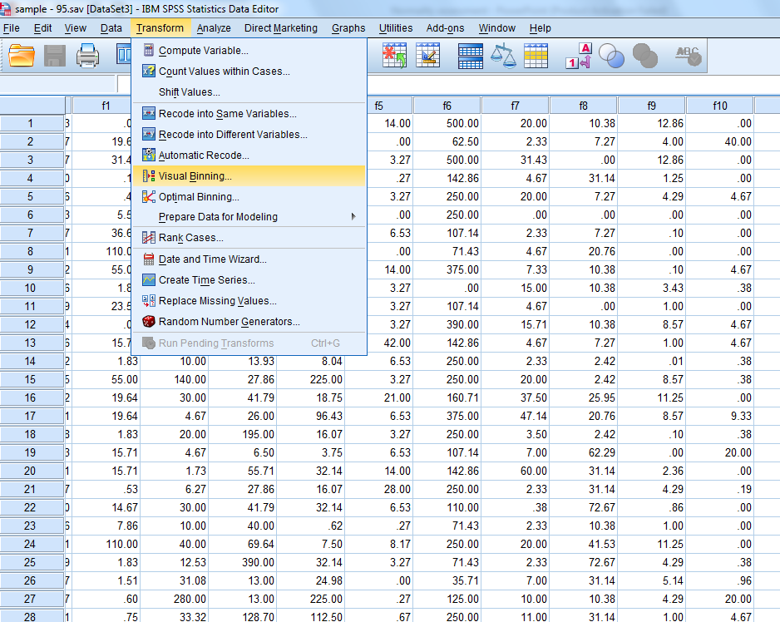
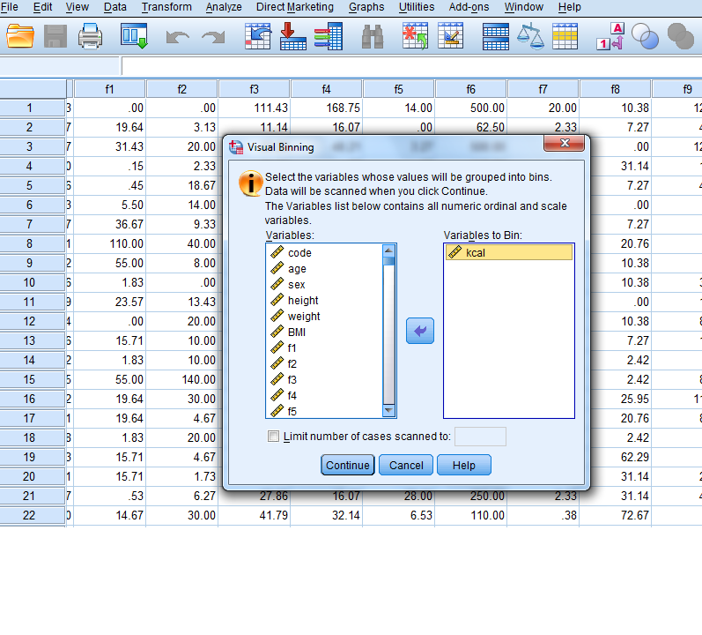
Two approaches to define median, tertile, ….. In SPSS

Slide 21
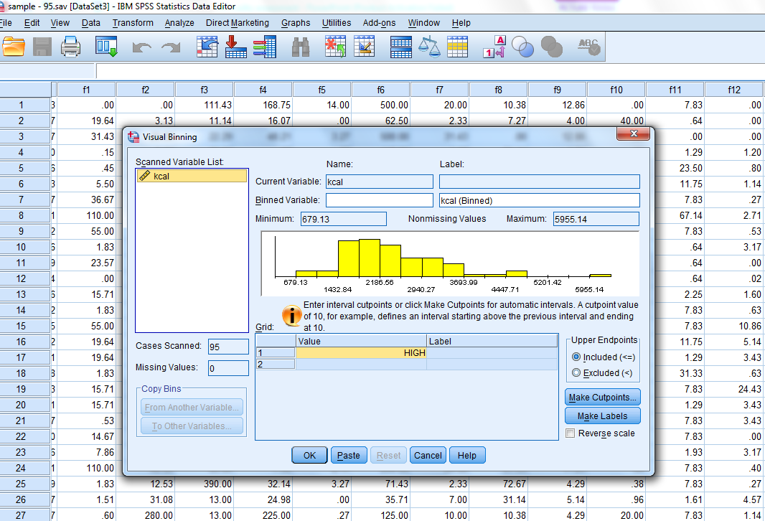

Slide 22
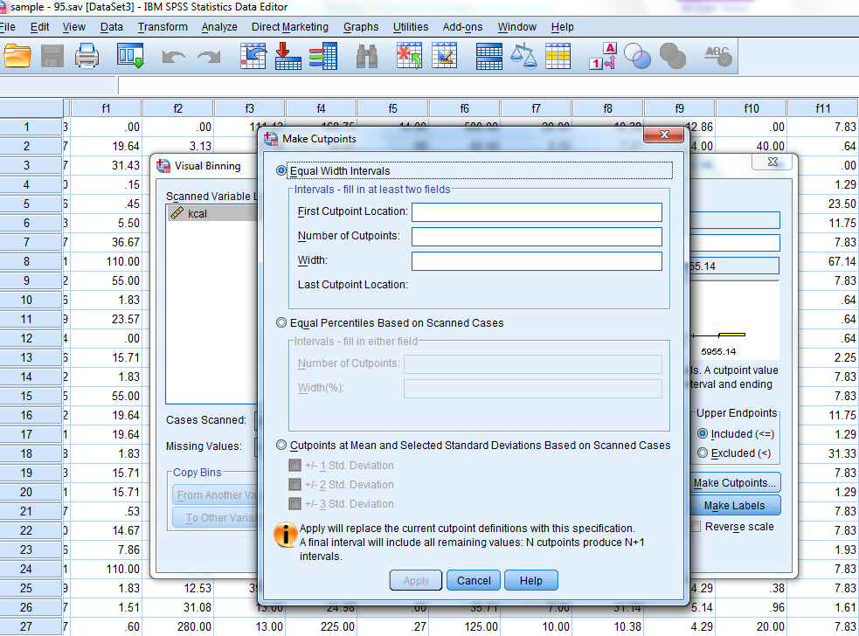

Slide 23
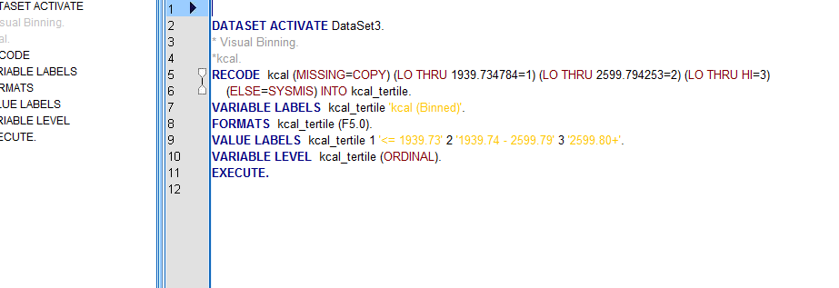

Slide 24
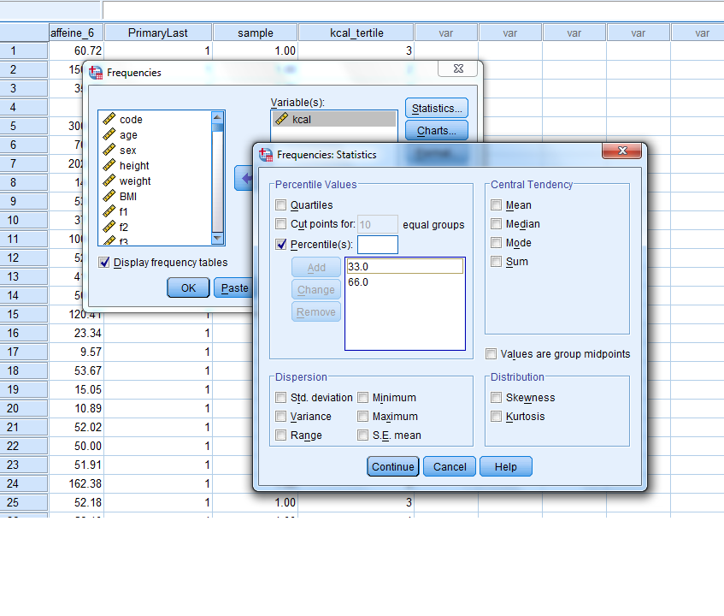
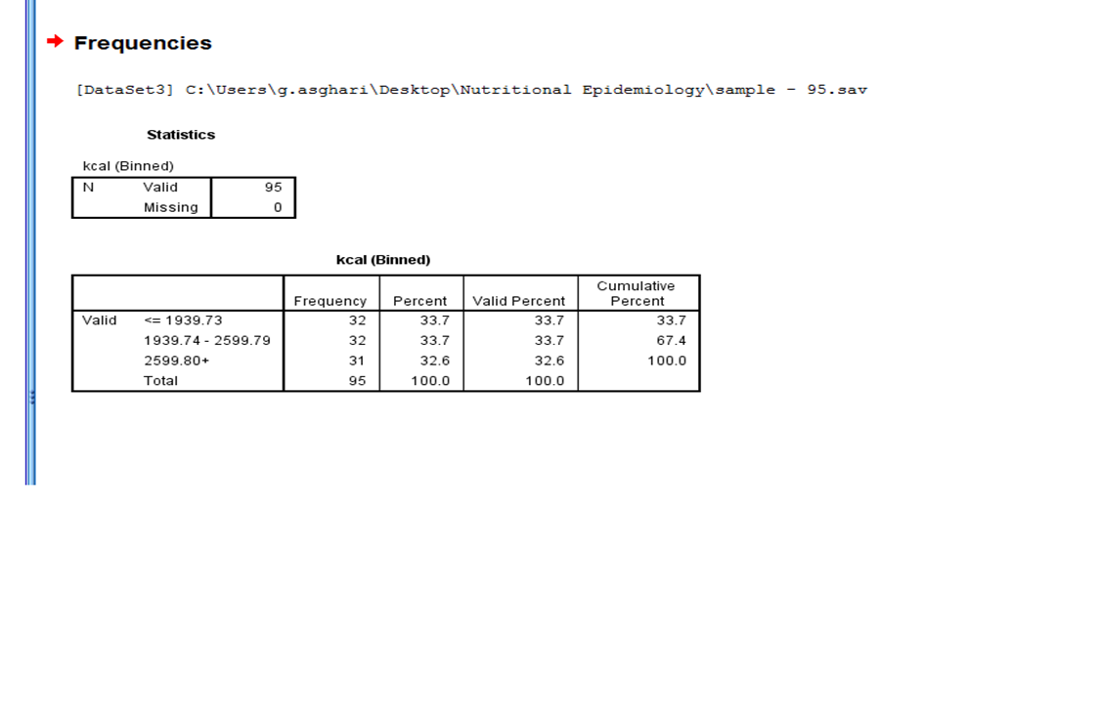
Two approaches to define median, tertile, ….. In SPSS

Slide 25
Points to be considered:
One of the main aims of epidemiological studies in nutrition is comparison between 2 different groups and classification.
This approach is better for interpreting data, as it is based on our study population not references (e.g. USDA).
Ex: we can compare the first 1/3 of calorie intake with the last 2/3 one.
Moreover, most of dietary characteristics have no cut off point.
It is important to consider the study sample size or the number of cases for classification (tertile or quartile….).

Slide 26
Descriptive statistics (cont.)
Once the data have been checked and edited, the first step of analysis is to simply
look at the data using descriptive statistics
become familiar with the data
and create a description of the study population
For the quantitative variables, this might be frequency histograms.

Slide 27
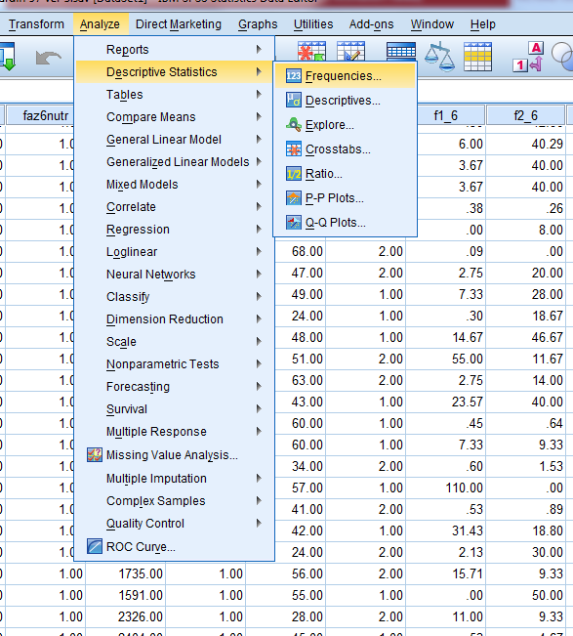

Slide 28
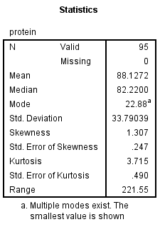
Descriptive statistics (cont.)

Slide 29
Descriptive statistics (cont.)
Where is mean? 88.1
Where is median? 82.2
Where is SD? 33.8
Mean and median should be near each other
SD should not be near mean
SD should be in from ¼ to ⅙ of range

Slide 30
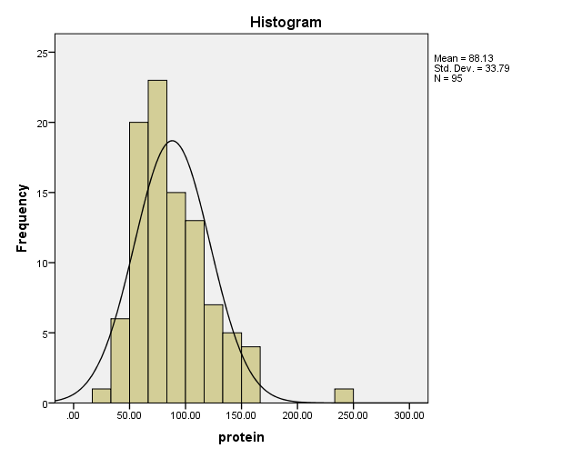
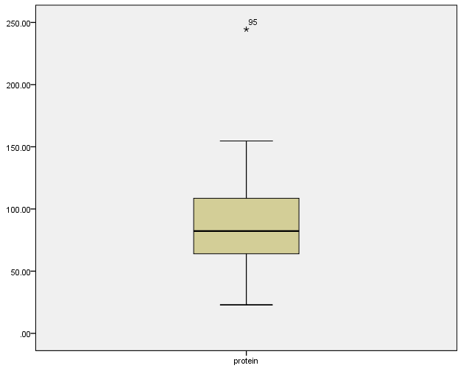
Descriptive statistics (cont.)
Skewness and Kurthosis
Outlier detection
Boxplots
Median
25 percentile, 75 percentile
75 percentile + 1.5 IQR
25 percentile – 1.5 IQR

Slide 31
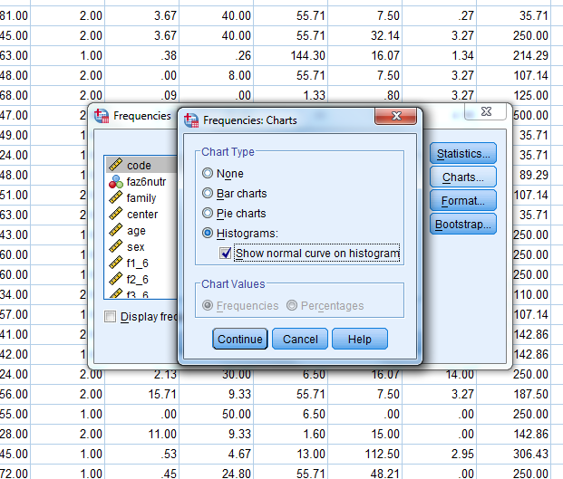

Slide 32
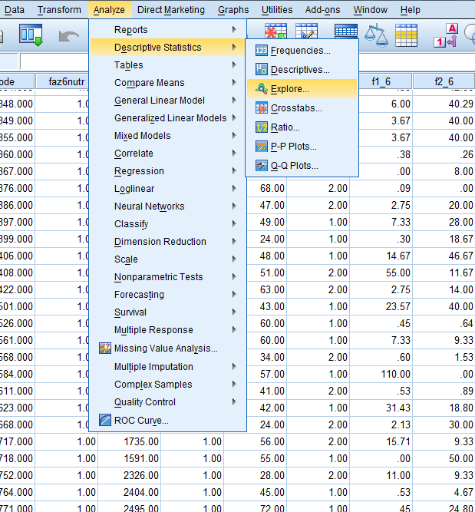

Slide 33
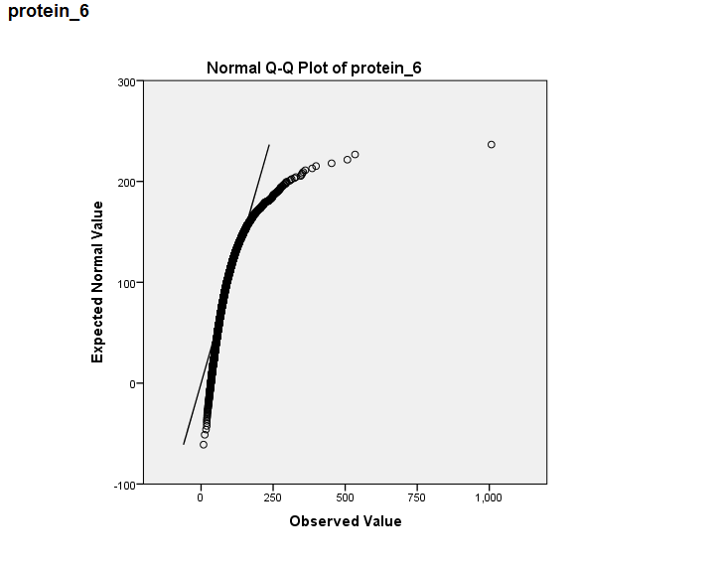

Slide 34
Descriptive statistics (cont.)
Statistical tests to check normality:
Shapiro–Wilk
Klomogorov-Smirnov

Slide 35
Descriptive statistics (cont.)
Comparison intake of zinc between obese and non-obese participants

Slide 36
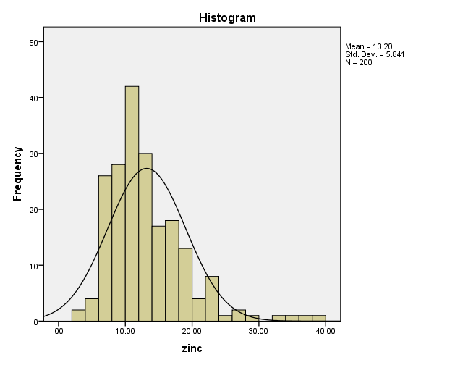
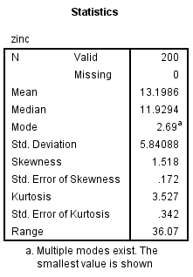
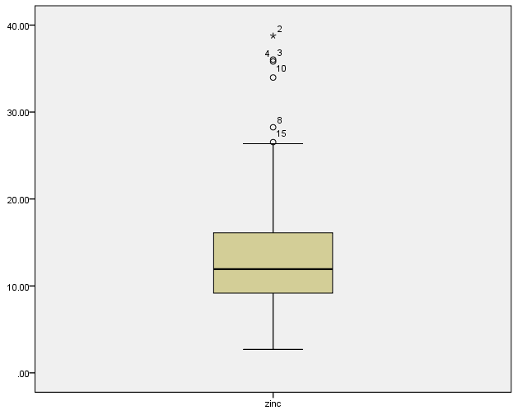

Slide 37
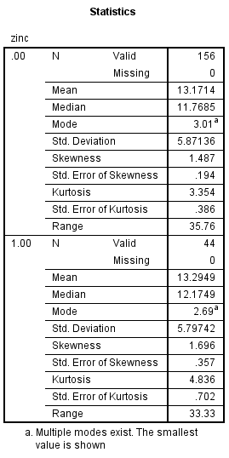
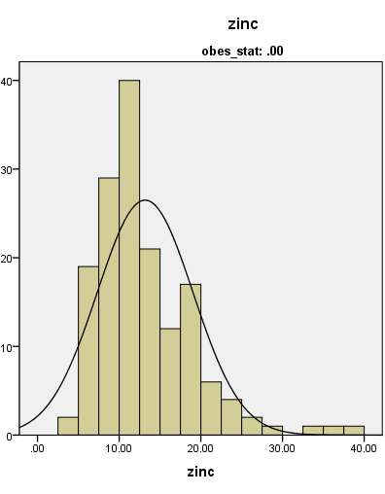
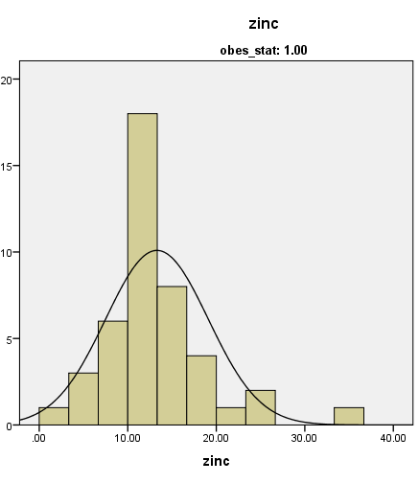

Slide 38
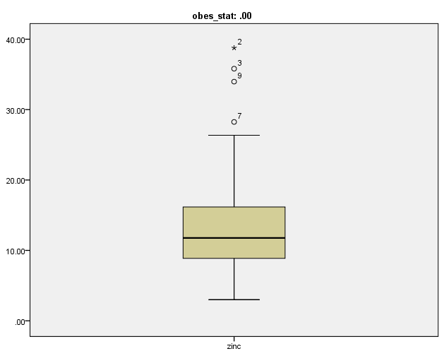
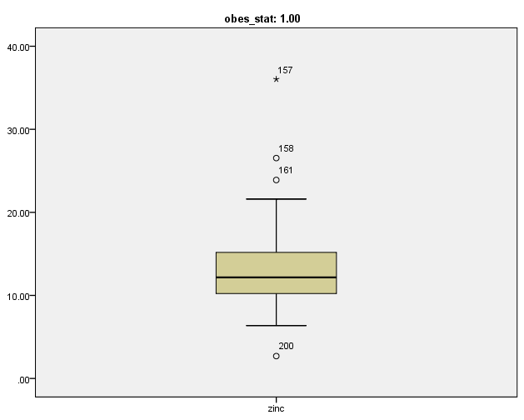

Slide 40
Is it necessary to test normality for dietary variables?

Slide 41
Normality assessment
What is the role of dietary variables in your study?
Descriptive or inferential statistics?
Exposure or outcome?

Slide 42
Descriptive statistics (cont.)
Presentation of results with and without outliers
Is one of the best approach for analyzing the dietary data

Slide 43
Descriptive statistics (cont.)
Transformation
For a researcher to proceed with parametric statistical inference, it is necessary to transform the data by applying a function such as the logarithm or a cubed root.
There are systematic principles that describe how transformations perform and can speed the process of applying an appropriate transformation.
For example, right-skewed data can usually be transformed to a more normal distribution with the use of the natural logarithm
CAROL J. et al; American Dietetic Association; 2008

Slide 44
Descriptive statistics (cont.)
If the data are not normally distributed and cannot be successfully transformed then parametric tests cannot be used.
Nonparametric tests must be used, such as the the Mann-Whitney test or the Kruskal-Wallis test that use proportions or rankings as the measures for comparison.
CAROL J. et al; American Dietetic Association; 2008

Slide 45
با سپاس از توجه شما

