Slide 1
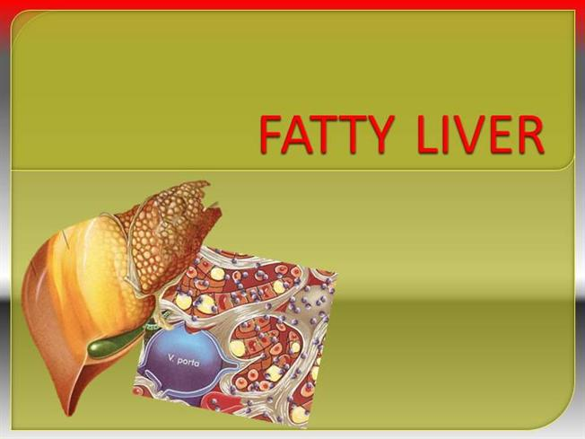
BARIATRIC SURGERY AND
Maryam Barzin, MD
Obesity Research Center
Research Institute for Endocrine sciences
Shahid Beheshti University of Medical Sciences
2016 July 21

Slide 2
Agenda
Introduction
BS indication
BS procedures
BS effectiveness
BS mechanism
Conclusions

Slide 3
Introduction
Definition:
Non-alcoholic fatty liver disease (NAFLD), defined by non-alcohol related excessive fat accumulation in the liver
Obesity is a major risk factor for NAFLD and NASH
Prevalence of NASH is high in morbidly obese (BMI≥ 40)
Only 5% of patients attending for BS had a normal liver histology, and that 25% had NASH
Dixon JB. Clin Liver Dis 2014;18:129–146.

Slide 4
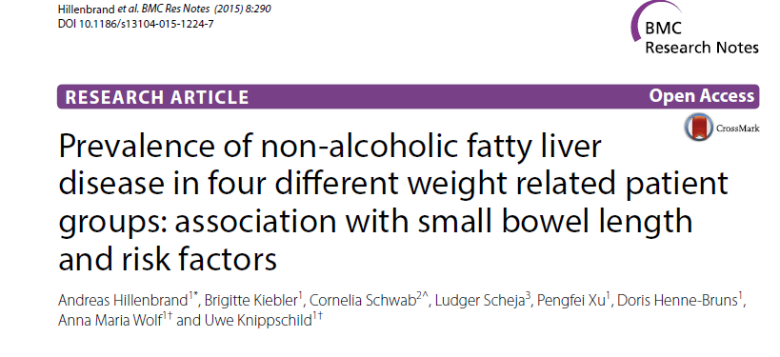
Introduction

Slide 5
Introduction
Liver samples were obtained from 136 patients (69 males; 67 females) between 2003 and 2007 in University Hospital Ulm; Germany
Liver samples were taken from the left liver lobe, and shock frozen in liquid nitrogen or fixed in formalin.
For evaluation, patients were divided into four groups according to their BMI:
            Group 1: Normal weight (BMI:18.5–24.9)
            Group 2: Overweigh (BMI:25.0–29.9)
            Group 3: Grade I/II obese (BMI:30.0–39.9)
            Group 4: Morbidly obese (BMI ≥ 40)

Slide 6
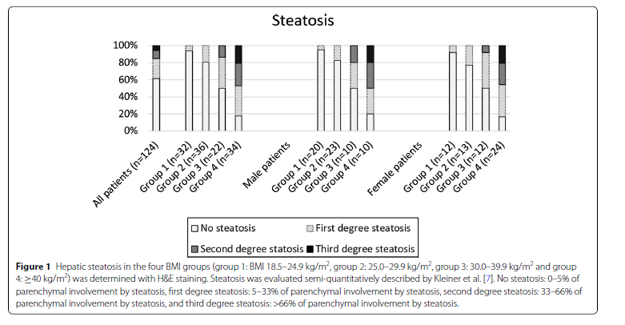


Introduction

Slide 7
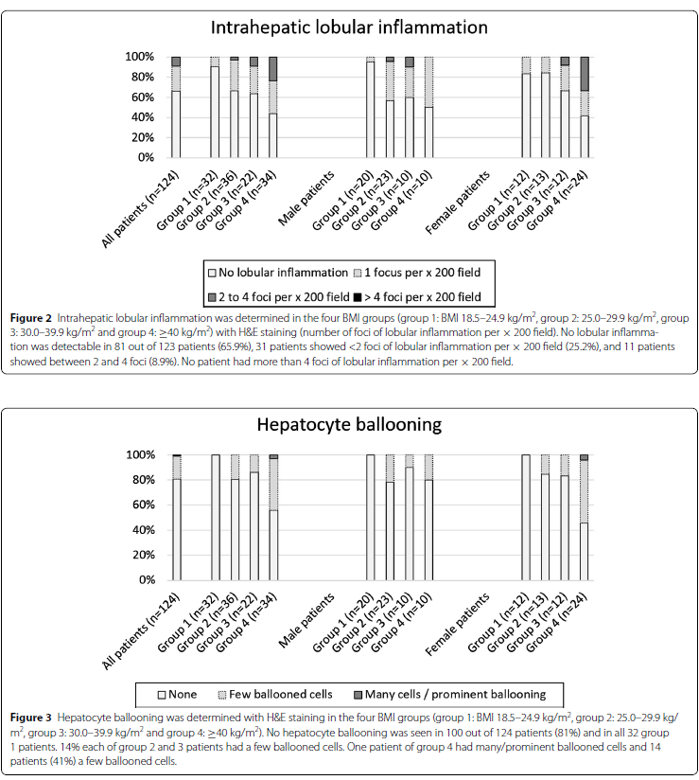
Introduction

Slide 8
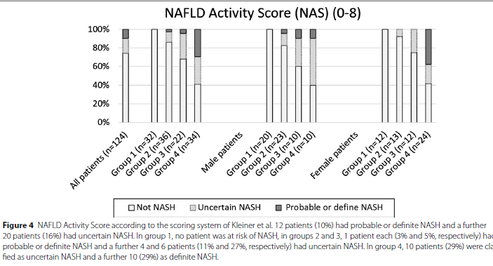
Introduction

Slide 9
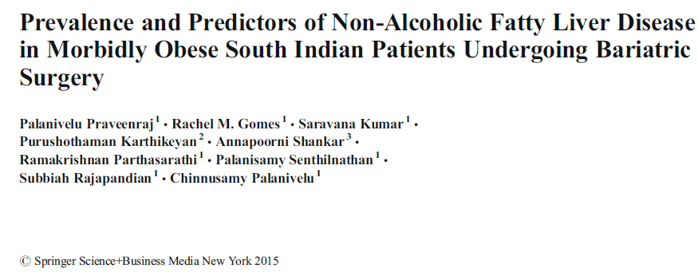
Introduction
134 morbidly obese patients who underwent bariatric surgery with liver biopsy:
88 (65.7%) NAFLD
45 (33.6%) NASH
42 (31.3%) Fibrosis
19 (14.1 %) Advanced fibrosis.
Higher ALT independently predicted NAFLD and was significantly associated
with NASH and fibrosis
T2DM & MetS were significantly associated with fibrosis
Systemic HTN independently predicted NASH and fibrosis.
Conclusions: NAFLD has a high prevalence among morbidly obese.
Elevated ALT, HTN, T2DM, and the MetS are predictors for NAFLD

Slide 10
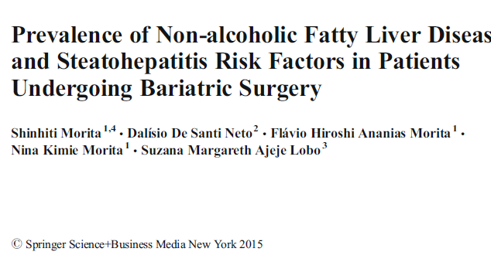
Introduction
184 morbidly obese patients undergoing bariatric surgery:
The prevalence of NAFLD was 84 %:
  22.0 % steatosis
  30.8 % mild steatohepatitis
  32.0 % mod-severe steatohepatitis
Independent predictive factors for
steatohepatitis were:
  Age OR, 1.05; p=0.011
  WC OR, 1.03; p=0.021
  ALT OR, 1.04; p=0.005
  TG OR, 1.01; p=0.042
Conclusions: Age, WC, ALT, and TG are efficient and non-invasive predictive markers for the diagnosis and management of steatohepatitis in morbidly obese patients.

Slide 11
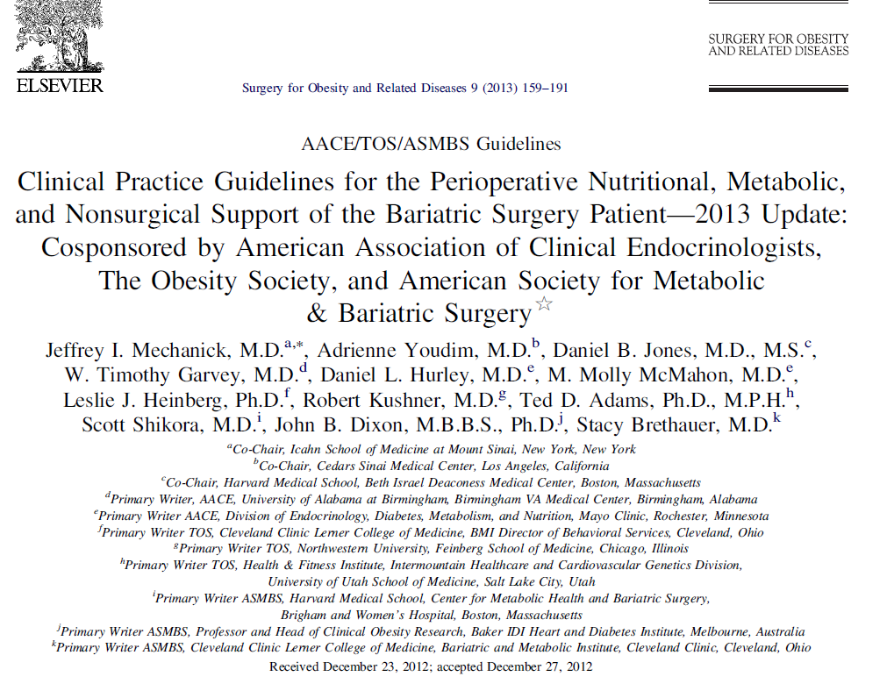
Indication
Patients with a BMI ≥ 40 without coexisting medical problems and for whom bariatric surgery would not be associated with excessive risk should be eligible for 1of the procedures (Grade A;BEL1).
Patients with a BMI ≥ 35 and 1 or more severe obesity-related co-morbidities(Grade A;BEL1), including:
        T2D
        HTN
        Hyperlipidemia
        OSA, OHS
        NAFLD, NASH
        Patients with BMI of 30–34.9 with T2D or MetS may also be offered although current evidence is limited (Grade C, BEL 3)

Slide 12
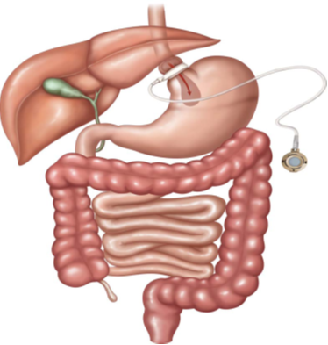
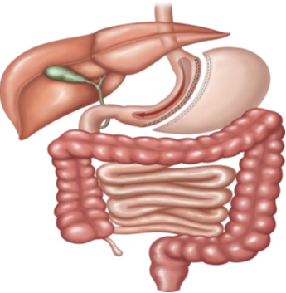
BS Procedures
هر یک از این روش‏ها فواید و مضرات خود را دارد.
انتخاب بهترین روش برای هر بیمار: پزشک و بیمار فواید و خطرات هر روش را در کنار سایر عوامل دیگر مانند BMI، رفتارهای غذایی، وضعیت سلامتی مرتبط با چاقی، و جراحی‏های قبلی در نظر می‏گیرند تا بهترین روش با کمترین خطر انتخاب شود.
Adjustable gastric band (AGB)
باعث کاهش مصرف غذا
با قرار دادن باند کوچک شبیه دستبند در بالای معده، کیسه ی کوچکی به اندازه انگشت شست ایجاد می شود که باعث محدود شدن مصرف غذا می شود
کنترل اندازه خروجی توسط یک بادکنک مدور در داخل باند بوسیله هوا یا نرمال سالین
Roux-en-Y gastric bypass (RYGB)
شایعترین روش در سراسر دنیا
محدود کردن مصرف غذا و کاهش جذب مواد غذایی
ایجاد یک کیسه کوچک با گنجایش 15 تا 30 میلی لیتر + کاهش جذب مواد غذایی در دستگاه گوارش به دلیل حذف قسمت زیادی از معده و دئودنوم
کاهش ترشح هرمون گریلین به دلیل برداشتن قسمت زیادی از معده (باعث کاهش حس گرسنگی بیش از سایر روش های جراحی محدود کننده مصرف غذا)
از نظر تکنیکی، آناستوموزکیسه کوچک جدا شده از قسمت فوقانی معده به ژژنوم از قسمت 75-30 cm از قسمت دیستال لیگامان تریتز (به این قسمت دیستال Roux-limbگفته می شود) حذف قسمت صفراوی و حفظ قسمت معده، گاستروژژنوستومی این قسمت معده در فاصله 150-75 cmدیستال
(BPD-DS)Biliopancreatic diversion with a duodenal switch
مناسب برای کسانی که چاقی بیش از حد (obese extremely)
برداشتن قسمت عمده معده (400 میلی لیتر از آن باقی مانده)
تکنیک: 250 cm از پروکسیمال روده کوچک جدا شده و به کیسه معده وصل شده و یک Roux-en-Y gastroenterostomy ایجاد می شود. آناستوموز دیگری بینbiliopancreatic و 50 cm پروکسیمال دریچهileocaecal ایجاد می شود
Vertical sleeve gastrectomy (VSG)
برداشتن عمودی معده،
باقی ماندن حجمی معادل 200 میلی لیتر از معده (یک لوله پر فشار)

Slide 13
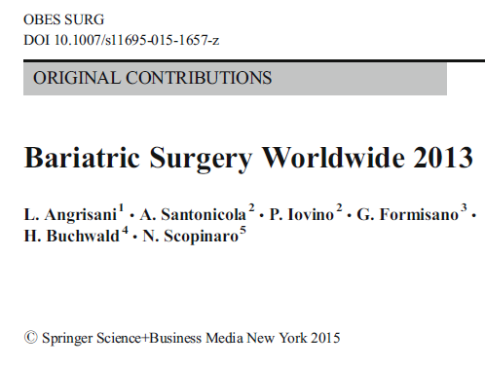
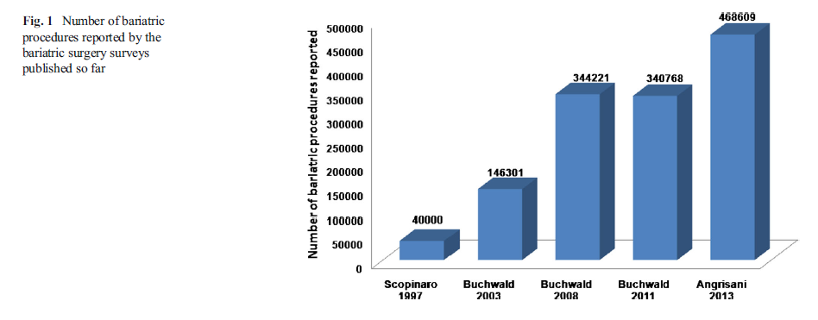
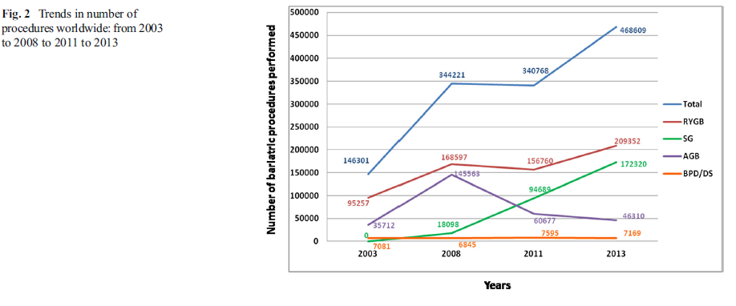
Worldwide Trend

Slide 14
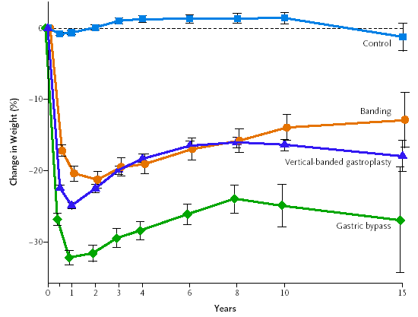
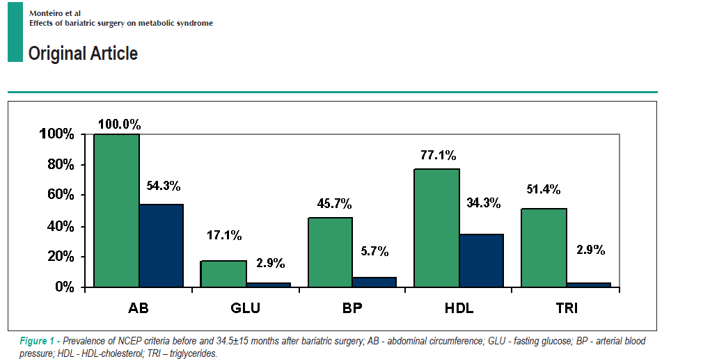

Slide 15
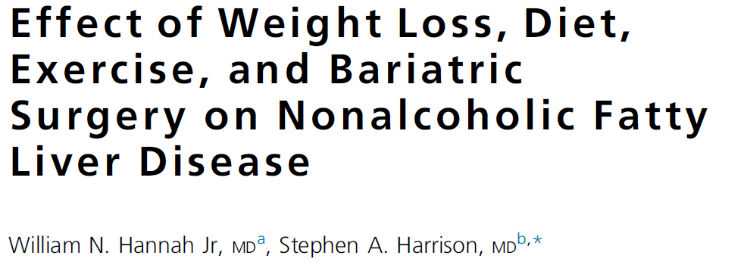
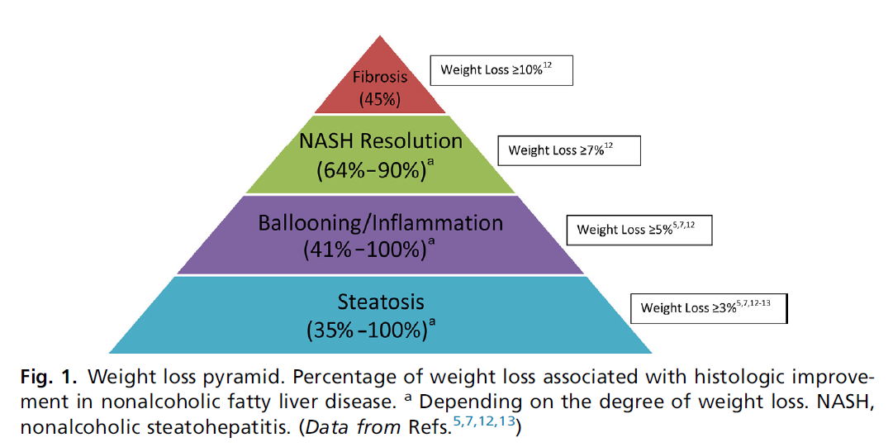

Slide 16
BS effectiveness
BS Improves Histological Features of NAFLD & Liver Fibrosis
Andrew A. et al.
  Methods: A blinded pathologist reviewed all liver biopsies done during the index bariatric procedure and any liver biopsies done during subsequent abdominal operations from 1998-2013.
  Results: Paired biopsies for 152 patients (82% women)
  Mean interval between biopsies was 29±22 months
  Mean age: 46±11 years; mean pre-op BMI: 52±10 kg/m2; mean excess body weight loss: 62±22% at the time of the subsequent biopsy
The findings on the initial biopsy | On the post-op biopsy:
78% Steatosis | resolved in 70% (82/118)
42% Lobular inflammation | resolved in 74% (46/62)
68% Chronic portal inflammation | resolved in 32% (32/99)
33% Steatohepatitis | resolved in 88% (44/50).
41% Fibrosis (Grade 2-3) | resolved in 21% & improved in 23%

Slide 17
Grade 2 fibrosis: was present in 52 patients pre-op
  16 (31%) resolved
  16 (31%) improved,
  15 (29%) did not worsen post-op.
Grade 3 fibrosis: of the 10 patients with bridging:
  one resolved
  seven improved
Cirrhosis: improved in 1 of 3 patients
Conclusion BS improves liver histology in severely obese patients and is associated with resolution of steatosis or steatohepatitis in the majority of patients.
Grade 2 or 3 (bridging) fibrosis is resolved or improved in 65% of patients.
BS should be considered as the treatment of choice of NAFLD in severely obese patients.

Slide 18
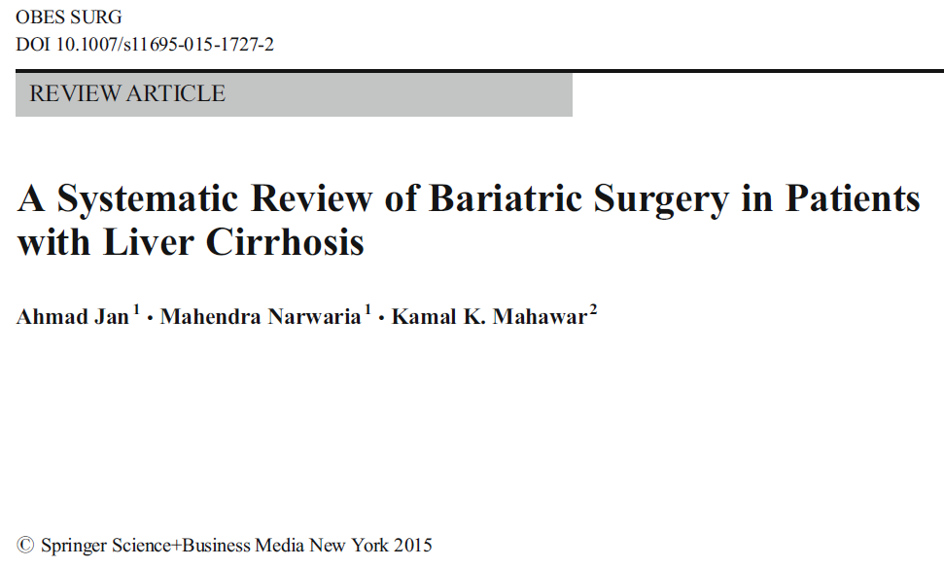
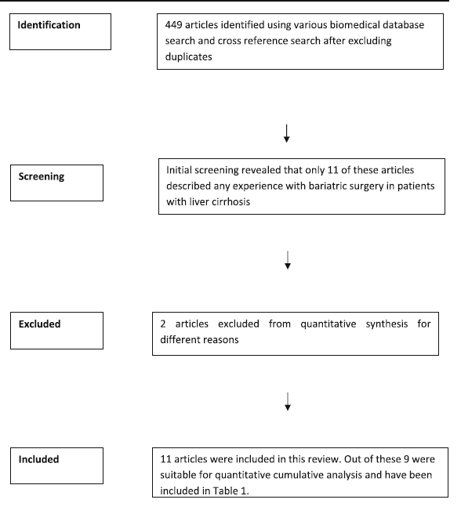
BS in patients with cirrhosis is associated with higher than usual risk of complications & mortality
SG and AGB are the safest BS options for patients with pre-diagnosed or incidentally detected cirrhosis
RYGB is also appropriate and probably best for patients unsuitable for SG/AGB.
BPD carries highest risk of mortality
Evidence is insufficient to make any clear recommendation
Surgeons should be aware that they would encounter incidental cirrhosis in some of their patients
Preparing an advanced plan of action for such an eventuality will empower patients and protect surgeons

Slide 19
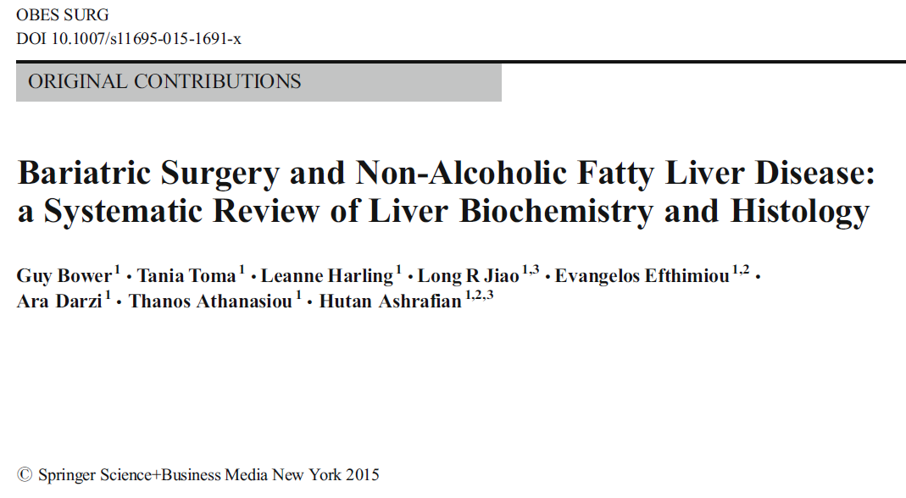
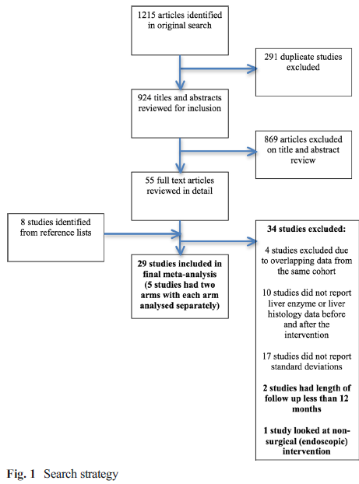
29 studies suitable for the final meta-analysis, out of 1215 articles identified in the original search

Slide 20
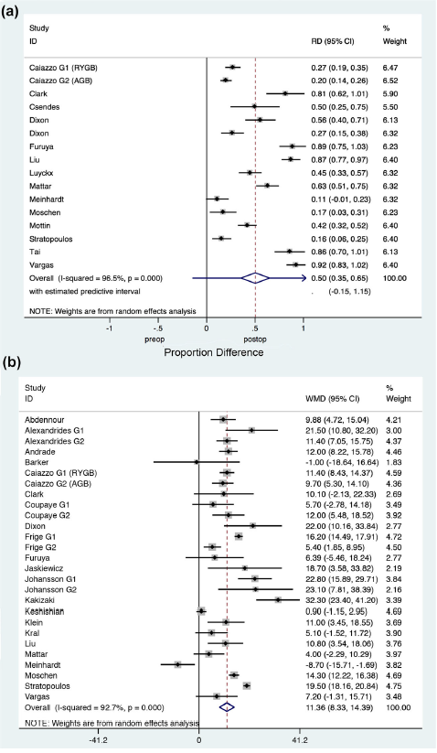
Liver histology for steatosis
Steatosis:
16 studies reported on the presence of steatosis before and after surgery. Pooled analysis of histological findings demonstrated the weighted mean decrease in the incidence of steatosis :
50.2% (95%CI 35.5–65.0, p=<0.0001, I2 96.5%)
Steatohepatitis:
3 studies reported on rates of steatohepatitis before and after surgery. Pooled analysis of histological findings demonstrated the weighted mean decrease
in the incidence of steatohepatitis: 3.8% (95%CI −13.4–21.0, p=0.66, I2 90.6%)
Portal Inflammation:
4 studies reported on rates of portal inflammation before and after surgery. Pooled analysis of
histological findings demonstrated the weighted mean decrease in the incidence of portal inflammation: 13.1% (95%CI −1.7–27.9, p=0.082, I2 72.7%).
Alanine aminotransferase (ALT)

Slide 21
Lobular Inflammation:
  7 studies reported on rates of lobular inflammation before and after surgery. Pooled analysisof histological findings demonstrated the weighted mean decrease in the incidence of lobular inflammation: 50.7% (95%CI 26.6–74.8, p=<0.0001, I2 94.4%)
Hepatocyte Ballooning:
  8 studies reported on rates of hepatocyte ballooning before and after surgery. Pooled analysis of histological findings demonstrated the weighted mean decrease in the incidence of hepatocyte ballooning: 67.7% (95 %CI 56.9–78.5, p=<0.0001, I2 66.6%)
Fibrosis:
  12 studies reported on rates of fibrosis before and after surgery. Pooled analysis of histological findings demonstrated the weighted mean decrease in the incidence of fibrosis: 11.9 % (95 %CI 7.4–16.3, p=<0.0001, I2 88.9 %)

Slide 22
Liver Biochemistry
Decrease in all four liver enzymes after BS:
  ALT: 26 studies reported ALT levels before and after
  surgery (Fig. 2b). Weighted mean reduction of 11.63 u/l (95 %CI 8.34–14.39,p=0.0001, I2 92.7 %)
  AST: 25 studies reported AST levels before and after
  surgery. Weighted mean reduction of 3.91 u/l (95 %CI 2.23–5.59, p=0.0001, I2 90.5 %)
  ALP: 11 studies reported ALP levels before and after surgery.
  Weighted mean reduction of 10.55 u/l (95 %CI 4.40–16.70, p=0.0001, I2 92.0 %)
  Gamma-GT: 17 studies reported gamma-GT levels
  before and after surgery. Weighted mean reduction of 18.39 u/l (95 %CI 12.62–24.16, p=0.0001, I2 94.8 %)

Slide 23
Conclusions:
BS is associated with a significant improvement in both histological and biochemical markers of NAFLD
Significant heterogeneity between studies limits our interpretation of the results
Reduction in ALT, AST and gamma-GT is consistent with the reduction in chronic inflammation seen following surgery and improvements in histological features associated with liver specific inflammation (e.g. hepatocyte ballooning)
Improvements in steatosis, steatohepatitic features and fibrosis are also consistent with current mechanistic evidence for the metabolic changes stimulated by bariatric procedures
Further studies, particularly RCTs with mechanistic studies, are justified to clarify the role of surgery in obesity and NAFLD and may help elucidate advances to current interventions and novel diagnostic tools to minimise the growing clinical burden of mortality and morbidity associated with obesity-associated liver disease.

Slide 24
Mechanism
Current treatment of NAFLD is based on weight reduction
Bariatric surgery is the most effective treatment for morbid obesity and its associated metabolic comorbidities.
There is evidence indicating that bariatric surgery improves histological and biochemical parameters of NAFLD
BS currently is not considered a treatment option for NAFLD

Slide 25
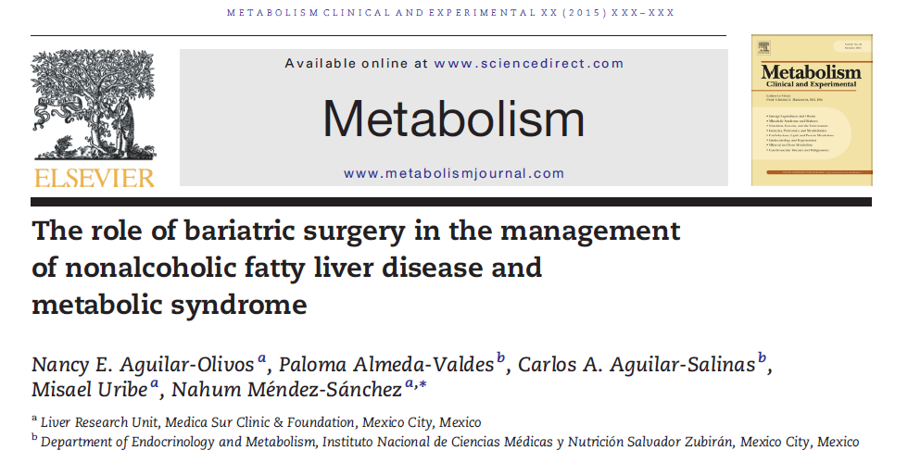
Mechanism
Effects on Weight:
  Weight loss is the most important intervention for NAFLD.
  BS induces weight loss, between 1 & 2 years after surgery.
2. Effects on Glucose Metabolism:
  The pathophysiology of IR & steatosis is closely related.
  IR and Glu metabolism improve after BS.
  The most effective procedure for resolution of DM:
    BPD-DS: 98.9%
    RYGB: 83.7%
    SG: 71.6%
    GB: 47.9%

Slide 26
Mechanism
3. Effects on Hypertension:
BS has also been shown to improve HTN
4. Effects on Plasma Lipids:
  The pathogeneses of dyslipidemia and NASH are closely interrelated.
  An overproduction of lipids and VLDL particles is a shared abnormality for these
  two conditions
  Plasma lipid concentrations are associated with the magnitude of steatosis and
  fibrosis in NASH
  All lipid concentrations were modified positively after surgery
  The most common underlying abnormality in both dyslipidemia and NASH is
  decreased insulin action in peripheral tissues.
  These abnormalities are corrected by the negative caloric balance caused by
  BS

Slide 27
Mechanism
Effects on Inflammatory Status:
  A significant reduction in inflammatory after BS:
    Alpha1-acid glycoprotein
    MCP-1
    TNF-alpha
    CRP
  and oxidative stress markers:
    malondialdehyde
    superoxide dismutase
    catalase,
    glutathione

Slide 28
Mechanism
6. Effects of Bariatric Surgery on NAFLD:
  The mechanisms through which BS improves NAFLD:
    Incomplete nutrient digestion and absorption
    Changes in gut hormones
    Gastrointestinal motility
    Gut microbiota
    Bile acids
    Decrease in ALT & AST
Effects on Nonalcoholic Steatosis:
  Important histological improvements in hepatic steatosis
  Studies reported that >75% of patients had no evidence of steatosis after weight loss.
  NAFLD activity score (NAS) decreased

Slide 29
Mechanism
Effects on Nonalcoholic Steatohepatitis:
  In this review, 14 studies that had evaluated the effects of BS on NASH or NAS components:
  Important improvements in ballooning, lobular inflammation, or the NAS
  The prospective study with the longest follow-up (5 years) reported changes:
      NAS from 1.97 to 1,
      ballooning from 0.2 to 0.1,
      % NASH from 27.4% to 14.2%
      Inflammation to be unchanged
  In a prospective study showed that BS induces the disappearance of NASH in around 85% of cases and significant reductions in ballooning & lobular inflammation

Slide 30
Mechanism
9. Effects on Liver Fibrosis:
  In patients with NAFLD, regression of fibrosis is possible when at least 10% of body weight is lost
  A meta-analysis included 12 studies that evaluated fibrosis before and after BS (including those studies showing no effect and worsening of fibrosis):
  The pooled analysis demonstrated a weighted mean decrease in the incidence of fibrosis of 11.9% (95 % CI 7.4–16.3, P ≤ 0.0001, I2 = 88.9%)
Effects on Hepatocellular Carcinoma:
  Obesity is a life-long risk factor for development of HCC; early-onset obesity
  The role of BS in the prevention of HCC = ?
Bower G et al. Obes Surg 2015 Apr 29

Slide 31
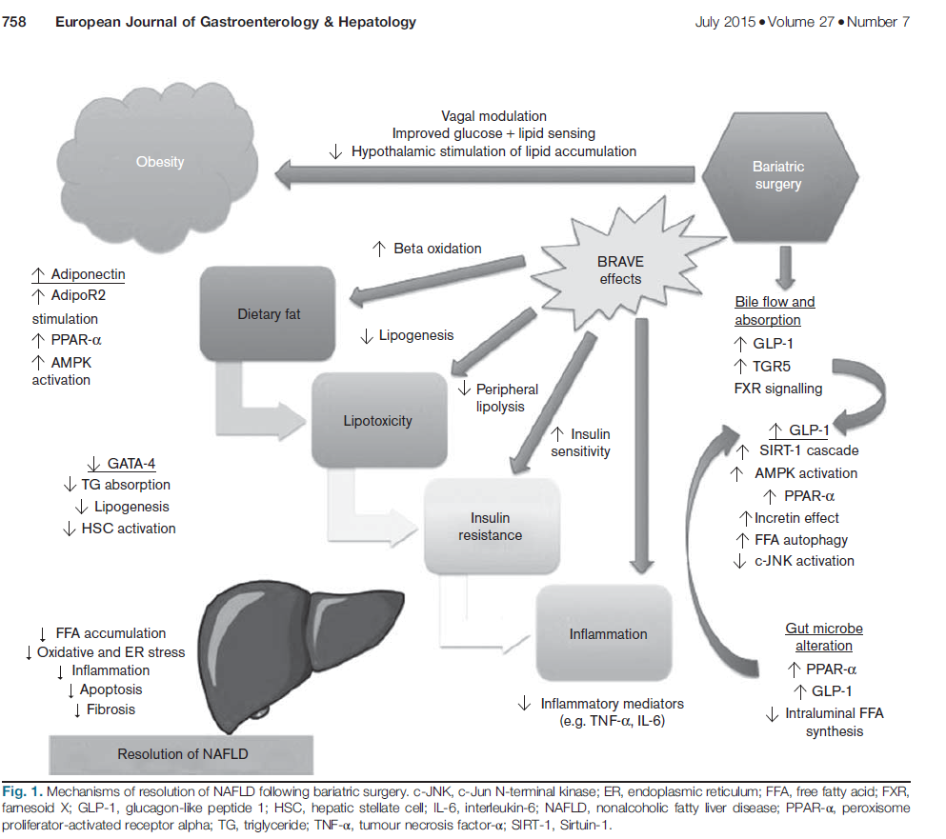
Mechanism

Slide 32
Take home message
Bariatric surgery is the most effective treatment for morbid obesity and its associated metabolic comorbidities for long term
Between patients ongoing bariatric surgery, the prevalence of simple steatosis greater than 95%, NASH about 20%–30%, and fibrosis between
10-14%
Between patients with severe obesity, components of the MetS are strong risk factors for NAFLD
BS has beneficial effects not only in weight loss, but also in MetS. In addition, a favorable change in the factors associated with the development of NAFLD such as IR, lipid profile, inflammation, adipokines and histological changes is observed after BS

Slide 33
Take home message
The recommendation of BS as an NAFLD treatment cannot be firmly stablished.
However, patients with indications for BS, with a BMI >40 kg/m2 and with BMI >35 kg/m2 and associated comorbidities, benefit from surgery improving the alterations of MetS including NAFLD, and reducing the cardiovascular and general mortality.
There are studies reporting the beneficial effects of BS in individuals with a lower BMI in the presence of associated comorbidities, specifically type 2 diabetes. Therefore, the indications for BS and endoscopic procedures for weight reduction may expand.

Slide 34

Thanks for your attention

