Slide 1
How stress affects diabetes control
Anita Eftekharzadeh, M.D.
Endocrinologist
August 2017, Tehran

Slide 2
Agenda and Scope
Defining the problem
Stress and development of diabetes
Stress and diabetes control
Behavior
Physiological mechanisms behind stressful experiences
Psychosocial aspects of diabetes
Psychosocial care; Recommendations
Case discussion

Slide 3
Clinical vignette
51 y/o woman, known case of DM for 5 years was first visited in Nov, 2015; and were followed for nearly 2 years
When asked, admitted occasional hypoglycemia, but never brought SMBG

Slide 4
 | Nov 2015 | Feb 2016 | May 2016 | No Show up for 15 months | Aug 2017
Weight | 88 Kg | 90 | 89 |  | 90
FBS | 326 | 443 | 161 |  | 246
2hPP | - | - | 424 |  | 405
Hb A1C | 11.4 | 12.2 | 10.3 |  | 11.7
Medications | Met, Premixed Insulin, Acarbose | Hospital admission, Insulin increased Cardiologic W/U | Diet, Advice about postprandials, Insulin, Met, Sitagliptin, Acarbose |  | ?

Slide 5
First things first
What do we mean by the term stress?
A physiological response to an external stimulus, or
A psychological response to external stimuli, or
Stressful events themselves, which can be negative or positive or both.

Slide 6
Defining the problem
Complex environmental, social, behavioral, and emotional factors, known as psychosocial factors, influence living with diabetes, both type 1 and type 2, and achieving satisfactory medical outcomes and psychological well-being.
Thus, individuals with diabetes and their families are challenged with complex, multifaceted issues when integrating diabetes care into daily life.

Slide 7
Defining the problem
Despite new medical treatments and therapeutic options, most people with diabetes still do not achieve target blood glucose levels
The lack of improved treatment outcomes may reﬂect suboptimal organization of chronic illness care and a deﬁciency of self-management and psychosocial support

Slide 8
What do cross-sectional studies show?
Cross-sectional studies have shown that people with T2D, compared with those who do not have T2D, have poorer general mental health, are more likely to be depressed, to be alcohol dependent, and to have post-traumatic stress disorder (PTSD).
Type 2 diabetics report more chronic stressors, greater work distress, and exposure to a greater number of stressful life events. There is a socioeconomic gradient in T2D such that the lower the SES, the greater the prevalence of T2D. Above and beyond the SES effect, disadvantaged minority populations are generally at greater risk of developing T2D.

Slide 9
Stress and Development of Diabetes
The immediate physiologic stress response is not thought to be the problem affecting health; rather, chronic activation of the PSR is thought to be the key.
A recent review has explored the association between T2D and psychosocial factors focusing on prospective studies of the risk for developing diabetes/T2D.
Even after controlling for conventional risk factors, an increased risk for T2D is seen in people: exposed to stressful working conditions or traumatic life events; with depression; with personality traits or mental health problems that put them in conflict with others (such as those with type A personality or schizophrenia); of low SES, either currently or during childhood; and in minority populations, independent of current SES.
The amount of research available to support these hypotheses varies considerably, with most of the literature focusing on mental health conditions and SES, and only a minority of writings looking at aggressive behavior and stessor exposure.

Slide 10
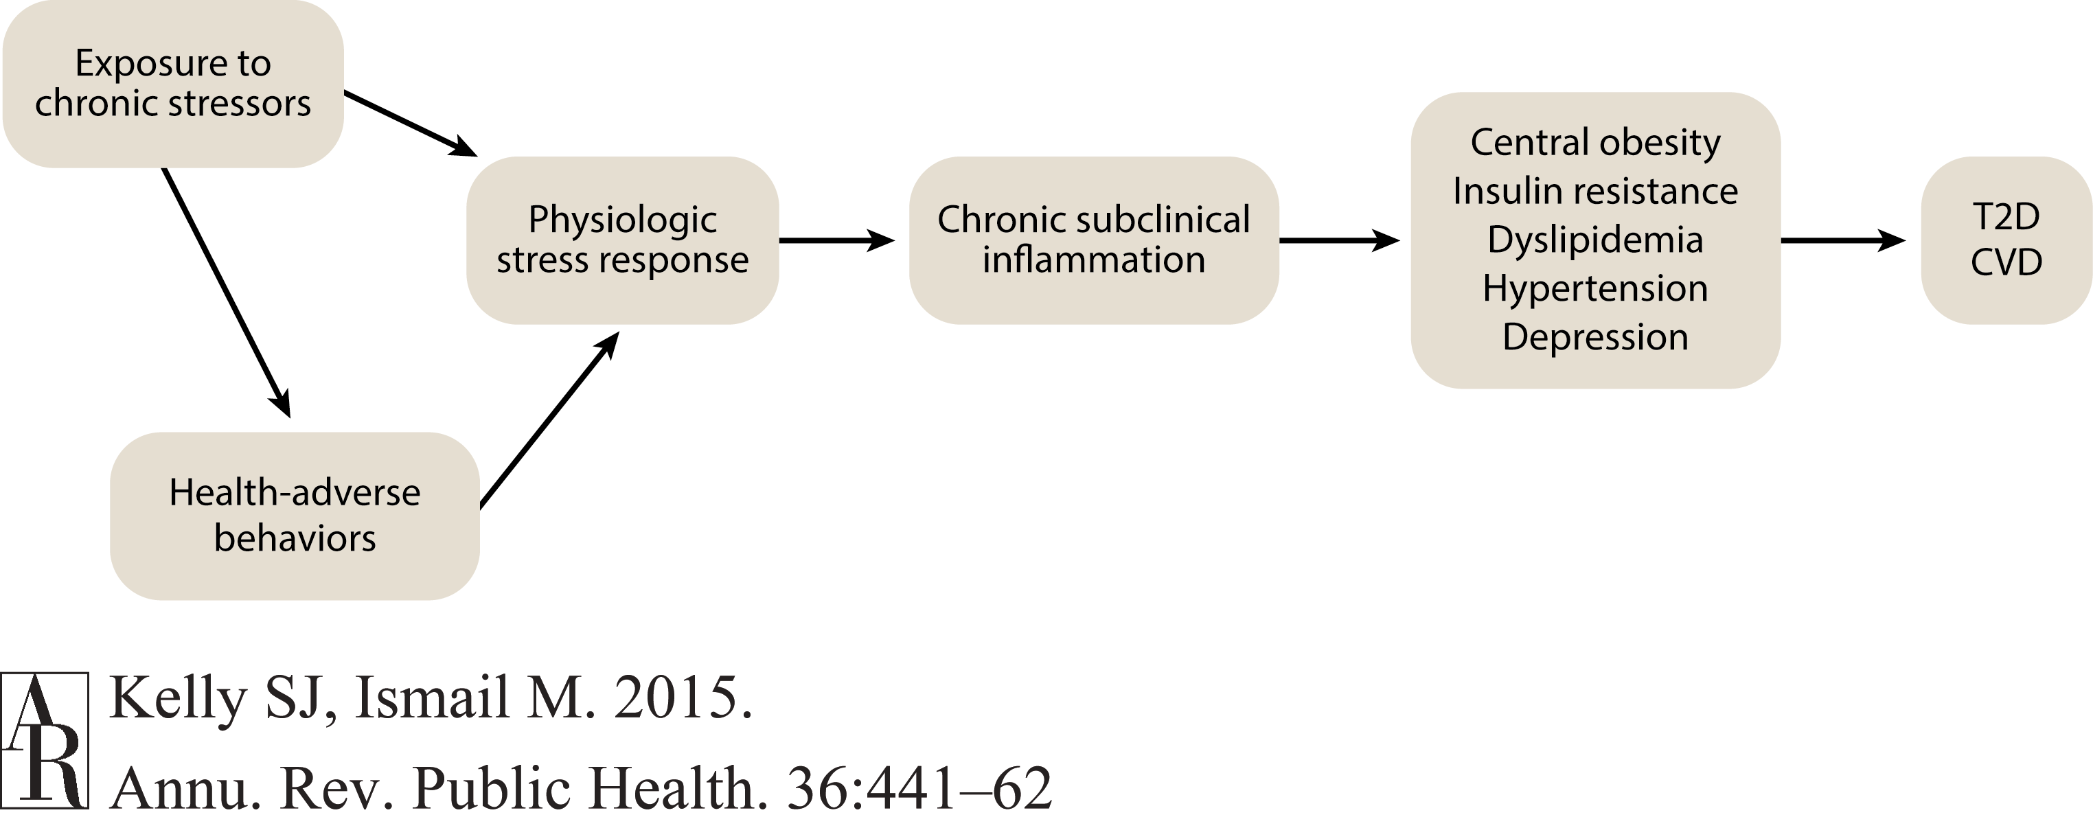

Slide 11
Diabetes Distress
Diabetes distress is very common and is distinct from a psychological disorder.
The constant behavioral demands (medication dosing, frequency, and titration; monitoring blood glucose, food intake and eating patterns, and physical activity) of diabetes self-management and the potential or actuality of disease progression are directly associated with reports of diabetes distress.
Its prevalence is reported to be 18–45% with an incidence of 38–48% over 18 months.
High levels of diabetes distress significantly impact medication-taking behaviors and are linked to higher A1C, lower self-efficacy, and poorer dietary and exercise behaviors.

Slide 12
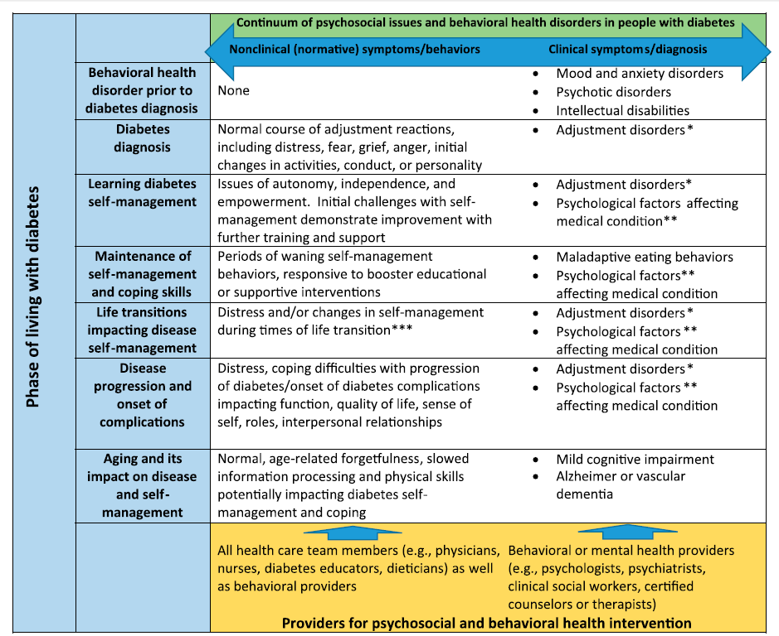
Diabetes Care 2016;39:2126–2140

Slide 14
Association between stress and glycemic control
Individuals with type 1 diabetes were interviewed using an indepth interview schedule and then followed up quarterly for a year with measures of diabetes control (hemoglobin A1c).
Unlike previous studies, the participants were asked about both negative and positive stressors in their lives.
The results showed that those whose glycemic control deteriorated over time were more likely to report negative stress, whereas those whose control improved over the follow-up period reported positive stress. Negative stressors included interpersonal conflicts, death of a close tie, and disturbed behavior of someone close, whereas positive stressors were events such as engagement to be married, birth of a child, or a desired change in employment

Slide 15
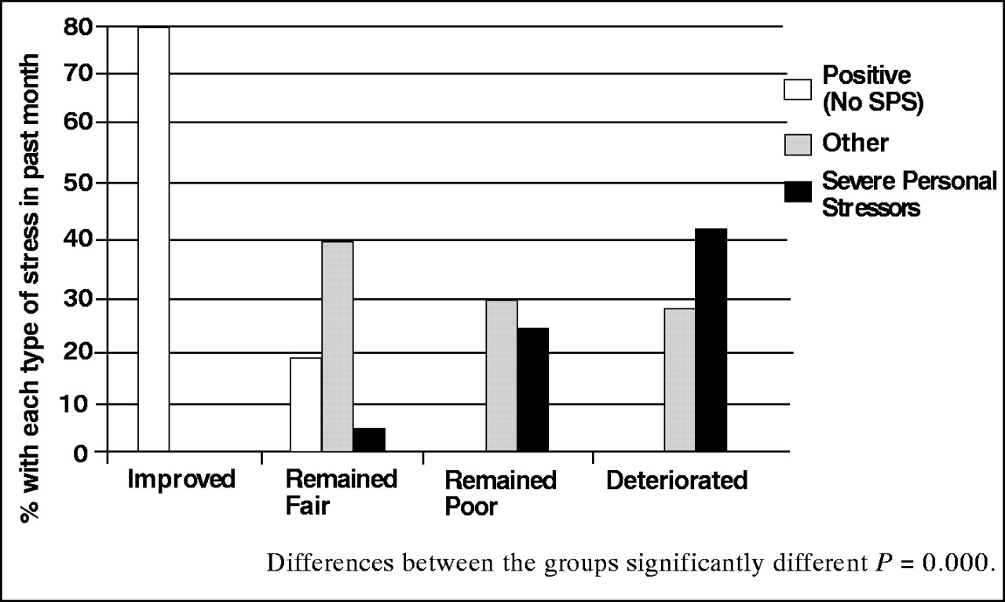
Relationship between stress and glycemic control.
Cathy Lloyd et al. Diabetes Spectr 2005;18:121-127
©2005 by American Diabetes Association
Notes:
Relationship between stress and glycemic control. From Ref. 21.

Slide 16
Behavior
The behavioral mechanisms through which stressful experiences might affect diabetes control are varied and often complex.
Reactions to external stressors, for example, feelings of anxiety or depression, may lead to difficulties with self-care manifested through less physical activity, poorer diet, or difficulties with medication taking.
Experiences of stress may lead to other unhealthy behaviors, such as smoking, which in turn are linked to poor blood glucose control but also to a greater risk of developing diabetes complications.

Slide 17
Physiological Mechanisms
The actions initiated by the central nervous system in response to a threat affect the entire body and are associated with three different bodily systems: the autonomic nervous system, the neuroendocrine system, and the immune system.
With regard to the effects of stress on the neuroendocrine system, the HPA axis is of considerable importance. Upon encountering a threat or a stressor, the hypothalamus secretes corticotropin-releasing factor, which causes the release of adrenocorticotropin. This in turn travels to the adrenal cortex, where it leads to the secretion of glucocorticoid hormones, in particular cortisol.

Slide 18
Physiological Mechanisms
Exposures to stress stimulate the HPA axis to release additional amounts of cortisol to maintain homeostasis and reduce the effects of stress.
Cortisol influences a wide range of processes, including the breakdown of carbohydrates, lipids, and proteins to provide the body with energy. It also has an effect on bone and cell growth and may modulate salt and water balance. Cortisol has an immunosuppressive effect and therefore plays a role in the regulation of immune and inflammatory processes.

Slide 20
The DAWN Survey
Interviews were conducted in 13 countries representing 11 regions: Australia, France, Germany, India, Japan, Netherlands, Poland, Scandinavia (Denmark, Norway, Sweden), Spain, UK and USA.
The global Diabetes, Attitudes, Wishes and Needs (DAWN) survey provided insights into the psychosocial challenges facing people with diabetes and showed that psychosocial problems can be barriers to achieving adequate glycemic control, that people with diabetes lack psychological support and that interdisciplinary care teams need to promote chronic illness care

Slide 22
The DAWN 2 study
Aimed to assess psychosocial outcomes in people with diabetes across countries for benchmarking. Participants were 8596 adults with diabetes across 17 countries.
Overall quality of life was rated ‘poor’ or ‘very poor’ by 12.2% of participants.
Diabetes had a negative impact on all aspects investigated, ranging from 20.5% on relationship with family/friends to 62.2% on physical health.
Approximately 40% of participants reported that their medication interfered with their ability to live a normal life. The availability of person-centred chronic illness care and support for active involvement was rated as low.
Following self-care advice for medication and diet was most common, and least common for glucose monitoring and foot examination, with marked country variation.
Only 48.8% of respondents had participated in diabetes educational programmes/activities to help manage their diabetes.

Slide 23
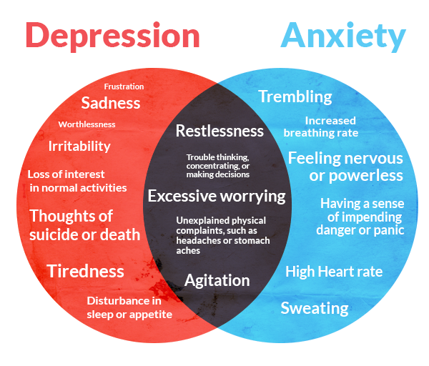

Slide 24
Psychological co-morbidities
Prevalence of clinically significant psychopathology in patients with diabetes (PWD) ranges across diagnostic categories, and some diagnoses are considerably more common in PWD than in those without the disease.
Depression and diabetes-related distress can occur together and can have serious implications for the management of diabetes.
Anxiety symptoms and diagnosable disorders (e.g., generalized anxiety disorder [GAD], body dysmorphic disorder, obsessive compulsive disorder [OCD], specific phobias, and posttraumatic stress disorder [PTSD]) are common in PWD;
The Behavioral Risk Factor Surveillance System estimated the lifetime prevalence of GAD to be 19.5% in people with either type 1 or type 2 diabetes.

Slide 25
Disordered Eating Behaviors
PWD with diagnosable eating disorders have high rates of comorbid psychiatric disorders .
People with type 1 diabetes and eating disorders have high rates of diabetes distress and FoH. For people with type 1 diabetes, insulin omission causing glycosuria in order to lose weight is the most commonly reported disordered eating behavior.
In people with type 2 diabetes, binge eating (excessive food intake with an accompanying sense of loss of control) is most commonly reported. Intentional insulin omission is also frequently reported. Binge eating disorder has been found to be more likely in PWD than in the nondiabetes population.

Slide 26
Role of psychosocial support
The impact of stressful experiences on diabetes is clearly varied and may depend on other psychosocial factors.
One of these is social support, and research has shown this may provide a buffering effect in times of stress. Psychological support is also important. In a recent meta-analysis of randomized controlled trials, Ismail et al. concluded that people with type 2 diabetes who received behavioral based diabetes education or psychological interventions were likely to show improvements in both glycemic control and psychological distress.

Slide 28
Psychological interventions to improve glycemic control in T2DM
25 trials were eligible for the review
In 12 trials, the mean percentage glycated haemoglobin was lower in people assigned a psychological intervention than in the control group (-0.32 [-0.57 to -0.07])
There were non-significant differences in blood glucose concentration (eight trials; –0·11 [–0·65 to 0·42]) and weight gain (nine trials; 0·37 [–0·18 to 0·93]).
Psychological distress was significantly lower in the intervention groups (five trials; –0·58 [–0·95 to –0·20]).
Lancet 2004; 363: 1589–97

Slide 31
Grade of Recommendations
A | At least one meta-analysis ,systematic review, or RCT rated as 1++ and directly applicable to the target population; or a body of evidence consisting principally of studies rated as 1+,directly applicable to the target population, and demonstrating overall consistency of results.
B | A body of evidence including studies rated as 2++, directly applicable to the target population and demonstrating overall consistency of results; or Extrapolated evidence from studies rated as 1++ or 1+.
C | A body of evidence including studies rated as 2+, directly applicable to the target population and demonstrating overall consistency of results; or Extrapolated evidence from studies rated as 2+.
D | Evidence level 3 or 4; or Extrapolated evidence from studies rated as 2=.

Slide 32
Psychosocial care for patients with diabetes A Position Statement of the ADA
Recommendations:
Psychosocial care should be integrated with collaborative, patient-centered medical care and provided to all people with diabetes, with the goals of optimizing health outcomes and health-related quality of life. A
Providers should consider an assessment of symptoms of diabetes distress, depression, anxiety, and disordered eating and of cognitive capacities using patient-appropriate standardized/validated tools at the initial visit, at periodic intervals, and when there is a change in disease, treatment, or life circumstance. Including caregivers and family members in this assessment is recommended. B

Slide 33
Selected measures in the clinical setting for psychosocial evaluation
Diabetes-related distress
Problem Areas in Diabetes (+ Peds, Teen and Parent version)
Diabetes Distress Scale
Depression
Patient Health Queastionnair (PHQ-9)
Beck Depression Inventory II
Child Depression Inventory (CDI-2)
Geriatric Depression Scale (GDS)

Slide 34
Selected measures in the clinical setting for psychosocial evaluation
Anxiety
Cognitive screening in older adults
Chronic pain
Eating disorders
Health literacy and numeracy
Self-care efficacy
Adherence to self-care

Slide 35
Psychosocial care for patients with diabetes A Position Statement of the ADA
Referrals for treatment of depression should be made to mental health providers with experience using cognitive behavioral therapy, interpersonal therapy, or other evidence-based treatment approaches in conjunction with collaborative care with the patient’s diabetes treatment team. A
People with hypoglycemic unawareness, which can co-occur with fear of hypoglycemia, should be treated using Blood Glucose Awareness Training (or other evidence-based similar intervention) to help re-establish awareness of hypoglycemia and reduce fear of hypoglycemia. A

Slide 36
Psychosocial care for patients with diabetes A Position Statement of the ADA
Serious Mental Illness
Annually screen people who are prescribed atypical antipsychotic medications for prediabetes/ diabetes. B

Slide 37
Psychosocial care for patients with diabetes A Position Statement of the ADA
Youth and Emerging Adults
Providers should consider monitoring youth and their parents about social adjustment (peer relationships) and school performance to determine whether further evaluation is needed. B
Consider assessing youth with diabetes for generic and diabetes related distress starting at about 7–8 years of age. B

Slide 38
Psychosocial care for patients with diabetes A Position Statement of the ADA
Providers should encourage developmentally appropriate family involvement in diabetes management tasks for children and adolescents, recognizing that premature transfer of diabetes care to the child can result in poor self-management behaviors and deterioration in glycemic control. A
Starting at puberty, preconception counseling should be incorporated into routine diabetes clinic visits for all females of child bearing potential. A

Slide 39
Psychosocial care for patients with diabetes A Position Statement of the ADA
Older Adults
Annual screening for early detection of mild cognitive impairment or dementia is indicated for adults aged 65 years or older. B
Within the primary care setting, a collaborative care model, incorporating structured nurse care management intervention, is recommended for treatment of comorbid depression in older adults with diabetes. A

Slide 40
Psychosocial care for patients with diabetes A Position Statement of the ADA
Diabetes Complications and Functional Limitations
Care providers should consider routinely monitoring for chronic pain associated with diabetes complications and its impact on quality of life. Appropriate pain management interventions, including referral to a behavioral health provider for pain management strategies, should be provided. B

Slide 41
When to refer to a mental health provider?
If self-care remains impaired in a person with diabetes distress after tailored diabetes education
If a person has a positive screen on a validated screening tool for depressive symptoms
In the presence of symptoms or suspicions of disordered eating behavior, an eating disorder, or disrupted patterns of eating
If intentional omission of insulin or oral medication to cause weight loss is identified

Slide 42
When to refer?
If a person has a positive screen for anxiety or fear of hypoglycemia
If a serious mental illness is suspected
In youth and families with behavioral self-care difficulties, repeated hospitalizations for diabetic ketoacidosis, or significant distress
If a person screens positive for cognitive impairment
Declining or impaired ability to perform diabetes self-care behaviors
Before undergoing bariatric surgery and after if assessment reveals an ongoing need for adjustment support

Slide 43
Clinical vignette
51 y/o woman, known case of DM for 5 years was first visited in Nov, 2015; and were followed for nearly 2 years
When asked, admitted occasional hypoglycemia, but never brought SMBG
Serious socioeconomic problems: Unemployment, charge problem, difficulty affording medications or attending visits, etc

Slide 44
 | Nov 2015 | Feb 2016 | May 2016 | No Show up for 15 months | Aug 2017
Weight | 88 Kg | 90 | 89 |  | 90
FBS | 326 | 443 | 161 |  | 246
2hPP | - | - | 424 |  | 405
Hb A1C | 11.4 | 12.2 | 10.3 |  | 11.7
Medications | Met, Premixed Insulin, Acarbose | Hospital admission, Insulin increased Cardiologic W/U | Diet, Advice about postprandials, Insulin, Met, Sitagliptin, Acarbose |  | ?

Slide 45
What is the cause of her poor glycemic control?
a) Weight gain
b) Improper medications
c) Noncompliance to treatment
d) Psychosocial problems
e) Poor diet

Slide 46
Next step?
Refer to psychiatrist
Refer to social worker
Omit expensive medications
Schedule for more regular visits
All

Slide 47
Take Home Messages
Stress, specially chronic stress is associated with poorer glycemic control in people with diabetes.
Identifying the problem in time is of considerable importance. So perform regular assessments for your patients as needed.
Consider referring the patient to mental health provider when needed

Slide 48
References
Young-Hyman D, de Groot M, Hill-Briggs F, Gonzalez JS, Hood K, Peyrot M. Psychosocial Care for People With Diabetes: A Position Statement of the American Diabetes Association. Diabetes Care. 2016 Dec;39(12):2126-40.
Lloyd C, Smith J, Weinger K Stress and Diabetes: A Review of the Links. Diabetes Spectrum 2005; 18 (2):121-127.
Kelly SJ, Ismail M. Stress and type 2 diabetes: a review of how stress contributes to the development of type 2 diabetes. Annual review of public health. 2015; 36:441-462.
Talbot F, Nouwen A. A review of the relationship between depression and diabetes in adults: is there a link? Diabetes Care. 2000;23(10):1556-62.
Sinha R, Jastreboff AM. Stress as a common risk factor for obesity and addiction. Biol Psychiatry. 2013 May 01;73(9):827-35.
Lloyd CE, Dyer PH, Lancashire RJ, Harris T, Daniels JE, Barnett AH: Association between stress and glycaemic control in adults with type 1 (insulin dependent) diabetes. Diabetes Care 22:1278–1283, 1999

Slide 49
Thank you for your attention

Slide 50
