Slide 1
کارگاه نسخه ورزشی
دکتر امیر حسین عابدی یکتا
متخصص پزشکی ورزشی
استادیار دانشگاه علوم پزشکی شهید بهشتی

Slide 3
سوال
با فرض ضربان قلب استراحت 75 در دقیقه، میزان VO2 ماکزیمم را محاسبه فرمایید.

Slide 4
Vo2max estimate
VO2 max = 15.3 x (MHR/RHR)
MHR = Maximum heart rate (beats/minute) calculated using age = 208 - (0.7 x age)
RHR = Resting heart rate (beats/minute) = number of heart beats in 20 seconds x 3

Slide 5
MHR=208-(0.7×43)=178
VO2max=15.3×(178/75)=36.31 ml/kg/min

Slide 6
Vo2max estimate
VO2max = 56.363 + (1.921 × PAR) – (0.381 × age) – (0.754 × BMI)+ (10.987 × gender) = ______ ml/kg/min

Slide 7
Vo2max estimate
VO2max = 50.513 + (1.589 × PAR) – (0.289 × age) – (0.522 × %fat) + (5.863 × Gender) = ______ ml/kg/min

Slide 8
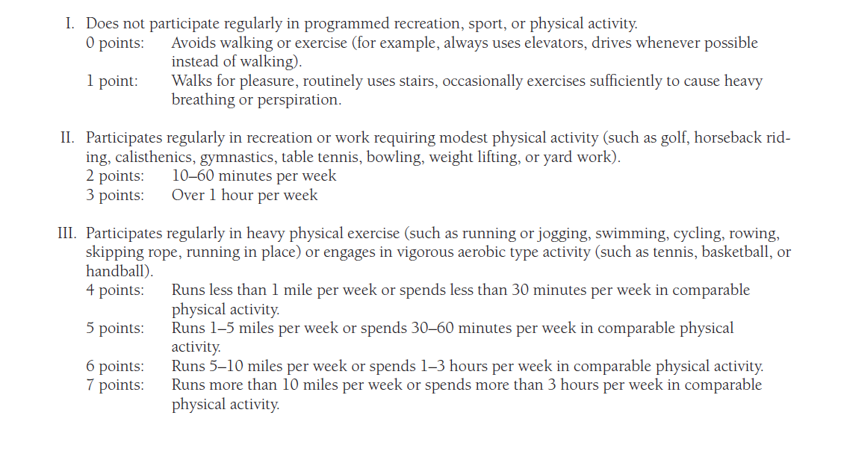

Slide 9
VO2max = 50.513 + (1.589 × PAR) – (0.289 × age) – (0.522 × %fat) + (5.863 × Gender) = ______ ml/kg/min
VO2max = 50.513 + (1.589 × 1) – (0.289 × 43) – (0.522 × 47.2) + (5.863 × 0) = 26.8 ml/kg/min

Slide 10
VO2max = 56.363 + (1.921 × PAR) – (0.381 × age) – (0.754 × BMI)+ (10.987 × gender)
VO2max = 56.363 + (1.921 × 1) – (0.381 × 43) – (0.754 × 41)+ (10.987 × 0) = 10.981 ml/kg/min

Slide 11
The Rockport Fitness Walking Test (RFWT) using a 1-mile (1.6-kilometer) walk:
VO2 max = 132.853 - (0.0769 x W) - (0.3877 x A) + (6.315 x G) - (3.2649 x T) - (0.1565 x H)
W = Weight (in pounds)
A = Age (in years)
G = Gender factor, G = 0 for females and G = 1 for males
T = Time to complete the 1-mile walk (in minutes)
H = number of heart beats in 10 seconds at the end of the 1-mile walk

Slide 12
3 Minute Step Test
Males: VO2max = 111.33 - 0.42H Females: VO2max = 65.81 - 0.1847H H = Heart rate (in beats/minute) after test completion

Slide 13
1.5 Mile Run-Walk Test
VO2max = 483/T + 3.5 T = Test completion time (in minutes)

Slide 14
Vo2max
Measured by open circuit spirometry.
Over estimated by exercise test (SEE 7%)
1 lit of O2 = 5 Kcal of energy (4.69 for fat and 5.05 for CH)
Resting Vo2 = 3.5 ml/kg/min =1MET

Slide 15
Metabolic equations
Walking is speeds between 50 to 100 m/min
Running is speeds >134 m/min
Horizontal walking = 0.1 ml/kg/m
Horizontal running = 0.2 ml/kg/m
Vertical walking = 1.8 ml/kg/m
Vertical running = 0.9 ml/kg/m

Slide 16
Metabolic equations
Walking
Vo2 (ml/kg/min) = (0.1× S) +(1.8 × S×G) +3.5
Running
Vo2 (ml/kg/min) = (0.2 ×S) +(0.9 ×S×G) +3.5

Slide 17
Metabolic calculation
Energy expenditure (Kcal/min)=
1 lit/min o2 =5 kcal /min
(1ml /min O2= 5cal/min)

