Slide 1
IN THE NAME OF ALLaH THE COMPASSIONATE THE MERCIFUL

Slide 2
How to manage persistent or relapsing Cushing’s disease?
10th August 2015
Farahnaz Salehinia,MD
Fellow of Endocrinology
Endocrine Research Center
Shahid Beheshti Medical University

Slide 3
AGENDA
1)Introduction
2)Outcome of Cushing’s disease after TSS
3)Medical Therapy in Cushing’s disease
4)Repeat Pituitary Surgery
5)Radiotherapy
6)Adrenalectomy
7)Endocrine Society Guideline
8)Conclusion

Slide 4
Introduction
Persistent CD: Sustained elevation in post surgical cortisol levels and/or a need for therapy whithin 6 months from the initial surgery caused by a residual tumor hidden

Slide 5
.
Introduction
Whithin the gland
In the cavernous sinus
In the clivus
In the dura
Ectopic parasellar(less commonly)

Slide 6
Introduction
Recrrent CD: Reappearance of clinical and hormonal features of hypercortisolism that occur more than 6 months after an initial post treatment remission.
Possible treatments : Reapeat pituitary surgery, Pituitary radiotherapy , Adrenal surgery for bilateral or less commonly monolateral adrenalectomy and /or medical therapy.

Slide 7
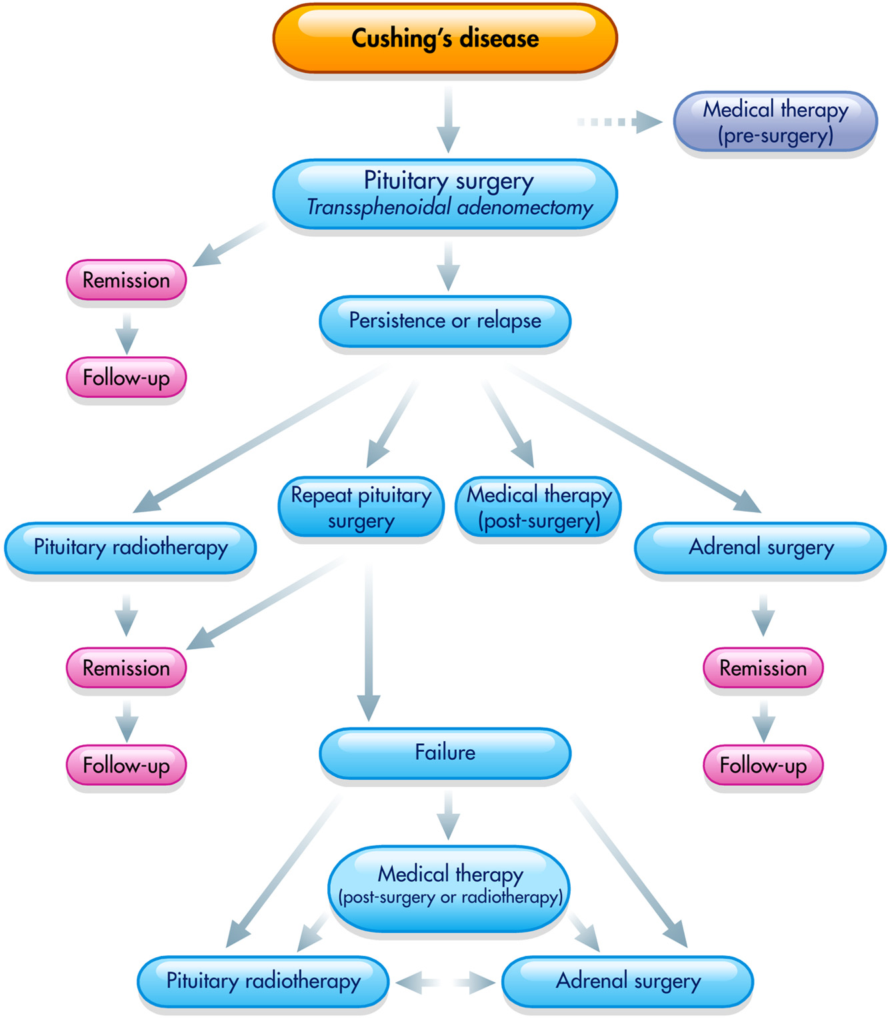

Slide 8
Introduction
A MULTIMODAL approach using a combination of these treatments my be an appropriate strategy in a consistent number of patients to achieve the best outcome.

Slide 9
Introduction
A reliable prognostic factor for success of surgery: Remove of hypercortisolism after TSS
“ Remission and a lower risk of recurrence”
BUT “ There is NO consensus on predictors of these outcomes.”
(Different remission and recurrence criteria used in the studies.)

Slide 10
Introduction
No agreement on the definitions of these outcomes:
The comparative evaluation of treatment options and patient management strategies from clinical studies is rather complicated.
Remission can be defined by :
Clinical and/or biochemical outcomes:
Reversal of clinical features and normalization of biochemical changes.

Slide 11
Introduction
Morning serum cortisol and UFC tests may be recommended to assess remission
BUT
There is no general agreement on their standard use in providing markers of treatment outcomes, further complicating patient management.

Slide 12
Remission after TSS: A variety of definitions are present:
1) Symptoms of hypercortisolism remitted.
2) A continuous need for corticosteroid
replacement for more than 6 months after TSS.
3) No need for additional treatment because of
clinical remission of the disease .
4) Resolution of symptoms and signs of
hypercortisolism or of clinical features.

Slide 13
5) Clinical evidence of eucortisolemia.
6) Appearance of clinical OR laboratory signs of
adrenal insufficiency.

Slide 14
AGENDA
1)Introduction
2)Outcome of Cushing’s disease after TSS
3)Medical Therapy in Cushing’s disease
4)Repeat Pituitary Surgery
5)Radiotherapy
6)Adrenalectomy
7)Endocrine Society Guideline
8)Conclusion

Slide 15
THERAPY OF ENDOCRINE DISEASE
Outcomes in patients with Cushing’s disease undergoing transsphenoidal surgery: systematic review assessing criteria used to define remission and recurrence
Stephan Petersenn, Albert Beckers, Diego Ferone, Aart van der Lely,Jens Bollerslev, Marco Boscaro, Thierry Brue,, Paolo Bruzzi,Felipe F Casanueva, Philippe Chanson,, Annamaria Colao,Martin Reincke, Gu¨ nter Stalla, and Stelios Tsagarakis
European Journal of Endocrinology2015

Slide 16
Subjects and Methods:Initial PubMed search to identify published articles(491 Articles) reporting studies of TSS in patients with Cushing’s disease from 1980 till November 2012.
Inclusion criteria: Those conducted in at least 40 adult patients that reported the results of initial TSS (regardless of the technique used, i.e., microscopy or endoscopy) and were published in English.(43 Articles)(total of 6400 patients)

Slide 17
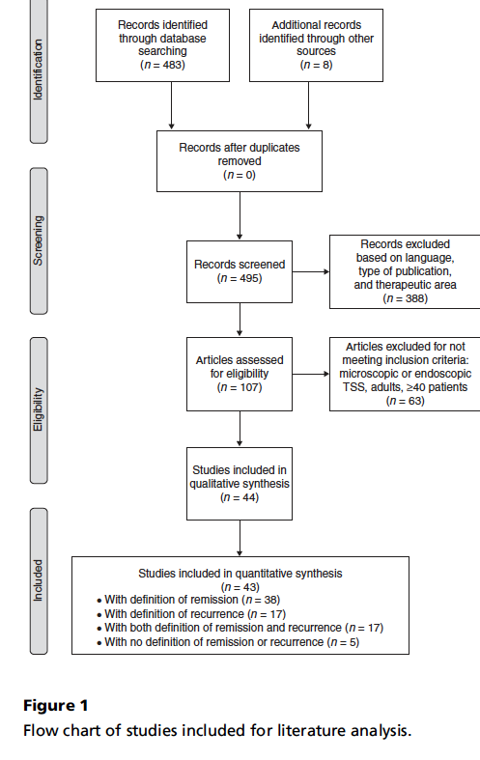

Slide 18
Exclusion criteria: Studies identified in the initial search as conducted in patients undergoing repeat TSS (i.e. after failure of initial surgery).
For the quantitative synthesis: Data were extracted from the studies using only microscopic TSS; data extraction was performed independently.
Duration of follow up for identification of remission rates: from 13 to 96 months

Slide 19
Biochemical Definitions: Serum cortisol level (morning and midnight assessments), UFC, and response to low-dose dexamethasone suppression test (LDDST).
END POINT:Reporting the ranges of the remission and recurrence rates, overal remission and recurrence rate.

Slide 20
Clinical evaluation was always combined with serum cortisol, UFC, and/or LDDST biochemical tests.
When remission was defined using biochemical tests including morning cortisol levels, the cut-off : 50 nmol/l

Slide 21
Morning cortisole cut off values
Remission rate

Slide 22
Calculation of Remission Rate
Biochemical assay only: 2014/2614
(52.1-96.6%)
77%
Clinical and Biochemical endpoint:
1428/1796
(65%-88.6%)
79.5%
Overal remission rate
78%

Slide 23
Early remission (less than6 months)
Late remission (more than6 months)
Similar rate of remission was reported
75.6%
& 72.3%

Slide 24
Remission Rate
Microadenoma:
A significant higher remission rate
(82.2%;1203/1463 patients; range 46.5–94.0%)

Slide 25
Remission Rate
Macroadenoma:
(60.1%; 187/311 patients; range 17.0– 91.7%; P!0.01).

Slide 26
A slight upward trend in remission rates :
With increasing surgical experience (patient numbers/year) (r=0.37; P=NS)
.

Slide 27
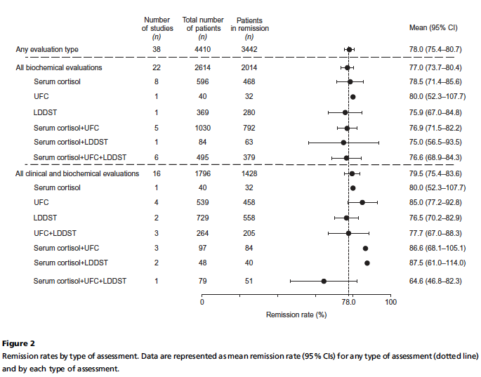

Slide 28
No change in remission rate was observed by decade of publication date (r=0.2; P=NS)
Persistence rate: 3.4 to 35.0%,
Mean rate :21.9%

Slide 29
Recurrence rates
Clinical evaluation + serum cortisol, UFC, and/or LDDST biochemical tests.
The most frequently used biochemical Test : 24-h UFC level.
Serum cortisol test :Mostly performed in the morning.

Slide 30
Mean time to recurrence (23 studies) :50.8
months (range 3–158 months)

Slide 31
Calculation of Recurrence Rate
Biochemical assays only :
(11.5 to47.4%)
Clinical and biochemical endpoints:(
5-20.8%)
oOveral recurrence rate:
15.2%

Slide 32
The combination of UFC + LDDST or
Serum cortisol lower recurrence rates
compared with UFC alone

Slide 33
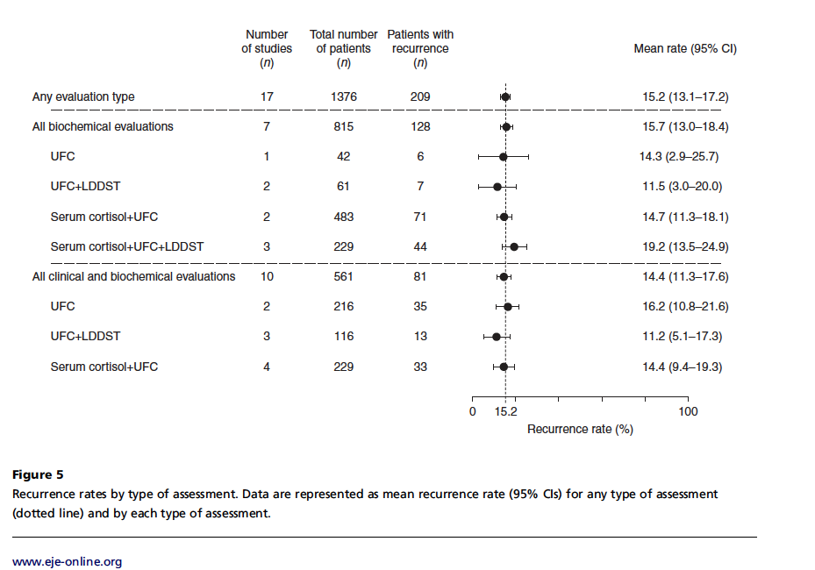

Slide 34
The effect of tumor size on recurrence outcomes
Slightly better outcomes in microadenomas than with macroadenomas;
A slightly higher but not statistically significant recurrence rate

Slide 35
Recurrence rate
Microadenoma
13.4%
101/752p
2-35%
Macroadenoma
17.6%
19/108p
0-80%

Slide 36
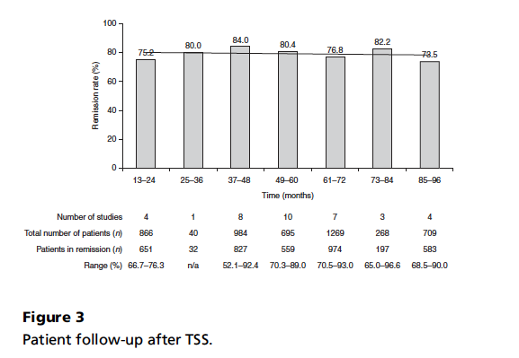
Recurrence rates did not vary with length of follow-up

Slide 37
Surgical experience
The highest recurrence rate (13.6%) : When 10 or fewer patients were operated per year of study duration (in 18 studies),
The lowest rate (6.7%) :When 31–40 patients were operated per year of study duration (r=0.3; P=NS; (only two studies )

Slide 38
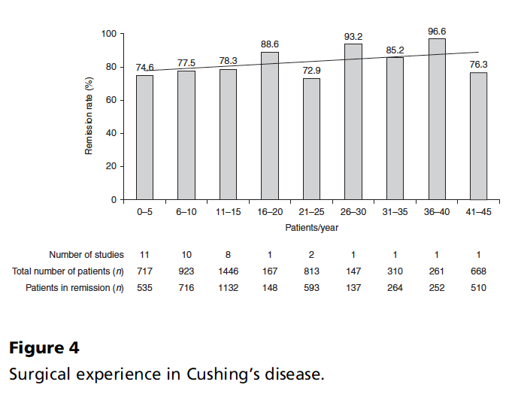

Slide 39
In contrast to remission, a trend toward an increase in recurrence rate could be noted over time, with the upper limit of recurrence rate ranges increasing steadily by decade of study publication poorer outcomes or better reporting of recurrence rates (r=0.8; P=NS; ).

Slide 40
Rate Range of Recurrence
1980–1990 2.2–9.3%
1991–2000 0.0–17.0%
2001–2010 2.3–24.4
2011 to 19th October 2012 6.7–47.4%

Slide 41
safety
Fewer complications reported with increasing surgical experience.
Overall, the mortality rate was relatively low (1.7%; range 0.0–18.1%);
There was no correlation of death with remission rate or the center’s surgical experience.

Slide 42
Key messages
Remission rates were higher in patients with microadenomas vs macroadenomas and recurrence outcomes were worse in patients with macroadenomas compared with microadenomas.
Duration of follow-up had no influence on recurrence rates , while it has been previously reported that the risk for recurrence increased with long-term follow-up .

Slide 43
Key messages
Certain types of tumor may be more aggressive than others and may recur early during the follow-up period. Conversely, less aggressive tumors would recur later.
The factors that may trigger early or late recurrence are so far unknown.
Improved outcomes could be suggested with improved surgical experience BUT it does not have a significant influence on remission rates(publication-to-publication differences)

Slide 44
Key messages
Endoscopic TSS: SIMILAR OUT COME WITH MICROSCOPIC TSS; 77%
Tumor size : An important predictor of outcome : only 14% of patients in remission had macroadenomas, while macroadenomas were confirmed in 25% of patients with unsuccessful initial endoscopic surgery .

Slide 45
Key messages
The type of biochemical assay used seemed to influence recurrence rates, while remission rates did not differ markedly(variability in the cut-off thresholds used for each biochemical assay).
Need for standardization of definitions of remission and recurrence and the methods of determining these outcomes.
With standardized and optimized methodology, clinical trial results can be confidently compared to inform clinical practice and maximize patient outcomes.

Slide 46
AGENDA
1)Introduction
2)Outcome of Cushing’s disease after TSS
3)Medical Therapy in Cushing’s disease
4)Other second line treatments of Cushing’s disease
5)Conclusion

Slide 47
THE TREATMENT OF CUSHING’S DISEASE
ROSARIO PIVONELLO, MONICA DE LEO, ALESSIA COZZOLINO and ANNAMARIA COLAO DIPARTIMENTO DI MEDICINA CLINICA E CHIRURGIA, SEZIONE DI ENDOCRINOLOGIA, UNIVERSITA’ FEDERICO II, NAPLES, ITALY
Copyright © 2015 by the Endocrine Society
Received May 2, 2013. Accepted May 13, 2015.

Slide 48
Medical Therapy
1) Before surgery as preoperative treatment,
1a) In severe disease,
2a)To control cortisol excess and
3a) Improve the clinical picture
2) After surgery, as adjuvant treatment in surgical failure or partial success,
Due to an uncomplete removal of the pituitary tumor, while awaiting for the decision of a definitive therapeutic approach repeat pituitary surgery, pituitary radiotherapy or adrenal surgery.

Slide 49
3) Before, during and after pituitary radiotherapy,as a bridging treatment while awaiting for the complete effectiveness of radiotherapy; and for surgery or refuse surgery.

Slide 50
4) First-line treatment:
4a) without a clear indication for surgery
4b) a pituitary tumor that is nonvisible
4c) with an extrasellar expansion
4d) with an unfavorable location
4e) invasive of the surrounding tissue
4f ) lack of availability of a neurosurgeon expert in pituitary tumors
4g) patients who display contraindications

Slide 51
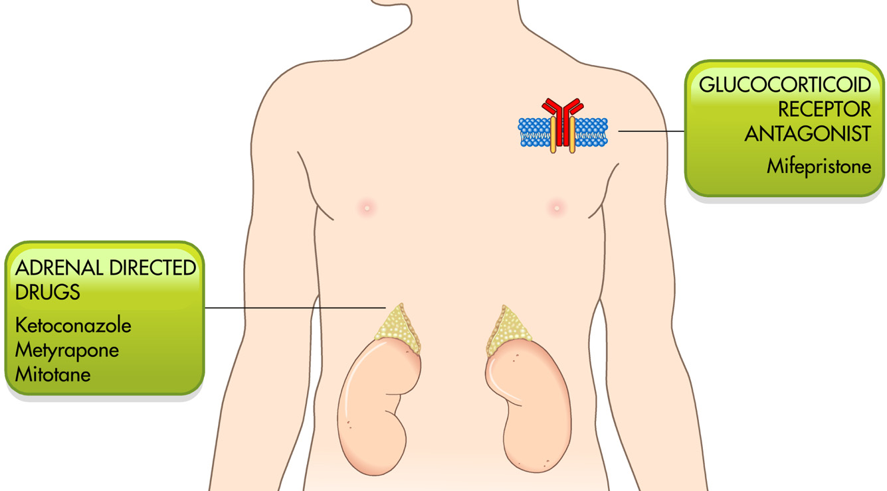

Slide 52
Drug Classification
1) adrenal-directed drugs: Block cortisol production through the inhibition of enzymes involved in steroidogenesis.
2) pituitary-directed drugs: Inhibit tumoral ACTH secretion cortisol production.
3) glucocorticoid receptor antagonists: peripherally block the activation of the glucocorticoid receptor, without influencing pituitary and adrenal hormone production.

Slide 53
The most physiological approach to the disease: Pituitary directed drugs
The most comymonly used drugs in clinical practice: Adrenal directed drugs

Slide 54
ADRENAL-DIRECTED THERAPY
1)Adrenostatic drugs (steroidogenesis inhibitors):Inhibit one or more enzymes responsible for the adrenal steroidogenesis.
2)Adrenolytic drugs : steroidogenesis inhibition + induce cell death at the level of adrenal gland.

Slide 55
Highly effective in controlling cortisol excess.
Do not treat the underlying corticotroph pituitary tumor or restore normal HPA axis function.
Dose-dependent manner and
“escape”phenomenon.

Slide 56
The usage:
To Preoperative preparation of patients who need to rapidly correct severe complications of the disease.
To control of cortisol excess during the period between irradiation and the complete response to pituitary radiotherapy.(need to be interpreted with caution!!!)
To rapid control of the clinical syndrome.

Slide 57
Approval in the European Union (EU) : ketoconazole and metyrapone, in the treatment of CS.

Slide 58
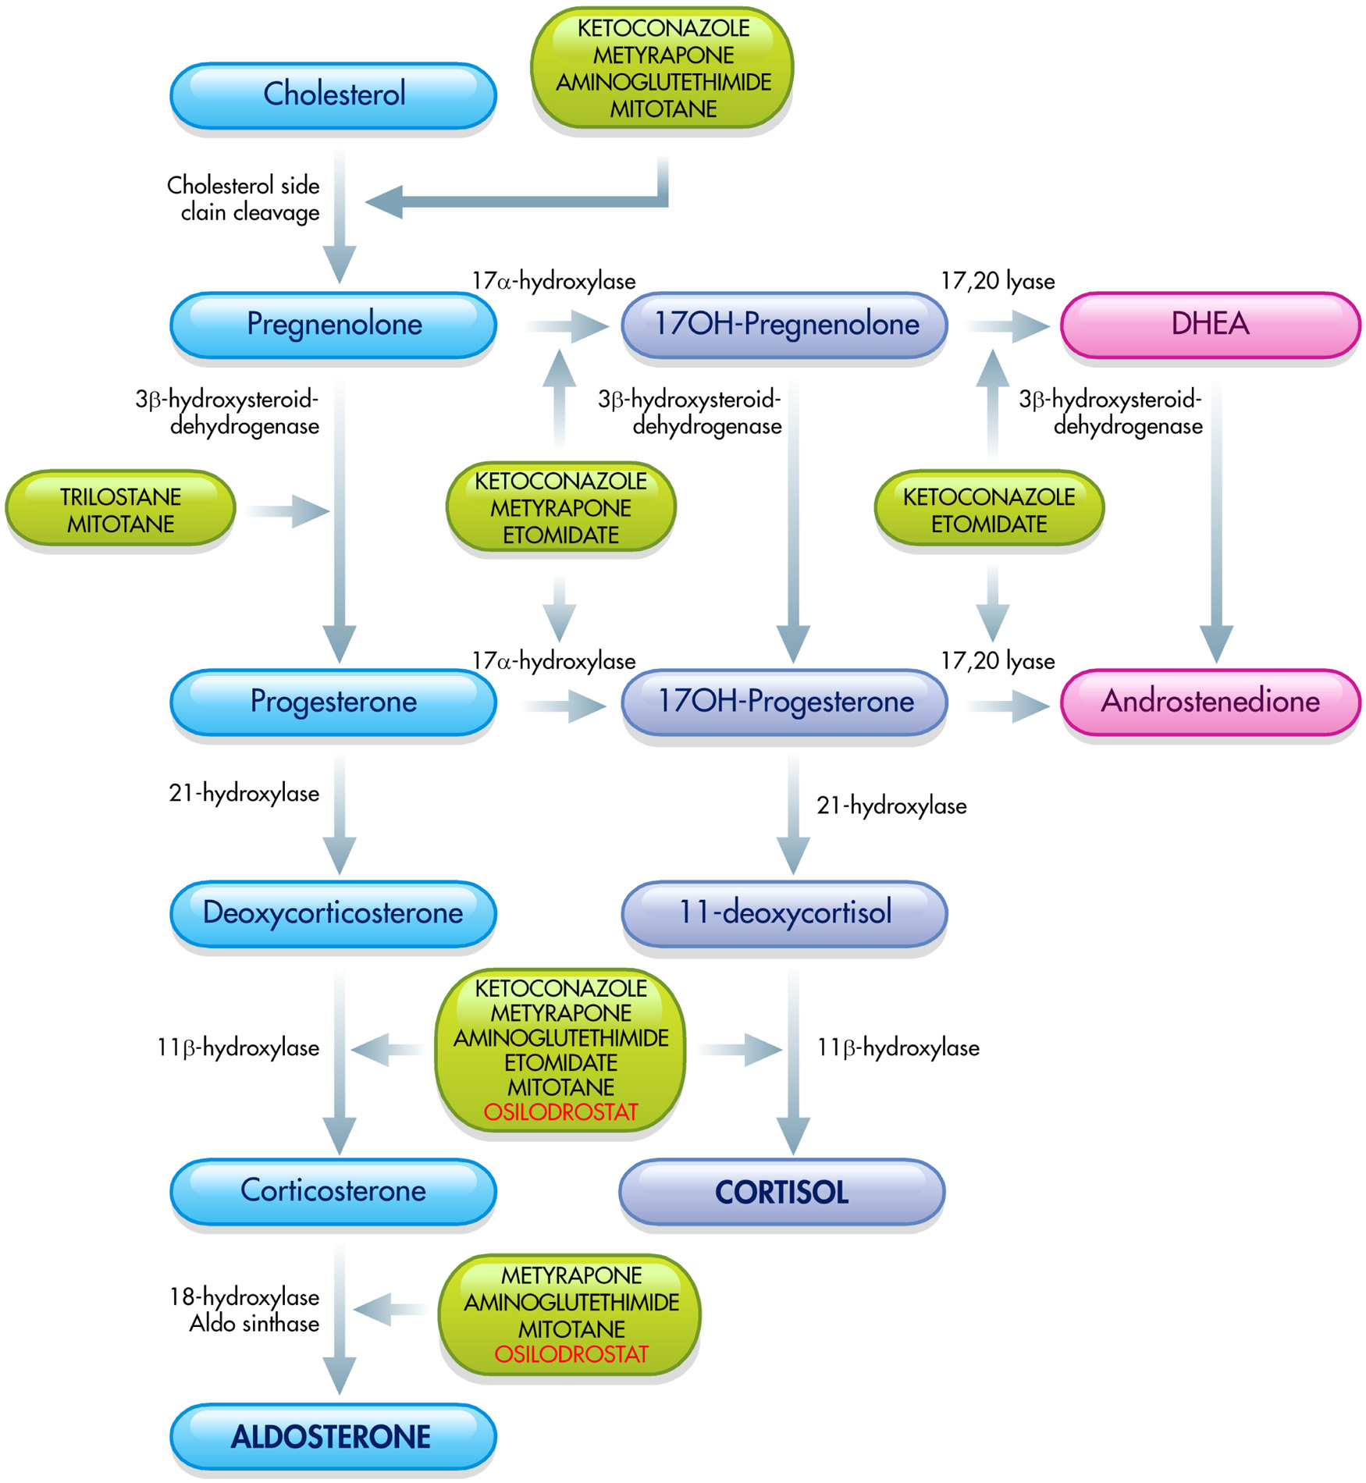

Slide 59
KETOCONAZOLE
An imidazole derivative used as an antifungal agent, 200 to 1200 mg/d
Rapid action
Relatively short half-life (mean half-life around 3.3 hours)

Slide 60
Normalization of cortisol between ketoconazole doses of 600–800 mg/d WITH a negative impact mainly on testicular function.

Slide 61
A possible but debated direct effect of ketoconazole on pituitary corticotroph tumor cells has been hypothesized.

Slide 62
Experimental studies :
Inhibits ACTH release?
Inhibit pituitary corticotropic tumor cell growth
In part inducing apoptosis

Slide 63
Ketoconazole treatment
Controlled cortisol secretion in 44.7% to 92.9% of patients,
Mean response rate 64.3%
Median R .R 50%,

Slide 64
The most recent paper:
Castinetti and coworkers (JCEM 2014)
Design: the largest retrospective multicenter study.
French Retrospective Study on Ketoconazole Outcome (FReSKO)
Subjects and method:200 patients followed in 14 French centers.
All were treated with Ketconazole as a single treatment for active Cd between 1995 and 2012.

Slide 65
Characteristic of the population before Ketoconazole use
Mean age at diagnosis: 41.9+-15.8y
Microadenoma: 106(53.4% )
Macroadenoma: 36(18.2%)
Lack of obvious adenoma: 58(29.4%)
TSS: 72%
Radiotherapy: 23.6%
Second surgery: 8%

Slide 66
Follow-up: From 0.03 to 135 months (mean: 14.4
months)
Primary Aim: Clarifying efficacy and tolerance to better determine the benefit /risk balance.
Efficacy analysis was performed in 197 patients, who had available urinary cortisol levels during the study.
50 Patients: as pre surgical treatment,
32 Patients: as primary treatment,
128 patients : as secondary treatment (after
unsuccessful surgery or following Radiotherapy)

Slide 67
Ketoconazole dose ranging :from 200 to 1200 mg/d (mean: 767.2 mg/d; median:600 mg/d).
At the last follow-up:
78 of 197 (49.3%) : Normal urinary cortisol levels,
37 (23.4%) :at least a 50% decrease
43 (27.2%) : unchanged levels.

Slide 68
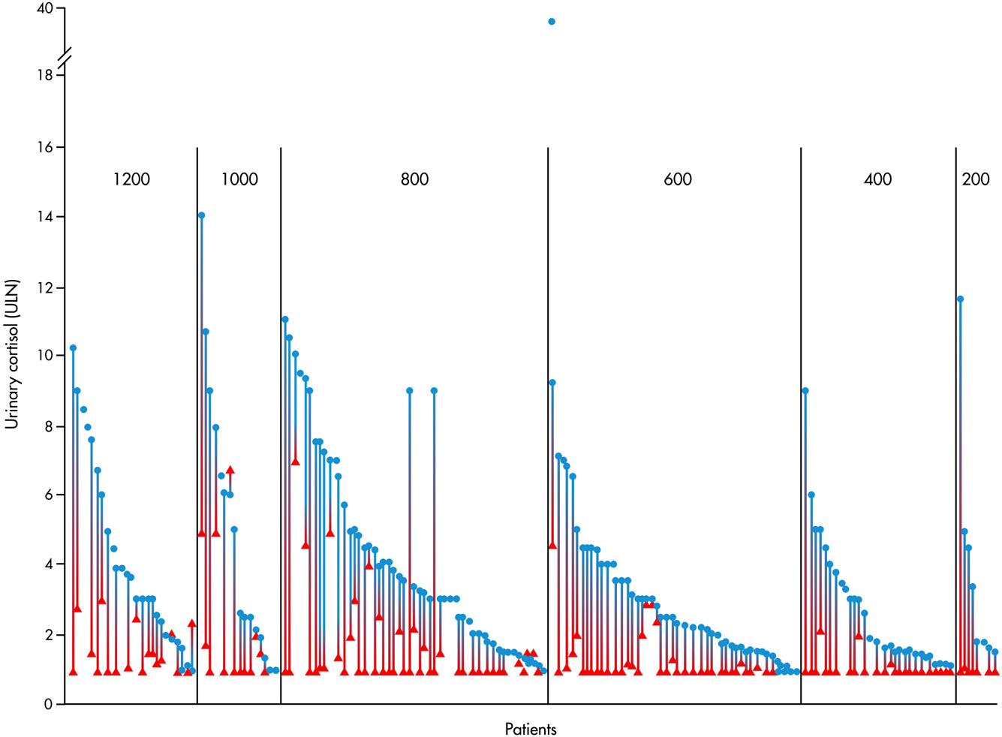

Slide 69
Clinical signs were improved in 74 of 134(55.2%)
Hypertension in 36 of 90 (40%)
Hypokalemia in 10 of 26(38.4%)
AND
Diabetes in 23 of 39(59%)

Slide 70
SURPRISINGLY:
Gender is a predictive factor of control of hypercrtisolism.
Proportion of males was higher in the uncontrolled than in the controlled group.

Slide 71
51 Patients (21.5%) : Stopped treatment because
of intolerance.
Frequency of adverse effects: 0.6–18.4%
An increase in liver enzymes: in 35 of 190 patients
(18.4%), among whom
Up to 5-fold normal values : in 30
patients(85.7%)
5–10-fold in 4 patients (11.4%) and
40-fold higher than normal values in 1 patient
(2.9%).

Slide 72
The elevation of liver enzyme levels generally normalized within 1–3 months after ketoconazole withdrawal and occurred :
at the beginning of treatment
or
2. after a dose change,

Slide 73
a strict follow-up of liver function(weekly) for 1 month after a dose change
the risk of hepatotoxicity.

Slide 74
No fatal hepatitis was observed.
Gastro-intestinal complaints (13.1%),
Adrenal insufficiency (5.3%)
pruritus(3.7%)

Slide 75
KEY MESSAGES
Ketoconazole is a highly effective drug to reduce hypercortisolemia.
No indentification of any other predictive factor of control of hypercortisolism including initial UFC ,other than male sex.
Hepatotoxicity: Relatively frequent but often moderate.

Slide 76
              Generally
In CS, as well as in CD, control of cortisol secretion was almost always associated with improvement of the clinical picture:
Control of BP and glucose tolerance

Slide 77
In July 2013, the Food and Drug Administration (FDA) and European Medicines Agency (EMA) have given strong warnings about the use of ketoconazole as an antifungal agent, due to its potential hepatotoxicity.
Fatal hepatitis: very rare
An increase in liver enzymes: ranging from
2.6 to 18.7%of cases in the studies.

Slide 78
The other limitation of ketoconazole : The impairment of its intestinal absorption when administered concomitantly with proton-pump inhibitors. ( GASTRIC ACIDITY is CRUCIAL).

Slide 79
Teratogenity??
Safety in Children and older age??

Slide 80
In summary, ketoconazole induce normalization of cortisol secretion at the end of the treatment period, in an average of 65% of patients, with a consequent improvement in clinical picture, but it is affected an escape from the response in up to 23% patients with initial response to treatment.

Slide 81
Therefore, it can be a good temporary option for controlling cortisol excess, but it might be considered a valuable alternative as chronic treatment for selected patients with CD and, in general, for CS
One of the advantages of ketoconazole is represented by its rapid action, whereas disadvantages are represented
by the multiple daily dosing and different drug-drug interactions.
It is noteworthy that the information related to
the use of ketoconazole in CD is supported mainly by
noncontrolled retrospective studies, which might have
overestimated the efficacy and underestimated safety of
the drug. I

Slide 82
Metyrapone
Metyrapone is a pyridine derivative with the ability to inhibit 11-hydroxylase, the enzyme responsible for the final step of the cortisol synthesis
Blocking cortisol Production .
Interfere with cortisol formation by inhibiting the cholesterol side chain cleavage complex , and to a lesser extent, 17-hydroxylase and 18-hydroxylase activity.

Slide 83
Orally at a dosage ranging from 500 to 6000
mg/d;
Rapid action, Short half-life (1.9 - 0.7 hours)
multiple daily dosing, up to six times a day.

Slide 84
According to the results of 5 main studies:
Metyrapone remission rate ranging:
45.4 to 100%,
Mean remission rate 71%
Median remission rate 75.5%

Slide 85
Thoren and coworkers
Metyrapone and/or Aminoglutethimide in 15 CS patients.
9 patients with CD were treated with metyrapone monotherapy,
Follow-up ranging: from 0.6 to 6.5 months (mean: 1.9 months; median: 1.2 month)
Metyrapone dose ranging: from 1000 to 3000 mg/d

Slide 86
8/9 patients: Pituitary irradiation
7/9 patients (77.8%): A significant reduction in urinary cortisol levels during a generally short period of time (0.6 –2.6 months),
1/9 (11.1%): Normalization after a longer time period (6.5 months) significant clinical improvement .

Slide 87
End point : A significant reduction of urinary cortisol levels together with improvement of clinical picture
The escape phenomenon was not considered in this study.
Adverse effects :An increase in facial hair and acne (12.5% of the female population), dizziness (44.4%) and recurrence of a duodenal ulcer (11.1%).

Slide 88
A recent paper :Van den Bosch and coworkers
Subjects and Method: Metyrapone as presurgical treatment in 22 patients with CD and metyrapone dose ranging from 1000 to 6000 mg/d.
Follow-up time: Ranging from 1.7 to 11.6 months (mean: 5.9 months; median: 5.8 months).
An adequate pretreatment: Normalization of urinary cortisol levels or a decrease in the mean serum cortisol level below 300 nmol/L, in 10 of 22 (45.4%) patients.

Slide 89
The escape phenomenon was not considered in this study.
Adverse effects : Arthralgia and myalgia(18.2%), hypokalemia (13.6%), fatigue and malaise(13.6%), nausea and vomiting (13.6%) and hirsutism(4.5%) .

Slide 90
Generally, in the studies reporting metyrapone treatment in CS, as well as in CD, control of cortisol secretion was almost always associated with improvement of clinical picture.
In particular “glucose tolerance and BP”

Slide 91
The analysis of the studies on metyrapone efficacy in patients with CD:
A frequent increase in ACTH levels
ACTH secretion may override blockade of steroidogenesis, at least in some patients and drive androgen and mineralcorticoid precursor overproduction.

Slide 92
BUT An escape from response has been described in 0%–13% (mean: 5.7%; median: 4.2%) of the total population of patients.

Slide 93
Limitations of Methyrapone
1)Second-line medical therapy in females(hyperandrogenism due to ACTH rising).
2)Mineralcorticoid precursor overproduction is responsible for mineralcorticoid adverse effects observed during metyrapone therapy, namely hypertension, hypokalaemia and edema that could limit long-termtreatment.

Slide 94
Most common during pregnancy:
The coadministration of metyrapone with an antihypertensive drug is recommended, in order to guarantee a safer outcome during pregnancy.
Safety in children and elderly.

Slide 95
Metyrapone: Normalization of cortisol secretion at the end of the treatment period in anaverage of 71% of patients,
Rapid improvement in clinical picture,
Escape from the response : In up to 19% of patients with initial response to treatment.
Therefore, metyrapone can be considered an effective drug in the medical management of CD.

Slide 96
Aminoglutethimide /Trilostane
Aminoglutethimide is phenylpiperidine with the ability to block cholesterol side-chain cleavage and the steroidogenic enzymes 11-hydroxylase and 18-hydroxylase .
Aminoglutethimide is no longer used in the treatment of CD, because of an unfavorable adverse event profile.

Slide 97
Trilostane is an androstene-carbonitrile derivative agent with the ability to competitively inhibit of 3-hydroxy-steroid dehydrogenase/5-4-isomerase, the enzyme that blocks an early stage of steroidogenesis, with a consequent block of the biosynthesis of the entire classes of adrenal hormones

Slide 98
Trilostane is no longer used in the treatment of CD because its limited efficacy in controlling hypercortisolism compared with different steroidogenesis inhibitors.

Slide 99
Etomidate
Imidazole derivative agent
Used as an anesthetic
Occasionally used in the treatment of CD, and in general of CS, (steroidogenesis inhibitor).

Slide 100
Studies in adrenal cell cultures :Etomidate is the most potent adrenostatic agent .
More recent studies :
Blocks aldosterone synthase
Anti proliferative effects on adrenal cortical cells.

Slide 101
Etomidate is the only drug used for CS with parenteral administration. very rapid onset of action: significant suppression of cortisol within 6 hours, and a maximal suppression within 12 hours, half life ranged between 3 and 5 hours. Therefore, after a bolus of a nonhypnotic dose, a constant infusion is required for the following 24 hours,when replacement treatment with hydrocortisone start to be required.
Etomidate can be particularly useful in patients with acute and/or life threatening complications of CS, such as serious psychosis and severe hypertension

Slide 102
Recently, Sohand coworkers described a protocol for etomidate infusion for the emergency management of hypercortisolism, suggesting a starting dose of 2.5 mg/h, regardless of the patient’s weight, with dose titration up to a maximum of 4 mg/h according to circulating cortisol levels, which canbe measured 4 hours after starting etomidate infusionand/or after each dose titration.

Slide 103
Adverse effectsdue to etomidate treatment include myoclonus, nausea,vomiting and dystonic reactions in up to one-third of patients etomidate might be considered an effective drug able to rapidly control hypercortisolism;,
it is indicated as an emergency drug for the acute
control of severe hypercortisolism and its associated severe
clinical conditions.

Slide 104
Mitotane
Mitotane, (o,p’DDD), is a diphenylmethane derivative agent chemotherapic drug, but it has been occasionally used in the treatment of CD, and in general of CS, for its adrenostatic and adrenolytic propertiesit is mostly used in the treatment of adrenal carcinoma, for which the
drug has the official indication.

Slide 105
Orally at doses generally ranging from 1 to 12 g/d, delayed efficacy due to the its slow onset of action, as therapeuticlevels are reached by up to three months, whereas its long half-life (18–159 d)
Careful monitoring of drug level is mandatory.

Slide 106
The escape phenomenon has not been described in patients treated with mitotane

Slide 107
PITUITARY-DIRECTED MEDICAL THERAPY
The first category is neuromodulatory drugs, which directly influence the HPA axis, and include some historical agents, such as serotonin antagonists and GABA receptor agonists, as well as modern agents such as dopamine agonists, mainly represented by cabergoline, and somatostatin analogues, mainly represented by pasireotide.

Slide 108
The second category is nuclear receptor ligands, which indirectly influence HPA axis, since they target different nuclear receptors involved in the regulation of the HPA axis, such as the peroxisome proliferator-activated receptor gamma (PPAR-gamma) agonists and retinoic acid receptor agonists.

Slide 109
NEUROMODULATORY DRUGS
Neuromodulatory drugs include serotonin antagonists and GABA agonists, as well as dopamine agonists and somatostati analoguesSerotonin antagonists andGABA agonists have been evaluated in the past :no efficacy
Conversely, the dopamine agonist cabergoline and the somatostatin analog pasireotide

Slide 110
However, cabergoline, whose efficacy has been demonstrated by single center or multicenter prospective studiesin a small population of patients withCD,is currently used as off-label treatment for CD, whereas pasireotide, whose efficacy has been demonstrated by a worldwide multicenter, randomized double-blind phase III study, has been approved by the EMA in EU and FDA in US for the treatment of patients withCDwhen surgery has failed or is not an option, and it is currently used as an on-label treatment.

Slide 111
GABA agonists.
Valproic acid
More recent study, :valproic acid was administered at the dose of 600 mg/d for 3 months in 19 patients which CD, before or after an unsuccessful
pituitary surgery: No patients normalized their
urinary cortisol levels during the period of treatment.

Slide 112
Bromocriptine was found to suppress ACTH secretion.
The efficacy of bromocriptine in different studies varied between 0 and 50%, with normalization of urinary and/or plasma cortisol in up to 40% of patients in various case reports and small study series after short-term treatment.

Slide 113
Cabergoline is administered orally from once a week to twice a day, and it has been administered in patients with Cushing’s disease at doses ranging from 0.5 to 7 mg/wk.

Slide 114
NUCLEAR RECEPTOR LIGANDS
The nuclear receptor ligands include the PPAR-gamma agonists and the retinoic acid receptor agonists; this group of drugs has been evaluated in few studies in a limited number of patients with CD, but both categories of agents are not used in the current clinical practice

Slide 115
AGENDA
1)Introduction
2)Outcome of Cushing’s disease after TSS
3)Medical Therapy in Cushing’s disease
4) Repeat Pituitary Surgery
5) Radiotherapy
6)Adrenalectomy
7)Endocrine Society Guideline
6)Conclusion

Slide 116
Repeat Pituitary Surgery
The preferred treatment option in cases of persistent or recurrent CD, especially when associated with imaging evidence of a clear-cut residual tumor.

Slide 117
No specific studies ,No evidence
Imaging of clear cut residual tumor
Better prognosis

Slide 118
The visualization of the residual pituitary tumor
A positive predictive factor for disease cure
And /or
A clear indication for repeat pituitary surgery

Slide 119
The detection of the residual pituitary tumor
A selective adenomectomy is a reliable option
No detection after initial surgery
Hemi or tatal-hypophysectomy

Slide 120
Persistent disease:
The timing between the first and second surgery:
Ranges from 1 week to 38 months after the initial
surgery.

Slide 121
Repeat TSS in the immediate postoperative
period:
A pituitary tumor is visualized at preoperative
imaging before the initial pituitary surgery.
AND /OR
2) A tumor was found intraoperatively.
3) Corticotroph lesion was documented in the
removed pituitary tissue after the initial
pituitary surgery.

Slide 122
1-No tumor is detected during initial surgery
2-Preoperative imaging is equivocal
Before re exploration
Inferior petrosal sampling

Slide 123
Accuracy of IPSS in predicting tumor laterality during repeated TSS :50%
Change of position in venous drainage of the gland during the initial surgery
False positive results
Impeding of drainage during the initial surgery
False-negative results

Slide 124
Repeat pituitary surgery after initial surgery within two months: Eraly Reoperation
1-Minimal additional trauma (before the formation of scar tissue and the modification of surgical anatomy)
2-Recall particular anatomical details of the earlier operation by surgeon,(essential for reoperation).
3-Relatively low morbidity as compared with delayed repeat surgery.

Slide 125
Summary of studies
17 studies published between 1987 and 2014, including 395 patients with persistent or recurrent CD.
The remission rate after repeat TSS : 30–87.5%,
Mean R.R: 58.3%
Median R.R: 61.1%
Mean follow-up period : 59.8 months

Slide 126
Early reoperation( within 60 days from the
initial surgery):
Sustained remission : 66.7–87.5% of patients
Mean Remission Rate : 76.8%
Median remission Rate : 76%

Slide 127
Delayed reoperation(reoperation at least 60 days after the initial surgery):
Remission Rate range: 30 -71.4%
Mean. R.R : 51.6%
Median R. R : 48.1%

Slide 128
Attention
Delayed remission : In about 5% of patients
after the initial operation.
Serial testing over a period of 1–2 months in
the patients with improve but not in a clear- cut
remission immediately after the first surgery,
prior to considering additional therapy.

Slide 129
The remission rate associated with a second operation
Lower than that obtained after the first operation:
1- Size of the residual pituitary tumor
2- Location of the residual pituitary tumor
The extension in the extrasellar region and/or the
location of residual tumor within the cavernous
sinus or skull base bone
Reduce the likelihood of achieving
REMISSION

Slide 130
Patients with large and/or invasive tumors.
Might not benefit from a second surgical procedure

Slide 131
The clinical variables that may predict the outcome of repeat TSS:
Positive predictive factors for a good outcome??
1-Surgical and pathological identification of a tumor during first and second surgery .
2-The limited extent of the initial pituitary surgery.
BUT
No significant correlation has been found among presurgical, surgical and pathological tumor identification and disease remission.
Notes:
Debatable/IN MOST SERIES NO SIGNIFICANT

Slide 132
Median rate of hypopituitarism 37% | Mean rate of hypopituitarism 38%
The general rate of hypopituitarism: between 9.1 and 78.6% | Repeat pituitary surgery is associated with a higher risk of hypopituitarism compared with initial pituitary surgery.

Slide 133
Hypothyroidism 11.8- 57.1% | Hypogonadism 11.8%-21.4% | GH deficiency 21-28.6% | Panhypopituitarism 5.2%-83%
Mean 30% | Mean 16.4% | Mean 24.8% | Mean 31.3%
Median 21% | Median 16% | Median 24.8% | Median 5.5%

Slide 134
Key message
Repeat pituitary surgery is considered an optional
second-line treatment after the failure of initial surgery, especially in case of:
1-Well-defined small and noninvasive residual tumors
and/or
2-Surgical and pathological tumor identification at the time of the first attempt of a selective adenomectomy.
Lower success rate
Higher prevalence of hypopituitarism
Notes:
SUCCESS RATE KAMTAR BE KHOSUS DAR INVASIVE SURGERY

Slide 135
AGENDA
1)Introduction
2)Outcome of Cushing’s disease after TSS
3)Medical Therapy in Cushing’s disease
4) Repeat Pituitary Surgery
5) Radiotherapy
6)Adrenalectomy
7)Endocrine Society Guideline
8)Conclusion

Slide 136
Pituitary radiotherapy
Second-line or third-line treatment in Cd patients:
1- After failure of initial or repeat pituitary surgery 2- In cases of aggressive and/or invasive tumors
:Disease Control

Slide 137
Type of pituitary radiotherapy
Conventional external radiotherapy (CRT),
A technique delivering ionizing radiation to the target tumor in small daily doses over a period of 25–30 days.
Radiation doses :range from 45 to 50 Gy, divided,
with a total dose of 1.8 to 2Gy per fraction.

Slide 138
Stereotactic radiotherapy (SRT),
A technique delivering ionizing radiation to the target tumor by stereotactic methods, which gives the precise identification of the tumor position with three spatial coordinates.

Slide 139
SRT :Delivery of a high dose of radiation to the tumor preserving the surrounding tissues and organs. (Choice of radiation method at present).
a single treatment [stereotactic radiosurgery (SRS)]
b)a fractionated treatment [stereotactic conformal radiotherapy (SCRT)].
SRT
A single treatment [stereotactic radiosurgery (SRS)]
A fractionated treatment [stereotactic conformal radiotherapy (SCRT)].
Notes:
Due to the physical properties of protons (Braggpeak
phenomenon), proton beams spare more normal surrounding
tissue to exposure than photon beam
technologies

Slide 140
SRS is given as a single dose of 18–24 Gy
The optic apparatus can tolerate a maximal radiation dose of 8–12 Gy.
SRS is limited to tumors smaller than 10 mm and 3–5 mm away from the optic apparatus.

Slide 141
Efficacy of pituitary radiotherapy
1) The control of 2)The control of
hormone secretion tumor growth

Slide 142
The results on the outcome of radiotherapy can be distinguished on the basis of the type of radiotherapy.

Slide 143
Conventional radiotherapy (CRT)
15 studies published between from 1971 and 2007
325 patients with CD treated with CRT.
Patient number per study more than 10 patients
Follow-up longer than 5 years.
7 studies CRT outcome was analyzed as a primary treatment
4 studies as a secondary treatment after surgery
4studies Either as first-line or second-line treatment

Slide 144
The mean total radiotherapy dose | 43.5Gy
Median total radiotherapy dose | 45Gy
Range of total radiotherapy dose | 20-45 Gy
The overall remission rate of CRT(normalization of cortisol secretion) | 19,6%-100%
Mean rate of remission(pre surgery) | 64.6%

Slide 145
Median rate of remission | 60.7%
Follow up time | 1-300 months/mean :81.9 m
The time to remission (nonhomogeneous) | 1-104 months
Mean remission rates(after pit.surgery) | 71.3%
Median remission rate(after pit.surgery) | 80%

Slide 146
CRT as primary therapy | after pituitary surgery
Mean recurrence rates: 25.8% | Mean recurrence rate 0%
Median recurrence rate:18.7% | Median recurrence rate 0%

Slide 147
CRT :
More effective when used as an secondary treatment for CD
Higher rate of disease remission
Lower risk of disease recurrence
Less effective at doses less than 40 Gy

Slide 148
The effect of CRT on tumor mass
Tumor control (follow-up period): 1–300 months | 53 -100%
Mean of tumor control | 91%
Median ot tumor control | 100%
Notes:
Unchanged or decreased tumor mass on post treatment imaging.

Slide 149
Stereotactic radiotherapy (SRT)
36 studies published between1986 and 2014
Real total patients number(SRTas a first-line treatment or secondary to an unsuccessful pituitary surgery) | 852
The radiosurgical margin dose (dose to the margin of the tumor) | 14.7 to 45Gy
Mean radiosurgical margin dose | 23.6Gy
Remission rate (hormone normalization) | 10-100%
Mean R.R | 60.7%
Median R.R | 57.2%

Slide 150
follow-up time | 2–264 months
Remission occurs after | 1-166 months
Mean time to hormone normalization | 16 months
Median time to hormone normalization | 24.5 months

Slide 151
Recurrence rate 0 to 100%
Mean R.R 12.2%
Median R.R 0%,

Slide 152
The treatment response to SRS, in terms of hormone normalization, equivalent across the different modalities (GK, LINAC or proton beam SRS).

Slide 153
Mean follow-up | 48.6 months
Tumor control after SRT | 33.3 to 100%
Mean tumor control rate and | 86.2%
Median tumor control rate | 93%
Tumor control | Reduction or stability of tumor volume on post radio-surgical imaging

Slide 154
Most of the pituitary tumors associated with CD are slow-growing lesions.
Long-term imaging follow-up.
Differentiate between the natural history of a corticotroph pituitary tumor and the true effect of radiotherapy.

Slide 155
Predictive factors for the outcome of radiotherapy
CRT
No correlation has been found between :
1-Outcome of radiotherapy and cortisol levels prior to irradiation,
2-The interval between surgery and radiotherapy,
3- Tumor size and the radiation dose.
Notes:
The variables of CRT and SRT treatment affecting the
rate of hormone remission remain debatable.

Slide 156
SRT
Remission
Maximal Radiation Dose
Notes:
SAFETY

Slide 157
Factors unfavorably affecting the outcome of
SRT
1-Postsurgical tumor remnant greater than 10 mm 2-Tumors with distance from the optic chiasm less than 5 mm,
(potentially undertreated)
Indirectly associated with a worse prognosis???
May be????

Slide 158
Correlation between:
Change in tumor volume &
Hormone response

Slide 159
Radioprotection
Pituitary hormone-suppressive medications
Notes:
The absence of hormone-suppressive medication at start associated with a higher likelihood of and
earlier remission

Slide 160
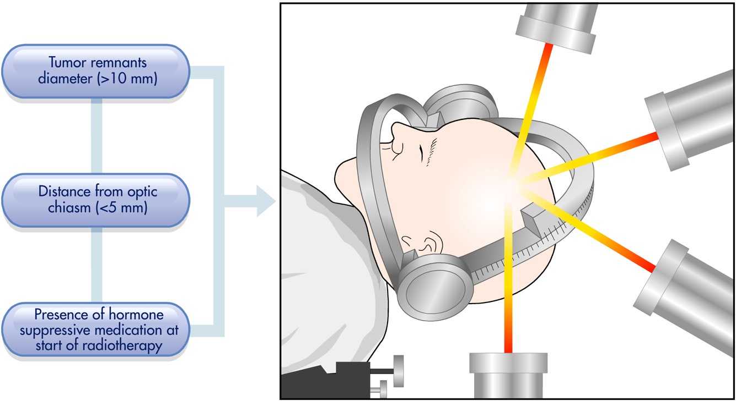
Main factors that can unfavorably affect the outcome of stereotactic radiotherapy in Cushing’s diseas

Slide 161
Safety of radiotherapy
The adverse effects and complications of pituitary radiotherapy:
1-Hypopituitarism
2-Neurocognitive
3- Cerebrovascular
4- Neoplastic

Slide 162
Hypopituitarism
CRT Hypothalamic-pituitary damage
SRT Direct damage to the pituitary gland and/or pituitary stalk .
True incidence???
(3P Effect):
Persistent hypercortisolism,
Pituitary mass effects
Prior pituitary surgery beyond radiation therapy

Slide 163
1-Most published reports include an average period of follow-up of less than 10 years.
2-Time-dependent
CRT:Dose of fractionated radiation less than 12 Gy did not incur detectable adrenal insufficiency.
Doses more than 20 Gy detectable deficiency in thyroid and gonadal function .

Slide 164
CRT
Rate of new onset hypopituitarism range | 0 -100%
Mean | 47.3%
Median | 54.9%
Follow-up period range | 1-300 months
F/U at least 5 years
Range | 0-100%
Mean | 56.5%
Median | 66.6%

Slide 165
SRT
Studies with a mean or median follow-up of at least of 5 years:
Mean 50%
Median rate of hypopituitarism 41.3%

Slide 166
KEY MESSAGE
In general for radiotherapy, sensitivity of individual hormonal axes to CRT and SRT varies among patients, with the exception of the GH-IGF-I axis, which is consistently the most sensitive.

Slide 167
KEY MESSAGE
With the high rate of pituitary dysfunction after radiotherapy, all patients should be counseled on the importance of a neuroendocrine evaluation and surveillance.

Slide 168
Neurocognitive complications.
Multiple cranial nerves: II (optic), III (oculomotor),IV (trochlear),V(trigeminal) and VI (abducens),
(location in the parasellar and suprasellar regions) are at risk of injury.

Slide 169
Damage of small vessels and protective Schwann cells or oligodendroglia.
Optic nerve( being a sensory nerve) :The least amount of tolerance
Nerves in the parasellar region, the facial nerves and the lower cranial nerves : The most amount of tolerance.

Slide 170
CRT
Total dose : Between 45–50 Gy
The risk of a deterioration in vision : Below 1%
Estimated incidence of 0.8–1.3% at 10 years
1.5% at 20 years

Slide 171
SRT
Incidence of optic neuropathy : 1.7%,
If the dose to the optic chiasm is less than 8 Gy: 1.7%
If it is between 8 and 10 Gy: 1.8%
If greater than 12 Gy: 6.9%

Slide 172
Temporal lobe necrosis
Rare complication
Long-term risk :0.2%
Cognitive impairment
In adults is not clear. large areas of normal brain to radiation, particularly in children.

Slide 173
Cerebrovascular complications
No reliable data.
Actuarial incidence of 4% at 5 years,
11% after 10 years
21% after 20 years.
The relative risk of developing cerebrovascular accident in comparison to the general population 4.1 and was higher in patients undergoing a debulking surgery.

Slide 174
Neoplastic complications.
Radiation-induced neoplasms :
The tumor must be within the previous field of
irradiation.
2) A sufficient interval must be registered between
the irradiation and the development of the new
tumor (typically 3 years).
3) The histological characteristics of the new tumor must differ from that of the original lesion.
4) The patient must not have a disease associated with the development of new tumors, such as neurofibromatosis, Li–Fraumeni syndrome, or tuberous sclerosis.
Notes:
the lack of a
control group that did not receive radiotherapy and a comparison
with the general population.

Slide 175
It seems that a strong relationship exists between radiation dose and the development of secondary brain tumors since the risk of a second tumor would seem to be associated with higher radiation doses.

Slide 176
There is no threshold dose of radiation at which tumor development is expected to occur and the minimum carcinogenic dose for brain tissue is not known.

Slide 177
16 studies from 1990 to 2012 | 3664 patients with pituitary tumors+CRT
Median dose | 42.5 Gy
Secondary brain tumors | 52 (1.42%)
Meningioma | 51.9% were
Astrocytomas | 15.3%
Mean latency period | 19.6 years for meningioma
Glioma | 11Years
Astrocytoma | 9 years
Actuarial risk of secondary brain tumor | 1.3–2.7%

Slide 178
To date, no case of secondary brain tumor after SRT in a patient with CD has been reported.
No study has estimated the risk of a secondary brain tumor after SCRT.

Slide 179
The risk of SRS-associated secondary brain tumors lower than for CRT
1-High-dose radiation administrated via SRS is cytotoxic rather than mutagenic;
2-Radiation volume in SRS is much smaller
3-A minimum carcinogenic radiation dose
for the brain could not be determined precisely.

Slide 180
Summary and General considerations on radiotherapy
Disease control:
Conventional 73%
Different types of stereotactic radiotherapy 66%
Disease recurrence around 8%

Slide 181
Radiotherapy as secondary treatment???
Radiotherapy
Third-line treatment after unsuccessful surgery and lack of effectiveness of, or presence of intolerance to, medical therapy, which is presently often considered before radiotherapy.

Slide 182
But…
Radiotherapy can be considered a reasonable treatment option when performed in conjunction
with medical therapy, or even adrenalectomy, to achieve a relatively rapid lowering of cortisol levels.

Slide 183
SRS
The most common type of radiotherapy used for persistent or recurrent CD.
Best choice in case of small postsurgical
remnants with a good target definition and
sufficient distance from the optic chiasm.
.

Slide 184
SCRT
An alternative treatment modality(Fractionated radiation therapy):
1)In cases with large tumors close to the optic chiams 2) Different neural and vascular surrounding structures.
How about occult tumors, namely those patients in whom no abnormality appears on pituitary imaging??
No study is available on the utility of SRT in the treatment of these patients.
Notes:
Without achievement of a suitable stereotactic radiosurgery dose plan

Slide 185
Radiotherapy as the first line treatment
1) In selected patients without a clear indication for pituitary surgery (location such as the cavernous sinus).
2) In patients with uncontrolled disease and severe comorbidities and clinical complications, with evident contraindications for surgery.

Slide 186
KEY MESSAGES
SRT does not appear to be more efficacious than CRT.
With no clear difference in the time of decline of cortisol levels compared to CRT.
It remains a good modality of radiotherapy for adjunctive therapy in CD.

Slide 187
KEY MESSAGE
No prospective studies comparing the outcome of the different radiation delivery methods used in SRT.

Slide 188
KEY MESSAGE
The main limitations :
1)The time elapsing between the administration and complete efficacy of the treatment,
2)The adverse events, the most common is the hypopituitarism that occur in a great majority of patients and develop along time after radiotherapy.

Slide 189
AGENDA
1)Introduction
2)Outcome of Cushing’s disease after TSS
3)Medical Therapy in Cushing’s disease
4) Repeat Pituitary Surgery
5) Radiotherapy
6)Adrenal Surgery
5)Endocrine Society Guideline
6)Conclusion

Slide 190
Adrenal Surgery
An alternative or adjuvant treatment of pituitary radiotherapy in patients with CD unsuccessfully treated by pituitary surgery:
1)Refractory to a number of previous treatments.
2)Those who require an immediate reversal of hypercortisolism because of the presence of severe disease .

Slide 191
Bilateral adrenalectomy
3)To avoid the risk of hypopituitarism that is associated with radiation therapy(at a reproductive age wishing to preserve their fertility), which can be invalidated either by pituitary surgery or radiotherapy.
Notes:
In the past, bilateral adrenalectomy was widely used as
a primary therapy in CD, prior to the technical improvements
of pituitary surgery.

Slide 192
28 studies | Published :1972 -2014
CD patients treated by bilateral adrenalectomy | 702
Mean follow-up period | 71.8 months
Range of follow-up period | 0.8–612 months
Laparoscopic adrenalectomy | 13 studies
Open adrenalectomy | 11 studies
Both treatment | 4 studies
Effective in controlling hormone excess and clinical | 78.9%–100%
persistent OR recurrence | 0-12%
Cinical symptoms or signs of hypercortisolism | Less than 1%

Slide 193
Relapse after adrenalectomy
1)Presence of adrenal rests, that have escaped the surgeon’s knife,( technical difficulties such as intra-operative bleeding and poor visualization due to scar tissue).
2) Adrenal accessory glands or adrenal rest tumors located in retroperitoneal tissue, kidney, mediastinum, or genital organs.

Slide 194
Bilateral adrenalectomy, in the studies involving only patients with CD
Mortality rate, ranging between | 0 and 11.1%
Perioperative complications ranging | 0 and 50%
Prevalence of Nelson’s syndrome | 0 to 34.6%
Notes:
MEAN NELSON 18

Slide 195
Nelson syndrome
Time interval between the bilateral adrenalectomy and a diagnosis of NS :0.5–24 years.
No consensus on the use of neoadjuvant pituitary radiotherapy after bilateral adrenalectomy in patients with CD.
May be lack of prophylactic pituitary radiotherapy is not a risk factor for the subsequent development of corticotroph tumor progression????

Slide 196
Although neoadjuvant pituitary radiotherapy may reduce the occurrence of corticotroph tumor progression in those patients with residual pituitary tumor ,
The potential benefits need to be weighed carefully against the high probability of the development of adverse consequences.
BUT

Slide 197
Laparoscopic adrenalectomy has been associated with a rate of perioperative complications :
Ranging from 0 to 50% (mean:20.3%; median: 13.3%)
Due to injury of the peritoneal and retroperitoneal organs, including injury to the liver, spleen, pancreas and colon.

Slide 198
Unilateral adrenalectomy
1)Followed by conventional radiotherapy
2)As an alternative to either bilateral
adrenalectomy or pituitary radiotherapy as single
treatments.
The concept behind this approach:
To correct hypercortisolism while avoiding an acute adrenal insufficiency and, especially corticotroph tumor progression_the main consequences of bilateral adrenalectomy_.

Slide 199
Unilateral adrenalectomy combined with Radiotherapy
Experience with this type of combination therapy is very limited.( Few studies reported in literature).
Average remission 64%
Recurrence rate 20%
Low incidence of corticotroph tumor progression and pituitary dysfunction.
No real advantage when compared to bilateral adrenalectomy. Presently, this approach is not used.

Slide 200
Key message
1)A second-line or third-line treatment, after failure of surgery and/or radiotherapy, especially in case of ineffectiveness of, or intolerance to, medical therapy.
2)Bilateral adrenalectomy is associated with definitive disease cure in the vast majority of patients with CD, an average of around 96% of cases, and with a disease recurrence in a negligible percentage of patients.(2-4%)

Slide 201
Key message
3) LBA is associated with reduced recovery time, hospitalization time and perioperative complications compared to OBA.
4) The major advantage of bilateral adrenalectomy : Rapid and definitive control of the clinical syndrome
Rapid improvement or reversal of the comorbidities and clinical complications
Lesser mortality

Slide 202
AGENDA
1)Introduction
2)Outcome of Cushing’s disease after TSS
3)Medical Therapy in Cushing’s disease
4) Repeat Pituitary Surgery
5) Radiotherapy
6)Adrenalectomy
7)Endocrine Society Guideline
8)Conclusion

Slide 203
Treatment of Cushing’s Syndrome: An Endocrine
Society Clinical Practice Guideline
Lynnette K. Nieman (chair), Beverly M. K. Biller, James W. Findling,M. Hassan Murad, John Newell-Price, Martin O. Savage, and Antoine Tabarin
Program in Reproductive and Adult Endocrinology (L.K.N.), The Eunice Kennedy Shriver National Instituteof Child Health and Human Development, National Institutes of Health, Bethesda, Maryland 20892;Neuroendocrine Unit (B.M.K.B.), Massachusetts General Hospital, Boston, Massachusetts 02114;Medical College of Wisconsin (J.W.F.), Milwaukee, Wisconsin 53226; Mayo Clinic (M.H.M.), Division ofPreventive Medicine, Rochester, Minnesota 55905; Department of Human Metabolism (J.N.-P.), Schoolof Medicine and Biomedical Science, University of Sheffield, Sheffield S10 2RX, United Kingdom; WilliamHarvey Research Institute (M.O.S.), Barts and the London School of Medicine and Dentistry, LondonEC1M 6BQ, United Kingdom; and Department of Endocrinology (A.T.), Centre Hospitalier Universitairede Bordeaux and Inserm 862, University of Bordeaux, 33077 Bordeaux, France
patient.
(J Clin EndocrinolMetab 100: 2807–2831, 2015

Slide 204
Patients with active CS continue to have an increased standardized mortality rate that is 1.7 to 4.8 fold greater than the general population.

Slide 205
As expected, patients with persistent or recurrent hypercortisolism
Higher than expected mortality (Hazard Ratio, 2.8–16)

Slide 206
Strong recommendations “we recommend” and the number 1
Weak recommendations “we suggest” and the number 2.
QEEE Very low quality evidence;
QQEE, Low quality;
QQQE, Moderate quality;
QQQQ, High quality.

Slide 207
The quality of the evidence for recurrence and
remission outcomes was low due to high risk of: Bias
Heterogeneity
Imprecision

Slide 208
Postoperative initial remission
Evidence
No consensus on the criteria for remission after resecting an ACTH-producing tumor.
In CD :The term “remission” is preferable to “cure.”
.

Slide 209
Remission
Morning serum cortisol values:
5g/dL (138 nmol/L)
or
UFC 28–56 nmol/d (10–20 g/d) within 7 days of selective tumor resection.
(Pediatrics:post-TSS serum cortisol of 1 g/dL [28 nmol/L]or 1.8 g/dL [50 nmol/L]

Slide 210
Adults:Remission rate of 73–76% for selectively resected microadenomas,
for macroadenomas (43%)
Pediatrics:
100 and 69%, respectively

Slide 211
Technical aspects
Surgeon experience
Tumor size
Lack of dural invasion
Successful outcome in patients of any age.

Slide 212
Eucortisolemic after resection, especially with
moderate preoperative hypercortisolism:
Residual tumors
More prone to recurrence
In comparison with the patients with prolonged postoperative hypocortisolism.

Slide 213
After bilateral adrenalectomy
1-Undetectable serum cortisol values
2-Morning plasma ACTH levels are often between 200 and 500 pg/mL.
After adrenal adenectomy
Morning cortisol values are 1.8g/dL (50 nmol/L)

Slide 214
Remission and recurrence after surgical tumor resection
We suggest an individualized management approach based on whether the postoperative serum cortisol values categorize the patient’s condition as:
hypocortisolism,
hypercortisolism,
or eucortisolism. (Ungraded best practice statement)

Slide 215
We recommend additional treatments in patients with:
Persistent overt hypercortisolism. (1QQQQ)
We recommend measuring late-night salivary or serum cortisol in patients with eucortisolism after TSS,including those cases where eucortisolism was established by medical treatment before surgery. (1QQEE)

Slide 216
Optimal adjunctive management
We recommend providing education to patients and their family/caretaker(s) about their disease, treatment options, and what to expect after remission. (Ungraded best practice recommendation)

Slide 217
Second-line therapeutic options
In patients with ACTH-dependent CS who underwent a noncurative surgery or for whom surgery was not possible,
we suggest a shared decision-making approach because there are several available second-line therapies
( repeat transsphenoidal surgery, radiotherapy, medical therapy, and bilateral adrenalectomy). (2QQEE)

Slide 218
Evidence
When surgery is not possible or is non curative, the choice of second-line therapy must take into account :
1-Patient preferences;
2-Treatment goals;
3-Biochemical control;
4- Size and location of residual tumors;

Slide 219
5-The urgency to treat;
6-Other medications (drug-drug interactions);
7-The patient’s personal history;
8- The method of delivery,
9-Side effects AND cost of medication;
10- Gender;
11- Age;
12-Availability of medical therapies

Slide 220
In patients with very severe ACTH-dependent disease who cannot be promptly controlled by medical therapy
We suggest bilateral adrenalectomy for occult or metastatic ectopic ACTH secretion (EAS) or as a life-preserving emergency treatment.
(2QQQE)

Slide 221
We recommend regularly evaluating for corticotrope tumor progression using pituitary MRIs and ACTH levels in patients with:
a- Known CD who undergo bilateral adrenalectomy
b- Who undergo this procedure for presumed occult EAS (because some of the latter have a pituitary and not ectopic tumor). (1QQQE)

Slide 222
Repeat transsphenoidal surgery
We suggest repeat transsphenoidal surgery, particularly:
1-In patients with evidence of incomplete resection
or
2- A pituitary lesion on imaging. (2QQEE)

Slide 223
We suggest RT/radiosurgery in patients who have
failed TSS or have recurrent CD. (2QQEE)

Slide 224
Medical treatment
We recommend steroidogenesis inhibitors under the following conditions:
1- As second-line treatment after TSS in patients with CD.
We suggest pituitary-directed medical treatments in patients with CD who are:
1-Not surgical candidates
or
2-Who have persistent disease after TSS. (2QQQE)
\

Slide 225
We suggest administering a glucocorticoid antagonist:
In patients with diabetes or glucose intolerance
1-who are not surgical candidates
or
2- who have persistent disease after TSS. (2QQQE)

Slide 226
We recommend testing for recurrence throughout life, except in patients:
who underwent resection of an adrenal adenoma with a computerized tomography (CT) density of less than 10 Hounsfield units.. (1QQQE)

Slide 227
Typical practice
Postoperative scan 1–3 months after surgery to serve as a new baseline in case of future recurrence.

Slide 228
We recommend additional treatments in patients with persistent overt hypercortisolism. (1QQQQ)
We recommend using tests to screen for hypercortisolism to assess for recurrence in patients with ACTH dependent CS. (1QQQE)

Slide 229
In one study, after initial remission,
23% of adults with microadenomas
33% with macroadenomas.
Recurrence rates vary from 15–66% within 5–10 years of initially successful surgery.
RECURRENCE

Slide 230
Clinicians should evaluate patients for possible CD recurrence:
1.When the HPA axis recovers If clinic is positive
2-Then annually Sooner
Early recovery (within 6 mo) of HPA axis function may indicate an increased risk of recurrence.

Slide 231
Elevated late-night serum/salivary cortisol is one of the earliest biochemically detectable signs of recurrence and almost always precedes elevated urine cortisol.

Slide 232
Although many such patients evolve to significant hypercortisolism BUT
.
It is uncertain whether there is any benefit to treating patients with a mild early recurrence if they are asymptomatic

Slide 233
After unsuccessful transsphenoidal surgery
1-If cortisol levels remain consistently elevated, the prompt titration of medical therapies (or bilateral adrenalectomy) is needed.
2-Even if cortisol levels are normal, careful observation is needed because cortisol levels may fall over subsequent weeks.

Slide 234
We suggest bilateral adrenalectomy for occult or metastatic EAS or as a life-preserving emergency treatment in patients with very severe ACTH-dependent disease who cannot be promptly controlled by medical therapy.(2QQQE)

Slide 235
We recommend regularly evaluating for corticotrope tumor progression using pituitary MRIs and ACTH levels in patients with known CD who undergo bilateral adrenalectomy and in patients who undergo this procedure for presumed occult EAS (because some of the latter have a pituitary and not ectopic tumor). (1QQQE)

Slide 236
Medical therapy
May be an initial approach in any patient with ACTH-dependent CS:
who has failed surgery,
who has persistent or metastatic disease,
or who has an occult tumor.
It is also useful in severely ill patients

Slide 237
Repeat transsphenoidal surgery
We suggest repeat transsphenoidal surgery, particularly
In patients with evidence of incomplete resection, or
a pituitary lesion on imaging. (2QQEE)

Slide 238
Although remission is less likely than after the first surgery
BUT
It can be achieved rapidly compared to some other second line treatments and is important to consider
P
ARTICULARL
YY
When there is access to an expert pituitary surgeon.

Slide 239
RT/radiosurgery
We suggest RT/radiosurgery in patients who have failed TSS or have recurrent CD. (2QQEE)
We recommend measuring serum cortisol or UFC off-medication at 6- to 12-month intervals to assess the effect of RT.
It is most often used as a second-line treatment when surgery fails.

Slide 240
If pituitary RT is planned
One should first demonstrate that adequate biochemicalcontrol is possible by medical means to ensure control while waiting for radiation effects to occur.

Slide 241
Conventional RT
Remission in up to 83% of adult patients, from 6–60 months after treatment, but often within 2 years.

Slide 242
Using single-dose stereotactic radiation is often termed “radiosurgery”;
Gamma knife, linear accelerator, and proton beam are administered in this way; there are no direct comparisons of effectiveness and safety, but for CD, results appear to be similar.

Slide 243
Radiosurgery increases patient convenience by allowing a single treatment day, rather than 6 weeks of therapy.
It may provide more rapid biochemical control of cortisol excess than conventional radiation and confer less risk of radiation damage to surrounding brain structures, but these anecdotal findings have not been definitively established.

Slide 244
Recommendation of radiosurgery;When?
1- When there is a clear target on MRI, bearing in mind that this may not be an ACTH-secreting tumor.
2- In all patients with adequate clearance of the neurovisual apparatus, targeting the whole sella and a few millimeters beyond if no lesion is visible.

Slide 245
Reports of radiation effectiveness in CD
Among publications over the last 15 years with at least 20 subjects, cortisol excess was biochemically controlled in 28–86%of patients
Tumor size was better controlled (83–100% success rate) than cortisol (102–104); this treatment option is particularly valuable for large tumors.

Slide 246
It has been suggested that recurrence may be more frequent after radiosurgery than after conventional RT, but this point is not firmly established.
.

Slide 247
A normal diurnal rhythm is not necessarily achieved after RT, so increased late-night cortisol levels should not be a criterion for remission.
The increased nocturnal value may represent the persistence of mild residual hypercortisolism in patients with normalized UFC, but this possibility has not been investigated.

Slide 248
Clinicians use medications to normalize cortisol until radiation takes effect.
We recommend assessing serum cortisol or UFC off-medication at 6- to 12-month intervals and if patients develop new adrenal insufficiency symptoms while on stable medical therapy.

Slide 249
All patients should undergo a careful assessment of anterior pituitary function post-therapy annually (at least) or sooner if hormone deficiency symptoms develop.

Slide 250
Patients should consider the cost, accessibility, and convenience of radiosurgery vs RT when choosing between the two.

Slide 251
Medical treatment
We recommend steroidogenesis inhibitors under the following conditions:
1- As second-line treatment after TSS in patients with CD, either with or without RT/radiosurgery;
2- As primary treatment of EAS in patients with occult or metastatic EAS;
3- As adjunctive treatment to reduce cortisol levels in ACC. (1QQQE)

Slide 252
We suggest pituitary-directed medical treatments in patients with CD
who are not surgical candidates or
who have persistent disease after TSS. (2QQQE)

Slide 253
We suggest administering a glucocorticoid antagonist in patients with diabetes or glucose intolerance
who are not surgical candidates
or who have persistent disease after TSS. (2QQQE)

Slide 254
Values
The choice of medical therapy should be guided by
efficacy,
individual patient factors,
cost.
The goal is clinical normalization using cortisol levels as a proxy endpoint (except for mifepristone, see below).

Slide 255
If there is evidence of significant cyclicity,
Block and replace maybe preferable, but it carries additional risk if higher doses and multiple medications are needed.

Slide 256
Remarks
Hypoadrenalism may occur. When???
1- Treating with mifepristone or any of the steroidogenesis inhibitors
2-Due to over treatment
3- The inability to mount a cortisol response to inter current infection
4- Cyclical or variable hypercortisolism.

Slide 257
Medical pituitary-directed treatments
Cabergoline and pasireotide
Act directly on corticotroph tumors
To inhibit ACTH production

Slide 258
Not effective in adrenal causes of CS,
In the treatment of ectopic ACTH production?? Cabergoline
Dopamine agonist

Slide 259
Pasireotide
Pasireotide is a somatostatin receptor (SST) agonist that binds to four of the five SST subtypes with substantially higher affinity for SST1 and SST5 than octreotide or lanreotide.
Corticotroph tumors have a high expression of SST5, and pasireotide decreased ACTH secretion and cell proliferation in cultured human corticotroph tumors.

Slide 260
A phase 3 trial administered pasireotide 600 or 900 g sc twice daily in 162 CD patients who had failed (or were not candidates for) surgery and had a mean baseline UFC level at least 1.5-fold above normal.
After 6 months 20% of the subjects attained a normal UFC.

Slide 261
About 90%of patients who were not controlled by month 1 or 2 remained uncontrolled at 6 and/or 12 months; thus, a brief trial may predict the chance of biochemical control.
Mean tumor volume decreased by 44% in 75 patients with a lesion on MRI at the 900-g dose.

Slide 262
Pasireotide was approved in 2012 in the European Union and the United States for the treatment of CD when surgery is not successful or cannot be performed.
Clinicians should correct hypokalemia and hypomagnesemia before initiating pasireotide

Slide 263
Targeted therapies for ectopic ACTH syndrome
ACTH-secreting tumors may express functional SST2 and Dopamine 2 receptors.
CASE REPORTS: Octreotide, a potent SST2 agonist, may control ACTH and cortisol secretion for a short- to midterm period in patients with recurrent or unresectable ectopic ACTH-secreting tumors.

Slide 264
Studies have occasionally reported hormonal control with the dopamine-2 agonist receptor cabergoline given alone or in combination with an SST2 agonist.
In three reports, the tyrosine kinase inhibitors vandetanib and sorafenib rapidly and fully controlled hypercortisolism caused by ACTH secretion from metastatic medullary thyroid carcinomas.

Slide 265
Approach for long-term follow-up
We recommend treating the specific comorbidities associated with CS (eg, cardiovascular risk factors, osteoporosis and psychiatric symptoms) in all patients with CS throughout their lives until resolution.
We also recommend testing for recurrence throughout life, except in patients who underwent resection of an adrenal adenoma with a computerized tomography (CT) density of 10 Hounsfield units. (1QQQE)

Slide 266
In patients with adrenal adenoma, we suggest follow- up tests for the specific comorbidities associated with CS if the adenoma density on CT was 10 Hounsfield units. (2QQEE)
For those with higher Hounsfield unit values or pathology consistent with possible carcinoma, we suggest evaluating for malignancy using imaging.(2QEEE)

Slide 267
Conclusion
The risk of surgery must be balanced against the likelihood of medical control.
If aggressive medical management does not control hypercortisolism, clinicians should consider bilateral adrenalectomy even in high-surgical- risk patients.

Slide 268
Conclusion
Steroidogenesis inhibitors such as ketoconazole and metyrapone can rapidly lower cortisol levels but often must be used together in severe hypercortisolism.
In critically ill patients, a high-dose regimen combining mitotane (3.0 –5.0 g/d), metyrapone (3.0–4.5 g/d), and ketoconazole (400–1200 mg/d) decreased UFC to near normal levels within 24–48 hours with dramatic improvement in clinical condition and acceptable side effects.

Slide 269
Conclusion
In more than 50% of patients, UFC remained low to normal, and metyrapone and ketoconazole could be discontinued after several months, whereas UFC remained controlled by mitotane monotherapy

Slide 270
Conclusion
The rapid onset of action of mifepristone is compatible with its use in life-threatening hypercortisolism but data are lacking.
Of note, it can ameliorate acute steroid psychosis within days.
Etomidate may be helpful in patients with life-threatening hypercortisolemia who cannot take oral medications.
Future Directions and Recommended

Slide 271
Conclusion
1-The preferred treatment option in cases of persistent or recurrent CD, especially when associated with imaging evidence of a clear-cut residual tumor.
2-Immediate,Early or Delayed
The remission rate after repeat TSS : 30–87.5%,

Slide 272
Conclusion
Repeat pituitary surgery is considered an optional
second-line treatment after the failure of initial surgery, especially in case of:
1-Well-defined small and noninvasive residual tumors
and/or
2-Surgical and pathological tumor identification at the time of the first attempt of a selective adenomectomy.
3-Lower success rate
4-Higher prevalence of hypopituitarism
Notes:
SUCCESS RATE KAMTAR BE KHOSUS DAR INVASIVE SURGERY

Slide 273
Conclusion
Second-line or third-line treatment in Cd patients:
1- After failure of initial or repeat pituitary surgery 2- In cases of aggressive and/or invasive tumors
Radiotherapy
:

Slide 274
Thanks for your kind attention

