Slide 3
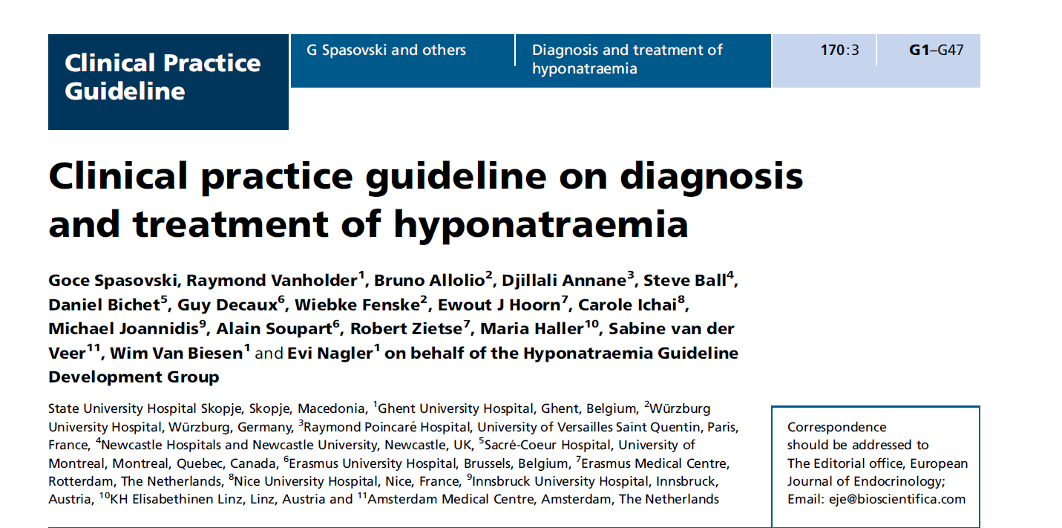

Slide 6
Drug-Induced Hyponatremia

Slide 9
the syndrome of inappropriate antidiuresis.

Slide 10
Diagnostic criteria for the syndrome of inappropriate antidiuresis.

Slide 11
Thiazide-Induced Hyponatremia

Slide 13
Risk factors for thiazide-induced hyponatraemia

