Slide 1
In the name of god

Slide 2
Case study of primary hyperparathyroidism

Slide 3
Endocrine grand rounds
Case 3o-10-98:A 68 year-old lady with a history of bone and muscle pain presented with parathyroid adenoma
Dr dehghan and Dr saberian

Slide 4
Chief complaint and present illness
CC:Skeletal and muscle pain(right lower limb)
PI:the patient is a 68 years old woman married to had 6 children and lives in mashhad,source of history was her dauther but not reliable.
2 years ago(in 1396)First presented to a physician with a history of confusion and delirium resolved rapidly.becauase of this presentation routine laboratory was performed that showed mild hypercalcemia(ca:10.3) and subclinical hyperthyroidiam(TSH:0.19,T4:97) and other laboratory was normal.
The patient had generalized muscle pain specially in neck and shoulders.

Slide 5
She hasn’t remember pattern of pain .because of this symptom and laboratory report, parathyroid scan with MIBI was done. The scan showed no evidence of abnormal parathyroid tissue in the thyroid bed, a focal area of increased radiotracer uptake in the upper mediastinum.
The patient treated with cinacalcet and methimazol with unknown diagnosis???
Because of severe muscle and skeletal pain she consumed multiple NSAIDS such as diclofenac and hadn’t proper F/U.
In 1397 Neck and shoulder pain was improved but lower limb specially right thigh pain was begun.

Slide 6
Pain was aggravated especially at night.she had claudication and muscle pain and inability to get up from the ground because of sever pain.
In 1397/1/26 , repeated parathyroid scintigraphy with TC-99-MIBI showed negative for either parathyroid adenoma or hyperplasia.

Slide 7
She had intermittent flank pain and hematuria from 2 years ago. She had also epigastric pain from 6 months ago exacerbating with eating and not improved with PPI.
She had constipation from many years ago and hadn’t
diarrhea, history of fx, weight loss,polyuria and polydipsia
Because of right lower thigh pain and her laboratory(ca:10.3,p:2.9,PTH:440,25(OH)VitD:15)with primary hyperparathyroidism diagnosis admitted to Taleghani hospital for further workup and treatment.

Slide 8
In 98/10/2 parathyroidectomy in Taleghani hospital was done.
During surgery the patient had crisis of blood pressure and treated with serum TNG.

Slide 9
Family,drug and social history

Slide 10
Past medical/surgical Hx:
HTN from 5 years ago
Depression from 20 years ago
IHD from 4 years ago

Slide 11
Family history
No history of similar problem in any first and second degree relatives

Slide 12
Drug history
Carvedilol tab 6.25 mg/BD
Citalopram40mg/HS
Alprazolam tab 0.5 mg/HS
ASA tab 80 mg /HS
Losartan tab25 mg /daily
Alendronate 70mg tab/weekly
Atrovastatin tab 20 mg/daily

Slide 13
Review of system
Constitutional symptoms: lack of energy and malaise
Eyes,Ears,nose,mouth,throat:Negative(difficultly with hearing,sinus problems,runny nose,post nasal drip,ringing in ears,mouth sores,loose teeth,ear pain,nosebleeds,sore throat,facial pain ornumbness)
Cardiovascular:Negative(iregular heartbeat,racing heart,chest pains,swelling of feet or legs,pain in legs with walking)
Respiratory:Negative(shortness of breath,right sweats,prolonged cough.wheezing,sputum production,prior tuberculosis,pleurisy,oxygen at home,coughing up blood)
Gastrointestinal:constipation,abdominal pain
Genitourinary:negative

Slide 14
Musculoskeletal:right lower limb pain,neck an shoulder pain,disability to get up the ground
Neurologic:problems with walking and balance due to sever pain
Psychiatric:depression
Endocrine:intolerance to heat
Hematologic/lymphatic:negative(easy bleeding,easy bruising,anemia,abnormal blood tests,leukemia,unexplained swollen area)
Allergic/immunologic:Negative(seasional allergies,hey fever symptoms.itching)

Slide 15
Physical Examination
General appearance:68 y/o female who is awake and alert and appears healthy and looks her stated age.
Wt:55kg Ht:160cm BMI:21.48kg/m2
BP:130/80 OT:37C GFR:60 VITALS:PR:86 kg RR:12

Slide 16
H&N:Bitemporal alopecia(-)moon face(-)buffalo hump(-)supraclavicular fat(-)LAP(-)increased muscular mass(-) no palpable mass
Thyroid:normal size and consistency,no detectable nodule
Chest:lung and heart ausculation was normal
Abdominal:no tenderness and guarding,no organomegaly
Ext:local tenderness in hip joint and right femor
Force and tone and DTR was normal.

Slide 17
Laboratory test

Slide 18
1396/8/6 Laboratory Mashhad
T4 | TSH | ALP | mg | Ph | Ca
96 | 0.19 | 327 | 2.8 | 2.6 | 10.3
volume | cr | ca | urine24hr
3120 | 600 | 550

Slide 19
Urine biochemistry 98/9/16
4.3 mg/24hr(<13.6) | VMA
3.3 mic/24hr(<350) | 24Hr urine Metanephrine ELISA
99 mic/24hr(<600) | 24Hr Normetanephrine ELISA
1 mic/24hr(<20) | 24Hr urine epinephrine(adrelanie)
22 mic/24hr(<90) | 24hr urine NorEpinephrine
1650 ml/24hr | Total volume
0.24 gr/24hr(0-0.15) | 24hr urine protein
85.1 mic/24hr(50-190) | 24hr U Free Cortisol
1900 ml/24hr | Total volume
0.6 gr/24hr(0.6-1.8) | Urine cr
0.5 gr/24hr | 24hr urine creatinine

Slide 20
PARS LABORATORY REPORT
ca | 11.3
ph | 2.7
PTH | 369
25(OH)Vit D | 50
TSH | 0.51
T4 | 7.3
T3 | 0.7

Slide 21
PARS LABORATORY REPORT (Urine 24hr urine)
volume | 1250
cr | 650
ca | 188
Ph | 454

Slide 22
Taleghani hospital labratory | Ca | Ph | Alb | PTH | Wbc | Hb | Plt | 25(OH) Vit D
9/12 | 10 | 2.5 | 3.6 | 362 | 8700 | 10.1 | 295 | 8
9/13 | 10.5 | 2.8 |  |  |  |  | 280
9/26 | 10.4
9/28 | 11.6
10/1 | 9.5 | 3.3
10/2 | 9 | 3.7 |  | 244 | 9000 | 11.4 | 230
10/3 |  | 3 |  |  | 11000 | 11.3

Slide 23
Post operative laboratory test
98/10/15 | Mashhad labratory
8.8 | ca
3.5 | ph
86.3(12-65) | PTH
22 | 25(OH)Vit D
0.2 | TSH
85 | T4
38.9(up tp115) | Gastrin

Slide 24
Imaging report

Slide 25
BMD
96/8/3

Slide 26
Parathyroid scan with MIBI
7/8/96

Slide 27
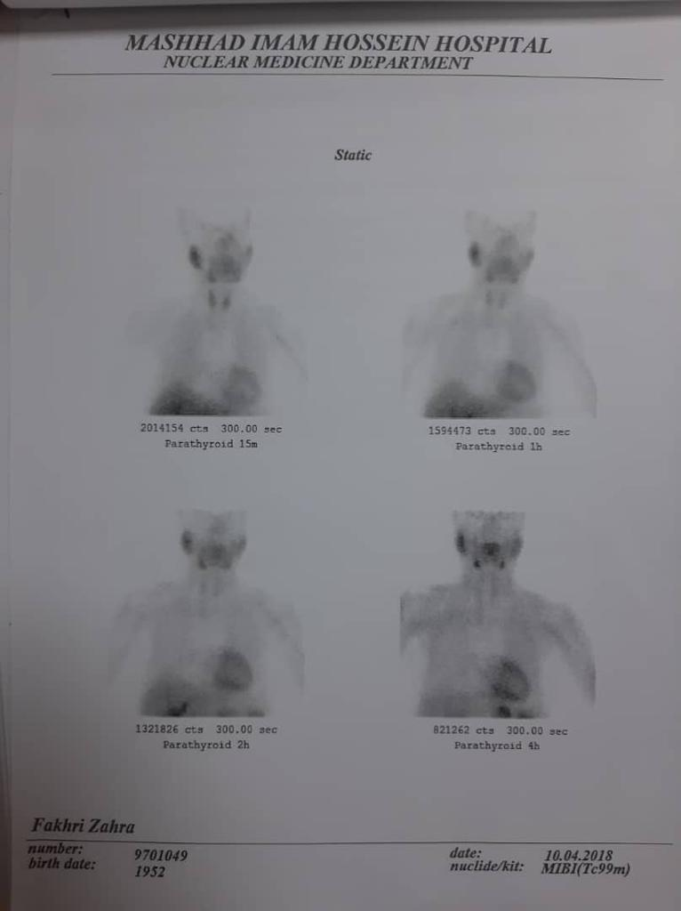

Slide 28
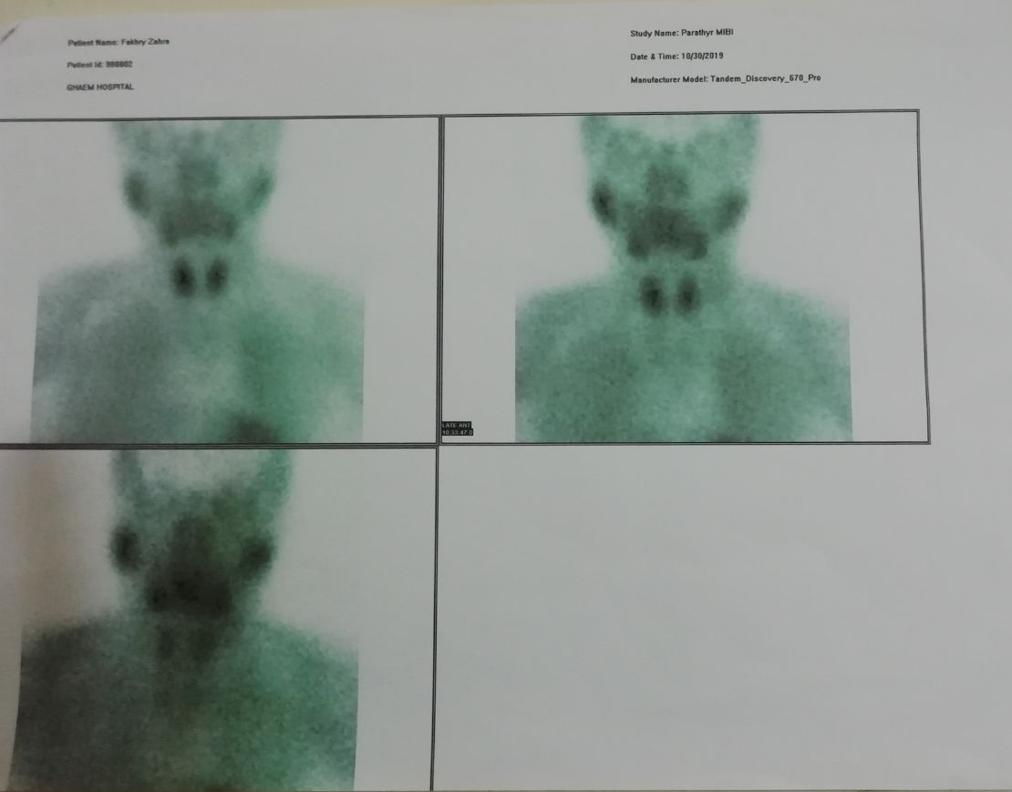

Slide 29
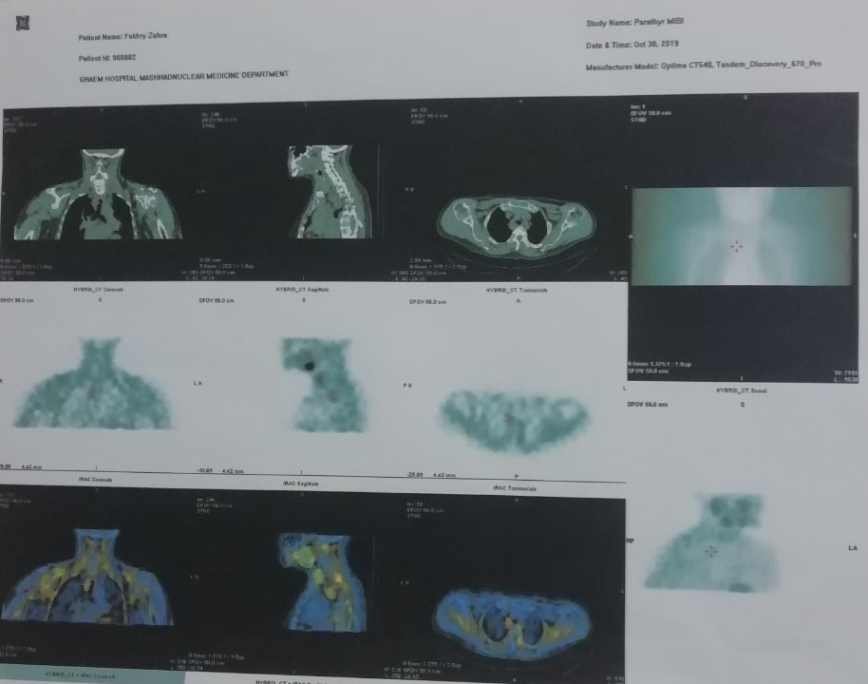

Slide 30
Parathyroid scintigraphy with Tc-99-MIBI
97/1/26

Slide 31
CT Scan axial of neck with and without IV Contrast
98/6/9

Slide 32
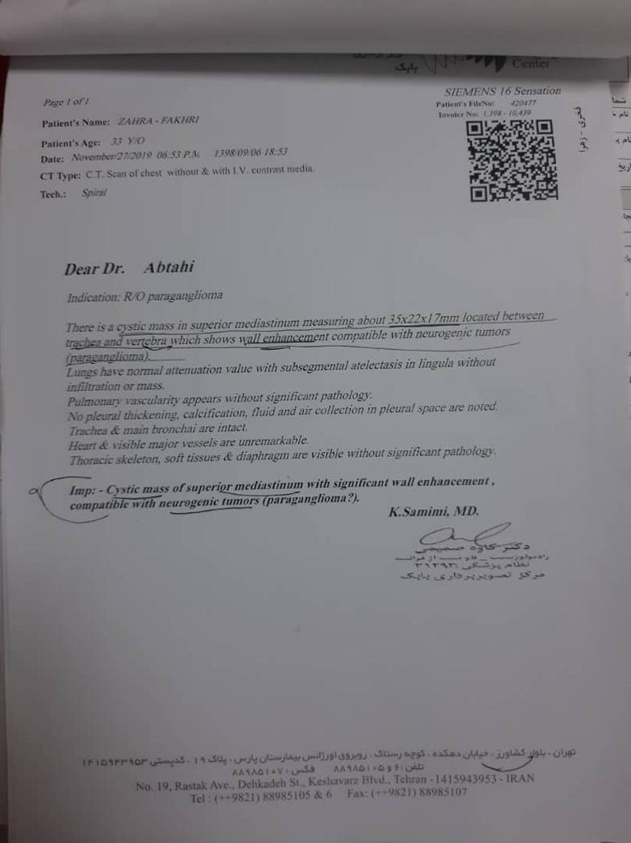
CT scan of chest with and without contrast
98/6/9

Slide 33
Parathyroid scan and SPECT/CT
98/8/8

Slide 34
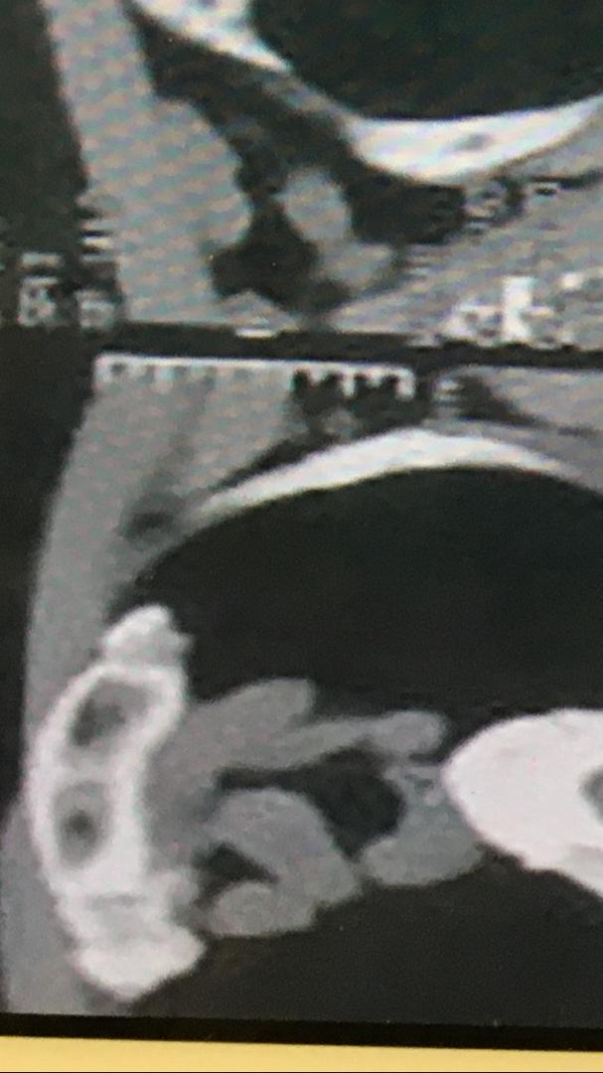

Slide 35
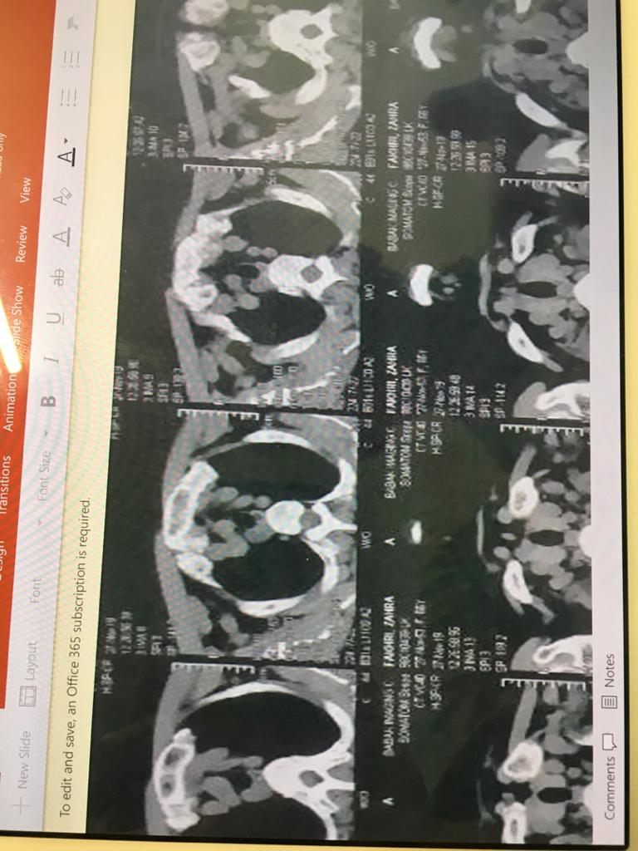

Slide 44
98/8/1

Slide 45
colonoscopy
98/9/23

Slide 46
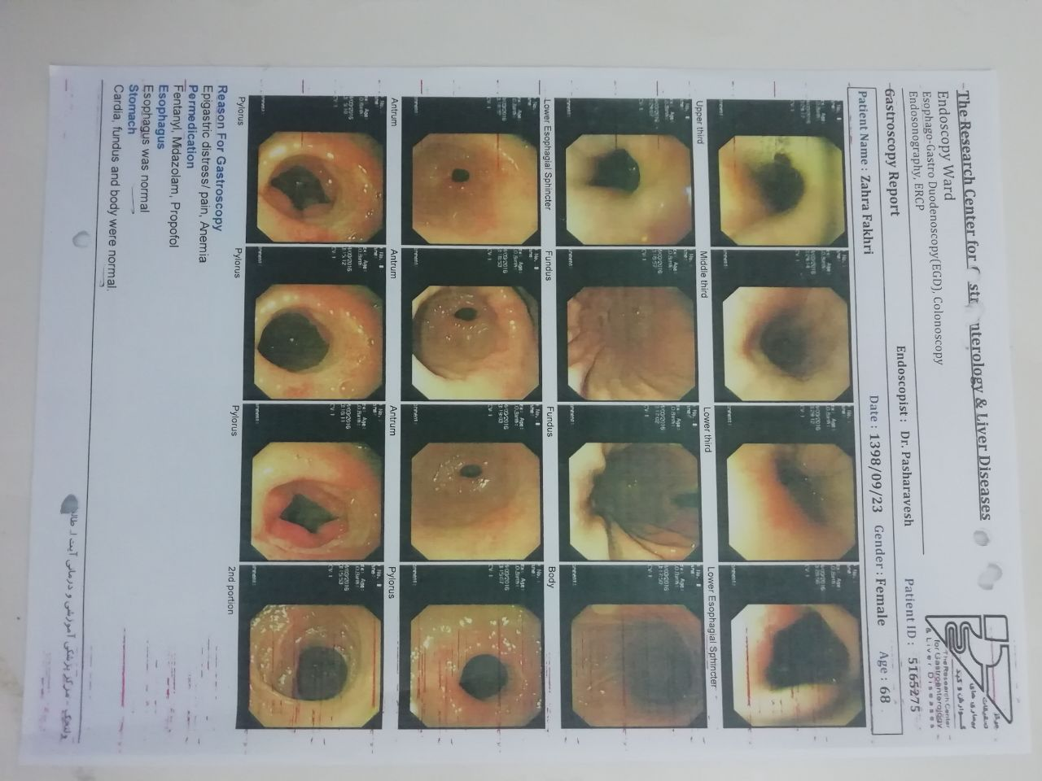
Endoscopy
98/9/23

Slide 47
There was at least six clean-based ulcers in antrum and one circumferential ulcer in pyloric valve

Slide 48
Kidney sonography
98/9/14

Slide 49
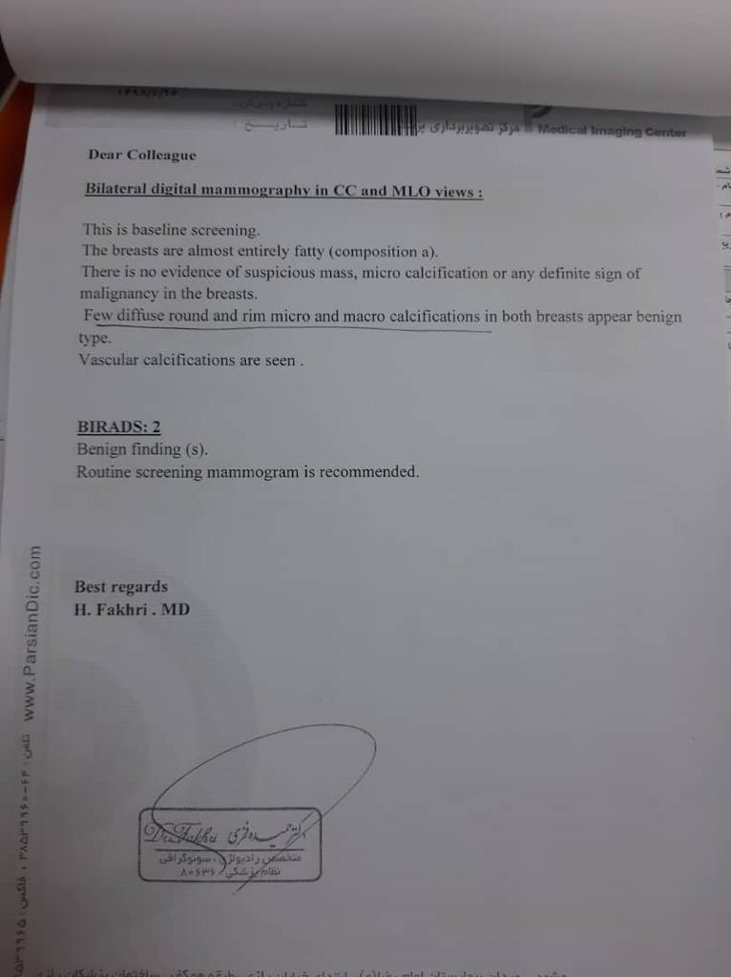

Slide 50
Operation report sheet
98/10/2

Slide 51
Operation report sheet
98/10/2

Slide 54
Pathology report

Slide 55
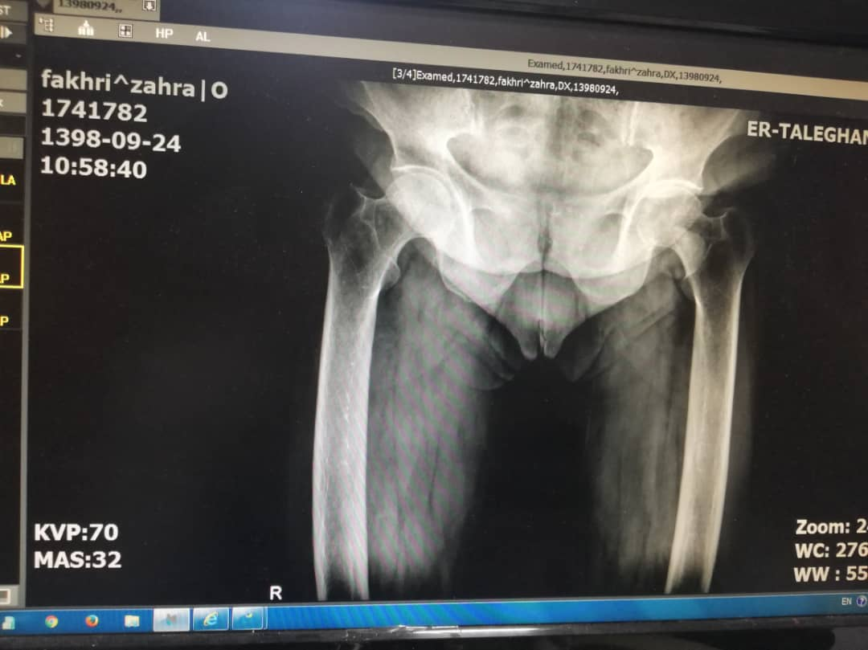

Slide 56
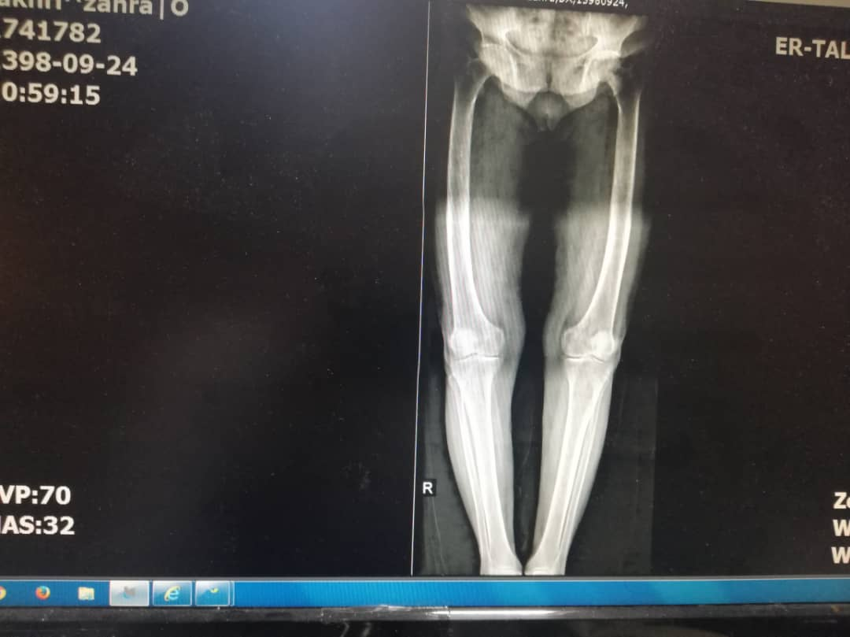

Slide 57
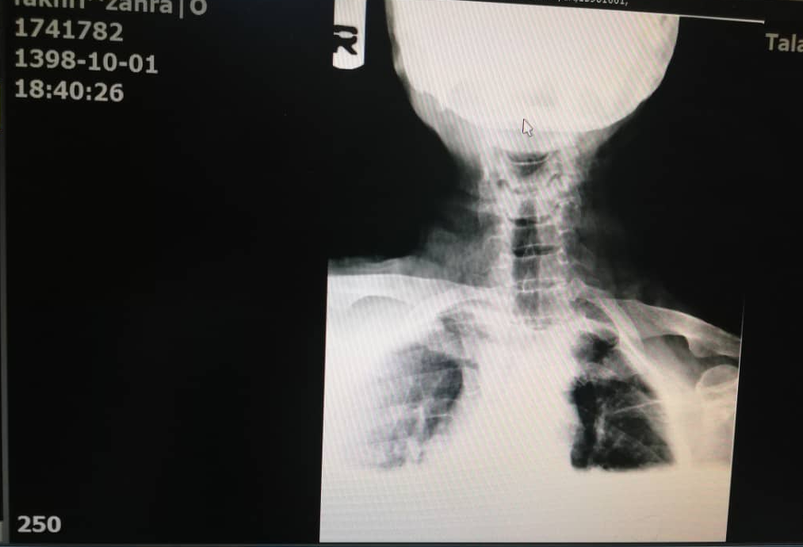

Slide 58
