Slide 1
Consensus in the Use of 131 I Therapy in Differentiated Thyroid Cancer Fatemeh Rahmani.MD Research Institute for Endocrine Science Shahid Beheshti University Of Medical Science

Slide 2
Agenda ●Introduction ●Risk classification ●Goals of 131 I therapy ●Response to therapy ●Survival rate ●Dosage of 131I ● use of rhTsh ●The Martinique principles

Slide 3
3 main categories depending on the patient’s estimated risk ●Remnant ablation ●Adjuvant therapy ●Therapy for known persistent disease

Slide 4
Remnant ablation use of 131-I to destroy normal residual functioning thyroid tissue (1)Facilitating the interpretation of subsequent Tg levels (2)Increasing the sensitivity of detection of locoregional and/or metastatic disease on subsequent follow-up RAI WBS (3)Maximizing the therapeutic effect of any subsequent 131-I treatments (4)Facilitating a postablation scan that may identify additional sites of disease that were not identified on the preablation scan or suspected if a preablation scan was not performed

Slide 5
Adjuvant treatment Use of 131-I to destroy unknown microscopic thyroid cancer and/or suspected but unproved residual thyroid cancer to potentially decrease recurrence and mortality from thyroid cancer. Treatment Use of 131-I to destroy known locoregional and/or distant metastasis with the objectives of potential cure, reduced recurrence and mortality from thyroid cancer, and/or palliation

Slide 6
Agenda ●Introduction ●Risk classification ●Goals of 131 I therapy ●Response to therapy ●Survival rate ●Dosage of 131I ● use of rhTsh ●The Martinique principles

Slide 7
Tools for risk classifications ●TNM anc prognostic scoring tools such a MASIC (metastases, age, completeness of resection, invasion, and size) for prediction of disease specific mortality ●Clinico-pathological staging system for prediction of recurrence ●Dynamic reclassification

Slide 8
●Majority(70-85%) of patients are at low-risk of mortality ●Higher risk :minority ●AJCC/IUCC staging :Predict risk of mortality ,not recurrence ●For assesemenf of risk of recurrence :A three-level stratification can be used

Slide 9
TNM staging AJCC UICC 2017 ●Eight edition downstage many patients into lower stages and classifies fewer patients as having stage 3 or 4 disease but conveys a poorer prognosis for those who do ●The expected 10-year,disease-specific survival for patients <55 years old with stage 1 or 2 is 98 to 100 and 85 to 95 %,respectively ●For patients >55years of age,the expected 10-year,disease specific survival for stage 1,2,3 and 4 disease is 98 to 100,85 to 95, 60 to 70 ,and<50 %,respectively

Slide 10
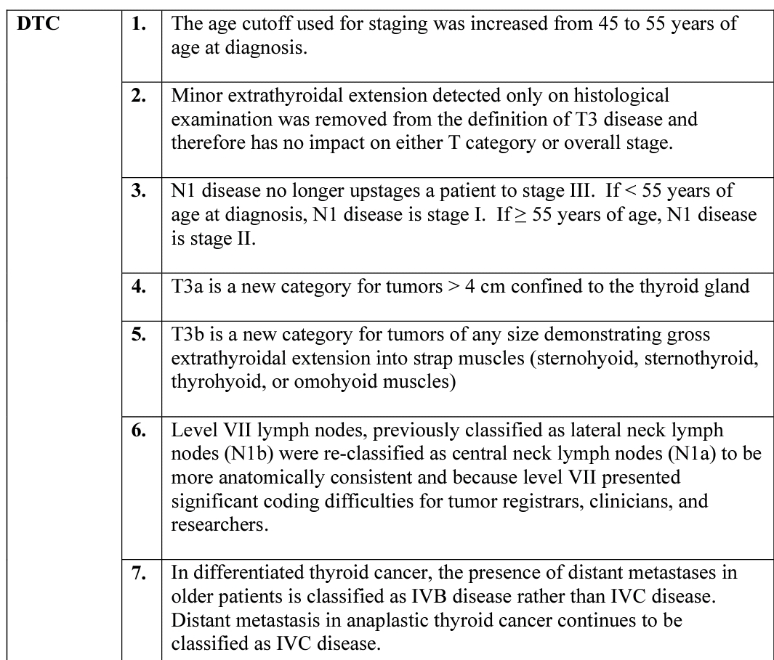

Slide 11
ATA low risk Papillary thyroid cancer (with all of the following) ●No local or distant metastase ●All macroscopic tumor has been resected ●No tumor invasion of loco-regional tissues or structures ●The tumor doesnot have aggressive histology(tall cell,hobnail variant, columnar cell carcinoma) ●If 131I is given, there are no RAI-avid metastatic foci outside thyroid bed on the post treatment WBS ●No vascular invasion ●Clinical N0 or《 5 pathologic N1 micrometastases (<0.2 cm in largest dimension)

Slide 12
ATA low risk… ●Intrathyroidal, encapsulated follicular variant of papillary thyroid cancer ●Intrathyroidal, well differentiated follicular thyroid cancer with capsular invasion and no or minimal (<4foci) vascular invasion ●Intrathyroidal, papillary microcarcinoma, unifocal or multifocal, including BRAFV600E mutated(if known)

Slide 13
ATA Intermediate risk ●Microscopic invasion of tumor into the perithyroidal soft tissues ●RAI-avid metastatic foci in the neck on the first post treatment WBS ●Aggressive histology(tallcell, hobnail variant, columnar cell carcinoma) ●Papillary thyroid cancer with vascular invasion ●Clinical N1 or> 5 pathologic N1 with all involved lymph nodes<3 cm in largest dimension ●Multifocal papillary microcarcinoma with ETE and BRAFV600E mutated

Slide 14
ATA high risk ●Macroscopic invasion of tumor into the perithyroidal soft tissues ●Incomplete tumor resection ●Distant metastases ●Postoperative serum Tg suggestive of distant metastases ●Pathologic N1 with any metastatic lymph node 》3cm in largest dimension ●Follicular thyroid cancer with extensive vascular invasion(>4 foci of vascular invasion

Slide 15
Agenda ●Introduction ●Risk classification ●Goals of 131 I therapy ●Response to therapy ●Survival rate ●Dosage of 131I ●Use of rhTsh ●The Martinique principles

Slide 16
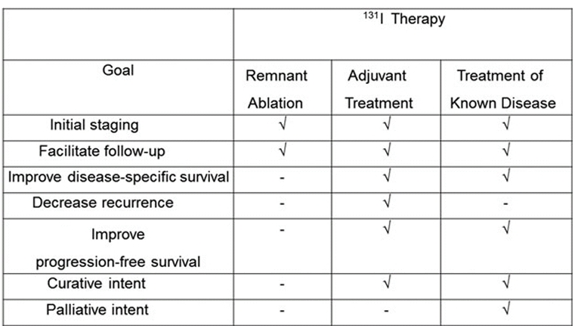
Goals of 131 I therapy

Slide 17
Agenda ●Introduction ●Risk classification ●Goals of 131 I therapy ●Response to therapy ●Survival rate ●Dosage of 131I ● use of rhTsh ●The Martinique principles

Slide 18
Response to therapy ●Excellent response: no clinical, biochemical, or structural evidence of disease ●Biochemical incomplete response: abnormal Tg or rising anti-Tg antibody levels in the absence of localizable disease. ●Structural incomplete response: persistent or newly identified loco -regional or distant metastases ●Indeterminate response: nonspecic biochemical or structural findings that cannot be condently classied as either benign or malignant. This includes patients with stable or declining anti-Tg antibody levels without definitive structural evidence of disease.

Slide 19
Agenda ●Introduction ●Risk classification ●Goals of 131 I therapy ●Response to therapy ●Survival rate ●Dosage of 131I ● use of rhTsh ●The Martinique principles

Slide 20
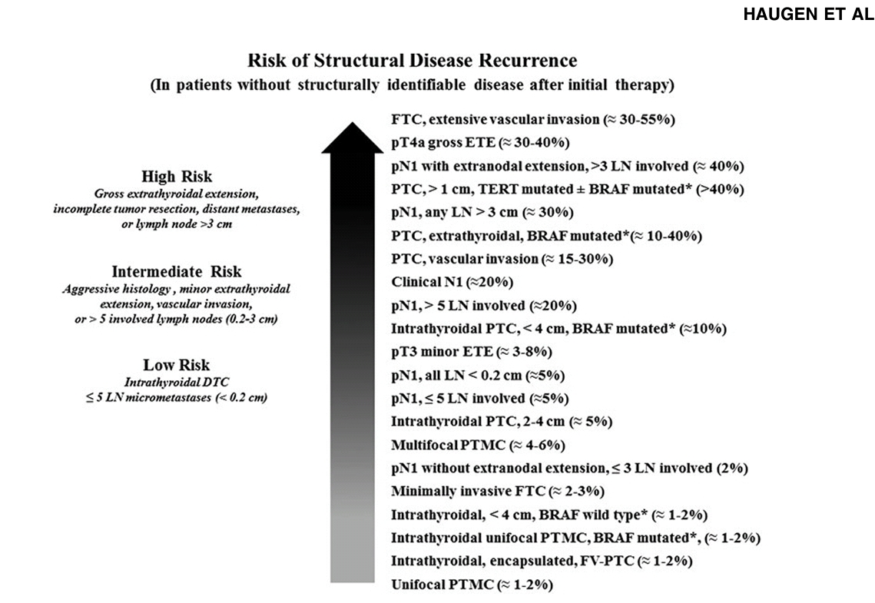

Slide 21
●The aim of this systematic review was to examine the evidence of RRA benefit in staging, follow up, and DR prevention in LR and IR DTC ●Since death rates in LR and IR DTC patients are extremely low , the prevention of recurrent disease has become the focus of contemporary management and research ●In LR and IR patients ,however ,the risk of persistent disease is a bout 2.5% and 11% respectively ,ranging from 1% to 20% according to the different pathological features

Slide 22
Results ●Neck US and serum Tg measurement are equivalent or superior in detecting and localizing residual disease compared to Rx-WBS ●It is doubtful that early detection of microscopic locoregional metastasis will impact on patient’s outcome ●10 OP showed some benefits in reducing DR rates with RAT in IR patients ●14 OP failed to show benefit from RRA in similar groups of patients

Slide 23
Results… ●No benefit from RAT has been shown for LR patients in prevention of DR ● For IR patients,no defined recommendation for or against RRA is made ●In IR patients,RAT may be beneficial in one or more of the following features: ●minimal extrathyroidal extension ●aggressive histology (tall cell,columnar,diffuse sclerosing varients) ●N1 ●uptake outside thyroid bed on DxWBS or RxWBS ●multifocality ●BRAFF mutation

Slide 24
Agenda ●Introduction ●Risk classification ●Goals of 131 I therapy ●Response to therapy ●Survival rate ●Dosage of 131 I ● use of rhTsh ●The Martinique principles

Slide 25
In a retrospective multicenter registry study, 1298 DTC patients between 1975 and 2005 categorized as being in the ATA low-risk level, were followed for a median of10.3 years, there was no signicant effect of RAI adjuvant therapy on overall or disease-free survival, using respective multivariate and stratied propensity analysis techniques

Slide 26
●The majority of the best available observational evidence suggests that RAI adjuvant therapy is unlikely to improve disease-specic or disease -free survival in papillary microcarcinoma (<1cm, uni-or multifocal), in the absence of other higher risk features ●In a recent retrospective analysis of 704 microPTC patients whose initial risk level was ATA low or intermediate who were followed for a median of 64 months, there was no signicant reduction in recurrence rates in patients treated with RAI compared to those not treated with RAI using a propensity score analysis

Slide 27
●examine the impact of RAI on overall survival in IR risk PTC patients. ●Adult patients with intermediate risk PTC(by ATA risk and AJCC disease) who underwent total thyroidectomy with/without RAI in the National Cancer Database, 1998–2006. ●Main Outcome Measures: Overall survival (OS) for patients treated with and without RAI using univariate and multivariate regression analyses. ●21,870 patients were included; 15,418 (70.5%) received RAI and 6,452 (29.5%) did not. Mean follow-up was 6 years.

Slide 28
Results ●29% reduced risk of death with RAI therapy [HR 0.71(CI 0.62–0.86)] in an adjusted analysis for all IR patients ●36% reduced risk of death for patients aged younger than 45 years ●RAI is associated with improved OS in intermediate-risk patients with PTC ●the decision to treat is based on clinical judgment(age, histology , size of tumor, status of lymph node metastasis, vascular invasion and tumor multifocality)

Slide 29
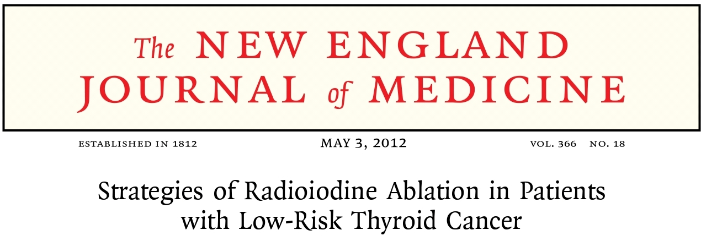
●In this RCT, they compared two thyrotropin-stimulation methods (thyroid hormone withdrawal and use of rhTSH) and two radioiodine (131I) doses(1.1 GBq and 3.7 GBq)in a 2-by-2 design ●Inclusion criteria were an age of 18 years or older; total thyroidectomy for DTC;TNM stage of LR

Slide 30
Results ●In the 684 patients with data that could be evaluated,US of the neck was normal in 652 (95%),and the stimulated Tg level was 1.0 ng /ml or less in 621 of the 652 patients (95%) without detectable Tg antibodies. ●Thyroid ablation was complete in 631 of the 684 patients (92%). ●The ablation rate was equivalent between the 131I doses and between the thyrotropin-stimulation methods. ●The use of rhTSH and low-dose (1.1 GBq) postoperative radioiodine ablation may be sufficient for the management of low-risk thyroid cancer.

Slide 31
ATA guidelines ● low-risk DTC RAI ablation is not routinely recommended after thyroidectomy(weak recommendation, low-quality evidence) ●Unifocal papillary microcarcinoma in absence of other adverse features RAI ablation is not routinely recommended (strong recommendation, moderatequality evidence) ●Multifocal papillary microcarcinoma in absence of other adverse features RAI ablation is not routinely recommendeda (weak recommendation, low -quality evidence) ●Intermediate-risk DTC RAI adjuvant therapy should be considered (weak recommendation, low- quality evidence) ●High-risk DTC: RAI adjuvant therapy is routinely recommended (strong recommendation, moderate-quality evidence

Slide 32
Locoregional disease ● ATA:RAI may be used in patients with low-volume disease or in combination with surgery in case of bulky disease

Slide 33
ATA Distant metastasi ●Pulmonary micrometastases: RAI treatment is recommended every 6– 12 mo as long as disease continues to concentrate RAI and respond clinically (strong recommendation, moderate-quality evidence) ●Pulmonary Macronodular metastases: may be treated with RAI and treatment repeated when objective benefit is demonstrated (decrease in the size of the lesions, decreasing Tg) (weak recommendation, low quality evidence) ●Bone:In iodine-avid bone metastases, RAI therapy should be used, although rarely curative(strongrecommendation,moderate-qualityevidence ●Brain:Surgical resection and EBRT are the mainstays of therapy for CNS metastases. RAI therapy can be considered in case of RAI-avid CNS metastases) weak recommendation, low-quality evidence(

Slide 34
ATA Absence of structurally evident disease ● stimulated serum Tg <10 ng/mL with thyroid hormone withdrawal or <5 ng/mL with rhTSH, the patient can be followed without empiric RAI therapy (weak recommendation, low-quality evidence). ●RAI therapy may beconsidered in patients with significantly elevated Tg levels, rapidly rising Tg levels, or rising anti Tg levels, in whom imaging (anatomic neck/chest imaging and/or PET/CT) has failed to reveal a tumor source . ●If empiric RAI therapy is given and the post-therapy scan is negative, the patient should be considered to have RAI-refractory disease and no further RAI therapy should be administered (weak recommendation, low-quality evidence)

Slide 35
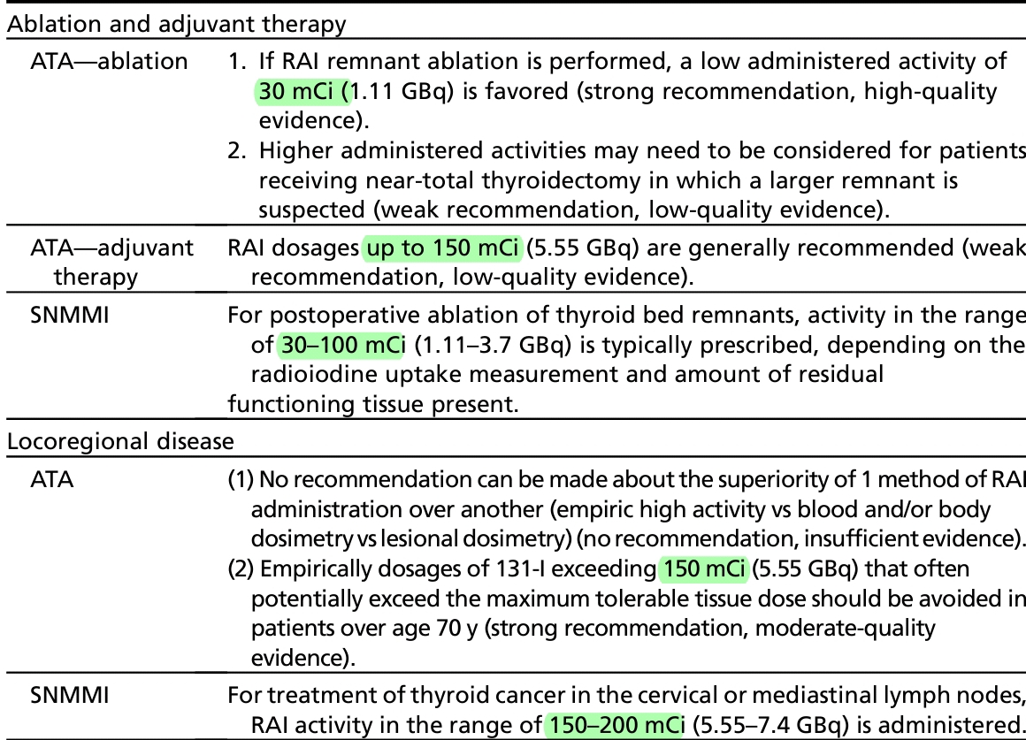

Slide 36
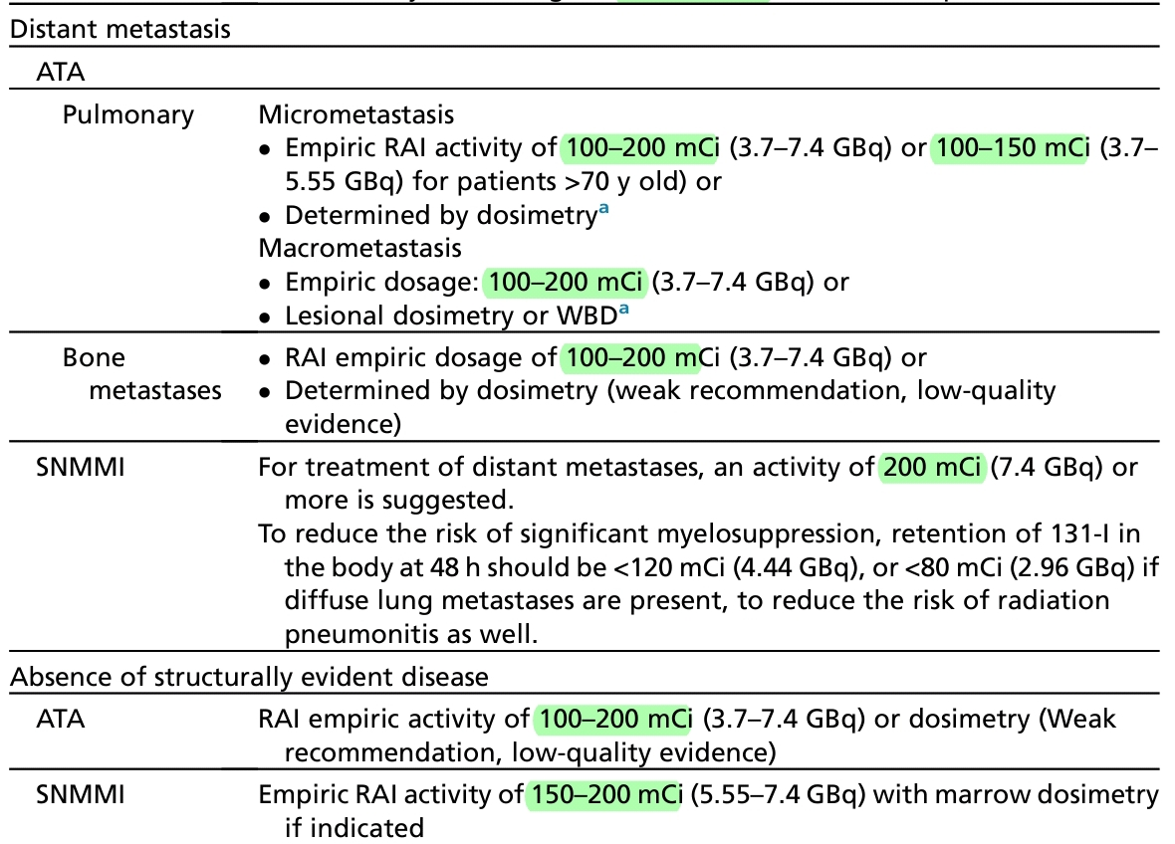

Slide 37
Agenda ●Introduction ●Risk classification ●Goals of 131 I therapy ●Response to therapy ●Survival rate ●Dosage of 131I ● use of rhTsh ●The Martinique principles

Slide 38
●use of rhTSH has become a safe and effective alternative to thyroid hormone withdrawal in the detection of recurrent or residual thyroid cancer and for facilitation of radioiodine ablation ●recent retrospective studies suggest that final clinical outcomes (recurrence rates and likelihood of achieving no evidence of disease status at final follow-up) over 5 years to 10 years of follow-up are very similar with either method of preparation

Slide 39
ATAguidelines suggest that preparation with rhTSH stimulation: (1)is acceptable in case of patients with ATA low-risk and ATA IR DTCwithout extensive lymph node involvement (ie, T1–T3, N0/Nx/N1a, M0), in whom RAI remnant ablation or adjuvant therapy is planned (2)is considered prior to adjuvant 131-I therapy in patients with ATA IR DTC with extensive lymph node disease in the absence of distant metastases (3)in the rare circumstance of patients with coincidental hypopituitarism who cannot raise their endogenous TSH after withdrawal or patients with such extensive metastatic disease that tumor production of thyroid hormone continues to suppress pituitary secretion of TSH after thyroxine withdrawal

Slide 40
Agenda ●Introduction ●Risk classification ●Goals of 131 I therapy ●Response to therapy ●Survival rate ●Dosage of 131I ●Use of rhTsh ●The Martinique principles

Slide 41
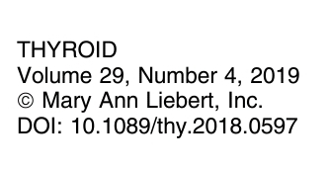

Slide 42
Principle 1 Advancing our understanding of optimal thyroid cancer management requires a commitment by clinicians, researchers, patients, and organizations to engage in proactive, purposeful, and inclusive interdisciplinary cooperation. Principle 2 The goal of 131I therapy should be characterized as remnant ablation, adjuvant treatment, or treatment of known disease using standardized definitions.

Slide 43
Principle 3 Assessment of postoperative disease status is required to optimize proper patient selection for 131I therapy (remnant ablation, adjuvant treatment, or treatment of known disease). Principle 4 Postoperative disease status evaluations should be standardized and integrated into routine clinical care. ●neck ultrasonography:operator dependent, sensitivity for cervical nodal metastases is high, except in the central compartment prior to thyroidectomy, its specificity is suboptimal ●Tg measurement ●Radioactive iodine scan

Slide 44
Principle 5 Optimal patient selection for 131I adjuvant treatment requires consideration and evaluation of multiple factors beyond postoperative disease status and risk stratification. assessment of potential side effect profile, patients preferences and values, the availability and quality of US, radioactive iodine imaging, Tg assays, experienced thyroid surgeons, and preferences of the local disease management team are additional key elements Principle 6 The optimal administered 131I activity for adjuvant treatment cannot be definitely determined from the published literature. Until definitive data are available, selection of the administered activity for adjuvant treatment should be based on multidisciplinary team management recommendations.

Slide 45
Principle 7 Characteristics used to classify patients as 131I refractory should be used to risk stratify patients with regard to the likelihood that a tumor will respond to 131I therapy and not necessarily as definitive criteria to mandate whether 131I therapy should be recommended.

Slide 46
Clinical Scenarios Suggesting 131I-Refractory DTC 1.No 131I uptake is present on a diagnostic 131I scan 2.No 131I uptake is present on a 131I scan performed several days after 131I therapy 3.131I uptake is only present in some but not other tumor foci 4.DTC metastasis progress despite 131I uptake 5.DTC metastasis progress despite a cumulative 131I activity of >600 mCi

Slide 47
1) No radioiodine uptake is present on a diagnostic radioiodine scan. confounders ● preparation, including avoidance of iodine excess and adequate TSH stimulation is important. ● the technique of radioactive iodine scanning is critical and varies significantly between different centers ●High-resolution SPECT/CT provides much more functional and anatomic detail than planar imaging ●A lack of optimization and standardization of radioactive iodine scans can lead to suboptimal imaging that may inappropriately classify a patient as having 131I-refractory disease

Slide 48
2) No radioiodine uptake is present on a radioiodine scan performed several days after 131I therapy. ●highest likelihood of 131I refractory DTC ●post-131I therapy scans may miss as many as 7.5–12% of metastases of DTC that do indeed have radioactive iodine uptake if the scan had been performed at a different time point 3)Radioactive iodine uptake is only present in some but not other tumor foci. ●because one or more metastases are non-131I avid, the disease should not be categorized 131I refractory. We could use local treatment to the site of non-131I-avid lesions (, surgery, radiotherapy, radiofrequency ablation, cryotherapy, embolization) and concurrently effectively treat the 131I-avid tumors with 131I therapy.

Slide 49
4: DTC metastases progress despite 131I uptake. confounding factors: ● metric(s) for successful response to the last 131I therapy ● duration of the response ● metric(s) for progression after 131I therapy ●amount of prescribed activity of 131I administered ●potential for administering a higher activity of 131I ●assessment of side effects and the patient’s risk-to-benefit tolerance

Slide 50
5) DTC metastases progress despite a cumulative 131I activity of > 600 mCi ●As the cumulative 131I activity and number of therapies increase, the likelihood of DTC becoming 131I refractory will increase ●Factors such as response to previous therapies, duration of response, the individual and not cumulative activity administered for each previous 131I treatment, side effects, and the patient’s view with regard to the risk-to-benefit ratio should influence the decision of whether to continue with further 131I administrations.

Slide 51
Principle 8 131I-refractory criteria will continue to evolve as (i) additional studies address important limitations and technical issues confounding the current literature, (ii) techniques for radioactive iodine imaging are optimized and standardized, and (iii) re-differentiation therapies enhance the effectiveness of 131I therapy. Principle 9 Major gaps in knowledge and evidence regarding optimal use of 131I therapy should be addressed with properly designed prospective studies

Slide 52
Thanks for your attention

