Slide 1
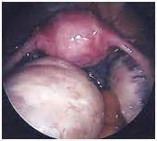
PCOS in pre menopausal and menopausal women
Minoo Yaghmaei

Slide 2
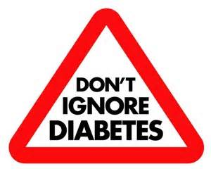
NIDDM
obese and non obese women with PCOS
Hyper insulinaemia and insulin resistance are characteristic features
β – cell dysfunction
Obesity
Insulin resistance impaired glucose tolerance & non
β – cell dysfunction insulin dependent diabetes

Slide 3
Cardiovascular disease
Atherogenic lipid profile (dyslipidemia)
Enhanced plasminogen activator inhibitor type 1
Peripheral insulin resistance

Slide 4
Prevalence of NIDDM, hypertension, CAD in perimenopausal women with a history of PCOS
Case group: 45-59 , treated for markedly expressed clinical symptoms of PCOS
Not significant difference
mean BMI, waist circumference, WHR
mean SBP, DBP, glucose, total chol, HDL, LDL, TG
Elevated total chol (>5.2 mmol/l) , HDL ( <1 mmol/l),
LDL (>3,7mmol/l), TG (>1.9 mmol/l), impaired
fasting glucose

Slide 5
Prevalence of NIDDM, hypertension, CAD in perimenopausal women with a history of PCOS
Prevalence of CAD, NIDDM, and HT in the PCOS and control groups
PCOS controls Pvalue
n=28 n=752
CAD 6 (21%) 38 (5%) p< 0.001
NIDDM 9 (32%) 60 (8%) P< 0.001
Arterial HT 14 (50%) 290 (39%) NS
human Reproduction vol.15 no.4 pp: 785-789. 2000

Slide 6
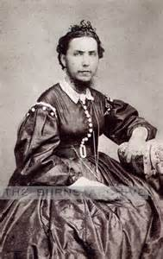
Hyperandrogenism in women with PCOS persists after menopause
Hyperandrogenism is a major pathophysiological feature of PCOS with 60% prevalence.
In reproductive age:
theca cells (main cause) &
adrenal androgen excess (20 to 60% of cases)

Slide 7
Hyperandrogenism in women with PCOS persists after menopause
FSH, LH, Estradiol, prolactin, urinary cortisol, 17-OH : NS
PCOS Controls
Progesterone 0.3 0.2 <0.05
17-OHP 0.5 0.33 <0.05
Δ 4 A 205 107 <0.05
DHEAS 1430 602 <0.05
Total T 0.47 0.37 <0.05
SHBG 43.2 67.7 <0.01
FAI 3.94 1.48 <0.001

Slide 8
Hyperandrogenism in women with PCOS persists after menopause
postmenopausal overweight women with PCOS are characterized by abdominal adiposity, a feature that apparently persists after menopause
At baseline, total T, Δ4A, DHEAS, and FAI levels are higher in postmenopausal PCOS than in non-PCOS women
The dexamethasone suppression results in postmenopausal PCOS women suggest that DHEAS and total T are partially of adrenal origin
This adrenal androgen hypersecretion does not seem to be related to a centrally originating hypothalamic-pituitary-adrenal axis dysfunction, as indicated by the normal ACTH and cortisol responses to CRH stimulation.
Ovarian androgen production also persists after menopause in women with PCOS as reflected by the higher Δ4A levels after dexamethasone suppression, although the ovarian contribution was not fully assessed (i.e. by hypothalamic-pituitary-gonadal axis suppression with a GnRH analog).
Thus, adrenal and ovarian hyperandrogenism persist in PCOS women for at least 5 yr after menopause continuing the exposure of these women to excess androgen, possibly resulting in multiple adverse clinical squeal.
The Journal of Clinical Endocrinology & Metabolism Volume 96, Issue 3

Slide 9
Postmenopausal Women with a History of Irregular Menses and Elevated Androgen Measurements at High Risk for Worsening Cardiovascular Event-Free Survival
Women with clinical features of PCOS were more often
diabetic (P < 0.0001),
obese (P = 0.005),
had the metabolic syndrome (P < 0.0001),
and had more angiographic coronary artery disease (CAD) (P = 0.04) compared to women without clinical features of PCOS. Cumulative 5-yr CV event-free survival was 78.9% for women with clinical features of PCOS (n = 104) vs. 88.7% for women without clinical features of PCOS (n = 286) (P = 0.006).

Slide 10
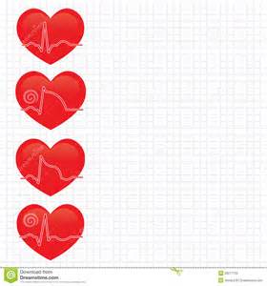
Postmenopausal Women with a History of Irregular Menses and Elevated Androgen Measurements at High Risk for Worsening Cardiovascular Event-Free Survival
Identification of postmenopausal women
with clinical features of PCOS may provide
an opportunity for risk factor intervention
for the prevention of CAD and CV events.
Postmenopausal women with polycystic ovarian
syndrome have a 3.3 fold higher risk of
cardiovascular death or myocardial ischemia
The Journal of Clinical Endocrinology & metabolism Volume 93, Issue 4

Slide 11
Searching for Polycystic Ovary Syndrome in Postmenopausal Women: Evidence for a Dose-Effects Association with Prevalent Cardiovascular Disease
Cross-sectional study of community-dwelling non-estrogen-using postmenopausal
Caucasian women (n=713) mean (± SD) age 73.8 ± 7.9
A putative PCOS phenotype was defined as the presence of ≥3 features:
recalled history of irregular menses,
(2) symptomatic premenopausal hyperandrogenism or biochemical evidence of current biochemical hyperandrogenism,
(3) History of infertility or miscarriage,
(4) central obesity, or
(5) biochemical insulin resistance.

Slide 12
Searching for Polycystic Ovary Syndrome in Postmenopausal Women: Evidence for a Dose-Effects Association with Prevalent Cardiovascular Disease
The PCOS phenotype was present in 9.3% of the entire cohort and 5.8% of non-diabetic women.
graded association between an increasing number of features of the PCOS phenotype (i.e., 0 – ≥3) and prevalent CVD (p=0.02) and coronary heart disease alone (p=0.03).
Conclusions: Among non-diabetic postmenopausal women with intact ovaries, prevalent atherosclerotic CVD is associated with features of a putative PCOS phenotype. This finding supports the thesis that PCOS increases the risk of atherosclerotic CVD years after menopause.
Menopause. 2007 ; 14(2): 284–292. doi:10.1097/GME.0b013e31802cc7ab

Slide 13
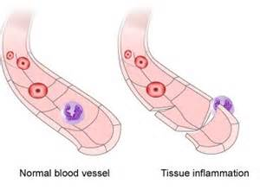
Unfavorable Hormonal, Metabolic, and Inflammatory Alterations Persist after Menopause in Women with PCOS
Twenty-one pre-MP (n=10) and post-MP (n=11) women diagnosed
with PCOS were compared with 29 healthy controls (pre-MP, n=11; post-MP, n=18). Two-hour oral glucose tolerance tests were performed, and ovarian steroid secretion capacity was assessed (human chorionic gonadotropin tests). Areas under the curves (AUC) were calculated.

Slide 14
Unfavorable Hormonal, Metabolic, and Inflammatory Alterations Persist after Menopause in Women with PCOS
Basal serum insulin levels were higher in women with PCOS than in control women in the postmenopausal group, and the same trend was also seen in the premenopausal group. In OGTT, AUC ins was increased in women with PCOS both in pre- and postmenopausal women compared with controls.
Basal serum levels of A were higher in premenopausal
women with PCOS compared with premenopausal con-
trol women, and they decreased significantly after meno-
pause in control women, whereas in women with PCOS,
they remained unchanged
J Clin Endocrinol Metab, June 2011, 96(6):1827–183

Slide 15
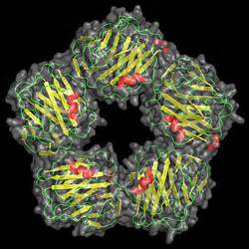
Unfavorable Hormonal, Metabolic, and Inflammatory Alterations Persist after Menopause in Women with PCOS
Basal serum levels of T did not differ
between the groups,
although FAI values were higher both in
premenopausal and postmenopausal women with
PCOS as a result of lower serum levels of SHBG.
Levels of CRP were significantly increased both in pre- and postmenopausal women with PCOS when compared with control women, and the difference remained after adjustment for BMI.

Slide 16
drugs
atenolol + spironolactone
atenolol and spironolactone both increase serum potassium. Potential
or dangerous interaction. Use with caution and monitor closely.
spironolactone + aspirin
spironolactone and aspirin both increase serum potassium. Potential for dangerous interaction. Use with caution and monitor closely.

Slide 17
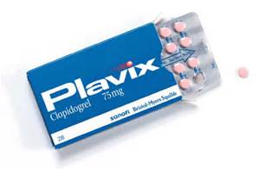
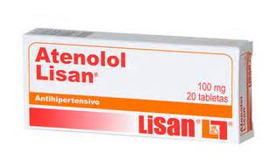
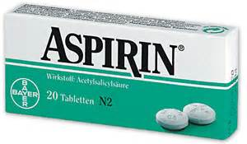
drugs
Plavix and spironolactone
No interaction

Slide 18
EFFECT OF BILATERAL OOPHORECTOMY ON ADRENOCORTICAL FUNCTION IN WOMEN WITH POLYCYSTIC OVARY SYNDROME
decreases in ovarian androgen levels (TT, FT, and E1),
and increases in FSH levels
no effect on basal DHEAS levels or DHEA levels, or on the secretion of DHEA in response to ACTH stimulation.
the relative level of adrenal androgen secretion remains the same over time
we also compared women with higher DHEAS (above the median) to lower DHEAS (below the median) levels and still found no difference in the adrenal response to oophorectomy.
However, it is possible that an ovarian effect may be observable in PCOS patients at the highest levels of DHEAS excess, as suggested by some investigators exploring the effects of medical oophorectomy.

Slide 19
You can take birth control pills as long as you need birth control or until you reach menopause, as long as you're generally healthy and don't smoke. This applies to all types of birth control pills, including combination birth control pills and progestin-only birth control pills.
Birth control pills aren't recommended for women age 35 or older who smoke and women who have certain medical conditions, such as blood-clotting disorders or uncontrolled high blood pressure.
Women who use oral contraceptives have reduced risks of ovarian and endometrial cancer. This protective effect increases with the length of time oral contraceptives are used.

Slide 20
Early Oral Contraceptive Use and Breast Cancer Among Premenopausal Women: Final Report From a Study in Southern Sweden
This case-control study investigates the relationship between the use of OCs and breast cancer development in women in southern Sweden diagnosed in the early 1980s.
In multivariate analyses including the different measurements of OC use, only starting age of OC use was significantly associated with breast cancer. The exposure-response relationship between duration of OC use and risk of breast cancer depended on the age at first use of OCs. Given a fixed duration of OC use, the risk increased with younger starting age of OC use. The findings point to the importance of the early reproductive years as risk determinants for breast cancer after OC use.

Slide 21
Oral Contraceptive Use as a Risk Factor for Premenopausal Breast Cancer: A Meta-analysis
Use of OCs was associated with an increased risk of premenopausal breast cancer in general (OR, 1.19; 95% CI, 1.09-1.29) and across various patterns of OC use. Among studies that provided data on nulliparous and parous women separately, OC use was associated with breast cancer risk in both parous (OR, 1.29; 95% CI, 1.20-1.40) and nulliparous (OR, 1.24; 95% CI, 0.92-1.67) women. Longer duration of use did not substantially alter risk in nulliparous women (OR, 1.29; 95% CI, 0.85-1.96). Among parous women, the association was stronger when OCs were used before first full-term pregnancy (FFTP) (OR, 1.44; 95% CI, 1.28-1.62) than after FFTP (OR, 1.15; 95% CI, 1.06-1.26). The association between OC use and breast cancer risk was greatest for parous women who used OCs 4 or more years before FFTP (OR, 1.52; 95% CI, 1.26-1.82).

Slide 22
Prospective study of past use of OCP and risk of cardiovascular events

Slide 23
Oral contraceptive use in perimenopause.
Am J Obstet Gynecol. 2001 Aug;185(2 Suppl):S32-7.
Oral contraceptive use in perimenopause.
Transitional Management: The Use of Oral Contraceptives in Perimenopause (2011)

Slide 24
Oral Contraceptives and the Risk of Breast Cancer in BRCA1 and BRCA2 Mutation Carriers
Methods: We performed a matched case–control study on 1311 pairs of women with known deleterious BRCA1 and/or BRCA2 mutations recruited from 52 centers in 11 countries.
Results: Among BRCA2 mutation carriers, ever use of oral contraceptives was not associated with an increased risk of breast cancer (OR = 0.94, 95% CI = 0.72 to 1.24).
For BRCA1 mutation carriers, ever use of oral contraceptives was associated with a modestly increased risk of breast cancer (OR = 1.20, 95% CI = 1.02 to 1.40).
Among BRCA1 mutation carriers, women who first used oral contraceptives before 1975, who used them before age 30, or who used them for 5 or more years may have an increased risk of early-onset breast cancer.

