Slide 2
NLA Task Force on Statin Safety - 2014 update

Slide 3
Introduction
Statins are the most widely prescribed class of medications in the United States and their benefits for lowering (LDL-C) and reducing the risk for (CHD) are well documented.
In 2006, the National Lipid Association (NLA) convened a Statin Safety Assessment Task Force of experts who published their findings on specific questions related to the muscle, liver, renal, and neurologic effects of statins.
The true frequency of statin intolerance in the population is unknown, but may approach 10%.
Muscle symptoms may occur in up to 29% of patients initiated on statin therapy, and may be an important causal factor for statin discontinuation, statin switching, and statin nonadherence.

Slide 4
Examples of exclusions from recent statin RCTs are:
Pregnancy
Reduced renal or hepatic function
On drugs known to affect statin metabolism
Advanced age >75 years
Uncontrolled DM
CHF
Dementia
Cancer
Active rheumatologic or musculoskeletal conditions.
Thus, patients who are more susceptible to adverse events may be under represented in RCTs.

Slide 5
Statin Intolerance
Muscle Safety
Cognition
Liver Safety
Diabetes

Slide 6
A clinician’s guide to statin drug-drug Interactions

Slide 7
INTRODUCTION
Peak plasma concentration averaging about 4 hours
When consumed with food, lovastatin is more efficiently absorbed.
Rosuvastatin and simvastatin are not affected by food.
Atorvastatin have a reduced absorption with food.

Slide 8
There appears to be a concentration-dependent relationship between the risk of myopathy/myonecrosis and the serum concentration of a statin.
An interaction resulting
In less than a 2-fold increase in statin AUC, a marker for systemic exposure, would be classified as ‘‘mild’’ risk.
Interactions producing more than a 2- but less than 5-fold increase in systemic exposure would be classified as ‘‘moderate.’’
A strong interaction would result in a 5-fold or higher increase in statin exposure.

Slide 9
Patient’s response may be dictated by other clinical features, such as
Inherent susceptibility to statin-related myopathy
Unidentified genetic predisposition
History or presence of other predictors of statin muscle side effects (hypothyroidism, vitamin D deficiency, electrolyte disturbances, low baseline muscle mass)

Slide 10
Common interacting drugs and over-the-counter medications, supplements, and foods
Rosuvastatin, is associated with fewer potentially severe interaction than those noted previously.
Fibrate: Gemfibrozil is known to reduce the glucuronidation and elimination of statins.
Concomitant ingestion of alcohol and statins, and other medications metabolized through the liver, can result in DDIs.
Grapefruit juice should be kept to less than 60 mL. This inhibitory effect can last for up to 24 hours.
Separating administration of grapefruit juice and statins by 4 hours may limit the interaction.

Slide 11
Special populations with potentially increased risk for DDIs
Elderly:
Muscle mass decreases with aging, may be an increased risk of myopathy in elderly patients.
Polypharmacy is a DDI.
Atorvastatin and Rosuvastatin may mildly increase serum concentrations of ethinyl estradiol and norgestrel, postmenopausal therapies.

Slide 12
Special populations with potentially increased risk for DDIs
Pediatrics:
There is little information with regard to safety issues in children who are on statins for (FH).
4 statins approved in children with FH by the FDA,, are lovastatin, simvastatin, pravastatin, and atorvastatin
FH:
Statin and ezetimibe interactions is minor.
Statins and bile acid resins have few interactions

Slide 13
Comparison of drug-drug interactions across all statins
 | Level 1 (severe) *Do not use* | Level 2 (major) *Use with caution* | Level 3 (moderate) *Less likely to cause severe drug interaction* | Level 4 (mild) *Unlikely to cause drug interaction*
Atorvastatin | Posaconazole | Verapamil | Amiodarone | Carbamazepine
 | Red yeast rice | Clarithromycin | Antacids | Cimetidine
 | Telithromycin | Cyclosporine | Omeprazole | Clopidogrel
 | Voriconazole | Digoxin | Pantoprazole | Oral contraceptives
 |  | Diltiazem | Rifampin | Spironolactone
 |  | Erythromycin | Warfarin
 |  | Fluconazole
 |  | Gemfibrozil
 |  | Grapefruit juice
 |  | Itraconazole

Slide 14
Comparison of drug-drug interactions across all statins
 | Level 1 (severe) *Do not use* | Level 2 (major) *Use with caution* | Level 3 (moderate) *Less likely to cause severe drug interaction* | Level 4 (mild) *Unlikely to cause drug interaction*
Rosuvastatin | Red yeast rice | Antacids | Itraconazole | Erythromycin
 |  | Clarithromycin | Niacin | Oral contraceptives
 |  | Cyclosporine | Warfarin
 |  | Gemfibrozil and other fibrates | Colchicine

Slide 15
An assessment by the Statin Muscle Safety Task Force: 2014 update

Slide 16
Muscle complaints represent the most frequent adverse reports among patients treated with statins.
Statin-associated adverse muscle symptoms may present at any time after beginning therapy with these drugs
These findings may include
Muscle discomfort (myalgia)
Muscle weakness (myopathy)
Tenderness to palpation, with or without muscle inflammation (myositis) and/or myonecrosis.

Slide 17
Spectrum of statin-associated muscle adverse events
Myalgia—unexplained muscle discomfort often described as ‘‘flu-like’’ symptoms with normal CK level.
Myopathy—muscle weakness (not attributed to pain and not necessarily associated with elevated CK).
Myositis—muscle inflammation
Myonecrosis—muscle enzyme elevations or hyperCKemia
 | Mild>3-fold greater than baseline untreated CK levels or normative upper limit that are adjusted for age, race, and sex.
 | Moderate ≥10-fold greater than untreated baseline CK levels or normative upper limit that are adjusted for age, race, and sex.
 | Severe ≥50-fold above baseline CK levels or normative upper limit that are adjusted for age, race, and sex.
Myonecrosis with myoglobinuria or acute renal failure (increase in serum creatinine ≥ 0.5 mg/dL (clinical rhabdomyolysis).

Slide 18
Severe CK elevations continue to be defined as >50 times the baseline concentration or upper normal range
When baseline values are unavailable.which is consistent with the absolute CK concentration of 10,000 IU/L.
Myalgia complaints are most common, ranging from 1% to 5% in controlled clinical trials to 11%to 29% in observational cohorts.

Slide 19
Can statin-associated myalgia be reliably differentiated from myalgia associated with a placebo?
Yes.
Considered to have developed statin associated myalgia if ALL of the following occurred:
New-onset or increased symptoms of myalgia
(muscle aches, stiffness, cramping, soreness, and tenderness) that were unassociated with recent exercise;
Symptoms that persisted for at least 2 weeks.
Symptoms that resolved within 2 weeks of stopping the study drug.
Symptoms that reoccurred within 4 weeks of restarting the medication.

Slide 20
Are statin-associated muscle complaints altered by acute and chronic physical activity?
Yes.
Acute physical activity increases the CK response to exercise in participants on statins.
Chronically physically active individuals and may also exacerbate CK release and presumably the skeletal muscle damage associated with acute exercise.
Other potential mediators of the relationship between acute/chronic exercise and statin myalgia include
Vitamin D status
Genetics

Slide 21
Serial assessment of muscle strength in asymptomatic individuals ought to occur once yearly in oligosymptomatic patients who elect to remain on statin therapy and whose CK is not >3 times the ULN

Slide 22
Are there recommendations when to obtain a muscle biopsy in patients with statin-associated muscle symptoms?
Yes.

Slide 23
Indications for skeletal muscle biopsy after excluding increased physical activity, trauma, metabolic derangements, comorbid conditions associated with increased CK, and known drug interactions
Threshold for biopsy—CK values should be adjusted ≥3 times the upper limit of normal above sex and racial norms in association with either severe myalgia or weakness. Isolated asymptomatic CK elevations between 3 and 10 times the ULN ought to be followed conservatively.
Electromyography myopathic discharges with fibrillations and/or positive sharp waves in affected muscles (usually proximal).
Proximal muscle weakness (≤4 on Medical Research Council scale) in upper and/or lower extremities.

Slide 24
Moderately elevated CK levels, alternative causes for high CK levels needs to be considered first.
These include Recent unaccustomed or eccentric exercise
Metabolic abnormalities
Hypothyroidism
Hypoparathyroidism
Vitamin D deficiency
Hypophosphatemia
Seizure
Acute alcohol toxicity
Other myotoxic drug exposure
Colchicine
Steroids
Antiretrovirals
Cocaine
Intramuscular injection.

Slide 25
Can patients who are initially intolerant to one statin generally tolerate a different statin?
Yes.
92% of patients can tolerate a second statin after discontinuing their initial statin due to a variety of adverse events.
Intolerant to two statins largely because of myalgia that 72.5% could successfully tolerate a third statin.

Slide 26
Does the evidence base for treating statin-associated muscle symptoms or statin muscle intolerance generally consist of high-quality, RCT with appropriate placebo or control groups?
No.
Whether these adverse events were reproducible on rechallenge with the use of a statin agent of equipotency.
Lowering the statin dosage
Switching to another statin
Minimize drug-drug interactions reducing the dosing frequency to less than daily
Combination lipid-lowering therapy to achieve further reductions in LDLC

Slide 27
Does the evidence base for treating statin-associated muscle symptoms
Lipophilic statins (simvastatin and lovastatin) are more likely to produce muscular effects as opposed to the more hydrophilic statins (pravastatin, rosuvastatin, and fluvastatin).

Slide 28
Alternate dosing strategies
For patients with intolerance to their first statin
We then suggest another statin at the initial starting dose.
For patients intolerant to multiple statins
We suggest a less-than-daily dose of a different statin.
The patient who is highly resistive to any statin therapy
We have found a once weekly dose of a long-acting statin, such as rosuvastatin or atorvastatin to be an attractive option.

Slide 29
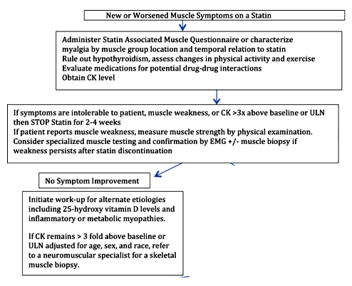

Slide 30
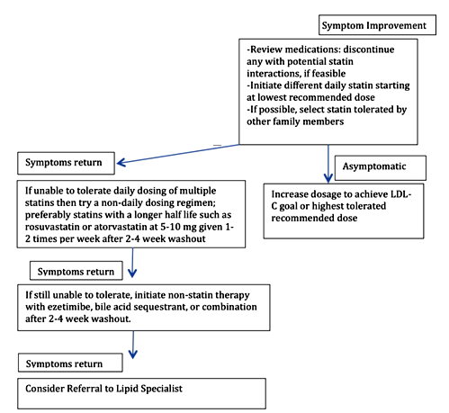

Slide 31
An assessment by the Statin Liver Safety Task Force: 2014 update

Slide 32
An assessment by the Statin Liver Safety Task Force: 2014 update
High risk for significant liver injury in patients with
Persistent and substantial (ALT) elevations (greater or equal to 3 times ULN )
In the presence of hyperbilirubinemia >2 times the ULN
Without elevated alkaline phosphatase
Without other causes of liver injury.

Slide 33
An assessment by the Statin Liver Safety Task Force: 2014 update
Mild to moderate elevations in liver enzymes alone
(Without an increase in bilirubin) may not always reflect a true ‘‘toxicity’’ because increases in hepatic aminotransferases are not technically abnormal‘‘liver function tests.’

Slide 34
Have any unexpected safety concerns arisen since the regulatory recommendation that liver enzymes need not be measured after initiating statin therapy?
No.
Liver enzyme tests should be performed
Before starting statin therapy
As clinically indicated
FDA has determined that all currently marketed statins appear to be associated with a very low risk of serious liver injury and that routine periodic monitoring of serum (ALT) does not appear to detect or preven serious liver injury in association with statins.

Slide 35
Hy’s law criteria must meet each of the following
Elevations in alanine or aspartate aminotransferase ≥3 times the upper limit of normal
Increases in total bilirubin >2 times the upper limit of normal
No other demonstrable cause, such as cholestasis (as might be suggested by an increase in alkaline phosphatase); viral hepatitis A, B, or C; preexisting or acute hepatobiliary disease; or another drug capable of causing the observed injury

Slide 36
Are statins safe to use in patients with nonalcoholic fatty liver disease?
Yes.
statin therapy can be used safely in dyslipidemic individuals with NAFLD and that weight loss in overweight or obese patients is often an effective treatment modality in NAFLD.
Decompensated cirrhosis or acute liver failure was a contraindication for statin use
Other chronic liver diseases were not contraindications for statin use
Compensated cirrhosis
Uncomplicated chronic hepatitis B and C

Slide 37
Do statins have drug interactions with medications used to treat infections (hepatitis B, C, etc.) that require change in statin, change in statin dosing, or change in antiviral regimen dosing?
Yes.
If a drug interaction is possible, then consideration should be given to change the statin to one without a potential drug interaction or to limit the statin to lower doses.

Slide 38
Can statins safely be used in liver transplant recipients?
Yes.
It seems appropriate to consider the use of statin therapy in clinically appropriate liver transplant recipients having a reasonable mid- to long-term prognosis

Slide 39
Can statins safely be used in patients with autoimmune hepatitis?
No evidence exists that statins are unsafe
When administered to patients with (non-statin) autoimmune liver disease, as long as the autoimmune liver disease is not associated with substantial liver dysfunction or damage.
If autoimmune diseases are to be treated with pharmacotherapy, then drugs potentially used to treat such disorders should be investigated for potential interactions regarding the catabolism and excretion of statins.

Slide 41
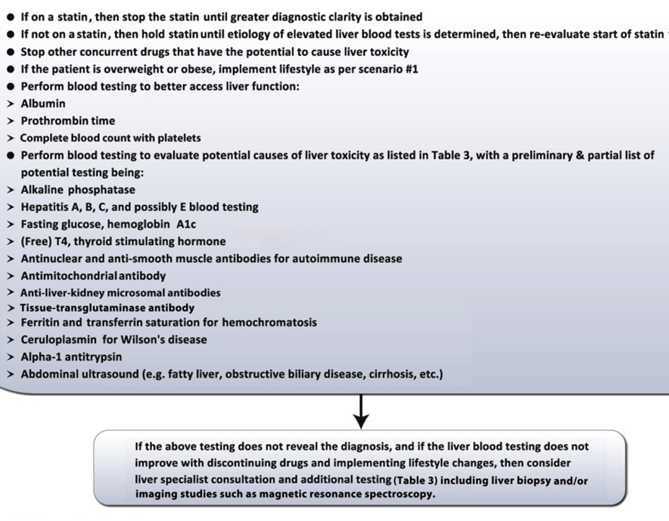

Slide 42
An assessment by the Statin Diabetes Safety Task Force: 2014 update

Slide 43
How robust is the evidence linking statin use to increased risk for DM?
Meta-analyses of statin trials indicate that statin increase in risk for the development of type 2 DM very low
Risks are higher for more intensive statin regimens.

Slide 44
Are there any patients in whom it would be prudent to consider alternatives to statin treatment because of concerns about increasing risk for newonset diabetes ?
No change is recommended to current practice on the basis of evidence for a modest increase in risk for diabetes associated with statin therapy
Those with diabetes risk factors should be counseled regarding
Lifestyle modification
Weight loss if overweight or obese
Adequate physical activity.
These strategies are efficacious for preventing or delaying the onset of type 2 DM in those with prediabetes (mainly IGT).

Slide 45
What is known about the mechanisms that mediate the relationship between statin use and risk of new-onset type 2 DM?
No firm conclusions can be drawn at present regarding the potential mechanistic link between statin therapy and increased risk for diabetes mellitus.

Slide 46
Should doctors measure glycemia parameters before starting a statin prescription and/or during statin therapy?
Screening should occur before initiation of statin therapy, although clinicians should not generally delay the initiation of statin therapy to await results from screening tests in a patient for whom statin therapy is indicated.
For those with diabetes risk factors, especially prediabetes, before starting statin therapy, the panel members feel that consideration should be given to screening or rescreening within 1 year of initiating statin therapy.

Slide 47
An assessment by the Statin Cognitive Safety Task Force: 2014 update

Slide 48
The FDA also stated that the data did not suggest these cognitive changes are common or
that they lead to clinically significant cognitive decline.
Iatrogenic cognitive impairment from pharmacotherapy is an important medical issue, potentially causing functional deficits and loss of quality of life.

Slide 49
Should a baseline cognitive assessment be performed before beginning a statin?
No.
Obtaining a baseline cognitive screening evaluation before beginning statin therapy would, therefore, be logistically difficult and unlikely to be helpful, especially given the highly prevalent use of these medications in practice.

Slide 50
What should the provider do if a patient reports cognitive symptoms after beginning a statin?
If a statin is suspected of contributing to cognitive symptoms, it is reasonable for the drug to be discontinued for 1 to 2 months before considering a rechallenge.
An important exception to discontinuing are patients who have had a recent stroke, because statin withdrawal in the acute setting increases the risk of recurrence and poorer outcomes

Slide 51
What should the provider do if a patient reports cognitive symptoms after beginning a statin?
Statins appear to be rapidly eliminated from the brain, but mechanisms remain elusive
Some statins (eg, pravastatin, rosuvastatin) are less likely to penetrate the CNS

Slide 52
An assessment by the Statin Intolerance Panel: 2014 update

Slide 53
Is there a universally accepted definition of statin intolerance that can be used by clinicians and regulatory authorities?
Statin intolerance is a clinical syndrome characterized by the inability to tolerate at least 2 statins:
one statin at the lowest starting daily dose AND another statin at any daily dose
due to either objectionable symptoms (real or perceived) or abnormal lab determinations, which are temporally related to statin treatment and reversible upon statin discontinuation
but reproducible by re-challenge with other known determinants being excluded (such as hypothyroidism, interacting drugs, concurrent illnesses, significant changes in physical activity or exercise, and underlying muscle disease).

Slide 54
The lowest starting statin daily dose, is defined as
Rosuvastatin 5 mg
Atorvastatin 10 mg
Simvastatin 10 mg
Lovastatin 20 mg

Slide 55
Recommendations from the Statin Intolerance Expert Panel
The clinician should acknowledge that statin intolerance is a real phenomenon, manifesting mostly as an array of muscle-related symptoms that include aching, stiffness, proximal motor weakness, fatigue, and back pain.
Estimates of the frequency verifiably related to statin use range from 1% to 10%.
Severe myopathy with objective weakness and/or markedly elevated muscle enzymes is rare.

Slide 56
Cognitive difficulties while taking statins continue to be reported by a small number of patients, but objective documentation of impaired cognition is generally lacking.
No evidence points toward progressive or permanent impairment of cognition induced by statins.
The frequency of cognitive difficulties is unknown, but is clearly much lower than that of muscle symptoms.

Slide 57
Statin treatment results in substantial increases in (ALTand/or AST increases >3 times the upper limit of normal) in 0.3%–3% of patients in a dose-dependent manner.
However, evidence does not support the concerns that statins may seriously impair the metabolic functions of the liver acutely
Baseline determination of liver function before statin initiation is recommended, but regular monitoring of hepatic transaminase levels in is no longer recommended.

Slide 58
The use of statins is associated with increased risk for new-onset diabetes mellitus, especially when greater doses of statins are used.
The magnitude of increased risk is small compared with other diabetes risk factors such as obesity.
The benefit of proven coronary heart disease reduction with statins outweighs the risk of new-onset diabetes.

Slide 59
The fraction of patients who reported muscle symptoms with high doses of statins (as currently recommended) was about 10%.
Atorvastatin or rosuvastatin at doses of 5–10 mg taken once or twice a week may reduce LDL-C by 16%–26%.

