Slide 1

Continuous Glucose Monitoring
دکتر سارا کاظم پور اردبیلی
مرکز تحقیقات پیشگیری از بیماریهای متابولیک
پژوهشکده علوم غدد درون ریز و متابولیسم
دانشگاه علوم پزشکی شهید بهشتی

Slide 2
Glycemic Assessment
Symptoms of hyperglycemia
Symptoms of hyperglycemia
Self Monitoring Blood Glucose (SMBG)
HbA1c

Slide 3
Limitations of Current Assessment Tools
Symptoms:
  Usually when too high or too low
SMBG:
  Inconvenient, sometimes painful, costly
  When? How often?
HbA1c:
  Gives no information on excursions
  Dependent on RBC lifespan and turnover
  ‘fast’ and ‘slow’ glycators
  Methodology must be standardized

Slide 4
Continuous Glucose Monitoring
Glucose sensor implanted in subcutaneous tissue
Measures glucose of interstitial fluid every 3 to 5 minutes for up to 10 days
Can show real-time glucose chart

Slide 5

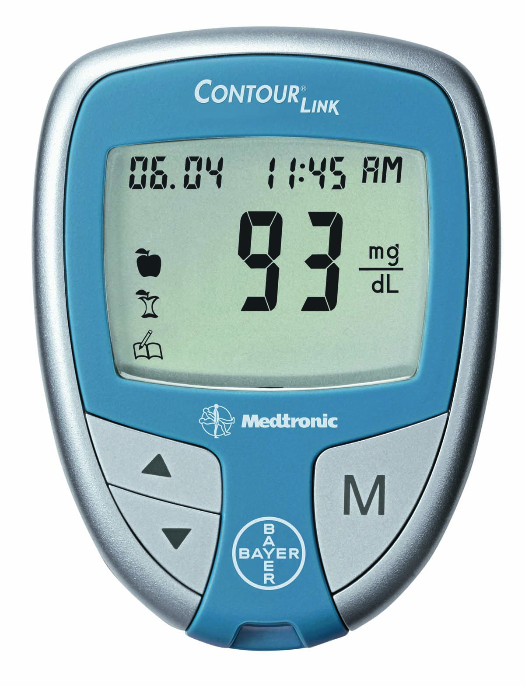
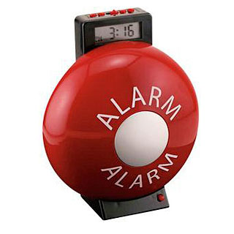
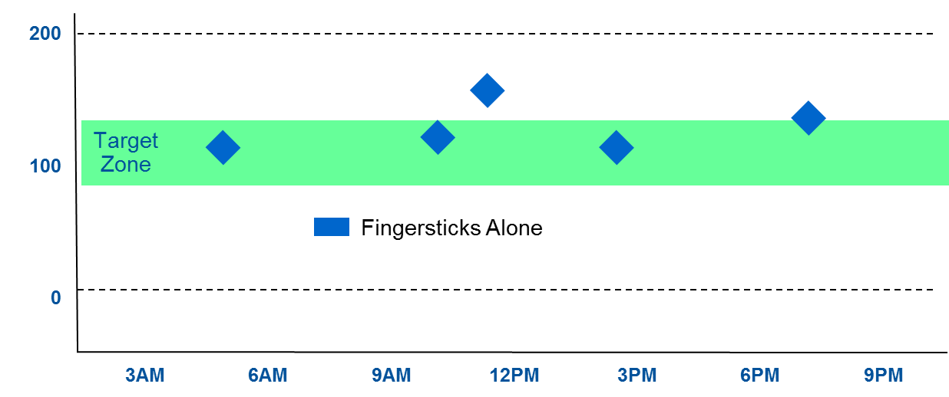
Limitations of Blood Glucose Meters
Self-monitoring Blood Glucose
GLUCOSE?
?
Blood Glucose
Notes:
Ordinarily, when you receive a 100 mg/dL result, you don’t know where you are.
Is it going up? Is it coming down?
An intelligent alarm is based on both point and rate. The Projected Low glucose alarm sounds based on the trajectory of the glucose curve – when the patient is 20 minutes from the 70 mg/dL threshold.
Just imagine the potential ….
The freedom from the fear of low sugars
Getting behind the wheel…
Swimming
Exercise

Slide 6
Continuous Glucose Monitoring (CGM)
300
200
100
0
Fingersticks Alone
Continuous Glucose Monitoring
Glucose – mg/dL
Target Zone
CGM enable HCPs to take better clinical decisions regarding Therapy adjustment to improve patients’ glycemic control
3AM | 6AM | 9AM | 12PM | 3PM | 6PM | 9PM
Time of Day
One Blood Glucose value every 5 minutes
⇒ 288 sensor Glucose readings per day !
Notes:
- Provides continuous info about glucose level and variability
- Tracks Direction, Amplitude & Duration of glucose variability
- Allows patients to monitor their Real-Time glucose variability, hence, identifying hyper or hypo
Identifies events behind glucose variability

Slide 7
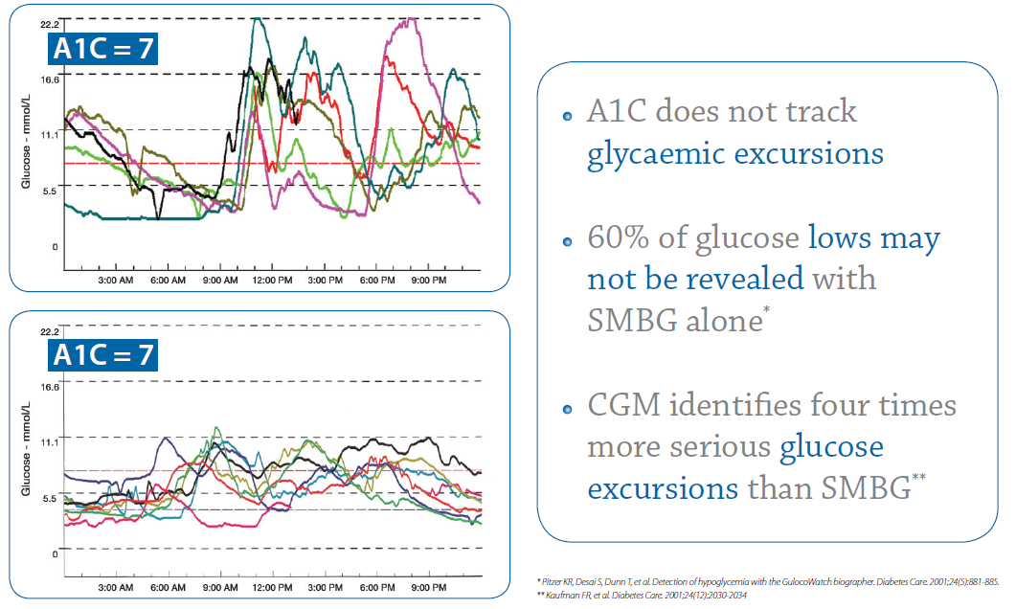
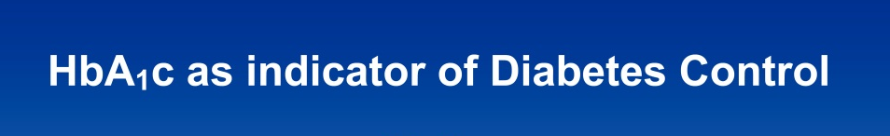
Continuous Glucose Monitoring (CGM)
Notes:
- Provides continuous info about glucose level and variability
- Tracks Direction, Amplitude & Duration of glucose variability
- Allows patients to monitor their Real-Time glucose variability, hence, identifying hyper or hypo
Identifies events behind glucose variability

Slide 8

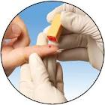
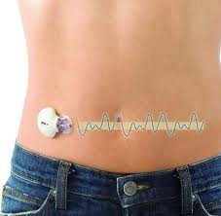
CGM offers a complete picture
SMBG
SMBG
CGM
CGM
Notes:
Donc … Les mesures capillaires donnent uniquement un aperçu de l'évolution du taux glycémique, tandis que le système de mesure du glucose en continu offre un tableau complet et fournit un trace précis des tendances glycémiques des patients, qui peuvent alors effectuer des ajustements thérapeutiques et améliorer leur contrôle glycémique. On obtient ainsi de meilleurs résultats cliniques et une réduction des complications a long terme.
En bref, a ne pas oublier que l’Auto surveillance glycémique ne représente que le « tip of the iceberg » alors que le SGC contient tous les détails nécessaire pour une bonne consultation et une une décision thérapeutique prudente

Slide 9
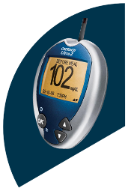

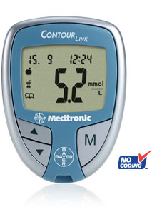

CGM is complimentary and essential beside other glucose diagnostic technologies
Fingerstick
Testing
A1C
Continuous Glucose Monitoring
Notes:
Over the last decade we now have 3 core glucose technologies each representing important aspects for assessment of glucose control. Together, these parameters can be used together to describe glucose patterns and glycemic control.
Optimal glycemic control defined by ADA as A1C 7%, by AACE as A1C of 6.5%. However A1C can be challenging even with motivated patients to monitor BG and manage their glucose levels.. A1C represents the average glucose levels in a period of three months.
Fingerstick testing is an accurate way to test the glucose level for the individual moment. Does not reflect if the glucose goes up or down, or where it has been.
So simply use A1C and SMBG is not giving you the full picture.
CGM will complete this since it provides the information beyond average glucose and snapshot of the glucose. It helps you to know what happens in between your fingerstick BG values, and serves as a “moving picture” of glucose changes over the day and over time. It truly allows you to see the whole picture.

Slide 10
Who is eligible for CGM Evaluation?
Experience nocturnal hypoglycemia or hypoglycemia unawareness
Inability to achieve target HbA1c
Children
Pregnant women
Experience significant glucose variability

Slide 11
Clinical indications for CGM Evaluation
To identify glycemic excursions, postprandial hyperglycemia and to make changes in treatment to improve therapy management in type 1 diabetes¹
To improve glycemic control in patients with insulin – treated diabetes without increasing the risk of hypoglycemia²
To improve glycemic control and reduce risk of macrosomia during pregnancy³
1.Maia F. and Araujo, L: Efficacy of Continuous Glucose Monitoring System (CGMS) to detect Postprandial Hyperglycemia and Unrecognized Hypoglycemia in Type 1 Diabetes Patients. Diabetes Research and Clinical Practice 2007; 75:30-34,
2.Tanenberg R. et al.: Use of the Continuous Glucose Monitoring System to Guide Therapy in Patients With Insulin-Treated Diabetes: A Randomized Controlled Trial. Mayo Clinic Proceedings 2004;79:1521–1526
3.Murphy H. et al.: Effectiveness of continuous glucose monitoring in pregnant women with diabetes: randomized clinical trial. BMJ 2008; 337; a1680
Notes:
1.Maia F. and Araujo, L: Efficacy of Continuous Glucose Monitoring System (CGMS) to detect Postprandial Hyperglycemia and Unrecognized Hypoglycemia in Type 1 Diabetes Patients. Diabetes Research and Clinical Practice 75:30-34, 2007
2.Tanenberg R. et al.: Use of the Continuous Glucose Monitoring System to Guide Therapy in Patients With Insulin-Treated Diabetes: A Randomized Controlled Trial. Mayo Clinic Proceedings 79(12): 1521-26, 2004
3.Murphy H. et al.: Effectiveness of continuous glucose monitoring in pregnant women with diabetes: randomized clinical trial. BMJ 2008; 337; a1680

Slide 12
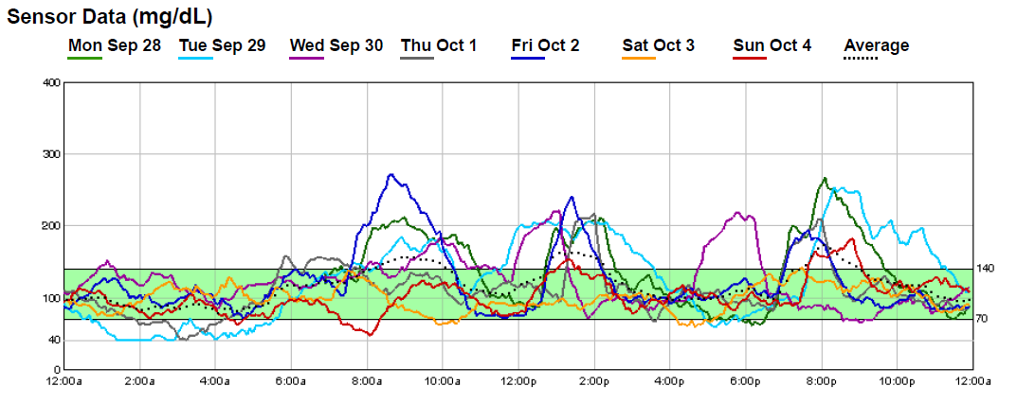
CGM Evaluation: Easy Reports for glucose profiling
Daily Overlay
Quickly identify patterns

Slide 13
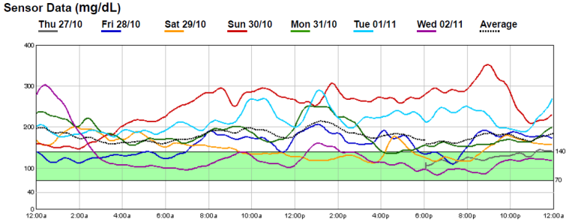
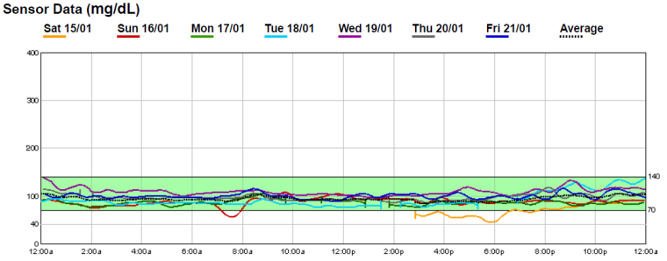
Potential benefits in real-life patients
Baseline CGM Evaluation
Post-therapy CGM Evaluation
Therapy
considerations:
Insulin, Lifestyle,
medications …
CANDIDATES:
Detection of hypoglycemia unawareness
Identification of nocturnal hypoglycemia
Screening for post-prandial hyperglycemia in pregnant women with diabetes
Insulin dose adjustments in type 1 diabetes
Profiling glucose profile in type 2 diabetes

Slide 14
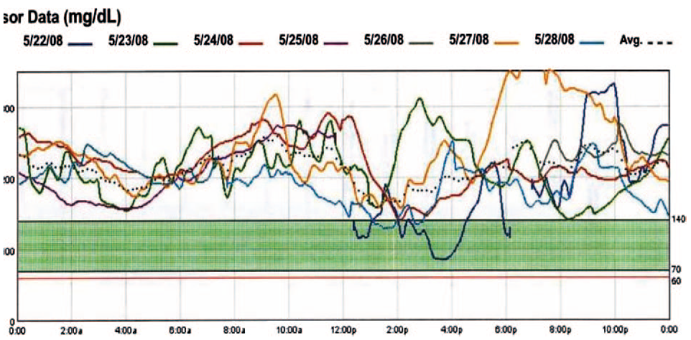
Clinical Case: CGM detecting behavioral hyperglycemia
Fear of Hypo
Data are shown for a 61 Y woman with a 6-yr Hx T2D.
CGM shows how she intentionally keeps her glucose levels above the target due to her extreme fear of hypoglycemia
J Clin Endocrinol Metab, July 2009, 94(7):2232–2238

Slide 15
Case: ESRD
76 y/o woman on hemodialysis
NPH insulin BD and erythropoietin
Her HbA1c has fallen to 6.7% but her glucoses have been high, typically 200-300, and very erratic
What’s happening?

Slide 16
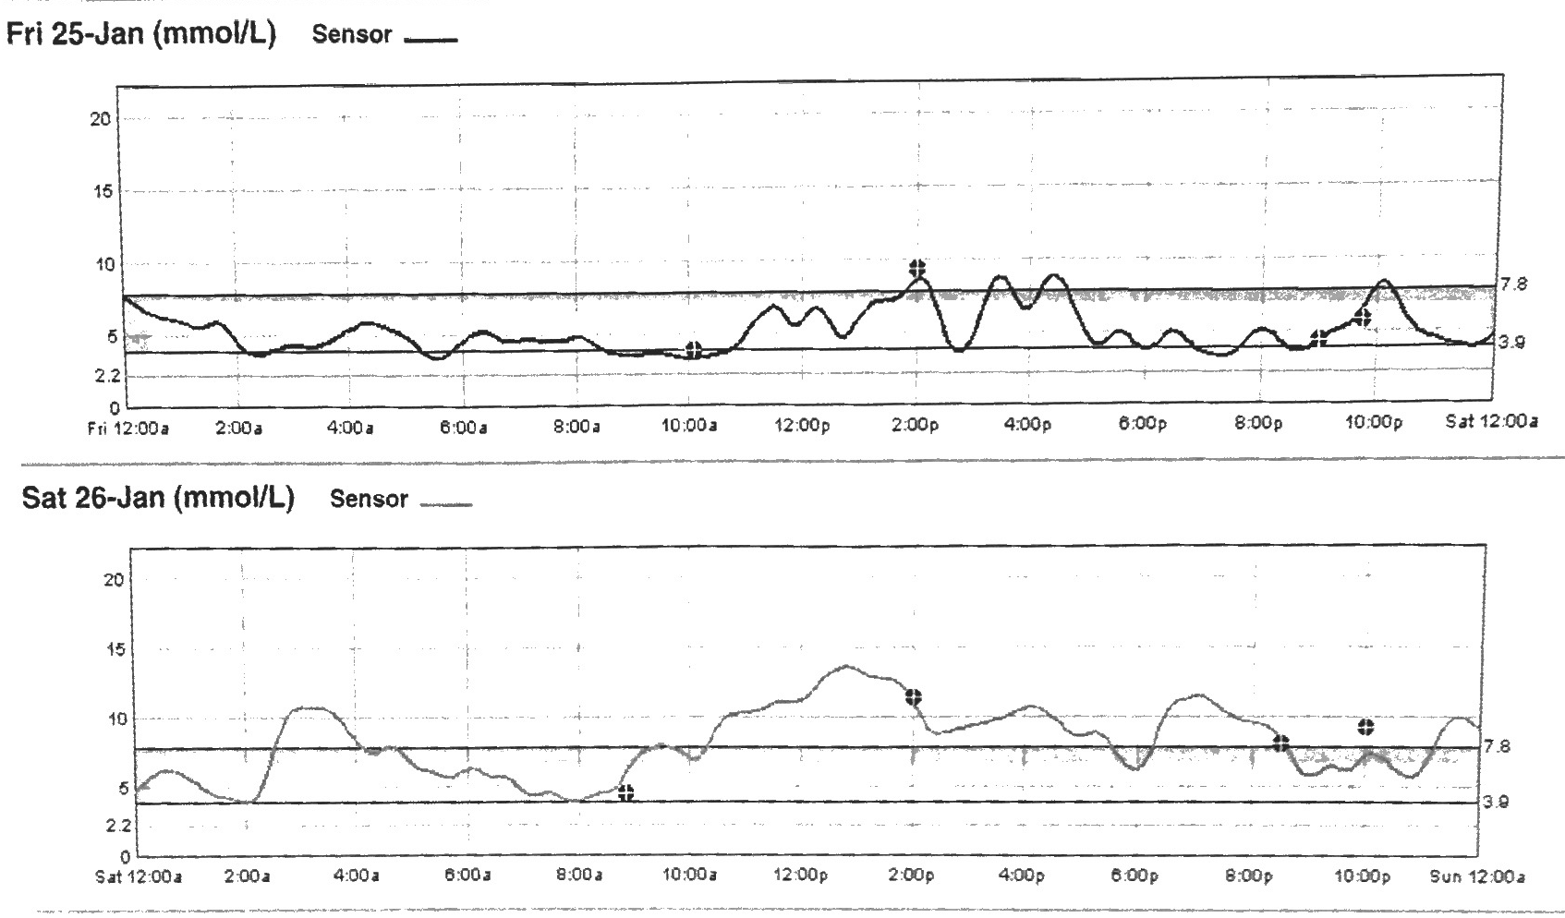
Case - CGMS

Slide 17
CGM Limitations
Measures interstitial glucose concentration
There is always a ‘lag time’ between circulating glucose values and interstitial glucose concentration
This lag time is prolonged for glucose extremes
Conditions that cause fluid retention decrease accuracy (pregnancy, ESRD, etc.)

Slide 18
Conclusion
Identifying patients who may benefit from CGM is important
CGM can reinforce patient education and behavioral change
CGM may be specially useful in special populations such as: children, pregnant women, dialysed patients, patients with brittle diabetes, etc.
It is important to be aware of CGM limitations

Slide 19


