Slide 1
Endocrine Grand Round
A 72 YEAR OLD MAN WITH ANOREXIA
By:
Dr.yaghoobpour
Presenter:
Dr.forouzandeh Sadrzadeh

Slide 2
Chief complaint:
Anorexia
Present illness:
72 year old man /from Tehran/neurosurgeon/presented with anorexia and 20 kg weight loss during one year.
Followed by sudden sever weakness and brief loss of consciousness one year ago .he was admitted to ICU and received supportive care.
SBP was low he was hydrated with normal saline and hydrocortisone
TSH >100 levothyroxine was started
He was discharged with a diagnosis of hypothyroidism

Slide 3
Accompanying symptoms
Weight loss(20 kg)
Fatigue(+)
Weakness(+)
Nausea and vomiting(-)
Headache(-)
Memory impairment(-)
Hypoglycemia(-)
Libido loss(-)
Orthostatic hypotension(-)
Blurred vision(-)
Hyper pigmentation(-)
Hyponatremia(+)

Slide 4
A month later he referred to endocrinologist lab data:
TSH 56 Anti TPO 675
WBC 3800
HB 11.6
Plt 61000
Cortisol Am 0.14 μg/dl
HB A1C 5.8

Slide 5
Tab Prednisolone 5mg daily was started
ACTH level was <5 pg/ml.
BMB : normal
Abdominopelvic sonography : normal
Endoscopy and colonoscopy : normal
Brain MRI

Slide 6
PSA 0.32
VIT D level 60
Fe 64 TIBC 232 Ferritin 171
Folic Acid 9.8 B12 943
LDH 322
CR 1.31
K 4.4
Na 141
LFT normal
ESR 23
Prolactin 20

Slide 7
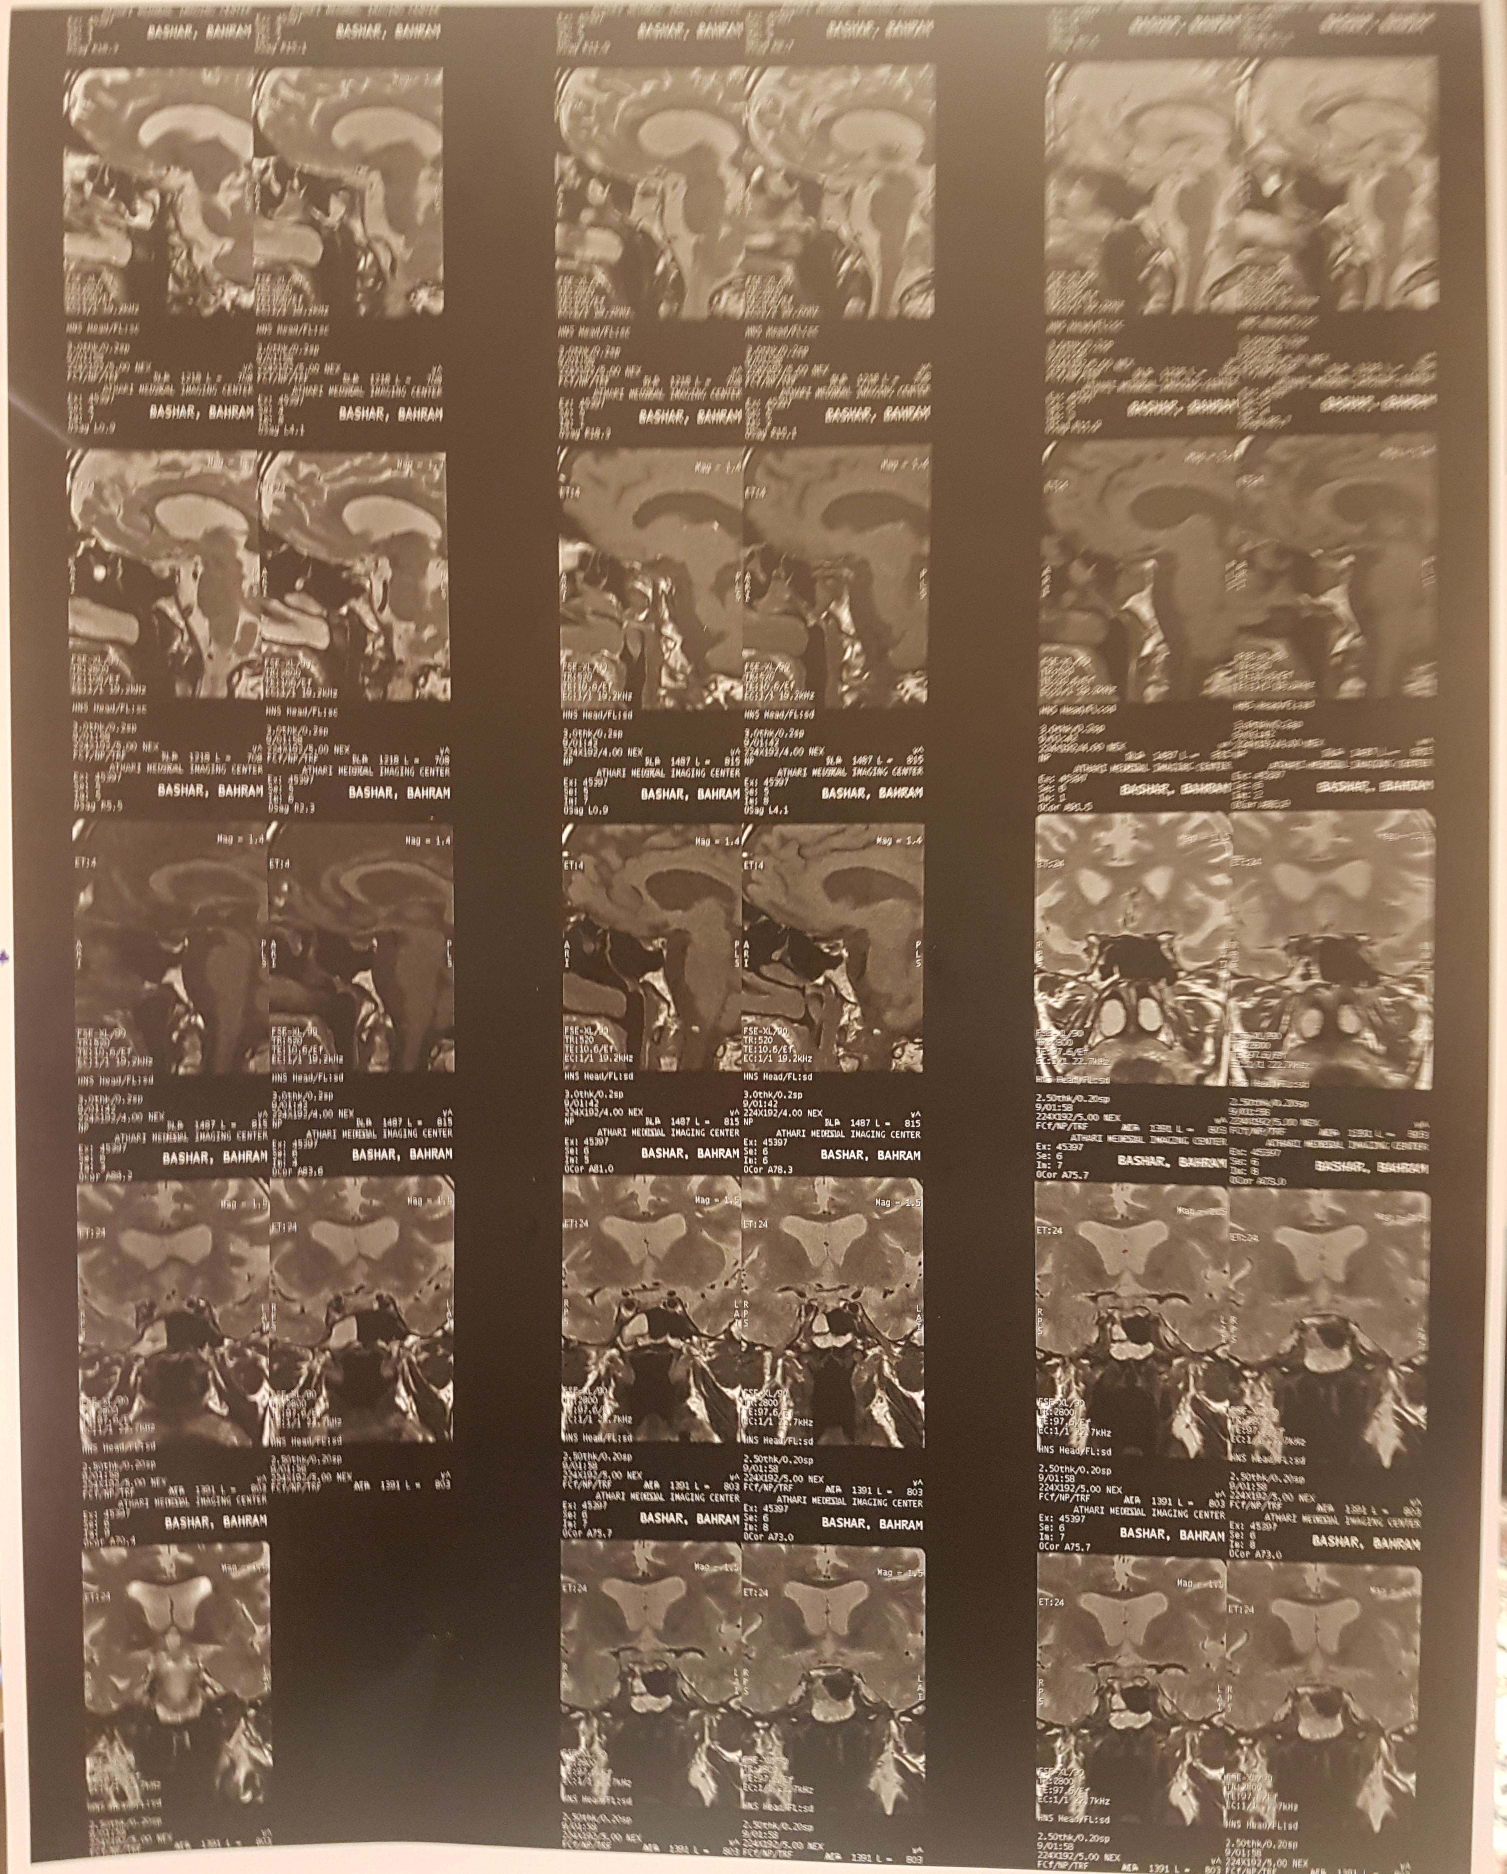

Slide 8
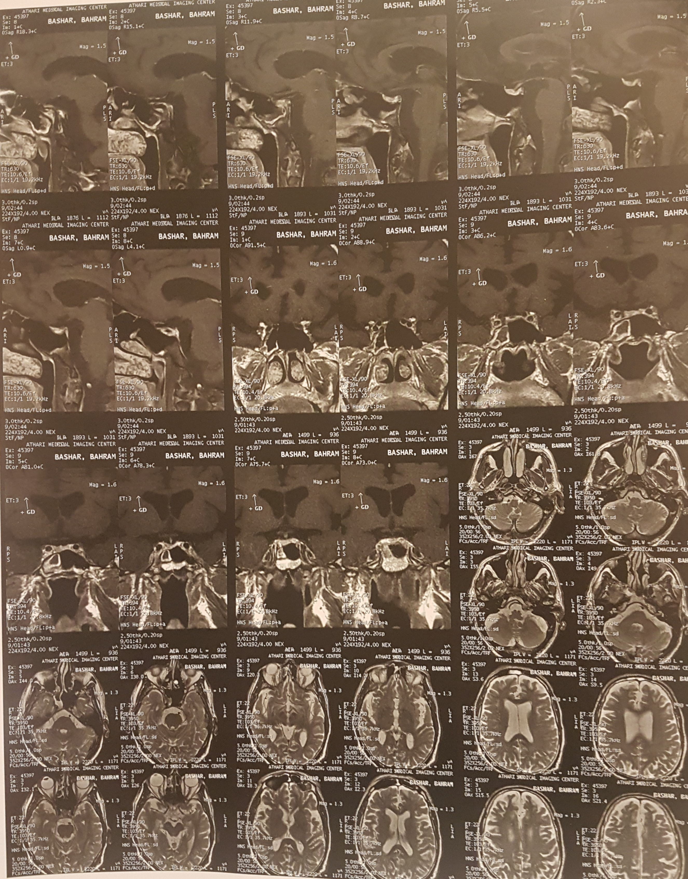

Slide 9
Report:
Questionable delayed enhancing area is seen at right side of adenohypophysis with about 2x2 mm size . possibility of small micro adenoma should be considered for patient. size ad shape of pituitary gland is normal and stalk is located normally in the midline.no bulge of diaphragma sella into the supra sellar cistern is seen

Slide 10
 | 97/6 | 97/9 | 97/10 | 97/12 | 98/2
WBC | 3800 | 3500 | 5600 | 5500 | 5100
HB | 11.6 | 10.8 | 13.2 | 13.8 | 13.9
MCV | 85 | 87 | 87 | 84
Plt | 61000 | 65000 | 90000 | 130000 | 165000
TSH | 57 | 10.2 | 25 | 2.29 | 2.87
Cortisol | 0.14 μg/dl | 0.83 μg/dl | 0.11μg/dl | 0.11μg/dl | 1.79μg/dl

Slide 11
PMH:
DM from 15 years ago treated with oral agents and after weight loss, no medications were necessary.
skin eczema and topical corticosteroids (many years ago)
Thoracic spine infection (staphylococcus aureus)

Slide 12
FH:
Impaired function of thyroid and radioactive iodine intake in his son when he was 6 years old
Hypothyroidism in his two daughters
DH: Tab propranolol 10mg daily
Tab prednisolone 5mg daily
Tab levothyroxine 900μg weekly

Slide 13
Physical Examination
General Appearance: old-age male, awake and alert
Wt.=70 kg, Ht.=176 cm, BMI=22.5 kg/m2
V/S → PR: 78/min, BP: 110/80 mmHg RR: 15/min, OT: 36.5 orthostatic hypotension :negative
Head and Neck : normal
Skin : red scars the right hand
Chest : kyphoscoliosis. Normal lung and heart sounds.
Abdomen: normal
Extremities : Normal (Joints, Pulses, Muscle tone, Force)
Neurologic : Normal (Cranial nerves, DTR, Gait, Sensory exams)

Slide 14
Prolactin 4.09 ng/ml (1.9-18.3)
Testosterone 206 ng/dl (129-767)
FSH 9.29 IU/L (1.5-12.4)
LH 3.54 IU/L (1.7-8.6)

Slide 15
Problem list:
72 years old man
Weakness ; anorexia ; weight loss
Hypotension
Hyponatremia
Low cortisol level
Low ACTH level
low T4 high TSH
Suspicious hypogonadism
Primary hypothyroidism + Central adrenal insufficiency

