Slide 1
بسم الله الرحمن الرحیم

Slide 2
Endocrine Grand round
A 54 years old woman with polydipsia and polyuria

Slide 3
HPI
CC : polydipsia and polyuria
A 54 years old woman known case of breast cancer (1389)
left total mastectomy and chemotherapy
Hysterosalpingoophorectomy (1391)
Metastasis to liver, lung and bone (1395)
She received chemotherapy and radoitherapy
chemotherapy until Khordad 1396

Slide 4
HPI
Ribs frachure in Dey 1396
Radiotherapy of lumbar vertebral, shoulder and left hemithorax
With the onset of radiotherapy in Dey 1396, it suddenly suffered from polyuria and polydipsia
Drinking 6 liters a day
Nocturia (4 times)

Slide 5
HPI
Symptoms continued for one year
During this period, changes have been made to chemotherapy drugs, but no changes in the symptoms of the patient have been made

Slide 6
PMH, PSH, HH, SH
Past medical history: Breast cancer , MNG
Past surgical history: mastectomy , HSO
Habitual History : No history of smoking or alcohol consumption
Social history: educated
Access to healthcare: adequate

Slide 7
Family history
She has 3 sisters and 3 brothers without DI
One of her sister had metastatic breast cancer and expired at 56 yrs
Her uncle had liver cancer and expired at 70 yrs , Her niece had liver cancer and expired at 33 yrs
Her grandmother had liver cancer and expired at 73 yrs.
Her aunt is 70 yrs and has metastatic breast cancer
Her mother, one sister and one brother have DM 𝛪𝛪

Slide 8
Drug history
Tamoxifen(1389-91)
Exemestane (Aromasin) 1391-95
Letrozole (1395-97)
Zolendronic Acid (1396)
Everolimus , Vinorelbine (1397)
Gemcitabin , carboplatin , sertraline, Alprazolam, Pantoprazole

Slide 9
Review of systems
Constitutional state: weakness, fatigue, NO nausea, vomiting, abdominal pain, myalgia, paresthesia, chest pain, dyspnea, hematuria, memory loss, constipation, anorexia ,weight loss,weight gain
Skin: mastectomy and HSO scare
Cardiovascular: No chest pain, irregular beat, racing heart , swelling of legs
Respiratory : No shortness of breath, night sweats, prolonged cough, wheezing, sputum production, pleurisy, oxygen at home,

Slide 10
Review of systems
Gastrointestinal: No heartburn, constipation, diarrhea, abdominal pain, difficult swallowing, nausea, vomiting, blood in stool, unexplained changes in bowel habits, incontinence
Psychiatric: Depression ,anxiety
No insomnia, irritability, recurrent bad thoughts, mood swing, hallucination, compulsion
Endocrine:polydipsia and polyuria , menopause 8 yrs ago , MNG
NO galactorrhea

Slide 11
Review of systems
Genitourinary: polyuria , nocturia
No dysuria, frequency, urgency, gross hematuria
Neurological: Negative ( frequent headaches, Double vision and ptosis, dizziness, tremor, loss of consciousness )
Hematologic and lymphatic: No anemia, easy bleeding, unexplained swollen area,lymphadenopathy
Muscloskeletal : NO muscle pain , muscle atrophy , pone pain

Slide 12
Genral appearance
A 54 years old woman is awake and alert who looks the same age .depressed mood
BMI : 22 kg/m²
BP : 110/80 mmHg
PR : 78 /min
RR : 12 /min
T : 37° C

Slide 13
Physical examination
Head and neck: normal. NO dry mouth ,NO lymphadenopathy
Thyroid : large and about 40 gr and nodular that largest nodule in the right lobe about 20 ×20 mm
Chest : normal lung and heart sound
Breast : left breast mastectomy , right breast normal
Abdomen :NO distension , ascites , hepatomegaly
Extremities : normal

Slide 14
Neurologic exams
Mental status : normal
Cranial nerve : normal, fundoscopic exam normal
Sensory exam : normal
Reflexes : in upper and lower was equally and normal

Slide 15
Lab Data
20/01/1397
WBC =4600 FBS =97 TSH =2.32 AST = 45
Hb = 15.3 Ca =9.1 T4 = 7.39 ALT = 50
PLT =254000 P = 4.5 Chol = 244 ALK = 368
BUN =18 Na = 138 TG = 99 FSH = 57 MIU/ml
Cr = 0.7 K = 4.7 LDL = 158 LH = 28 MIU/ ml
Uric acid 5.7
U/A …… SG = 1012

Slide 16
Lab Data
1397/10/3 1397/10/15
FBS = 90 AST = 40 Urine 24 hr vol = 5500 ml
TSH =0.54 ALT = 64 Cr = 14.4 mg/kg
T4 = 9 ALK = 553 SG = 1008
Ca = 9.2
P = 4.8
Na = 143 Na = 136
K = 4.4 k = 3.9
U/A …..SG = 1007

Slide 17
Water restriction test 25/10/1397
Urine out put | Weight | Na | SG | BP | Time
200 cc | 62 | 143 | 1004 | 110/85 | 10.15 am
100 cc | 61.600 |  | 1006 | 110/80 | 11.15
200 cc | 61.300 | 145 | 1005 | 110/75 | 12.15
150 cc | 60.700 | 147 | 1004 | 110/80 | 13.15

Slide 18
Desmopressin Test 25/10/1397
Urine out put | Na | SG | BP | Time
 |  | 1009 | 105/80 | 14.15 pm
70 cc | 145 | 1011 | 105/75 | 14.45
 |  | 1012 | 110/80 | 15.15
50 cc | 146 | 1012 | 110/80 | 15.45

Slide 19
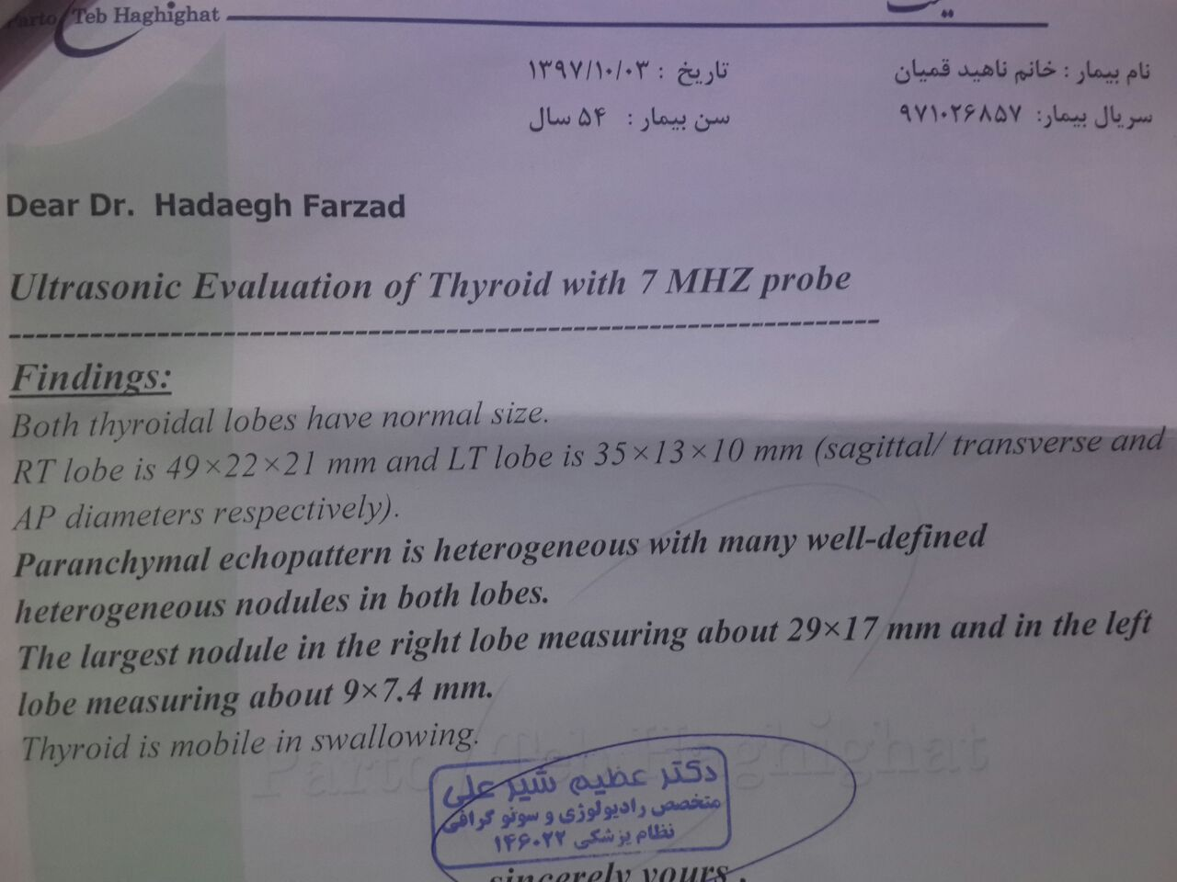

Slide 20
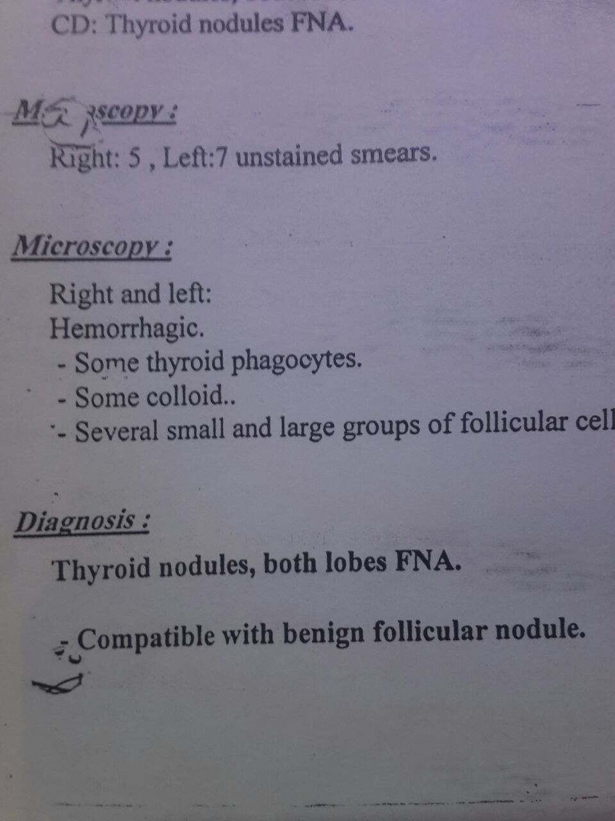

Slide 22
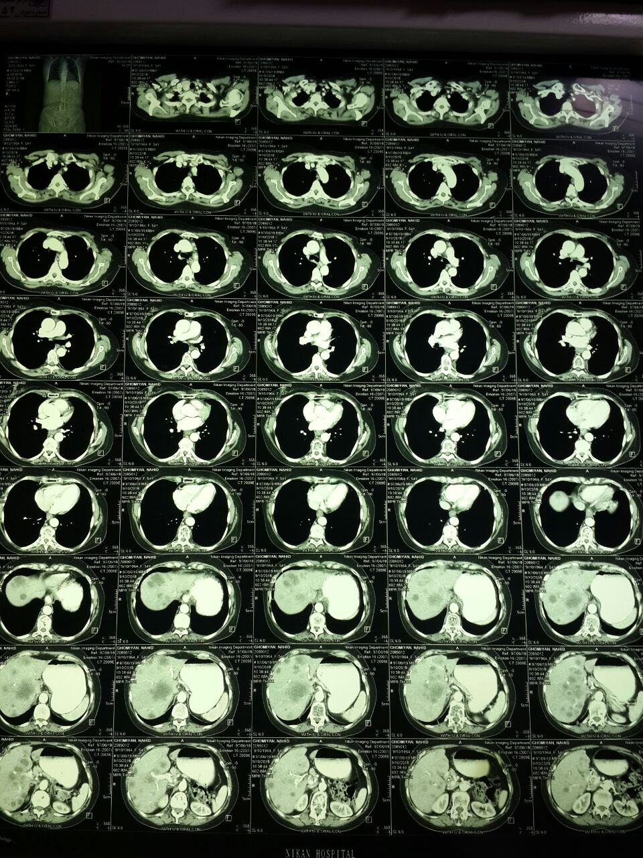

Slide 23
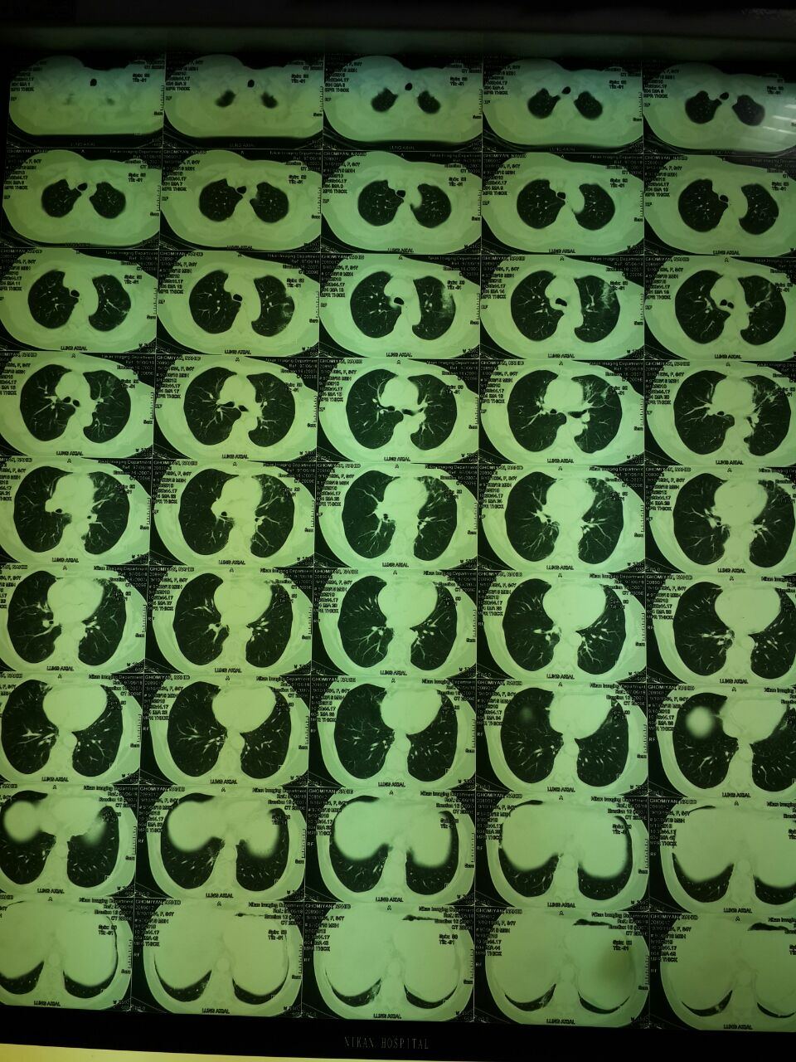

Slide 24
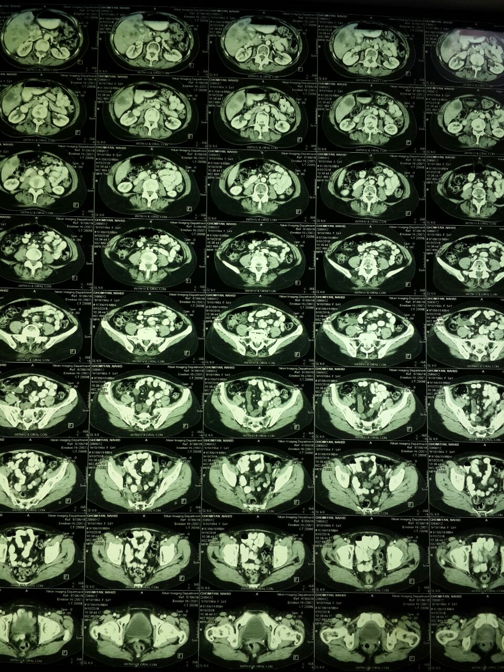

Slide 25
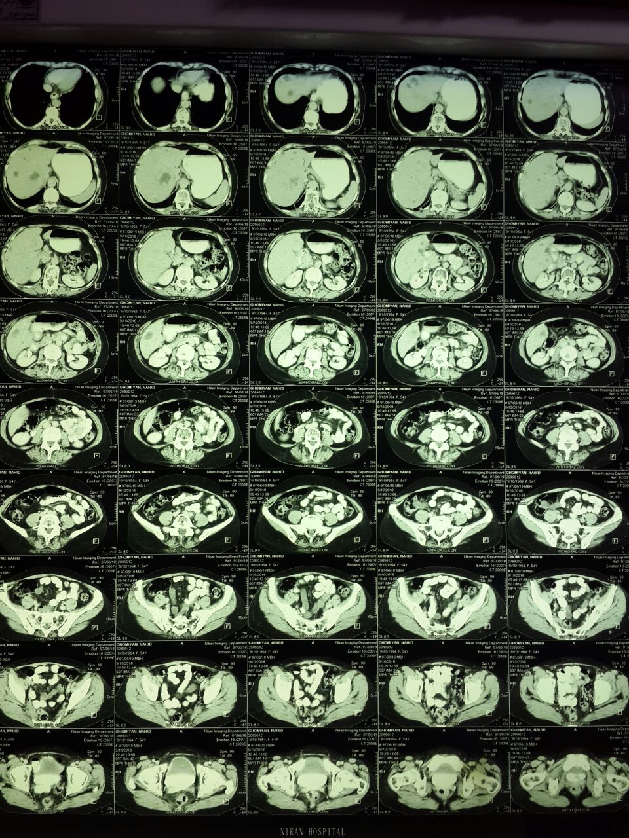

Slide 26
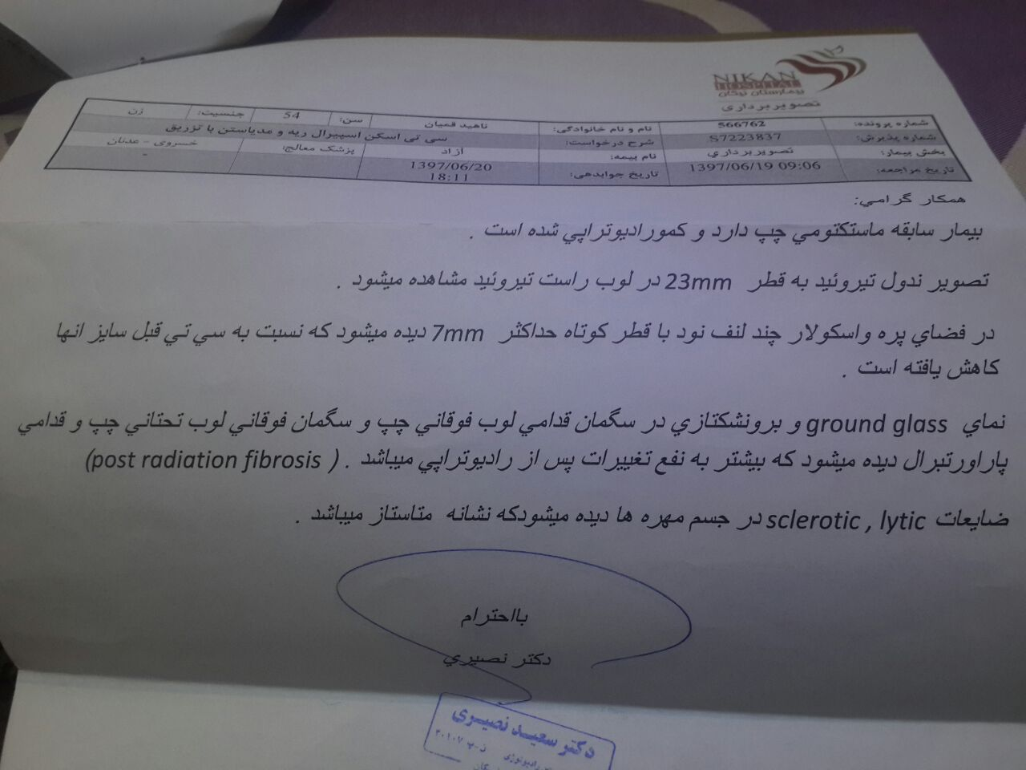

Slide 27
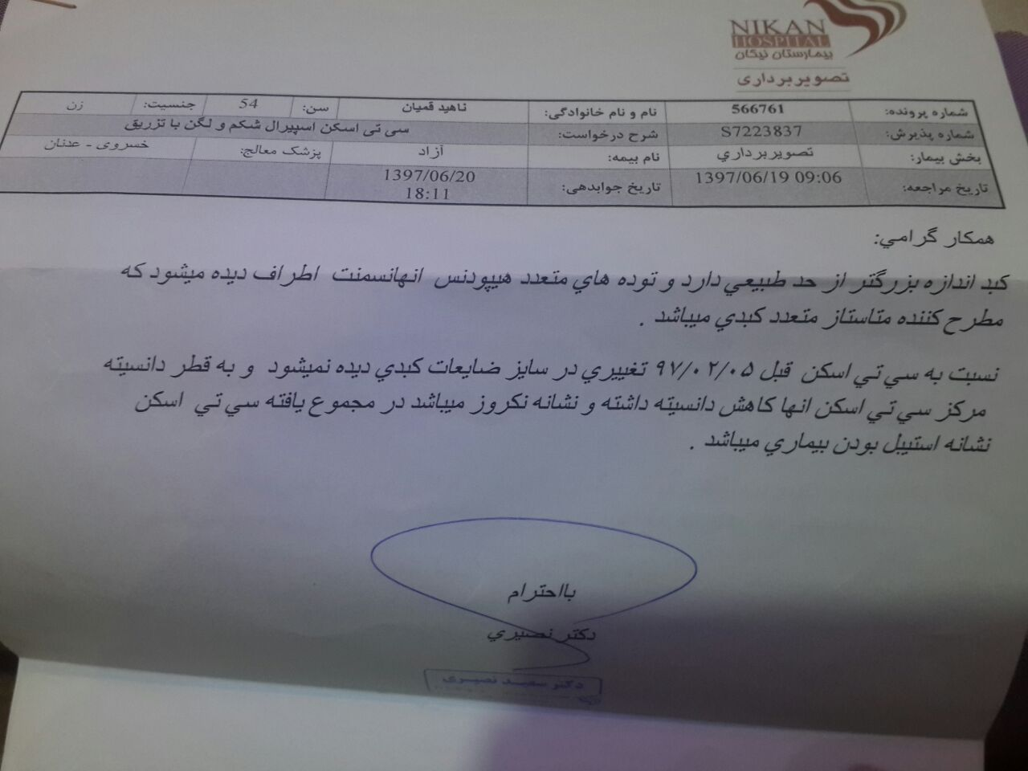

Slide 28
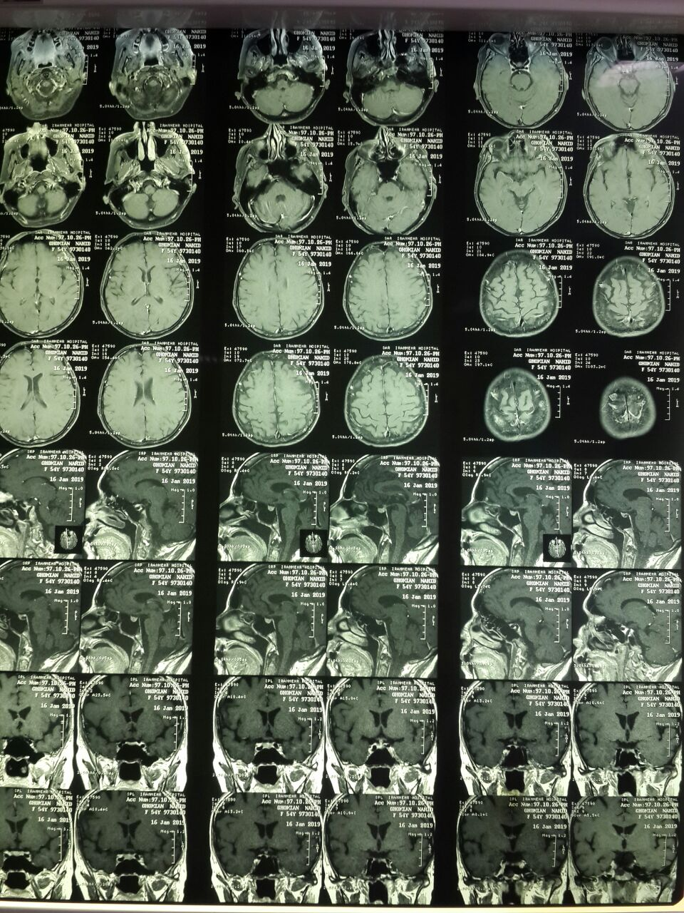

Slide 29
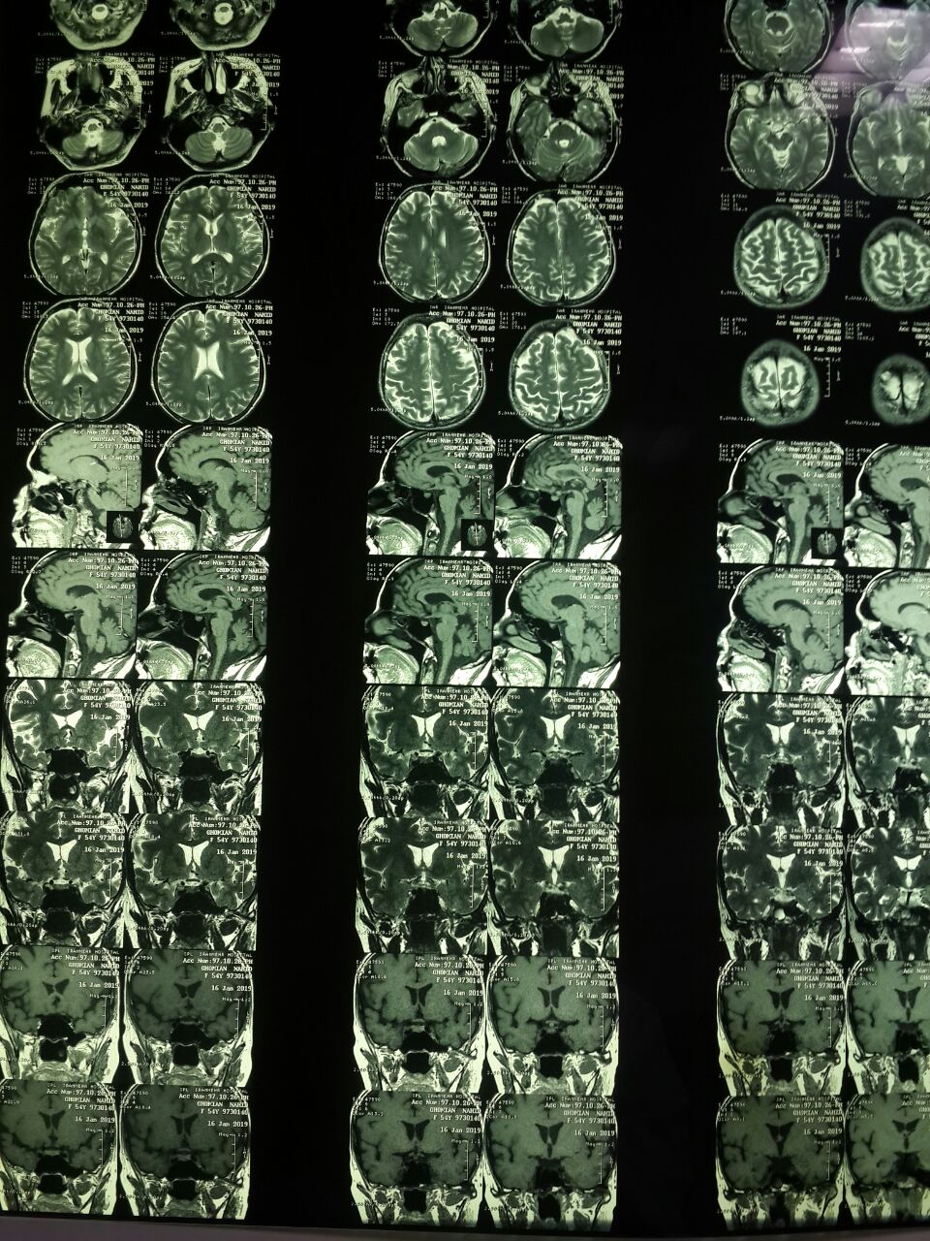

Slide 30
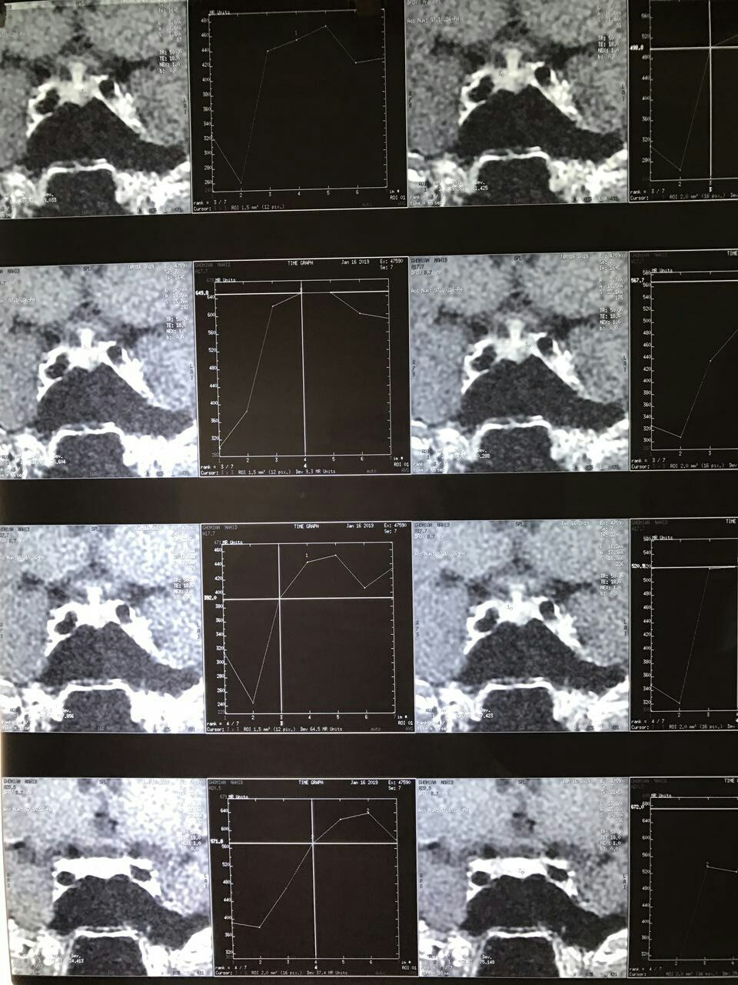

Slide 31
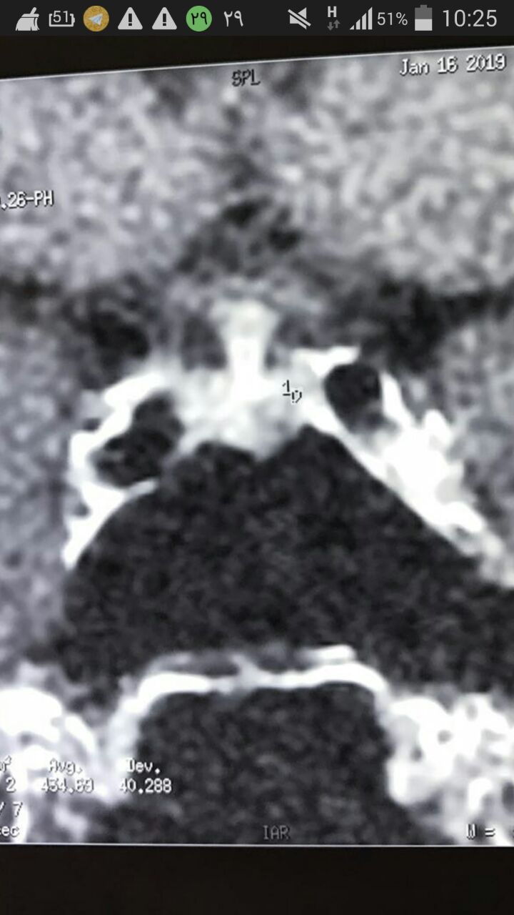

Slide 32
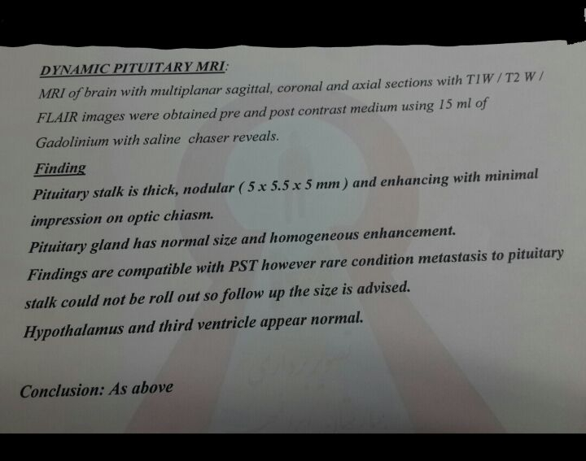

Slide 33
