Slide 1

Gonadal dysgenesis & gonadal tumors
Maryam Tohidi
Associate professor of anatomical & clinical pathology
Research Institute for Endocrine Sciences
Shahid Beheshti University of Medical Sciences

Slide 2
Gonadal dysgenesis
Definition: any of a multitude of conditions that can cause complete or partial impaired development of the gonads (testes or ovaries).
A genetic condition due to:
  errors in cell division or  alterations in genetic material
Time of beginning of development of gonadal dysgenesis: early at
  fertilization or
  shortly after in the early stages of the embryo and fetus

Slide 3
Pure gonadal dysgenesis
Female phenotype with normal Mullerian structures but are considered infantile due to their lack of adequate hormonal stimulation.
46,XX form results from a gene mutation, which is classified as an autosomal recessive disorder.
Swyer’s 46,XY form is clinically identical to the previous description.
The potential genetic etiology the Swyer form is due to an autosomal gene disorder, with recessive or dominant features, but is restricted to males .
10-15% of cases of this gonadal dysgenesis are attributed to a mutation or deletion in SRY, but 70-80% of cases are of unknown etiology

Slide 4
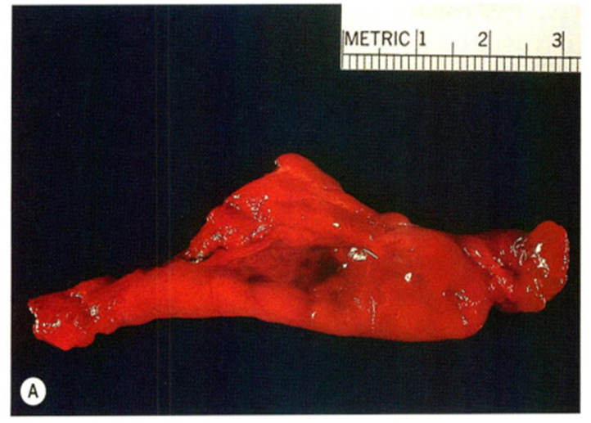
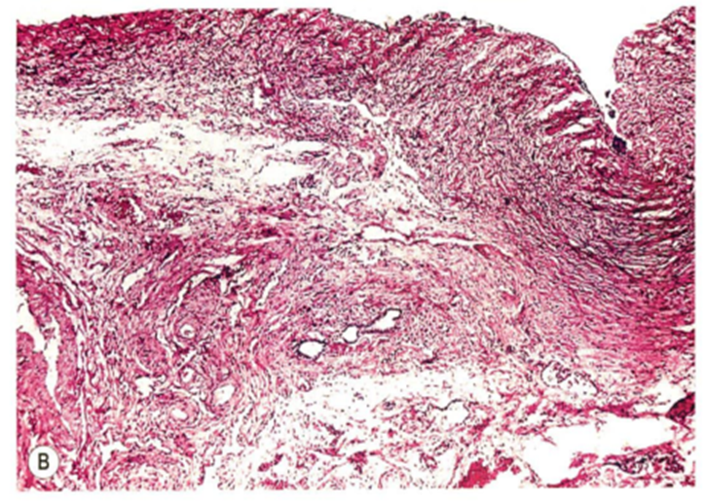
Macroscopy & microscopy of gonads in gonadal dysgenesis
Pure gonadal dysgenesis (46, XX or 46, XY (Swyer syndrome)
Gonadal dysgenesis associated with somatic feature of Turner syndrome (with 45, XO karyotype)
Both gonads are represented by a streak of fibrous tissue that resembles ovarian stroma.

Slide 5
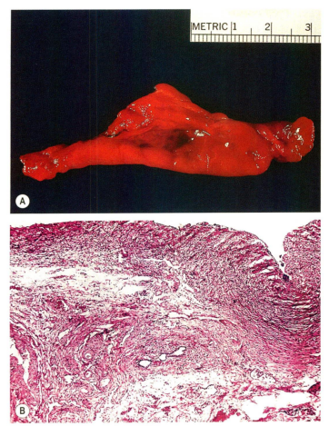
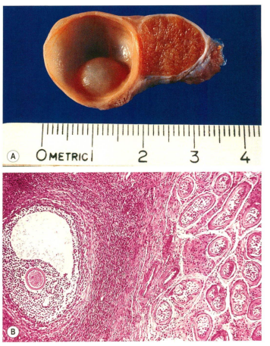
Ovarian component
Testicular component
Ovotestis in true hermaphroditism.
Streak gonad

Slide 6
Macroscopy & microscopy of gonads in gonadal dysgenesis
Mixed gonadal dysgenesis (usually characterized by a 45, X/46, XY mosaicism or 46 XY phenotype)
One gonad is represented by a streak gonad or streak testis & a contralateral testis (typically cryptorchid)
Bilateral streak testis
Mullerian structures develop on one side and are inhibited by the presence of anti-Mullerian hormone (AMH) that is produced by the Sertoli cells of the testicle.

Slide 7
Gonadal dysgenesis & gonadal tumors
Pure gonadal dysgenesis (46,XX or 46,XY (Swyer syndrome) & gonadal dysgenesis associated with somatic feature of Turner syndrome (with 45,XO karyotype)
No increased risk of gonadal tumors (in the absence of Y chromosome specific sequences)
Increased risk of various types of non-gonadal neoplasm
  atypical adenomyoma of uterus
  leukemia
  soft tissue tumors
Mixed gonadal dysgenesis (usually characterized by a 45,X/46,XY mosaicism or 46,XY phenotype)
increased risk gonadoblastoma

Slide 8
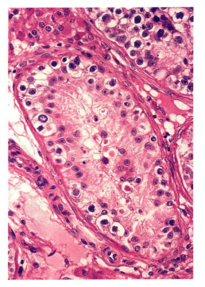
Gonadoblastoma
The better-known member of the group of tumors composed of a combination of germ cells & sex cord-stromal cells
Similarity between gonadoblastoma & intra-tubular germ cell neoplsaia of the testis suggests that gonadoblastoma is an in situ germ cell malignancy arising in disgenetic gonads.
Intra-tubular germ cell neoplasia of testis
A row of atypical germ cells with clear cytoplasm is seen against a thickened basement membrane. No spermatogenesis is occurring in this tubule.

Slide 9
Gonadoblastoma
  Nearly always in individuals with underlying gonadal disorders, most commonly gonadal dysgenesis & carrying all or part of the Y chromosome
  Risk of neoplsia in dysgenetic gonads: 25%
  b. In phenotypically & chromosomally normal females are also reported, even in ptegnancy.
  c. In association with ataxia-telangiectasia
The putative gene for gonadoblastoma locus on the Y chromosome: testis-specific protein Y-encoded gene

Slide 10
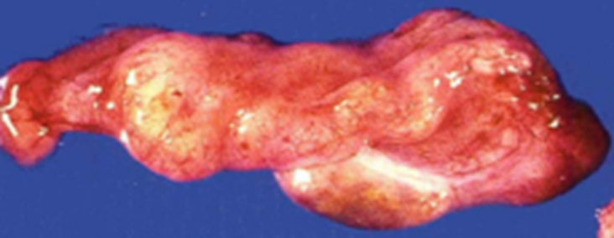
Gonadoblastoma
Usually discovered during the first to fourth decades of life.
One third are detected before the age of 15.
∼ 36 % of gonadoblastoma are bilateral. (35-40%)
Macroscopy:
  usually small
  may be not detected at gross examination
  Often impossible to determine nature of gonad bearing tumor
Streak gonad with hardly apparent tumor, grossly

Slide 11
Gonadoblastoma
Microscopy:
admixture of primitive germ cells & sex-cord stromal cells
circumscribed nests of neoplastic germ cells are encompassed individually or in groups by sex-cord derivatives with inconspicuous cytoplasm and small round to oval nuclei resembling immature Sertoli cells.
  germ cell component resembling dysgerminoma
  sex-cord stromal component resembling immature Sertoli & granulosa cells
  Hormonally active cells (stromal derivatives) that resemble lutein and Leydig cells are found interspersed among the nests of tumor in about two-thirds of cases., especially after puberty.

Slide 12
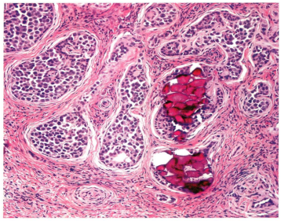

Gonadoblastoma
microscopically shown to contain gonadoblastoma.
Sharply outlined tumor nests and the heavy calcification.

Slide 13
Gonadoblastoma
Microscopy (Cont.)
  Hyalinization (hyalinized areas are reacted to anti-laminin Abs indicating basement membrane deposition)
  Calcification (may be obvious on plain abdominal radiograph in case of abundant calcification)
Immunochemistry
  Markers of germ cells
    Placental alkaline phosphatase+ (PLAP+)
    c-kit (CD117+)
    OCT3/4
  Markers of granulosa cells
    FOXL2+
Microscopic appearance of germ cell neoplasia in situ
(GCNIS) Nuclear OCT3/4 expression in GCNIS

Slide 14
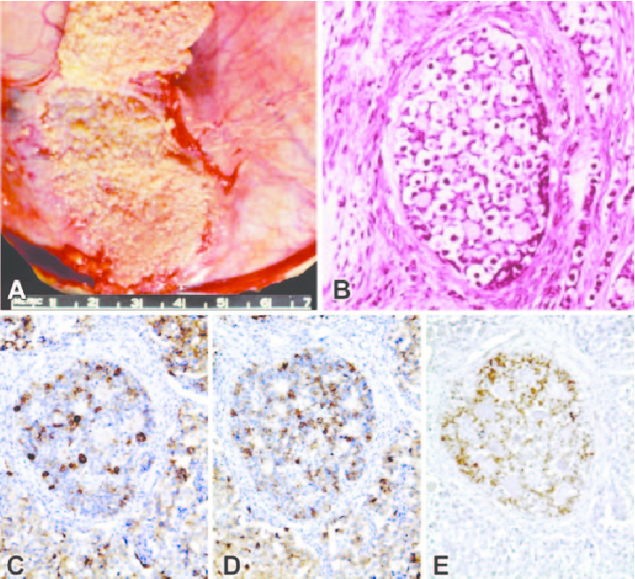
The gonadoblastoma grossly appears as calcifications.
Immature granulosa/Sertoli cells surround nests of tumour (H&E). Immunoreactivity for germ cells
PLAP
c-kit and granulosa-type cells
Foxl2
(Figures from Robboy and Jaubert)

Slide 15
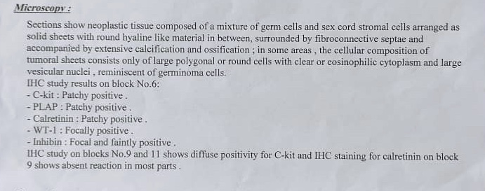
In the presented case
Inhibin (marker of granulosa cells)
Calretinin (a more sensitive but less specific marker than alpha-inhibin for ovarian sex cord-stromal neoplasms)
WT- 1: Fallopian tube, kidney, mesothelium, ovarian granulosa cells, Sertoli cells, spleen

Slide 16
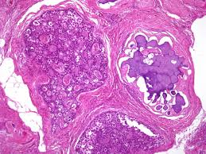
A heavily calcified area in a gonadoblastoma

Slide 17
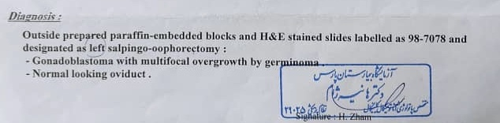
Gonadoblastoma
The germ cell component of gonadoblastoma may overgrow the stromal elements and result in the formation of a germinoma (seminoma in testis or dysgerminoma in ovary) or, exceptionally, another type of germ cell tumor.
Only under these circumstances is the tumor have a malignant potential.

Slide 18
Gonadoblastoma
Much more unusual is the overgrowth of the sex cord-stromal component, which may acquire the features of a Sertoli cell tumor.

Slide 19
Dysgerminoma
Approximately 5% of dysgerminomas arise in abnormal gonads: pure or mixed gonadal dysgenesis (from a gonadoblastoma)
less than 1% of all ovarian tumors
Most patients are young
In a series of nearly 300 cases, 81% were under 30 years of age and 44% were under 20 years of Age.
made up 6% of 188 childhood ovarian neoplasms collected by Abell et al.361

Slide 20
Typical nesting appearance of ovarian dysgerminoma.

Slide 21
Tumors of ovary
Surface epithelial tumors
Germ cell tumors
  Dysgerminoma
  Yolk Sac Tumor and Embryonal Carcinoma
  Choriocarcinoma
  Teratomas
Sex-chord stromal tumors
  Granulosa Cell Tumor
  Thecoma, Fibroma, and Related Tumors
Germ cell-sex cord-stromal tumors

Slide 22
Tumors of Testis
Germ cell tumors (90%) arising from the germinal epithelium of the seminiferous tubules
  Germ cell tumors associated with germ cell neoplasia in situ
  Germ cell tumors unrelated to germ cell neoplasia in situ
Sex cord–stromal tumors
  Leydig Cell Tumor and Related Lesions
  Tumors and Tumorlike Conditions of Sertoli Cells
  Other Sex Cord–Stromal Tumors
Mixed germ cell–sex cord–stromal tumors
Primary tumors not specific to the testis
Metastatic tumors.

Slide 23
Germ cell tumors
Germ cell tumors associated with germ cell neoplasia in situ
  Noninvasive germ cell neoplasia
  Invasive germ cell neoplasia (Seminoma)
Classic Seminoma. Compact nests of large tumor cells are separated by fibrous septa heavily infiltrated by lymphocytes.
Uniform cells with clear
cytoplasm, sharp cell membranes, and centrally located nuclei, some
with flattened edges.

Slide 24



