Slide 2
Sulfonylurea and cardiovascular safety

Slide 3
Agenda
Classification
Mechanism of action
Cardiovascular safety profile
Conclusions

Slide 4
The story of sulfonylureas:
began more than 70 years ago in wartime France, when a sulfonylurea precursor under study for its slight antibacterial activity was shown to cause potentially deadly hypoglycemia.
Glyburide (also known as glibenclamide in Europe), the first of the more potent second-generation sulfonylureas, was developed in 1966 and entered the US market in 1983.

Slide 5
classification
First generation
Tolbutamide
Acetohexamie
Tolazamide
Chlorpormide
Second generation
Glyburide (Glibenclamide)
Glipizide
Gliclazide
Glimepiride

Slide 6
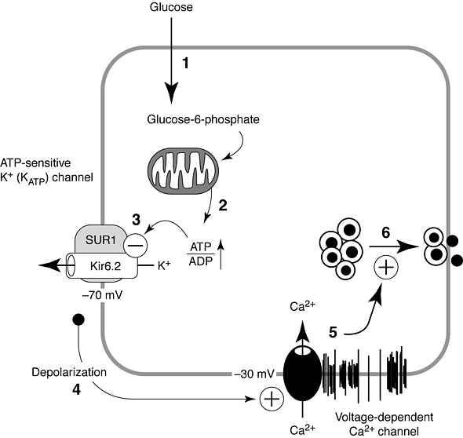

★

Slide 7
ATP and Sulfonylurea Linkage in the KATP Channel Solves a Diabetes Puzzler
Peter Drain

Slide 9
Cardiovascular safety
Concern about possible adverse cardiovascular effects has waxed and waned for several decades
It dates from publication of the findings of the University Group Diabetes Program (UGDP) study, in which cardiovascular mortality rates of type 2 diabetic patients treated with the sulfonylurea tolbutamide exceeded those of patients treated with placebo or insulin

Slide 10
Myocardial ischemic preconditioning
Myocardial ischemic preconditioning
This is a process by which transitory ischemia “conditions” the myocardium in a protective fashion, allowing greater tolerance of subsequent ischemia
ATP-dependent potassium (KATP) channels in myocardial cells have an important role in this process

Slide 11
ATI'-dependent potassium channels and their physiologic functions
Isoforms of the Sulfonylure receptor
Tissue | Receptor | Basal state | Stimulus | Effect
Pancreatic–β cells | SUR-1 | Open | Hyperglycemia | Insulin secretion
Myocardial cells | SUR-2A | Closed | Ischemia Hypoxia | Energy consumption
Vascular smooth | SUR-2B | Closed | Ischemia Hypoxia | Vasodilatation

Slide 12
Glibenclamide & Glipizide : Interact with the cardiac and vascular SUR2A/B
Glimepiride & Gliclazide : show very little interaction with SUR2A/B

Slide 13
Sulfonylureas are recommended in clinical practice guidelines for management of patients with type 2 diabetes because they effectively lower blood glucose and reduce the risk of microvascular complications such as nephropathy and retinopathy
However, debate regarding the cardiovascular safety of sulfonylureas is ongoing. Findings from several studies and meta-analyses suggest that sulfonylureas are associated with a significantly higher risk of mortality and adverse cardiovascular events than metformin and other antidiabetic drugs.

Slide 15
The affinity characteristics seem to vary among sulfonylureas towards SUR1, SUR2A, and SUR2B, with some—such as gliclazide—binding selectively to SUR1 when given at usual therapeutic doses, and others—such as glibenclamide—binding to sulfonylurea receptors in both the heart and pancreas when given at therapeutic doses .

Slide 16
The first plausible biological mechanism canters on an extension of the beneficial pharmacological action of sulfonylureas.
These drugs bind to sulfonylurea receptors (SUR1) on pancreatic β cells and inhibit ATP-sensitive potassium channels
this process promotes insulin release and lowers blood glucose concentrations .
However sulfonylureas also bind to receptors on myocardial (SUR2A) and vascular smooth muscle (SUR2B) cells, so can inhibit cardiac ATP-sensitive potassium channels.
Binding of Sulfonylureas to SUR2A or SUR2B receptors can interfere with ischaemic conditioning—an endogenous cardiac protective mechanism—and possibly with cardiac conduction.

Slide 17
The second plausible mechanism for the higher risk of adverse cardiovascular effects associated with sulfonylurea involves hypoglycaemia—a common, well known adverse effect of sulfonylurea treatment.
Episodes of hypoglycaemia can prolong the QT interval and are associated with cardiac ischaemia

Slide 18
A prolonged QT interval and cardiac ischaemia can increase the risk of adverse cardiovascular events, such as ventricular arrhythmias, myocardial infarction, and sudden cardiac death.
Differences in SUR1 receptor affinity an pharmacokinetic properties seem to create differences in the risk of hypoglycaemia, with glibenclamide, which has the highest affinity for SUR1,having the highest risk among the sulfonylureas.
Increased secretion of intact proinsulin, increased amount of visceral adipose tissue, and weight gain.

Slide 19
UK Prospective Diabetes Study
20-year Interventional Trial from 1977 to 1997
5,102 patients with newly-diagnosed DM2
Median follow-up 10.0 years, range 6 to 20 years
Results presented in 1998
10-year Post-Trial Monitoring from 1997 to 2007
Annual follow-up of the survivor cohort
Clinic-based for first five years
Questionnaire-based for last five years
Median overall follow-up 17.0 years, range 16 to 30 years

Slide 20
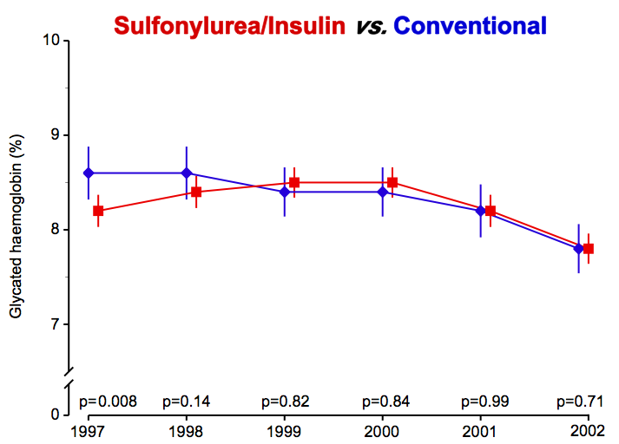
Post-Trial Changes in HbA_{1c}
UKPDS results presented

Slide 21
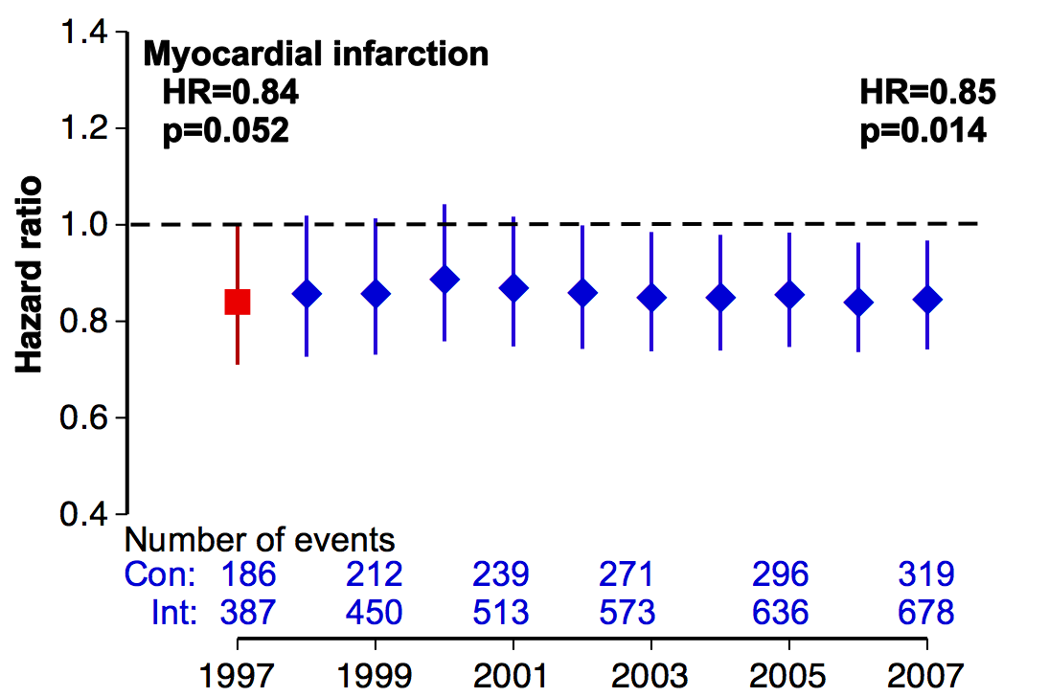
Myocardial Infarction
(fatal or non-fatal myocardial infarction or sudden death)
Intensive (SU/Ins) vs. Conventional glucose control

Slide 22
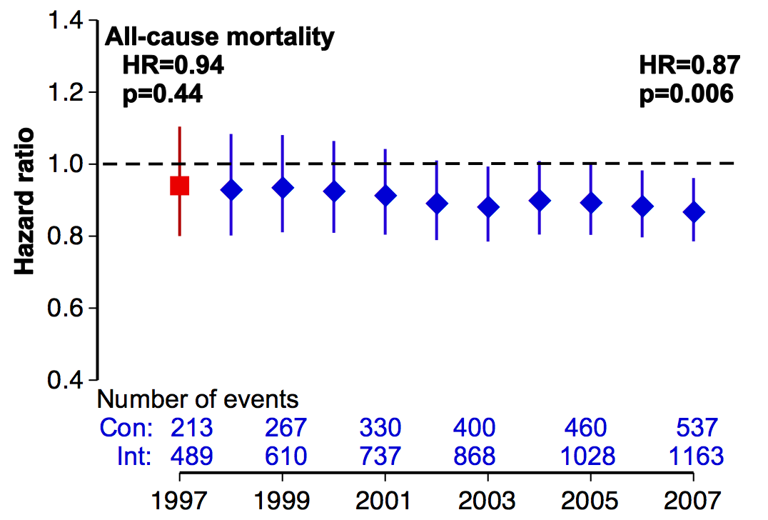
All-cause Mortality
Intensive (SU/Ins) vs. Conventional glucose control

Slide 23
UKPDS Conclusions
Despite an early loss of glycemic differences, a continued reduction in microvascular risk and emergent risk reductions for MI and death were observed during 10 years of post-trial follow-up

Slide 24
Adverse effects
• Weight gain : 1 – 4 kg
• Hypoglycemia
• Very occasionally, sensitivity reactions :
usually transient cutaneous rashes.
• Erythema multiforme (rarely)
• Fever, jaundice, acute porphyria, photosensitivity
and blood dyscrasias are also (rerely)
• Chlorpropamide (no longer in common use) :
- Facial flushing with alcohol
- Water retention and hyponatremia.

Slide 25
Sulfonylurea in CKD
Chlorpropamide is eliminated almost exclusively by the kidney
Glyburide has weak active metabolites that are excreted in the urine and accumulate in patients with impaired kidney function
Glimepride is primarily metabolized by the liver, with renal excretion of active metabolites
Glipizide is metabolized by the liver and primarily excreted in the urine as inactive metabolites
Gliclazide is predominantly metabolized by liver and less than 5% is excreted in urine

Slide 26
Sulfonylurea in CKD
Repaglinide is principally metabolized by the liver, with less than 10 percent renally excreted
Nateglinide is hepatically metabolized, with renal excretion of active metabolites
Glipizide , gliclazide (MR) and repaglinides are reasonable options

Slide 27
Glycemic targets and glucose-lowering therapies must be individualized
Diabetes Care Publish Ahead of Print, published online April 19, 2012

Slide 29
Conclusions
Sulfonylureas are not first choice of drug for the management of patients with type 2
Sulfonylureas can be regarded as one of available choices for the management of patients with type 2 diabetes who are intolerant of metformin and for whom lifestyle alone is not sufficient to achieve blood glucose targets
Sulfonylureas can be considered ;as one of available options; for combination therapy in those patients who are not controlled with metformin alone

Slide 30
Conclusions
Sulfonylureas are associated with modest weight gain and risk of hypoglycemia
Some studies have demonstrated a secondary failure rate that may exceed other drugs, ascribed to an exacerbation of islet dysfunction (low durability)
Given similar efficacy (HbA1c reduction) ,the choice of sulfonylurea is dependent upon cost , availability ,risk of hypoglycemia (age, GFR)

Slide 31
Conclusions
Certain sulfonylureas have been proposed to aggravate myocardial ischemia through effects on ischemic preconditioning. However actual clinical relevance of this remains unproven

Slide 32
Mortality risk among sulfonylureas: a systematic review and network meta-analysis
Scot H Simpson et al
Lancet Diabetes Endocrinol 2014

Slide 33
methods
Medline and Embase from inception to June 11, 2014, we excluded review articles, editorials ,commentaries, and animal studies (appendix) patients were adults with type 2 diabetes; group allocation was based on sulfonylurea use; the study reported at least two different sulfonylurea groups; patients were followed up for at least 30 days; the number of all-cause deaths, cardiovascular related deaths, or myocardial infarctions were reported according to individual sulfonylurea. We excluded studies examining only one sulfonylurea to ensure that we gathered data for direct, within-study comparisons between two or more sulfonylureas for the network metaanalysis..

Slide 34
Limitation
First UK Prospective Diabetes Study (UKPDS)was the only trial to report cardiovascular events as prespecified outcomes.
Second, the remaining six randomised controlled trials were not designed to examine risk of adverse cardiovascular events and therefore had insufficient power because of small sample sizes (30–1044 patients enrolled), short follow up (median 6 months), and few reported events (24 deaths in total).
In the absence of definitive evidence from randomised controlled trials, observational studies and meta-analyses of these data can provide information to help guide treatment decisions.

Slide 35
Antidiabetic drug exposure was defined according to each study and categorized as new user (follow-up began with first ever sulfonylurea prescription) or prevalent user (exposure assessed during a fixed time point).
The table summarises characteristics of the seven studies that randomly allocated patients to different sulfonylureas and 17 observational studies in which patients were grouped by sulfonylurea for analyses.

Slide 38
In three observational studies, incident sulfonylurea users were enrolled because recruitment was on the basis of the first known prescription for sulfonylurea.
In the remaining 14 observational studies ,prevalent users were enrolled because patients were using a sulfonylurea before study enrolment The analyses of all-cause mortality risk included data from 18 studies reporting 14 970 (9%) deaths in 167 327 patients who used a sulfonylurea. 841 (4%) of 19 334 gliclazide users, 5482 (11%) of 49 389 glimepiride users, 2106 (15%) of 14 464 glipizide users, 5296 (7%) of 77 169 glibenclamide users, 1066 (17%) of 6187 tolbutamide users, and 179 (23%) of 784 chlorpropamide users died

Slide 39
In the remaining 14 observational studies ,prevalent users were enrolled because patients were using a sulfonylurea before study enrolment The analyses of all-cause mortality risk included data from 18 studies. reporting 14 970 (9%) deaths in 167 327 patients who used a sulfonylurea. 841 (4%) of 19 334 gliclazide users, 5482 (11%) of 49 389 glimepiride users, 2106 (15%) of 14 464 glipizide users, 5296 (7%) of 77 169 glibenclamide users, 1066 (17%) of 6187 tolbutamide users, and 179 (23%) of 784 chlorpropamide users died

Slide 40
REPORTING
14 970 (9%) deaths in 167 327 patients who used a sulfonylurea.
841 (4%) of 19 334 gliclazide users,
5482 (11%) of 49 389 glimepiride users,
2106 (15%) of 14 464 glipizide users,
5296 (7%) of 77 169 glibenclamide users,
1066 (17%) of 6187 tolbutamide users,
and 179 (23%) of 784 chlorpropamide users died

Slide 41
Gliclazide seemed to have the lowest risk of mortality compared with the other sulfonylureas, followed by glimepiride glipizide, glibenclamide, tolbutamide, and chlorpropamide.
Gliclazide and glimepiride use was associated with a signifi cantly lower risk of mortality compared with glibenclamide, whereas glipizide use had a similar risk.

Slide 42
Cardiovascular-related mortality analyses were based on data from 13 studies reporting 7158 (5%) deaths in 145 916 patients who used a sulfonylurea. Gliclazide use was associated with a significantly lower risk of cardiovascular-related mortality compared with glibenclamide. Glimepiride use was associated with a numerically lower risk, but the difference compared with glibenclamide was not significant

Slide 43
Myocardial infarction analyses were based on 1012 (12%) events in 8124 patients receiving a sulfonylurea who were enrolled in seven studies. There were no significant differences among sulfonylureas when direct evidence was pooled by traditional metaanalyses or when direct and indirect evidence were combined in a network meta analysis

Slide 44
Discussion
In this systematic review, we identified 24 controlled studies that reported the risk of adverse cardiovascular outcomes for two or more sulfonylureas. We were able to combine mortality data from 23 of these studies that enrolled a total of 172 349 patients who used a sulfonylurea;18 of these studies (167 327 patients) were included in our main analyses. In all direct or direct and indirect analyses, gliclazide use was associated with a significantly lower risk of all-cause and cardiovascular-related mortality compared with glibenclamide use Glimepiride use was associated with a lower risk of all-cause mortality compared with glibenclamide use. Glipizide use was associated with a similar risk of all-cause and cardiovascular-related mortality compared with glibenclamide use. There were no clear signifi cant differences in risk of myocardial infarction among the sulfonylureas.

Slide 47
We expected some inconsistency between the direct and indirect data since most studies included in this systematic review were observational studies.
Several factors could contribute to the inconsistencies noted in the main analysis. For example, duration of diabetes ranged from newly diagnosed to 14 years,
Patients could either be new sulfonylurea users or prevalent users at study enrolment, and the duration of follow-up ranged from 30 days to 14 years.

Slide 48
Despite these variations, the reported associations in the network meta-analysis of adjusted hazard ratios were consistent with the associations noted in the main analysis—that gliclazide use was associated with a significantly lower risk of all cause and cardiovascular-related mortality compared with glibenclamide.

Slide 49
Several limitations should be considered when interpreting our findings:
First and foremost, selection bias could have affected the reported associations because data for these network meta-analyses were taken mainly from cohort studies.
Although concerns about selection bias affecting reported differences between metformin and sulfonylureas are well known, removal of metformin from our analysis did not have a substantial effect on the associations among the commonly used sulfonylureas.

Slide 50
glimepiride and gliclazide, which were only available in trade name formulations during many of the study periods, might have been selectively used in patients with a higher socioeconomic status .
Although this factor might partially explain the differences seen between these two sulfonylureas and glibenclamide, we also noted important differences between gliclazide and glimepiride.

Slide 51
Second, the main analyses examined the relative risks using raw event count data and, therefore, we did not control for any potential confounding, both within the studies and across studies. Although a sensitivity analysis of all-cause mortality using adjusted hazard ratios produced similar results, residual confounding is still an important factor to consider.
Many of the included observational studies could not account for important clinical measures such as blood glucose concentrations, history of hypoglycaemia, blood pressure, lipid concentrations, renal function, left ventricular function, and smoking status in the adjusted hazard ratios

Slide 52
Thirdsome patients who stopped using a sulfonylurea might have been misclassified as exposed. For example, several trials used a time-fixed definition to allocate patients to a sulfonylurea group and excluded patients if there was evidence of switching to or concurrent use of a second sulfonylurea.
Schramm and colleagues’ study was the only one in which investigators checked at regular intervals to ensure patients continued to use a sulfonylurea during the observation period.

Slide 53
Fourth, the limited amount of available information did not allow us to examine other factors that could affect risk of adverse effects. For example, different formulations of sulfonylureas, such as the regular and modified-release formulations of gliclazide, and regular and extended release formulations of glipizide, could have different levels of cardiovascular risk because of possible differences in risk of hypoglycaemia.
For these reasons, findings from this study should be considered hypothesis generating and need to be verified in a properly designed randomised clinical trial.

Slide 54
ongoing trials
TOSCA IT
(NCT00700856) and CAROLINA (NCT01243424) trials

Slide 55
Cardiovascular safety of sulfonylureas: a meta-analysis of randomized clinical trials
M. Monami1, S. Genovese2 & E. Mannucci3
1Geriatric Cardiology, Careggi Teaching Hospital, Florence, Italy
2Diabetes and Metabolic Diseases Unit, IRCCS Multimedica, Sesto San Giovanni, MI, Italy
3Diabetes Agency, Careggi Teaching Hospital, Florence, Italy

Slide 56
The aim of this study : collection and overall assessment of all data on the cardiovascular effects of sulfonylureas in patients with type 2 diabetes.
Materials and Methods
The meta-analysis was reported following the PRISMA checklist .
Data Sources and Searches
Extensive Medline, Embase and Cochrane database search for sulfonylureas.
Collecting all randomized clinical trials on humans up to 31 October 2012.

Slide 57
Study Selection ➔
A meta-analysis was performed including all randomized clinical trials with a duration of at least 24weeks, enrolling patients with type 2 diabetes, comparing sulfonylureas WITH placebo or active drugs (oral hypoglycaemic agents, GLP- 1 receptor agonists and/or insulin) different from other sulfonylureas

Slide 58
The principal outcome of this analysis :
The effect of sulfonylureas, compared either with placebo or active drugs ,on the incidence of MACE including :
cardiovascular death,
non-fatal myocardial infarction (MI)
Stroke
acute coronary syndromes
and/or heart failure

Slide 59
Secondary outcomes :
➔Fatal and nonfatal MI and stroke
➔All-cause and cardiovascular mortality
➔ severe hypoglycaemia.
(MH-OR) was calculated for all the adverse events defined above, on an intention-to-treat basis, excluding trials with zero events.

Slide 64
Retrieved trials included
20 885 patients: in Sulfonylurea groups
24603 patients: in comparator groups
Mean trial duration :70weeks.
The mean age:56.6
duration of diabetes: 6-3
baseline HbA1c : 8.4%
BMI : 29-7Kg/m
RESULTS: 62:MACE, 57:MI 56:STROKE , 88:All Cause Mortality ,
78:C.V Mortality

Slide 65
Of the 62 trials reporting information on MACE, 32 detected no events
the main analysis was
performed on 30 trials. (p=0.002).

Slide 66
The use of sulfonylureas was not associated with any significant difference in the incidence of MACE with respect to comparators (MH-OR: 1.08 [0.86–1.36], p=0.52)

Slide 68
In subgroup analyses versus different comparators, sulfonylureas were associated with a significantly higher incidence of MACE than DPP4 inhibitors;
no other significant difference was observed .

Slide 70
When considering individual sulfonylureas, a non-significant trend towards increased risk was observed with glimepiride only; in direct comparisons, this drug was associated with a significantly higher risk than DPP4 inhibitors

Slide 72
MI
The use of sulfonylureas was not associated with any significant difference in the incidence of MI with respect to comparators (MH-OR: 0.88 [0.75–1.04], p=0.13),
although a non-significant trend towards a reduction was observed in comparison with placebo or no therapy.
None of the sulfonylureas appeared to affect the incidence of MI.

Slide 73
Stroke
In 16 trials reporting at least one stroke, a significantly higher risk was observed in association with sulfonylureas (MH-OR: 1.28 [1.03–1.60], p=0.026).
The increase in risk reached statistical significance in direct comparisons with DPP4 inhibitors (MH-OR: 4.51 [1.60–12.66], p=0.004) and in trials with glimepiride (MH-OR: 4.22 [1.65–10.79], p=0.003)

Slide 74
All-Cause and Cardiovascular Mortality
No significant association with all-cause
or
cardiovascular mortality was observed for trials with different comparators, or for individual sulfonylureas

Slide 76
Severe Hypoglycaemia
In trials reporting at least one event, sulfonylureas were associated with a significantly increased risk of severe hypoglycaemia in comparison with metformins (N=2 trials
MH-OR: 14.72 [2.81–77.30], p=0.001) and placebo or no therapy (N=5 trials; MH-OR: 6.06 [2.12–17.27], p=0.001),
whereas a non-significant trend was observed in trials versus thiazolidinediones (N=9 trials; MH-OR: 1.8 [0.92–3.51],P=0.09

Slide 77
Interpretation
The overall number of trials with sulfonylureas is quite substantial, with a total observation of over 50000 patient×years.
Unfortunately, the quality of retrieved trials is heterogeneous, and the information on cardiovascular events is not always reported.
Moreover, recent trials are usually superior for quality ,and they report more detailed information on severe adverse events; however, in those studies sulfonylureas are often used as comparators for newer drugs, the manufacturers of which are sponsoring the study.

Slide 78
Overall, sulfonylureas do not appear to be associated with a significant increase in cardiovascular risk.
However, this result could be due to insufficient sample size; in fact, the upper limit of the confidence interval remains above the threshold (1.30) recommended by some regulatory authorities for final approval of new drugs for type 2 diabetes.

Slide 79
the overall analysis includes trials in which sulfonylureas were compared with placebo or no therapy, resulting in an improvement of glycaemic control, which could have produced a reduction of cardiovascular risk
Therefore, the separate analyses versus individual comparators, although limited for sample size, could yield more relevant information

Slide 80
The odds ratio for major cardiovascular events with sulfonylureas was below 1 in trials versus placebo or no therapy, suggesting a possible benefit of improved glycaemic control.
A similar result was obtained in direct comparisons with rosiglitazone, which was suspended because of insufficient cardiovascular safety
However, none of the observed differences reached statistical significance, due to insufficient sample size.

Slide 81
Unfortunately, results of the UKPDS could not be included in this analysis, because events with sulfonylureas were not reported separately from those of insulin in the overweight group, which could be randomized to metformin.

Slide 82
hus, the meta-analysis is largely driven by the ADOPT, which reported a trend in favour of sulfonylureas for cardiovascular events, and by a more recent study showing the superiority of metformin over glipizide in patients with prior events.
Despite the evident limitation in sample size and number of events, in direct comparisons with DPP4 inhibitors sulfonylureas were associated with a remarkable and statistically significant increase in the incidence of cardiovascular events.

Slide 83
It should also be noted that, unlike findings on DPP4 inhibitors, no difference in cardiovascular risk was observed in direct comparisons between sulfonylureas and GLP1 receptor agonists.

Slide 84
the incidence of stroke was significantly increased with sulfonylureas. It should be noted that some sulfonylureas have been reported to increase blood pressure with a possible detrimental effect on the risk of stroke??

Slide 85
the estimated odds ratios for cardiovascular mortality were similar or superior to those for all-cause mortality, although statistical significance was not reached due to the smaller number of observed events.

Slide 86
It can be speculated that the reported adverse effects of sulfonylureas on cardiac function, mediated by the interaction with myocardial ATP-dependent potassium channel are present only in case of myocardial ischaemia

Slide 87
Sulfonylureas were associated with an increased risk of severe hypoglycaemia in the present analysis, at least in comparisons with placebo or no therapy and metformin.

Slide 88
Previous observational studies had suggested that individual sulfonylureas could be associated with different mortality rates; this hypothesis is not confirmed in the present meta-analysis.

Slide 89
In conclusion, sulfonylureas do not appear to be associated to a relevant increase in the overall incidence of cardiovascular events, although they may produce an increased risk of stroke, whereas treatment with sulfonylureas is associated with a significant increase in mortality.
Despite the large amount of available data, the cardiovascular safety of sulfonylureas cannot be considered established unless it is far from proven and deserves further investigation, evaluated in long-term cardiovascular outcomes trials.

Slide 90
Sulfonylurea Use and Incident Cardiovascular Disease Among Patients With Type 2 Diabetes: Prospective Cohort Study Among Women
Diabetes Care 2014
Yanping Li, Yang Hu, Sylvia H. Ley,Swapnil Rajpathak, and Frank B. H

Slide 91
Sulfonylurea Use and Incident Cardiovascular Disease Among Patients With Type 2 Diabetes: Prospective Cohort Study Among Women
Diabetes Care 2014;37:3106–3113 | DOI: 10.2337/dc14-1306

Slide 92
We aimed to prospectively evaluate the association between sulfonylurea use and risk of cardiovascular disease among patients with diabetes using the Nurses’ Health Study (NHS), a well-established cohort of U.S. women with long-term follow-up.

Slide 93
RESEARCH DESIGN AND METHODS
Study Population
The NHS cohort was established in 1976
121,700 female registered nurses aged 30 to 55 years residing in 11 U.S. states completed a mailed questionnaire on their medical history and lifestyle characteristics .
Every 2 years, follow-up questionnaires have been sent to update information on potential risk factors and to identify newly diagnosed cases of type 2 diabetes and cardiovascular and other medical events.

Slide 94
In 2000 and 2005, 5,536 patients with type 2 diabetes responded to the supplemental questionnaires .
prevalent cardiovascular disease (n =634)were excluded .
4,902 participants were included in the current study investigating incident cardiovascular disease.
The end of the follow-up period was 30 June 2010.

Slide 95
1 -Ascertainment of Type 2 Diabetes
2-Assessment of Cardiovascular Events and Mortality
3-Assessment of Diabetes Treatments and Complications
4-Assessment of Covariates

Slide 97
As shown in Table :
sulfonylurea therapy was associated with longer duration of diabetes, diabetes related complications, and use of other antihyperglycemic medications.
The prevalence of smoking, multivitamin use, aspirin use, use of antidepressant medications, family history of cardiovascular diseases, and presence of hypertension at baseline were similar across categories of sulfonylurea therapy.

Slide 99
In conclusion, our study suggests that a longer duration of sulfonylurea therapy was associated with a higher risk of CHD, and the combination therapy of metformin and sulfonylurea was associated with an increased CHD risk compared with metformin monotherapy or sulfonylurea monotherapy.
Further prospective cohort studies are warranted to replicate our findings.

