Slide 1
IN THE NAME OF GOD
DR MARYAM DEHGHANI

Slide 2
PROBLEM LIST
A 68 Y/O woman
Bone pain ,HTN, Intractable gastric ulcer
Biochemically abnormal: compatible with hyperparathyroidism
Radiologically sup mediastinal mass: compatible with paraganglioma?

Slide 3
Questions:
1- how is the anatomical distribution of ectopic parathyroid glands & adenomas?
2- What are the differences between solid & cytic parathyroid adenomas( size, symptoms,ectopia, atypical adenoma)?
3- what is the significans of cystic aspect of parathyroid adenoma?
4- was ectopic CYSTIC parathyroid adenoma the definit diagnose or a pth-secreting tumor such as neuroendocrine tumor can be considered?
5- how can we differentiate them? what are the similarities and differences between neuroendocrine tumor and parathyroid adenoma on pathologic study?

Slide 4
CYSTIC PARATHYROID ADENOMA
V/S
PARAGANGLIOMAS

Slide 5
Mediastinal Cancer 2019
53%
Neurofibroma
Neuroblastoma
ganglioneuromas
paragangliomas

Slide 6
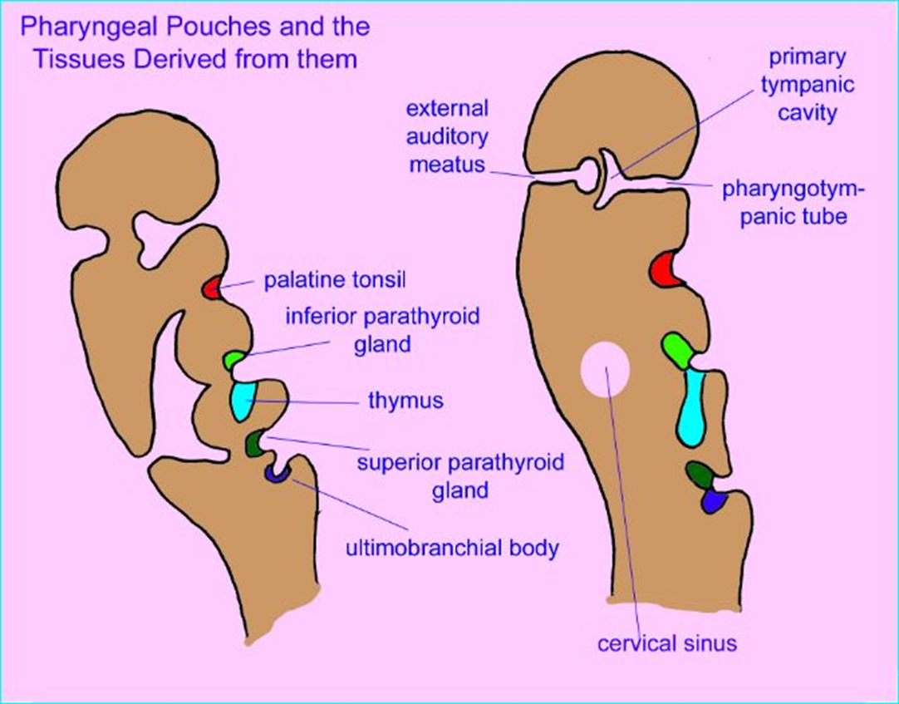
In the sixth gestational week: 3rd pharyngeal pouch : Lower parathyroid (Dorsal) Thymus (ventral) 4th pharyngeal pouch: Upper parathyroid (Dorsal ) Lateral thyroid from neural crista(ventral)

Slide 7
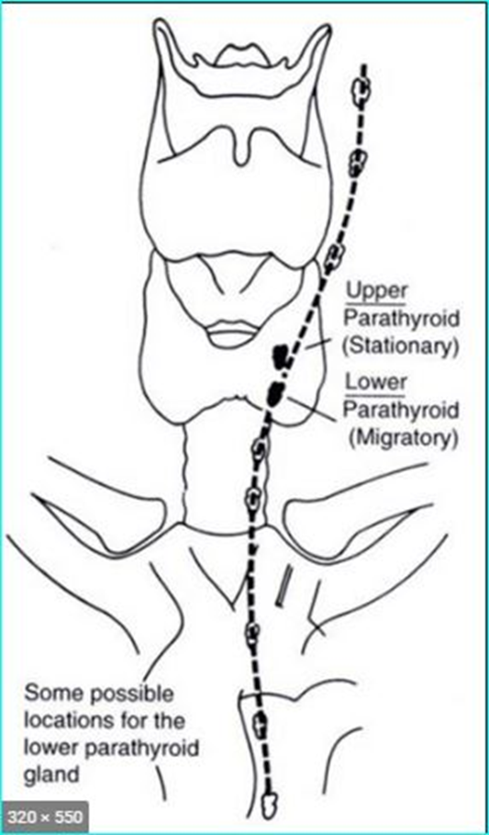
Location congenital ectopy = abnormal migration during embryological development (most often seen in lower parathyroids) Acquired ectopy = migration of pathologically enlarged parathyroid (most often seen in upper parathyroids ) size : 5x3x1 mm weight : 35 to 40 mg .

Slide 8
1-how is the anatomical distribution of ectopic parathyroid glands & adenomas?
2-What are the differences between solid &cytic parathyroid adenomas( size, symptoms,ectopia, atypia)?
3-what is the significans of cystic aspect of parathyroid adenoma?
4-was ectopic parathyroid adenoma the definit diagnose of our patients or a pth-secreting tumor such as neuroendocrine tumor can be considered?
5- how can we differentiate them? what are the similarities and differences between neuroendocrine tumor and parathyroid adenoma on pathologic study?

Slide 9
Parathyroid Re-exploration A Clinical and Pathological Study of 112 Cases CHIU-AN WANG, M.D.*
From the Department of Surgery, Harvard Medical School and the Massachusetts General Hospital, Boston, Massachusetts
* Associate Clinical Professor of Surgery, Harvard Medical School, Visiting Surgeon, Massachusetts General Hospital.
Reprint requests: Chiu-an Wang, M.D., Massachusetts General Hospital, Boston, Massachusetts 02114. Submitted for publication November 29, 1976.

Slide 10
712 patients with primary hyperparathyroidism were surgically treated at the Massachusetts General Hospital.
In approximately 85% : straightforward operation
The remaining 15% : problem cases
These problem cases is the subject of this paper
Materials and methods
This study includes 112 patients who had had one or more previous unsuccessful operations for primary hyperparathyroidism.

Slide 11
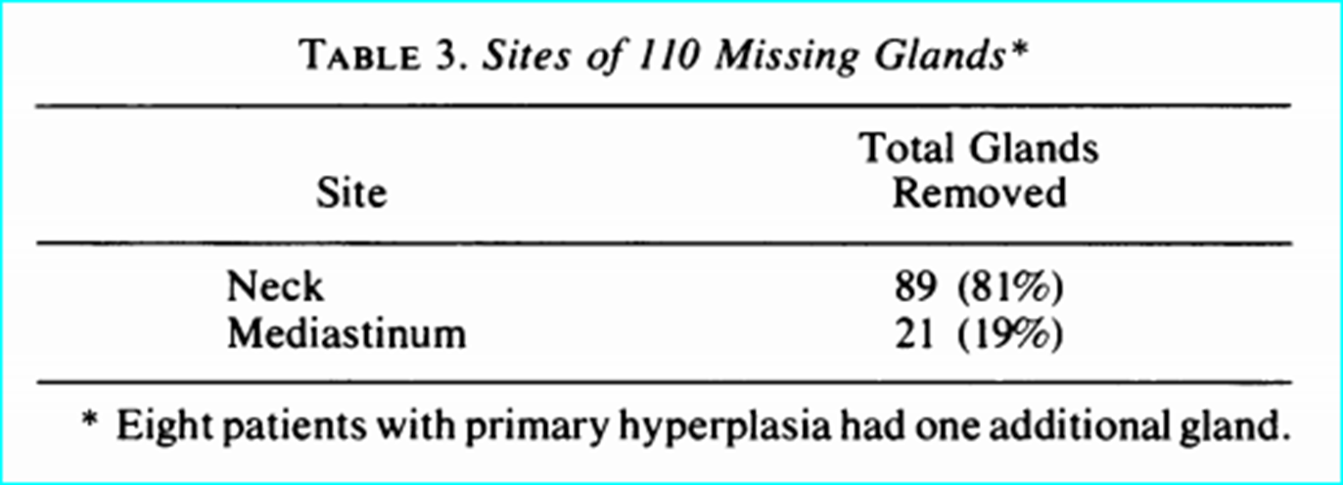
102 patients were successfully re-explored the exception of 6 glands the location was not clearly defined 104 were found in the following sites :

Slide 12
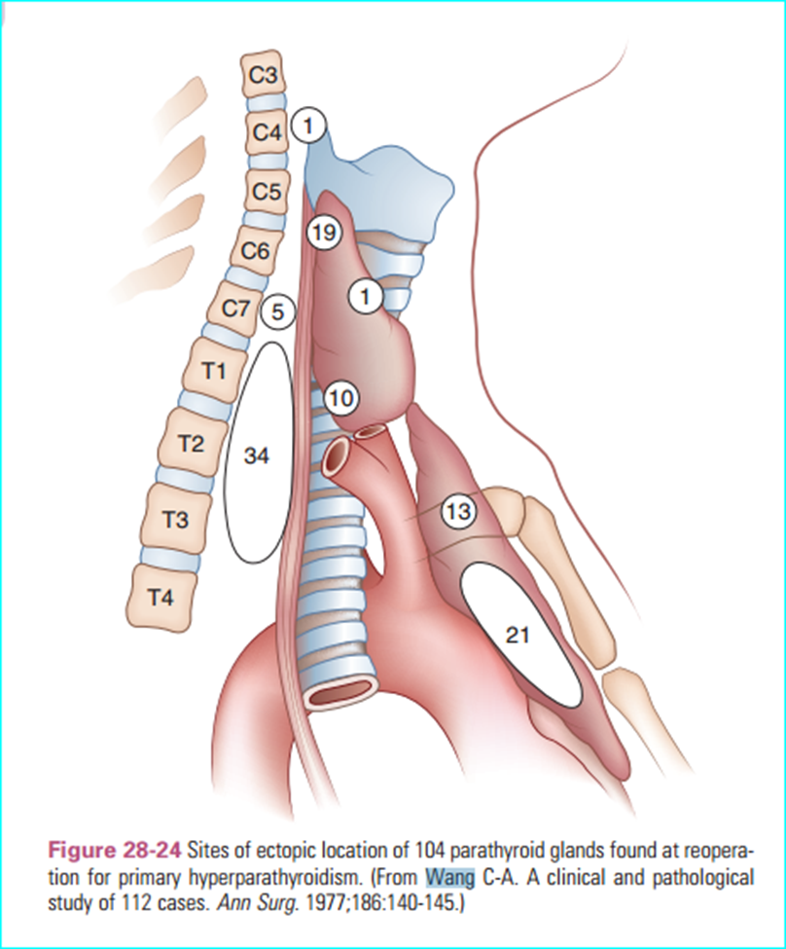
34 : superior posterior mediastinum
21 : anterior mediastinum
19 : dorsum of upper thyroid pole
10 : behind the lower thyroid pole
13 : within the thymic tongue
5 : behind the upper esophageal wall
1 : at the angle of the jaw
1 : within the thyroid

Slide 13
At re-exploration of neck, the superior posterior mediastinum was the most common site of missing parathyroid (34, or 38%)
…
Thymic tongue
superior posterior mediastinum
upper pole of the thyroid
neck

Slide 14
Of the 21 missing glands recovered by mediastinotomy
14 (67%) : within the thymus
(upper anterior mediastinum )
Conceivably, some had originally been hidden at the thoracic inlet where they might have been retrieved via the neck.
7 (33%) : caudally behind the thymus, anterior to the great vessels or the bronchus

Slide 15
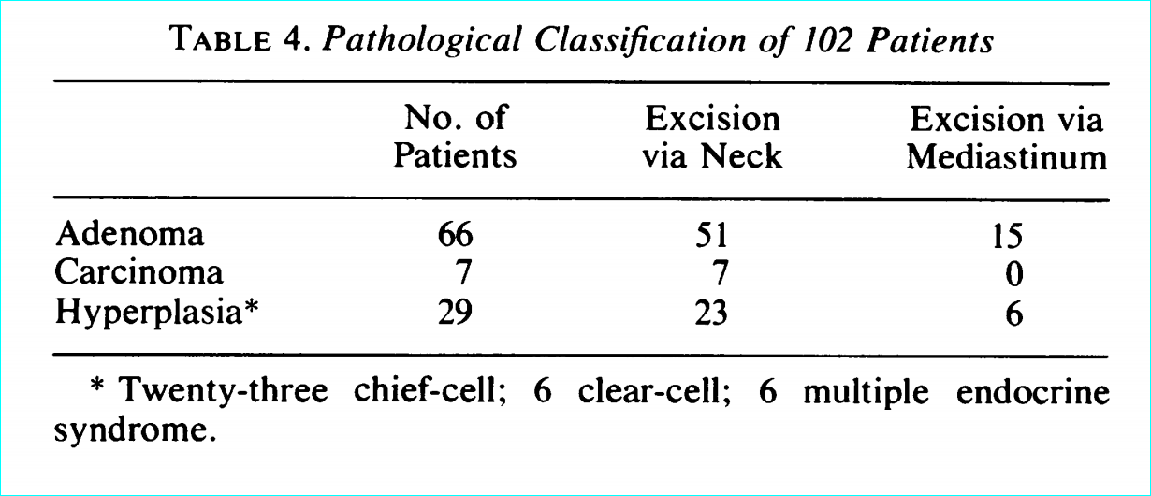
Pathology of the Missing Glands
Six patients had the multiple endocrine syndrome.

Slide 16
Unsuccessful Reoperation
In 10 of the 112 patients, the diseased gland was not found at reoperation

Slide 17
1-how is the anatomical distribution of ectopic parathyroid glands & adenomas?
2-What are the differences between solid & cytic parathyroid adenomas( size, symptoms,ectopia, atypia)?
3-what is the significans of cystic aspect of parathyroid adenoma?
4-was ectopic parathyroid adenoma the definit diagnose of our patients or a pth-secreting tumor such as neuroendocrine tumor can be considered?
5- how can we differentiate them? what are the similarities and differences between neuroendocrine tumor and parathyroid adenoma on pathologic study?

Slide 19
Cystic parathyroid adenomas are reported to be very rare and account for 1-2% of PHPT cases(1)
Cystic adenomas: predominantly cystic lesions (>50% of the estimated volume of lesions)
These lesions have been generally thought to be secondary to degenerative changes in parathyroid tumors
This is one of the largest published series
Method:
At Peking Union Medical College Hospital, From 2009 - 2017,
A retrospective review of a prospectively collected database that includes data from pts who were diagnosed with PHPT(retrospective cohort)
907 pts underwent parathyroidectomy & diagnosed: parathyroid adenomas on pathology.
parathyroid hyperplasia or carcinoma were not included.
(1) T. Makino, T. Sugimoto, H. Kaji et al., “Functional giant parathyroid cyst with high concentration of CA19-9 in cystic fluid,” Endocrine Journal, vol. 50, no. 2, pp. 215–219, 2003.

Slide 20
-Solid adenoma -Solid adenoma with an insignificant cystic component -Cystic adenoma

Slide 21
Cystic parathyroid adenomas are traditionally believed to represent a small percentage of PHPT cases. However, the incidence of cystic adenomas was 4.1% in the present study, which is much higher than the incidence (<3%) in most previous reports from western countries. Another study from Iran reported a much higher incidence of cystic adenoma (17%)
1. Differences in the criteria
2. Severe PHPT in developing countries ,Unlike patients in western countries : biochemical screening

Slide 22
Comparison of clinicopathological features between solid adenomas & cystic adenomas. Total=907
82 patients with microcystic adenomas
cystic adenomas were nt associated: MEN-1,ectopic mediastinal parathyroid adenomas.
!
The percentage of males was much higher in cystic adenoma group than in solid adenoma group 43 % v/s 25%

Slide 23
The maximum diameter of adenomas in the cystic adenoma group was much larger than that in the solid adenoma group (40.5 ± 13.9 mm versus 21.6 ± 9.6 mm, ). ( )
For all patients with cystic adenomas, the serum iPTH on postoperative day 1 decreased to a value within the normal range. ( )

Slide 24
US-guided FNA was performed in 11 patients (30%) for whom the results of MIBI scintigraphy and/or US imaging were inconclusive.
In all cases, iPTH in cystic fluid was >2500 pg/mL, which was markedly higher than the serum level of iPTH measured at the same time.
The use of FNA is discouraged in the diagnosis of parathyroid lesions because of the risk of seeding along the needle tract .( Caution! )

Slide 25
1-how is the anatomical distribution of ectopic parathyroid glands & adenomas?
2-What are the differences between solid &cytic parathyroid adenomas( size, symptoms,ectopia, atypia)?
3-what is the significans of cystic aspect of parathyroid adenoma ?
4-was ectopic parathyroid adenoma the definit diagnose of our patients or a pth-secreting tumor such as neuroendocrine tumor can be considered?
5- how can we differentiate them? what are the similarities and differences between neuroendocrine tumor and parathyroid adenoma on pathologic study?

Slide 26
Cystic adenoma Significanse :
1.The rupture of cystic parathyroid adenomas has been reported to release a large amount of PTH into blood circulation, a phenomenon can cause parathyromatosis and hematosis .
2. The diagnosis of atypical adenoma :
the presence of broad fibrous bands, trabecular growth, cytological atypia, marked mitosis, and the exclusion criteria corresponding to carcinomas
Approximately one-fourth of the resected cystic adenomas in the present cohort were identified as atypical parathyroid adenomas upon pathological examination.
Atypical parathyroid adenomas, which present with atypical features but do not fulfill the criteria of carcinoma, have been reported to have a low but real risk of recurrence .
Close follow-up is necessary for patients with cystic parathyroid adenomas, which account for a substantial percentage of atypical parathyroid adenoma cases.

Slide 27
Endocrine-Related Cancer (2019)

Slide 28
After sx
No specifc guidelines for the surveillance of patients with atypical parathyroid adenomas after parathyroid surgery exist so far.
At our institution, regardless of the results of parafbromin immunostaining, we recommend annual follow-up evaluations including biochemical testing and neck ultrasound for the first 5 years after initial surgery and every 2–3 years thereafter.

Slide 29
1-how is the anatomical distribution of ectopic parathyroid glands & adenomas?
2-What are the differences between solid &cytic parathyroid adenomas( size, symptoms,ectopia, atypia)?
3-what is the significans of cystic aspect of parathyroid adenoma?
4-was ectopic parathyroid adenoma the definit diagnose of our patients or a pth-secreting tumor such as neuroendocrine tumor can be considered?
5- how can we differentiate them? what are the similarities and differences between neuroendocrine tumor and parathyroid adenoma on pathologic study?

Slide 31
Case description
A 73 y/o female
Referred to Tulane University Medical center endocrine surgery clinic, for surgical management of recurrent PHP.
PMHX : Osteopenia + HTN + nephrolithiasis+ depression + recent onset of fatigue.
PSHX: LT thyroid lobectomy & parathyroid surgery at age 31.
lab : elevated i PTH (126 pg/ml), ca (10.6 mg/dl).
Sestamibi & sonography failed to localize
A 1.1 cm hypoechoic nodule was in RT thyroid lobe. FNA: benign thyroid nodule.

Slide 32
Bilateral neck exploration performed.
Nl parathyroid was found & confirmed on frozen section
Thyroidectomy was performed with removal of the right thyroid lobe because of the possibility of intrathyroidal parathyroid
Dissection of RT central compartment : a 1.5 cm lesion in the thyrothymic ligament behind the RT sternoclavicular joint. The lesion weighed 520 mg.
PTH dropped to 12 pg/ml 10min after removal of the lesion.
Frozen section analysis revealed evidence of a multicystic NET, with no parathyroid tissue.

Slide 33
A. Diffuse strong cytoplasmic staining for chromogranin by IHC B. Diffuse cytoplasmic staining for PTH by IHC
Foci of normal parathyroid tissue were also identified within the lesion which exhibited diffuse cytoplasmic staining for PTH and diffuse strong immunohistochemical cytoplasmic staining for chromogranin A. and B).

Slide 34
Chromogranin A and neuron-specific enolase are commonly expressed in neuroendocrine neoplasms
This paper reports a patient with elevated PTH caused by ectopic production of this hormone by a neuroendocrine tumor in the neck .
Pathological examination of the lesion confirmed the diagnosis of a neuroendocrine tumor. Using immunohistochemistry, the tumor stained positive for PTH ,which confirmed the ectopic PTH secretion by the tumor.

Slide 35
(Clin Nucl Med)

Slide 36
A 32-year-old man
Recurrent ureteric stones, HTN, episodic H/A.
Ca = 11.1 mg/dL
PTH = 650 pg/mL
Neck CT scan :
heterodense mass on the LT
posteroinferior to thyroid left lobe
4 * 3 cm
from thyroid lower lobe to suprasternal notch.

Slide 37
Radionuclide scintigraphy performed after injecting 20 mCi of Tc-99m sestamibi IV :
large focus of increased tracer concentration at lower pole of thyroid left lobe

Slide 38
SPECT of neck & chest:
The coronal section also showed a smaller focus separate from and cranial to the main larger mass (arrow) with a central photopenic area.
The findings were reported:
to be consistent with a large parathyroid adenoma with a nonfunctional center, suggestive of central necrosis.
Operative findings also :
parathyroid adenoma at the site described on CT scan and MIBI scintigraphy.
Postop Ca and PTH were within normal limits.

Slide 39
special staining using neuron-specific enolase and chromogranin confirmed a diagnosis of a paraganglioma.
Immunostaining of the specimen was positive for PTH.

Slide 40
Tc-99m sestamibi (MIBI) scintigraphy is a well-established test to confirm and locate parathyroid adenomas in pts with findings suggestive of hyperpara.
Although this imaging technique has a high sensitivity for locating hyperfunctioning parathyroid glands, false-positive uptake in various other cervical tumors is also known:
1- Paragangliomas or glomus tumors
2- brachial & thymic carcinoid tumors
3- medullary & follicular thyroid carcinoma
4- Ectopic ACTH-producing tumors in the neck & mediastinum as well as in tumors of the brain, breast, parathyroid, lung, and kidney.
Increased mitochondrial trapping by hypermetabolic tissue, probably related to cell proliferation, may be the principle mechanism of uptake and retention of MIBI in these tumors.
In-111 octreotide & I-123 MIBG are generally accepted as the radiopharmaceuticals to be used to locat NET , especially paragangliomas in head & neck
This case also suggests that a (PTH)-secreting neuroendocrine tumor should be considered in DfDx of focal cervical MIBI uptake.

Slide 41
Paraganglioma imaging
On CT typical appearance of a paraganglioma is a mass :
Unenhanced density greater than 10 Hounsfield units (HU)
Avid contrast enhancement due to a rich capillary network and delayed washout .
Internal hemorrhage sometimes within the tumor ,Cystic changes, necrosis, internal calcifications are commonly described.
Rarely, these masses show low attenuation or minimal enhancemen.
2012 International Cancer Imaging Society
Department of Radiology, Brigham and Women’s Hospital, Boston, MA, USA; bDepartment of Imaging,

Slide 42
PARAGANGLIOMA!!?
RADIOLOGIC FINDIG
LOCATION & SIZE OF CYSTIC LESION
MULTIPLE GASTRIC ULCER
HYPERTENSION

Slide 43
Ectopic Production of PTH Degroot 2016
18 cases exist in literature of ectopic hyperparathyroidism by a nonparathyroid tumor.
These include : NETs, HCC , MTC, ovarian carcinoma, SCC, squamous carcinoma, rhabdoid kidney, endometrial adenosquamous carcinoma, thymoma.
NETs = Neoplasms of NEC
NEC: defined by production of neuropeptides & hormones; intracellular secretory granules , absence of neural structures.
NEC distribute widely in the body
NETs can secrete hormones unrelated to those secreted by the corresponding normal neuroendocrine cells, such as hCG, renin, ACTH, CRH, GHRH, GH, PTH, PTHrp, calcitonin, ghrelin, demonstrating that NETs are made of abnormally differentiated cells.
The hormonal profile of a NET can change over time. A NET can change from nonfunctioning into functioning, and vice versa

Slide 45
1-how is the anatomical distribution of ectopic parathyroid glands & adenomas?
2-What are the differences between solid &cytic parathyroid adenomas( size, symptoms,ectopia, atypia)?
3-what is the significans of cystic aspect of parathyroid adenoma?
4-was ectopic parathyroid adenoma the definit diagnose of our patients or a pth-secreting tumor such as neuroendocrine tumor can be considered?
5- how can we differentiate them? what are the similarities and differences between neuroendocrine tumor and parathyroid adenoma on pathologic study and ihc?

Slide 46
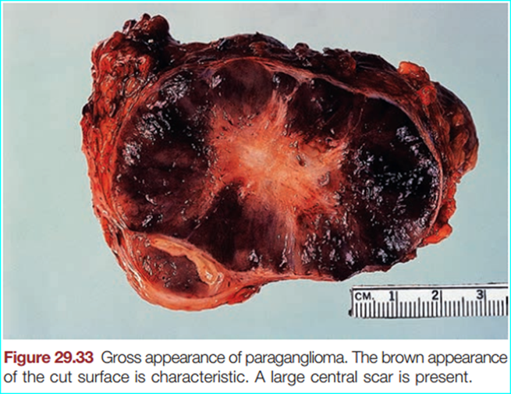
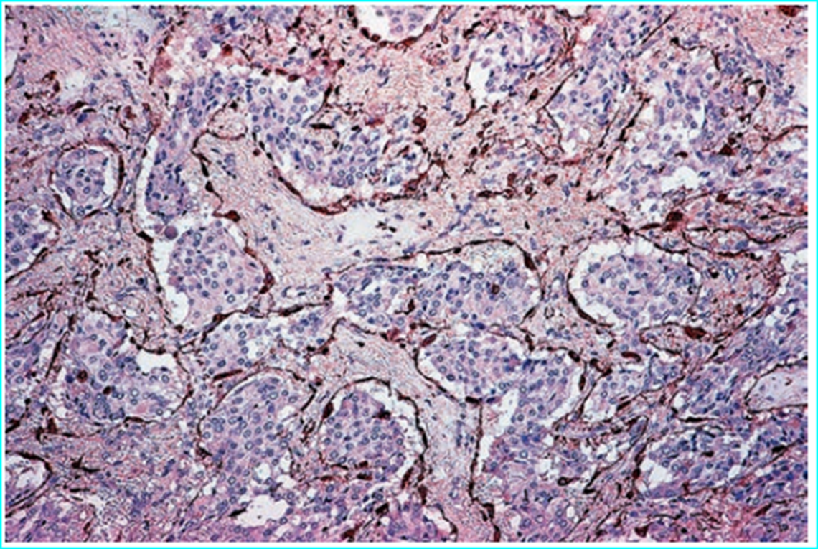
Pathology Ackerman 2018
Paraganglion System
Common morphology : cytoplasmic neurosecretory CA granules
Microscopically: all paraganglia have a similar morphology, characterized by chief cells arranged in well-defned nests (“Zellballen”) encircled by a thin layer of S-100 protein–positive sustentacular cells.

Slide 47
Tumors & Tumorlike Lesions of other Paraganglia
Extra-adrenal paragangliomas may arise:
1-Parasympathetic paraganglia (mostly of the head & neck))
2- Sympathetic paraganglia (along the sympathetic nerve chain adjacent to the vertebral bodies in abdomen, pelvis, thorax , along sympathetic nerve fbers).

Slide 48
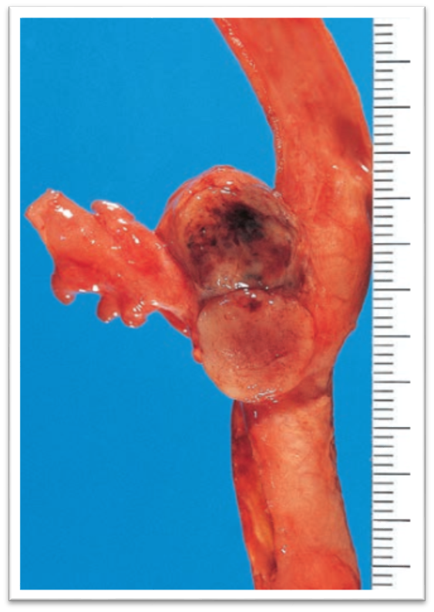
Paraganglioma subtypes
Parasympathetic (Head and Neck) (9, 10 , possibly 3 and 5 nerves)
Most are nonfunctioning with only very rare cases secreting CA .
Interestingly head & neck paragangliomas :more frequently chromogranin - ive
carotid body tumor is most common, middle ear, vagus nerve, larynx.
manifestations: pulsatile mass, hypoxemia.
commonly benign/ 5% malignant course.
Metastatic paragangliomas of head & neck are more commonly functioning, present at younger age, multifocal disease.
The rate of germline mutations specifcally in head & neck paragangliomas approaches at least 20%.
The most common mutations involve genes encoding the subunits of succinate dehydrogenase (i.e. hereditary paraganglioma syndrome), including SDHD, SDHB, SDHA, and SDHC.

Slide 49
Sympathetic Paraganglioma
Most commonly in the retroperitoneum, typically adjacent to the adrenal gland or kidney, along the axial trunk in the prevertebral and paravertebral sympathetic chains, as well as in and around pelvic organs.
These are capable of CA synthesis ( norepinephrine alone or norepinephrine + dopamine)
These are hereditary up to 30% of cases, and should be strongly suspected in younger pts

Slide 50
Nl paraganglion in retroperitoneal region
Hematoxylin–eosin
chromogranin

Slide 51
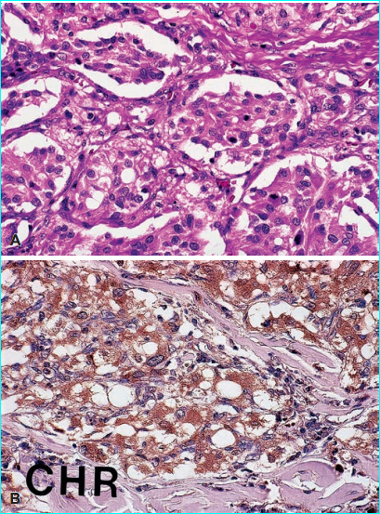
Morphologic Features
head & neck paragangliomas have been described as more cellular.
Well-defned nests of cuboidal cells (“Zellballen”) are separated by highly vascularized fibrous septa .
The individual cells have a moderately abundant granular basophilic cytoplasm.
On occasion, a brown melanin-like pigment is present (pigmented or black paraganglioma).

Slide 52
Electron Microscopic & IHC Features
IHC + ive for : NSE, chromogranin, synaptophysin, neurofilaments, opioid peptides, serotonin, somatostatin, other peptide hormones.
Similar to pheo, GATA3 , PHOX2B also show frequent in paragangliomas.
Keratin is almost always –ive , but :
1-Rare cases have focal staining (a fact of importance in the dfdx with neuroendocrine carcinomas)
2- The curious exception being paraganglioma of the filum terminale in which stronger keratin reactivity is more common.
The sustentacular cells can be demonstrated with S-100 protein, another feature of importance in the dfdx from other endocrine neoplasms

Slide 53
Parathyroid adenoma Pathology Ackerman
Immunohistochemically, there is reactivity for :
1- PTH
2- various types of keratin
3- neuroendocrine markers (chromogranin A & synaptophysin)
4- adenoma cells express neurofilament, intermediate filament not found in nl parathyroid cells.
5- Cyclin D1 & bcl-2 expression can be observed in a subset of adenomas
6- Expression of Ki-67 is observed, but the frequency of positive cells is lower compared to carcinoma.
7- The large majority of adenomas express parafibromin, the gene product of CDC73, which is lost in the majority of parathyroid carcinomas.
.

Slide 54
M. T. Levy L. D. R. Thompson (&) Department of Pathology, Southern California Permanente Medical Group, Woodland Hills Medical Center, 5601 De Soto Avenue, Woodland Hills, CA 91365, USA Department of Pathology, Maryland General Hospital, Baltimore, MD, USA M. Pennant Department of Head and Neck Surgery, Maryland General Hospital, Baltimore, MD, USA

Slide 55
Case Presentation
A 69 year old black woman
Presentation: nodular goiter in left thyroid gland ( +ive hypothyroidism)
+ fatigue, heat intolerance, increased sweating, palpitation, constipation, thinning of her hair and some difficulty swallowing.
- She denied flushing, headaches, worsening BP
An ultrasound : a retrosternal solid mass, interpreted to be in direct continuity of the thyroid lobe.
FNA : follicular epithelial cells , suggestion of intranuclear inclusions.
Past medical history: HTN ,heart disease (VSD) Approximately 13 months before the patient had a right kidney clear cell RCC (Stage I).

Slide 56
Specifically, she did not have any parathyroid gland disease clinically or radiographically, this was an isolated finding without any other stigmata of (MEN) or inherited syndromes.
calcium ranging from 8.5 up to 10.2 mg/dl (normal, 8.6–10.0 mg/dl),except 1 of them
other analytes were normal, obtained either pre- or immediately postoperatively, including alkaline phosphatase; PTH: 43 ,metanephrines, epinephrine, norepinephrine, dopamine and aldosterone .
LT hemithyroidectomy & excision of substernal thyroid mass.
During surgery, the mass in the substernal area was not attached to the thyroid gland. The left superior parathyroid gland was visualized and was interpreted to be normal.
substernal mass, showed an egg shaped mass 3.2 cm and weighing 8 g. The tissue was fleshy-gray to hemorrhagic

Slide 57
The histology of the substernal mass showed a well encapsulated and defined parathyroid gland, within which was a neoplastic proliferation of nests of paraganglia cells At the periphery, the parathyroid gland parenchyma was unremarkable,The neoplastic cells were arranged in a zellballen architecture

Slide 58
There was an intimate blending between the parathyroid parenchyma and the paraganglia cells, although without a destructive growth

Slide 60
The neoplastic cells were strongly and diffusely immunoreactive for chromogranin, synaptophysin, and CD56

Slide 62
That although rare, parathyroid gland tissue and paraganglia can coincide: intraparathyroid gland paraganglioma.
There is a report of a cervical paraganglioma mimicking a parathyroid adenoma by ectopic secretion of parathyroid hormone, confirmed by immunohistochemistry .
Both paraganglia and parathyroid tissues are derived from neural crest, and both follow a sometimes similar

Slide 63
Pathologic Features
Similarity:
The chromogranin, synaptophysin and CD56 are neuroendocrine markers, which can be positive in both the paraganglia cells as well as in parathyroid gland tissue.
Difference:
*** Since the parathyroid tissue is keratin positive, it can be difficult to separate the cell types, perhaps even raising the possibility of a carcinoid tumor.
***The ‘‘zellballen’’ or nested pattern is identified easily, highlighted by S-100 protein immunohistochemistry.
However, strong and intense staining with keratin and parathyroid hormone in the parathyroid parenchymal cells helps to separate the two populations.

Slide 64
Parathyroid Paraganglioma

Slide 66
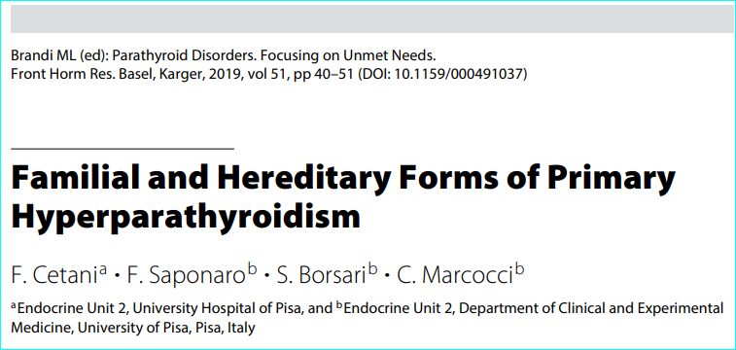

Slide 67
PHPT is the main manifestation of HPT-JT and affects about 95% of patients.
pathological features of atypical adenoma (cystic aspect, fibrosis, mitosis)
Parathyroid carcinoma (PC) is frequent in HPT-JT (15% - 37% of the cases)
Patients carrying MEN1 and CASR mutations are young and have multiglandular disease, whereas those with CDC73 mutations more frequently manifest PC or parathyroid cystic tumors

Slide 68
2012, sweden
CDC73 gene mutations in parathyroid adenomas seem rare, but are reported, especially in cystic or atypical adenomas

Slide 69
Additional clinical considerations & surveillance
Once the histopathological diagnosis ( atypical adenoma) has been confrmed, parafbromin immunohistochemistry should be carried out, as suggested by other authors, together with the germline testing of CDC73 gene(cardoso2017)
Conversely, Gill and coworkers suggested that for atypical adenomas without concerning clinical features of family history the genetic screening should only be performed in patients with parafibromin loss (gill 2019)
When a CDC73 germline mutation is identifed, the genetic testing should be offered to frst-degree relatives, to identify mutation carriers who are at high risk of developing HPT-JT-associated tumors. At the same time, the identifcation of relatives not carrying the CDC73 mutation would allow reassuring them from the anxiety of developing the disease and prevent unnecessary screening.

Slide 71
In most consecutive series of patients undergoing surgery for PHPT, the incidence of atypical parathyroid adenoma ranged from 0.5 to 4.4% An incidence as high as 14% has been reported in the Asian countries

