Slide 1
Thyroid Paraganglioma
Dr.Rahim Zahedi MD

Slide 2
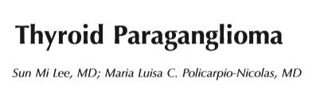
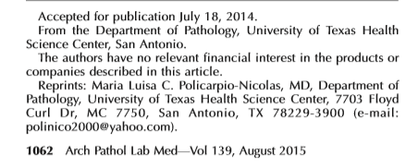

Slide 3
Paragangliomas are uncommon neuroendocrine tumors, arising from the neural crest-derived paraganglia of the autonomic nervous system
Paraganglioma adjacent to or inside the thyroid gland is a subset of laryngeal paragangliomas, which was ﬁrst described in the right upper lobe of the thyroid gland by Van Miert in 1964
Because thyroid paragangliomas arise from the inferior laryngeal paraganglia, one theory is that as paraganglioma develops from the inferior laryngeal paraganglia, it is slowly pulled downward and eventually rests lateral to the thyroid gland
It is also probable that the inferior laryngeal paraganglia may form within the thyroid capsule, which could eventually develop into an intrathyroidal paraganglioma.

Slide 4
CLINICAL PRESENTATION
Thyroid paraganglioma has a strong female predominance, and the mean age of presentation is 48 years
Most patients are asymptomatic, with a nonfunctional thyroid nodule for several years discovered incidentally with radiographic imaging
In the few symptomatic patients, their presentation ranged from an anterior neck mass, dysphagia, dyspnea, stridor, and hemoptysis
The reported incidence of functional paragangliomas is only 1% to 3% in the head and neck, with a single case report of functional thyroid-associated paraganglioma

Slide 5
Paragangliomas located in the skull base, head and neck, and thyroid are associated with the parasympathetic nervous system, which often lacks tyrosine hydroxylase Hence, they usually present with minimal or no catecholamine synthesis (nonsecreting)
all patients with newly diagnosed paraganglioma should receive a biochemical workup for catecholamine excess and their O-methylated metabolites (normetanephrine, metanephrine, and methoxytyramine)
Most patients with thyroid paragangliomas are euthyroid,with normal calcitonin and CEA levels and are negative for antiperoxidase, parathyroid hormone, and antithyroglobulin antibodies in their serum

Slide 6
follow-up imaging should include computed tomography or magnetic resonance imaging of the neck, chest, and abdomen/pelvis
The use of F-6ﬂuorodihydroxyphenylalanine positron emission tomography has been described as the most valuable functional imaging modality for localization of succinate dehydrogenase related to head and neck paragangliomas
Follow-up imaging should occur relatively soon after initial surgery so that concurrent disease can be identiﬁed and not confused with metastatic or recurrent disease

Slide 7
MOLECULAR GENETICS
Paragangliomas and pheochromocytomas are tumors derived from the extra-adrenal paraganglia or adrenal medulla, respectively
Although most of these tumors are considered sporadic, to date, approximately 30% to 40% are associated with at least 14 known susceptibility genes (MEN1, NF1, RET, VHL, SDHA, SDHB, SDHC, SDHD, SDHAF2, TMEM127, EGLN1, HIF2A, KIF1Bb, and MAX)
Up to 30% of all head and neck paragangliomas are hereditary and are associated with different tumor syndromes
Major hereditary disorders associated with paraganglioma or pheochromocytoma are multiple endocrine neoplasia, von Hippel–Lindau disease, neuroﬁbromatosis, and familial paraganglioma syndromes 1 to 4

Slide 8
The paraganglioma syndromes caused by mutations of the succinate dehydrogenase (SDH) genes make up most of the familial cases
Multiple head and neck paragangliomas and the occurrence of head and neck paragangliomas together with pheochromocytomas are more commonly seen in SDHD and SDHB mutation carriers
The risk for the development of malignancy is signiﬁcantly higher in patients with SDHB mutations, compared with patients with SDHC and SDHD mutations or those with sporadic tumors
Therefore, it has been recommended that patients with an SDHB mutation be screened for local and systemic metastatic disease

Slide 9
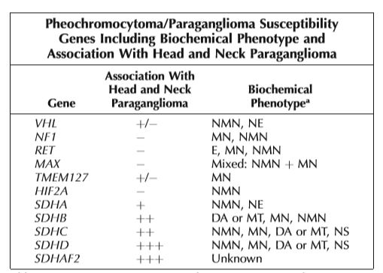

Slide 10
DIFFERENTIAL DIAGNOSIS
The differential diagnosis for thyroid paraganglioma includes the following tumors: follicular neoplasm, metastatic renal cell carcinoma, metastatic neuroendocrine tumor, medullary thyroid carcinoma, hyalinizing trabecular tumor, and intrathyroid parathyroid proliferation
Differentiating thyroid paraganglioma from medullary thyroid carcinoma is extremely important because of the difference in prognosis and treatment
Morphologically, it can be difﬁcult to differentiate thyroid paraganglioma from medullary carcinoma. In medullary carcinoma, the tumor cells are immunoreactive for cytokeratin, TTF-1, neuroendocrine markers, calcitonin, and CEA

Slide 11
TREATMENT AND PROGNOSIS
Surgical excision is the treatment of choice for thyroid paragangliomas
Depending on the size, number of tumor foci, and extent of involvement, different options range from subtotal thyroidectomy to total thyroidectomy
The beneﬁt of radiation therapy is controversial
There are no unequivocal histologic or immunohistochemical markers that distinguish benign from malignant paragangliomas

Slide 12
Per 2004 World Health Organization criteria, malignancy in paraganglioma or pheochromocytoma is deﬁned by the presence of metastasis to sites where paraganglionic tissue is not normally present
Cervical lymph nodes are the most common site of regional spread, whereas lung, liver, bone and skin are the most common sites of distant metastasis
Surgical removal is the mainstay of management for resectable metastasis
For unresectable tumors, radioactive isotope treatment and chemotherapy may be helpful

Slide 13
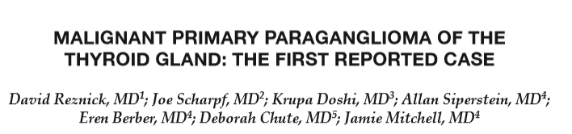
Primary paragangliomas of the thyroid gland are rare tumors with just 45 previously reported cases in the literature
We present the first case of a malignant primary thyroid paraganglioma with regional and distant metastases.

Slide 14
A 73-year-old Caucasian female with a past medical history significant for longstanding hypothyroidism, hypertension, and hyperparathyroidism underwent subtotal parathyroidectomy in 2009
In 2010 An ultrasound performed at that time revealed a rapidly enlarging right thyroid mass (Fig. 1). The mass measured 3.56 C 4.03 C 7.91 cm and had a heterogeneous sonographic echotexture and hypervascularity on color flow Doppler exam
Concern over the rapid tumor growth and the conflicting biopsy reports prompted a recommendation for total thyroidectomy.

Slide 15
Intra-operatively, a large mass with an unusual appearance had replaced the right thyroid lobe, with locally aggressive behavior evident, including invasion of the tracheal and esophageal surfaces and complete encasement of the right recurrent laryngeal nerve
These characteristics prompted an incisional biopsy, which was read as highly suspicious for lymphoma
However, the final pathology was interpreted as showing an epithelioid neoplasm with neuroendocrine differentiation. Tumor cell staining at this time was negative for AE1/ AE3, Cam5.2, and CK7
Histologically, the mass and central neck lymph nodes both showed tumor cells that were positive for synaptophysin and neuron-specific enolase, and negative for chromogranin, calcitonin, CEA, CAM 5.2, and TTF-1

Slide 16
Within 6 months, a surveillance ultrasound exam showed a suspicious mass in the right central neck
Within 12 months, repeat imaging was obtained for unexplained weight loss and revealed a large lesion in the left lateral segment of the liver
Percutaneous biopsy confirmed metastatic paraganglioma
left lateral segmentectomy was performed. Eight months later, the patient developed diffuse metastases throughout the liver and peritoneal cavity and ultimately succumbed to her disease 13 months after her last surgery.

Slide 17
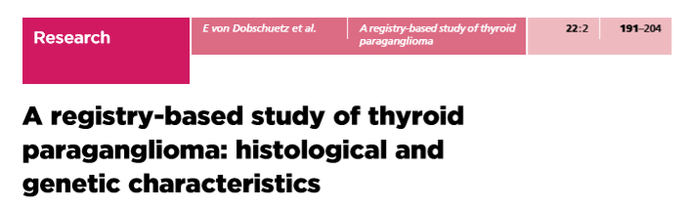
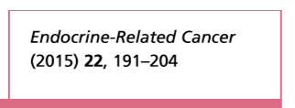


Slide 18
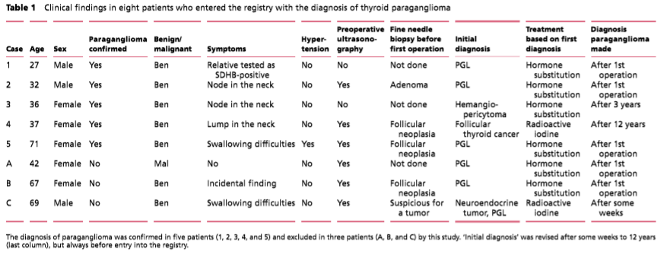

Slide 19
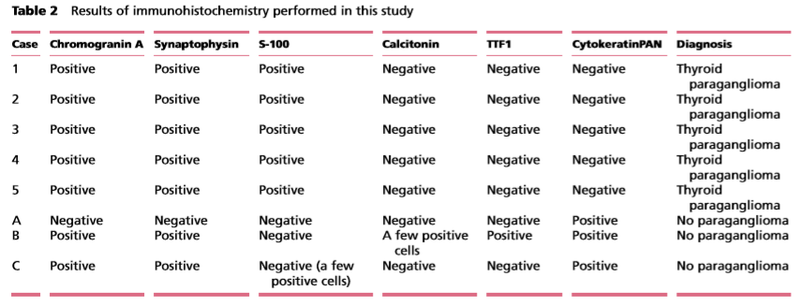

Slide 20
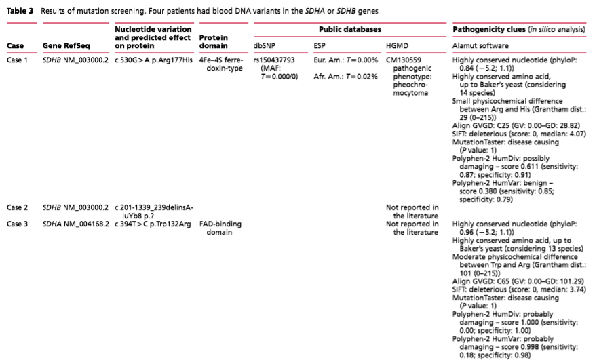

Slide 21
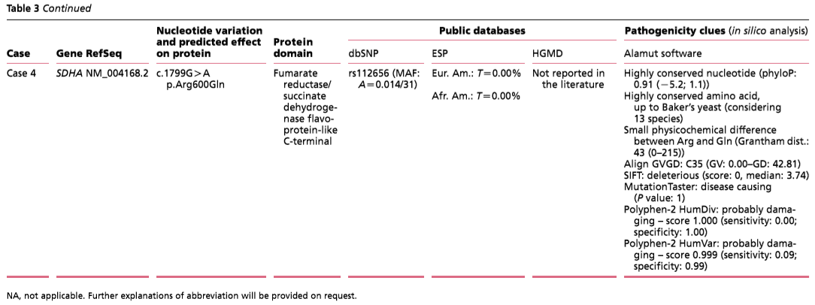

Slide 22
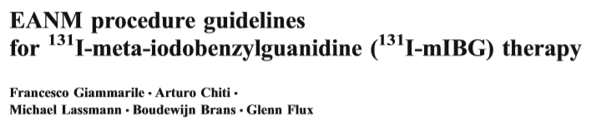
The indications are tumours showing adequate uptake and retention of radiolabelled mIBG on the basis of a pretherapy tracer study. Because there is no clear agreement on what should be considered adequate uptake,the final decision must be based on imaging and clinical considerations

Slide 23
Indications
1. Inoperable phaeochromocytoma
2. Inoperable paraganglioma
3. Inoperable carcinoid tumour
4. Stage III or IV neuroblastoma
5. Metastatic or recurrent medullary thyroid cancer

Slide 24
Contra-indications
Absolute:
1. Pregnancy; breastfeeding
2. Life expectancy less than 3 months, unless in case of intractable bone pain
3. Renal insufficiency, requiring dialysis on short term
Relative:
1. Unacceptable medical risk for isolation
2. Unmanageable urinary incontinence
3. Rapidly deteriorating renal function—glomerular filtration rate less than 30 ml/min
4. Progressive haematological and/or renal toxicity because of prior treatment
5. Myelosuppression: – Total white cell count less than 3.0×109/l – Platelets less than 100×109/l

Slide 25
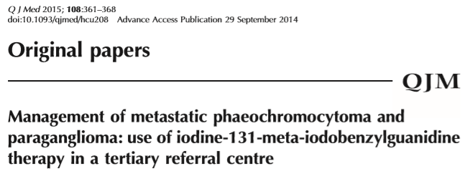
from 1986 to August 2012 All patients(PGL or phaeo )with I-MIBGavid disease and evidence of metastases either locally or in distant organs (bone/liver/lungs) were included.

Slide 26
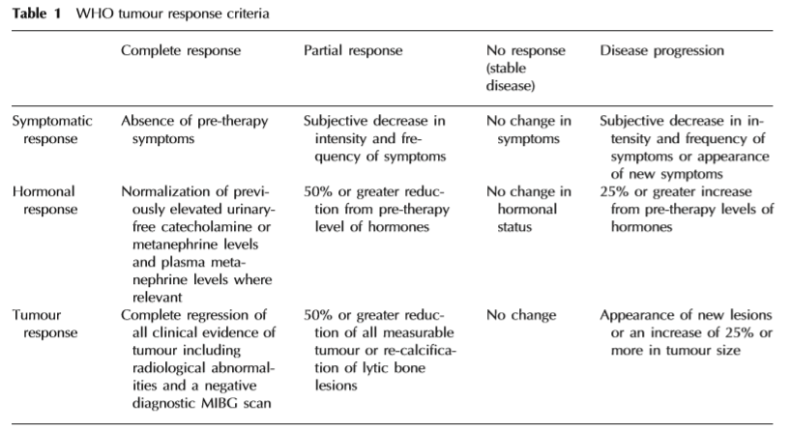

Slide 27
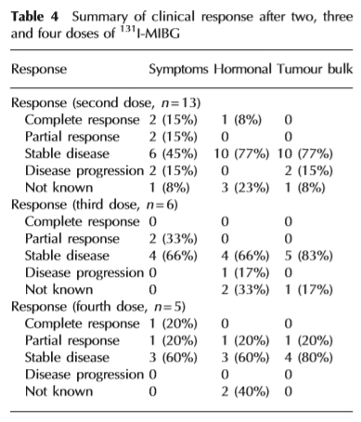
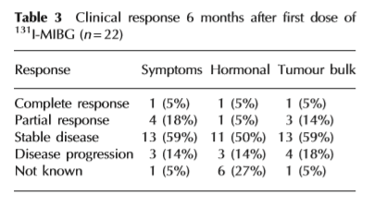

Slide 28
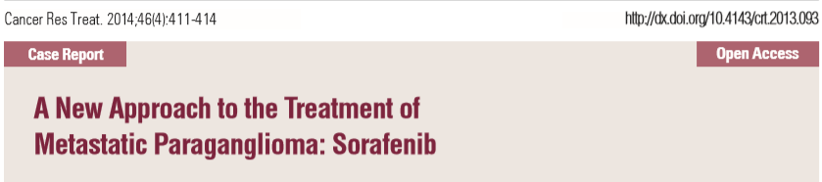
a 43-year-old woman who was admitted to the hospital with a history of episodic headaches, diaphoresis, and weakness. Elevated plasma catecholamine levels and a right paraaortic mass were observed on computed tomography. The mass was excised, and a diagnosis of paraganglioma was confirmed. After 20 months of follow-up, local recurrence and metastases were detected in the thorax, abdomen, and skeletal system

Slide 29
An anthracycline plus CVD regimen (adriamycine 7 mg/m2, dacarbazine 400 mg/m2, cyclophosphamide 500 mg/m2, vincristine 1.4 mg/m2) on days 1 and 2, and zoledronic acid (4 mg) every 21 days were administered, and no improvement was observed on PET following a treatment of six cycles
Therefore, sorafenib tosylate (400 mg twice daily) was administered for three months due to recurred-progressive disease

Slide 30
The patient’s plasma and 24-hour urinary catecholamine levels finally decreased, and PET/CT showed that metastatic lesions had regressed after 12 weeks . In addition, the patient’s symptoms decreased
After 64-week treatment with sorafenib, distance and cerebral metastasis occurred, and the patient died.

Slide 31
Thank you for your attention

