Slide 2
Definition:
The symptoms and signs that results from chronic glucocorticoids state.

Slide 3
History:
Harvey Williams Cushing (April 8, 1869 – October 7, 1939) was an American neurosurgeon.
." He published his findings in 1932 as "The Basophil Adenomas of the Pituitary Body and Their Clinical Manifestations: pituitary Basophilism".

Slide 4
Cushing in animals

Slide 6
Classification
Exogenous
Endogenous
ACTH dependent
ACTH independent

Slide 7
Establishing diagnosis is often difficult because:
Nonspecific symptoms & signs (no pathognomonic)
Large spectrum of manifestations:
Subclinical →→ overt disease
Some of them are common without adrenal hyperfunction

Slide 8
Pitfalls in Cushing's syndrome
Diagnosis
Mild forms → → → → → severe form
Pseudocushing
Localization (causes)
ACTH
Imaging
HDDST
IPSS

Slide 9
A rule in endocrine
First biochemistry then imaging

Slide 10
Cushing,s syndrome: A case study
By: Dr. M. Valizadeh
Associate professor of Shahid Beheshti University of medical Sciences

Slide 11
Case presentation
A 42 yrs old man is referred for further evaluation of possible Cushing syndrome. The patient has been generally healthy, and he fathered 2 children (4 and 8 years ago).
Over 2 past years: 12 Kg weight gain mostly abdominal
(despite dieting and exercise)

Slide 12
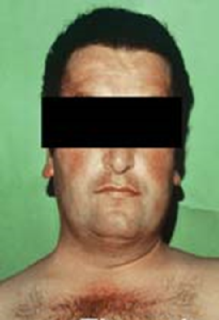
New onset HTN from last month
PE: BP: 145/95 weight : 81 Kg
Small dorsocervical fat pad, acne, ruddy complexion, protuberan abdomen, proximal muscle weakness in his lower extremity

Slide 13
primary lab study :
Cortisol (8 am): 18 µg/dl
ODST: 12 µg/dl / K: 2.8 mEq/L
UFC: 360 µg/24 h (→ 90 ) / Ucr: 1.65 gr/24 h

Slide 14
Is there necessary that perform further evaluation for confirmation of the diagnosis ?

Slide 15
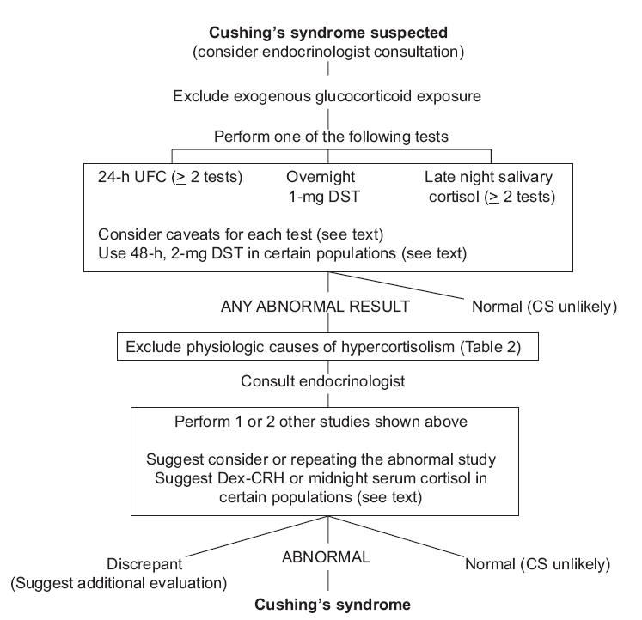
Diagnostic algorithm
Depression
Anxiety disorder
Obesity
Alcohol dependence
Diabetes mell.
Stress
Malnutrition
Pregnancy
Epilepsy
Renal failure
Cycling CS
Adren. incidentaloma
Nieman et al., Clinical Practice Guideline, 2008
Notes:
Longer low-dose DST (2 mg/d for 48 h)

Slide 16
ACTH: 86 pg/ml
HDDST: 95 µg/24 h (Ucr: 1600 mg/24 h)
Serum Cortisol (8 am) after 8 mg Dexamethazone the night before: 8.5 µg/dl

Slide 17
Differential Diagnosis
Plasma ACTH level
ACTH> 10 - 20 pg/ml
ACTH< 5 pg/ml
ACTH dependent Cushing´s syndrome
ACTH independent Cushing´s syndrome
CT/MRT Adrenal gland
High-dose DST (8mg) Cut-off: cortisol suppression >50-80%
CRH test Cut-off: increase ACTH >35%, cortisol >20%
MRT Adenoma in 60% (10% incidentalomas!)
If applicable, sinus petrosus inferior catheter ACTH basal >2,0 after CRH >3,0
yes
no
Cushing´s disease
Ectopic ACTH syndrome
CT/MRT Cervical/Thorax/Abdomen
Octreotide-Scintigraphy
Arnaldi et al., Consensus statement, 2003

Slide 18
Why ectopic cushing
ACTH dependent Cushing
Central or peripheral?
IPSS
His sex
Small adenoma in MRI (< 6 mm)
High dose suppression < 50%
Hypokalemia is a sign of greater cortisol excess

Slide 19
MRI: 4 mm lesion at right side of pituitary that is hypoenhancing after gadolinium
MRI negative in 40% of Cushing‘s disease
Pitfall: >10% Incidentalomas in normal population (usually <5mm)!

Slide 21
Which of the following should be performed next?
BAVS
IPSS
CRH after Dexamethazone
TSS
Midnight salivary free cortisol

Slide 23
Is it functional?

Slide 24
Is that really source of ACTH secretion?

Slide 25
In the case of octerotide negative case?

Slide 26
Thoracotomy was performed
The lesion was excised.
Pathology: carcinoid tumor
Clinical problems was resolved.
Laboratory tests:PG/ML
Cortisol : < 1 µg/dl
ACTH < 5 Pg/ml
UFC: < 20 µg/24 h

Slide 27
Take-home-message
in case of CS clinical suspicion, diagnosis has to be proven
if CS diagnosis cannot be proven, repeat screening tests
once CS confirmed, perform differential diagnostic tests
if no pituitary adenoma > 5 mm revealed, perform BIPSS
in case of discrepant results, repeat diagnostics
in case of failed pituitary surgery with CS persistence, re-check DD
paradox high cortisol values do not always imply CS!
(stress, depression, oral contraceptives etc.)

Slide 28
Thank you for your attention

