Slide 1
In the name of GOD,
The Compassionate &
The merciful
PCOS; an apparently simple but challenging diagnosis
Especially among adolescent
Fahimeh Ramezani Tehrani
Professor
Reproductive Endocrinology Research Center
Research Institute for Endocrine Sciences
Shahid Beheshti University of Medical Sciences
January 2015

Slide 2
Case 1
A 32 y woman, BMI 31kg/m² with hirsutism, hair loss and menstrual cycles with 40-45 days interval and no evidence of Cushing syndrome and no rapid progress of hirsutism referred to your clinic. What are the tests that should be ordered? 1- Total testosterone 3-170HP
2-DHEAS 4-TSH-PRL
5-AMH 6-Ovarian sonography

Slide 3
Case 2
A 14y.o girl with chief complaints of excessive hair growth and irregular menses. Menarche occurred 1.5 years ago, and she has 4 cycle/year. She is in Tanner breast stage 5, obese(BMI percentile:97%), has facial hirsutism.
What is your requested tests:
1- DHEAS 3-Ovary sonography
2-LH/FSH 4-AMH
5-Total Testosterone 6-none

Slide 4
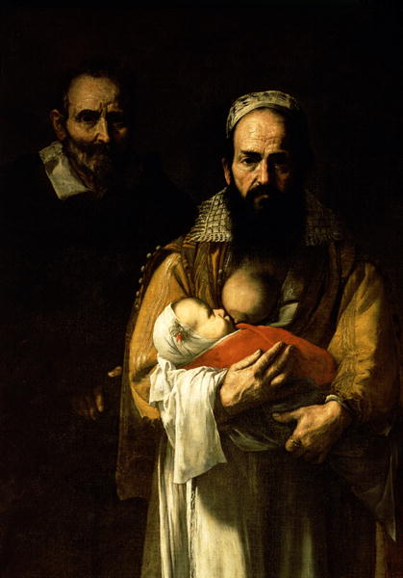
The Bearded Woman Breastfeeding 1631
Jusepe de Ribera
The Bearded Woman Breastfeeding 1631
Jusepe de Ribera

Slide 5
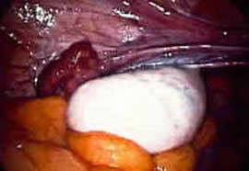
Stein and Leventhal described PCOS in 1935 as
Amenorrhea associated with bilateral polycystic ovaries

Slide 6
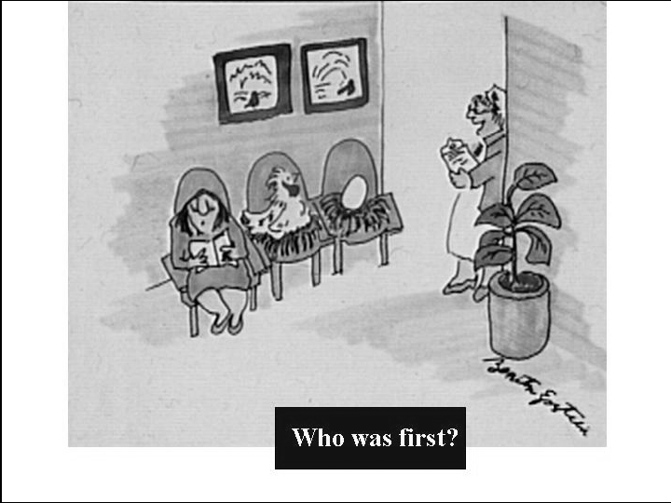
Where is the primary defect?
Hypothalamus
Ovary
Adrenal
Insulin resistance

Slide 7
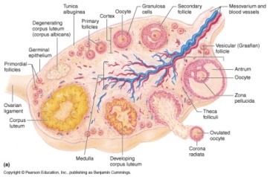
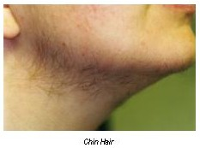
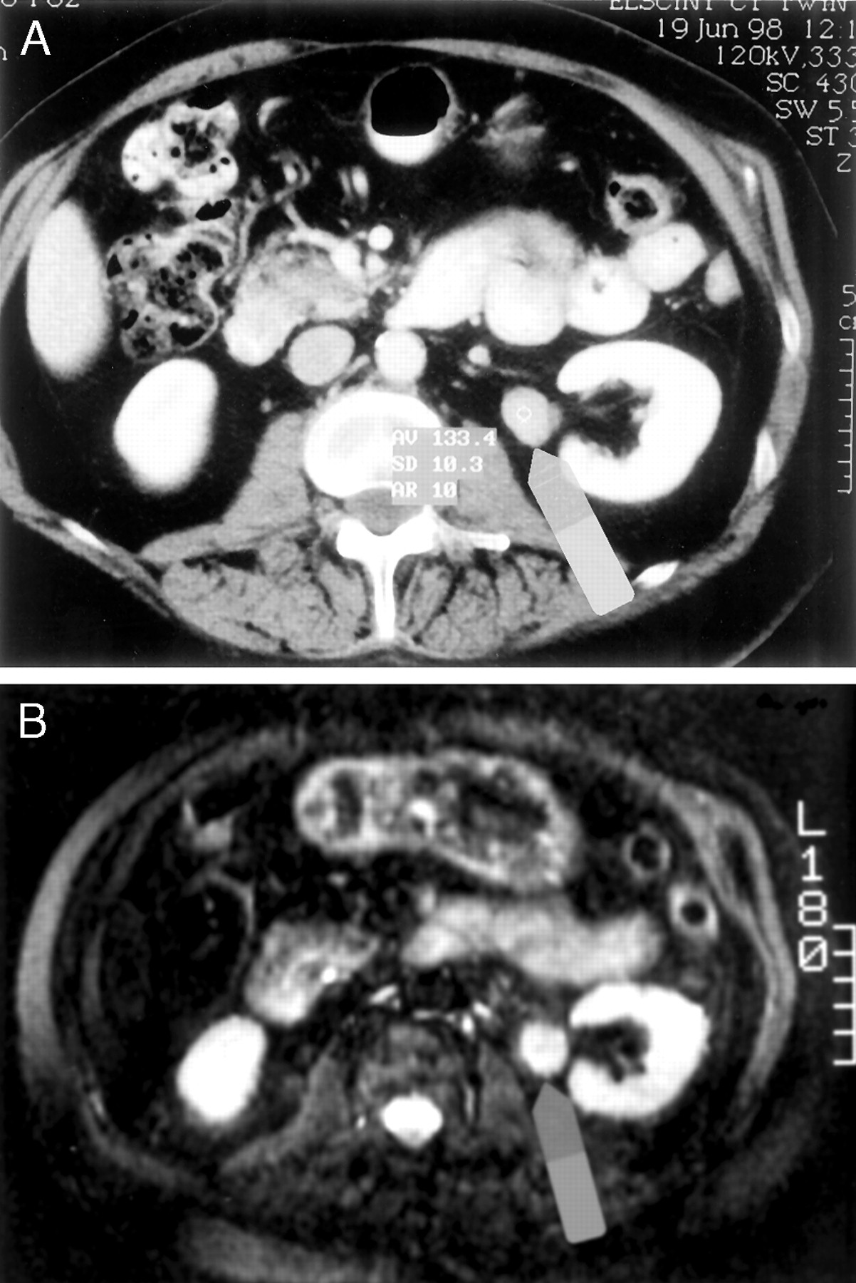
Diagnosis of PCOS(NIH criteria)
Ovulatory dysfunction
Clinical hyperandrogenism and/or hyperandrogenemia
Exclusion of other disorders
  Non classic adrenal hyperplasia
  Androgen secreting tumors
  Hyperprolactenemia
  Thyroid disorder

Slide 8
Rotterdam ESHRE/ASRM Consensus Conference 2003
Requires 2 out of 3
  Oligoovulation or anovulation
  Clinical and/or biochemical signs of hyperandrogenism
  Polycystic ovaries on ultrasound
  Exclusion of other disorders
    Non classic adrenal hyperplasia
    Androgen secreting tumors
    Hyperprolactenemia
    Thyroid disorders

Slide 9
Androgen Excess Society Criteria(2006)
Hyperandrogenism: Hirsutism and/or hyperandrogenemia
Ovarian dysfunction: oligo-anovulation and/ or polycystic ovaries
Exclusion of other androgen excess related disorders

Slide 10
PCOS criteria
 | NIH_PCOS | RottPCOS | Androgen Excess Society
Hyperandrogenemia | Mandatory |  | Mandatory
Oligo-anovulation | Mandatory
Polycystic ovary

Slide 11
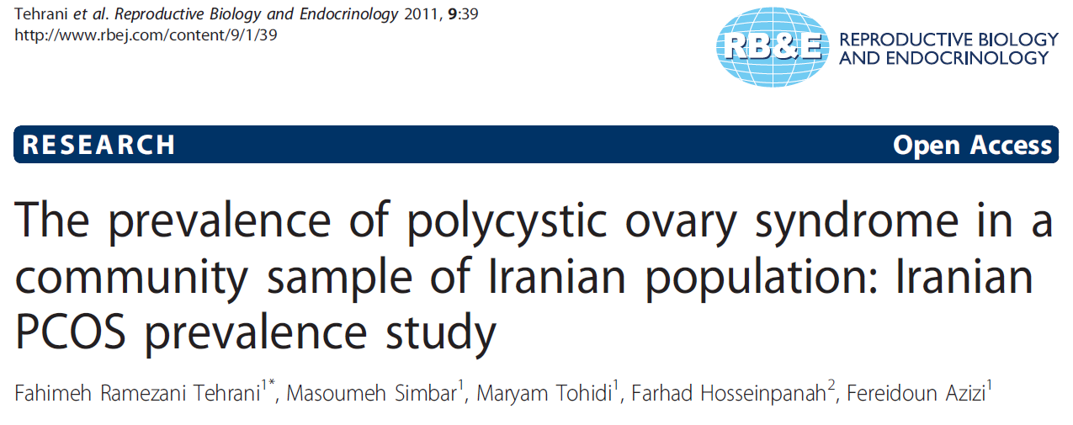
The prevalence of PCOS using the NIH definition :7.1%
The prevalence of PCOS using Rott definition: 14.6%
The prevalence of PCOS using the AES: 11.7%

Slide 12
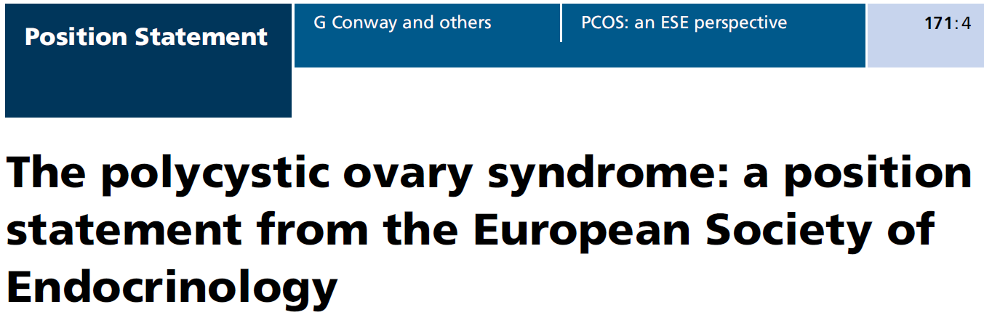
2014
Not only PCOS criteria must to revised
But also its “name” is misleading and need to be revised

Slide 13
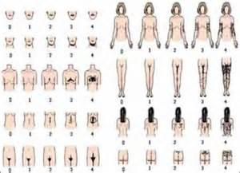
Hirsutism
Ferriman-Gallwey scoring system

Slide 14
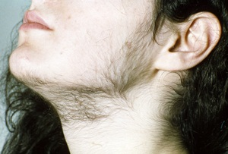
Hirsutism
Definition
Cut off value for Ferriman Gallwey score(6-8)
(JCEM 1998, Clin Endocrin 1999, JCEM 2006)
Body area varied base on race and ethnicity
(JCEM 2004, Fert Strili 2002)
Progress to PCOS from unwanted hair gross <cut off (Am J Obst Gyncol 2004)

Slide 15
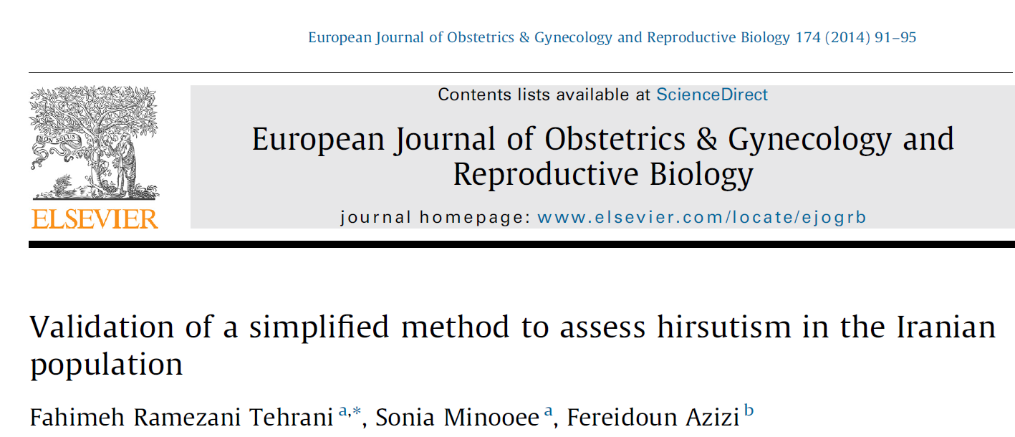
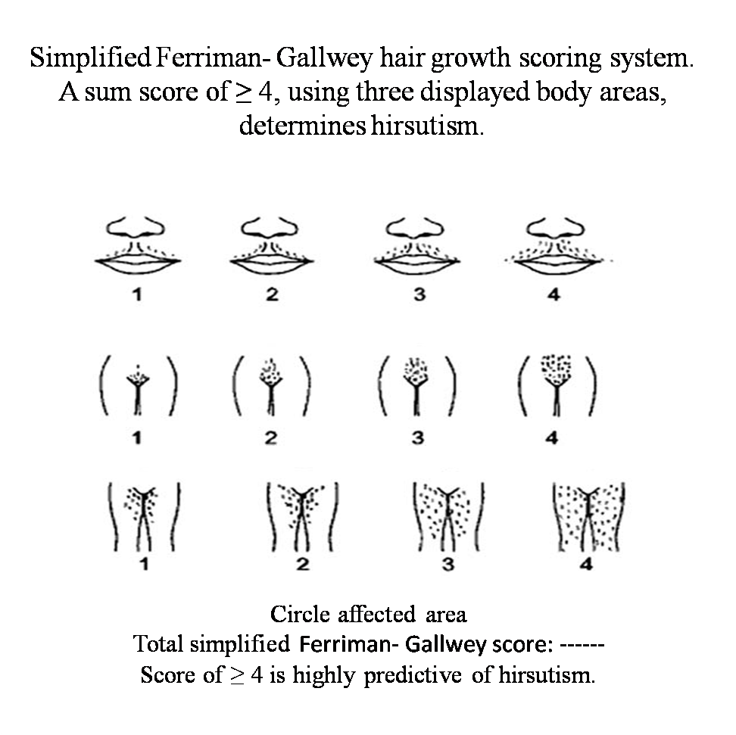

Slide 16
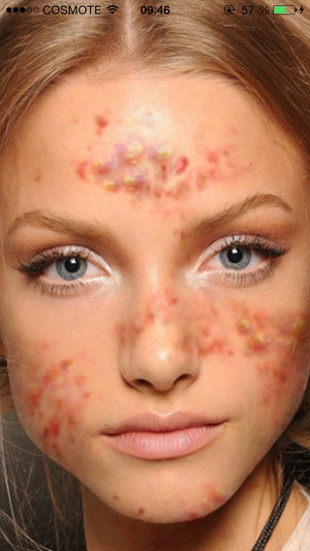
Acnea
It is unclear whether the prevalence of acnea in PCOS women over that observed in general population
It is high prevalent in general population, particularly among younger women
Its prevalence varies with ethnicity and age
(Br Dermatol 2005)
There is not single scoring system
Acnea per se is considered as hyperandrogenism

Slide 17
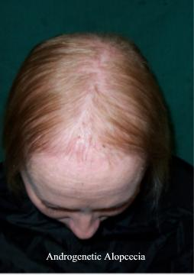
Hair loss
Poor correlation between alopecia and clinical hyperandrogenism (Endocr Rev 2010)
Role of other potential etiologies :genetic, environment, nutrition,.. (JCEM 2009)
Pattern of hair loss, thinning of the crown with preservation of the anterior line (Fert Str 2009)
It may be the sole dermatologic sign of PCOS (Fert Str 2009)

Slide 18
Ovulatory dysfunction
Menstrual dysfunction is generally characterized by infrequent or absent of menstrual bleeding
Polymenorrhea is also a symptom in 1.5-12% of PCOS women (JCEM 2004)
20- 30% of women with PCOS are eumenorrheic (Fert Stril 2004)
14-40% of eumenorrheic hirsute women are oligoovulatory (Eur J Endocinol 1998-Fert Stril 1998)
Subclinical ovulatory dysfunction may be determined by progesterone level day 20-24<5ng/ml for two cycles (Fert Stril 2009)

Slide 19
Incidence of cycle irregularity in PCOS
Oligomenorrhea: 43%
Primary amenorrhea: 7%
Secondary amenorrhea: 21%
Polymenorrhea: 7%
Regular menstrual cycle: 21%
Hum Rep 2010

Slide 20
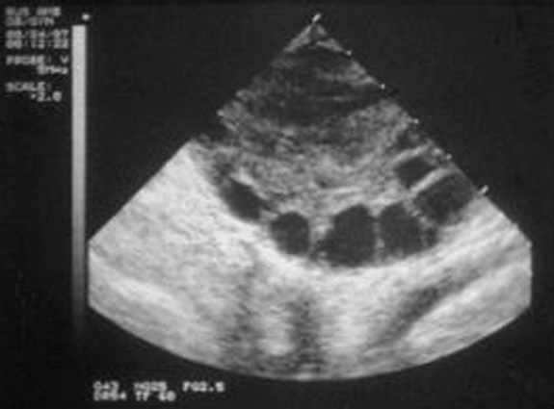
Sonographic criteria for polycystic ovaries
Definition
  12 or more follicles in each ovary, 2-9 mm and-/or
  Increased ovarian volume(>10 ml)
Only one ovary fitting this definition is sufficient
Not apply OCPs users
Repeat next cycle if a dominant follicle(>10 mm) is existed

Slide 21
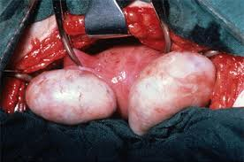
Polycystic ovary
PCO observed in 20-30% of general population
(Lancet 1998)
23% of normal weight, regular menstrual cycle and non hirsute women has PCO (N Z J Obest Gynecol 2005)
Its prevalence decreases with increasing age
Can be seen during pubertal development
Can be seen in women with hypothalamic amenorrhea or hyperprolactinemia
20% of PCOS women has PCO (Fertil Stril 2009)
Inter observer bias(43%) (Fertil Stril 2007)

Slide 22
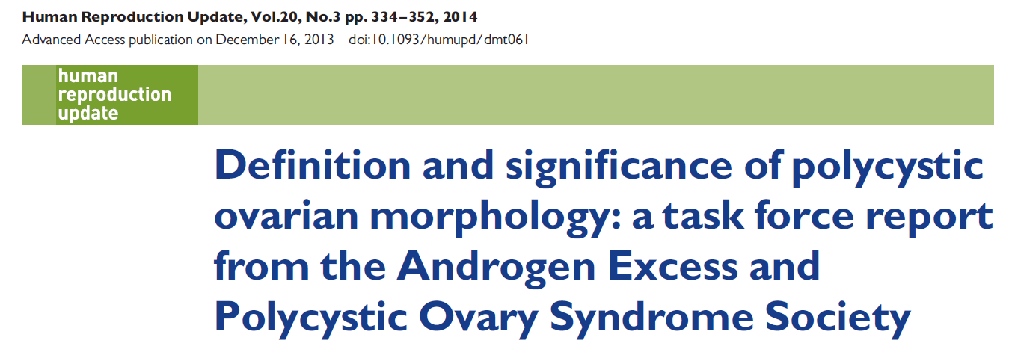
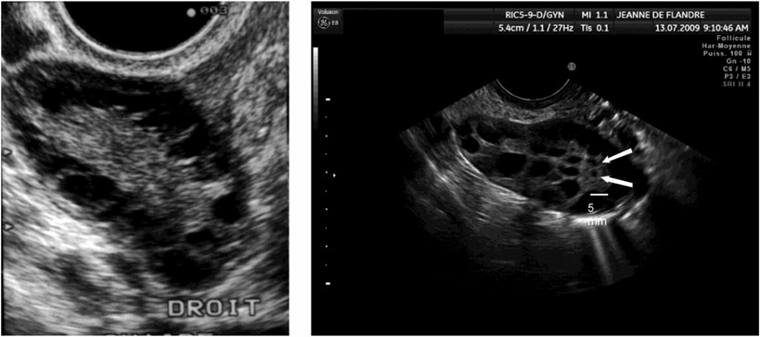
Threshold of FNPO have to be increased to 25 when using high resolution sonography
OV>10 cm3 is better if this sonography is unavailable
Still unmet need for standardization of FNPO
PCOM per se has no further risk except OHSS for those
Require gonadotrophin therapy

Slide 23
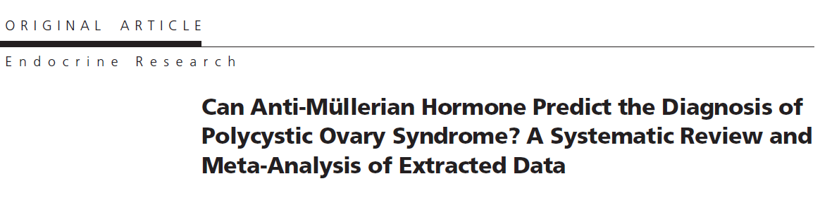

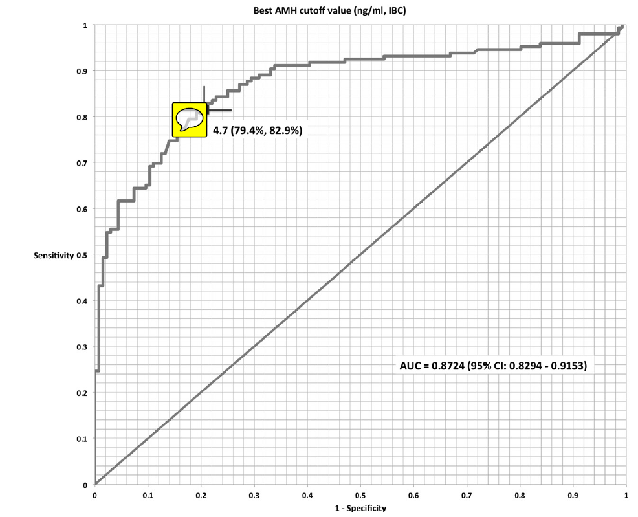
Full standardization for
AMH must be developed
before using any threshold
for PCOS definition

Slide 24


Should all suspicious women be screened for thyroid disturbances
The prevalence of thyroid dysfunction among androgen excess women is similar to general population(0.46% for subclinical hyper, 7.3% for sub clinical hypo thyroid(Eur J Clin Endocrinol 2000, JCEM 2001)
More Anti TPO ? (Eur J Clin Endocrinol 2004, JCEM2011)
Exclusion of hypo or hyperthyroidism may not be mandatory to make a diagnosis of PCOS in absence of thyroid’s symptom (Fert Stri 2009)

Slide 25
A 32 y woman, BMI 31kg/m² with hirsutism, hair loss and menstrual cycles with 40-45 days interval referred to your clinic what is your diagnosis? Which tests do you requested?
If TSH=6.1 µIU/ml (0.27-4.2), free T4: 1.15(0.9-1.7) ng/dl?

Slide 26

Hyperprolactinemia
Hyperprolactinemia is associated with excess production of adrenal androgens in vivo and in vitro (JCEM 1986)
PCOS is associated with an increase of PRL(up to two times) (JCEM2005)
Assay problem, confounders, macroprolactinemia
Its prevalence is0.2- 0.3% among hyper androgenic women
( fertil Stril 2004, Fertil Stril 2002, Hum Rep 1998)
Whether screen all suspicious PCOS women without clinical symptom( headache, galactorrhea, visual disturbances)

Slide 27
A 32 y woman, BMI 31kg/m² with hirsutism, hair loss and menstrual cycles with 40-45 days interval referred to your clinic what is your diagnosis? Which tests do you requested?
If TSH=6.1 µIU/ml (0.27-4.2), free T4: 1.15(0.9-1.7) ng/dl
If PRL=35.3ng/mL( 4.8-23.5)

Slide 28
Androgens assessment
Serum Testosterone is the most important androgen in women
Measurement of FT by RIA is highly inaccurate
Equilibrium dialysis have technical complexity, high economic cost and not widely available
FAI has good concordance with FT(JCEM2004)
How can we determine the cut off value?
  General population PCOS prevalence 7% vs. 5%
  Eumenorrheic non hirsute normal weight women
Whether FAI has to be assessed for all suspicious PCOS women
7% of non hirsute women without acnea has ↑ FT (Eur J Endocinol 2002)

Slide 29
Androstenedione
Can be synthesized in adrenal cortex and in ovarian theca cells
18% of women with PCOS has ↑A4
Whether A4 has to be assessed for all suspicious PCOS women?
9% of PCOS women may have been missed by not measuring A4(JCEM 1998)

Slide 30
DHEAS
DHEA,The principle androgen distinguishing adrenal androgen from ovarian ones
It has diurnal and wide inter subject variation
Any stress, blood drawing can result in increase
Its metabolite DHEAS, use as the marker for adrenal androgen excess
Stable throughout the day and menstrual cycle, easily measured, long half life
50% PCOS women has ↑DHEAS
Whether A4 has to be assessed for all suspicious PCOS women?
In 10% of PCOS women, ↑DHEAS is the sole androgen abnormality (Fert Stril 2009)

Slide 31
NC-Congenital adrenal hyperplasia
Screening for 21OHdeficient when 17HP >2ng/ml
If measured in the luteal phase, it would be >2ng/ml in 50% of normal subjects
NC-CAH affecting 1-10% hyperandogenic women
(MOL Gene Metab 2007)
Clinical features do not distinguish between PCOS and NC-CAH
Screening is recommended, especially for high risk ethnicity

Slide 32
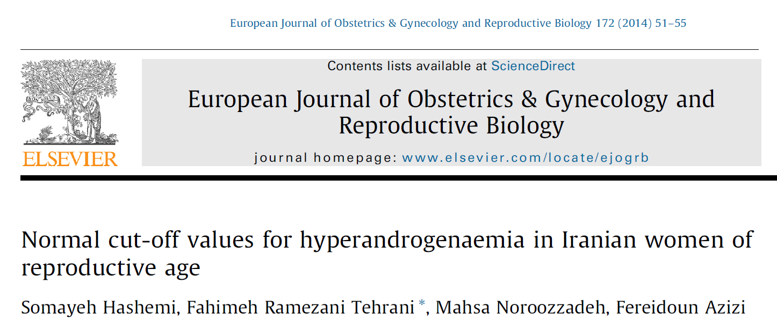
TT = 0.88 ng/ml
A4 = 2.3 ng/ml
DHEAS= 246 µg/Dl
FAI = 5.47

Slide 33
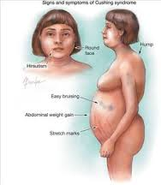
Cushing’s syndrome
The prevalence of Cushing’s syndrome in hyperandrogenic women is less than 1% (JCEM2005, Med RES1995, N Eng J med 1998)
Routine screening when high clinical suspicion

Slide 34
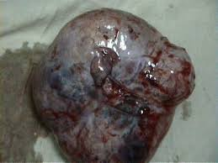
Androgen Secreting Tumor
Rapidly onset of hyperandrogenemia
Markedly and persistently increase in T (>150-200 ng/ml,DHEAS(>600-700 ng/ml)
More than 90% of women with persistently elevated T did not have AST (JCEM2007)
50% of AST do not have levels of T, DHEAS above this cut off (JCEM2005)
Further diagnostic tests, primarily sonography or radiology

Slide 35
When to make the diagnosis of PCOS in adolescents?
Puberty is a PCOS-like state:
Immature hypothalamic-pituitary-ovarian axis
  65% of adolescents at 1 year postmenarche and 90% at 3 years postmenarche have achieved a regular menstrual pattern
Increase in androgen levels associated with initial ovulatory function
  Increase in acnea
  Hirsutism
Insulin resistance of puberty, hyperinsulinemia
  Weight gain
  Ovaries often appear multi-fullicular/cystic on ultrasound
  JCEM 2000, Hum Rep 2011, JCEM 2006

Slide 36
Early warning signs for PCOS development
Congenital virilization
Above/ low birth weight
Precocious adrenarche
Childhood obesity
Acanthosis nigricans
Girls born to parents with PCOS, central obesity or diabetes

Slide 37
Causes for concern
No pubertal development by age 13
No menses within 3 years of thelarche
No menses by age 14 and
  Hirsutism
  Excessive exercise or eating disorder
  Concern for outflow obstruction
No mense by age 15
Menses 90 days apart, even for one cycle
Regular mense become markedly irregular
Menses<21>45 days apart
Duration of mense>7 days
Hypermenorrhea
ACOG 2009

Slide 38
New PCOS criteria for adolescents
Must have all 3 elements:
Biochemical hyperandrogenemia and clinical hyperandrgenism
  Elevated total/free testosterone and/DHEAS
  Progressive hirsutism
Oligomenorrhea/amenorrhea for at least 2 years
  <10 menses/year or>35 day interval
  Primary amenorrhea at age 16
PCO on ultrasound
  Increased ovarian volume≥10 cm3
  One PCO is sufficient
JCEM2012

Slide 39
Take home messages
For those women with both clinical symptoms of Hyperandrogenism and Oligoovulation(Not rapidly onset) and no thyroid’s symptom or suspicious clinical symptoms for hyperprolactinemia no hormonal assessments may be needed.
For those women either Hyperandrogenism or Oligoovulation, further assessments for identification of subclinical oligoovulation or hyperandrogenemia or PCO morphology are needed.
However the cost effectiveness of identification of these mild phenotypes is questionable.

Slide 40
Take home messages
Puberty is a PCOS-like state
Pay attention the early warning signs indicating a possible diagnosis of PCOS in adolescent female
Evaluate the need for early screening and early intervention
Using full criteria to make PCOS criteria in adolescent female

Slide 41

Thank you for your
attention

