Slide 1

In the name of GOD

Slide 2
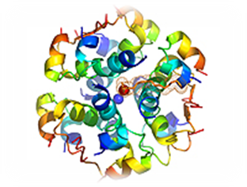
New advancement in basal insulins
F.Sarvghadi MD
Endocrinologist
Research Institute for Endocrine sciences
Shahid Beheshti Universityof Medical Sciences
Tehran 95.11.28

Slide 3
Agenda
Introduction
Basal insulin therapy: An historical overview
Formulation engineering strategies for basal insulins
Insulin degludec (IDeg)
Gla-300
Conclusion

Slide 4
Introduction
Type 2 diabetes is progressive in nature and many people with the condition will inevitably require insulin therapy to attain and maintain adequate glycaemic control.
Manufacturers of insulin products have long sought ways to modify the absorption rate of exogenously administered insulins in an effort to better reproduce the naturally occurring pharmacokinetics of endogenous insulin secretion.
Heise et al Diabetes Obes Metab 2017; 19(1):3–12

Slide 5
Clinical and patient inertia:
Delayed basal insulin initiation despite elevated HbA1c
No improvement in insulin initiation practices from 2005 to 2010¹
HbA1c at insulin initiation was 8.4% in Germany and 9.8% in the UK in 2010¹
HbA1c at time of insulin initiation (%)
Time to insulin initiation (years)
2010
2005
DAWN | 52% of insulin-naïve T2DM patients expressed anxiety about starting insulin therapy²
1. Kostev K, Rathman R. Prim Care Diabetes 2013;7:229–33
2. Peyrot M, et al. Prim Care Diabetes 2010;4 Suppl 1:S11–8

Slide 6
Early discontinuation and non-adherence with
insulin therapy
The estimated probability of discontinuation was 41.0% in the first 31 days, 61.5% in the first 90 days and 82.0% in the ﬁrst year¹
Retrospective
analysis of 74,399
T2DM patients in the
US Truven's Health
Analytics Commercial
Claims and
Encounters database
2008–2011¹
Patients (%)
        “There is a need for insulin regimens that are less restrictive and burdensome”
1. Ascher-Svanum H, et al. Diabetes Ther 2014;5:225–42
2. Peyrot M, et al. Diabet Med 2012;29:682–9
Notes:
6

Slide 7
Fear of hypoglycemia is a major barrier
In a multivariable logistic regression analysis, the primary predictor of early basal insulin discontinuation was ≥1 documented hypoglycemic event (OR: 2.20; 95% CI: 1.27–3.82)¹
In patients with T2DM, worries about hypoglycemia are a barrier to optimal treatment and may be more widespread than commonly assumed²
Insulin users
Non-insulin users
Patients (%)
1. Kostev K, et al. Prim Care Diabetes 2015]
2. Polonsky WH, et al. J Diabetes Complications 2015

Slide 8
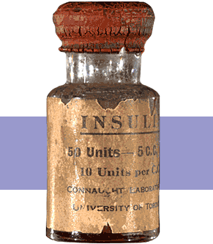
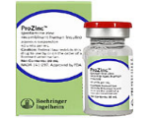
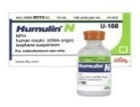
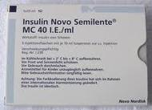

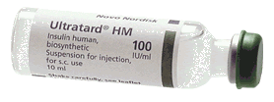
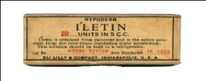
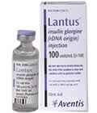
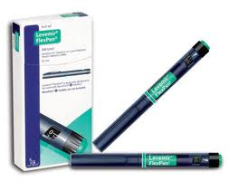
Basal insulin therapy: An historical overview
1922
1936
1946
1951
Protamine/ zinc
Isophane (NPH)
Lente insulin
2000
2005
Lantus/ Gla-100
Levemir

Slide 9
Aspiration for a new basal insulin product
> 24-hour coverage
Long duration of action
Reduced hypoglycaemic risk
Flat time-action profile
Stable glucose lowering
High day-to-day reproducibility
Dosing flexibility
Flat time-action profile
Long duration of action
Notes:
For a new basal insulin product, the following target characteristics should be achieved:
A basal insulin should have sufficient duration of action to conveniently cover the 24-hours period for once-daily dosing in all patients.
The ideal basal insulin products should have a constant or flat time-action profile without peak effect to avoid increased risk of hypoglycemia during peak activity. It is important to bear in mind that this feature does not reflect the physiologic basal secretion pattern which is aligned with diurnal changes of insulin sensitivity and secretion patterns of other hormones affecting insulin action in normal physiology. Such pattern can only be achieved with variable continuous subcutaneous insulin infusion.
The intra-individual, between-day variability of insulin action should be as low as to ensure predictable stable glucose lowering rendering titration of insulin dose simple for patients and physicians. The less reproducible the glucose lowering effect, the higher the risk for hyper- and hypoglycemic events.
The flat action profile of long duration allows flexibility in once daily dosing. Toujeo can be given any time of the day the same time every day with the same efficacy when given plus or minus 3 hours to the fixed injection time.
Although fixed injection times are preferred by many patients, knowing about some flexibility in dosing time to adjust to occasional needs, is reassuring.

Slide 10
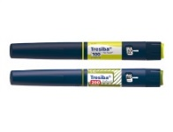
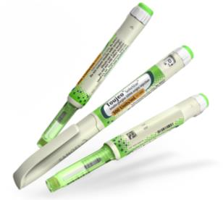
Basal insulin therapy:
The next generation on the market
2013
2015
Tresiba/
IDeg 100 U/mL*
Toujeo/
Gla-300
*IDeg is also approved at a 200 U/mL concentration
Gla-300, insulin glargine 300 U/mL; IDeg, insulin degludec

Slide 11
Formulation engineering strategies for basal insulins
Increased self association :
NPH , Lente
Precipitation after injection :
Glargine U100
Protein bound insulin analogues :
Detemir
Multihexamer chain formation :
Degludec U100
Up-concentrated formulation :
Glargine U300 , Degludec U200
PEGylation :
PEGlispro
Heise et al Diabetes Obes Metab 2017; 19(1):3–12

Slide 12
Next generation basal insulins:
Insulin degludec (IDeg)
Heise et al Diabetes Obes Metab 2017; 19(1):3–12

Slide 13
IDeg dihexamer formation
Heise et al Diabetes Obes Metab 2017; 19(1):3–12

Slide 14
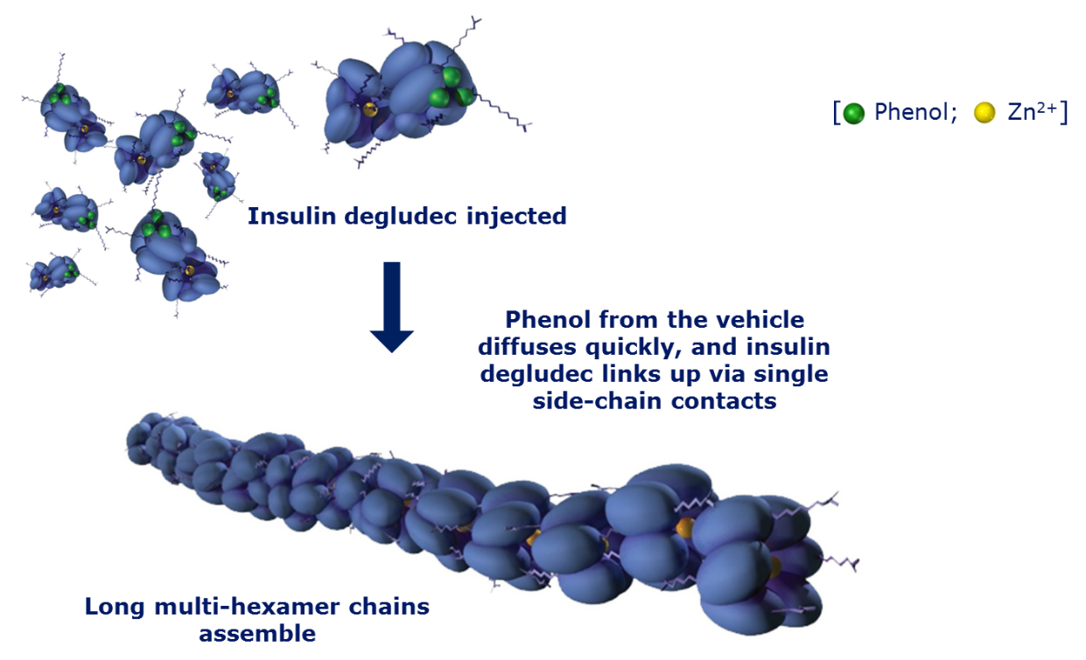
Next generation basal insulins:
Insulin degludec (IDeg)
Long-acting
basal insulin currently
approved in Europe,
Japan and other markets.
Upon
subcutaneous injection
forms soluble and
stable multihexamers,
that allow slow and
continuous absorption
of monomers into
the circulation^{1,2}
1. Owens DR, et al. Diabetes Metab Res Rev 2014;30:104–19
2. Shah VN, et al. Diabetes Technol & Ther 2013;15:727–32
Notes:
Degludec is a soluble, basal insulin analogue which differs from human insulin by the deletion of threonine at position 30 and the addition of a 16-carbon fatty acid attached to a LysB29 via a glutamic acid linker.
It is injected subcutaneously as a zinc phenol formulation composed of di-hexamers. Upon injection, rapid loss of phenol results in the formation of multi-hexamers. As zinc slowly diffuses from this complex, the multihexamer chains break into dimers and monomers before entering the circulation, allowing slow and continuous absorption into the circulation and accounting for a prolonged action profile.

Slide 15
Half-life & Pharmacodynamic profiles for IDeg and IGla- 100 at steady state.
Heise et al. Expert Opin. Drug Metab. Toxicol. (2015) 11(8):1193-1201

Slide 16
Long-acting profile of IDeg
A long duration of action (>42 hours), with a relatively peakless profile^{1,2}
A half-life of ~25 hours, and is detectable in serum for >120 hours post-injection²
  Four times lower day-to-day variability in
  glucose lowering effect for IDeg vs Gla-100³
  Consistent lower within-subject
  (intra) fluctuation of IDeg over time
  compared to Gla-100³
5
0.8 U/kg
Glucose Infusion Rate in T1DM patients at Day 6, mg/kg/min
0.6 U/kg
4
0.4 U/kg
3
2
1
0
0
4
8
12
16
20
24
Hours
1. Owens DR, et al. Diabetes Metab Res Rev 2014;30:104–19
2. Heise T , et al. Diabetes Obes Metab 2012;14:944–50
3. Heise T, et al. Diabetes Obes Metab 2012;14:859–64
Notes:
Design (variability studies):
Day-to-day variability in glucose-lowering effect was investigated in 54 subjects with type 1 diabetes who underwent a 24-h euglycemic glucose clamp on the 6th, 9th and 12th day of treatment with 0.4 U/ kg of insulin degludec or insulin glargine 100 U/ml (U100) once daily.
Within-subject (intra) variability was estimated using a linear mixed model on log-transformed pharmacodynamic endpoints derived from the glucose infusion rate (GIR) profiles during the clamps.

Slide 17
IDeg: glycemic control & weigh gain
Similar HbA1C reduction vs. Gla-100 with similar insulin doses^{1–5}
Phase IIIa BEGIN clinical trial program
Greater end-of-trial reduction in FPG
compared to Gla-100 in T2DM insulin-naïve patients and in T1DM on a basal-bolus therapy (p<0.05) and numerically (but not significantly) greater in basal-bolus treated T2DM⁶
Similar weight changes vs. Gla-100^{2–5}
Assessed IDeg once daily in ~5,500 T1DM and T2DM patients in 9 clinical trials
1. Owens DR, et al. Diabetes Metab Res Rev 2014;30:10419
2. Garber AJ, et al. Lancet 2012;379:1498–507
3. Zinman B, et al. Diabetes Care 2012;35:2464–71
4. Gough SCL, et al. Diabetes Care 2013; 36:2536–42
5. Onishi Y, et al. J Diabetes Investig 2013;4:605–12
6. Vora J, et al. Diabetes Ther 2014;5:435–46

Slide 18
Vora J, et al. Diabetes Ther 2014;5:435–46

Slide 19

Clinical efficacy : Degludec vs Glargine U100
Trial | Population/ comparator | Duration (wks) | Efficacy
 |  |  | Non-inf. HbA_{1c} | FPG mmol/L [mg/dL]
ONCE LONG (core and extn) | Insulin naïve, T2D | 104 |  | -0.38 [-6.84]
BB | Previously treated with insulin, T2D | 52 |  | -0.29 [-5.22]
FLEX* | Insulin naïve and insulin treated, T2D | 26 |  | -0.42 [-7.56]
LOW VOLUME | Insulin naïve, T2D | 26 |  | -0.42 [-7.56]
ONCE ASIA | Insulin naïve, T2D | 26 |  | -0.09 [-1.62]
T1 BB LONG (core and extn) | Type 1 | 104 |  | -0.29 [-5.22]
T1 FLEX* (core and extn) | Type 1 | 52 |  | -1.07 [-19.26]
✓
✓
Non-Inferiority achieved in all the clinical trials compared to insulin Glargine U100
✓
✓
✓
✓
✓
Insulin degludec significantly better
No significant
difference
extn, extension; non-inf., non-inferior; wks, weeks
* Data depict results for IDeg Flexible vs. IGlar
Vora J, et al. Diabetes Ther 2014;5:435–46
Notes:
In the clinical development programme of insulin degludec versus insulin glargine non-inferiority is achieved in terms of HbA1C reduction in all the clinical trials and some of the trials have shown significant reductions in Fasting Plasma Glucose.

Slide 20
Total daily dose overview by trial
0.89 [0.84;0.93]
0.87 [0.81;0.94]
1.03 [0.97;1.10]
Glycaemic control achieved at significantly lesser doses compared to insulin glargine
0.97 [0.89;1.05]
0.89 [0.82;0.98]
0.80 [0.71;0.90]
0.90 [0.82;0.99]
†The ratios reported in Mathieu et al. 2013 (Table 2) deviate from those above as the publication analyses all IDeg patients (i.e. both the forced flex and standard arms)
References: 1. Data on file, DOF-MA-IDeg-24APR2013-001, Novo Nordisk A/S; 2. Heller et al. Lancet 2012;379:1489–97; 3. Garber et al. Lancet 2012;379:1498–507; 4. Zinman et al. Diabetes Care 2012;35:2464–71 (+ supplementary online data); 5. Gough et al. Diabetes Care 2013;36:2536–42; 6. Onishi et al. J Diabetes Investig 2013;4:605–12 (+ supplementary online information)
Notes:
But the glycaemic control is obtained at significantly lesser doses in the individual trials and the dose reduction is 12% in Type 1 DM patients and 10% in Type 2 DM patients.

Slide 21
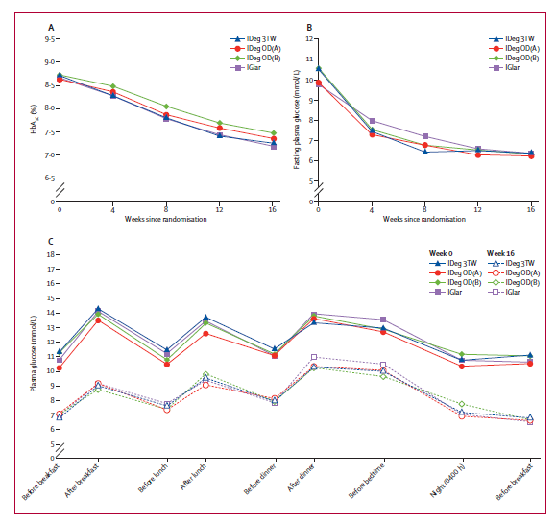
Mean HbA1C and plasma glucose concentrations by trial intervention
HbA1C
FBS
SMBG
Bernard Zinman et al Lancet 2011 ,377: 924-31

Slide 22
IDeg: Safety
Similar rates of other adverse events were observed between IDeg and Gla-100 across all T2DM Phase IIIa studies^{1,2}
While the EMA and PMDA (Japan) did not raise cardiovascular safety concerns, the FDA has requested a long-term cardiovascular study³
1. Owens DR, et al. Diabetes Metab Res Rev 2014;30:104–19; 2. Kalra S. Diabetes Ther 2013;4:167–73;
3. Novo Nordisk. Press release, 10 February 2013. http://www.novonordisk.com/bin/getPDF.1676900.pdf. Accessed Sept 09, 2015.
Notes:
MACE analysis:
The original data set, included with the company's new drug application on January 31, 2011, contained a total of 3570 patients with type 1 and type 2 diabetes who were exposed to insulin degludec (IDeg) or insulin degludec with aspart (IDegAsp) and 1874 patients who were exposed to a comparator (insulin glargine 100 U/ml in most of the studies).
An updated data set, submitted at the FDA's request, included extension data from 6 studies and an additional trial, for a total 5153 patients exposed to IDeg/IDegAsp and 2563 patients exposed to comparators.This included events reported up to 30 days after drug discontinuation (instead of 7 days).
In an updated analysis performed by the FDA, insulin degludec (either alone or in combination with aspart) conferred a 30% increased risk of MACE+ relative to comparators (HR 1.30, 95% CI 0.88–1.93).
When unstable angina events were excluded from the composite outcome, the increased risk with insulin degludec was 67% (HR 1.67, 95% CI 1.01–2.75).
When data from all extension trials were excluded, and unstable angina was included, analysis performed by the sponsor gave a HR of 1.13 (95% CI 0.71–1.80), similar to the pre-specified primary analysis (HR 1.10). In view of these findings presented to an advisory panel convened by the FDA in November 2012, all twelve advisors recommended that a dedicated cardiovascular outcomes study should be performed to address these concerns. The committee voted 8–4 in favour of recommending approval of insulin degludec with the requirement for a post-marketing cardiovascular outcomes trial.
Advisory committee members agreed that the small absolute number of MACEs (95 with IDeg/IDegAsp vs 37 for comparators, using the definition that included unstable angina) were too small to determine whether the signal was real. Rigorous postmarketing analysis of MACE was recommended.
In February 2013, the FDA requested additional cardiovascular data from a dedicated cardiovascular outcomes trial before insulin degludec could be approved in the United States.

Slide 23
IDeg:: Overall hypoglycemia vs. Gla 100
Meta analysis of phaseIII trial in T2DM patients
OVERALL confirmed (BG <3.1 mmol/L) or severe hypoglycemia
(Baseline to 26 or 52 weeks)
(Baseline to 15 weeks)
(16 weeks onwards)
RR: 0.92
(0.80–1.05)
Estimated RR reduction
RR: 0.83 *
(0.74–0.94)
RR: 0.75 *
(0.66–0.87)
*Significant
Ratner RE, et al. Diabetes Obes Metab 2013;15:175–84

Slide 24
IDeg: Nocturnal hypoglycemia vs. Gla 100
Meta analysis of phaseIII trial in T2DM patients
Nocturnal (00:01–05:59 h) confirmed (BG <3.1 mmol/L) or severe hypoglycemia
(Baseline to 26 or 52 weeks)
(Baseline to 15 weeks)
(16 weeks onwards)
Estimated RR reduction
RR: 0.81
(0.64–1.02)
RR: 0.68 *
(0.57–0.82)
RR: 0.62 *
(0.49–0.78)
Clinical
Implications
For every 8 subjects initiated and treated with degludec instead of Gla-100 for 1 year,1 nocturnal confirmed episode will be avoided
*Significant
Ratner RE, et al. Diabetes Obes Metab 2013;15:175–84
Notes:
Titration period: 0-15 weeks of treatment
Maintenance period: from 16 weeks to end of treatment
Insulin-naive T2D subjects experienced significantly lower rates of overall confirmed episodes (RR 0.83[0.70;0.98]) and nocturnal confirmed episodes (RR 0.64[0.48;0.86]) with IDeg than with glargine 100 U/ml (U100) across the entire treatment period. The majority of these overall confirmed and nocturnal confirmed episodes were symptomatic (53.3%, 69.5% [IDeg]; 58.4% and 73.6% [U100]). The rates of overall confirmed episodes (RR 0.72[0.58;0.88]) and nocturnal confirmed episodes (RR 0.51[0.36;0.72]) during the maintenance period were even lower with IDeg than with U100, compared with the titration period. A significantly lower rate of severe episodes (RR 0.14[0.03;0.70]) was reported with IDeg than with U100 across the entire treatment period.
Significantly lower rates of overall confirmed and nocturnal confirmed episodes were reported with IDeg than with U100 in the overall T2D population across the entire treatment period, and these differences were more apparent during the maintenance phase. The majority of these overall confirmed and nocturnal confirmed episodes were symptomatic (71.6 and 80.2% [IDeg]; 73.6 and 83.0% [U100]). The rate of severe episodes was lower with IDeg than with U100 across the entire treatment period, although this difference was not statistically significant.
The flexible dosing arms of Trial 3668 was excluded from this meta-analysis as this regimen does not reflect the intended use of IDeg in clinical practice.

Slide 25
IDeg: Hypoglycemia in T1DM
IDeg (BEGIN Basal-Bolus Type 1)
  Overall hypoglycemia and severe hypoglycemia were similar in both groups.
  Nocturnal hypoglycemia: 25% lower rate with IDeg compared with Gla-100.
Heller S, et al. Lancet 2012;379:1489–97

Slide 26
IDeg: Summary
During a period of 24 hours with once-daily treatment, exposure of IDeg is evenly distributed between the first and second
12 hours
IDeg vs. Gla-100 exhibited:
Similar glycemic control as defined by HbA1c when assessed over a period of 6–12 months
Similar weight changes
Insulin Degludec achieved significantly lower hypoglycaemia vs Glargine

Slide 27
IDeg vs. Gla 100 :Summary
During a period of 24 hours with once-daily treatment, exposure of IDeg is evenly distributed between the first and second 12 hours.
Similar glycemic control as defined by HbA1c.
Significantly lower hypoglycaemia.
Flexibility for injection time.
Beneficial for those patients who require twice-daily dosing to maintain full basal insulin coverage.
Up- concentrated for lower volume( IDeg U200 ).
Co-formulated with GLP-1 Analogues & rapid acting insulins.

Slide 28
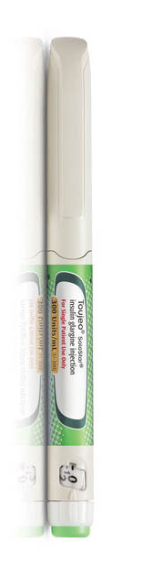
Insulin Glargine 300 (Gla-300)

Slide 29
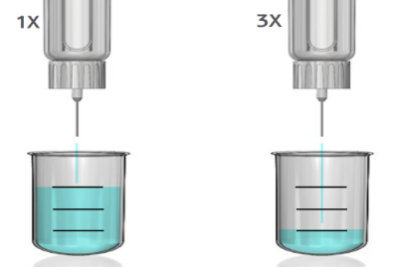
Insulin Glargine 300 (Gla-300)
1/3 of the volume
Reduction of depot
surface by 1/2
Same amount
of units
Gla-100
Gla-300
Gla-100
Gla-300
Gla-300 contains the same insulin glargine monomer as Gla-100¹
Gla-300 forms smaller subcutaneous depots than Gla-100, which results in a more gradual release of the insulin glargine monomer with Gla-300
1. Becker RHA, et al. Diabetes Care 2015;38:637–43
2. Steinstraesser A, et al. Diabetes Obes Metab 2014;16:873–6
Notes:
Steady and prolonged PK/PD profile vs Lantus
Greater consistency over the course of a day- CGM study with more consistent glucose levels throughout the day compared to Lantus (T1D)

Slide 30
Up-concentrated formulation : Gla-300
Half-life : 19 hours.
Steady state is reached after 3 to 4 days.
Duration of action:36 h.
Heise et al Diabetes Obes Metab 2017; 19(1):3–12

Slide 31
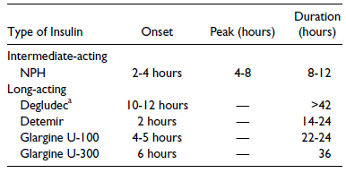
Pharmacokinetic Profiles of Basal Insulins

Slide 32
Gla-300 :More constant and prolonged PK/PD profile
Euglycemic clamp study in patients with T1DM after 8 days’ treatment
20
Gla-300 0.4 U/kg
Median insulin concentration (µU/mL)
Gla-100 0.4 U/kg
10
0
0 6 12 18 24 30 36
3
Glucose infusion rate (mg/kg/min)
2
1
0
160
0 6 12 18 24 30 36
140
Blood glucose (mg/dL)
120
100
0 6 12 18 24 30 36
Becker RHA, et al. Diabetes Care 2015;38:637–43
Time (h)
Notes:
Results of a euglycemic clamp study in type 1 diabetes (T1D) in steady state.
Euglycemic clamp: a method for quantifying insulin secretion and insulin resistance. In the euglycemic clamp technique, the concentration of plasma insulin is acutely raised to 100 uU/mL and maintained by a continuous infusion of insulin. Then a variable infusion of glucose is given to keep the plasma glucose concentration constant at basal levels. Under these steady-state conditions of euglycemia, the glucose infusion rate equals glucose uptake by all the tissues in the body and is therefore a measure of tissue sensitivity to exogenous insulin. The test therefore tests the amount of glucose needed to compensate for the increased amounts of insulin, thus measuring insulin sensitivity. (DeFronza et al. Am J Physiol. 1979;237(3):E214-223)
Study design:
A randomized, double-blind, cross-over study (N=30) in 2 parallel cohorts was conducted, applying the euglycemic clamp technique over a period of 36 h.
In this multiple-dose to steady-state study, participants received once-daily subcutaneous administrations (in the evening) of either 0.4 (cohort 1) or 0.6 (cohort 2) units/kg U300 for 8 days in one treatment period and 0.4 units/kg U100 for 8 days in the other.
The results of a direct comparison between 0.4 units/kg of each treatment is demonstrated.
PK and PD assessments performed on the last treatment day included serum insulin measurements and the automated euglycemic glucose clamp technique over 36 h.
Reference: Arnolds S et al. Int J Clin Pract. 2010;64(10):1415-1424
PK may be regarded as what the body does to a drug, and PD as what a drug does to the body.
PK consists of the relationship between drug input and the concentration achieved with time.
PD consists of the relationship between drug concentration and both the intended and adverse effects produced with time.
In the case of insulins, a key PK parameter is serum insulin concentrations (insulin exposure) and a key PD parameter is glucose infusion rate (insulin activity)

Slide 33
More constant glucose profile with
Gla-300 vs. Gla-100*
Average 24-hour
glucose profiles
showed a more
constant glucose
level with Gla-300 vs Gla-100
Gla-100
11
Gla-300
10
Morning
injection
Average glucose (mmol/l)
9
8
7
0
2
4
6
8
10
12
14
16
18
20
22
24
Time (h)
11
10
Evening
injection
Average glucose (mmol/l)
9
8
7
0
2
Bergenstal RM, et al. Poster presentation at EASD 2014; Abstract 949
4
6
8
10
12
14
16
18
20
22
24
Time (h)
n=60

Slide 34
More constant glucose profile with
Gla-300 vs. Gla-100*
Gla-300
11
Average glucose profiles, mean (SE), mmol/L
Average 24-hour
glucose profiles
showed a more
constant glucose
level with Gla-300 vs Gla-100
10
9
8
7
Morning
Evening
0
2
4
6
8
10
12
14
16
18
20
22
24
Gla-100
11
10
9
8
7
Morning
Evening
0
2
4
6
8
10
12
14
16
18
20
22
24
Time (h)
Bergenstal RM, et al. Poster presentation at EASD 2014; Abstract 949
Mean glucose profiles were more constant with Gla-300 compared with Gla-100, independent of the time of injection (morning or evening)

Slide 35
Gla-300 : phase II results
After subcutaneous injection, Gla-300 has been shown to have smoother, more stable, and prolonged pharmacokinetic and pharmacodynamic profiles than Gla-100.
Low within-day variability (fluctuation) in insulin exposure with Gla-300.
Reduce hypoglycemic risk.
Low between-day (within-subject) variability( high reproducibility).
More predictable insulin exposure.
Flexibility.

Slide 36
EDITION program:
Phase III trials of comparing Gla-300 vs. Gla-100
T2DM
T1DM
EDITION 1*¹
N=807
BB
Basal insulin plus mealtime bolus insulin (fast-acting analoge)
EDITION 2*²
N=811
BOT
Basal insulin plus OAD (excl. SU)
EDITION 4⁵
N=549
BB
Basal insulin plus mealtime bolus insulin (fast-acting analog)
EDITION 3³
N=878
Basal Insulin Naive
OAD (excl. SU) and/or GLP-1 receptor agonists
EDITION JP 2⁴
N=241
BOT
Basal insulin plus OAD
EDITION JP 1⁶
N=243
BB
Basal insulin plus mealtime bolus insulin (fast-acting analog)
All Phase III, age of participants ≥18 years, randomization ratio 1:1
BB, basal-bolus therapy; BOT, basal-only therapy;
1. Riddle MC, et al. Diabetes Care 2014;37:2755–62; 2. Yki-Järvinen H, et al. Diabetes Care 2014;37:3235–43; 3. Bolli GB, et al. Diabetes Obes Metab 2015;17:386–94;4. Terauchi Y, et al. Poster presentation at EASD 2014; Abstract 976; 5. Home PD et al. Diabetes Care 2015;ePub Jun 17:pii: dc150249
6, Matsuhisa M et al. Poster presentation at EASD 2014; Abstract 975

Slide 37
EDITION: study design
Randomized 1:1, open-label, parallel-group, multinational studies
The EDITION program includes ~3,500 patients with T1DM and T2DM participating in 6 clinical trials
EDITION program has similar design across studies
Gla-300 ± OADs ± mealtime insulin
Participants
Randomized
(1:1)
6-month
extension period
6 months
Gla-100 ± OADs ± mealtime insulin
        Primary endpoint: HbA1c reduction at Month 6
        Main secondary endpoint*: Confirmed and/or severe nocturnal hypoglycemia in selected trials
1. Riddle MC, et al. Diabetes Care 2014;37:2755–62
2. Yki-Järvinen H, et al. Diabetes Care 2014;37:3235–43
3. Bolli GB, et al. Diabetes Obes Metab 2015;17:386–94
4. Terauchi Y, et al. Poster presentation at EASD 2014; Abstract 976
Notes:
Primary endpoint: Non-inferiority to U100 in HbA1C reduction at Month 6
Main secondary endpoint*: Incidence (%) of participants with at least one confirmed (≤3.9 mmol/L) and/or severe nocturnal (00:00–05:59) hypoglycemia from Week 9 to Month
U300 was always given in the evening (for EDITION 4: injection was either in the morning or evening)
Titration steering committee was in place with adjustments at investigators’ discretion for safety
All means in the analyses are reported as least square means*
*least squares mean: the estimated mean of a variable obtained from an analysis of variance model or analysis of covariance model. It is the adjusted mean after adjusting for any other factors and covariates in the model (Day S. Dictionary for Clinical Trials. 2nd ed. 2007. John Wiley & Sons, Ltd.

Slide 38
Primary endpoint: Gla-300 non-inferior to
Gla-100 in HbA1c change at Month 6, T2DM
EDITION 1¹
BB
EDITION 2²
BOT switch
EDITION 3³
BOT start
EDITION JP 2⁴
BOT switch
LSM difference: 0.00%
(–0.11 to 0.11)
LSM difference: –0.01%
(–0.14 to 0.12)
LSM difference: 0.04%
(–0.09 to 0.17)
LSM difference: 0.10%
(–0.08 to 0.27)
LSM HbA1c change from baseline (%)
Gla-300
Gla-100
LSM, least square means
1. Riddle MC, et al. Diabetes Care 2014;37:2755–62
2. Yki-Järvinen H, et al. Diabetes Care 2014;37:3235–43
3. Bolli GB, et al. Diabetes Obes Metab 2015;17:386–94
4. Terauchi Y, et al. Poster presentation at EASD 2014; Abstract 976

Slide 39
Primary endpoint: Gla-300 non-inferior to
Gla-100 in HbA1c change at Month 6, T1DM
EDITION 4¹
EDITION JP 1²
LSM difference: 0.04%
(–0.10, 0.19)
LSM difference: 0.13%
(–0.03, 0.29)
LSM HbA1c change from baseline (%)
Gla-300
Gla-100
1. Home PD, et al. Diabetes Care
2. Matsuhisa M, et al. EASD 2014;Abstract 975

Slide 40
Higher Gla-300 doses at Month 6
 | T2DM studies |  |  |  | T1DM studies
 | EDITION 1¹ | EDITION 2² | EDITION 3³ | EDITION JP 2⁴ | EDITION 4⁵ | EDITION JP 1⁶
Mean weight (kg) | 106 | 98 | 95 | 67 | 82 | 63
Mean insulin dose for Gla-300 (U/kg) | 0.98 | 0.93 | 0.62 | 0.35 | 0.47 | 0.36
Mean insulin dose for Gla-100 (U/kg) | 0.88 | 0.85 | 0.53 | 0.30 | 0.40 | 0.29
This increase is likely to reflect the more prolonged absorption of Gla-300 from the more compact SC depot, as seen in the PK studies, which might result in lower bioavailability secondary to longer exposure to tissue peptidases
The circulating molecule after SC Gla-300 and Gla-100 injection is the same, resulting the same glucose-lowering action at receptor level – so cannot explain differences in dose requirement
1. Riddle MC, et al. Diabetes Care 2014;37(10):2755–62; 2. Yki-Järvinen H, et al. Diabetes Care 2014;37(12):3235–43
3. Bolli GB, et al. Diabetes Obes Metab 2015;17(4):386–94;4. Terauchi Y, et al. ADA 2014;Abstract 94-LB
5. Home PD, et al. Diabetes Care 2015;ePub Jun 17:pii: dc150249; 6. Matsuhisa M, et al. EASD 2014;Abstract 975
Notes:
Following once daily multiple SC dose:
The glucose lowering effect of glargine 300 U/mL increased with daily administration. The pharmacody-namics profile of glargine 300 U/mL and glargine 100 U/mL after 8 days of once-daily subcutaneous injections of 0.4 U/kg in a euglycemic clamp study in 30 patients with type 1 diabetes is shown in Figure 2. At steady state, the maximum (GIR^{max}) and 24 hour glucose lowering effect (GIR-AUC⁰⁻²⁴) of glargine 300 U/mL 0.4 U/kg was approximately 19% and 27% lower, respectively, with a different distri-bution profile than that of an equivalent dose of glargine 100 U/mL.

Slide 41
Less or similar weight gain with
Gla-300 vs. Gla-100 at Month 6, T2DM
EDITION 1¹
EDITION 2²
EDITION 3³
EDITION JP 2⁴
0.9
(3.2)
0.9
(3.1)
0.7
(3.0)
0.7
(3.8)
0.4
(3.8)
0.3
(2.2)
0.1
(3.5)
Weight change from baseline, kg (±SD)
–0.6
(2.0)
Gla-300
Gla-100
1. Riddle MC, et al. Diabetes Care 2014;37:2755–62
2. Yki-Järvinen H, et al. Diabetes Care 2014;37:3235–43
3. Bolli GB, et al. Diabetes Obes Metab 2015;17:386–94
4. Terauchi Y, et al. Poster presented ADA 2014;Abstract 94-LB

Slide 42
Gla-300 cardiovascular safety
Regulatory bodies including FDA, EMA, PMDA and Health Canada satisfied with cardiovascular safety^{1,2}
Gla-300 has the same metabolism as Gla-100 (M1 metabolite)³
  Extensive safety data available for Gla-100 (cardiovascular and cancer safety)⁴
  Expect to see similar long-term safety profile for Gla-300
Steinstraesser A, et al. Diabetes Obes Metab 2014;16:873–6; 4.
ORIGIN trial investigators. New Engl J Med 2012;367:319–28

Slide 43
Gla-300 in comparison to Gla-100: Summary
More constant and prolonged PK/PD profile
More stable 24-hour profile by CGM in T1DM
Comparable HbA1c reduction in the treat-to-target RCT setting
Slightly lower or similar weight gain
Similar overall safety and tolerability
Slightly higher dose requirement
Age 20 to 79 years old
The same metabolism as Gla-100 (M1), supporting long-term cardiovascular safety
In pooled
analysis
of T2DM data
there was similar
improvement
in glycemic
control

Slide 44
Defining hypoglycemia
 | BEGIN program (degludec)¹ | EDITION program (Gla-300)²
Treat-to-target | Fasting SMBG 4–4.9 mmol/L (72–88 mg/dL) | Fasting SMBG 4.4–5.6 mmol/L (79–101 mg/dL)
Confirmed hypoglycemia | Plasma glucose <3.1 mmol/L (56 mg/dL) or severe hypoglycemia | Plasma glucose ≤3.9 mmol/L (70 mg/dL) or severe hypoglycemia
Nocturnal confirmed hypoglycemia | Confirmed between 00:01 and 05:59 hr | Confirmed between 00:00 and 05:59 h
Severe hypoglycemia | Requiring assistance | Requiring assistance
Reporting method | Incidence (% of subjects) Rate (# of episodes per patient year of exposure) | % of subjects reporting ≥1 hypoglycemic event Annualized rate (events per participant-year) Cumulative mean number of hypoglycemic events
1. Ratner RE, et al. Diabetes Obes Metab 2013;15:175–84
2. Ritzel R, et al. Diabetes Obes Metab 2015; doi:10.1111/dom.12485

Slide 45
Gla-300:
Participants (T2DM) reporting ≥ 1 hypoglycemic event at any time (24 hours)
Participants with ≥1 confirmed (≤3.9 mmol/L) and/or severe hypoglycaemia (%)
Gla-300 (n=1242)
Gla-100 (n=1246)
RR 0.92
(95% CI: 0.86, 0.98)†
72.0
Participants (%)
65.5
62.5
57.5
44.7
Entire treatment period
(Baseline to Month 6)
Titration period
(Baseline to Week 8)
Maintenance period
(Week 9 to Month 6)
Clinical
Implications
For every 15 subjects initiated and treated with Gla-300 instead of Gla-100, 1 less patient will have confirmed hypoglycemia at any time (24 hours)
Ritzel R, et al. Diabetes Obes Metab 2015; doi:10.1111/dom.12485.;
†Significant
Notes:
U300 resulted in a reduction in confirmed (≤3.9 mmol/L) or severe hypoglycemia:
At any time (24 h), as well as during the night
With more pronounced reduction during the first 8 weeks, when most of the dose increases occurred
When the stricter threshold (<3 mmol/L) was applied at any time and at night

Slide 46
Gla-300:
Participants (T1DM) reporting ≥ 1 hypoglycemic event at any time (24 hours)
Participants with ≥1 confirmed (≤3.9 mmol/L) and/or severe hypoglycaemia (%)
Gla-300 (n=1242)
Gla-100 (n=1246)
RR 0.75
(95% CI: 0.68, 0.83)†
RR 0.80
(95% CI: 0.71, 0.91)†
RR 0.69
(95% CI: 0.58, 0.81)†
Participants (%)
Entire treatment period
(Baseline to Month 6)
Titration period
(Baseline to Week 8)
Maintenance period
(Week 9 to Month 6)
Clinical
Implications
For every 10 subjects initiated and treated with Gla-300 instead of Gla-100, 1 less patient will have nocturnal confirmed hypoglycemia
¶ Nocturnal, 00:00–05:59 h; †Significant
Ritzel R, et al. Diabetes Obes Metab 2015; 16
Notes:
U300 reduced the incidence of severe and/or confirmed hypoglycemia over 6 months during the night.

Slide 47
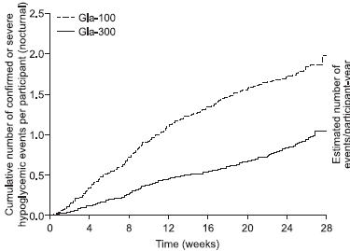
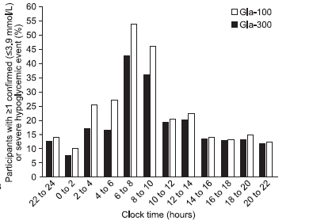
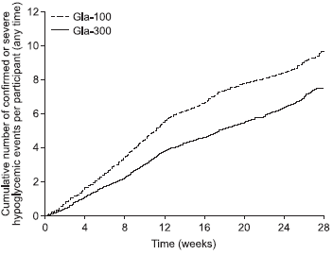
Edition II :Hypoglycemia
Nocturnal
Clock time
Any time
Yki-J¨arvinen et al Diabetes Care 2014;37:3235–3243

Slide 48
Hypoglycemia in T1DM
Gla-300 (EDITION 4)
  Overall and nocturnal hypoglycemia (entire treatment period) were similar between treatment groups.
  Nocturnal confirmed or severe hypoglycemia (baseline to 8 weeks): 31% lower incidence with Gla-300 (risk ratio 0.69 [95% CI 0.53-0.91])
. Home P, at al. Diabetes Care 2015 [Epub ahead of print

Slide 49
Gla 300 vs. Gla 100: summary
Comparable HbA1c reduction in the treat-to-target RCT setting.
Slightly lower or similar weight gain.
Slightly higher dose requirement.
Lower hypoglycemia event rate.
Beneficial for those patients who require twice-daily dosing to maintain full basal insulin coverage.
Flexibility to select the timing of injections to either am or pm dosing and withina ± 3 hours window when needed.
Lower volume for insulin resistance cases.

Slide 50
Hypoglycemia : summary
Gla-300 and IDeg both reduce hypoglycemia vs. Gla-100 in T2DM.
Gla-300 reduced hypoglycemia risk in and rate.
IDeg reduced hypoglycemia risk during the overall and maintenance study periods with impact mainly on episodes of hy the overall, titration and maintenance study periods, with impact on both incidence poglycemia (i.e. rate reduction).
Overall hypoglycemia in T1DM is comparable to Gla-100 for both Gla-300 and IDeg
  Nocturnal hypoglycemia in T1DM is reduced with IDeg vs. Gla-100

Slide 51
Conclusion
Gla-300 and IDeg have shown similar efficacy when compared to Gla-100.
Although comparisons of hypoglycemia results from the Gla-300 and IDeg development programs are difficult due to the differing definitions and glycemic targets, both of the new basal insulins reduce the risk of hypoglycemia compared with Gla-100 in T2DM.
Long-acting basal may have a place for patients with T1DM or T2DM, with the possibility for improved hypoglycemia and patient tolerability.

Slide 52

Next generation basal insulin analogs offer longer duration and less variability – IDeg and Gla-300.
Gla-300 and IDeg have shown similar efficacy when compared to Gla-100.
Both of the new basal insulins reduce the risk of hypoglycemia compared with Gla-100.
Flexibility.
Beneficial for those patients who require twice-daily dosing to maintain full basal insulin coverage.
The recent development of hepato-preferential or very long-acting (once-weekly) insulins promises the potential to achieve further clinical improvements.

Slide 53

Thank you

Slide 54


Rate of nocturnal (00:00–05:59 h) confirmed (≤70 mg/dL [≤3.9 mmol/L]) or severe hypoglycemia in T2DM studies at Month 6
2.5
EDITION 1¹
BB
Gla-300
Gla-100
2.5
EDITION 2²
BOT switch
2.0
2.0
1.5
1.5
1.0
1.0
0.5
Rate ratio (95% CI)
0.75
(0.58 to 0.95)
0.5
Rate ratio (95% CI)
0.52
(0.35 to 0.77)
0.0
4
0.0
0
8
12
16
20
24
0
4
8
12
16
20
24
28
Cumulative mean numbers of confirmed
(≤70 mg/dL [≤3.9 mmol/L]) or severe events
4
EDITION 3³
BOT start
5
EDITION JP 2⁴
BOT switch
3
Rate ratio (95% CI)
0.98
(0.64 to 1.48)
4
Rate ratio (95% CI)
0.45
(0.21 to 0.96)
3
2
2
1
1
0
0
0
4
8
12
16
20
24
28
0
4
8
12
16
20
24
28
Time, weeks
Time, weeks
Safety population; rate ratio and 95% CI are based on annualized rates per patient-year for confirmed (≤70 mg/dL [≤3.9 mmol/L]) or severe hypoglycemia
BB, basal-bolus therapy; BOT, basal-oral therapy; CI, confidence interval; T2DM, type 2 diabetes mellitus
1. Adapted from Riddle MC et al. Diabetes Care. 2014;37:2755-62; 2. Yki-Järvinen H et al. Diabetes Care. 2014;37:3235-43; 3. Bolli GB et al. Diabetes Obes Metab 2015;17:386-394
(main article and Supplementary Figure 3); 4. Terauchi Y et al. Diabetes Obes Metab. 2016;18:366-74
54

