Slide 1
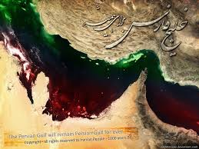
Persian Gulf National Day

Slide 2
Symposium no. 127 Acromegaly
Research Institute for Endocrine Sciences
Shahid Beheshti University of Medical Sciences
30 April 2015

Slide 3
The importance of knowing about acromegaly (a rare disease):
Delayed diagnosis
Persistence of disease activity even after surgery
Multimodal treatment
Increased mortality
(Lowering GH and normalizing IGF‑I levels in patients with acromegaly results in mortality rates similar to those expected in the general population.)
Increased comorbidities
Management of patients with acromegaly is problematic, complex and costly, and requires approaches tailored to each individual patient.

Slide 4
List of symposium sessions:
Diagnostic approach
Surgical therapy
Medical therapy
Radiotherapy
Follow-up and Monitoring
Endocrine Society Clinical Practice Guideline (2014) overview
Panel discussion

Slide 5
Interactive case study
Courtesy of Dr. Maria Fleseriu
Oregon Health and Science University, Portland, OR, USA

Slide 6
Presentation:
27-year-old male with seizure disorder for 10 years
3-year history of snoring, constant sweating, increase in shoe size (EU: 42 to 45), headaches and diffuse joint aches
Physical examination: Tall, frontal bossing, coarse facial features, teeth spacing, protruding mandible, large hands/feet
PMH: Lower lip revision and bilateral breast reduction; OSA on CPAP
OSA: Obstructive Sleep Apnea
CPAP: Continuous Positive Airway Pressure

Slide 7
Lab data:
IGF-I: 1250 ng/mL (normal 115–350)
OGTT:
OGTT: 75 g oral glucose

Slide 8
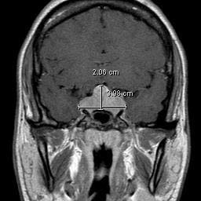
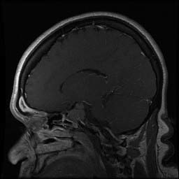
GAD-enhanced MRI

Slide 9
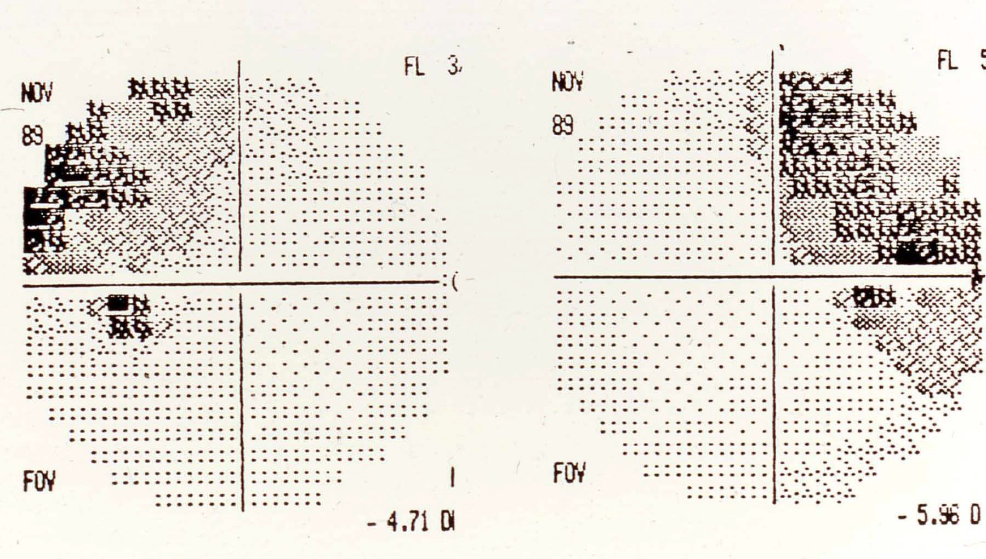
Perimetry: Bitemporal hemianopsia

Slide 10
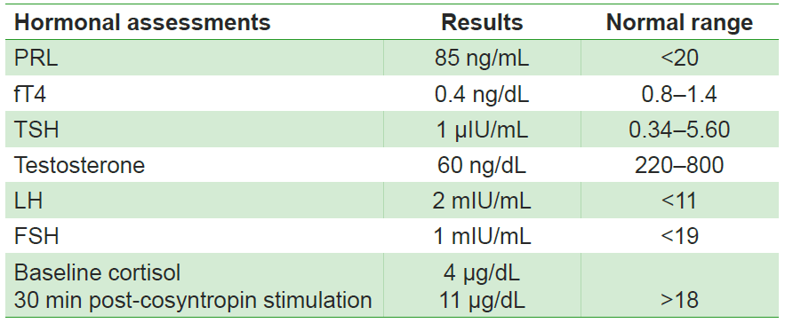
Complete hormonal evaluation

Slide 11
How do you manage this patient?
Panel Discussion

Slide 12
Persian Gulf National Day

