Slide 1
IN THE NAME OF GOD
Dr. Anahita Zakeri
99/12/11

Slide 2
QUESTIONS :
- Was the diagnosis of PAI (CAH ) correct in infancy for both patients?
-In which part of the follow up the misdiagnosis was possible ?
- Was the diagnosis correct with delayed puberty and negative molecular genetic
test & lab in patient A ?
- Was the diagnosis of precocious puberty correct with low testesterone in
patient B? Was the injection of Depherelin indicated?
-What is the final diagnosis of both brothers ?
-Will fertility methods be effective in two brothers?

Slide 3
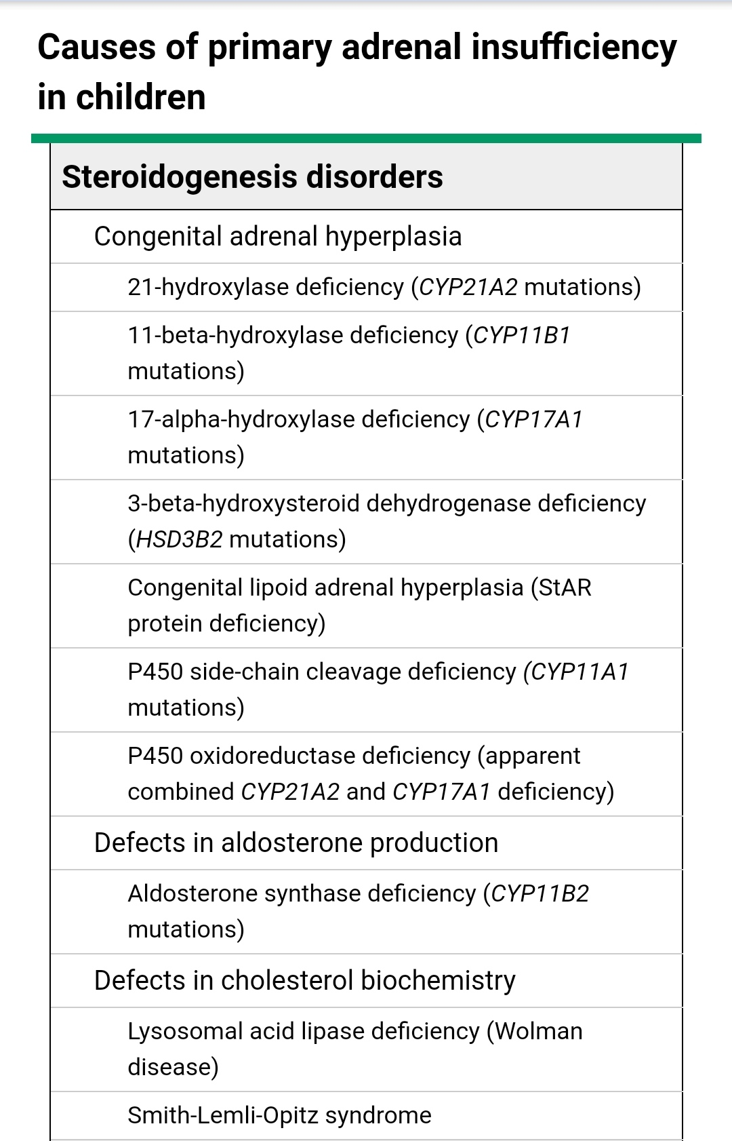

Slide 4
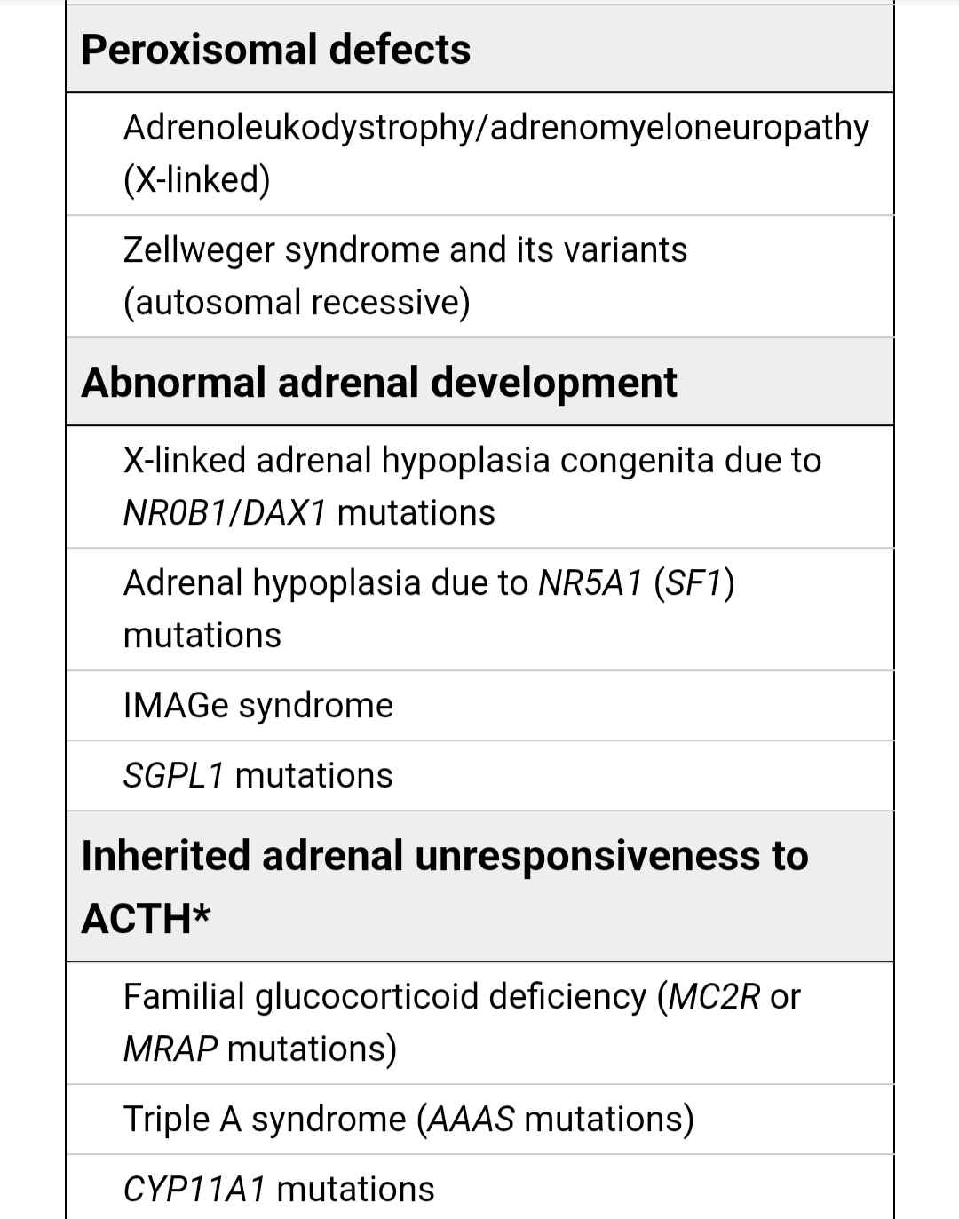

Slide 5
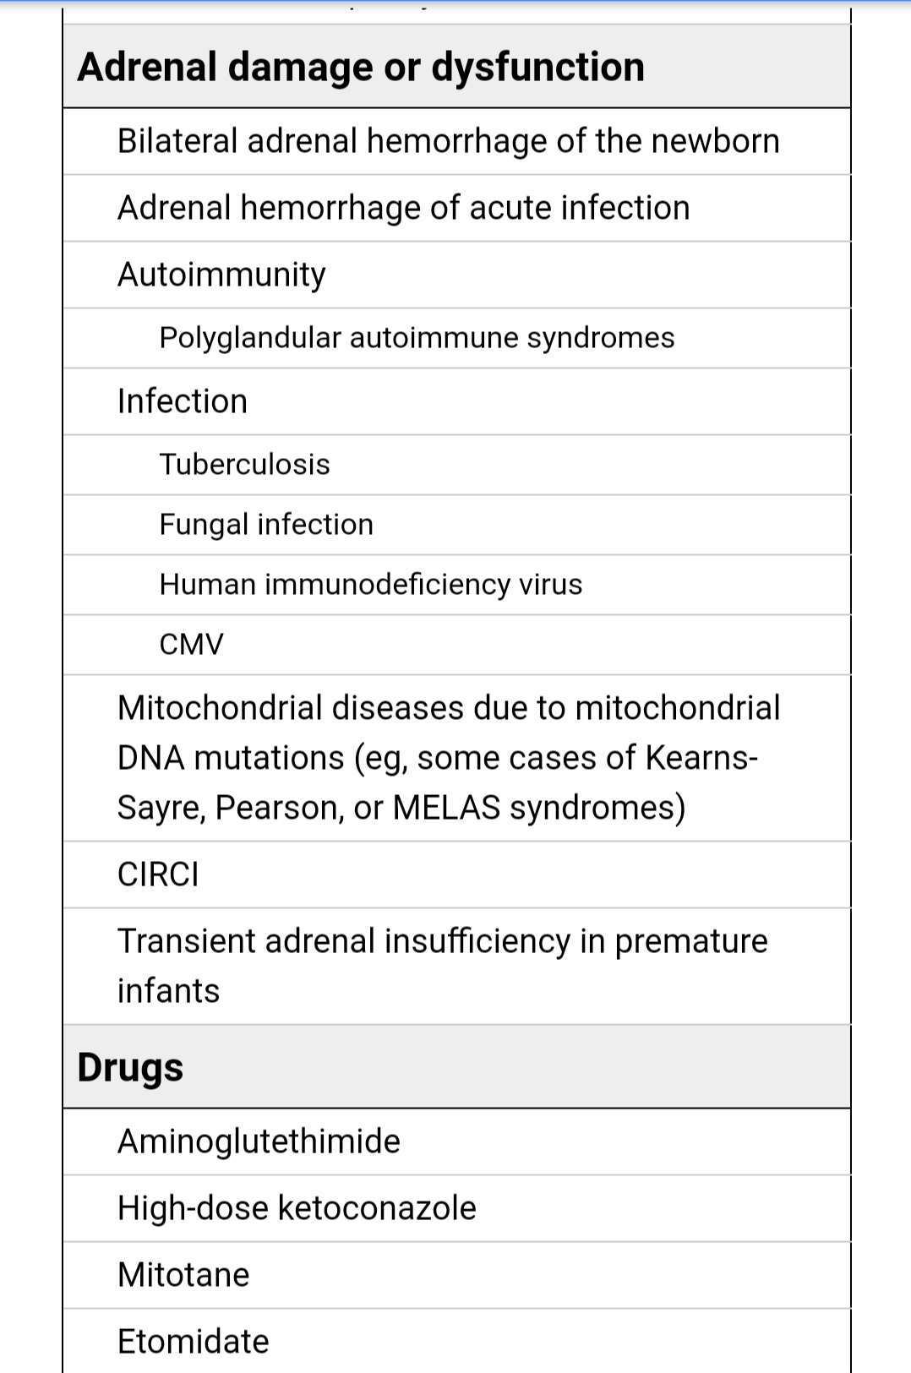

Slide 6
K Na 17 0hp Testosterone DHEA-S BP
Male genitalia with out ambiguity
Response to hydrocortisone
21-hydroxylase deficiency

Slide 7
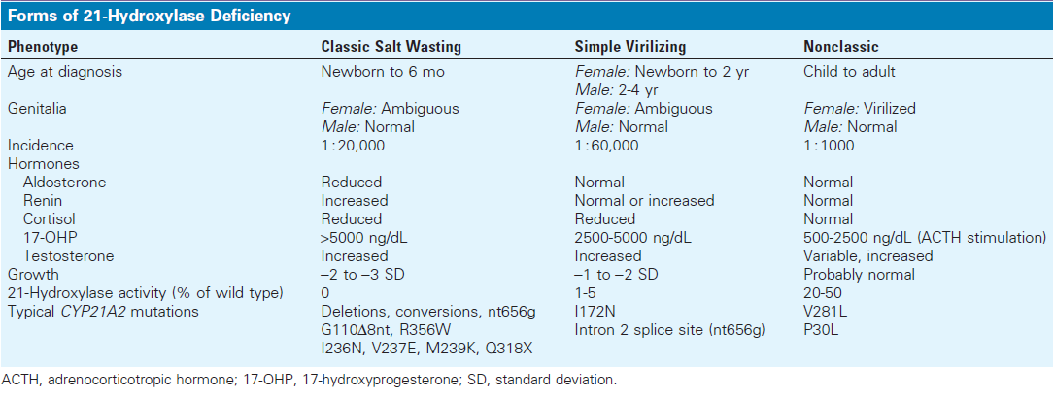

Slide 8
Clinical parameters ;the gold standard for adequate control of CAH
Height and virilization
Growth velocity
X-rays of the hand should be performed annually, for evaluation of bone age
Decreased growth velocity may be a sign of overtreatment, especially with weight gain or retardation of bone age
Growth velocity was a better predictor of the ratio of bone age than single morning 17OHP concentrations
An Pediatr (Barc). 2017;87:116.0

Slide 9
S
A target 17-OHP range of 500 to 1,000 ng/dL
A target ACTH range of 20 to 50 pg/ml
Androstenedione and testosterone are the best markers of adequate glucocorticoid therapy in pre pubertal patients
An Pediatr (Barc). 2017;87:116-124.

Slide 10
 | ACTH | 17(oH)p | Renin | LH | Testosteron | FSH | Stage pubery | T,therapy | H-F
85 | - | <0.1 | 0.9 |  |  |  | P2G2 T=6 |  | 15-0.1
86 | - | <0.1 | 0.8 |  |  |  | p2G2 T=6 |  | 15-0.1
87 | - | <0.2 | 0.3 |  |  |  | p3G3 T=8 |  | 15-0.1
88 | 9.3 | <0.1 | 0.3 |  |  |  | p3G3 T=8 |  | 15-0.1
89 | - | <0.1 | 0.3 | 1.0 | 0.5 ng/ml | 4.75 |  |  | 15-0.1
90 | 171 | <0.1 | <0.5 |  |  |  | P4G4 T=? |  | 15-0.1
91 | 251, 79 | <0.3 |  |  |  |  |  |  | 20-0.1
92 |  |  |  | 1.42 | 0.4 ng/ml | 7.93 | P3G3 T=10 | 50mg/monthly | 25-0.1
93 | 155 |  |  |  |  |  | P5G5 T=10 | 100mg/monthly | Pred=7.5,0.1

Slide 11
Treatment
J Clin Endocrinol Metab, November 2018, 103(11):1–46

Slide 12
A | ACTH | 17(oH)p | Renin | LH | Testosteron | FSH | Stage pubery | T,therapy | H-F
85 | - | <0.1 | 0.9 |  |  |  | P2G2 T=6cc |  | 15-0.1
86 | - | <0.1 | 0.8 |  |  |  | p2G2 T=6cc |  | 15-0.1
87 | - | <0.2 | 0.3 |  |  |  | p3G3 T=8cc |  | 15-0.1
88 | 9.3 | <0.1 | 0.3 |  |  |  | p3G3 T=8cc |  | 15-0.1
89 | - | <0.1 | 0.3 | 1.0 | 0.5 ng/ml | 4.75 |  |  | 15-0.1
90 | 171 | <0.1 | <0.5 |  |  |  | P4G4 T=? |  | 15-0.1
91 | 251, 79 | <0.3 |  |  |  |  |  |  | 20-0.1
92 |  |  |  | 1.42 | 0.4 ng/ml | 7.93 | P3G3 T=10cc | 50mg/monthly | 25-0.1
93 | 155 |  |  |  |  |  | P5G5 T=10cc | 100mg/monthly | Pred=7.5,0.1

Slide 13
B | ACTH | 17(OH)p | Renin | LH | Testosteron | FSH | Stage puberty | T,therapy | H-F
85 |  | <0.1 | 0.8 |  |  |  | P2G2 T=4 |  | 10-0.1
86 |  | <0.1 | 0.9 |  |  |  | P1G2 T=4 |  | 10-0.1
87 |  | <0.2 | 3 | low | low | low | P2G3 |  | 10-0.1
87 |  |  | 11 | 0.6 | 0.04 |  |  |  | 10-0.1
88 |  |  |  |  | Start Depherlein |  | P3G3 T=6 |  | 10-0.1
89 |  | <0.1 | <0.3 | 0.4 | 0.1 | 0.9 |  |  | 10-0.1
90 |  | <0.1 | <0.3 |  | DC Depherelin |  |  |  | 10-0.1
91 |  |  |  |  |  |  |  |  | 10-0.1
92 | 53 | <0.1 |  |  |  |  | P4G4 T=12 |  | 10-0.1

Slide 14
B | ACTH | 17(oH)P | Renin | LH | Testosteron | FSH | Stage puberty | T,therapy | H-F
93 | 78 |  | 46 |  |  |  |  |  | 10-0.1
94 | <1 |  | 10 |  |  |  |  |  | 20-0.1
94 | 32 |  | 34 |  |  |  | P5G5 T=15 |  | 25-0.1
95 | 7 |  | 21 |  |  |  |  |  | 25-0.1
96 | 79 |  | 80 |  |  |  |  |  | continue
96 | 184pg/ml | 0.3 | 72 |  | Genetic moulcular |  | P5G5 T=10 |  | 25-0.1
97 | 2 |  | 47 | 1.4 | 0.3ng/ml | 5.8 |  | ------ | 25-0.1
97/8 | 24 |  | 32 |  |  |  |  | 100mg/ 1/4 | 25-0.1
97/11 | 17 |  | 52 |  |  |  | P5G5 T=12 | cut | 30-0.2
98 | 84 |  | 43 | 1.1 | 0.9 | 6.2 |  |  | 25-0.2

Slide 15
 | ACTH | 17(oH)p | Renin | LH | Testosteron | FSH | Stage pubery | T,therapy | H-F
85 | - | <0.1 | 0.9 |  |  |  | P2G2 T=6cc |  | 15-0.1
86 | - | <0.1 | 0.8 |  |  |  | p2G2 T=6cc |  | 15-0.1
87 | - | <0.2 | 0.3 |  |  |  | p3G3 T=8cc |  | 15-0.1
88 | 9.3 | <0.1 | 0.3 |  |  |  | p3G3 T=8cc |  | 15-0.1
89 | - | <0.1 | 0.3 | 1.0 | 0.5 ng/ml | 4.75 |  |  | 15-0.1
90 | 171 | <0.1 | <0.5 |  |  |  | P4G4 T=? |  | 15-0.1
91 | 251, 79 | <0.3 |  |  |  |  |  |  | 20-0.1
92 |  |  |  | 1.42 | 0.4 ng/ml | 7.93 | P3G3 T=10cc | 50mg/monthly | 25-0.1
93 | 155 |  |  |  |  |  | P5G5 T=10cc | 100mg/monthly | Pred=7.5,0.1

Slide 16
 | ACTH | 17(OH) P | Renin | LH | Testeston | FSH | Stage puberty | T,therapy | Pred,F
93 | 9.9 |  |  |  |  |  |  | continue | 7.5-0.1
94 | 9.6 |  | 10.6 |  |  |  | P5G5 | Continue250mg/ 2w | F0.125p=7.5
95 | 3.5 |  | 31 | 0.27 | 1.29 ng/ml | 2.02 | P4G4 | DC-start 250mg/ monthly | continue
96 |  |  |  |  |  |  |  | DC | continue
98 | 10.2 |  | 0.81 |  |  |  |  | Start 250mg /monthly | continue
99 |  |  |  |  |  |  |  | DC | continue

Slide 17
B | ACTH | 17(OH)p | Renin | LH | Testosteron | FSH | Stage puberty | T,therapy | H-F
85 |  | <0.1 | 0.8 |  |  |  | P2G2 T=4cc |  | 10-0.1
86 |  | <0.1 | 0.9 |  |  |  | P1G2 T=4cc |  | 10-0.1
87 |  | <0.2 | 3 | low | low | low | P2G3 |  | 10-0.1
87 |  |  | 11 | 0.6 | 0.04 |  |  |  | 10-0.1
88 |  |  |  |  | Start Depherlein |  | P3G3 T=6cc |  | 10-0.1
89 |  | <0.1 | <0.3 | 0.4 | 0.1 | 0.9 |  |  | 10-0.1
90 |  | <0.1 | <0.3 |  | DC Depherelin |  |  |  | 10-0.1
91 |  |  |  |  |  |  |  |  | 10-0.1
92 | 53 | <0.1 |  |  |  |  | P4G4 T=12cc |  | 10-0.1

Slide 18
B | ACTH | 17(oH)P | Renin | LH | Testosteron | FSH | Stage puberty | T,therapy | H-F
93 | 78 |  | 46 |  |  |  |  |  | 10-0.1
94 | <1 |  | 10 |  |  |  |  |  | 20-0.1
94 | 32 |  | 34 |  |  |  | P5G5 T=15cc |  | 25-0.1
95 | 7 |  | 21 |  |  |  |  |  | 25-0.1
96 | 79 |  | 80 |  |  |  |  |  | continue
96 | 184pg/ml | 0.3 | 72 |  | Genetic moulcular |  | P5G5 T=10cc |  | 25-0.1
97 | 2 |  | 47 | 1.4 | 0.3ng/ml | 5.8 |  | ------ | 25-0.1
97/8 | 24 |  | 32 |  |  |  |  | 100mg/ 1/4 | 25-0.1
97/11 | 17 |  | 52 |  |  |  | P5G5 T=12cc | DC | 30-0.2
98 | 84 |  | 43 | 1.1 | 0.9 | 6.2 |  |  | 25-0.2

Slide 19
PAI + HH
X-LINKED AHC
Adrenal Hypoplasia Congenital

Slide 20
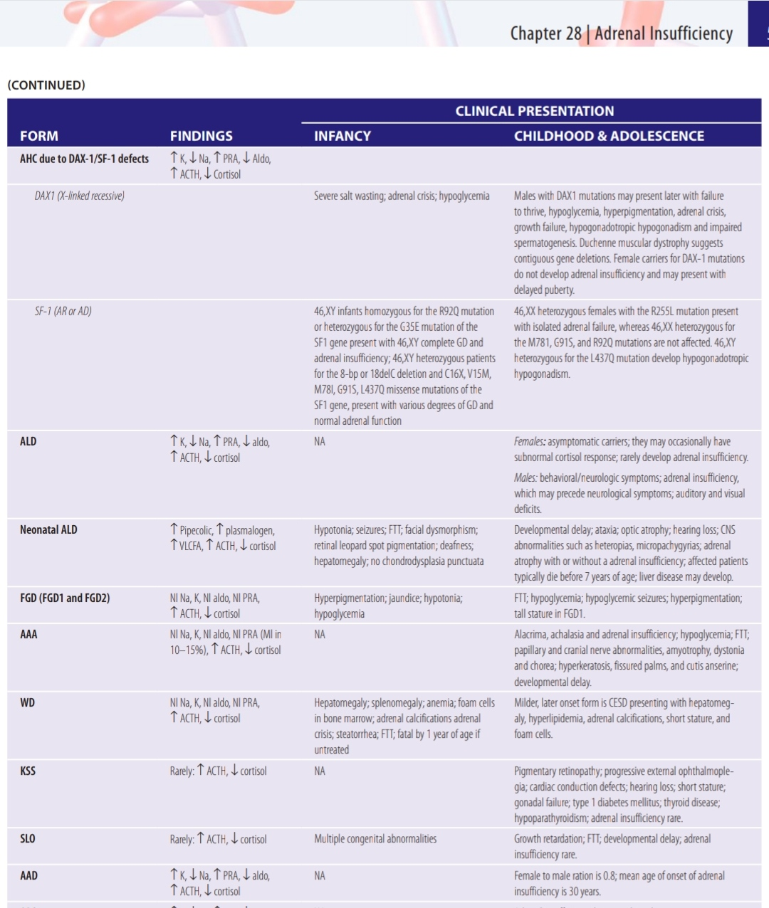

Slide 22
Adrenal hypoplasia congenital (AHC) :
- Rare ,prevalance 1:140,000 – 1:1,200,000
- An X-linked disorder
Affects the adrenal cortex permanent zone ,lack the definitive zone of adrenal cortex, large vacuolated cells
-primary adrenocortical insufficiency (PAI)
Hypothalamus ,pituitary gonadal (HPG) axis leading to --Hypogonadotropic hypogonadism (HH)
BMC Endocr Disord.2020; 20: 21

Slide 23
It is caused by mutations in NR0B1 (Nuclear Receptor subfamily 0, group B, member 1; also know as Dosage-sensitive sex reversal, Adrenal hypoplasia congenita, critical region on chromosome X, gene 1, DAX-1)
A gene encoding an orphan nuclear receptor expressed in hypothalamus, pituitary, adrenal gland and gonads.
BMC Endocr Disord.2020; 20: 21

Slide 24
Its expression is restricted to those tissues involved in steroidogenesis such as adrenal cortex, Leydig and Sertoli cells, theca and granulosa cells, pituitary gonadotropes, and the ventromedial hypothalamic nucleus.
BMC Endocr Disord.2020; 20: 21

Slide 25
Primary adrenal insufficiency in the first (or second) month of life: - hypotention -low Na - High K -vomiting - hypoglycemia - shock & sudden death - lethargy , convulsion - generalized hyperpigmentation - failure to thrive
NROB-Related Adrenal Hypoplasia Congenita.2001Nov 20(Updated 2018 Jan 25

Slide 26
Hypogonadotropic hypogonadism in young adulthood :
-Unilateral or bilateral cryptorchidism
-Less , delayed (onset age >14 y/o ), precocios puberty
-oligospermia or azoospermia
-Infertility
NR0B1 (DAX1) is expressed in Sertoli cells; thus it is directly involved in the spermatogenesis process.
NROB-Related Adrenal Hypoplasia Congenita.2001Nov 20(Updated 2018 Jan 25

Slide 27
Hormone Levels : - ACTH levels high - cortisol levels low - plasma renin activity high - aldosterone levels inappropriately low -17(OH) P low - Androstenedione low - Testosterone levels low - LH levels low - FSH levels low - Low inhibin B
Pediatr Rep. 2015 Sep 28; 7(3): 5936.

Slide 28
LHRH independed precocious puberty :
cases of transient isosexual precocity in infancy and childhood high testosterone levels for age , low gonadotropin levels , penile elongation, pubic hair, testicular enlargement, advanced bone age and no other signs of sexual development :
ACTH-mediated stimulus of testicular steroidogenic cells
Autonomous hyperplasia of leydig cells
Persistent androgen production by fetal adrenal
EndocrinolNutr.2012;59:140---2

Slide 29
Males may experience pubertal arrest, they enter puberty normally and progress to about Tanner Stage 3 (or testicular volume of 6-8 cc) after which pubertal development ceases. Without testosterone treatment, full attainment of secondary sexual characteristics is unlikely.
NROB-Related Adrenal Hypoplasia Congenita.2001Nov 20(Updated 2018 Jan 25

Slide 30
LHRH dependent precocious puberty:
physiologically , temporary minipuberty of infancy can occure 6 m but activity of the HPG axis returns to low levels by 6 months of age, transiant activation of the HPG axis in AHC suggest , may play in the control mechanism of prepubertal gonadotropin secration.
.
Horm Res Paediatr 2019;91(5):336-345.

Slide 32
QUESTIONS :
Was the diagnosis of CAH ,correct in infancy for both patients?
Was the management of CAH appropriate untill puberty?
Was the diagnosis of CAH made with delay puberty and negative molecular genetic testing and Lab in patient A ?
Was the diagnosis of precocious puberty & CAH with low testesteron correct in patient B? Was the patient indicated to receive Depherelin?
What is the final diagnosis of both brothers ?
Will fertility methods be effective in two brothers?

Slide 33
In the absence of endogenous GnRH pulses, the initial GnRH response may reflect the release of small amounts of accumulated gonadotropins. However,these stores are rapidly depleted, and in the absence of effective gonadotropin biosynthesis, the gonadotropes are unable to respond to further pulses of GnRH.
Molecular Biology Reports (2019) 46:4599–4604

Slide 35
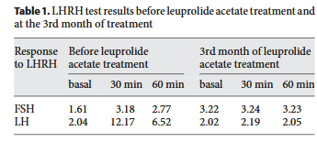
Horm Res Paediatr 2011;75:153–156

Slide 36
injections therapy of hCG (human Choriogonadotropin) has also been used in AHC ,but hss not been effective , use of external testosterone replacement is essential for puberty .
Molecular Biology Reports (2019) 46:4599–4604

Slide 37
- Menopur (150 IU of FSH and 150 IU of LH ), three times weekly + hCG 1500 IU, twice weekly). - One month later, his testosterone level reached 4 ng/ml. - After 20 months of treatment, testis volume reached 11 and 12 ml
- Azoospermia persisted , bilateral testicular biopsies
Human Reproduction, Vol.26, No.3 pp. 724–728, 2011.

Slide 38
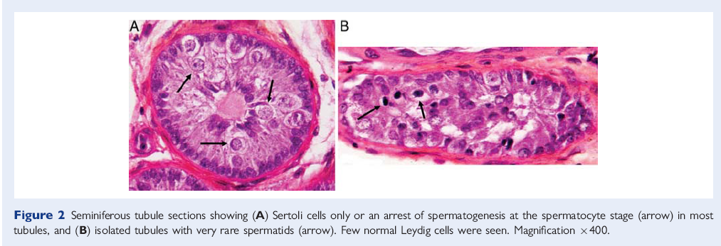

Slide 39
Assessment of adrenal function :
- Assess adrenal glucocorticoid function (basal ACTH, cortisol, cosyntropin test) growth velocity,weight,blood pressure ,skin pigmentation , hyperglycemia
- Assess adrenal mineralocorticoid function (sodium, potassium, aldosterone, plasma renin activity) , blood pressure ,fatigue
-Assessment for early puberty or hypogonadotropic hypogonadism
NROB!-Related Adrenal Hypoplasia Congenita.2001Nov 20(Updated 2018 Jan 25

Slide 40
Treatment is usually initiated at around or just after the time puberty would be expected ,age 12 years in boys.
Testosterone doses are increased gradually over a two- to three-year period until adult replacement doses are reached.
Lifelong hormone replacement is needed. Testosterone supplementation is also needed to support growth and bone mineralizalization
NROB1-Related AdrenalHypoplasia
Congenita.2001Nov(Updated2018Jan 25

Slide 41
با تشکر

Slide 42
The human melanocortin 1 receptor (MC1R) was detectedby immuno histochemical analysis in human Leydig cells. Human MCR1 binds mainly to MSH, but also to ACTH,which might indicate a potential action of these hormones on Leydig cell steroidogenesis.
Elevated T levels + Low LH levels
The Journal of Clinical Endocrinology & Metabolism 86(9):4068 – 4071,21(Feb)2021

Slide 43
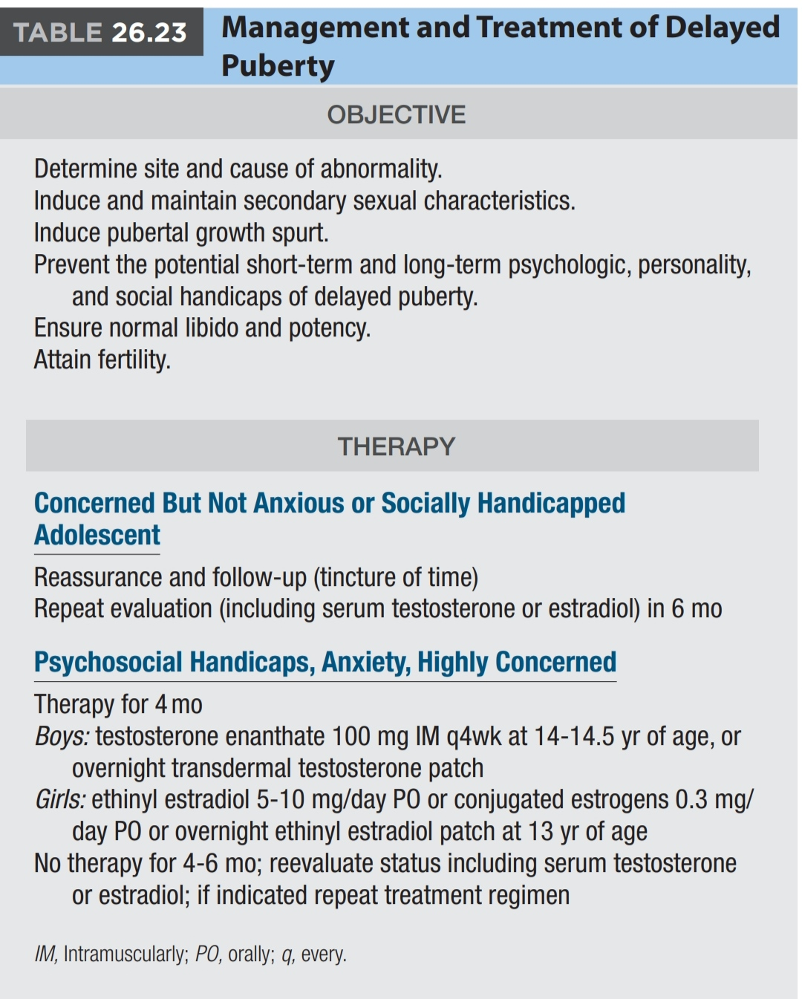

Slide 44
Risk to Family Members – X-Linked AdrenalHypoplasia
The father of an affected male will not have NR0B1-related AHC nor will he be hemizygous for the NR0B1 pathogenic variant; therefore, he does not require further evaluation/testing. In a family with more than one affected male, the mother of an affected male is an obligate heterozygote (carrier). If a woman has more than one son and no other affected relatives and if the NR0B1 pathogenic variant cannot be detected in her leukocyte DNA, she most likely has germline mosaicis.
NROB-Related Adrenal Hypoplasia Congenita.2001Nov 20(Updated 2018 Jan 25

Slide 45
If a male is the only affected family member, the mother may be a carrier or the affected male may have a de novo pathogenic variant, in which case the mother is not a carrier. The percent of male probands with a negative family history in whom the pathogenic variant occurred de novo is unknown but probably low.
NROB-Related Adrenal Hypoplasia Congenita.2001Nov 20(Updated 2018 Jan 25

